Slide 1
Cortical motor function
Ben Simpson
Division of Neuroscience
Hammersmith Hospital Campus
Imperial College London

Slide 2
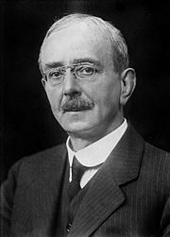
Sherrington (1924)
“To move things is all mankind can do, for such the sole executant is muscle, whether in whispering a syllable or felling a forest”

Slide 3
Motor control hierarchy
LEVEL
STRUCTURES
FUNCTION
Association areas
of neocortex & basal ganglia
high
strategy
Motor cortex & cerebellum
middle
tactics
Brain stem
& spinal cord
low
execution

Slide 4
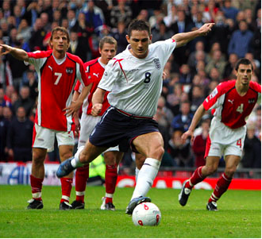
Association neo-cortex
Information where the body is in space (based on vision, audition and somatic sensations)
Strategies need to be devised: move the body
Several options available:
Possible alternatives filtered
through the basal ganglia
Back to the cortex
Best course of action is planned
Motor areas and cerebellum make the tactical decision
Activation of neurons in the brain stem and spinal cord cause the movement to be executed

Slide 5
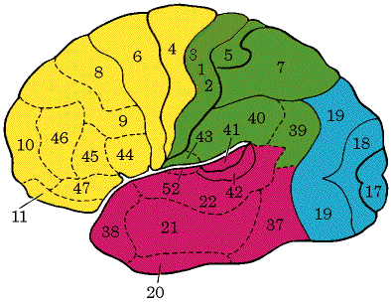
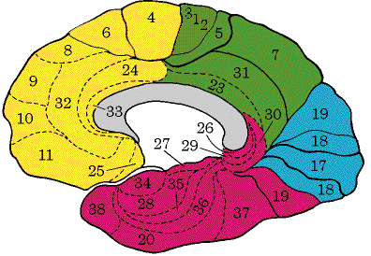
Brodmann areas
PMA/SMA
Primary motor cortex
Central sulcus
Somatosensory cortex
4
Posterior parietal cortex
6
4
6
lateral view
medial view

Slide 6
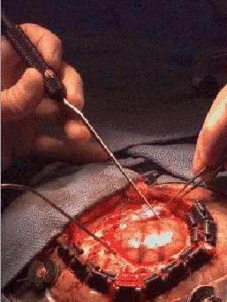
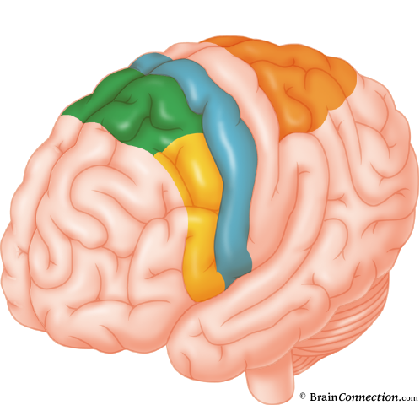
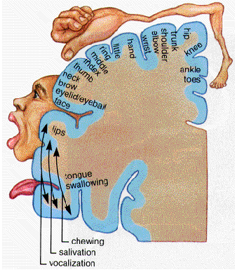
Cortical motor areas
Primary motor cortex(M-I)
Supplementary
motor cortex
(SMA)
Brodmann’s area 6
Brodmann’s area 4
Premotor area
(PMA)
Motor homunculus

Slide 7
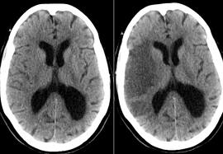
Stroke: MCA infarct

Slide 8
Cortical motor areas
Primary motor cortex(M-I)
Supplementary
motor cortex
(SMA)
Brodmann’s area 6
Brodmann’s area 4
Premotor area
(PMA)
Motor homunculus

Slide 9
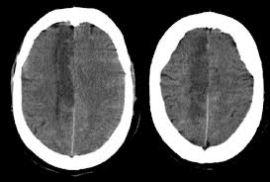
Stroke: ACA infarct

Slide 10
Cortical motor areas
Primary motor cortex(M-I)
Supplementary
motor cortex
(SMA)
Brodmann’s area 6
Brodmann’s area 4
Premotor area
(PMA)
Motor homunculus

Slide 11
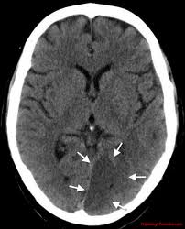
Stroke: PCA infarct

Slide 12
Primary motor cortex (M-I)
1. Stimulation of primary motor cortex produces muscle movement at stimulus intensity far lower than any other part of the cerebral cortex
area 4
2. Activity in cortical neurons related to motor acts begins diffusely throughout the cortex and converges in M-I.
Motor act occurs only after the activity in M-I has reached a peak
3. M-I neurons encode the force of muscle contraction and the direction of movement
4. Small groups of motor neurons in the spinal cord are controlled by small population of cortical neurons in M-I.
The control is specific
Directed to the most distal part of the limbs
Related to the most delicate and precise movements

Slide 13
Premotor cortex (PMA)
Electrical stimulation of PMA does not produce muscle movement unless the stimuli are much more intense than effective stimuli for M-I
Premotor cortex
(PMA)
PMA is necessary to prepare M-I for the impending motor act

Slide 14
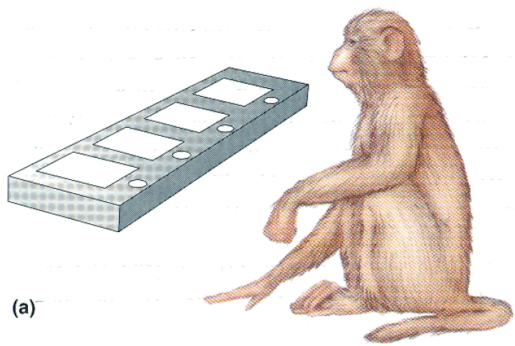
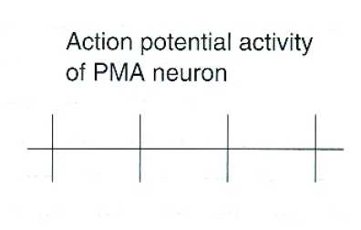
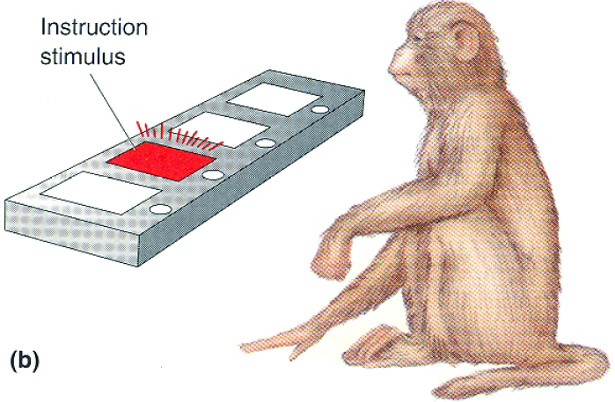
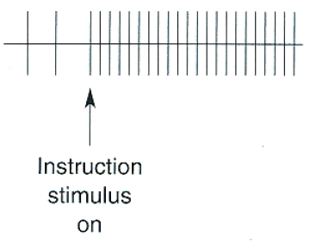
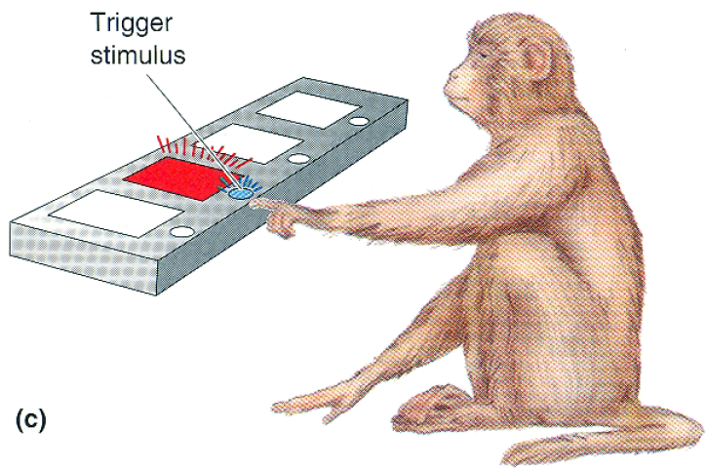
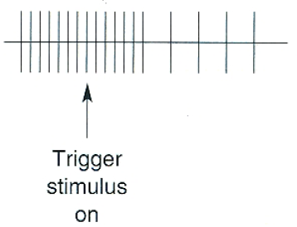
Action potential activity of a PMA neuron
“ready”
“ready”
“go”
“go”
(voluntary movement starts)

Slide 15
Premotor cortex (PMA)
important role in preparing M-I for a specific motor act
PMA activity facilitates multiple motor columns in M-I preparing them for action
facilitated M-I neurons are more easily stimulated by stimuli arriving from other areas of the cortex and close to the threshold activity critical for the start of the movement
Lesions to the PMA in humans do not cause paralysis but slow complex movements
Lack of sufficient facilitation from PMA on M-I
Unprepared M-I neurons will take longer to get into actions

Slide 16
Supplementary motor cortex
(SMA)
Stimulation of SMA neurons elicits complex movements involving many muscle groups
Entire arm, both hands or postural movements
Ablation of unilateral SMA results in limitation of the ability to perform complex bimanual movements
Each movement in one hand is mirrored by the same
movement in the other hand
In the absence of SMA the motor system is controlling
both hands as they were a single unit

Slide 17
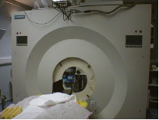
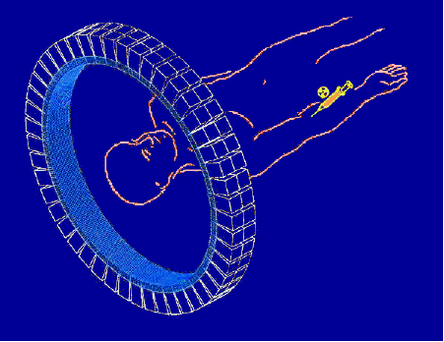
Supplementary motor cortex
(SMA)
Positron emission tomography (PET)
To study in vivo in humans changes in regional cerebral blood flow
Regional blood flow increases as regional neuronal activity increases

Slide 18
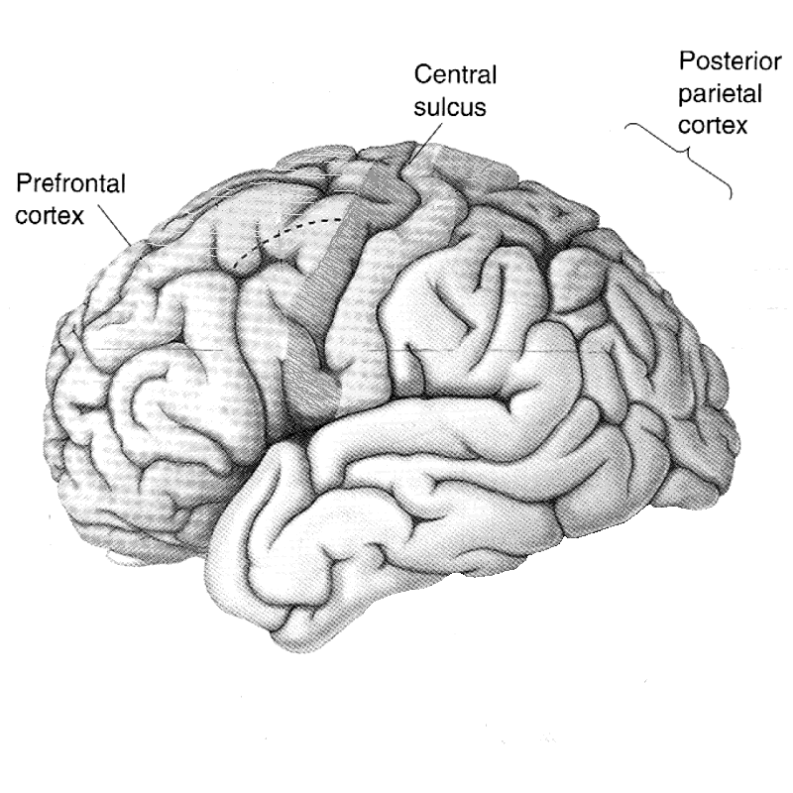
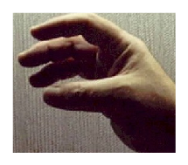
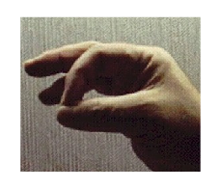
M-I
SMA
S1

Slide 19
Supplementary motor cortex
(SMA)
Not necessary for simple repetitive motor acts that require little thought or preparation
Important for planning complex movements that require conscious effort

Slide 20
Descending motor pathways
Motor cortex
Direct connection
between neurons in motor cortex
and neurons in spinal cord
Indirect pathways
Extrapyramidal tracts
Corticospinal
tract
Pyramidal tract
Descends through the pyramids at the base of the medulla
red nucleus
reticular
nuclei
vestibular nuclei
rubro-spinal
tract
reticulo-spinal
tracts
vestibulo-spinal
tracts
Voluntary movements of distal muscles
Spinal cord
Lateral pathways
(Lateral columns)
Ventro-medial pathways
(Ventro-medial columns)
Control of posture

Slide 21
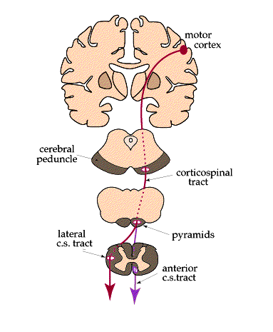
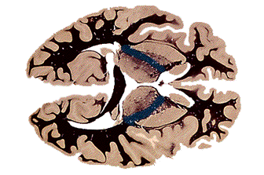
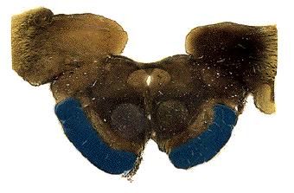
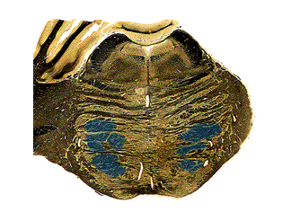
CST
brain
internal capsule
(posterior limb)
cerebral peduncle
midbrain
pons
Notes:
In summary: Here is a diagram summarizing the two main pathways of the voluntary motor system:

Slide 22
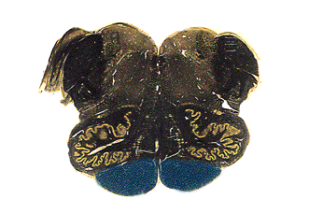
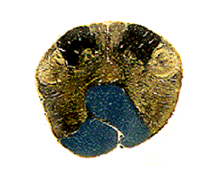
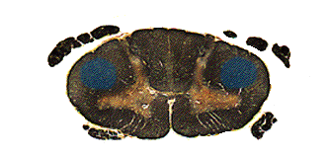
R
CST
brain
pyramids
medulla
decussation
of pyramids
spinal cord
direct
L

Slide 23
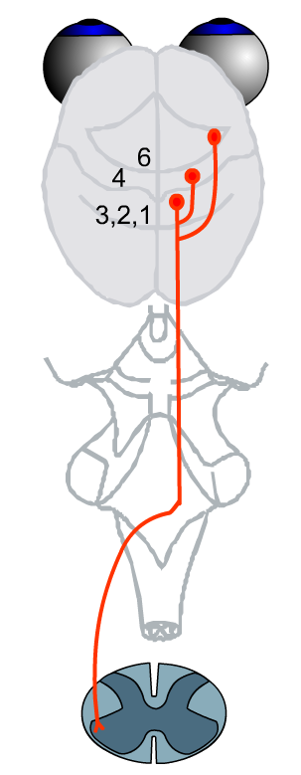
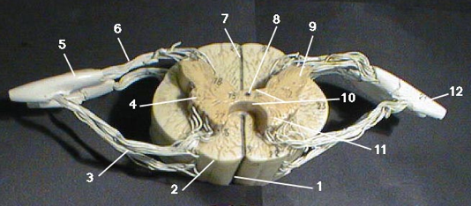
CST
premotor cortex
primary motor cortex
The largest is the lateral corticospinal tract
with 70-90% of the fibers
somatosensory cortex
fibers cross at the pyramidal decussation
Fibers are located in the lateral column of the spinal cord, they project to the lateral anterior horn making monosynaptic connections on the motoneurons which control distal muscles.
fine independent movements

Slide 24
CST
premotor cortex
primary motor cortex
Anterior corticospinal tract
remains uncrossed until the spinal cord
They terminated at the level of medial anterior horn were contralateral and polysynaptic connections are made on medial motoneurons which control proximal and axial muscles
Involved in the control of posture

Slide 25
Clinical manifestations of lesions to the motor systems
Upper motor neuron (UMN)
upper part of motor system
Motor cortex and descending pathways
from brain to spinal cord
Lower motor neuron (LMN)
Alpha motor neurons and their axons (motor part of peripheral nerves)

Slide 26
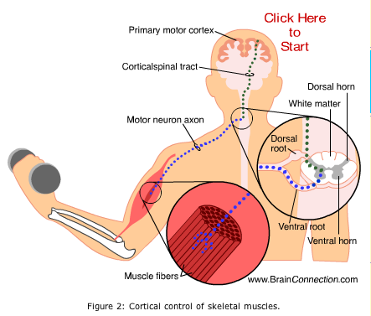
motor cortex
Internal capsule
UMN
CST
Dorsal horn
Peripheral nerve
LMN
Muscle fibers

Slide 27
UMN lesions
Symptoms and signs
1. Weakness
Voluntary muscle weakness
paresis
Complete loss of voluntary motor control
plegia
On one side of the body
Hemiparesis/ hemiplegia
Affecting voluntary muscles of both legs
Paraparesis/ paraplegia
Involving four limbs
Quadriparesis/ quadriplegia

Slide 28
UMN lesions
Symptoms and signs
2. Spasticity
Increased muscle tone in the affected voluntary muscles
In acute extensive lesion first sign is flaccid weakness
Spasticity only several days after the acute event

Slide 29
UMN lesions
Symptoms and signs
3. Increase muscle stretch reflexes
(hyperreflexia) (clonus)

Slide 30
UMN lesions
Symptoms and signs
4. Babinski sign
(abnormal plantar reflex)
Scratching the lateral margin of the sole of the foot from the heel toward the small toe normally would cause the toes to curl downward (plantar flexor)
If the UMN has been damaged the toes extend and flare - Babinski sign

Slide 31
Functional imaging in “minimally conscious state”

