Slide 1
Introduction to cognitive functions and cognitive neurology
Richard Wise
Imperial College London

Slide 2
How do you know you are alive?
How do you know someone else is alive?

Slide 3
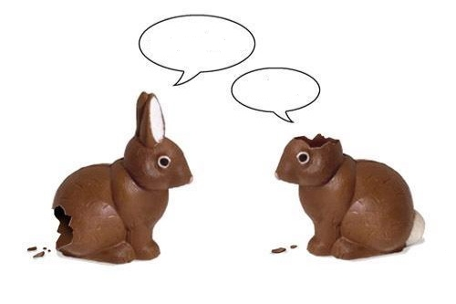
The Easter chocolate bunny card
My arse hurts
What?

Slide 4
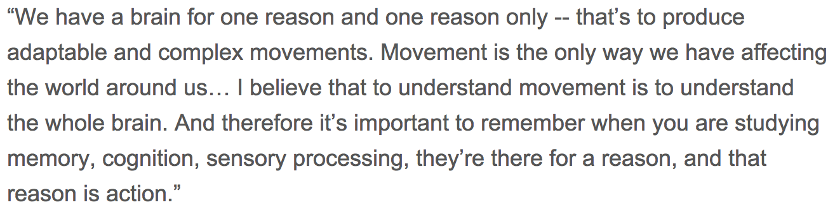

Daniel Wolpert

Slide 5
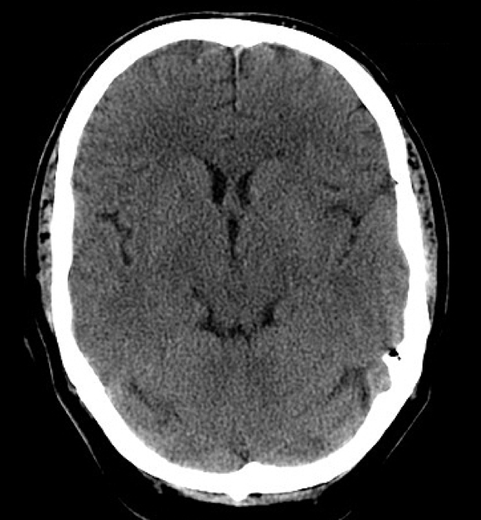
Brain scan of subject one hour after death from cardiac arrest
X-ray CT scan

Slide 6
Brain scan of subject one hour after death from cardiac arrest
X-ray CT scan
PET scan
CBF
CMRO₂
CMRGlu

Slide 7
Two cardinal elements of consciouness
Wakefulness
Awareness
In coma, both are absent
In the vegetative state (VS), there is wakefulness but no awareness
In the minimally conscious state (MCS), there is wakefulness and at least a degree of awareness
In the locked-in syndrome, there is both normal wakefulness and awareness
In the behaviourally non-responsive patient, what is the measure of awareness?
Is an assertion that the VS exists because of negative evidence for the presence of awareness valid? - vulnerable to a Type II error

Slide 8
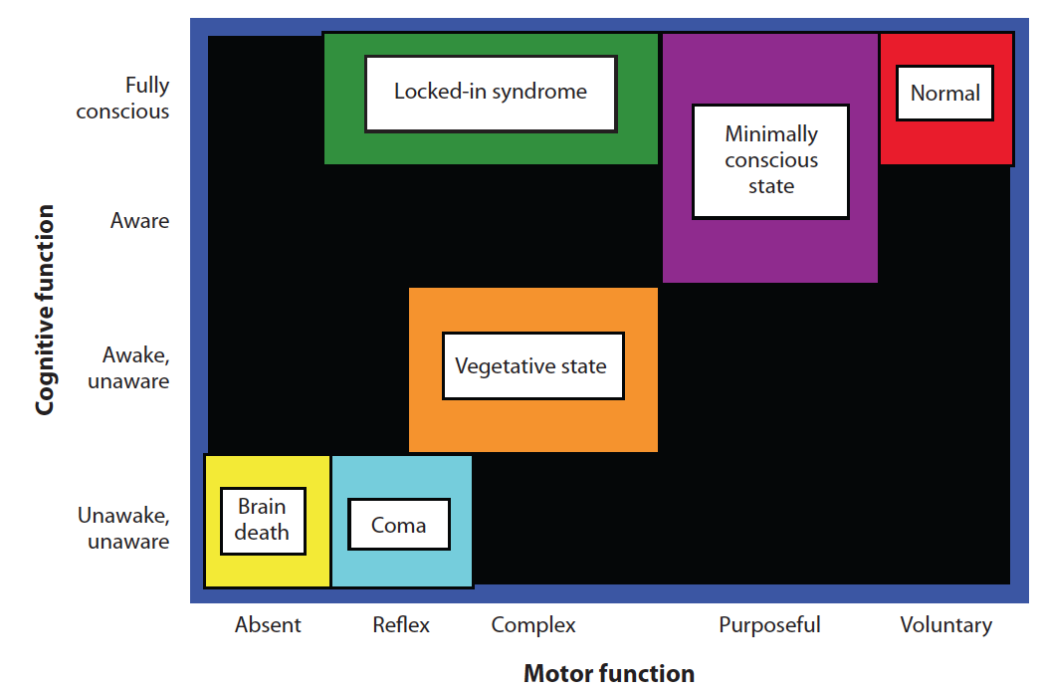
Bernat JL (2009) Chronic consciousness disorders. Annual Review of Medicine 60: 381-392

Slide 9
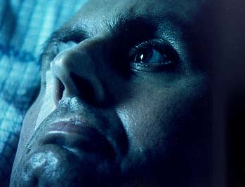
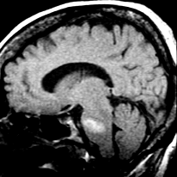
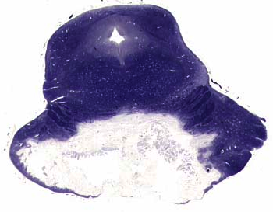
Locked-in syndrome

Slide 10
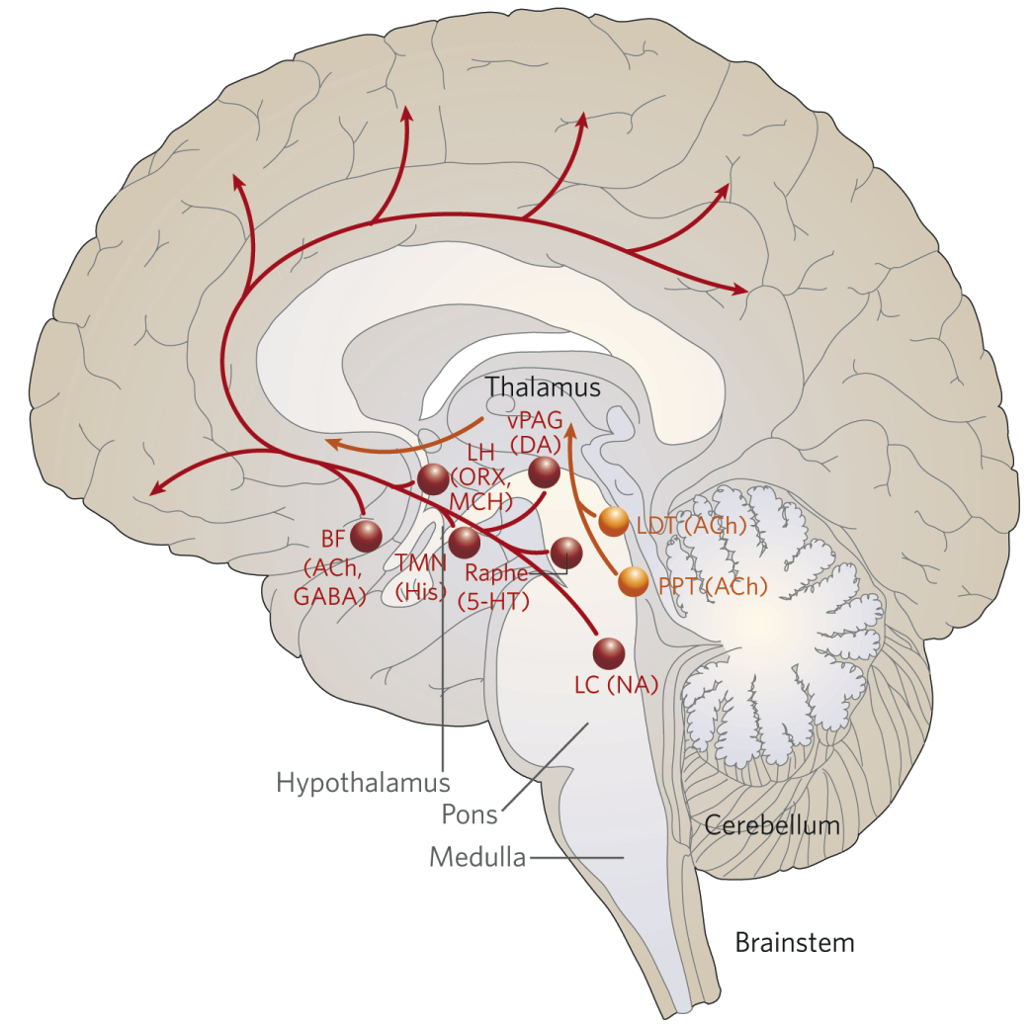
Coma - ascending projections from brainstem to thalamus and cortex control arousal, wakefulness and consciousness: acsending reticular activating system (ARAS)
Conditions that produce coma interfere with the function of the ARAS

Slide 11
Smith E, Delargy M (2005) Locked-in syndrome. British Medical Journal 330: 406-409
Locked-in syndrome is the result of a focal lesion in the ventral pons, most usually due to stroke (infarct or haemorrhage) or trauma
Defined as qudariplegia and anarthria with preservation of consciousness
Cerbral cortical metabolism, measured with PET, only mildly reduced
Electroencephalogram normal
Anarthria, aphagia and absent facial expression, coupled with an inability to gaze horizontally
In contrast, upper eyelid control (blink) and vertical gaze preserved (usually)
Hearing usually preserved
Even when state is chronic, the majority of patients want to continue life, and would want antibiotics if they develop a potentially life-threatening bacterial infection

Slide 12
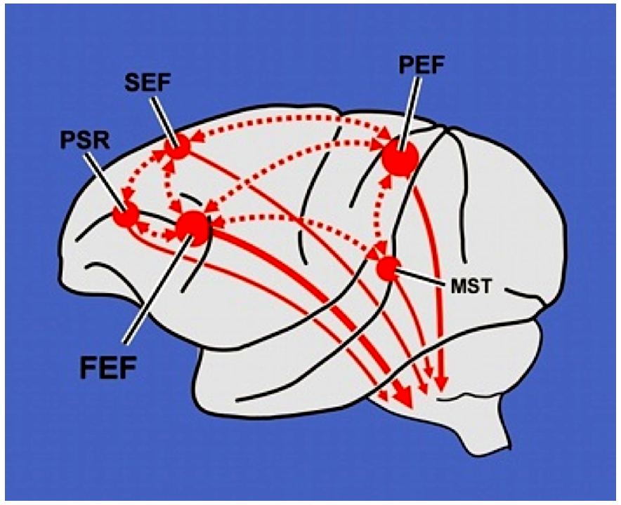
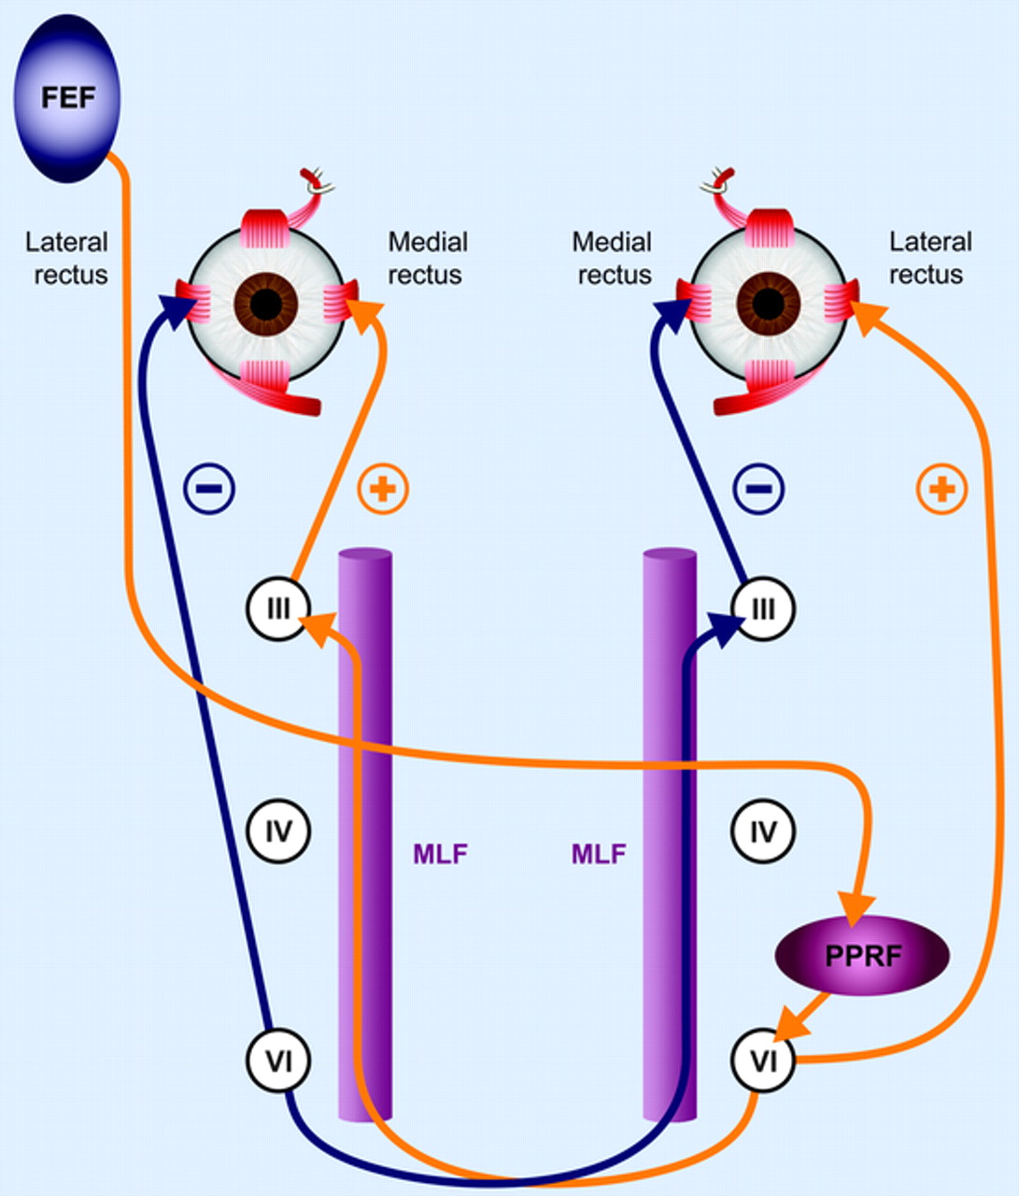
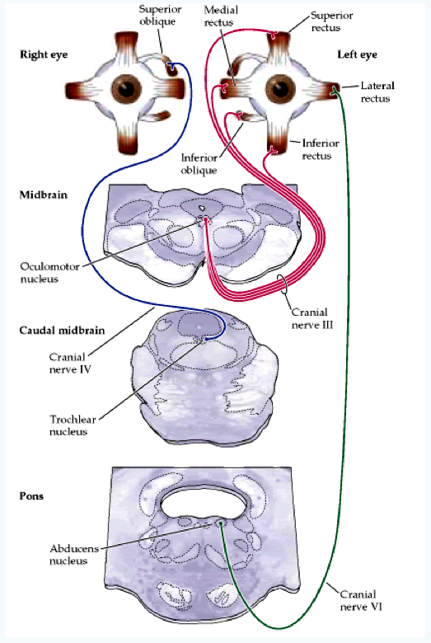

Slide 13
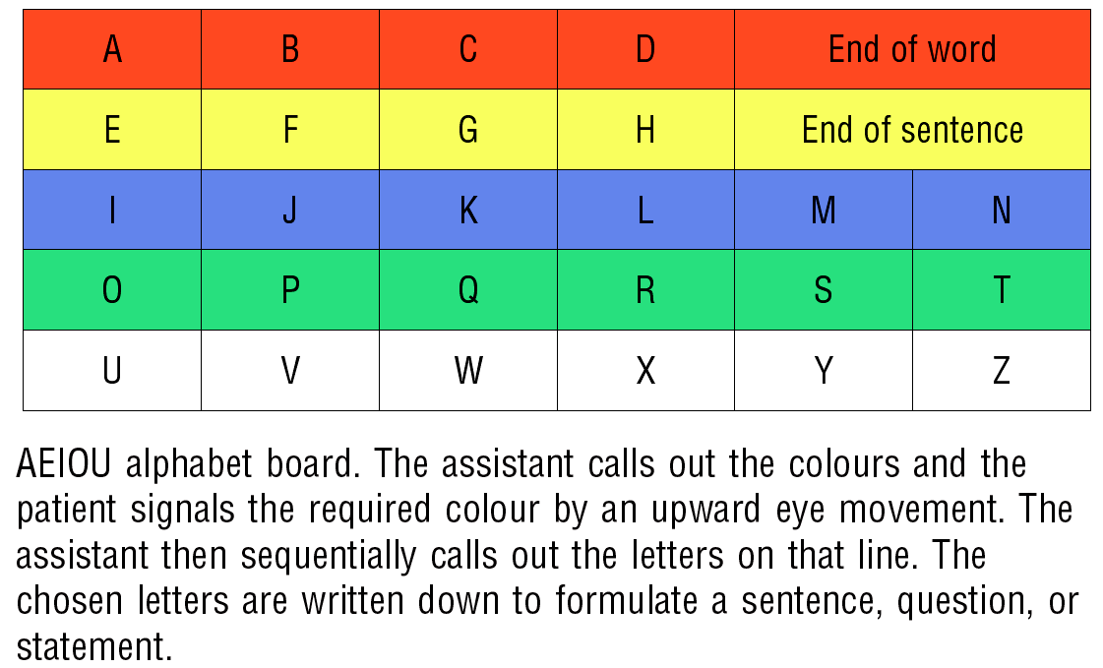
Smith E, Delargy M (2005) Locked-in syndrome. British Medical Journal 330: 406-409

Slide 14
EEG rhythms
Alpha 8-13 Hz, 15-50μV
Beta > 13 Hz
Theta 4-7 Hz
Delta < 4 Hz

Slide 15
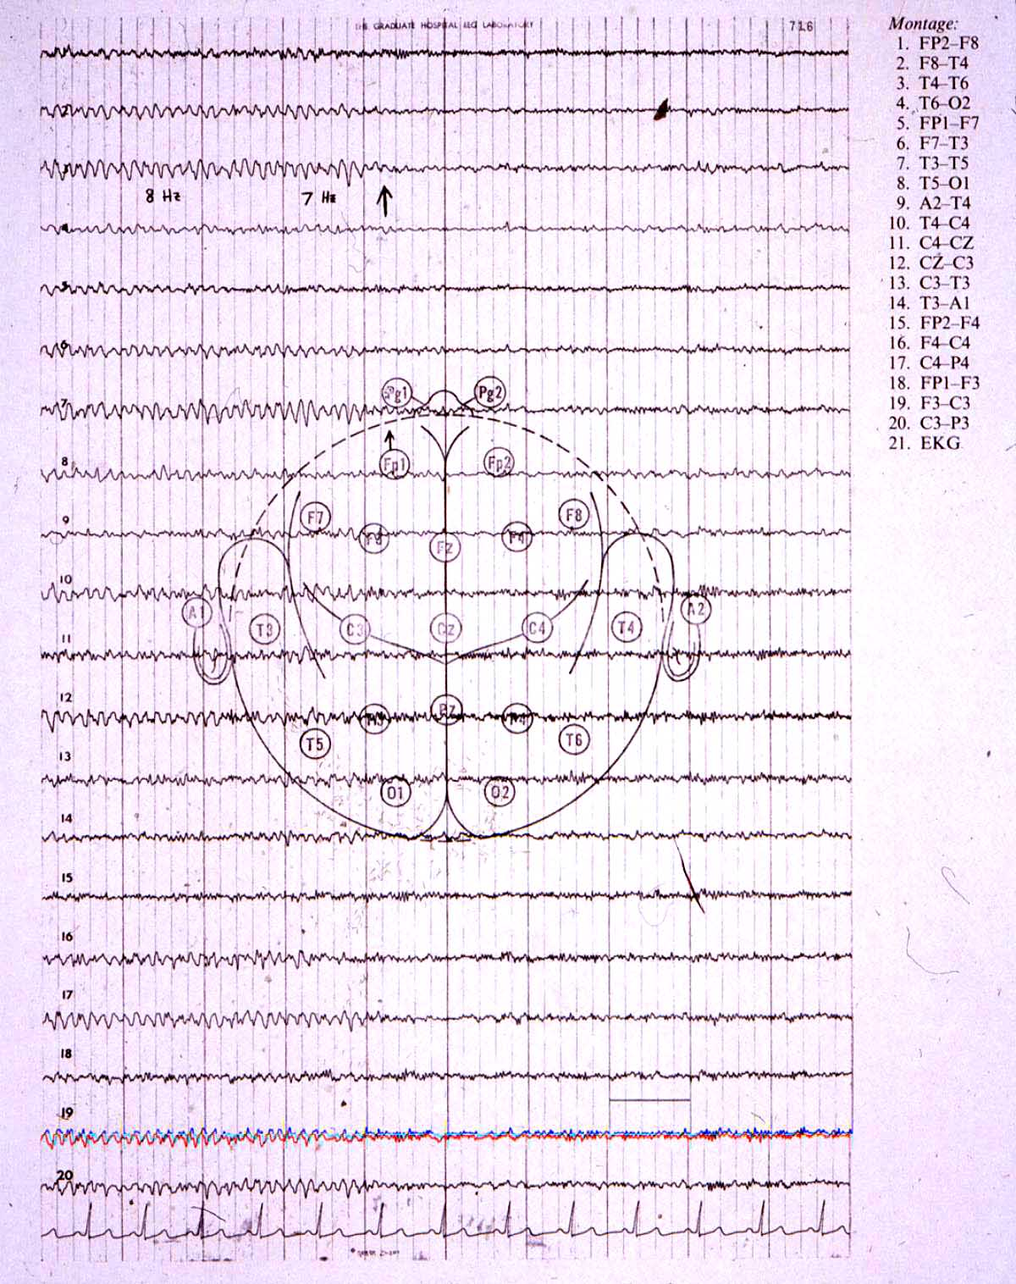
EEG rhythms
Alpha attenuation on eye opening

Slide 16
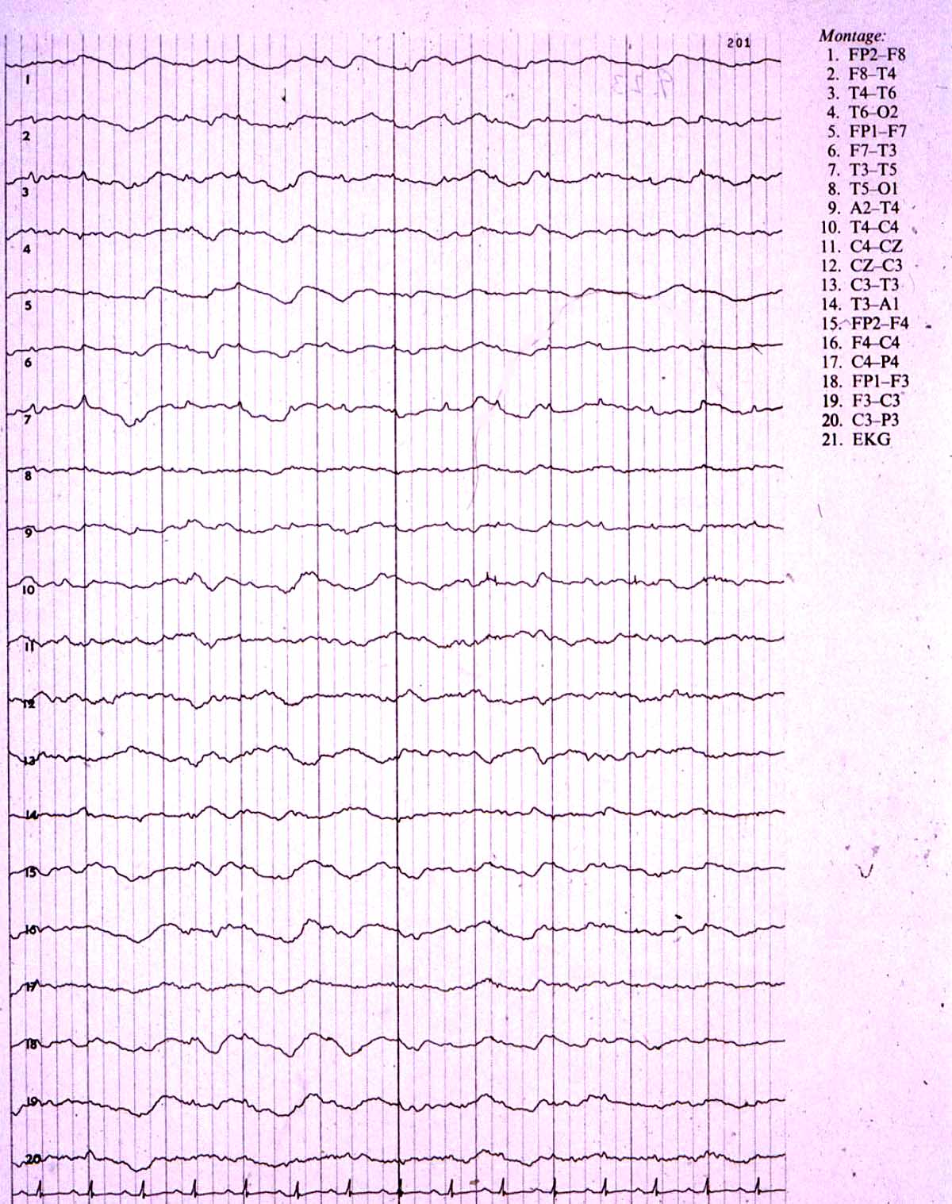
Delta coma

Slide 17
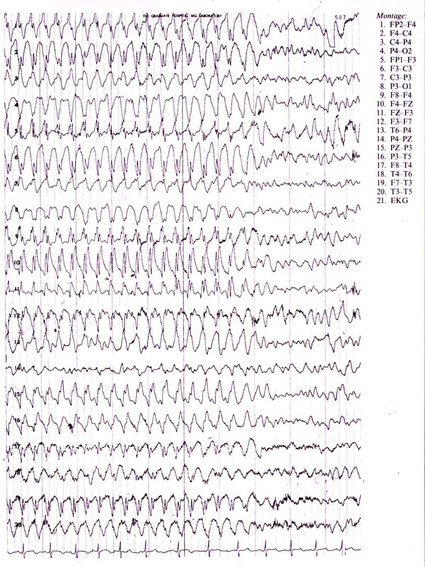
Absence epilepsy

Slide 18
Wijdicks EFM (2001) The diagnosis of brain death. New England Journal of Medicine 344: 1215-1221
1959, Mollaret & Goulon described 23 patients without consciousness, brain stem reflexes and respiration, and whose EEGs were isoelectric (flat)
‘Death’ is synonymous with ‘brain death’
‘Death’ is not synonymous with severe brain damage
‘Brain death’ means that continued life support is futile
and
A diagnosis of ‘brain death’, while circulation, blood oxygenation and metabolism are maintained in a medical setting, means that organs can be harvested for transplantation
In adults, the main causes of brain death are TBI and SAH

Slide 19
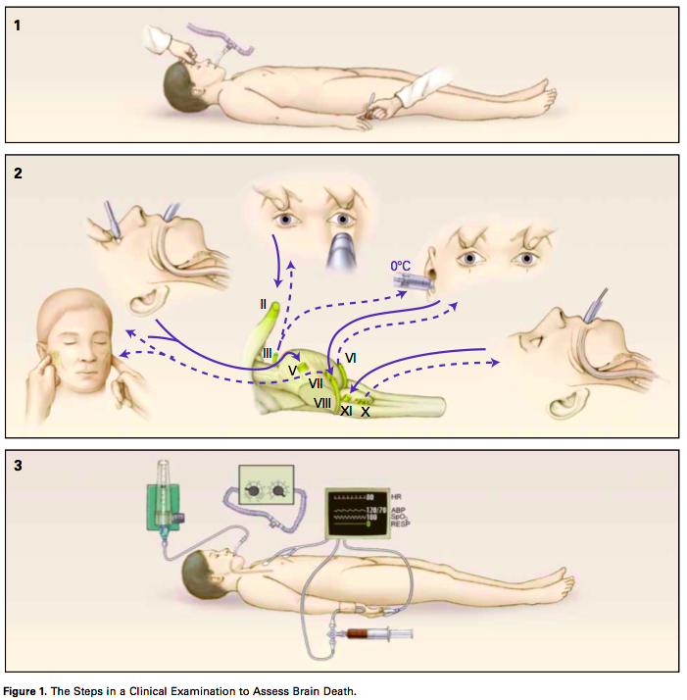
Wijdicks EFM (2001) The diagnosis of brain death. New England Journal of Medicine 344: 1215-1221

Slide 20
Royal College of Physicians (2003) The vegetative state: guidance on diagnosis and management
Patients with the MCS demonstrate a degree of awareness, even though inconsistently; which distinguishes this state from the VS
This distinction is important for:
prognosis
treatment decisions
resource allocation
medicolegal considerations
Studies had suggested a large number of misdiagnosis of the MCS (false +ve and -ve, w.r.t. VS)
Prognosis better after traumatic brain injury (TBI) than other causes (e.g. after global anoxia and/or ischaemia)
Importantly, this report emphasises observation of behaviour only

Slide 21
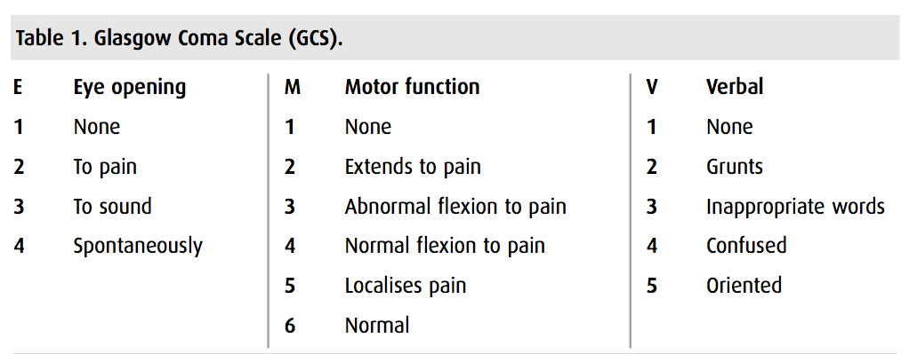

Slide 22
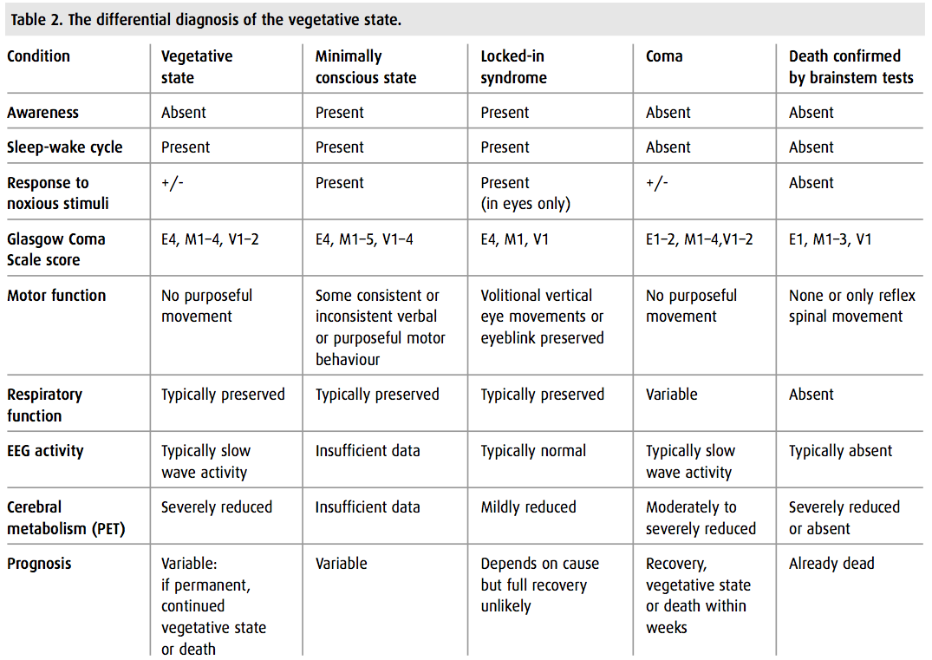

Slide 23
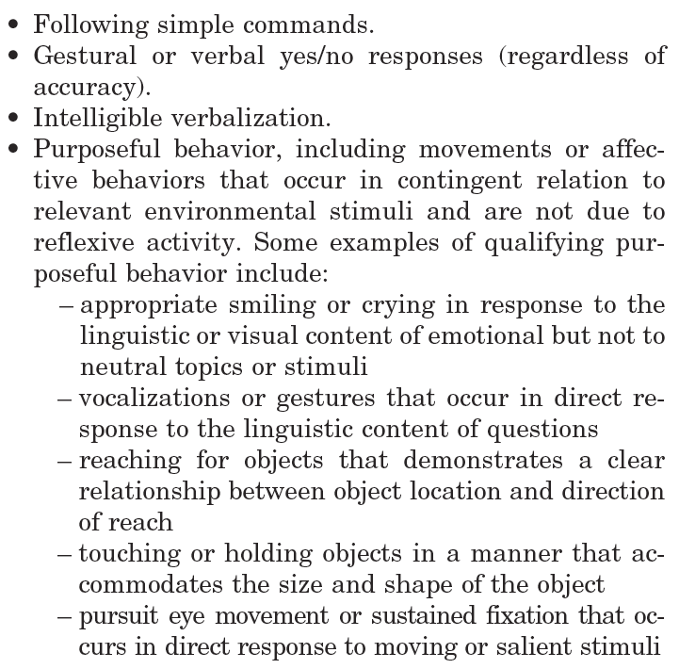
Giacino JT (2002) The minimally conscious state: definition and diagnostic criteria. Neurology 58: 349-353
Functional communication
Functional object use

Slide 24
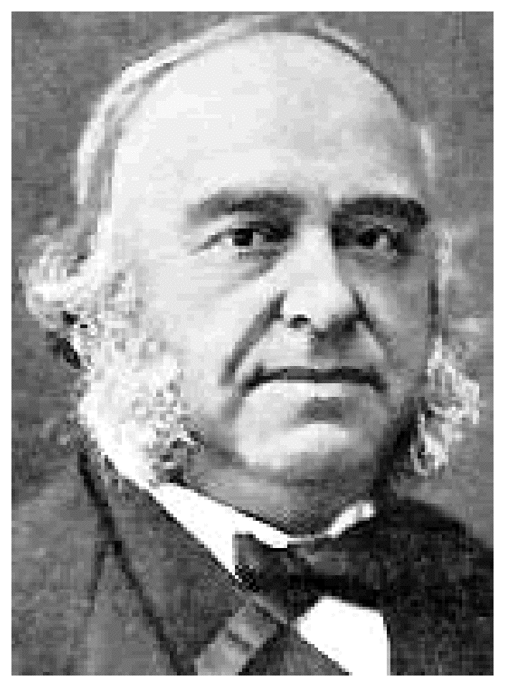
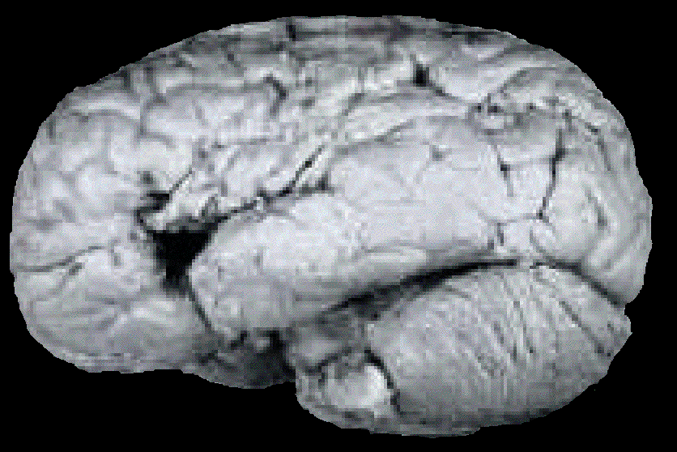
Paul Broca 1861 - patient Leborgne, or ‘Tan’
Both localised and lateralised the faculty of articulate language;
with speculations that recovery of speech may depend on right
hemisphere function

Slide 25
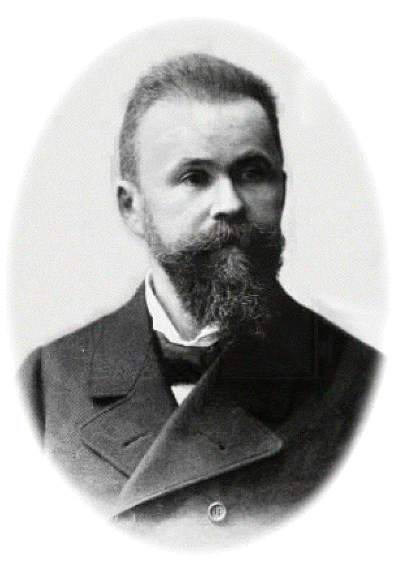
Wernicke (1874)
Broca’s area
Wernicke’s area
Speech out
Speech in

Slide 26
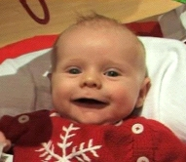
Wernicke (1874)
Broca’s area
Wernicke’s area
Speech out
Speech in

Slide 27
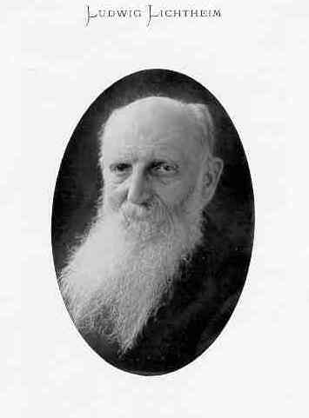
Lichtheim (1885)
‘Concept’ area
Broca’s area
Wernicke’s area
Speech out
Speech in

Slide 28
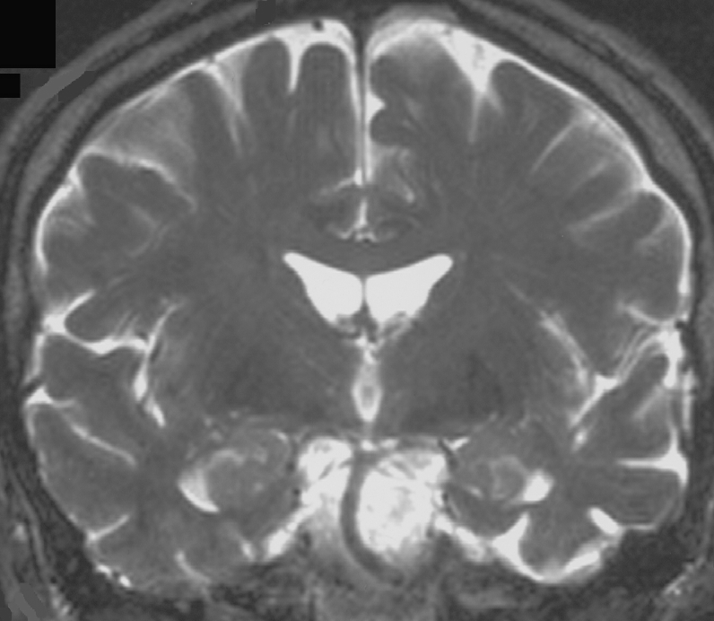
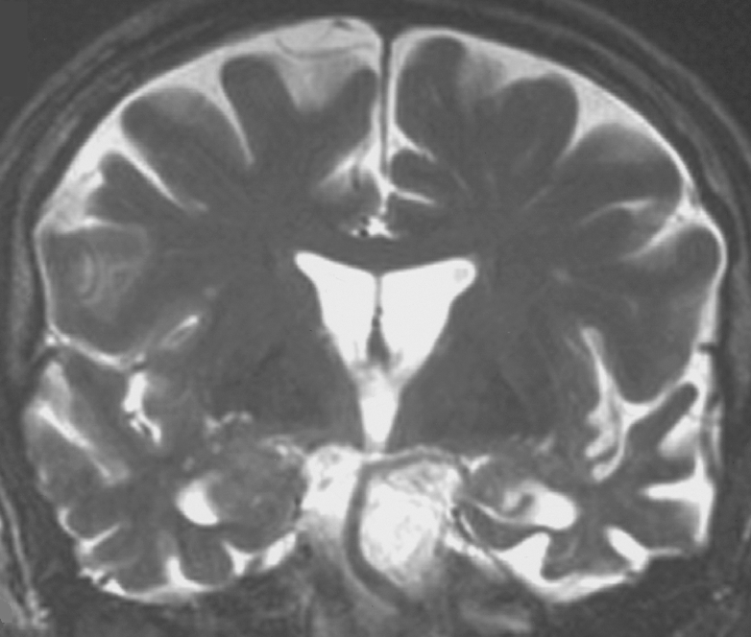
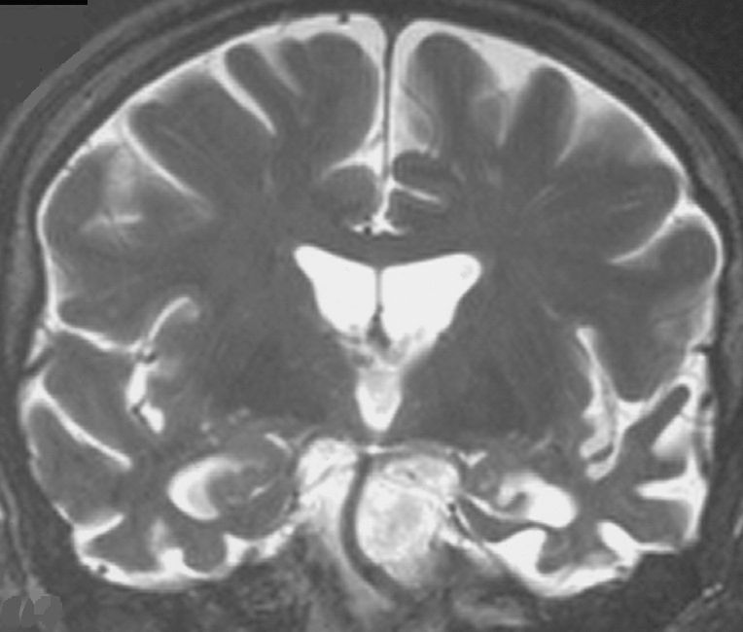
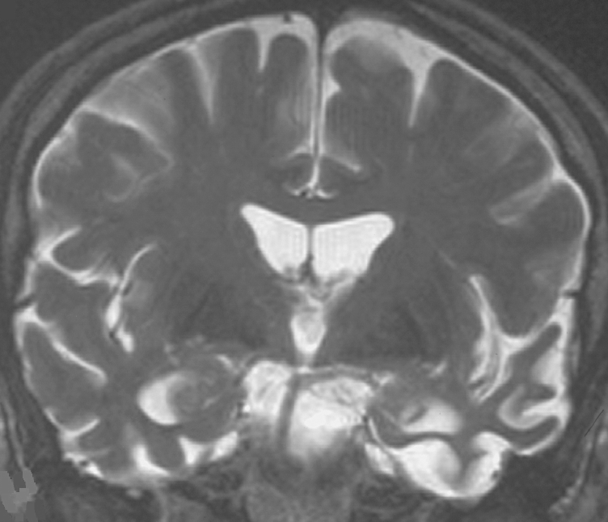
Semantic dementia
R
7/1998
R
6/2001
R
6/2002
R
9/2002
Progressive rostral temporal lobe atrophy

Slide 29

A swan

Slide 30
30 F, HR manager
Right handed
2 days post partum
Sudden onset right sided weakness and speech disturbance

Slide 31
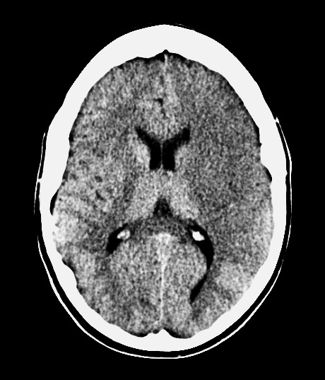
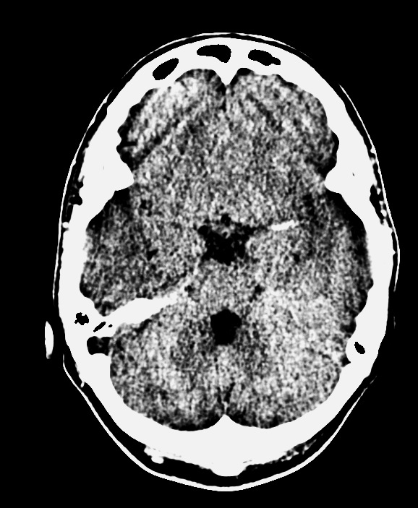
Exact time between ictus and scan uncertain
Notes:
Large MCA infarct. loss of grey-white matter differentiation, and hypoattenuation of deep nuclei. Gyral effacement
Vasogenic odema takes about 48 hrs to develope. She has no vasogenic odema
But she has cytotoxic odema because of the loss of tissue contrats

Slide 32
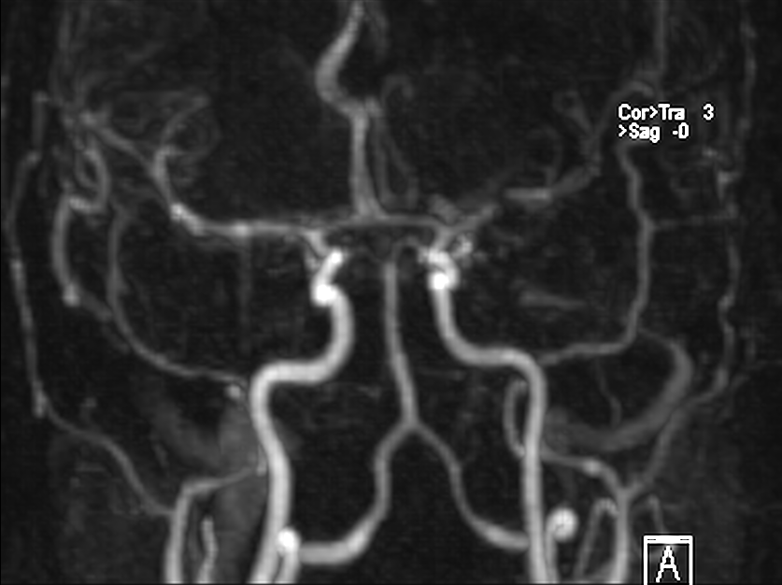
Notes:
Not for clot retrieval due to the extent of damage already and technical difficulties

Slide 34
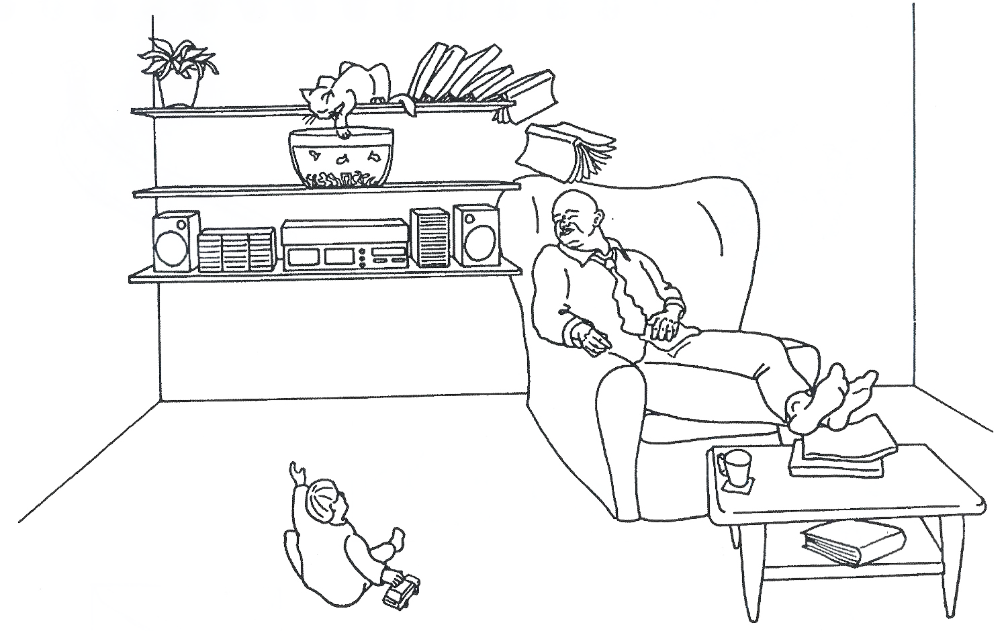
Notes:
Production tested with fluency and CAT picture

Slide 35
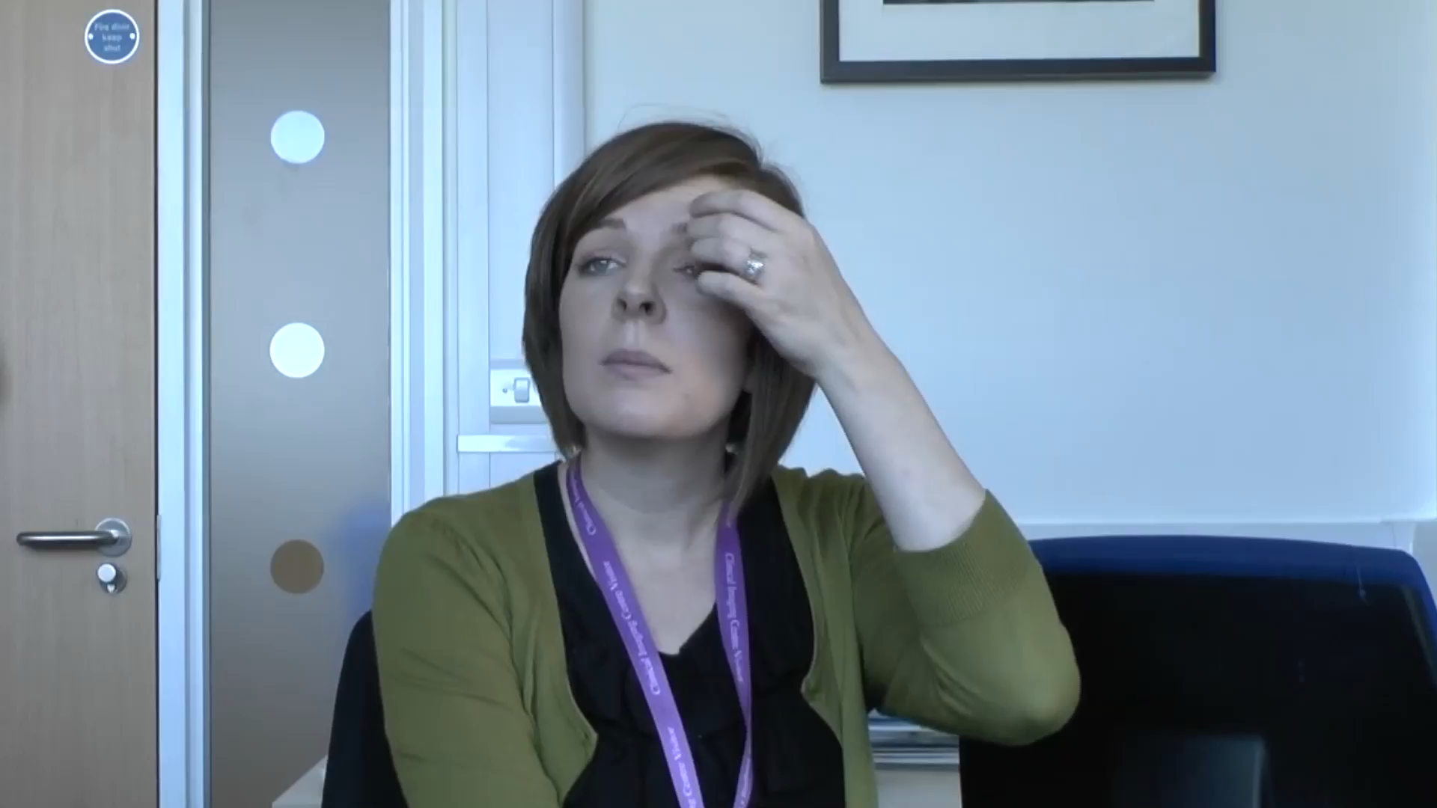

Slide 36
Patient JP - History
52 year old man
Left-handed senior press officer
Referred by a local neurologist to the specialist cognitive neurology clinic
<1 year
worsening agraphia
word finding difficulties
intermittent disorientation in time and place
visuospatial difficulties (e.g organising the distribution of objects on the table)
driving accident
Able to read to understand, forever re-reading passages of text - “losing the plot”

Slide 37
Patient JP - Examination
On neurological examination:
Normal affect with no frontal release signs
Pursuit and saccadic eye movements appeared normal
No evidence of extrapyramidal signs
OPD neuropsychological assessment:
MMSE 22/30
ACE 69/100

Slide 38
Neuropsychological Assessment
Verbal IQ (“left”) 87
Vocabulary 9
Similarities 10
Arithmetic 5
Digit span 7
Performance IQ (“right”) 55
Picture Completion 3
Block Design 1
Picture Arrangement 4
<4: extremely low, 5-6: borderline, 7-8: low-average, 9-11: average
National Adult Reading Test (NART) High average (~110)
Notes:
NART - low frequency irregular words - premorbid IQ

Slide 39
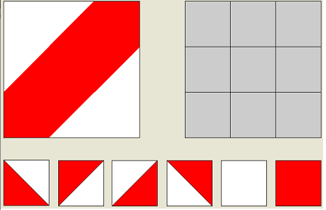
Block design

Slide 40
Neuropsychological Assessment - March 2009
Verbal memory - < 5th percentile
Language - 24/30 graded naming test
24/30 graded oral spelling
Calculation dyscalculia, with spatial difficulties
Visual perception - impaired fragmented letter identification
Visuospatial skills - impaired dot counting
Notes:
Graded naming - pictures become more and more low frequency (AD - frequent anomia)
Intersecting pentagons

Slide 41
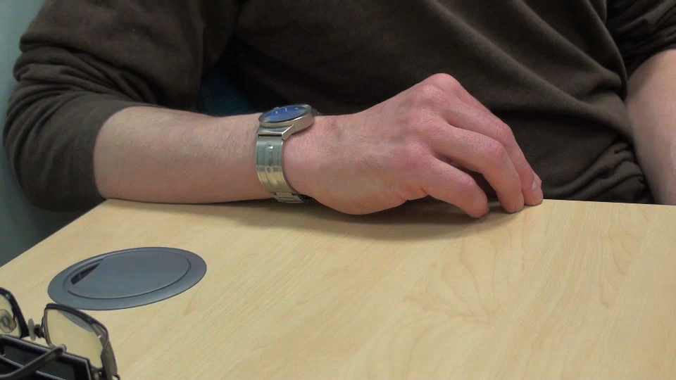
Notes:
Intersecting pentagons
Next - clock

Slide 42

Notes:
Clock
Next - Dots

Slide 43
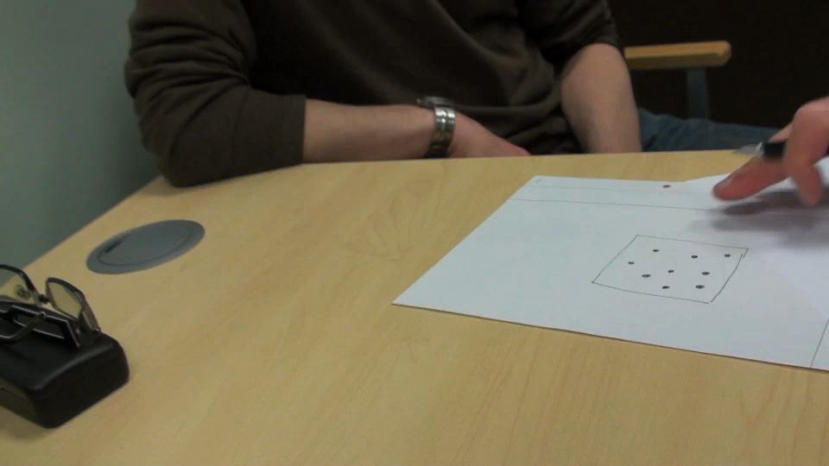
Notes:
Dots
Next Arithmatic

Slide 44
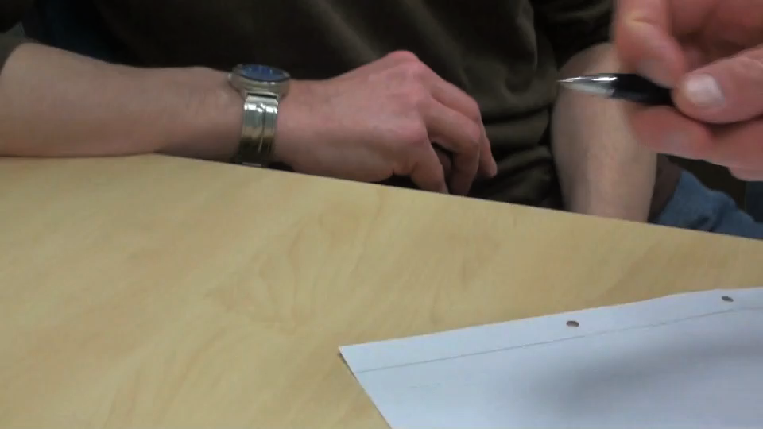
Notes:
Sums
Next Sentence

Slide 45
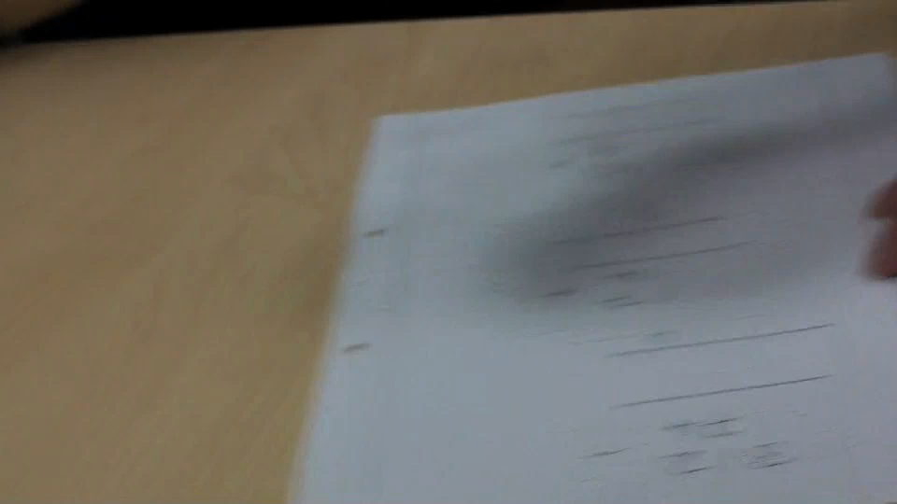
Notes:
Sentence
Next Praxis

Slide 46
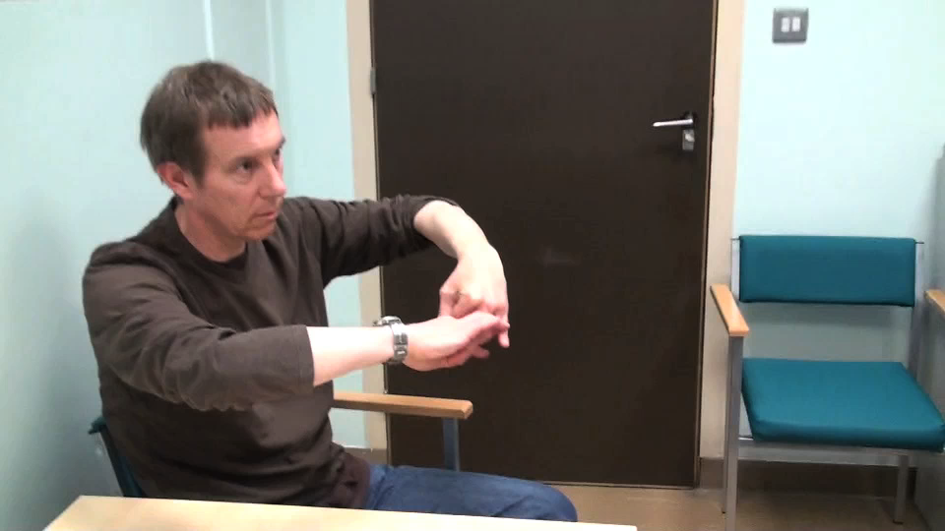
Notes:
Praxis
Next Verbal fluency

Slide 47
Summary
1 year history of progressive symptoms dominated by agraphia, acalculia, visuospatial difficulties, disorientation in time and place
Neuropsychological testing indicates a marked decline in IQ, with greater dysfunction of the right hemisphere than left. The deficits were most marked for “parietal’ functions. Episodic memory also affected
Imaging reveals atrophy of bilateral parietal cortex, with relative preservation of medial temporal volumes

Slide 48
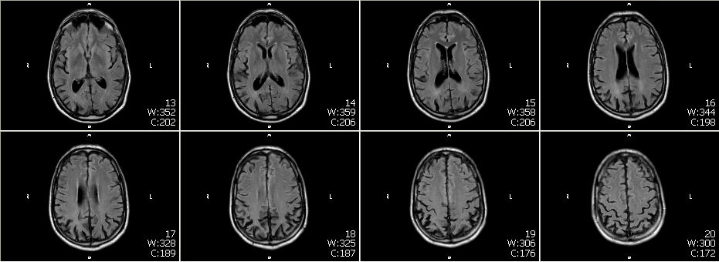
T₁-weighted MRI - axial sections

Slide 49
What are executive functions?
Umbrella term for processes that CONTROL behaviour.
Allow us to co-ordinate psychological processes (attention, memory, perception, etc.) in order to achieve goals

Slide 50
Executive Functions include:
  Inhibition
  Flexibility
  Planning
  Multi-tasking
  Judgement

Slide 51
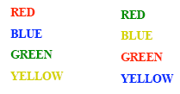
Executive functions include:
  Inhibition
Stroop Task

Slide 52
Executive functions include:
  Multi-tasking
Tasks
  Buy 6 items (e.g. lettuce, a bar of soap)
  Find out 4 pieces of information (e.g. coldest place in Britain yesterday)
  Be outside travel agent shop in 15 minutes
Rules
  Spend as little money and take as little time as possible
  Don’t enter a shop except to buy something
  Don’t use anything not bought on the street (except a watch)
  Inform experimenter of purchases straight after leaving a shop
Multiple Errands Test

Slide 53
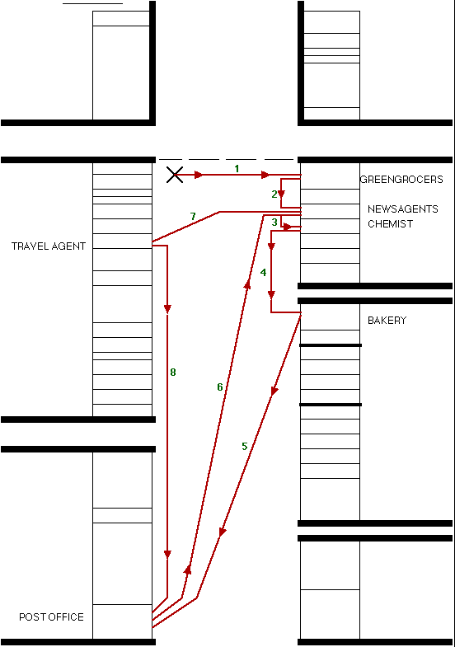
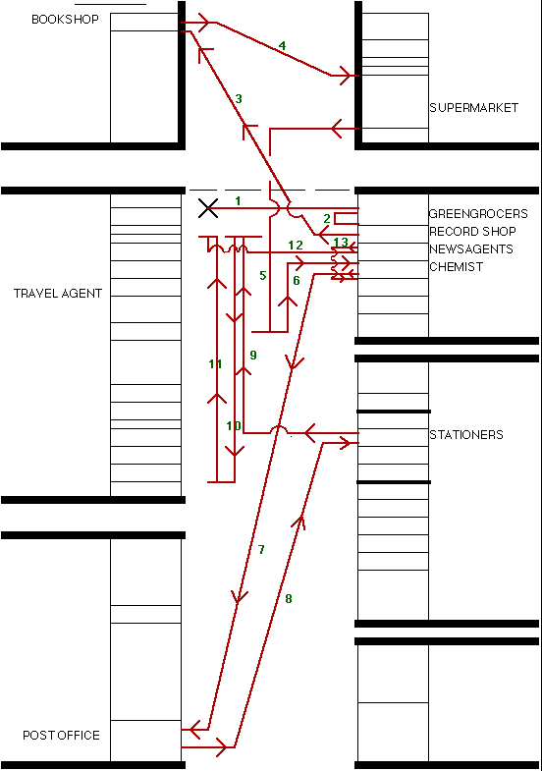
Healthy Volunteer
Patient

Slide 54
Examples of errors made only by patient
Recorded incorrect information
Ate purchase (chocolate) before test finished
Left boundaries of shopping centre
Jumped queue at payment point
Swore loudly
Removed shoes
Purchased pornographic magazine

Slide 55
