Slide 1
Blood supply to the central nervous system
Professor Steve Gentleman
Neuropathology Unit
Department of Medicine
Charing Cross campus
05/10/12

Slide 2
The demands of the brain
Brain makes up 2% of body weight but uses:
10-20% of cardiac output
20% of body O₂ consumption
66% of liver glucose
The brain is therefore very vulnerable if its blood supply is impaired

Slide 3
Blood supply to the brain
Two sources:
Internal carotid arteries
Vertebral arteries
Circle of Willis
Cerebral arteries

Slide 8
Venous drainage of the brain
Cerebral veins
Venous sinuses
Dura mater
Internal jugular vein

Slide 10
Stroke
Cerebrovascular accident (CVA)
Definition:
rapidly developing focal disturbance of brain function of presumed vascular origin and of >24 hours duration
Infarction (85%) or haemorrhage (15%)

Slide 11
Transient Ischaemic Attack (TIA)
Definition:
rapidly developing focal disturbance of brain function of presumed vascular origin that resolves completely within 24 hours

Slide 12
Infarction
Degenerative changes which occur in tissue following occlusion of an artery

Slide 13
Cerebral ischaemia
Lack of sufficient blood supply to nervous tissue resulting in permanent damage if blood flow is not restored quickly
hypoxia/anoxia

Slide 14
Causes of occlusions
Thrombosis
formation of a blood clot (thrombus)
Embolism
plugging of small vessel by material carried from larger vessel e.g. thrombi from the heart or atherosclerotic debris from the internal carotid

Slide 15
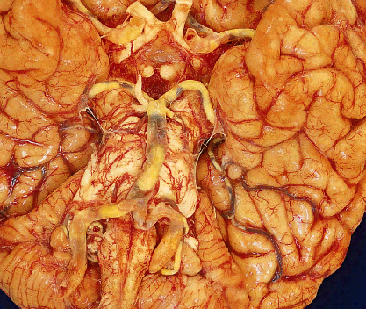

Slide 16
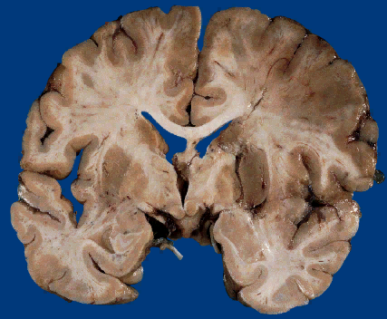

Slide 17
Epidemiology
3rd commonest cause of death
100,000 deaths in UK per annum
50% of survivors are permanently disabled
70% show an obvious neurological deficit

Slide 18
Risk factors for stroke
Main risk factors:
Age
Hypertension
Cardiac disease
Smoking
Diabetes mellitus

Slide 19
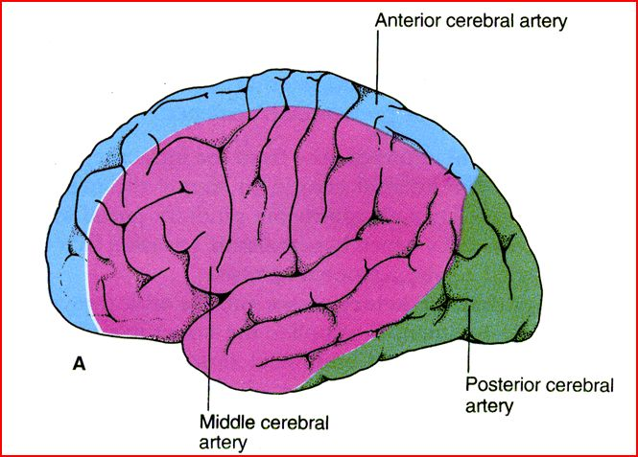

Slide 20
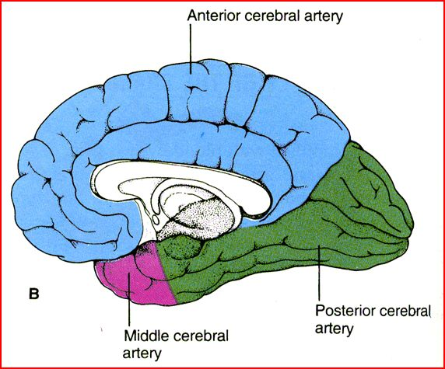

Slide 21
Anterior cerebral artery
Paralysis of contralateral leg > arm, face
Disturbance of intellect, executive function and judgement (abulia)
Loss of appropriate social behaviour

Slide 22
Middle cerebral artery
“Classic stroke”
Contralateral hemiplegia: arm > leg
Contralateral hemisensory deficits
Hemianopia
Aphasia (L sided lesion)

Slide 23
Posterior cerebral artery
Visual deficits
homonymous hemianopia
visual agnosia

Slide 24
Lacunar infarcts
Lacune is a small cavity
Appear in deep structures as a result of small vessel occlusion
Deficit is dependent on anatomical location
Hypertension

Slide 25
Haemorrhagic stroke
Extradural - trauma, immediate effects
Subdural - trauma, delayed effects
Subarachnoid - ruptured aneurysms
Intracerebral – spontaneous hyper-tensive

Slide 27
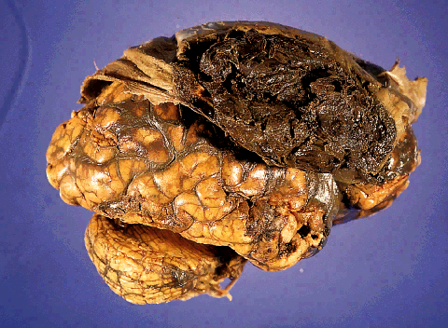
Extradural haematoma

Slide 28
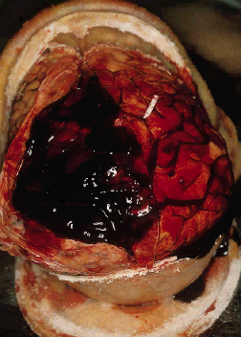
Subdural haemorrhage

Slide 29
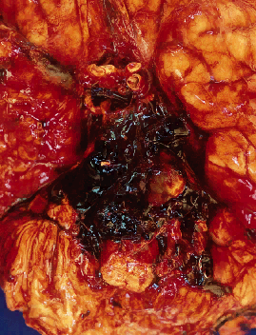
Subarachnoid haemorrhage

Slide 30
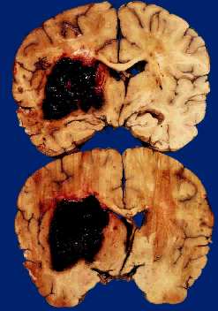
Intracerebral haemorrhage

