Slide 1
Basal ganglia and cerebellum
Ben Simpson
Division of Neuroscience
Imperial College London

Slide 2
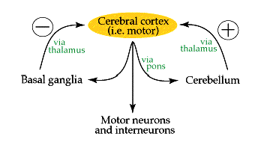
Basal ganglia and cerebellum
Motor cortex
via
thalamus
via
thalamus
basal ganglia
cerebellum
motor neurons & interneurons
spinal cord
The balance between these two systems allows for a smooth, coordinated movement, and a disturbance in either system will show up as movement disorders

Slide 3
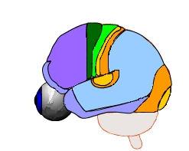
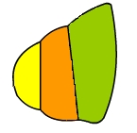
The circuit of the basal ganglia
cortex
Basal ganglia consist
Caudate and putamen (striatum)
Internal and external segments of the globus pallidus (GPi and GPe)
Subthalamic nucleus (STN)
Pars reticulata and pars compacta of the substantia nigra (SNr and SNc)
Thalamus
(VA/VL)
caudate
STN
striatum
GPe
GPi
putamen
SNc
SNr

Slide 4
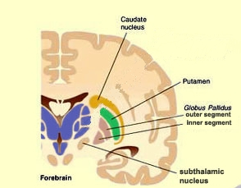
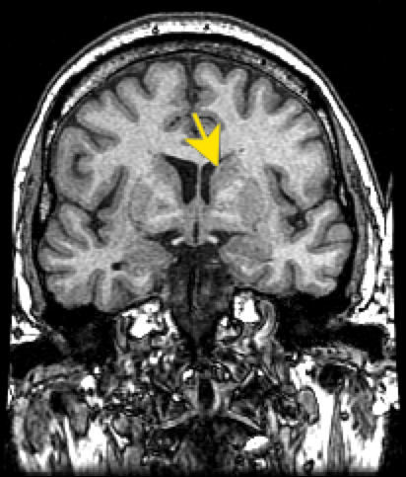
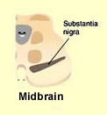
The circuit of the basal ganglia
caudate
nucleus
caudate
putamen
globus
pallidus
GPe
GPi
putamen
GPi
GPe
subthalamic
Nucleus
(STN)
forebrain
coronal view
substantia
nigra
midbrain

Slide 5
The circuit of the basal ganglia
SMA
primary motor
somatosensory
From cerebral cortex
SMA, PMA, M-I, somatosensory, parietal cortex project to
caudate and putamen
parietal association
PMC
From the putamen projections to
GPi and SNr (direct pathway)
GPe
to GPi via STN (indirect pathway)
Thalamus
(VA/VL)
caudate
STN
striatum
GPi and SNr are the only ouput of the basal ganglia
Projections to thalamus
GPe
GPi
putamen
SNc
Via thalamus
Back to cortex: SMA & PMA the two regions involved in movement preparation and planning
SNr
Nigro-striatal pathway

Slide 6
How the basal ganglia
communicate with cortex ?
cortex
+
+
The gobus pallidus (Gpi) inhibits thalamus.
The putamen inhibits Gpi which in turn releases thalamus from inhibition.
The thalamus (less inhibited) through its projections to the cortex releases the selected movement.
+
caudate
The correct balance is maintained by the SNc which provide excitatory inputs to the caudate and putamen
_
_
Thalamus
(VA/VL)
_
_
STN
GPe
The GPi and SNr are the messengers of all information from BG. They perform this role by inhibiting the thalamus. Their code consists in the modulation of the inhibitory input to the thalamus.
GPi
gaba
gaba
_
putamen
gaba
gaba
+
gaba
DA
SNc
gaba
_
SNr
Nigro-striatal
pathway

Slide 7
Basal Ganglia Circuit

Slide 8
Focused Inhibition

Slide 9
Disorders of the basal ganglia
Parkinson’s disease
&
Huntington’s disease

Slide 10
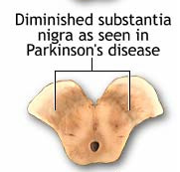
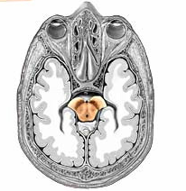
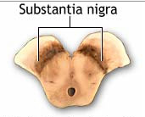
PRIMARY PATHOLOGY OF PARKINSON’S DISEASE
NEURONAL DEGENERATION
SUBSTANTIA NIGRA / SNpc ( DA)
Substantia nigra
(Parkinson’s disease
>80% loss dopamine cells)
Substantia nigra
(Normal subject)

Slide 11
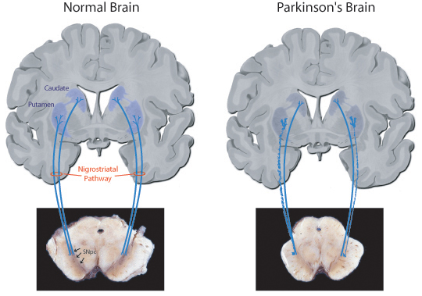
Normal brain
Parkinson’s brain
caudate
dopamine
dopamine
putamen
dopamine
dopamine
Nigrostriatal
pathway
Degeneration of dopamine neurons
loss of nigro-striatal dopaminergic terminals (axons)
in caudate & putamen
Coronal view

Slide 12
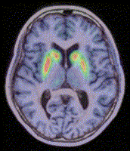
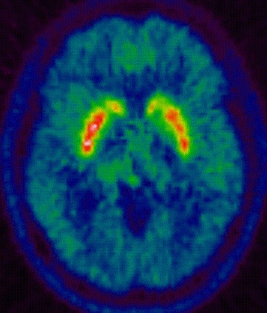
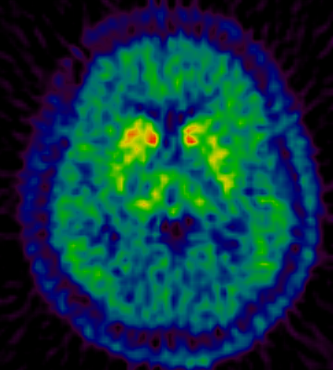
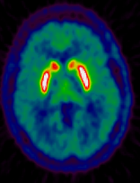
Positron emission tomography (PET) ¹⁸F-dopa
caudate
putamen
R
transaxial view
L-side hemiparkinson
Advanced Parkinson’s disease
Normal subject

Slide 13
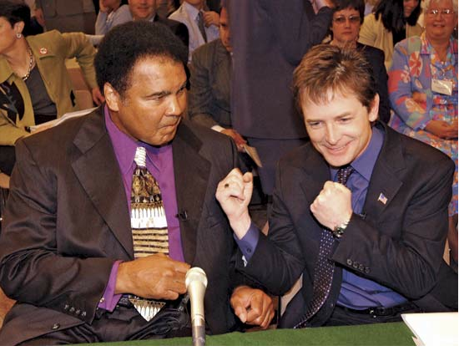
Parkinson’s disease

Slide 14
Parkinson’s disease
Bradykinesia-sloweness of movements
Difficulty in small movements: doing up buttons, handling a knife
Face hypomimic (absence of movements that normally animate the face, expressionless, mask-like)
Akinesia- difficulty in the initiation of movements. Needs external sensory triggers to initiate movement: e.g. a visual trigger because cannot initiate movements internally
Tremor at rest-cease with voluntary activity-usually starts in one hand (asymmetry) tends to spread with time to other parts of the body
Rigidity-(no to be confused with spasticity) a type of resistance to passive movements. To the physician passively moving the patient’s limb feels like bending a lead pipe- lead pipe rigidity

Slide 15
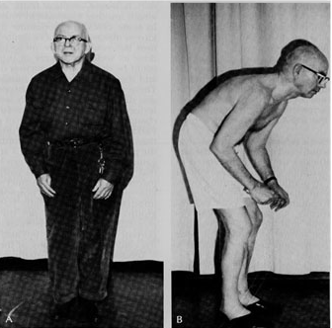
Parkinson’s disease
walking slow, small steps, shuffling feet, reduced arm swing
stooped posture: head and body bent forward and downward

Slide 16
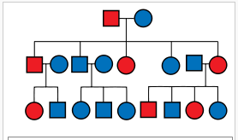
Huntington’s disease
HD is caused by a mutation of the huntingtin gene on chromosome 4. The mutation is expressed as an autosomal dominant disease.

Slide 17
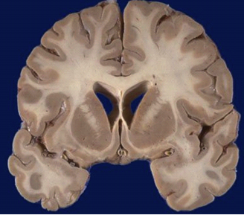
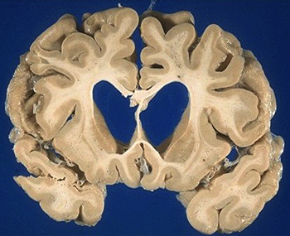
Huntington’s disease
The main pathology consists in degeneration of spiny GABAergic neurons in the striatum: caudate first and later putamen.
Profound atrophy of caudate and putamen nuclei (loss of neurons in these areas).

Slide 18
Huntington’s disease
Choreic movements (Chorea): Rapid jerky involuntary movements of the body
These movements usually affect the hands and the face at first.
Early in the course of the disease patients can mask the spontaneous movements by incorporating them into socially acceptable movements.
They gradually increase overtime until the patients become totally incapacitated by them.
Later on cognitive decline and dementia
Death usually 10-15 years from symptoms onset

Slide 19
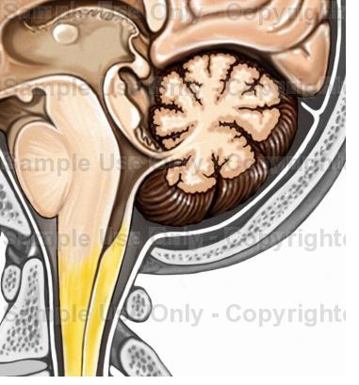
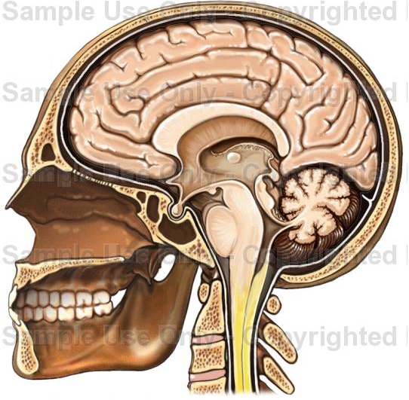
The cerebellum
“Little Brain”
occipital lobe
IV ventricule
pons

Slide 20
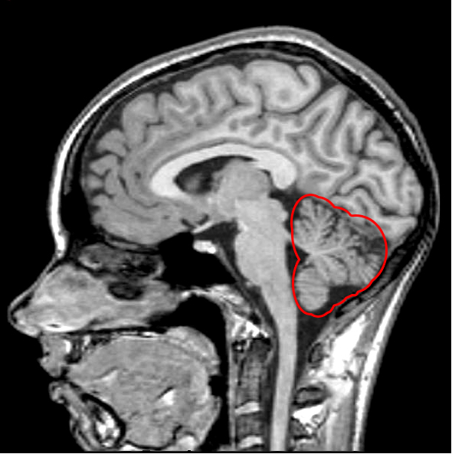

Slide 21
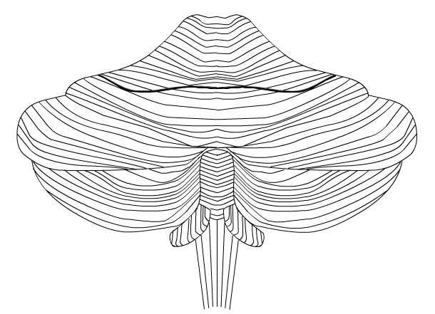
The cerebellum
anatomy
Folds of the cerebellar surface: folia

Slide 22
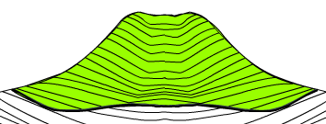
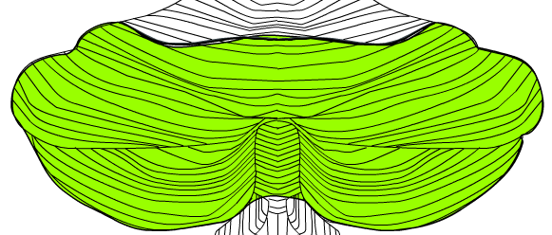
The cerebellum
anatomy
The cerebellum is divided horizontally into 3 lobes
1. anterior lobe
2. posterior lobe
3. flocculonodular lobe

Slide 23
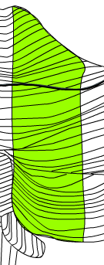
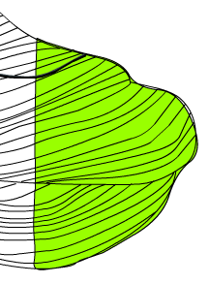
The cerebellum
anatomy
vermis
intermediate
cerebellum
lateral
cerebellum

Slide 24
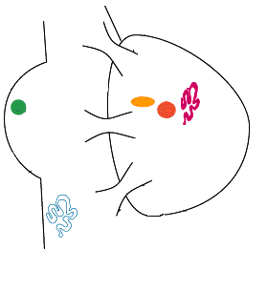
Deep cerebellum nuclei
Superior cerebellar
peduncle
pons
Dentate nucleus
fastigial
interposed
Middle cerebellar
peduncle
Inferior cerebellar
peduncle

Slide 25
Cerebellar Function: Efference Copy

Slide 26
3 functional divisions of the cerebellum
1. Vestibulocerebellum
2. Spinocerebellum
3. Cerebrocerebellum

Slide 27
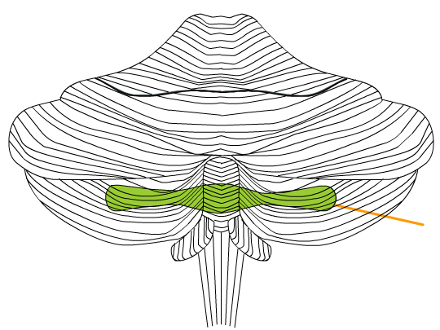
The 3 functional divisions of the cerebellum and their input and output
1. Vestibulo cerebellum
The flocculonodular lobe (the oldest part of the cerebellum)

Slide 28
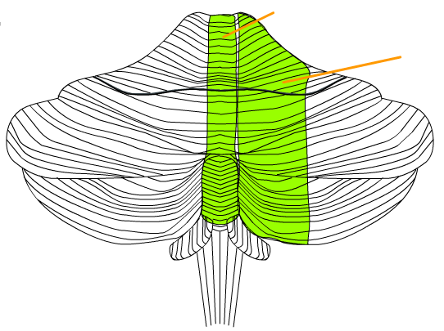
The 3 functional divisions of the cerebellum and their input and output
2. Spinocerebellum
The vermis projects to the fastigial nucleus
The intermediate projects to the interposed nucleus

Slide 29
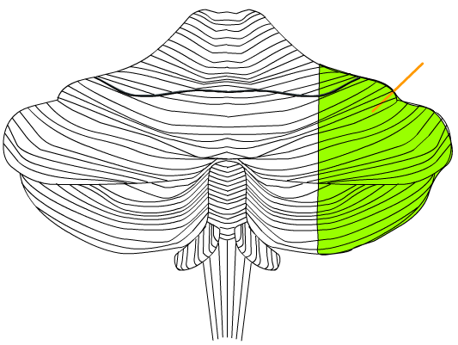
The 3 functional divisions of the cerebellum and their input and output
3. Cerebrocerebellum
The lateral lobe (the newest part of the cerebellum) projects to the dentate nuclei

Slide 30
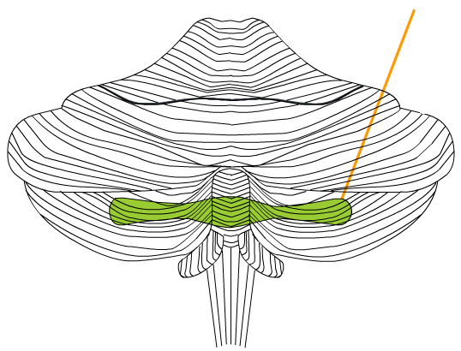
Main projections and function
1. Vestibulo cerebellum
Superior cerebellar
peduncle
pons
floccoulonodular
cortex
Inferior cerebellar
peduncle
Functions:
Regulation of gait and posture
and equlibrium
Coordination of head movements
with eye movements
Vestibular system
(vestibular nuclei &
vestibular nerve)

Slide 31
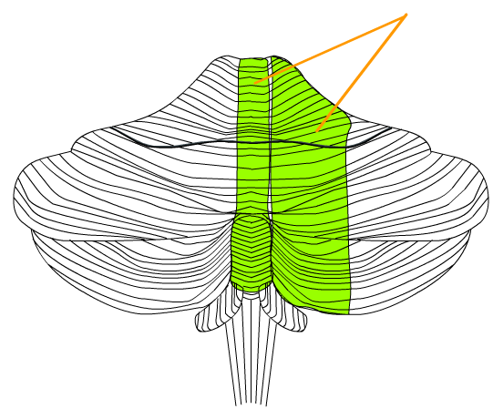
Main projections and function
2. Spinocerebellum
red
nucleus
Superior cerebellar
peduncle
pons
reticular formation nuclei
Nuclei
Fastigial Interposed
Function:
Coordination of speech
Adjustment of muscle tone
Coordination of limb movements
Inferior cerebellar
peduncle
Spinal afferents from axial portions of the body, trigeminal, visual and auditory inputs project to the vermis
Spinal afferents from the limbs project to the intermediate areas-
Somatotopic organization in the cerebellum cortex
Dorsal & Ventral Spinocerebellar tracts
(Somatosensory inputs
from proprioceptors and exteroceptors)
Reticulo-spinal and Rubro-spinal tracts
(to spinal cord-motor neurons)
spinal cord

Slide 32
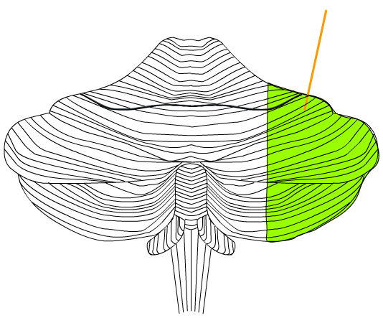
Main projections and function
3. Cerebrocerebellum
Cerebral cortex
(MI, SMA, S1, PP & primary visual cortex)
thalamus
Superior cerebellar
peduncle
Reticular
formation
& pontine
nuclei
pons
Function:
Coordination of
skilled movements
Tactics of
immediate movements
Dentate
nucleus
Middle cerebellar
Peduncle
Cognitive function
Attention,
processing of language
Emotional control
inferior olive nuclei
Inferior cerebellar
peduncle

Slide 33
Main signs in cerebellar disorders
1) Instability when standing or walking-Wide based stance, staggering and wide based walking (looks drunk) (Ataxia)
2) Romberg sign negative
3) Reduced muscle tone (floppy limbs) (Hypotonia) ??
4) Inability to judge distance and when to stop (Dysmetria)
5) Slurred speech (Dysarthria)
6) Inability to coordinate movements – inability to perform rapid alternating movements (Dysdiadochokinesia)

