Slide 1
Psychological Disorders and Therapy
Dr Stephen Gunning
Clinical Psychologist
8th March 2013

Slide 2
Classical Conditioning
US UR
Active Treatment Therapeutic Effect
CS CR
Associated Stimuli ?placebo

Slide 3
Epidemiology
According to the WHO, one half of all the suffering due to ill-health in western Europe is due to mental illness. It accounts for as much suffering as all physical illnesses put together (WHO International Consortium in Psychiatric Epidemiology, 2000)
Depression has now superseded stroke as the number one cause of disability worldwide (WHO, 2005)

Slide 4
UK Mental Health
1 in 4 British adults experience at least one diagnosable mental health problem in any one year, and 1 in 6 experiences this at any given time.
Mixed anxiety & depression is the most common mental disorder in Britain, with almost 9% of people meeting criteria for diagnosis.
Between 8-12% of the population experience depression in any year.
The Office for National Statistics Psychiatric Morbidity report, 2001

Slide 5
Case study
Michelle, a working mother of two, is in a rush to pick her kids up from school. Whilst waiting in heavy traffic she starts to feel anxious and notices her heart beating rapidly, she starts sweating and her vision becomes blurry. She thinks “I’m having a heart attack!” It becomes unbearable and she leaves the road at the nearest exit. All subsequent cardiac investigations were normal. She hasn't been back in the car since.

Slide 6
Panic Attack (DSM-IV)
Four or more of the following symptoms:
  palpitations, pounding heart, or accelerated heart rate
  sweating
  trembling or shaking
  sensations of shortness of breath or smothering
  chest pain or discomfort
  feeling dizzy, unsteady, lightheaded, or faint
  feelings of unreality (derealization) or being detached
  from oneself (depersonalization)
  fear of losing control or going crazy
  fear of dying
  paresthesias (numbness or tingling sensations)
  chills or hot flushes

Slide 7
Panic Disorder (DSM-IV)
A. Both (1) and (2):
1. recurrent unexpected panic attacks
2. at least one of the attacks has been followed by 1 month (or more) of one (or more) of the following:
  persistent concern about having additional attacks
  worry about the implications of the attack or its consequences (e.g., losing control, having a heart attack, "going crazy")
  significant change in behaviour related to the attacks

Slide 8
Panic Disorder
B. The presence (or absence) of agoraphobia
C. The panic attacks are not due to the direct physiological effects of a substance (e.g., a drug of abuse, a medication) or a general medical condition (e.g., hyperthyroidism).
D. The panic attacks are not better accounted for by another mental disorder

Slide 9
Agoraphobia
Develops as a complication of panic attacks
Agoraphobia may arise by the fear of having a panic attack in a setting from which there is no easy means of escape
As a result, sufferers of agoraphobia avoid public and/or unfamiliar places, especially large, open, spaces where there are few 'places to hide‘ or prevent easy escape

Slide 10
Psychological Treatments
Goal of all psychotherapy is to help people change maladaptive thoughts, feelings, and behavior patterns
Four major schools:
Psychodynamic
Systemic
Behavioural
Cognitive

Slide 11
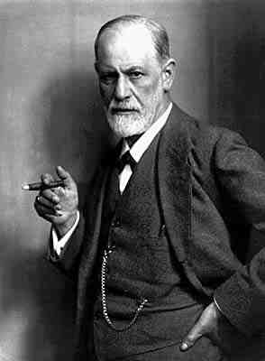
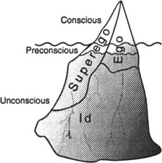
Psychodynamic therapy
Dr Sigmund Freud

Slide 12
Psychodynamic Approach to Panic
Panic patients have particular difficulties with angry feelings and fantasies, such as wishes for revenge
Triggered in adulthood, when the individual experiences or perceives a threat to the integrity of important attachment relationships
Typically include conflicts surrounding anger recognition and management, ambivalence about autonomy, fears of loss or abandonment, and conflicted aspects of sexual excitement

Slide 13
Systemic Therapy
Roots in postmodernism and family therapy
Common idea is that symptoms are not assigned to one particular individual who is labelled ‘the problem’ but rather examined and understood in the context in which they have arisen
Symptoms are seen as problems in interaction and communication between people rather than as existing within persons

Slide 14
Solution Focused Approach to Panic
Avoid ‘problem’ talk
Look for resources not deficits
Explore possible and preferred futures
Use of ‘miracle question’:
  “If your panic difficulties disappeared overnight how would things be different?”
  “And what would that look like?”
  Not absence of problem or vague ‘happier’ but concrete, observable changes
Notes:
Sinking feeling in stomach would have gone – what would that mean – I could get up and go to work – what would have changed at work – I would feel confident in my ability at work – so it sounds like you have trouble feeling confident at work – would it help if we looked at ways to help you feel more confident in your abilities/less doubting?
Start to think of the solution and move away from problem talk as well
14

Slide 15
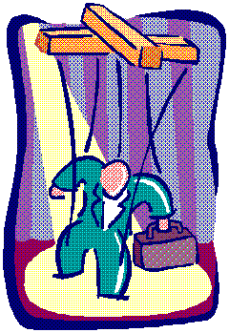
Behaviour Therapies
Behavioural approaches believe that:
  Maladaptive behaviours are not merely symptoms of underlying problems
    The behaviours are the problem
  Problem behaviours are learned in the same ways normal behaviours are

Slide 16
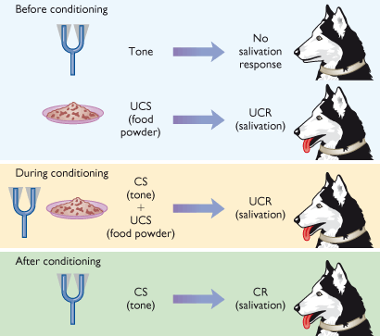
Classical Conditioning

Slide 17
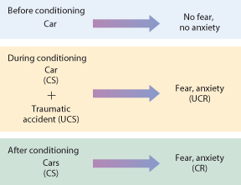
Phobia Development

Slide 18
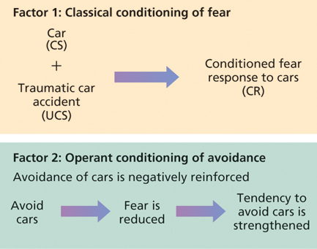
Two-factor theory of maintenance of classically conditioned associations e.g. fear

Slide 19
Behaviour Therapies
Exposure Approach:
  Treat phobias through exposure to the feared CS (i.e. car) in the absence of the UCS (i.e. accident)
  Response prevention is used to keep the operant avoidant response from occurring
  Highly effective for reducing anxiety responses
  Controversial because intense temporary anxiety is created by treatment

Slide 20
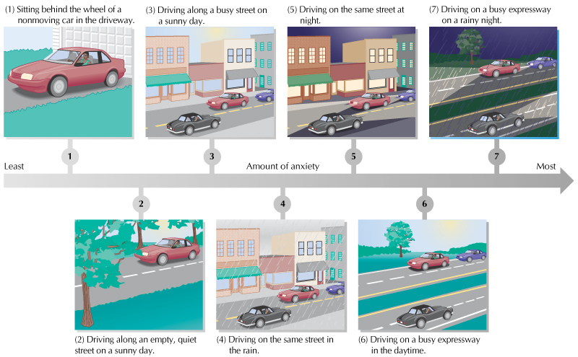
Systematic Desensitisation

Slide 21
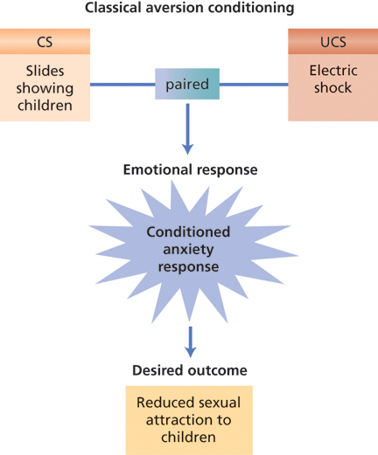
Behaviour Therapies

Slide 22

Operant Conditioning Techniques
Therapists consistently reward desired behaviour and withhold reward for undesired behaviour.
Commonly used by parents and teachers to change problem behaviours in children
Often a whole environment is converted in to an operant conditioning arena, termed a token economy

Slide 23
Cognitive Therapy
Emphasises role of attributions in understanding emotional disorders
Originally devised for treatment of depression

Slide 24
ABC MODEL
A
Activating Event
C
Consequences
A
Activating Event
B
Beliefs
C
Consequences

Slide 25
You’re walking down the High Street, and someone you know walks by without acknowledging you…

Slide 26
THOUGHT | EMOTION
Nobody wants to talk to me, no-one likes me | Sad
Who does she think she is, ignoring me?! | Angry
Ha, she’s probably hungover! | Amused
I don’t want her to see me, I won’t know what to say | Anxious
She obviously didn’t see me | Unconcerned

Slide 27
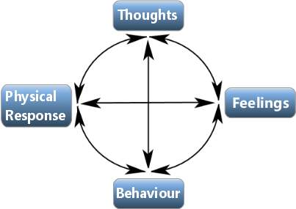
Cognitive-Behavioural Model

Slide 28
Cognitive Therapy and Panic
Panic may only occur if bodily sensations are interpreted in a particular way
This is the central notion behind cognitive models of panic

Slide 29
Clarke’s (1986) theory of catastrophic interpretation
Individuals with PD interpret certain bodily sensations in a catastrophic fashion
Sensations (esp. those involved in normal anxiety responses e.g., palpitations, breathlessness, dizziness, paresthesias) are considered to be a sign of impending physical or psychological disaster
e.g. palpitations → having heart attack

Slide 30
Clarke (1986)
Internal/External Trigger
Perceived Threat
Misinterpretation
Anxiety
Physical/Cognitive Symptoms

Slide 31
Clarke’s (1986) theory of catastrophic interpretation
7–28% of population will experience an occasional unexpected panic attack
Only go on to develop PD if they develop a tendency to interpret in a catastrophic fashion
Studies demonstrate that PD can be alleviated with cognitive techniques e.g. cognitive restructuring

Slide 32
Cognitive therapy techniques for panic disorder
Explanation of symptoms
Identify & challenge negative automatic thoughts
Reappraisal of idiosyncratic beliefs
Relaxation, breathing exercises.
Graded exposure to feared stimuli
Dropping of safety behaviours

Slide 33
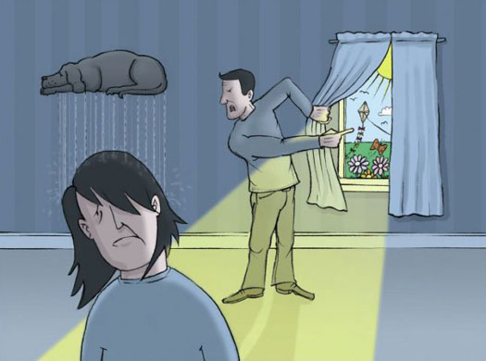
Depression
Depression Example

Slide 34
Depression (DSM-IV)
A. Five (or more) of the following symptoms have been present during the same 2-week period and represent a change from previous functioning; at least one of the symptoms is either
(1) depressed mood or
(2) loss of interest or pleasure.
(3) Loss of appetite
(4) Insomnia or Hypersomnia nearly every day
(5) psychomotor agitation or retardation nearly every day
(6) fatigue or loss of energy nearly every day
(7) feelings of worthlessness or excessive or inappropriate guilt
(8) diminished ability to think or concentrate
(9) recurrent thoughts of death, recurrent suicidal ideation without a specific plan, or a suicide attempt or a specific plan for committing suicide

Slide 35
Depression (DSM-IV)
B. The symptoms do not meet criteria for a Mixed Episode
C. The symptoms cause clinically significant distress or impairment in social, occupational, or other important areas of functioning.
D. The symptoms are not due to the direct physiological effects of a substance (e.g., a drug of abuse, a medication) or a general medical condition (e.g., hypothyroidism).
E. The symptoms are not better accounted for by Bereavement,

Slide 36
Beck’s schema theory
Early Experience
Dysfunctional schemas formed
Critical Incident
Schema Activated
Negative Automatic
Thoughts
Symptoms of
Anxiety/Depression

Slide 37
Beck’s schema theory
“If I don’t always do well I’m worthless”
Critical
parents
Fail Exam
Feelings of worthlessness
I am a total failure
Sadness, withdrawn, loss of energy

Slide 38
Negative Thinking Traps
38
LABELLING: Place a fixed, global label on oneself without considering evidence that leads to a less disastrous conclusion
“I’m a loser” ; “I’m no good.”
OVERGENERALIZATION: Drawing general conclusion based on single incident
  “I felt nervous with others at the party; I don’t think I have what it takes to make friends.”
PERSONALIZATION: Inappropriately relating external events to oneself without an obvious basis for making such connections
“She didn’t say hello to me because I must have done something wrong.”
DICHOTOMOUS THINKING: View a situation in only two categories instead of on a continuum
“If I’m not a total success, I’m a failure”
Notes:
38

Slide 39
General Principles of Cognitive Therapy
Focuses on problematic beliefs and behaviours that maintain disorders (rather than original causes).
Goal oriented i.e. Specific and measurable
Problem solving
Collaborative relationship e.g. Explicit formulation
Brief (8-16 sessions)
'Scientific' approach e.g. Collecting data, testing hypotheses

Slide 40
Mindfulness-Based Cognitive Therapy
Paying attention in a particular way: on purpose, in the present moment and non-judgementally.
Fostering a ‘decentred’ relationship to mental contents by training clients to take a wider perspective.
Recognising thoughts as thoughts – not ‘you’ and not ‘reality’.
Notes:
40

Slide 41
Evaluating Psychotherapies
The Specificity Question: which types of therapy administered by which kinds of therapists to which kinds of clients having which kinds of problems produce which kinds of effects?
  Ongoing question for psychotherapy research
  Attempts to establish an evidence base

Slide 42
Evaluating Psychotherapies
Eysenck (1952):
  Found that the rate of spontaneous recovery in the absence of any treatment was just as high as the success rates reported by psychotherapists
  Called for more objective measures of clients’ improvement
  Sparked intense controversy and stimulated a great deal of research

Slide 43
Evidence Base for CBT
Recovery Rate
All Anxiety Disorders 71%
Panic disorder 75%
Posttraumatic stress disorder 75%
Social Phobia 76%
Generalised anxiety disorder 69%
Obsessive compulsive disorder 49%
Specific Phobias 81%
Major depressive disorder 60%

Slide 44
CBT vs Medication
CBT has been shown to have significantly lower relapse rates than anti-depressant medications.
Panic disorder: 5% vs 40%
Social Phobia: 0% vs 33%
OCD: 12% vs 45%
Depression 45% vs 86%

Slide 45
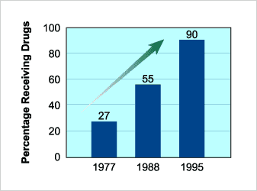
Use of Drugs in Treating Psychological Disorders

Slide 46
Antidepressants: Placebo?
Kirsch et al (1998) analyzed 38 published clinical trials involving more than 3,000 depressed patients.
Conclusion: At least 75 percent of the antidepressant effect was also produced by placebos
Moncrieff, Wessely & Hardy (2004) Conducted systematic Cochrane review of Active placebos versus antidepressants for depression.
They found, once blinded, efficacy of antidepressants was even smaller

Slide 47
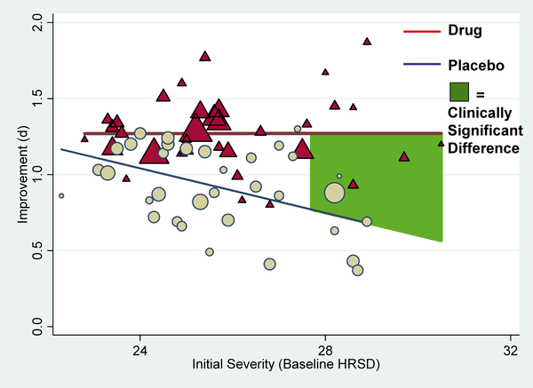
Kirsch, 2008 – FDA Unpublished data

Slide 48
NICE guidelines
CBT recommended as first line treatment for:
Depression,
Social anxiety,
PTSD,
Generalised anxiety disorder,
OCD,
Bulimia,
Panic disorder and specific phobia
(see NICE at www.nice.org.uk)

Slide 49

By 31 March 2011:
142 of the 151 Primary Care Trusts in England had a service from this programme in at least part of their area and just over 50 per cent of the adult population had access,
3,660 new cognitive behavioural therapy workers had been trained, and
over 600,000 people started treatment, over 350,000 completed it, over 120,000 moved to recovery and over 23,000 came off sick pay or benefits (between October 2008 and 31 March 2011).

Slide 50
Happiness & Positive Psychology
“We believe that a psychology of positive human functioning will arise that achieves a scientific understanding and effective interventions to build thriving in individuals, families, and communities.”
(Seligman & Csikszentmihalyi)

Slide 51
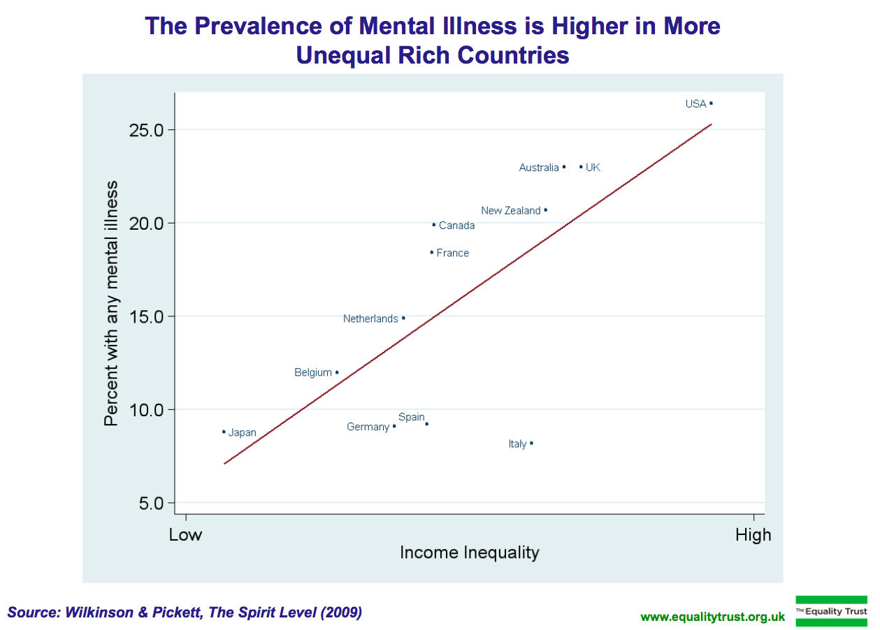
Wellbeing

Slide 52
National Wellbeing Project
David Cameron argues that gross domestic product (GDP) - the standard measure of economic activity used around the world - is no longer up to the job of evaluating the wellbeing of a nation
The Office for National Statistics now includes subjective measures of wellbeing

Slide 53
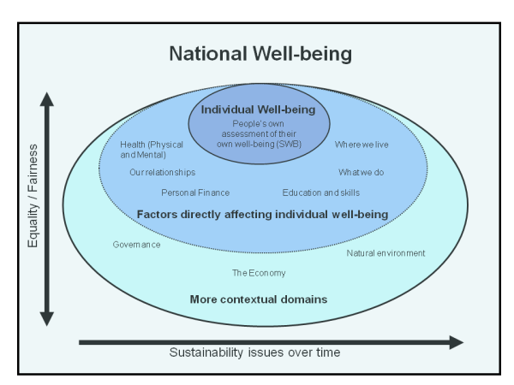

Slide 54
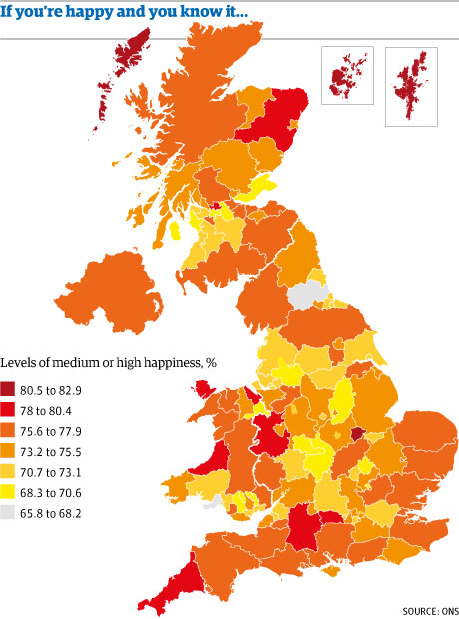

Slide 55
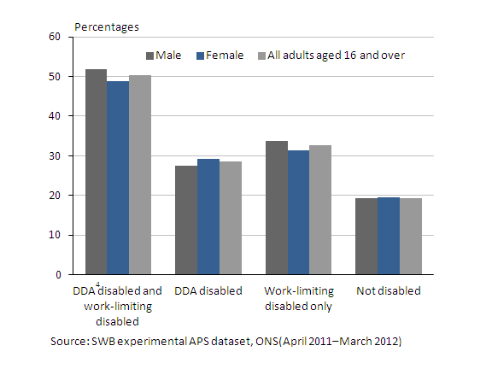
Disability and low life satisfaction

Slide 56
Five steps to mental wellbeing
Connect. Connect with the people around you: your family, friends, colleagues and neighbours. Spend time developing these relationships.
Be active. You don't have to go to the gym. Take a walk, go cycling or play a game of football.
Keep learning. Learning new skills can give you a sense of achievement and a new confidence. So why not sign up for that cooking course?
Give to others. Even the smallest act can count, whether it's a smile, a thank you or a kind word. Larger acts, such as volunteering at your local community centre, can improve your mental wellbeing
Take notice. Be more aware of the present moment, including your feelings and thoughts, your body and the world around you. Some people call this awareness “mindfulness”, and it can positively change the way you feel about life and how you approach challenges.

Slide 57
Subjective Wellbeing questions
The four questions are as follows:
Overall, how satisfied are you with your life nowadays?
Overall, to what extent do you feel the things you do in your life are worthwhile?
Overall, how happy did you feel yesterday?
Overall, how anxious did you feel yesterday?
(All asked on a 0 to 10 scale, where 0 is 'not at all' and 10 is 'completely'.)

