Slide 1
Regulation of muscle mass
Notes:
The talk that I am going to give describes the mechanisms that regulate the amount and type of muscle that we have in our bodies. This is becoming an increasingly important area of study and I hope by the end of this I will have explained the reasons for the importance as well as the intracacies.

Slide 2
Outline
Why is it important?
How does a cell become a muscle cell?
How is a muscle-specific gene regulated?
Regulation of protein synthesis
Regulation of protein breakdown
Regulation of nuclear number
Notes:
The areas I will cover are
Why is it important that we know how muscle mass is regulated?
How does a muscle cell become a muscle cell
How is muscle gene expression regulated
How is muscle protein synthesis regulated
And how is muscle protein breakdown regulated

Slide 3
Ageing and loss of muscle mass
Increased risk of 1 year mortality at a BMI of less than 22 at age 65
In people over 50 the unintended loss of 10% of body mass in a year increases likelihood of mortality 60%
Notes:
So why is muscle mass important. Well as we age we lose muscle mass. Once you get past 50 you muscle mass will decrease. If you have a low BMI (less than 22) at the age of 65 you are more likely to die than if you have a normal BMI. Secondly if you lose more than 10% of you body mass in a year and you are over 50 it also increases your liklehood of dying in that year.

Slide 4
Approximately 1 in 4 patients with COPD are cachectic
Loss of muscle mass is a co-morbidity for many chronic diseases
Notes:
So why is it important as part of the health service. Well loss of muscle mass is an important co-morbidity in a lot of diseases especially chronic ones. The best known example to you is probably cancer, but loss of muscle mass also occurs in AIDS patients, heart failure patients, in patients who are put into critical care. In all these instances it is not good news as patients with cachexia are less likely to survive and more likely (in ICT) to take longer over weaning from their ventilator.
The example I am going to use is COPD. COPD is a disease of the lung but as well as the effects on the lungs in many patients there is also a loss of muscle mass and up to 1 in 4 patients can be described as cachectic. Estimates of this vary and the number you get depends on whether you consider BMI or lean mass as your measure of cachexia but this is a reasonable estimate that is present in the literature. Does this matter?

Slide 5
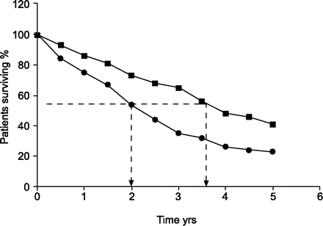
Effect of cachexia on the survival of patients with COPD
Non-cachectic
cachectic
Eur J Respir 2008 31 492-501
Notes:
Well if you want your patients to survive then yes. Here is a graph showing the effect of cachexia on survival in a population of patients with COPD and you can see relatively clearly a significant effect of cachexia on survival. Now you may think that this is just an effect of lung function and that the more cachectic patients have worse lung function and therefore are more likely to die

Slide 6
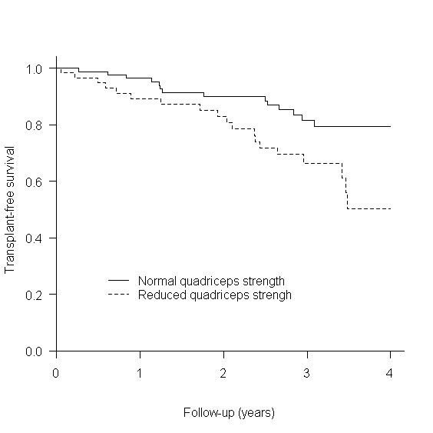
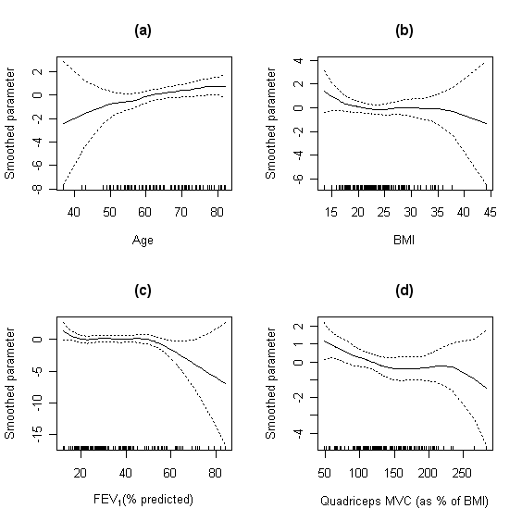
Quadriceps weakness is associated with increased mortality
Swallow et al Thorax 2007;62:115-20
Notes:
However, if lung capacity was the reason for the fatalities when you looked at survival then the FEV1 (the amount of air you can force out of your lungs in a minute so a measure of usable lung capacity) would be an important predictor. You could say at one extreme it is but that is here right at the limits of capacity. So when you have no residual lung capacity you die. But if you look at the range of lung capacities from 50% to about 20% of predicted FEV1 there is no predictive power of FEV1 other than the fact that you are more likely to die than if you are normal. Age predicts survival not really surprising, BMI is not a good predictor but if you look at the relative strength of the person there is a good correlation of how strong you are with whether you will survive. Muscle mass is a good predictor of strength so just like the cachectic patients I showed in the previous slide, the weak patients are more likely to die or need a transplant than the strong ones.

Slide 7
Ability to move and muscle size
800
600
6 minute walk distance
400
200
0
40
80
120
160
Mid thigh cross sectional area
Notes:
The amount of skeletal muscle you have is also important in determining how far the patients can walk this may not be surprising but

Slide 8
Quality of life and ability to move
Sad
100.00
80.00
60.00
40.00
20.00
Happy
0.00
100
300
500
700
900
6 minute walk distance
Notes:
How far you can walk is a very good predictor of the quality of life of the patients. So now we have a link between both how much muscle the patients have with both how long they survive and how good their quality of life is. So how much muscle you have how you regulate muscle mass is important.

Slide 9
Skeletal muscle is not uniform
Skeletal muscle fibre type
Type IIB
Type IIX
Type IIA
Type I
glycolytic
oxidative
Fast
slow
Power
Endurance
Notes:
But the formation of myofibres is not the end of the story and there is further specification that many of you will be aware of. Not all skeletal muscle fibres are the same and they contract with different kinetics and use different fuels. At one end there are the type II fibres which have fast contraction kinetics and rely predominantly on glycolytic metabolism and at the other extreme there are the slow fibres that have slower contraction kinetics and tend to use oxidative metabolism. This is achieved by expressing different myosin heavy chains that have different ATPase activities. The type of activity that a muscle does reflects the fibre types that it contains and the myosin heavy chains that it expresses. There is also some ability of the fibre types within a muscle to change.

Slide 10
Which myosin predominates dictates endurance
8
80
6
60
Amount of MHCIIa
Amount of MHCI
4
40
2
20
0
0
200
400
600
800
200
400
600
800
How far can you walk in 6 mins (m)
How far can you walk in 6 mins (m)
Notes:
This relationship is not one directional so the amount of each type of MHC that you have dictates how far you can walk in 6 mins. For example the more MHCI you have the further you can go whereas the more MHC II you have the shorter distance you can go. One reason for this is that the more glyolytic metabolism that you do the sooner your muscles will tire and the less distance you can walk. What this data says is that it is not just how much muscle you have that is important but the type of muscle that you have that is important. So how do we control all of this?

Slide 11
Activity modulates myosin type
8
80
6
60
Amount of MHCIIa
Amount of MHCI
4
40
2
20
0
0
50
150
250
50
150
250
How much do you move in a day (min)
How much do you move in a day (min)
Notes:
Given that muscle is all about activity it is perhaps unsurprising that the amount of movement a patient does in a day affects the expression of each MHC and the fibre-type distribution in the muscle. The more a person moves in a day the more type I fibre they have and the less type II fibre they have. This is shown here by looking at the different MHCs and comparing that with the amount of movement that the individuals do in a 12h period.

Slide 12
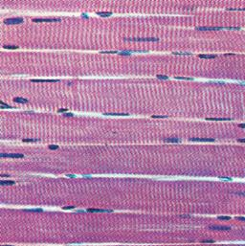
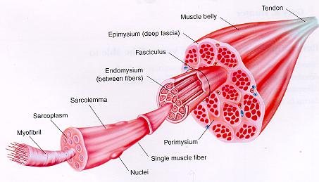
Muscle fibres
Notes:
So I am sure you are aware that this is the tissue we are looking at. Muscle fibres are long. A single cell stretches from the tendon at one end of the muscle to the tendon at the other end. However, unlike most cell types the cell contains many nuclei each controlling an area of the muscle.

Slide 13
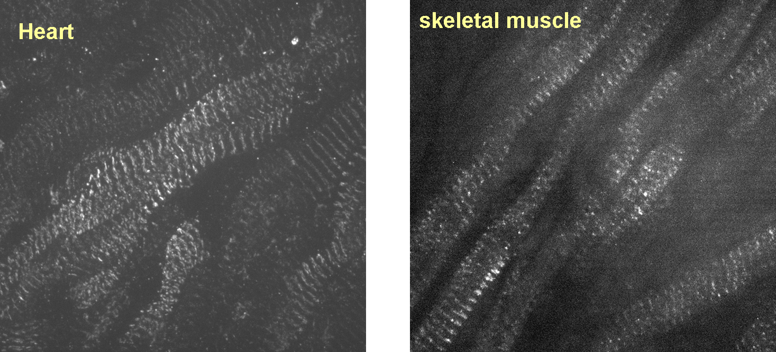
Myotubes from Embryos
Notes:
But in embryonic muscle the nuclei are located in the centre of the fibre.

Slide 14
Skeletal muscle
Nuclear division without cell division ?
Fusion of mononuclear cells ?
Notes:
The question is how do we get to this state. One possibility would be to have nuclear division of a single cell without the cell dividing and this is how megakaryocytes that make platelets are generated. The other is for cells to fuse together each bringing their own nucleus. And this is what happens with skeletal muscle.

Slide 15
Skeletal muscle
myoblast
Myogenin
MyoD/Myf-5
MRF-4
myotube
myofiber
Notes:
This process is part of a system that is controlled by a set of proteins the myogenic transcription factors. The archetypal one of these and the first discovered was MyoD which was identified as a protein that can make non muscle cells become muscle cells and trigger the fusion of those cells into myotubes. However, MyoD is not alone in the formation of skeletal muscle but is one of a number of proteins, three of which are from the same class of proteins that contain a basic-helix-loop-helix motif important in protein dimerisaiton and DNA binding. Each of these bHLH proteins is important in distinct parts of the formation of a skeletal muscle with MyoD and Myf5 important in the differentiation to a committed myoblast, myogenin required for the fusion of those myoblasts into myotubes and MRF-4 required for the fusion of the myotubes into myofibres.

Slide 16
How is muscle phenotype controlled?
Replication
DNA
Transcription
RNA
Translation
Protein
Notes:
So how is muscle mass and type controlled. Well as you might predict from a molecular biologist it all comes down to dogma and the central dogma of DNA makes RNA makes protein. We can modulate muscle mass by changing the number of nuclei we have and to increase the number of nuclei we can cause satellite cells to proliferate and become incorporated into the muscle syncitium and reduce the number by apoptosis of these nuclei. But I don’t want to talk about that. We can increase or decrease the amount of RNA that is made, but I am not going to talk about that either today. Finally we can modify the amount of protein that we have in the cell by making more or breaking down what we have and this is where I will focus the rest of this talk.

Slide 17
Transcription
Transcription is controlled by differential activation of the promoter region of specific target genes using distinct transcription factors
What information does the promoter of a skeletal muscle-specific gene need to have?

Slide 18
Skeletal muscle actin
SRF
MyoD, myogenin, MRF4, Myf5
I’m a contractile protein gene
SRF, MEF-2, NF-AT
I need to be expressed in a skeletal muscle cell
I Need to respond to changing work load
I don’t want to be expressed during cell proliferation
Id, Twist
TATA
Notes:
The promoter region as you will know from you lectures last year is a DNA sequence that binds proteins (transcription factors) that alter the ability of RNA polymerase to transcribe the associated gene. Within this region of DNA are sequences that bind specific transcription factors. When they bind to DNA they can increase or decrease the ability of RNA polymerase to work. There are a number that are of importance to the regulation of skeletal muscle gene expression and they fulfil different functions. For example, MyoD and the similar TFs say that the protein is required in a skeletal muscle cell. The activity of MyoD is inhibited by two related proteins Id and Twist which stop MyoD working when the cells are proliferating. There are also a lot of transcription factors that can bind to different DNA sequences present in the promoter of muscle-specific genes in response to changing circumstances to allow increased or reduced expression changing cell phenotype in response to an altered environment.

Slide 19
Can regulate amount or activity of each transcription factor
Notes:
So what we can do to change the amount of RNA that is produced is to alter the amount and activity of each transcription factor to match that which best drives the expression of the genes we are interested in. So if we look in different muscle fibres we have different arrays of TFs depending on the fibre type and the amount of work.

Slide 20
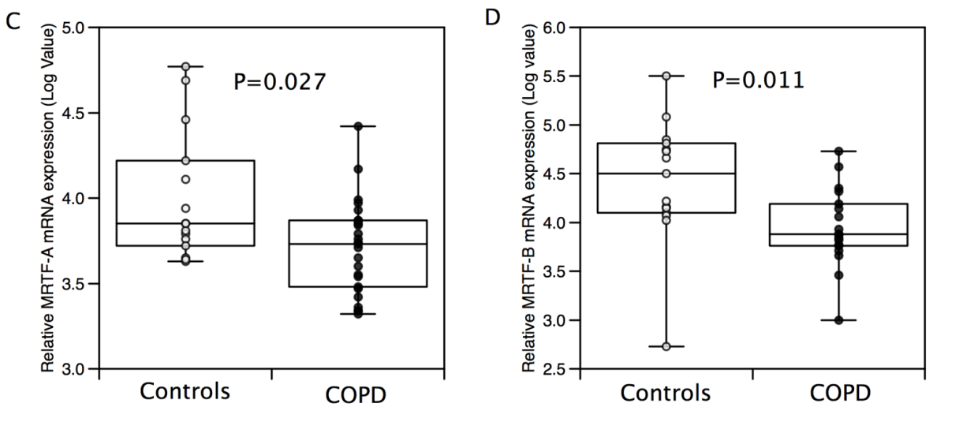
Increased demand
Increased by exercise
Altered expression
Reduced in COPD
MRTF-A/Mal
Acitvator (SRF)
Inhibitor (YY1)
+
-
TATA

Slide 21
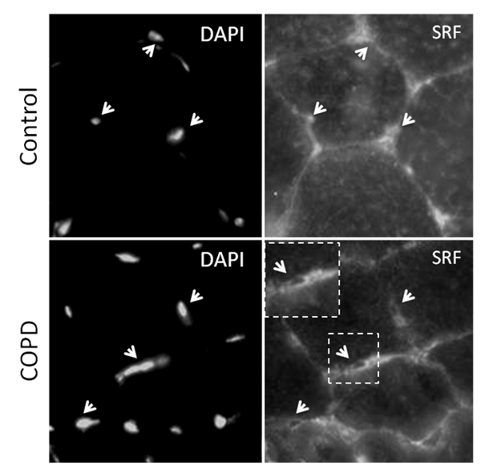
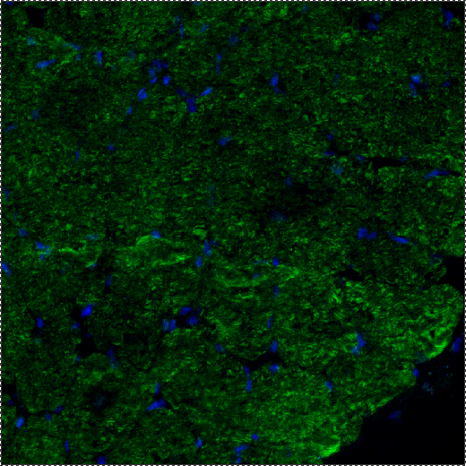
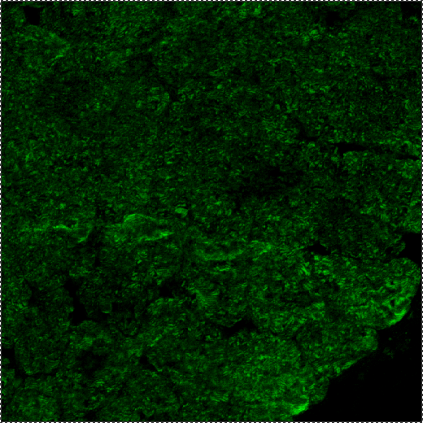
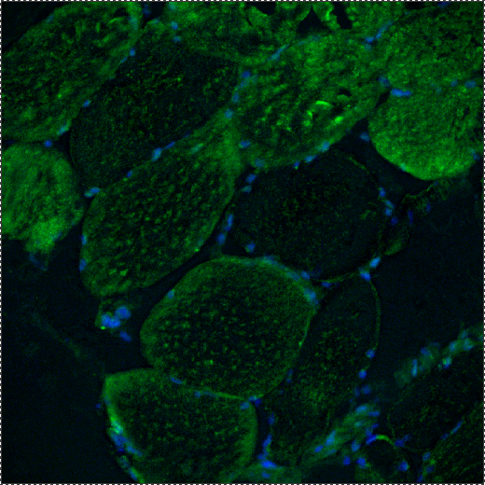
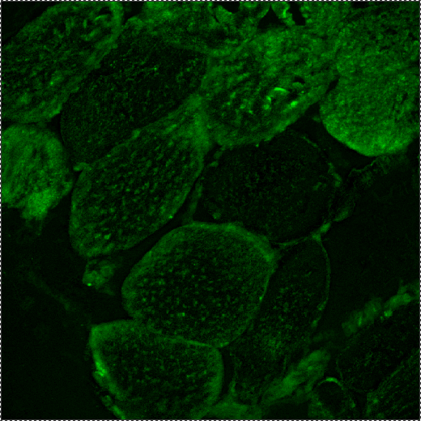
Increased demand
Nuclei
50μm
50μm
Nuclei
50μm
50μm
SRF
YY1
Altered localisation

Slide 22
Skeletal muscle fibre type
Type IIB
Type IIX
Type IIA
Type I
SRF
SRF
SRF
SRF
NFATC4
NFATC2, 3, 4
NFATC2, 3, 4
NFATC1, 2, 3,4
PGC-1α
MyoD
MyoD
myogenin
Notes:
So if we look at the expression and importance of different fibres for transcription factors we find the following

Slide 23
How is muscle mass controlled?
Replication
DNA
Transcription
RNA
Translation
Protein
Notes:
So how is muscle mass controlled. Well as you might predict from a molecular biologist it all comes down to dogma and the central dogma of DNA makes RNA makes protein. We can modulate muscle mass by changing the number of nuclei we have and to increase the number of nuclei we can cause satellite cells to proliferate and become incorporated into the muscle syncitium and reduce the number by apoptosis of these nuclei. But I don’t want to talk about that. We can increase or decrease the amount of RNA that is made, but I am not going to talk about that either today. Finally we can modify the amount of protein that we have in the cell by making more or breaking down what we have and this is where I will focus the rest of this talk.

Slide 24
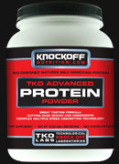
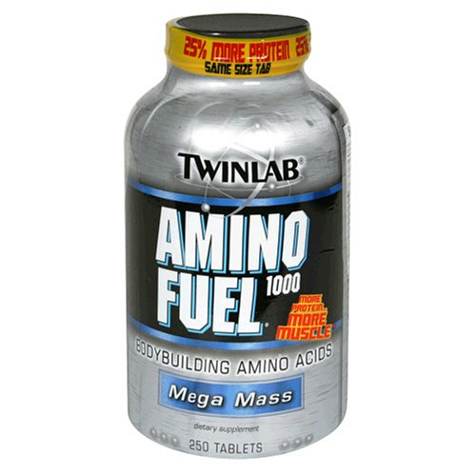
Protein synthesis
Protein breakdown
Notes:
As indicated the amount of protein we have is regulated by two processes synthesis and breakdown which can be depicted as a cycle. As I am sure you are aware these cycles are everywhere in biology and the reason for this is that they allow the body an amazing degree of regulation so that under many different circumstances we can produce the right amount of whatever it is we are interested and in this case that is protein and muscle mass.

Slide 25
Fractional changes in muscle protein homeostasis
Breakdown
synthesis
Normal
exercise
Chronic disease
Immobility/ acute disease
Notes:
So to keep a stable amount of muscle we must balance fractional synthetic rate with fractional breakdown rate and this is what happens in most adults and occurs with a high degree of fidelity. During growth either in childhood or in response to exercise we find that the fractional synthetic rate is higher but so is the fractional breakdown rate such that as long as the synthetic rate is higher than the breakdown rate muscle mass will increase. In chronic disease the fractional synthetic rate tends to fall but so does the fractional breakdown rate but the net effect this time is loss of muscle mass as we are now breaking down more muscle protein than we are making. In acute disease for example immobility there is an increase in both the fractional synthetic rate and the breakdown rate but the much larger increase in the breakdown rate is what gives us the marked loss in muscle mass that can occur in immobile patients.

Slide 26
Regulation of protein synthesis
Increased anabolic hormones or activity activate protein synthesis
Increased catabolic hormones or reduced activity activate protein breakdown
IGF-1
+
Muscle protein amount
myostatin
Notes:
Unsurprisingly protein synthesis and protein breakdown are regulated by hormones and there are hormones that increase the production of muscle protein (anabolic hormones) which I am sure you have all heard of their misuse in sport, and there are hormones that are catabolic and lead to a reduction in muscle protein synthesis. The ones I will focus on are IGF-1 which increases muscle protein synthesis and myostatin which promotes muscle protein degradation.

Slide 27
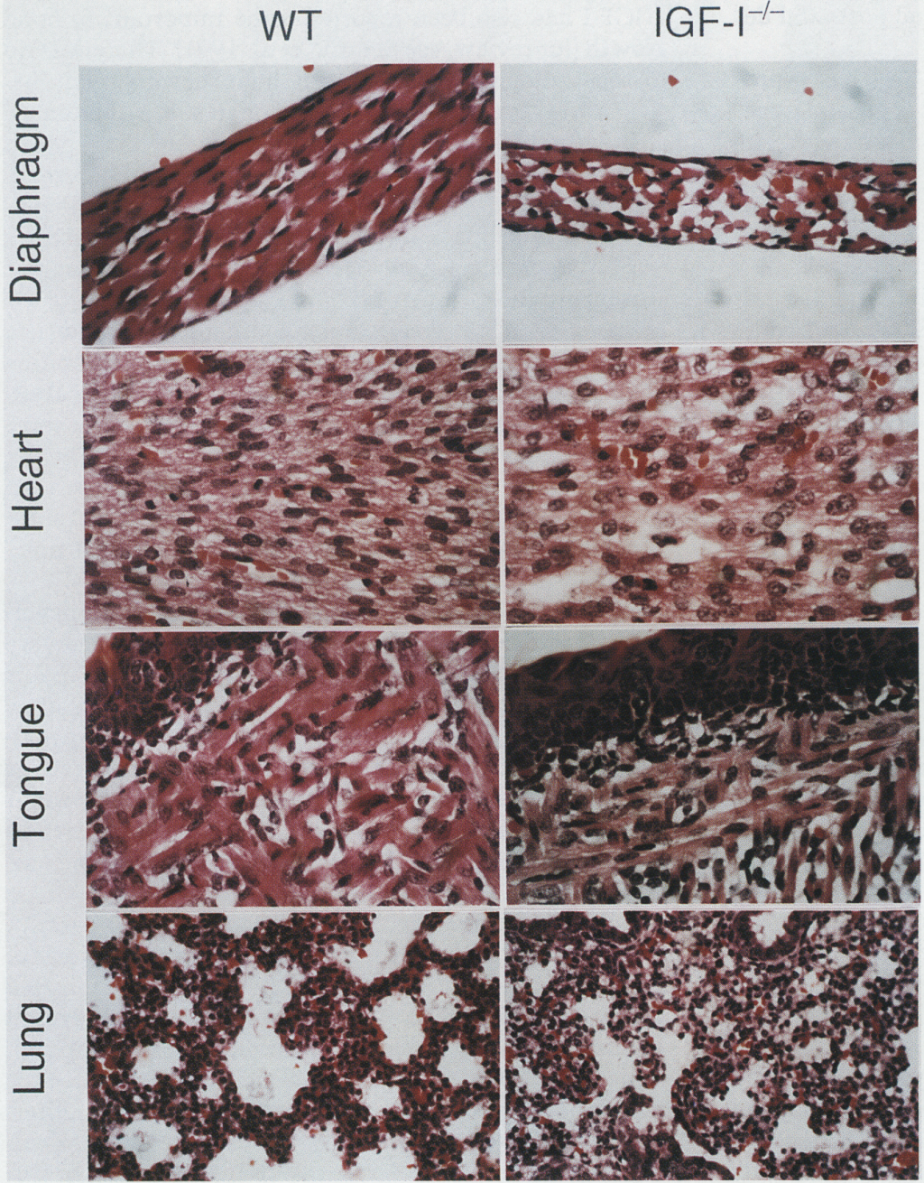
IGF-1
Notes:
So IGF-1 is a growth factor that promotes cell survival and hypertrophy. In mice that lack IGF-1 the muscle cells are smaller shown best here in the diaphragm and there are fewer cells probably due to increased apoptosis.

Slide 28


IGF-1 has been evaluated in clinical trials for a variety of muscular dystrophies

Slide 29
IGF signalling
PI-3K
IRS-1
Grb-2
SOS
ras
+
Akt
+
MEK
mTOR
-
GSK3-β
Notes:
IGF-1 signals through a tyrosine kinase receptor, a type of receptor that you will come across next term in your cancer lectures. Activation of the receptor leads to an increase in tyrosine phosphorylation of a number of proteins which activates the ras signalling pathway and also (more important here) the PI3 kinase pathway. PI3k is another kinase that activates a protein called Akt, activation of Akt increases the activity of the protein mTOR and inhibits the protein GSK3b. So what.

Slide 30
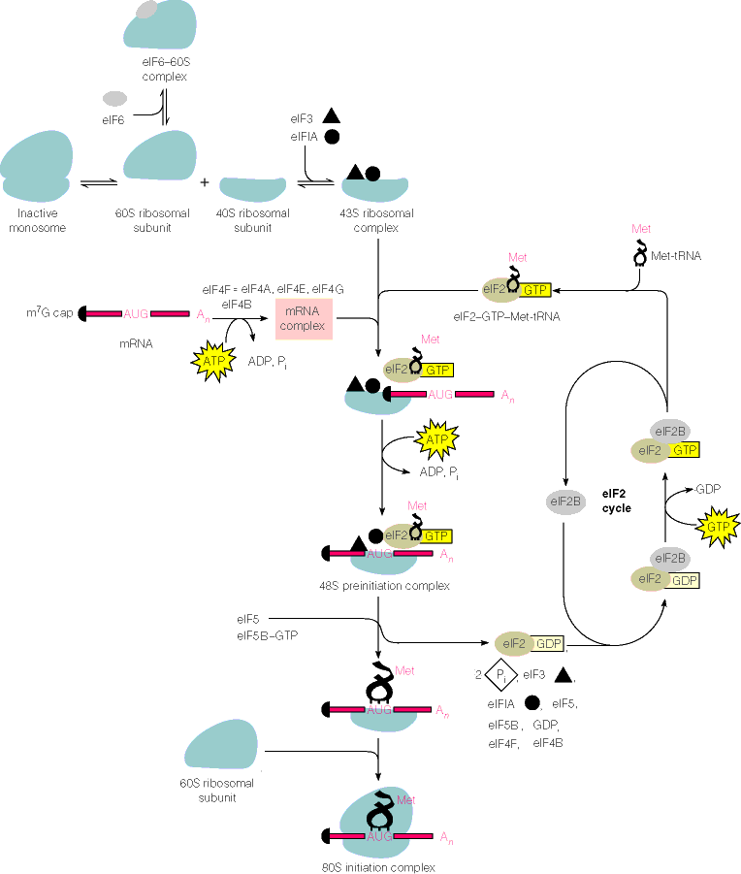
Notes:
Well to explain that first we need to do a little revision on protein synthesis which you will have learnt in your MCD lectures.
To translate an RNA message into protein we need to read the message and assemble the product using the ribosome. The major point of regulation of this process is at the beginning so the binding of the first amino acid. As you will remember to do this the ribosome dissociates into a 40S particle and a 60s particle. The 40s particle is activiated by binding 2 initiation factors. It then binds a met-charged tRNA (ATG complementary) bound to a protein called eIF2 and the mRNA. eIF2 is a G protein so it is only active when it is bound to GTP and inactive when it is bound to GDP. The charged tRNa is loaded into the binding site and the eIF2 is released the full ribosome is reassembled and ready to function.

Slide 31
Notes:
If we concentrate on this bit we find that the exchange of GDP for GTp on eIF2 is controlled by a GAP called eIF2B.

Slide 32
GSK3-β and protein synthesis
Inhibition
GSK3-β
Notes:
The activity of this GAP is inhibited by GSK3b such that in the GSK3B slows protein synthesis. Akt dependent inhibition of GSK3b increases protein synthesis by removing this inhibition.

Slide 33
mTOR and protein synthesis
Ribosomal protein S6
S6 Kinase
mTOR
Notes:
mTor functions by phosphorylating another protein called s6 kinase which phosphorylates a protein called S6 a component of the ribosome that allows for the activation of the ribosome and the binding of the mRNA and tRNA

Slide 34
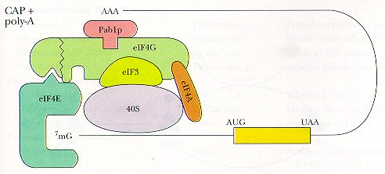
mTOR
P
eIF4-E
eIF4E-BP
eIF4E-BP
⁷mG
Notes:
mTor also phosphorylates a protein called eIF-4EBP which stops it binding and inhibiting eIF4-E a protein which binds to the mRNA 5’ CAP and helps to organise the binding of the mRNA to the ribosome

Slide 35
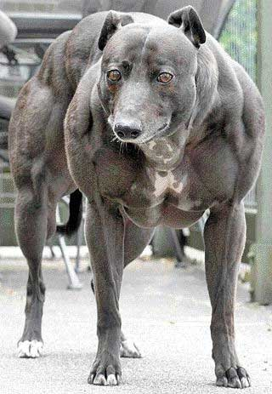
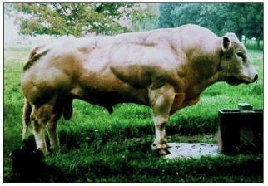
Myostatin
Notes:
So that is how IGF1 can increase protein synthesis. What is the role of myostatin. Well myostatin was discovered through the analysis of hypermuscular animals including the Belgian Blue cow and the bully whippet. These animals lack functional myostatin and although the cow looks like a farmers delight the meat is not the best quality and the dog can run fast but not very far and is susceptible to cramp. Both of these features are because of the effect of a loss of myostatin on fibre type. So are there situations when myostatin is increased and what happens? Well yes there are and muscle wasting is the outcome.

Slide 36
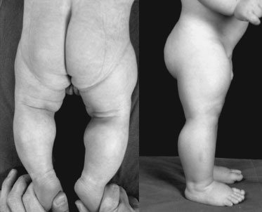
“Somewhere in Germany is a baby Superman, born in Berlin with bulging arm and leg muscles. Not yet 5, he can hold seven-pound weights with arms extended, something many adults cannot do. He has muscles twice the size of other kids his age and half their body fat. “
Associated press 2004

Slide 37
Myostatin in COPD patients
750
r
s
-0.62
p<0.01
500
6 Minute Walk (meters)
250
0
0.0000
0.0025
0.0050
0.0075
0.0100
Normalised Myostatin mRNA (AU)
Notes:
In patients with COPD there is an inverse correlation of muscle mass with strength and with how far the patients can walk so increased myostatin is associated with adverse consequences for the patients

Slide 38
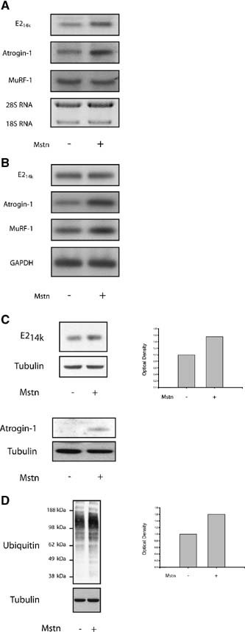
Myostatin activates the expression of MuRF1 and atrogin-1
Notes:
So what does myostatin do that might cause this response. Well if you measure both protein and RNA shown here by western blotting and northern blotting there is a increase in the expression of two proteins atrogin and MurF but what are these proteins?

Slide 39
What are MuRF1 and atrogin-1?
Ubiquitin ligases
Add ubiquitin molecules onto other proteins
Ubiquitin: a protein tag that labels proteins for destruction by the proteosome
Notes:
Well these proteins are ubiquitin ligases that is they put ubiquitin molecules onto other proteins. Again so what. Well ubiquitin is a protein that is a tag that labels proteins for targeting to the proteosome. O

Slide 40
Protein breakdown
proteosome
Notes:
What happens is that the ligase adds a ubiquitin to the target protein, this then gets extended to give a polyubiquitin chain this targets the protein to the proteosome and leads to the destruction of the protein

Slide 41
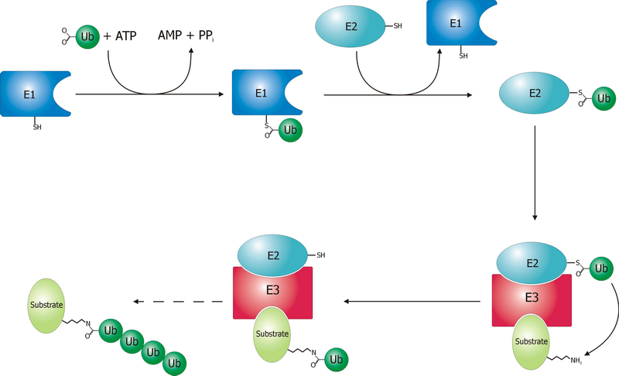
Ubiquitin dependent degradation
Notes:
MuRF and atrogin are this red part of the process so they recognise the substrate and act as a bridge between the substrate and the ubiquitination machinery

Slide 42
How else is MuRF controlled ?
Akt
PI-3K
IRS-1
P
Foxo
MuRF1
Foxo
Notes:
So in addition to the increased expression of MuRf and atrogin in response to myostatin how is the expression of MuRf and therefore protein degradation controlled. Well unsurprisingly given that IGF-1 activates protein synthesis is also inhibits the expression of MuRF and it does this by regulating one of the transcription factors that regulates MuRF expression a protein called Foxo. Foxo is only active when it is in the nucleus (as that is where the DNA is) and it is only in the nucleus if it is dephosphorylated. However, one protein that phosphorylates Foxo is Akt, so when IGF activates Akt as shown earlier it phosphorylates Foxo so that Foxo comes out of the nucleus and reduces MuRF expression

Slide 43
Energy status
ATP
ADP + Pi
Adenylate kinase
2ADP
ATP + AMP
Intracellular concentrations of AMP are very low
Notes:
Another thing that regulates MuRF expression is energy status. This would occur during starvation and the mechanism relies on the fact that although ATP levels do not necessarily drop that far we can detect changes by the following reaction where ADP can reform ATP by the transfer of one phosphate from one ADP to another generating one ATP and one AMP. As the levels of AMP are kept very low in the cell a small change in ATP gives a large change in AMP.

Slide 44
How are MuRF and atrogin controlled (energy status)
AMPK
AMP
P
Foxo
MuRF1
P
Foxo
P
P
Notes:
As AMP increases is activates a protein called AMP activated protein kinase. This phosphorylates Foxo but on a different part of the molecule so that it stays in the nucleus and becomes more active

Slide 45
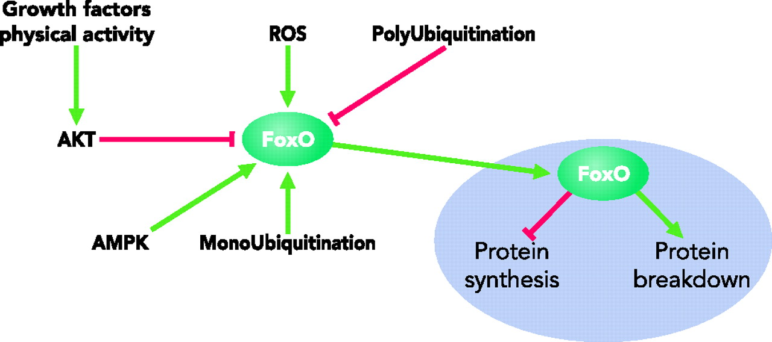

FoxO a nodal point for the regulation of protein turnover
Growth inhibitors
TGF-β, myostatin
Sandri, M. Physiology 23: 160-170 2008;
doi:10.1152/physiol.00041.2007
Copyright ©2008 American Physiological Society
Notes:
So Foxo and Aktt act as integrating or nodal points for the regulation of protein synthesis and breakdown

Slide 46
How is muscle mass controlled?
Need more nuclei

Slide 47
Satellite cell recruitment
IGF-1

Slide 48
Need fewer nuclei (and fewer organelles)
Apoptosis and autophagy
myostatin

Slide 49
Methods to inhibit myostatin signalling
M
M
Follistatin
Myostatin propeptide
Myostatin antibody
Soluble Act IIRB ECD
I
SMAD2/3
Act IIRB
P
P
Imidazo-pyridines
SB-431542
SB-505124
A-83-01
Alk 4/5
Notes:
So just to finish the question is can we do anything about muscle breakdwon. Well a number of pharmaceutical companies are trying and the most successful approach so far is to inhibit myostatin signalling and a range of methods have been tried including inhibiting the down stream parts of the pathway and inhibiting the binding of myostatin to the receptor. Of these the latter methods have entered clinical trial.

Slide 50
Summary
1. The amount and type of muscle you have is important to survival and quality of life
2. Fibre type and muscle gene expression is controlled by a range of transcription factors
3. The amount of muscle protein is controlled by regulating protein synthesis and protein degradation and by modifying the number of nuclei in a muscle
4. IGF-1 and myostatin are key regulators of muscle protein turnover

