Slide 1
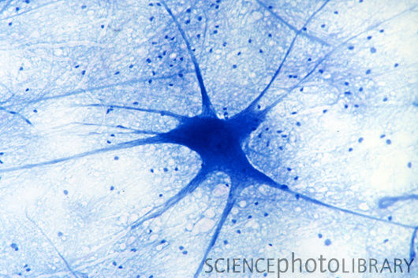
Musculoskeletal course
Skeletal Muscle Contraction:
How it works in vivo
Dr V Caorsi
v.caorsi@imperial.ac.uk

Slide 2
Motor Units
Muscle Fibre
Muscle plasticity
Definition
Recruitment
Distribution
Physiological properties
Structural properties
Metabolic properties
Training
Disuse
Aging

Slide 3
Chain of Command
Intention to move
Activity in cerebral cortex, basal ganglia, cerebellum
Motor cortex firing
Impulses in descending motor pathways
Motoneuron Excitation
Impulse propagation to axon terminal
Neuromuscular transmission
Impulse propagation along muscle fiber plasmalemma
Impulse into T-tubules
Ca2+ release from SR
Cross-bridges engagement
Movement
Central Elements
Peripheral Elements
Roy RR., Edgerton, VR Skeletal Muscle Architecture in Encyclopedia of Neuroscience

Slide 4
Motor Units
Muscle Fibre
Muscle plasticity
Definition
Recruitment
Distribution
Physiological properties
Structural properties
Metabolic properties
Training
Disuse
Aging

Slide 5
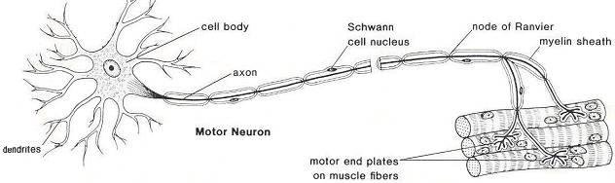
Motor Unit
Motor Neuron + all the muscle fibres it innervates
http://www.biologymad.com/nervoussystem
Same type of muscle fibres in 1 motor unit
Contract simultaneously (all or none fashion)
Size - number of muscle fibres 1motor unit innervates
Number - how many motor units are in a muscle

Slide 6
Motor Unit
Motor Neuron + all the muscle fibres it innervates
http://www.biologymad.com/nervoussystem
AJ. McComas – Skeletal Muscle Form and Function

Slide 7
Motor Unit
Motor Neuron + all the muscle fibres it innervates
Increasing the number of active motor units
Increasing the firing rate
http://www.biologymad.com/nervoussystem
Henneman size principle
dependent on FORCE production needs of the muscle
from the ‘smallest‘ motor units to ‘largest’ motor units

Slide 8
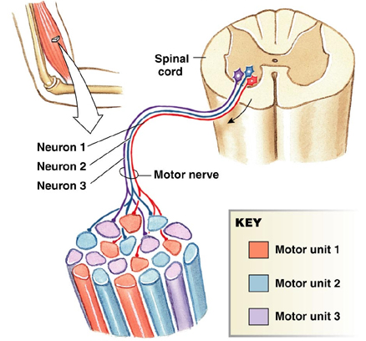
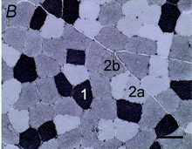
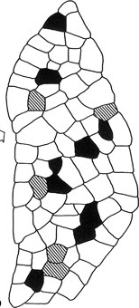
Motor Unit
Motor Neuron + all the muscle fibres it innervates
http://www.biologymad.com/nervoussystem
Nakano J et al. Expphysiol 2009
Pearson education, Inc. Publishing as Benjamin Cummings

Slide 9
Motor Units
Muscle Fibre
Muscle plasticity
Definition
Recruitment
Distribution
Physiological properties
Structural properties
Metabolic properties
Training
Disuse
Aging

Slide 10
Contractile properties
Twitch = Force-time response to a single action potential
Contraction
Latent
period
Relaxation
http://www.physiol.med.uu.nl/interactivephysiology/ipweb

Slide 11
Contractile properties
Temporal Summation = a second stimulus is applied before complition of relaxation
Additional influx of Ca2+ promotes a second contraction which is added to the first
http://www.physiol.med.uu.nl/interactivephysiology/ipweb
http://www.physiol.med.uu.nl/interactivephysiology/ipweb

Slide 12
Contractile properties
Tetanus = rapid multiple stimulation fuse into a smooth continuous total contraction
Abundant intracellular calcium provides continual availability binding sites on actin for cross-bridge cycling
Incomplete
Tetanus
Temporal
summation
Fused
Tetanus
Fatigue
http://www.physiol.med.uu.nl/interactivephysiology/ipweb

Slide 13
Contractile properties
Neuroscience 4th edition

Slide 14
Muscle Fibre Type
I IIA IIB
S, SO FR,FOG FF, FG
Property
Twitch speed slow fast fast
Magnitude of force low medium high
Fatigue resistance high high low
Contractile

Slide 15
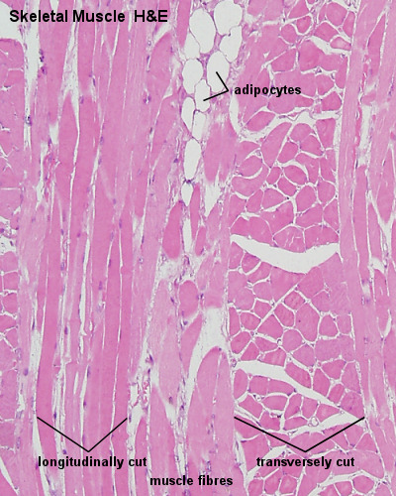
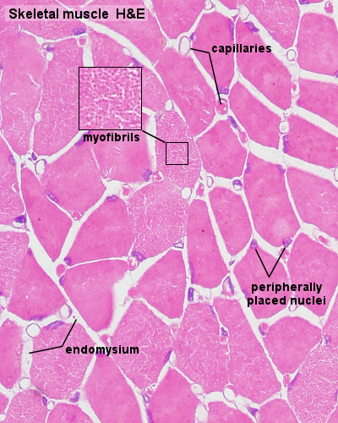
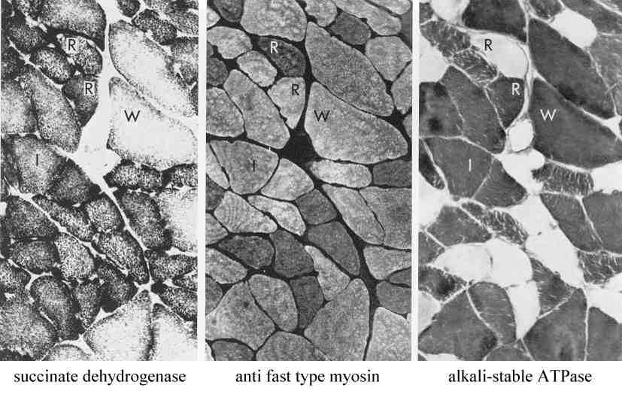
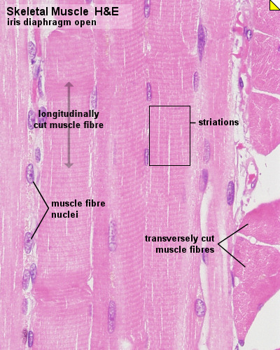
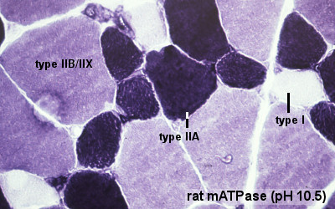
Metabolic and Hystological properties
by Gauthier and Lowey (1979) J. Cell Biology 81, 10-25

Slide 16
Muscle Fibre Type
I IIA IIB
S, SO FR,FOG FF, FG
Property
Twitch speed slow fast fast
Magnitude of force low medium high
Fatigue resistance high high low
Red colour dark dark pale
Myoglobin content high high low
Capillary supply rich rich poor
Mitochondria many many few
Oxidative enzymes high med/high low
Glycogen low high low
Alkaline ATPase low high high
Acid ATPase high low moderate
Myosin isoform I IIA IIB
Contractile
Metabolic
Hystological

Slide 17
Motor Units
Muscle Fibre
Muscle plasticity
Definition
Recruitment
Distribution
Physiological properties
Structural properties
Metabolic properties
Training
Disuse
Aging

Slide 18
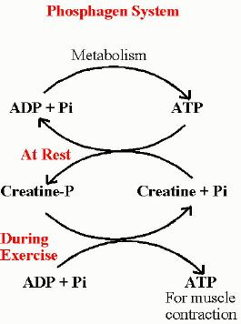
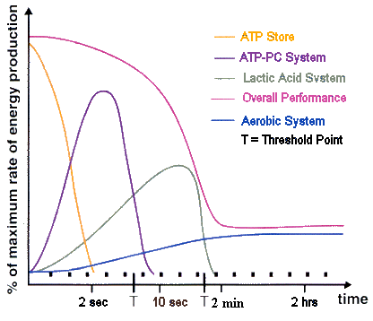
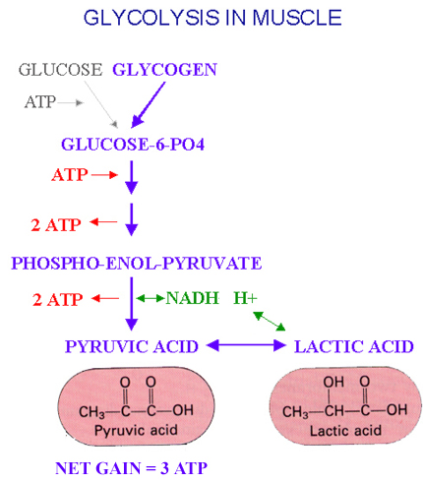
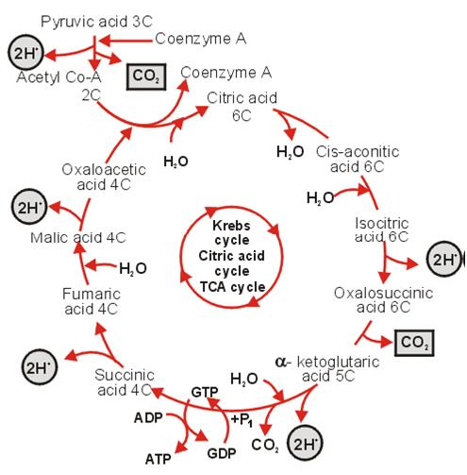
Energy Landscape during training
http://lighter4life.wordpress.com/2011/04/28/energy/

Slide 19
Strength training
High force, few repetitions, partially due to muscle hypertrophy
Same number of fibres, diameter of each fibre increases, more contractile filaments, more force
Anaerobic training: ATP, ATP-CP, Lactate

Slide 20
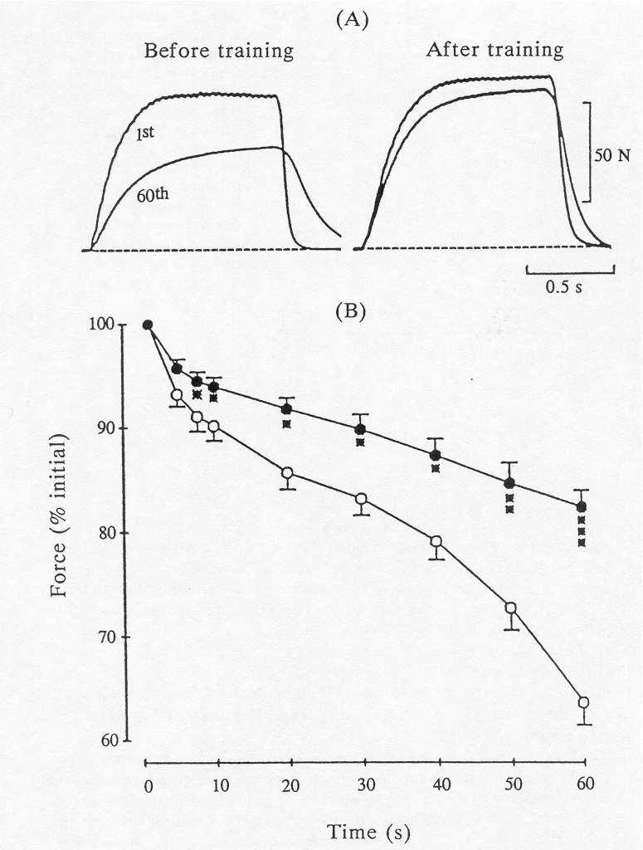
Endurance training
Many repetitions, increasing duration of performance, improving fatigue resistance
Aerobic training: Improving oxygen transport and utilization
enhance the capacity of the central circulation to deliver blood
develop the metabolic machinery to consume oxygen
Non-metabolic adaptation
Change in myosin isoform IIB → IIA → I

Slide 21
Disuse
Reduced recruitment of motor units leading to atrophy
Same number of fibres, diameter of each fibre decreases, less contractile filaments, less force
Absence of load-bearing is the most potent cause…bed rest
anti-gravity muscles are the most affected (quadriceps, etc)
Metabolic adaptations
Shift toward glycolysis
Decreased capacity for fat oxidation
Energy substrate accumulation
Change in myosin isoform I → IIA → IIB
Non-metabolic adaptation

Slide 22
Aging
Muscles twitches become smaller and slower (only modest decline prior 60years)
Muscle mass is reduced (contractile elements replaced by fat and connective tissue)
Loss of muscle fibres
Type2 fibres undergo the greatest atrophy
Losses of motoneurons and ventral root axons (after 70 functioning motoneurons are less than 50%)
Capacity of re-innervated is limited
Nerve pulses are conducted more slowly
But... Training HELPS!
Suetta C. et al. 2009 J Appl Phys
100
men
50
Total Muscle Mass
women
0
30 40 50 60 70 80
Age
AJ. McComas Skeletal Muscle Form and Function

Slide 23
Aging
Muscles twitches become smaller and slower (only modest decline prior 60years)
Muscle mass is reduced (contractile elements replaced by fat and connective tissue)
Loss of muscle fibres
Type2 fibres undergo the greatest atrophy
Losses of motoneurons and ventral root axons (after 70 functioning motoneurons are less than 50%)
Capacity of re-innervated is limited
Nerve pulses are conducted more slowly
But... Training HELPS!
Suetta C. et al. 2009 J Appl Phys
100
men
50
Total Muscle Mass
women
0
30 40 50 60 70 80
Age
AJ. McComas Skeletal Muscle Form and Function
Slivka D et al. 2008 J phys

Slide 24
Motor Units
Muscle Fibre
Muscle plasticity
Definition
Recruitment
Distribution
Physiological properties
Structural properties
Metabolic properties
Training
Disuse
Aging
Dr. V. Caorsi
v.caorsi@imperial.ac.uk

