Slide 1
Applied vascular anatomy of the lower limb Dr Peter Clark

Slide 2
Overview
Arterial anatomy
Venous anatomy
Clinical applications

Slide 3
Overview of arterial anatomy (1)
Aorta
Common iliac arteries
External iliac / internal iliac arteries
Femoral artery
Profunda femoris artery
Circumflex femoral arteries

Slide 4
Overview of arterial anatomy (2)
Femoral artery
Popliteal artery
Trifurcation
Anterior tibial artery – dorsalis pedis artery
Posterior tibial artery
Popliteal artery

Slide 5
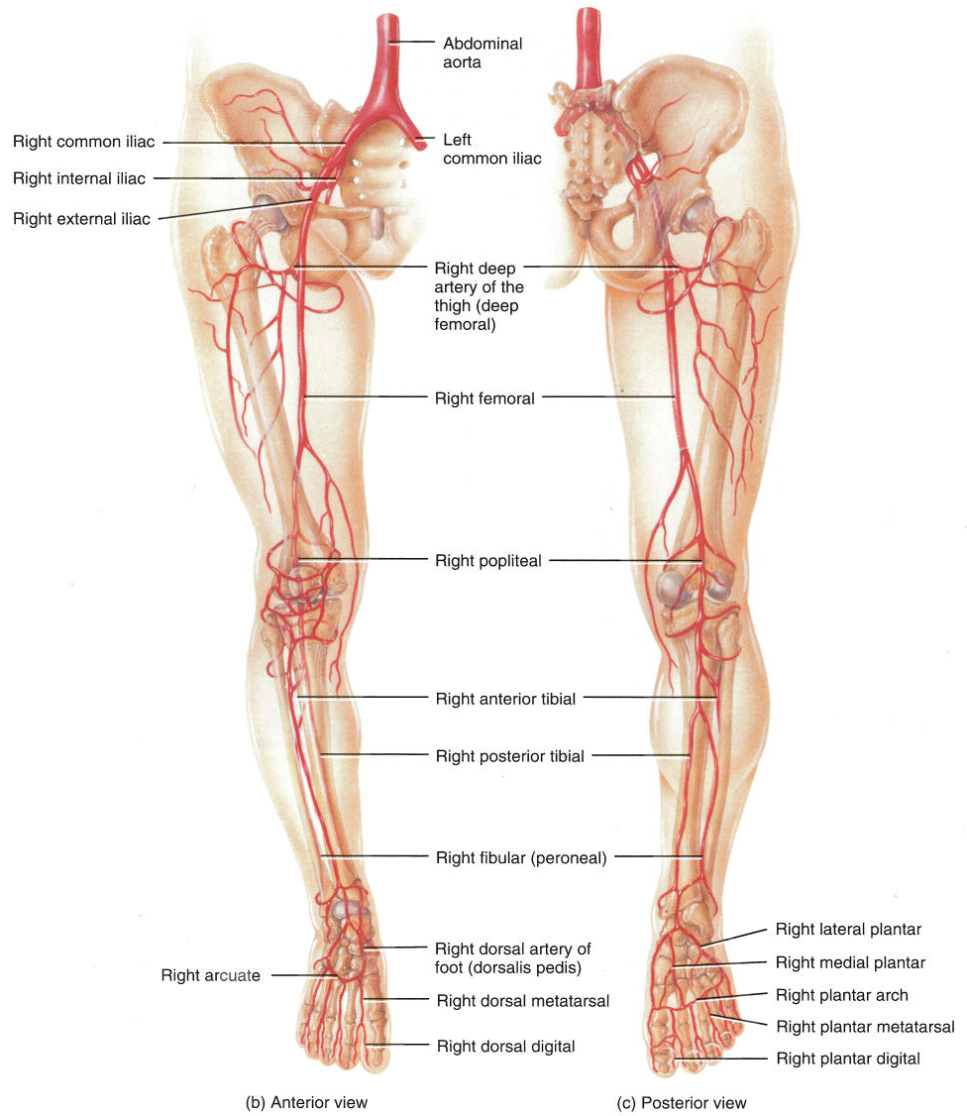
Arterial Supply of the Lower Limb
Aorta
Common iliac arteries
Internal iliac artery
External iliac artery
External iliac artery
Femoral artery (pulse)
Deep femoral artery
Popliteal artery (pulse)
Posterior tibial artery (pulse)
Anterior tibial artery (pulse)
Peroneal artery
Dorsalis pedis (pulse)

Slide 6
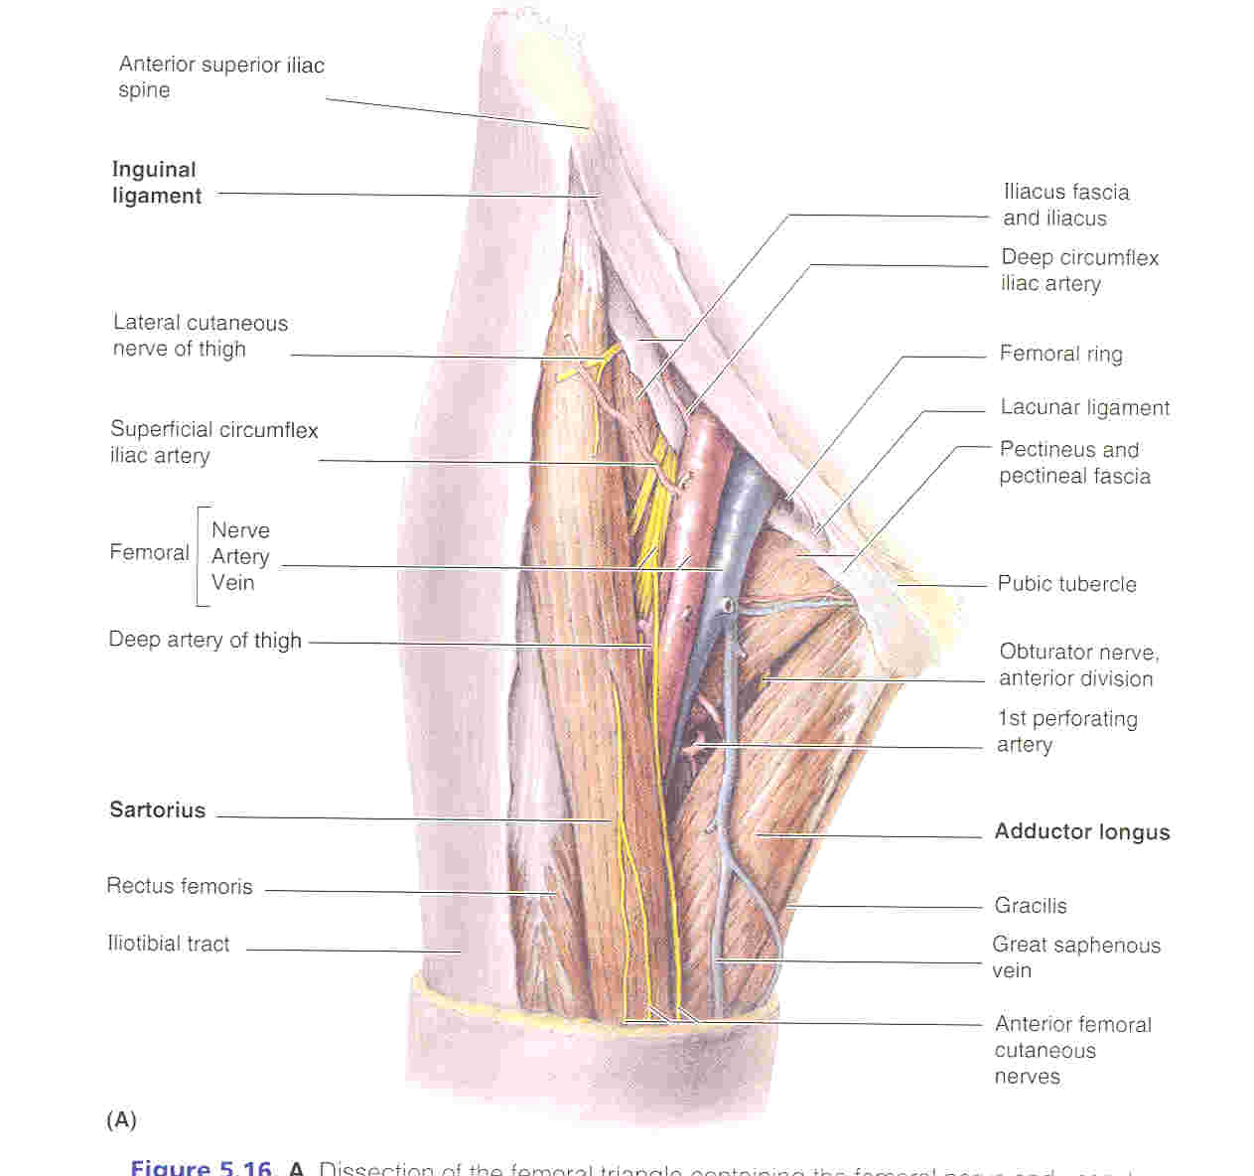
The femoral triangle

Slide 7
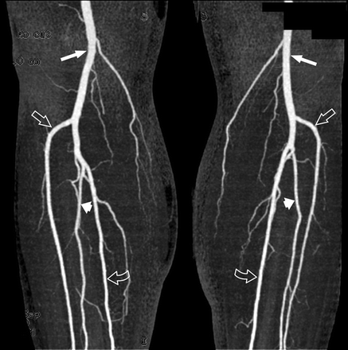
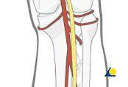
Leg arteries
Popliteal
Ant. Tibial
Peroneal
Popliteal
Ant. Tibial
Post. Tibial
Popliteal
Post. Tibial

Slide 8
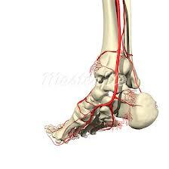
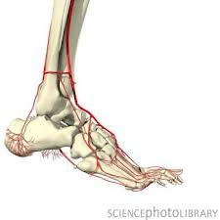
Arteries of the Ankle
Ant. Tibial Artery
Post. Tibial Antery
Dorsalis PedisAntery

Slide 9
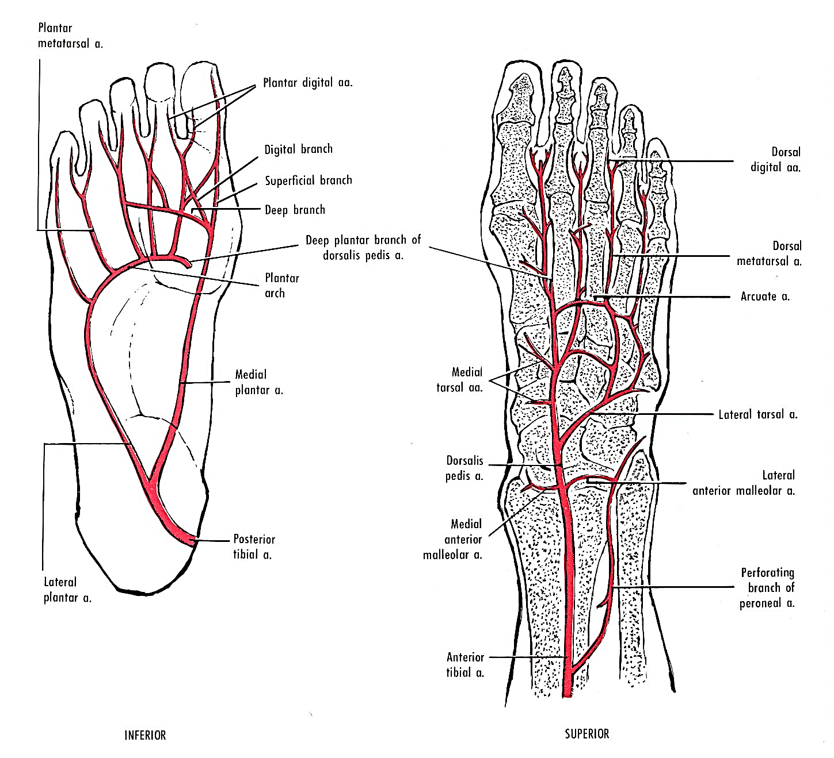
Arteries of the Foot
Medial Plantar artery
Dorsalis pedis artery
Lateral Plantar artery
Anterior tibial artery

Slide 10
The femoral artery in the groin

Slide 11
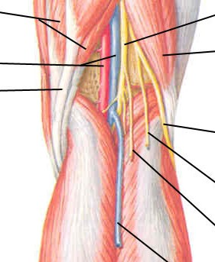
The popliteal fossa
Popliteal artery and vein
Short saphenous vein

Slide 12
Dorsalis pedis artery

Slide 13
Posterior tibial artery

Slide 14
Overview of venous anatomy
Superficial veins
Deep veins

Slide 15
Superficial veins
Dorsal venous arch
Long saphenous vein
Short saphenous vein
Perforating veins
Sapheno-femoral junction
Blood flow is from superficial to deep

Slide 18
Deep veins
Run alongside arteries, venae comitantes
“Muscle pump” in the calf
Anterior and posterior tibial veins
Popliteal vein (receives SSV)
Profunda femoris vein
Femoral vein (receives LSV)
External iliac vein

Slide 20
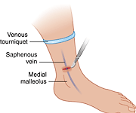
Cut-down of the LSV at medial malleolus
Shocked patient, ATLS
2cm lateral and proximal to medial malleolus

Slide 21
Cannulation of the femoral artery and vein

Slide 22
Arterial embolism
Sudden occlusion
Acute ischaemia
Intermittent claudication (muscle pain commonly in calf during activity, associated with arterial disease)

Slide 23
Compartment syndrome

Slide 24
Compartment syndrome
Ischaemia caused by trauma-induced increased pressure in a confined limb compartment
Commonly the anterior, posterior and lateral compartments of the leg
Normal pressure = 25mmHg
Acute compartment syndrome
Chronic compartment syndrome

Slide 25
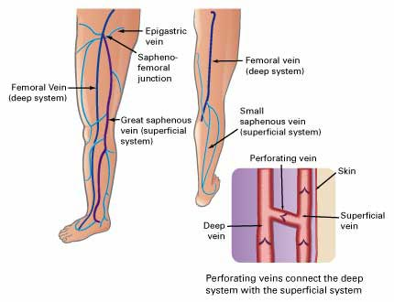
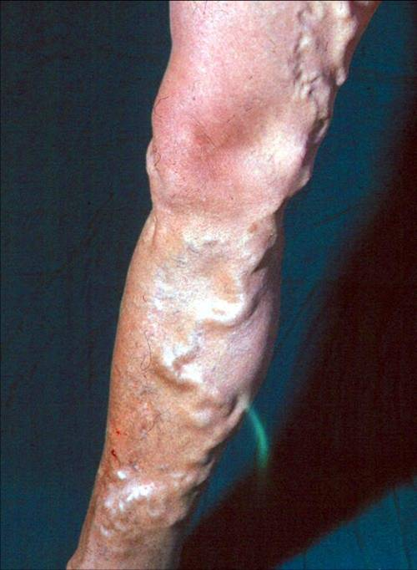
Lower Limb Veins: important clinical points
Perforating veins connecting superficial and deep veins contain a valve that will allow flow only from superficial to deep. If such a valve is compromised, blood is pushed from deep to superficial veins leading to varicose veins.

Slide 26
Varicose veins
Valves in superficial, deep and perforating veins
Sapheno-femoral junction
Venous “insufficiency”
Lipodermatosclerosis (skin thickening)
Venous ulcers

Slide 27
Deep venous thrombosis
Clot in deep veins
Clinical diagnosis
Risk factors
Proximal and distal DVT
Relationship to pulmonary embolism (PE)
Post-phlebitic syndrome
Superficial thrombophlebitis

Slide 28
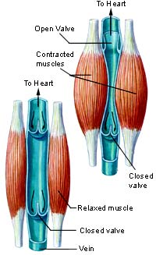
Lower Limb Veins: important clinical points
Valves in the veins allow flow only up towards the heart. In the leg, the deep vessels are sandwiched between layers of calf muscles. During walking and running, contractions of these muscles squeeze the thin-walled veins and push blood up the veins: the calf pump. Immobility (e.g. a long plane journey) means less efficient venous return from the foot and leg. Sluggish deep venous return can lead to Deep Vein Thrombosis (DVT). Elastic surgical socks compress the superficial veins promoting more vigorous deep venous return.
Muscle Pump

Slide 29
Venous grafts
CABG
Arterial by-pass surgery
Valves! (only allow flow in one direction, so graft must be oriented in the correct direction)

Slide 30
Summary
Arterial anatomy
Superficial veins
Deep veins
Embolism and ischaemia
DVT
Compartment syndome

