Slide 1
The elbow, forearm and wrist
Anatomy of the Limbs Session 3

Slide 2
The bones of the region
The muscular anatomy of the region
The joints of the region
The blood vessels of the region
The lymphatic drainage of the region
The nerves of the region

Slide 3
The Bones of the Elbow, Forearm and Wrist
The Humerus
The Radius
The Ulna
The carpal bones
  Proximal row: scaphoid, lunate, triquetrum, pisiform
  Distal row: trapezium, trapezoid, capitate, hamate

Slide 4
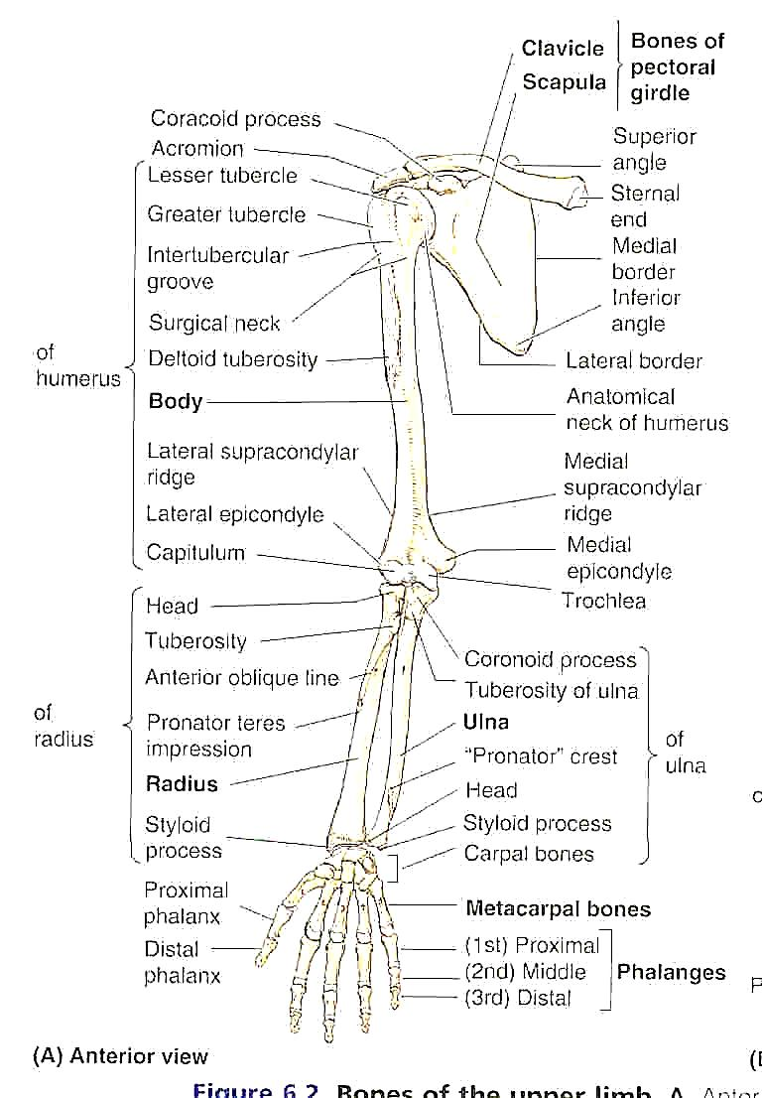
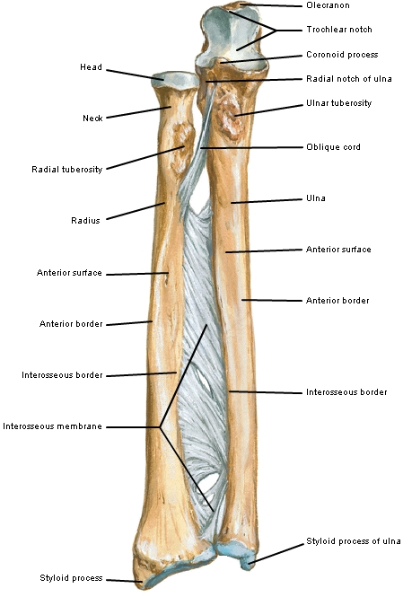
The Bones of the Region

Slide 5
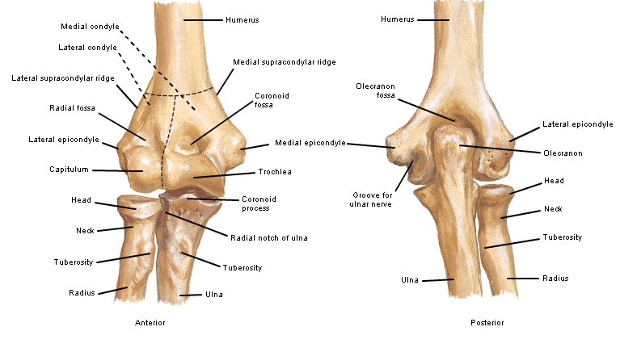
Bones of the elbow joint

Slide 6
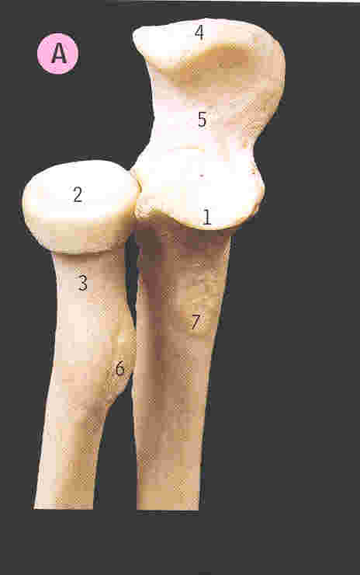
The Proximal Radio-Ulnar Joint

Slide 7
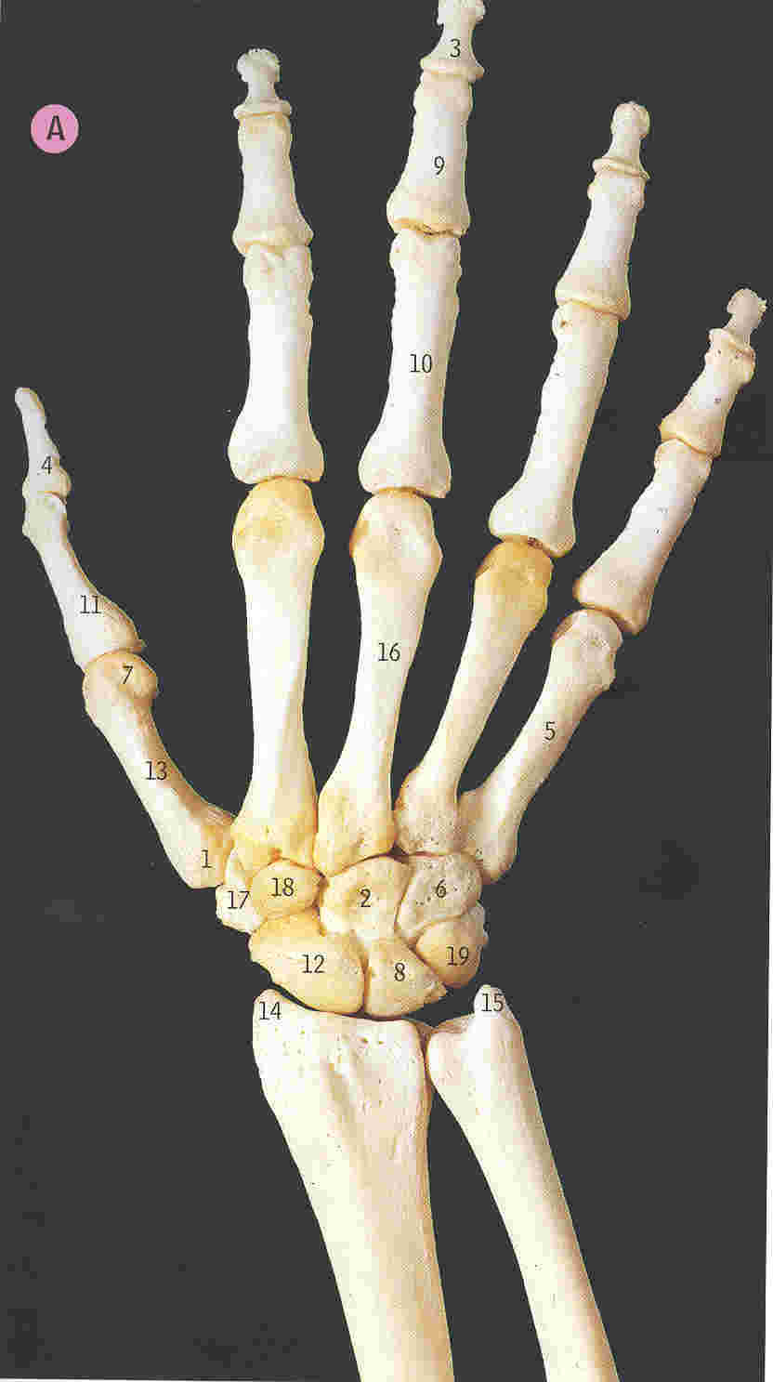
The Wrist and Distal Radio-Ulnar Joints

Slide 8
Muscles of the Region
Anterior compartment of the upper arm
Posterior compartment of the upper arm
Anterior compartment of the forearm
  Superficial compartment
  Deep compartment
Posterior compartment of the forearm

Slide 9
Anterior Compartment of the Arm (revision)
(many arm muscles act across elbow joint)
Biceps
Brachialis
Coraco-brachialis (does not act over elbow)
Musculocutaneous nerve (C5,6)

Slide 10
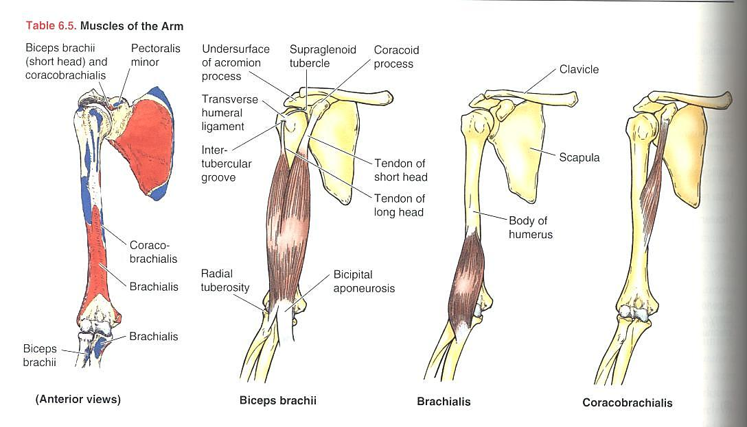
Anterior Compartment of the Arm (revision)

Slide 11
Posterior Compartment of the Arm (revision)
Triceps
Anconeus
Radial nerve (C7,8)

Slide 12
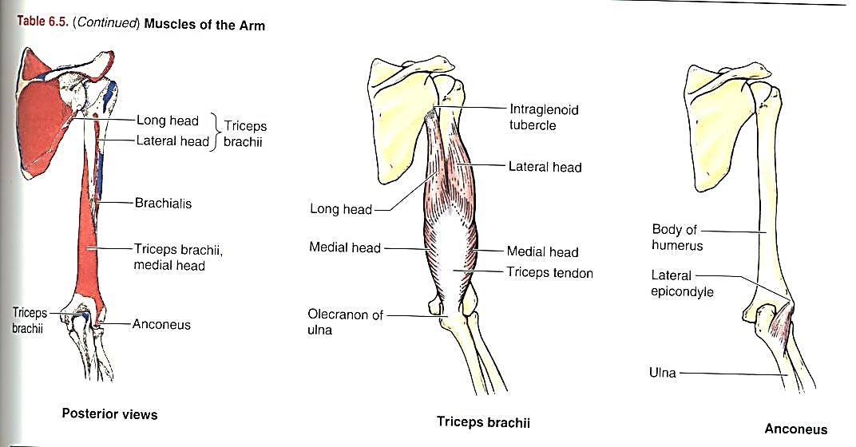
Posterior Compartment of the Arm (revision)

Slide 13
The Forearm Muscles
The hand and wrist are operated by ‘remote control’ by these muscles
The forearm muscles actually take origin from the distal humerus as well as the radius and ulna
Flexors (and pronators) anteriorly
Extensors (and supinators) posteriorly

Slide 14
Anterior Compartment of the Forearm
Superficial compartment
Deep compartment

Slide 15
Superficial Anterior Compartment of the Forearm
Pronator teres (PT)
Flexor carpi radialis (FCR)
Palmaris longus (PL)
Flexor digitorum superficialis (FDS)
Flexor carpi ulnaris (FCU)

Slide 16
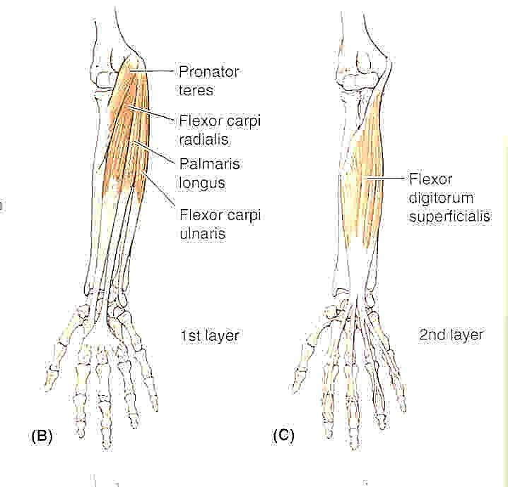
Superficial Anterior Compartment

Slide 17
Deep Anterior Compartment of the Forearm
Flexor digitorum profundus (FDP)
Flexor pollicis longus (FPL)
Pronator quadratus (PQ)

Slide 18
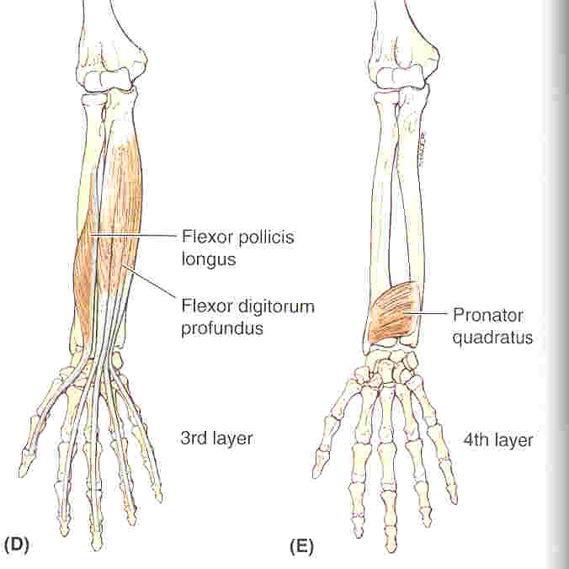
Deep Anterior Compartment

Slide 19
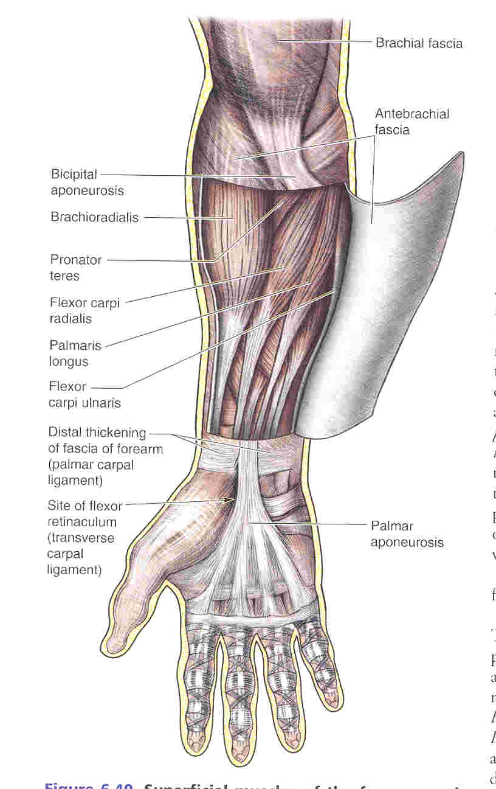
Fascia of the region

Slide 20
Extensor Compartment of the Forearm
Muscles that move the wrist joint
  Extensor carpi radialis longus (ECRL)
  Extensor carpi radialis brevis (ECRB)
  Extensor carpi ulnaris (ECU)
Muscles that move the digits
  Extensor digitorum (ED)
  Extensor indicis (EI)
  Extensor digit minimi (EDM)
Muscles that move the thumb
  Abductor pollicis longus (APL)
  Extensor pollicis brevis (EPB)
  Extensor pollicis longus (EPL)
Other muscles
  Brachioradialis
  Supinator

Slide 21
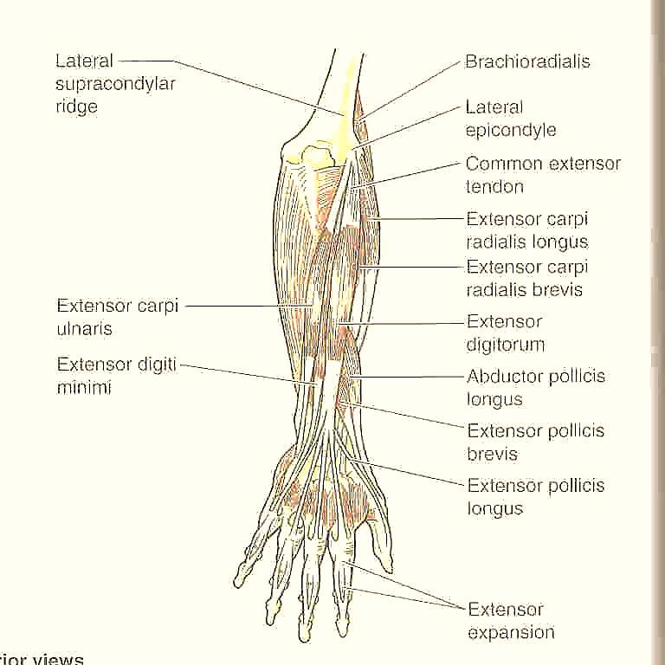
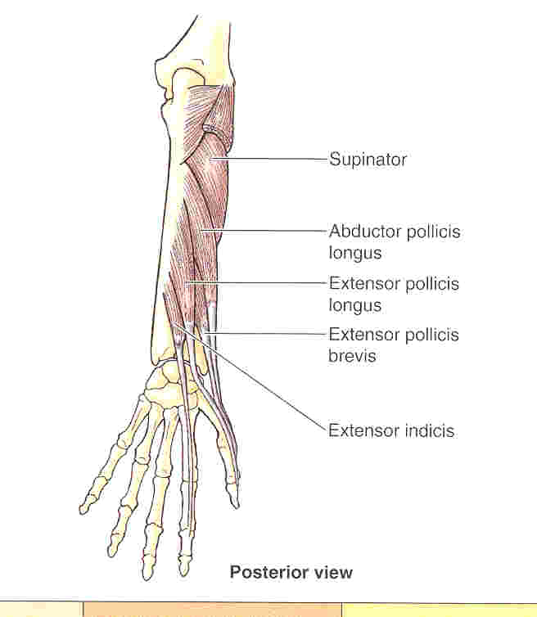
Extensor Compartment of the Forearm

Slide 22
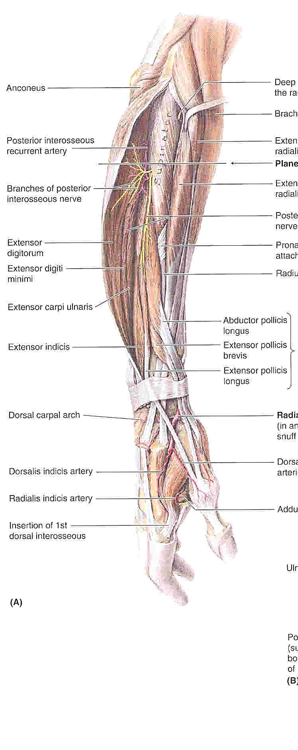
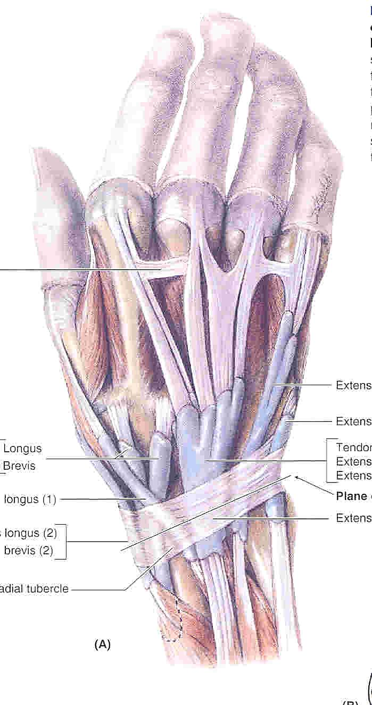
Anatomical snuff-box

Slide 23
Muscle Attachments at the Radius and Ulna and interosseous membrane

Slide 24
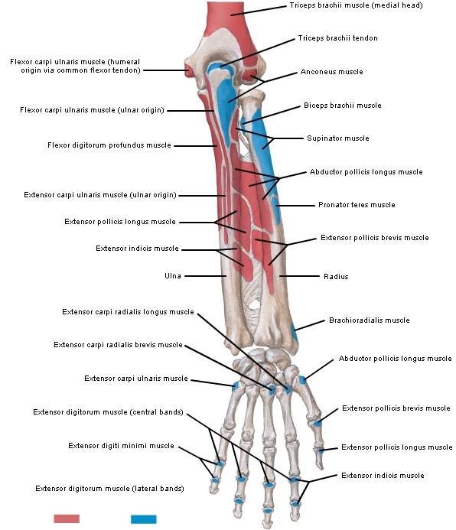
Muscle Attachments at the Radius and Ulna and interosseous membrane

Slide 25
The Joints of the Region
Elbow joint
Proximal radio-ulnar joint
Distal radio-ulnar joint
Wrist joint

Slide 26
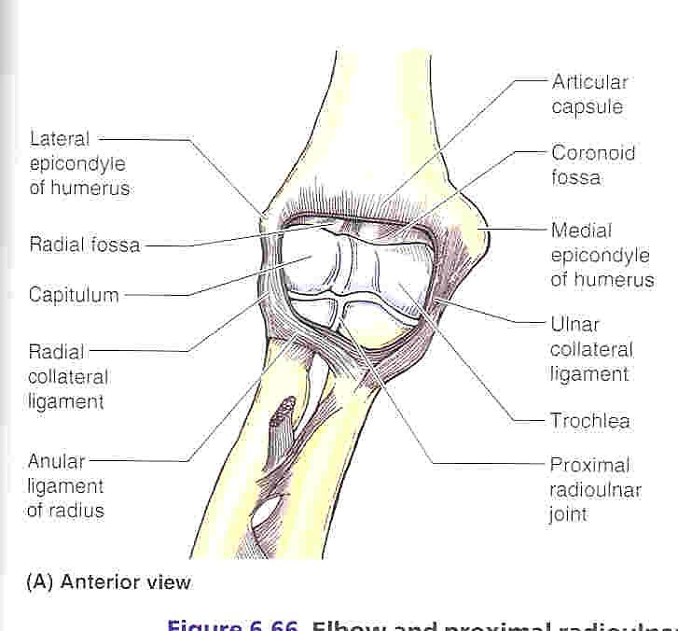
The Elbow Joint

Slide 27
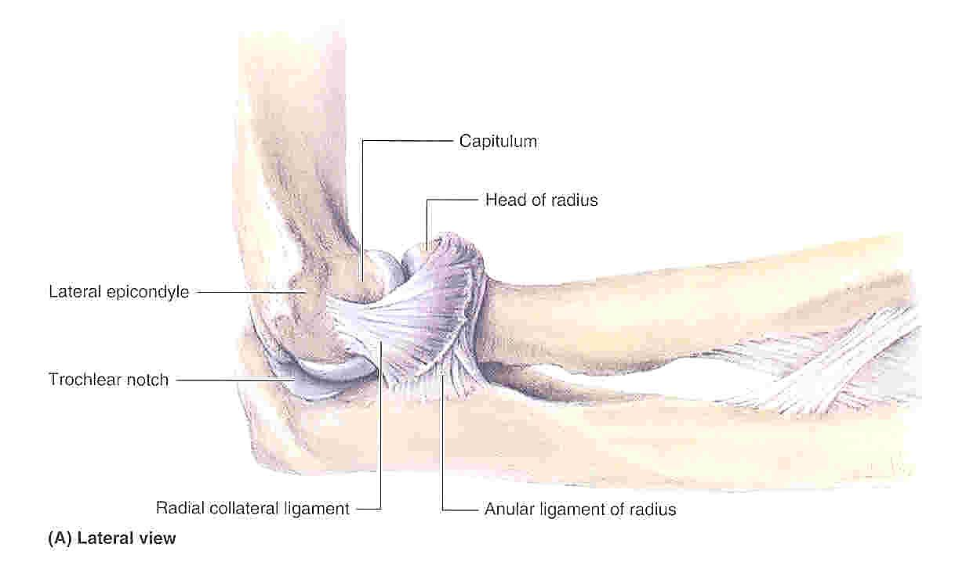

Slide 28
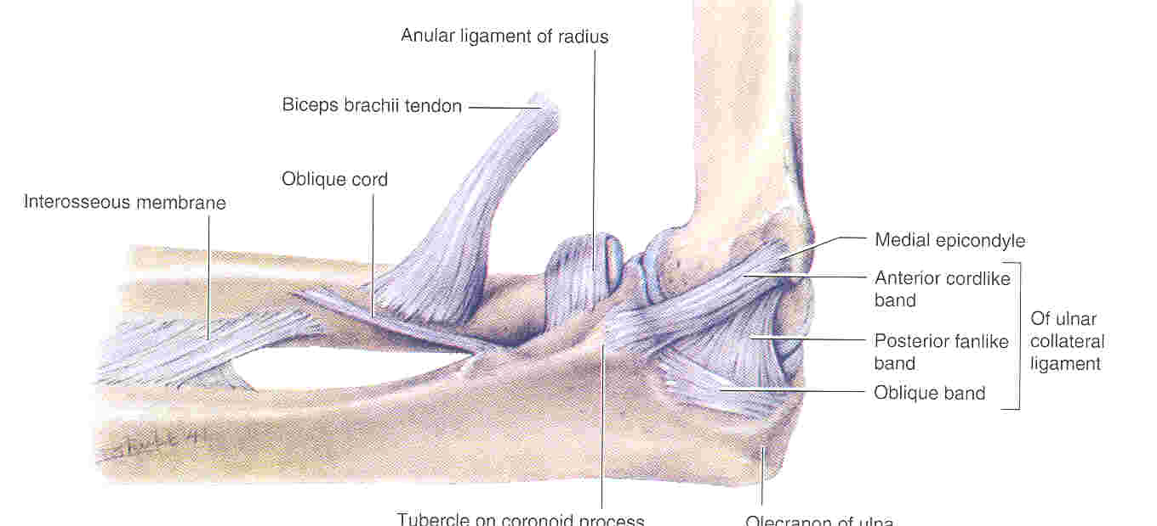

Slide 29
Movements of the Elbow Joint
Flexion
  Brachialis
  Biceps
  Brachioradialis
  Pronator teres
Extension
  Triceps
  Anconeus

Slide 30
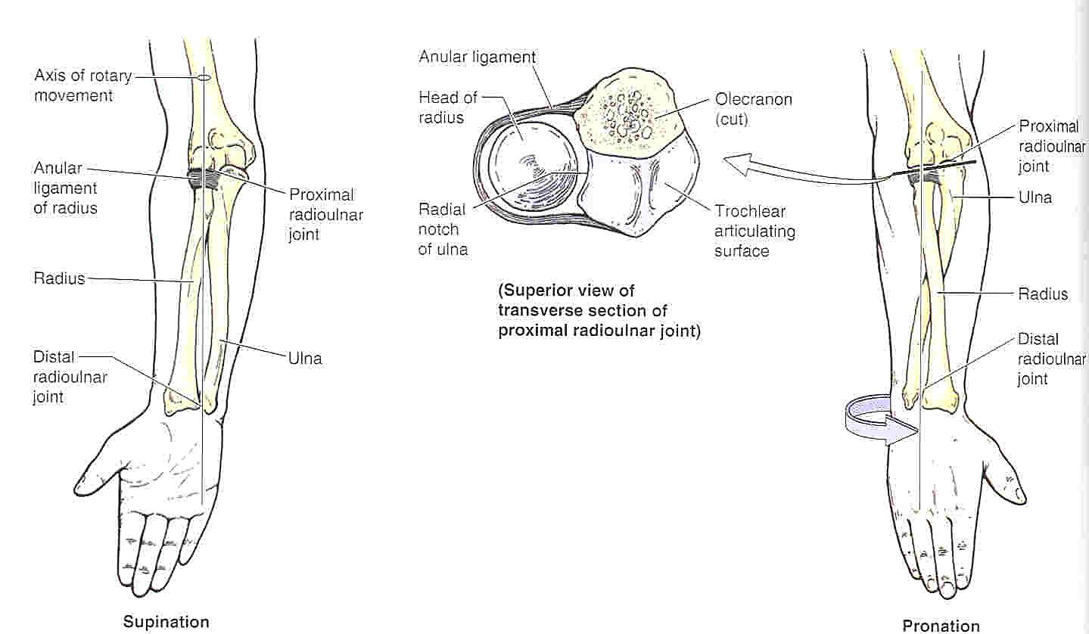
The Proximal and Distal
Radio-Ulnar Joints

Slide 31
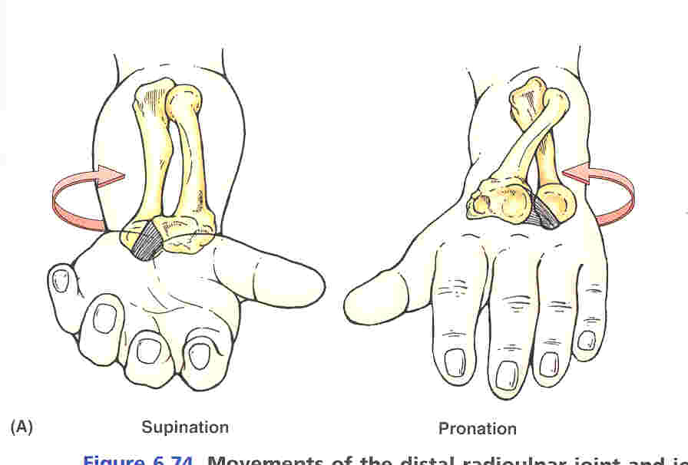

Slide 32
Movements of the Radio-Ulnar Joints
Supination
  Supinator
  Biceps
  (EPL, ECRL)
Pronation
  Pronator quadratus
  Pronator teres
  (FCR, PL, brachioradialis)

Slide 33
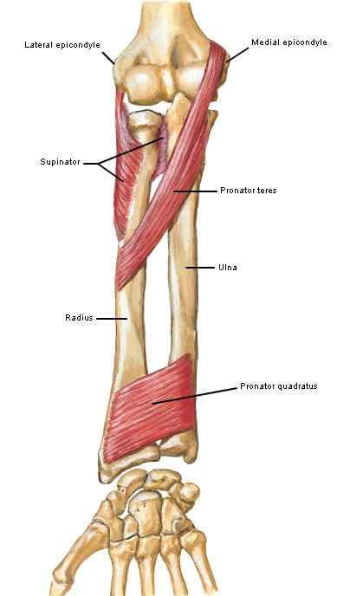
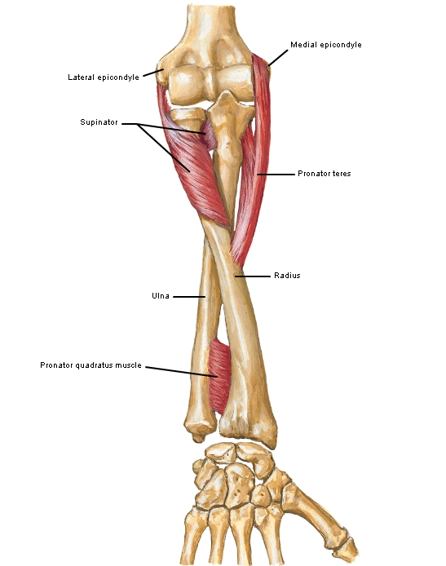
Pronation and Supination
Supine
Prone

Slide 34
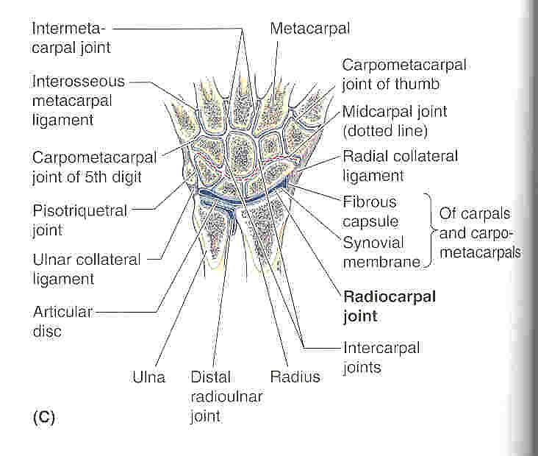
The Wrist Joint

Slide 35
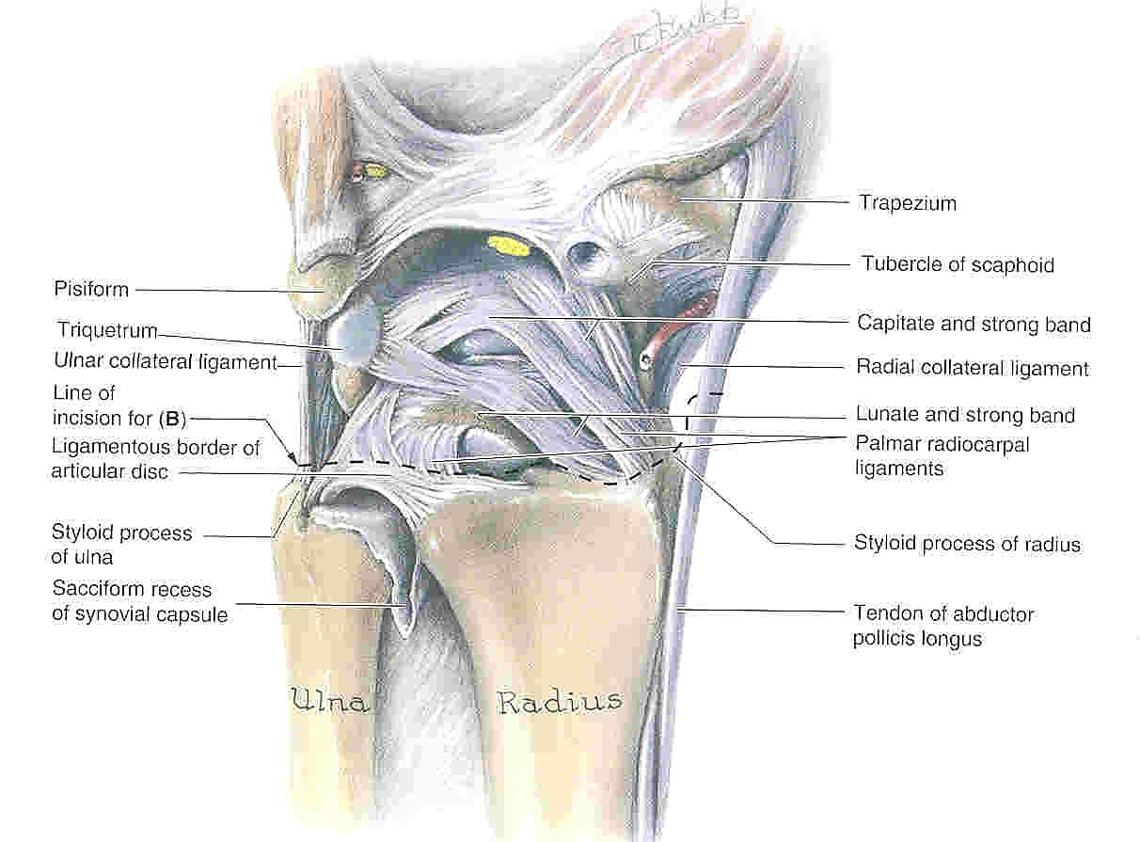
Wrist joint

Slide 36
Movements of the Wrist Joint
Flexion
  FCR and FCU – important
  Long flexors of thumb and fingers
  (PL, APL)
Extension
  ECRL, ECRB, ECU – important
  Long extensors of the thumb and fingers
Radial deviation (abduction)
  APL, FCR, ECRL, ECRB
Ulnar deviation (adduction)
  ECU, FCU

Slide 37
The Arteries of the Region
Subclavian artery
  passes over the first rib to become…
Axillary artery
  at the lower border of teres major becomes the…
Brachial artery
  Gives off a large branch in the arm – Profunda brachii
  Divides as the level of the elbow into…
Ulnar and Radial arteries
Arches of the hand – anastomosis of the radial and ulnar arteries

Slide 38
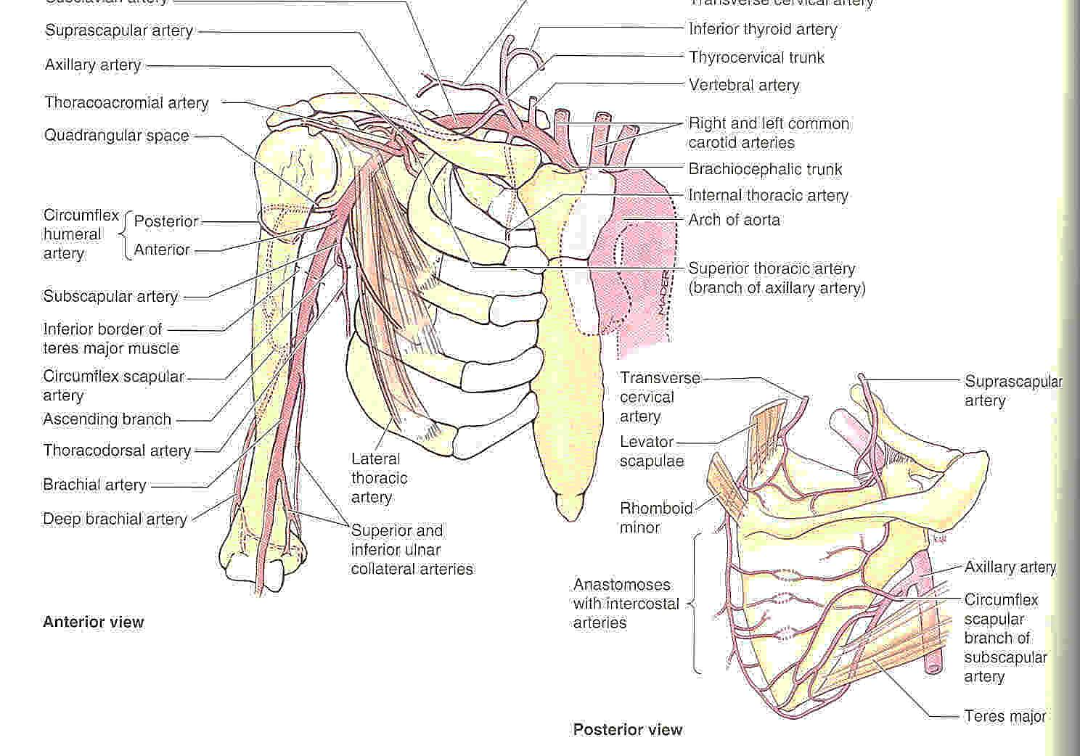
The Arteries of the Region

Slide 39
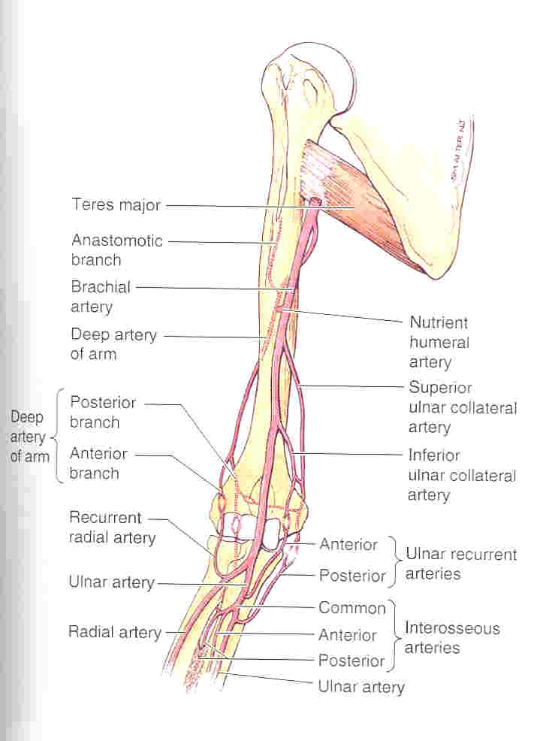

Slide 40
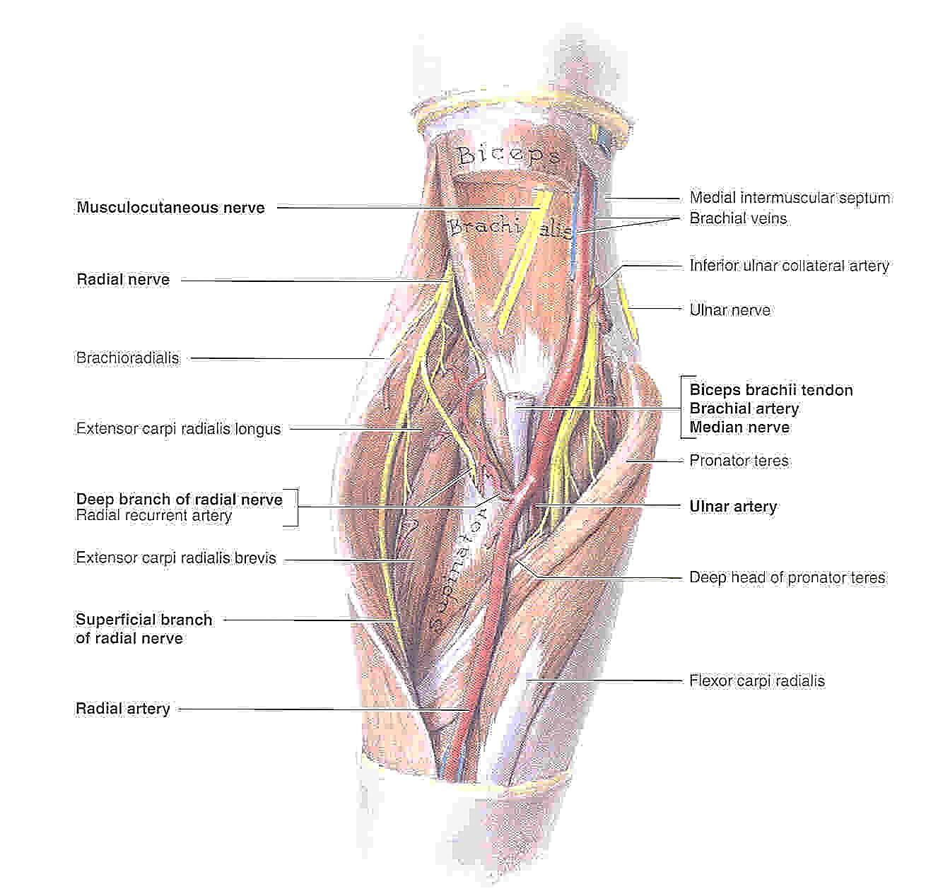

Slide 41
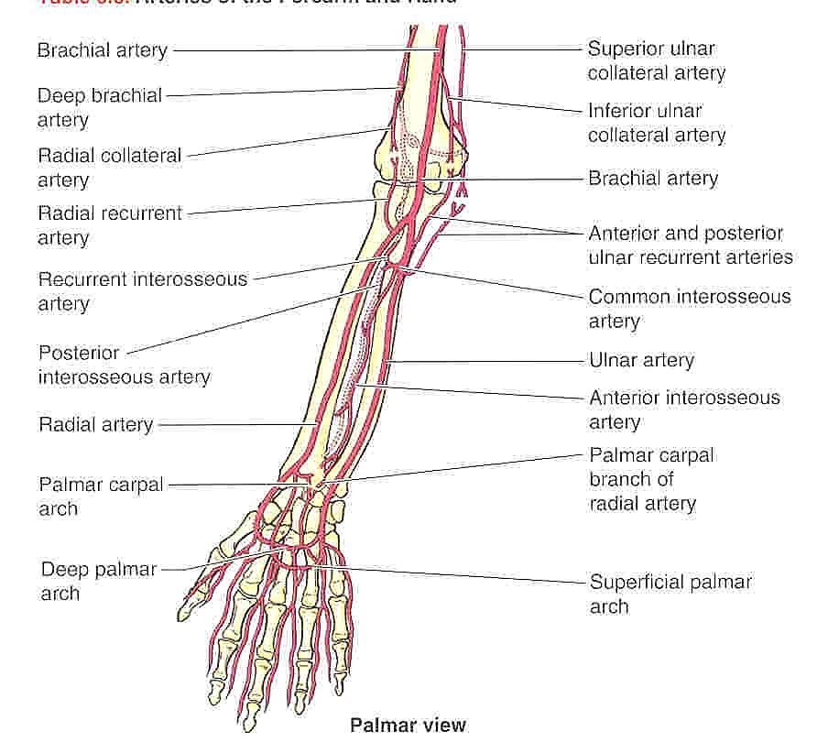

Slide 42
The Veins of the Region
Superficial and deep systems
Cephalic vein (superficial) runs up lateral border of
arm
Basilic vein (superficial) runs up the medial border
of arm
Basilic veins joins venae comitantes to form the
axillary vein in the arm
Cephalic vein joins axillary vein in the axilla
Axillary vein becomes the subclavian vein at the
level of the first rib

Slide 43
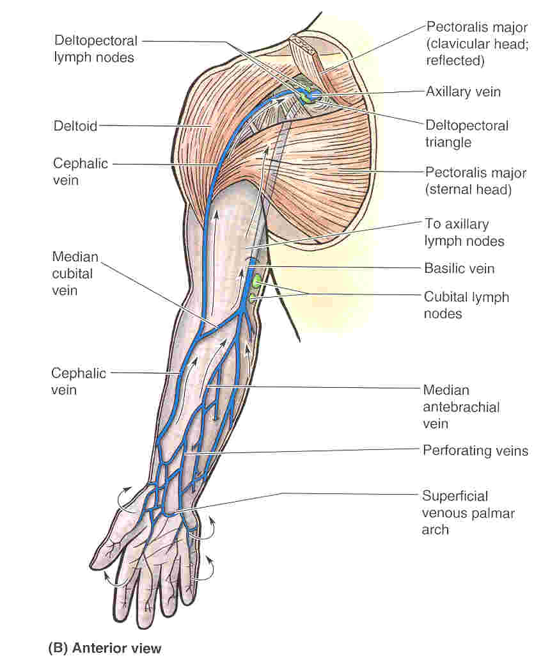
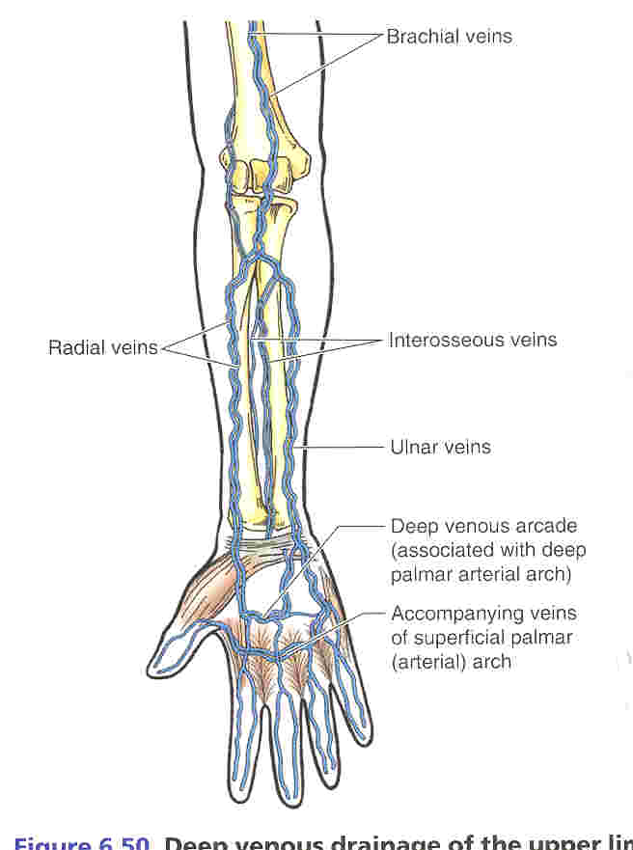
The Veins of the Region
Superficial
Deep
= venae comitantes

Slide 44
Lymphatic Drainage of the Region
Superficial and deep systems, run with veins
Cubital lymph nodes

Slide 45
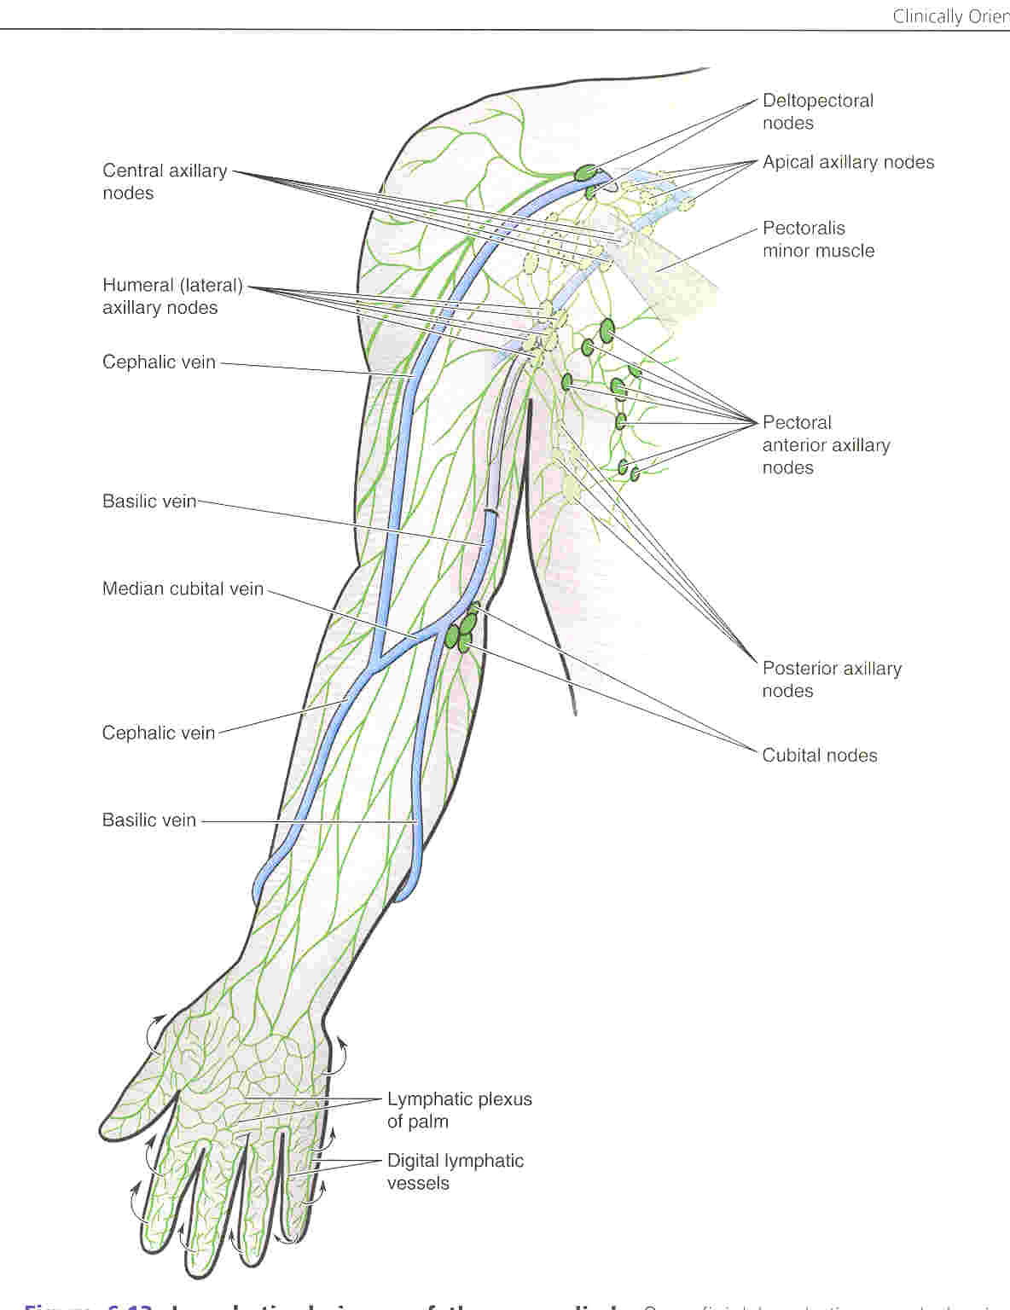
Lymphatic Drainage of the UL

Slide 46
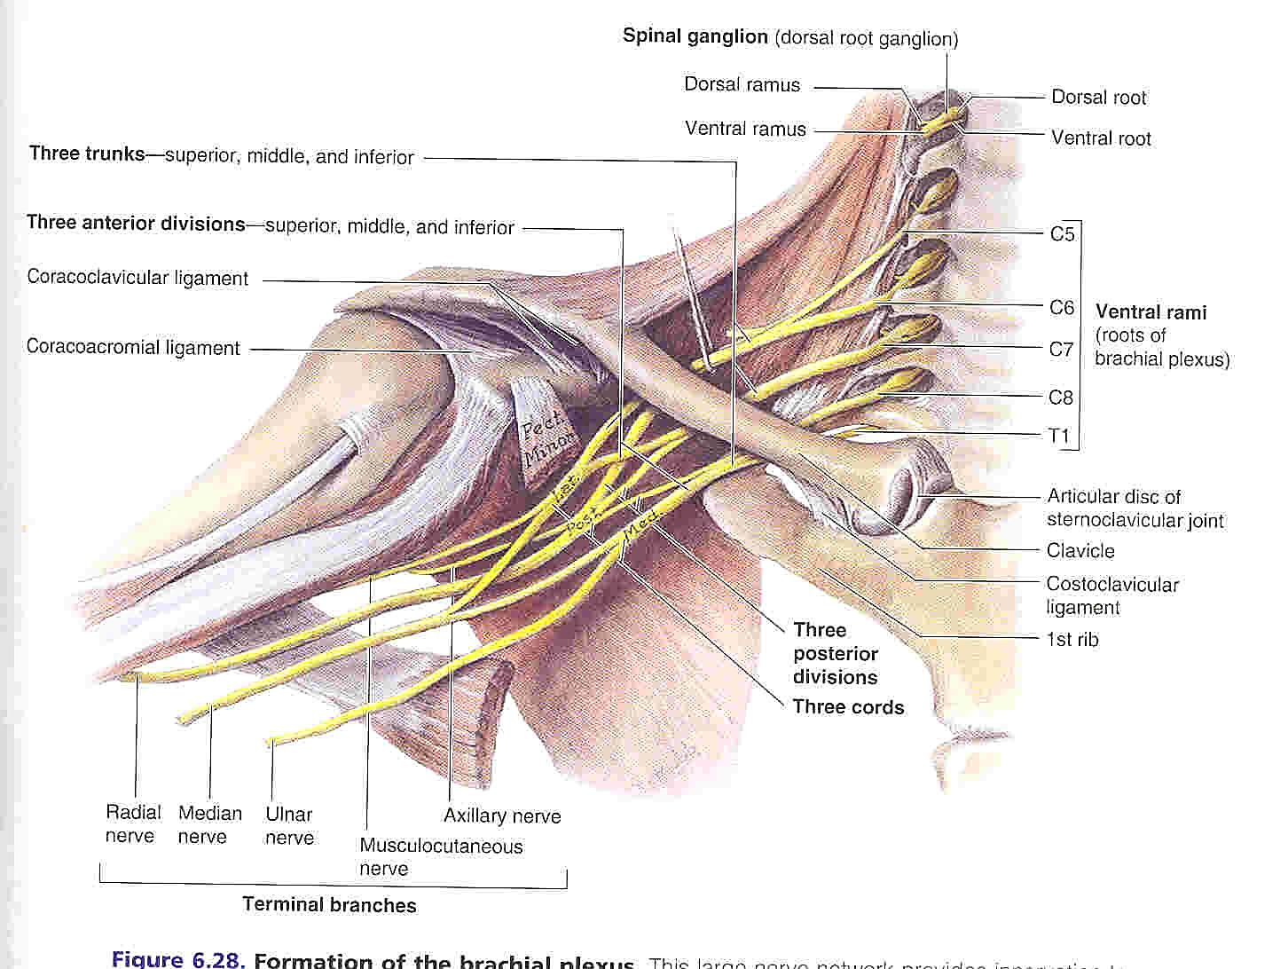
Nerves of the Region: the Brachial Plexus

Slide 47
Main Nerves of the Upper Limb
Musculocutaneous nerve (C5,6,7)
Ulnar nerve (C8,T1)
Median nerve (C6,7,8,T1)
Radial nerve (C5,6,7,8,T1)

Slide 48
Musculocutaneous Nerve (C5,6)
Supplies all the anterior compartment of the upper arm
Sensory to the lateral forearm (as the lateral cutaneous nerve of the forearm)

Slide 49
Median Nerve (C6,7,8,T1)
Courses through the anterior compartment of the arm (no significant branches) and lies anterior to the elbow, with the brachial artery (easily damaged!)
Main nerve to the muscles of the forearm

Slide 50
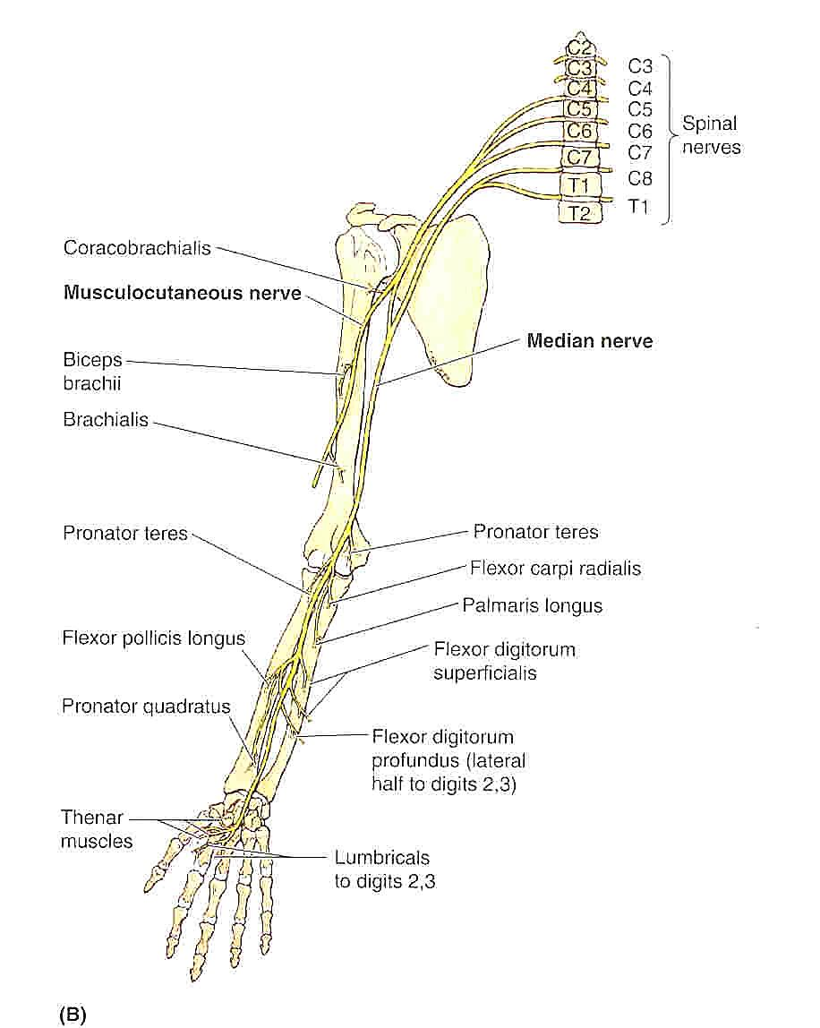

Slide 51
Ulnar Nerve (C8,T1)
Courses via the posterior compartment of the upper arm
No significant branches in the upper arm
Lies behind the medial epicondyle at the elbow (easily damaged)
The main nerve of the hand

Slide 52
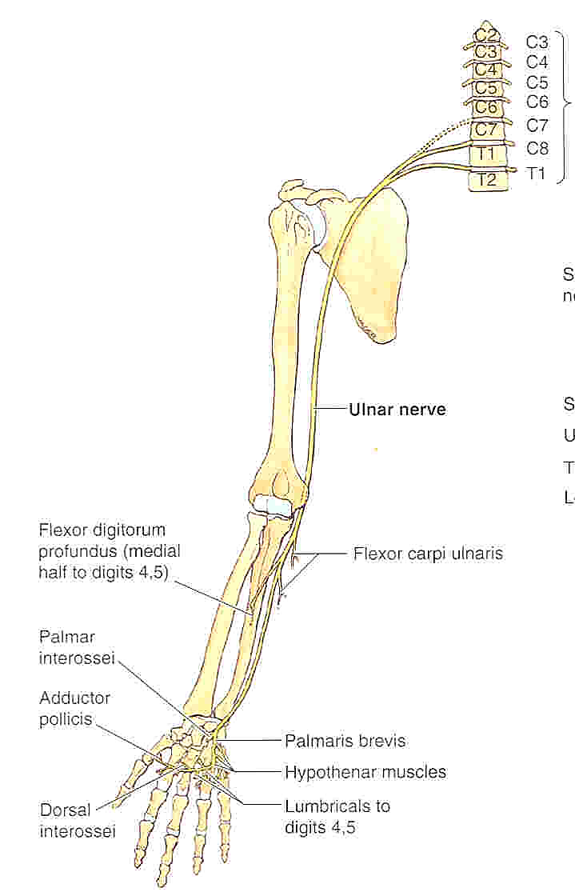

Slide 53
Radial Nerve (C5,6,7,8,T1)
Supplies all the muscles of the posterior compartments of the upper arm and forearm
Passes around the body of the humerus at its mid-shaft in the radial groove (easily damaged!)
Supplies triceps in the arm
Courses via the anterior compartment of the upper arm more distally
Divides just above the level of the elbow into;
  Deep branch – the posterior interosseous nerve (motor)
  Superficial branch – the superficial radial nerve (sensory)

Slide 54
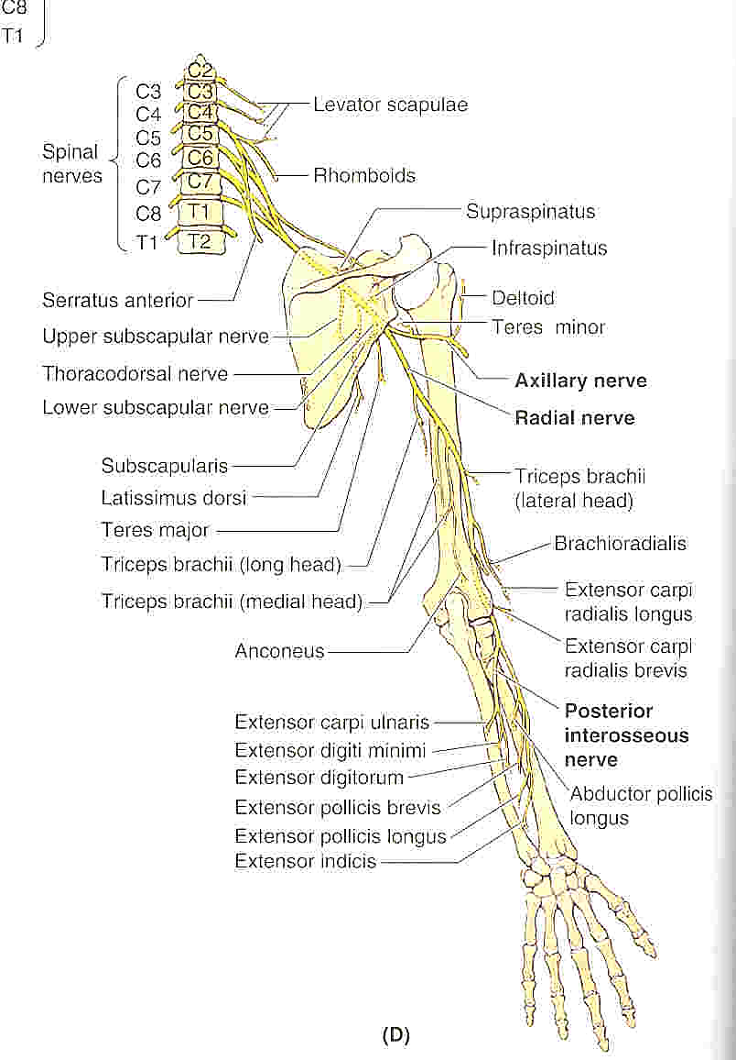

Slide 55
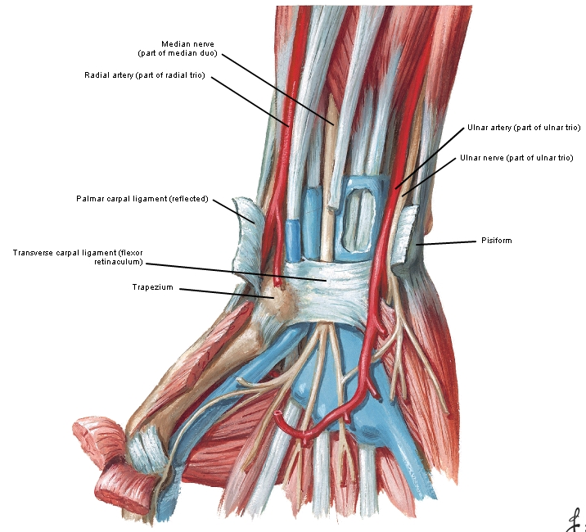
Wrist: flexor retinaculum

