Slide 1
Pharmacology & therapeutics: Haemostasis & thrombosis
Dr Sohag Saleh

Slide 2
Learning objectives
Differentiate between the terms haemostasis and thrombosis
Outline the process of coagulation and the actions of drugs that affect production or activation of clotting factors
Describe the process of platelet activation and the action of specific antiplatelet drugs
Describe the actions of fibrin and the role of thrombolytic drugs
To understand which of these classes of drugs can be used in specific clinical situations

Slide 3
Lecture Structure
Coagulation
Haemostasis
Thrombosis
Coagulation process
Anticoagulants
Antithrombin III
Vitamin K
Factors II & X
Antiplatelets
P2Y receptor
COX-1
GPIIb/IIIa receptor
Thrombolytics & treatment
Plasminogen
Arterial thrombosis
Venous thrombosis

Slide 4
Basics: haemostasis
LUMEN
ENDOTHELIUM
SMOOTH MUSCLE
ADVENTITIA
HAEMOSTASIS
Blood vessels act as transportation routes for blood
If a vessel is damaged it is imperative that blood loss is minimised
Haemostasis is an essential physiological process where blood coagulation prevents excessive blood loss

Slide 5
Basics: thrombosis
LUMEN
ENDOTHELIUM
SMOOTH MUSCLE
ADVENTITIA
THROMBOSIS
Occasionally blood can coagulate within a blood vessel
Thrombosis is a pathophysiological process where blood coagulation occurs within an intact blood vessel and obstructs blood flow
The clot becomes life-threatening if it dislodges from the vessel (embolises) and becomes trapped in another vessel
Venous thromboses (red thrombi) have high fibrin components

Slide 6
Basics: atherosclerosis
LUMEN
ENDOTHELIUM
NEOINTIMA
SMOOTH MUSCLE
ADVENTITIA
ATHEROSCLEROSIS
A thrombus can form within an atherosclerotic plaque
If the plaque ruptures the thrombus is released into the bloodstream, when this occurs within a coronary artery it can cause a myocardial infarction
Arterial thromboses (white thrombi) have high platelet components

Slide 7
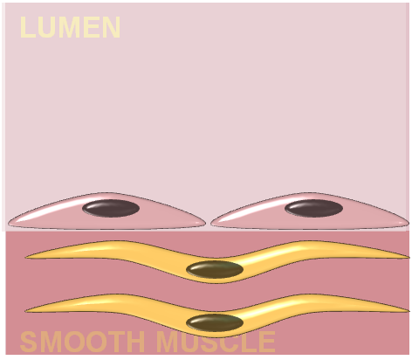
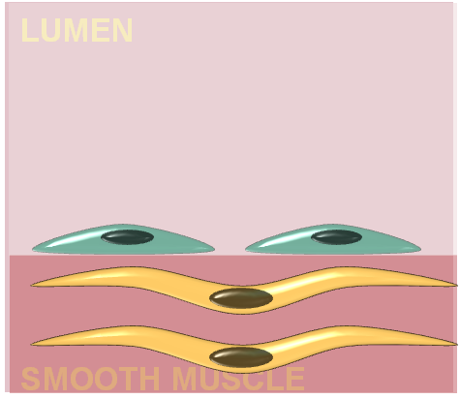
Why does a thrombus form?
VIRCHOW’S TRIAD
The rate of blood flow
When blood flow is slow or stagnating supplies of anticoagulant factors are not replenished
This adjusts the balance in favour of coagulation e.g During long haul flights
The consistency of the blood
In certain conditions the blood may contain more procoagulation factors than anticoagulation factors e.g. Factor V leiden
The blood vessel wall integrity
Damaged endothelia results in the blood being exposed to tissue factor e.g. Atherosclerosis
ANTICOAGULANT
PROCOAGULANT

Slide 8
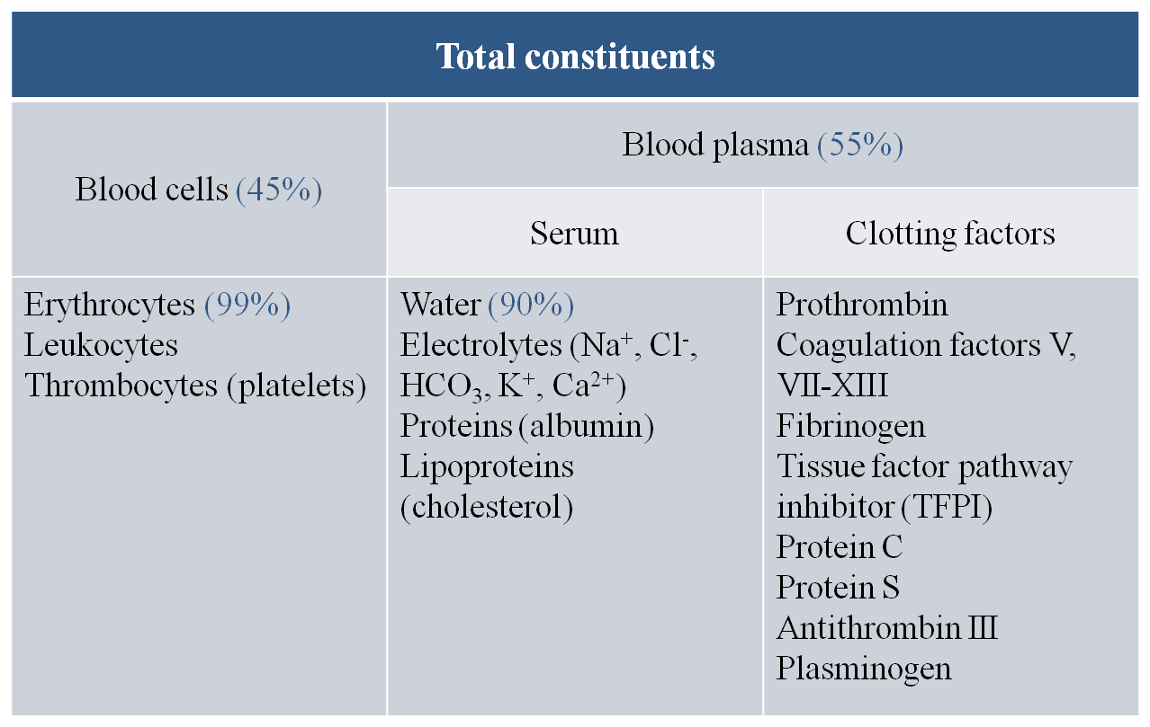
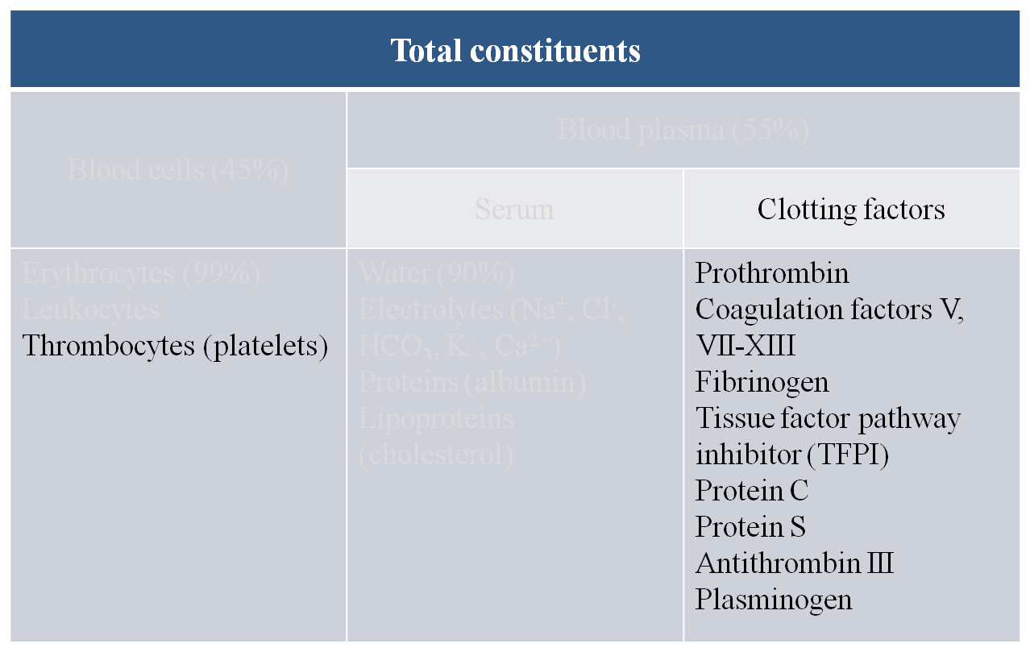
Blood constituents
Blood plasma consists mainly of water but also contains numerous other substances including lipoproteins and a variety of factors involved in the clotting process
Prothrombin, the coagulation factors and fibrinogen are all PROCOAGULANTS
TFPI, Proteins C & S, AT-III and plasminogen are ANTICOAGULANTS

Slide 9
Coagulation cascade
The extrinsic pathway
The intrinsic pathway
Contact with e.g glass
Tissue factor
XIIa
XII
X
VII
VIIa
XIa
XI
IXa
IX
Xa
XIII
II
IIa
XIIIa
Va
V
Fibrinogen
Fibrin

Slide 10
Coagulation: cell based theory
CELL BASED THEORY
Initiation
Small scale production of thrombin
Amplification
Large scale thrombin production on the surface of platelets
Propagation
Thrombin mediated generation of fibrin strands
ANTICOAGULANTS
ANTI-PLATELETS
THROMBOLYTICS

Slide 11
Practice SAQs
Define the terms haemostasis and thrombosis (2 marks)
Haemostasis is an essential physiological process where blood coagulation prevents excessive blood loss
Thrombosis is a pathophysiological process where blood coagulation occurs within an intact blood vessel and obstructs blood flow
In terms of their vascular location and composition what are major differences between red thrombi and white thrombi (2 marks)
Red thrombi: Venous thromboses have high fibrin components
White thrombi: Arterial thromboses have high platelet components
Provide details of Virchow’s triad (6 marks)
The rate of blood flow: Slow or stagnating supplies of anticoagulant factors are adjusts the balance in favour of coagulation
The consistency of the blood: When blood contains an imbalance of coagulation factors favouring coagulation
The blood vessel wall integrity: Damaged endothelia results in the blood being exposed to tissue factor

Slide 12
Lecture Structure
Coagulation
Haemostasis
An essential physiological process
Thrombosis
A pathophysiological process
Thrombi form within atherosclerotic plaques
Coagulation process
Virchow’s triad
Cell-based theory of coagulation
Anticoagulants
Antithrombin III
Vitamin K
Factors II & X
Antiplatelets
P2Y receptor
COX-1
GPIIb/IIIa receptor
Thrombolytics & treatment
Plasminogen
Arterial thrombosis
Venous thrombosis

Slide 13
Initiation: anticoagulants
INITIATION
Tissue factor
Tissue factor bearing cells activate factors factors V & X forming a Va-Xa complex known as the prothrombinase complex
Prothrombinase complex
This activates factor II (prothrombin) creating factor IIa (thrombin)
Antithrombin III (AT-III)
AT-III will ordinarily inactivate thrombin
II
TF
Va
Xa
IIa
AT-III

Slide 14
Initiation: anticoagulants
ANTICOAGULANTS
Direct thrombin inhibitors
Inhibit thrombin (e.g. Bivalirudin, BvRUDIN)
Heparin and derivatives
Heparin activates antithrombin-III but derivatives (low-molecular weight heparins, LMWHs) also inhibit factor Xa
Factor Xa inhibitors
e.g. Rivaroxaban & Apixaban
Vitamin K antagonists
Vitamin K is essential for the production of the factors II, VII, IX & X
RvX
II
BvRUDIN
TF
Va
Xa
IIa
LMWH
AT-III
HEPARIN

Slide 15
Anticoagulants
Direct thrombin inhibitors
Bivalirudin is administered subcutaneously and are licensed for the treatment of heparin induced thrombocytopenia
Dabigatran is the first orally available direct thrombin inhibitor and was only recently approved for the prophylaxis of venous thromboembolism during surgery
Heparin and derivatives
Heparin exerts a conformational change on AT-III making it more potent but has a short half- life (~ 1hour) and must be given at regular intervals or by continuous infusion.
The low-molecular weight heparins (LMWH) e.g. Dalteparin are more effective at inhibiting factor Xa and have longer half-lives
Factor Xa inhibitors
Fondaparinux was the first direct factor Xa inhibitor but requires once daily s/c administration
Rivaroxaban is the first orally available factor Xa inhibitor and was recently approved for the prophylaxis of venous thromboembolism during surgery
Vitamin K antagonists
Warfarin and is still the most commonly used oral anticoagulant even though it has a long delay of onset (~ 5 days), a narrow therapeutic window, unpredictable pharmacokinetics and numerous drug interactions

Slide 16
Summary slide
Coagulation
Haemostasis
An essential physiological process
Thrombosis
A pathophysiological process
Thrombi form within atherosclerotic plaques
Coagulation process
Virchow’s triad
Cell-based theory of coagulation
Anticoagulants
Antithrombin III
Physiological anticoagulant activated by heparin (sc) and LMWHs (sc)
Vitamin K
Required by fII, fVII, fIX & fX
Inhibited by Warfarin (oral)
Factors II & X
DTIs include Bivalirudin (sc) & Dabigatran (oral)
fX inhibitors include rivaroxaban (oral)
Anti-platelets
P2Y receptor
COX-1
GPIIb/IIIa receptor
Thrombolytics & treatment
Plasminogen
Arterial thrombosis
Venous thrombosis

Slide 17
Amplification: antiplatelets
AMPLIFICATION
Platelet activation
Thrombin activates platelets, which produce a number of other clotting factors
von Willebrand factor (vWF) liberation
This activates factor II (prothrombin) creating factor IIa (thrombin)
II
IIa
PLATELET
PLATELET
IIa
vWF

Slide 18
Platelet activation
PLATELET
PLATELET
PLATELET ACTIVATION
Thrombin acts on the protease-activated receptors (PAR) located on the surface of platelets. This leads to a rise in intracellular Ca²⁺
which causes the change of shape and the release of adenosine diphosphate (ADP) from dense granules
Pharmacology: PAR antagonists (Atopaxar, Vorapaxar) are in phase III clinical trials
ADP receptor antagonist
ADP has both autocrine and paracrine effects activating P2Y receptors
Pharmacology: P2Y receptors antagonists are in clinical use e.g. Clopidogrel & Prasugrel
Atopaxar
Clopidogrel
IIa
PAR
P2Y
PLATELET
Ca²⁺
Ca²⁺
Ca²⁺
Ca²⁺
Ca²⁺
Ca²⁺
Ca²⁺
Ca²⁺
Ca²⁺

Slide 19
Platelet activation
PLATELET
PLATELET
PLATELET ACTIVATION
Cyclo-oxygenase inhibitors
PAR activation also liberates arachidonic acid (AA) and the action of cyclo-oxygenase (COX) generates thromboxane A₂ (TXA₂)
Pharmacology: low dose (75mg) Aspirin
NB: Higher doses of aspirin inhibit endothelial COX, which produces the protective prostacyclin (PGI₂)
Glycoprotein IIb/IIIa receptor (GPIIb/IIIa)
TXA₂ activation causes expression of GPIIb/IIIa receptor on the surface of platelets and these play an important role in platelet aggregation
Pharmacology: Several GPIIb/IIIa receptor antagonists are licensed for the treatment of thrombotic disorders e.g. Abciximab, Eptifibatide, Tirofiban
Abciximab
IIa
PAR
COX
TXA₂
Aspirin

Slide 20
Summary slide
Coagulation
Haemostasis
An essential physiological process
Thrombosis
A pathophysiological process
Thrombi form within atherosclerotic plaques
Coagulation process
Virchow’s triad
Cell-based theory of coagulation
Anticoagulants
Antithrombin III
Physiological anticoagulant activated by heparin (sc) and LMWHs (sc)
Vitamin K
Required by fII, fVII, fIX & fX
Inhibited by Warfarin (oral)
Factors II & X
DTIs include Bivalirudin (sc) & Dabigatran (oral)
fX inhibitors include rivaroxaban (oral)
Anti-platelets
P2Y receptor
Involved in platelet activation & inhibited by clopidogrel (oral)
COX-1
Involved in platelet aggregation & irreversibly inhibited by aspirin (oral)
GPIIb/IIIa receptor
Involved in platelet activation & inhibited by abciximab
Thrombolytics & treatment
Plasminogen
Arterial thrombosis
Venous thrombosis

Slide 21
Propagation: thrombolytics
PROPAGATION
Generation of fibrin strands
Large-scale thrombin production converts fibrinogen in fibrin strands
IIa
PLATELET
vWF

Slide 22
Thrombolytics: mechanism
THROMBOLYTICS
Anticoagulants & anti-platelets are ineffective at removing pre-formed clots
Thrombolytics convert plasminogen to plasmin, which is a natural protease that degrades fibrin strands
All thrombolytics are administered intravenously
Pharmacology
Alteplase is a tissue type plasminogen activator that is indicated for the treatment of acute MI & ischaemic stroke
Needs to be given within 12 hours of symptoms onset
Streptokinase is a bacterial product that is cheap and effective
Tolerance will develop after first administration
Plasminogen
Alteplase
Plasmin
Antiplatelet
Anticoagulant

Slide 23
Treatment of thrombosis
Diseases associated with thrombosis
Anti-platelets
Thrombolytics
Arterial
Venous
Anticoagulants
Brain
Stroke
Heart
Acute Coronary
Syndromes
Arteries
Aortic aneurysm
PAD
Deep vein thrombosis
Pulmonary embolism
Atrial fibrillation
Thrombolytics
Anti-platelets
Anticoagulants
Thrombolytics
Anti-platelets
Anticoagulants

Slide 24
Practice SBAs
What is the mechanism of action of Bivalirudin?
Inhibits the glycoprotein IIb/IIIa receptor
Inhibits thromboxane A₂ sysnthesis
Activates antithrombin-III
Is a direct thrombin inhibitor
Is a vitamin K antagonist
Why is aspirin a more effective anti-platelet at low-doses?
Because it only reversibly inhibits COX-1 at low doses
Because it only irreversibly inhibits COX-1 at low doses
Because it produces fewer systemic side-effects
Because it preferentially inhibits prostacyclin at low doses
Because it preferentially inhibits platelet derived COX-1 at low doses
Which one of the following drugs inhibits the P2Y ADP receptor
Clopidogrel
Abciximab
Warfarin
Alteplase
Fondaparinux

Slide 25
Lecture Structure
Lecture Structure
Coagulation
Haemostasis
An essential physiological process
Thrombosis
A pathophysiological process
Thrombi form within atherosclerotic plaques
Coagulation process
Virchow’s triad
Cell-based theory of coagulation
Anticoagulants
Antithrombin III
Physiological anticoagulant activated by heparin (sc) and LMWHs (sc)
Vitamin K
Required by fII, fVII, fIX & fX
Inhibited by Warfarin (oral)
Factors II & X
DTIs include Bivalirudin (sc) & Dabigatran (oral)
fX inhibitors include rivaroxaban (oral)
Anti-platelets
P2Y receptor
Involved in platelet activation & inhibited by clopidogrel (oral)
COX-1
Involved in platelet aggregation & irreversibly inhibited by aspirin (oral)
GPIIb/IIIa receptor
Involved in platelet activation & inhibited by abciximab
Thrombolytics & treatment
Plasminogen
Dissolves thrombin, activated by Alteplase
Arterial thrombosis
Prophylaxis: anti-platelets
Treatment: thrombolytics
Venous thrombosis
Prophylaxis: anticoagulants
Treatment: thrombolytics

Slide 26
Learning Objectives: Revisited
Differentiate between the terms haemostasis and thrombosis
Haemostasis is a physiological process preventing blood loss whereas thrombosis is a pathophysiological process
Outline the process of coagulation and the actions of drugs that affect production or activation of clotting factors
The cell based theory of coagulation consists of three stages. Anticoagulants inhibit stage 1 and affect the activity/ production of clotting factors
Describe the process of platelet activation and the action of specific antiplatelet drugs
Platelets are activated by thrombin, which causes Ca²⁺ rise, ADP release and GPIIb/IIIa receptor expression
Antiplatelet drugs fall into 4 categories

Slide 27
Learning Objectives: Revisited
Describe the actions of fibrin and the role of thrombolytic drugs
Fibrin is produced from fibrinogen and stabilises blood clots
Plasmin can degrade fibrin strands and thrombolytic drugs activate plasmin
Understand which of these classes of drugs can be used in specific clinical situations
Anticoagulants: More effective in the treatment of venous red thrombi e.g. Deep vein thrombosis
Antiplatelets: More effective at treating arterial white thrombi e.g. Acute coronary syndromes, ischaemia
Thrombolytics: used in the treatment of MI, stroke & pulmonary embolism

