Slide 1
Drugs and the Cardiovascular System 2
Anti-dysrrhythmics
Alpha blockers and sympatholytics
Vasoconstrictors
Therapeutic applications
© ADH 2013

Slide 2
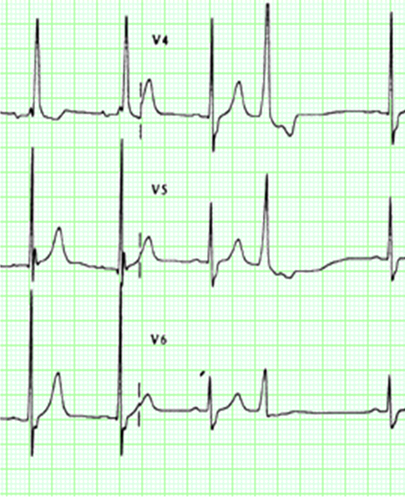
Drugs to control heart rhythm and rate

Slide 3
Disturbances of rhythm
Abnormalities of cardiac rhythm (arrhythmias/dysrhymias) affect around 700,000 people in UK.
Aims of treatment are
Reduce sudden death
Prevent stroke
Alleviate symptoms
Management is complex; usually undertaken by specialists ; and may involve cardioversion, pacemakers, catheter ablation therapy and implantable defibrillators as well as drug therapy

Slide 4
Disturbances of rhythm - classification
May be associated with decreased heart rate (bradyarrhythmias) or increased heart rate (tachyarrhythmias).
A simple classification of arrhythmias is based on site of origin:
Supraventricular arrhythmias (e.g. amidoarone, verapamil)
Ventricular arrhythmias (e.g. flecainide, lidocaine).
Complex (supraventricular + ventricular arrhythmias) (e.g. disopyramide).

Slide 5
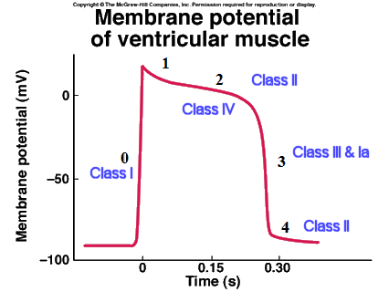
Disturbances of rhythm – classification
The Vaughan
-
Williams classification of anti
-
arrhythmic drugs
Class
Mechanism of action
I
Sodium channel blockade
II
Beta adrenergic blockade
III
Prolongation of repolarisation
('Membrane stabilisation',
mainly due to potassium channel
blockade)
IV
Calcium channel blockade
Vaughan Williams classification is of limited clinical significance

Slide 6
Selected antiarrhythmics: adenosine
Uses
Used intravenously to terminate supraventricular tachyarrhythmias (SVT). Its actions are short-lived (20-30s) and it is consequently safer than verapamil.
Mechanism of action:
An endogenous mediator produced by the metabolism of adenosine triphosphate (ATP).
Acts on adenosine (A₁) receptors to hyperpolarize cardiac tissue and slow conduction through the AV node.
Adverse effects
Chest pain, shortness of breath, dizziness and nausea

Slide 7
Amiodarone & dronedarone
Uses:
superventricular and ventricular tachyarrhythmias
Mechanism of action:
Complex action probably involving multiple ion channel block
Adverse Effects
Amiodarone accumulates in the body (t½ 10 - 100days) and has a number of important adverse effects including:
photosensitive skin rashes
hypo- or hyper-thyroidism
pulmonary fibrosis
corneal deposits
neurological and gastrointestinal disturbances
Dronedarone is non iodinated and is less toxic than amiodarone but is also less effective

Slide 8
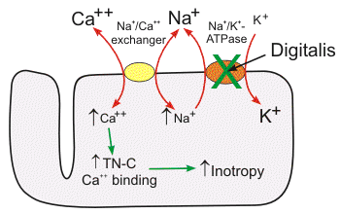
Digoxin and cardiac glycosides
Inhibition of Na-K-ATPase (Na/K pump). This results in increased intracellular Ca²⁺ via effects on Na⁺/Ca²⁺ exchange → positive inotropic effect
central vagal stimulation causes increased refractory period and reduced rate of conduction through the AV node

Slide 9
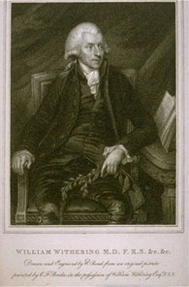
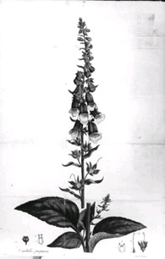
Digoxin and cardiac glycosides
Digoxin has some positive intropic activity and slows ventricular rate.
It can be used in atrial fibrillation and relieves symptoms in chronic heart failure
Long t½ (~40 hours)
Narrow therapeutic window
an immune Fab (Digibind) is available for digoxin toxicity.
Adverse Effects (common and severe)
dysrhythmias (e.g. AV conduction block, ectopic pacemaker activity)
Note: Hypokalaemia and hypomagnesaemia (usually a consequence of diuretic use) lower the threshold for digoxin toxicity

Slide 10
Ivabradine
Mechanism of action:
blocks I_{f} channel (f is for "funny“) – a Na/K channel important in the sinoatrial node.
Slows heart rate
Uses
Angina in patients in normal sinus rhythm
Contraindications
severe bradycardia / sick sinus syndrome / 2-3rd degree heart block
cardiogenic shock
recent myocardial infarction
Adverse Effects
bradycardia
first-degree heart block
ventricular and supraventricular arrhythmias

Slide 11
Cardiac Inotropes
Agents that increase the force of cardiac contraction are used to treat acute heart failure in some situations (e.g. after cardiac surgery or in cardiogenic or septic shock).
Dobutamine is a beta₁ adrenoceptor agonist that stimulates cardiac contraction without a major effect on heart rate.
Inhibitors of phosphodiesterase, such as milrinone, have inotropic effects by inhibiting breakdown of cyclic AMP in cardiac myocytes. But despite increasing cardiac contractile function so far all inotropes have reduced survival in chronic heart failure.

Slide 12
Alpha blockers & sympatholytics
Alpha blockers are antagonists of α₁-adrenoceptors. They can be competitive (e.g. doxazosin) or irreversible (phenoxybenzamine). Used occasionally in combination with other antihypertensives in resistant hypertension, but their routine use has declined since they were shown to be associated with increased rates of chronic heart failure in the ALLHAT study. Phenoxybenzamine (combined with a beta blocker) is used to provide long-lasting alpha-blockade in catecholamine secreting tumours (pheochromocytoma)
Centrally acting antihypertensive agents e.g. clonidine (alpha₂-adrenoceptor agonists), moxonidine (imadazoline agonist) inhibit sympathetic outflow from the brain, occasionally used as antihypertensive agents

Slide 13
Vasoconstrictors
Sumitriptan
Agonist at 5HT_{1D} receptors
constricts some large arteries and inhibits trigeminal nerve transmission.
Used to treat migraine attacks, but contraindicated in patients with coronary disease.
Other ergot alkaloids are also used in migraine and probably act as partial agonists of 5HT₁ receptors but their usefulness is limited by side effects.
Sympathomimetic agents
Adrenaline, the endogenous catecholamine, produced by the adrenal gland is used in cardiac arrest and anaphylactic shock

Slide 14
Selected therapeutic applications
Angina
Hypertension
Chronic Heart Failure

Slide 15
Angina = myocardial ischaemia
Myocardial oxygen supply
WORK →
Myocardial oxygen demand
⬆ Coronary blood flow
Arterial O₂ content
⬆ Heart Rate
⬆ Preload
⬆ Afterload
⬆ Contractility

Slide 16
Angina: how drugs act
Myocardial oxygen supply
Myocardial oxygen demand
Beta blocker
CCB
⬆ Coronary blood flow
Arterial O₂ content
Heart rate
Preload
⬆ Afterload
⬆ Contractility
Nitrate
?
Nitrate

Slide 17
A ‘typical’ drug combination in angina
Beta blocker [or CCB in beta-blocker intolerant patient] to provide background anti-anginal cover
Glyceryl trinitrate (for symptomatic relief)
Therapy to prevent cardiovascular disease - statin (to lower LDL cholesterol) and aspirin (to inhibit platelet activation)

Slide 18
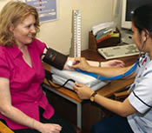
Hypertension
A common condition affecting ~ 1 billion people worldwide
Characterised by elevated blood pressure (>140/90)
Results in increased risk of myocardial infarction, stroke, heart failure and renal disease

Slide 19
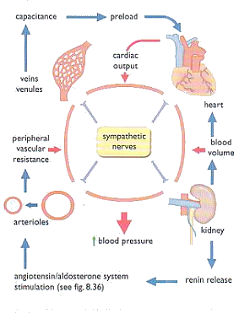
Hypertension
Blood pressure control is a complex process involving multiple systems
There is no clear single cause of hypertension in the majority of cases and treatment is directed at the physiological regulators of blood pressure
(Page et al., 2002)

Slide 20
Hypertension
Typically patients require at least 2 drugs of different classes to control BP
Angiotensin converting enzyme inhibitor (ACEI) or Angiotensin Receptor Blocker (ARB)
Calcium antagonist (long acting dihydropyridine)
Thiazide diuretic
Other CVD prevention measures (e.g. statin to lower LDL cholesterol)
Beta blockers are no longer first line agents for hypertension in UK but may have a role in younger patients

Slide 21
Chronic heart failure (CHF)
Impaired cardiac function due to ischaemic heart disease, hypertension or cardiomyopathy that results in fluid retention, oedema and fatigue
Serious condition with high mortality (5 year survival ~35%)¹
Increasingly common, accounts for ~4% of all deaths in UK².
¹Givertz, M.D. N Engl J Med 2000; 342:1120-1122
²BHF Statistics Website: http://www.heartstats.org/datapage.asp?id=752

Slide 22
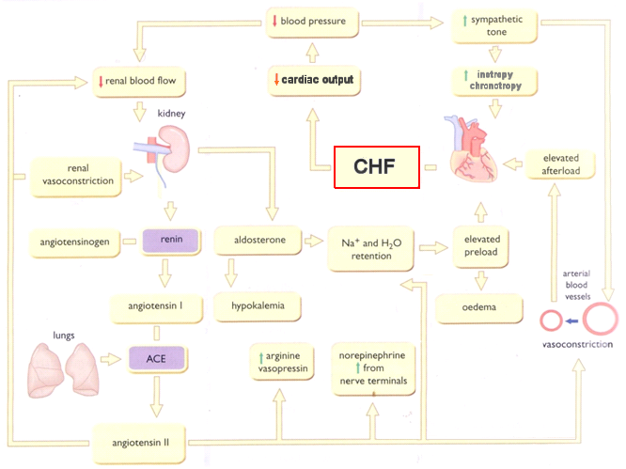
Neuroendocrine compensatory mechanisms in CHF are complex
Modified from Page et al., 2002

Slide 23
Chronic heart failure (CHF)
Typically patients will receive
Diuretic
ACEI (ARB)
Beta blocker
+/- spironolactone
+/- digoxin
ACEI (ARB), beta-blockers, spironolactone have been shown to improve survival.
Note – while beta-blockers can occasionally precipitate acute heart failure in at risk patients due to their negative inotropic effects they have been shown to benefit survival in chronic heart failure and are standard therapy.

Slide 24
References and further reading
GENERAL
Pharmacology (5th ed, 2003) Rang, Dale, Ritter & Moore, Churchill Livingstone; ISBN: 0443071454 – Chapter 18.
Integrated Pharmacology (2nd ed, 2002) Page, Curtis, Sutter, Walker, Hoffman – Chapter 18.
Guidelines
Angina
http://www.cks.library.nhs.uk/angina
Hypertension http://www.nice.org.uk/nicemedia/pdf/HypertensionGuide.pdf
Chronic Heart failure http://www.nice.org.uk/nicemedia/pdf/Full_HF_Guideline.pdf
Atrial Fibrillation http://www.nice.org.uk/nicemedia/pdf/cg036fullguideline.pdf

