Slide 1
Drugs and the Cardiovascular System part 1
Alun Hughes
Clinical Pharmacology, NHLI Division
© ADH 2013

Slide 2
Learning objectives
PART 1
Renin-angiotensin system calcium antagonists, beta blockers, nitrates,
PART 2
Anti-dysrhythmics, sympatholytics, vasoconstrictors
Outline of therapeutic applications
RELEVANT BUT COVERED ELSEWHERE
Lipid lowering agents
Antiplatelet agents including aspirin and drugs affecting clotting
Diuretics and aldosterone antagonists
Hypoglycaemic agents

Slide 3
Leading causes of death worldwide
20
High-income countries
Low/middle income countries*
18
16
14
12
% total deaths
10
8
6
4
2
0
COPD
Breast cancer
Ischaemic heart disease
Diabetes mellitus
Stomach cancer
Cerebrovascular disease
Lower respiratory infections
Colon and rectum cancers
Trachea, bronchus, lung cancers
Alzheimer's diseas and other dementias
*Cause of death not shown if not in the top 10 rates for low/middle income countries
Lopez AD et al. Lancet 2006;367:1747-1757).
Notes:
GLB.IRB.08.01.01
080108a_Irbe

Slide 4
Prescriptions in UK
Prescription items
Net ingredient cost
(millions)
(£ millions)
RANK ORDER
2008
2009
2008
2009
Cardiovascular system
266.1
277.2
1,614.6
1,627.3
Central nervous system
145.3
154.6
1,731.0
1,783.3
Endocrine system
72.4
77.2
904.9
955.9
Gastro
-
intestinal system
64.1
68.7
459.2
440.2
Respiratory system
55.6
57.8
955.6
983.1
Infections
45.2
45.4
202.5
191.3
Nutrition & blood
35.6
40.8
419.7
463.0
Skin
37.0
38.6
252.0
259.6
Musculoskeletal & joint diseases
29.4
30.2
187.5
188.4
O&G UTI
19.3
20.3
287.3
298.7
Cardiovascular drugs are the most commonly prescribed agents in UK
http://www.ic.nhs.uk/pubs/presdisp99-09

Slide 5
Renin Angiotensin Aldosterone system (RAAS) and cardiovascular disease
The RAAS system is primarily responsible for fluid and blood pressure regulation, but it has many other effects that contribute to cardiovascular and metabolic disease
Angiotensin II
Increased
insulin
resistance
Activation
cellular
immunity
Increased
BP
Increased
Na⁺/fluid
retention
Cardiovascular
remodelling
Pro-fibrotic
Pro-thrombotic
Athero-thrombotic disease
Diabetes
Hypertension
Kidney disease
Heart failure

Slide 6
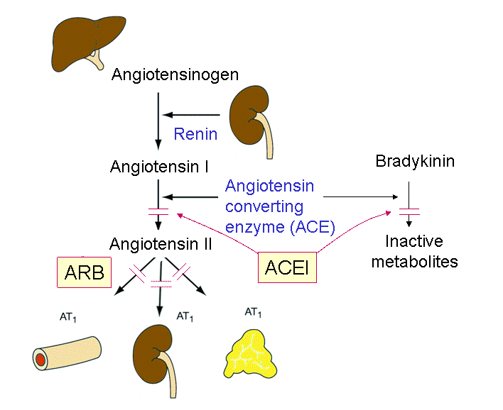
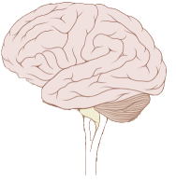
Renin-angiotensin system
↓renal Na+ reabsorption
↓ renal perfusion pressure
↑ sympathetic NS
Renin
inhibitors
AT₁
SNS activation/
thirst
Vasoconstriction
Aldosterone secretion
Salt and water retention

Slide 7
Angiotensin converting enzyme inhibitors (ACEI)
Inhibit the somatic form of angiotensin converting enzyme (ACE)
Prevent the conversion of angiotensin I to angiotensin II by ACE
Uses:
• hypertension
• heart failure
• post-myocardial infarction
• diabetic nephropathy
• progressive renal insufficiency
• patients at high risk of cardiovascular disease
Example: Enalapril

Slide 8
Angiotensin receptor blockers
(ARB or AIIA)
Example: losartan
Act as antagonists of type 1 (AT₁) receptors for Ang II, preventing the renal and vascular actions of Ang II.
They are widely used in hypertension as an alternative to ACEI with fewer side effects
Used in chronic heart failure in patients who cannot tolerate ACEI

Slide 9
Direct Renin Antagonists
Example: aliskiren
Inhibit enzyme activity of renin preventing conversion of angiotensinogen into angiotensin I and hence generation of Ang II.
A new class of agents, probably similar to other RAS inhibitors but limited clinical experience as yet.

Slide 10
Unwanted effects of ACEI and ARB
Generally well tolerated – particularly ARB
Cough (ACEI)
Hypotension (both)
Urticaria / Angioedema (ACEI - v. rarely)
Hyperkalaemia (care with K supplements or K sparing diuretics)
Fetal injury (both)
Renal failure in patients with renal artery stenosis (both)

Slide 11
Calcium antagonists

Slide 12
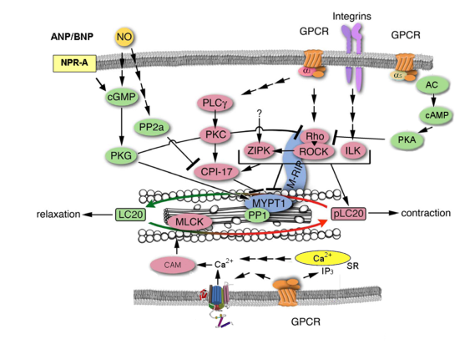
Intracellular calcium and contraction of cardiac and smooth muscle
Cardiac myocyte
Vascular myocyte
While the mechanisms of excitation-contraction coupling
differ in cardiac and smooth muscles, influx of Ca²⁺ ions through L-type voltage-operated calcium channels plays a key role in excitation-contraction coupling.

Slide 13
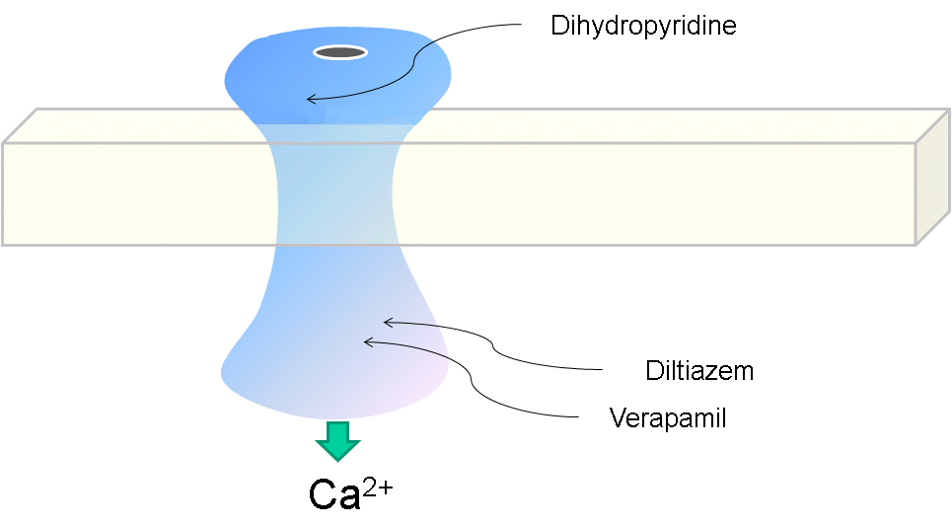
Calcium Antagonists (CCB) molecular mechanisms
L-type calcium channel
extracellular
++++++++++++++++++++++++
– – – – – – – – – – – – – – – – –
intracellular

Slide 14
Drugs acting on afterload and/or cardiac muscle : Calcium antagonists
TWO CLASSES:
Rate slowing (Cardiac and smooth muscle actions)
  Phenylalkylamines (e.g. Verapamil)
  Benzothiazepines (e.g. Diltiazem)
Non-rate slowing (smooth muscle actions)
  Dihydropyridines (e.g. amlodipine)

Slide 15
Calcium antagonists
(Calcium channel blockers)
Uses:
Hypertension (mainly dihydropyridines)
Angina
Verapamil is used to treat paroxysmal SVT and atrial fibrillation (assuming no abnormal conduction pathways).
Mechanism of action at clinical doses:
Verapamil & diltiazem: reduce Ca²⁺ entry into cardiac and smooth muscle cells
Dihydropyridines inhibit Ca²⁺ entry into vascular smooth muscle cells
Negative inotropic effect (verapamil > diltiazem, not dihydropyridines)
Inhibit AV node conduction (verapamil)

Slide 16
Unwanted effects of calcium antagonists
Verapamil
Bradycardia and AV block
Worsening of heart failure
Constipation
Dihydropyridines
Ankle Oedema
Headache / Flushing
Palpitations

Slide 17
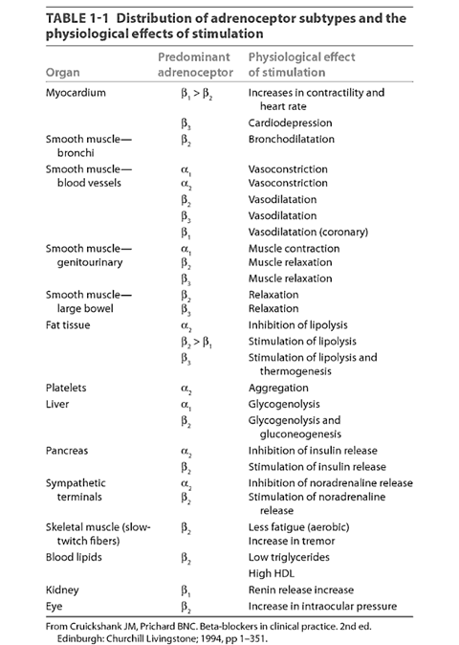
Beta blockers
(β-adrenoceptor antagonists)

Slide 18
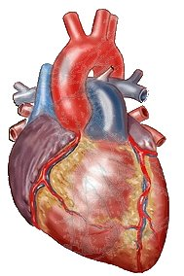
Sympathetic control of the heart
Sympathetic neuron
NA
Beta blockers
β₁
Cardiac myocyte
↑ Heart rate
↑ Contractility
↑ Excitability

Slide 19
Beta blockers
Uses:
Angina
Post myocardial infarction
Cardiac dysrhythmias
Chronic heart failure
Hypertension
Also thyrotoxicosis, glaucoma, anxiety states, migraine prophylaxis, benign essential tremor
Mechanism of action:
competitive antagonists of beta-adrenoceptors – many clinically used agents show selectivity for beta1-adrenoceptors
Example: Atenolol

Slide 20
Beta blockers and hypertension
Beta blockers no longer 1st line for hypertension in UK.
Mechanism of hypotensive action not fully understood but beta₁ antagonists preferred.
Beta blockers do not reduce peripheral resistance (PVR) (except partial agonists / vasodilatory beta blockers).
Beta blockers
  Reduce cardiac output
  reduce renin release by the kidney
  may diminish noradrenaline release by sympathetic nerves,
  lipophilic agents (e.g. propranolol) exert central sympatho-inhibitory actions.

Slide 21
Unwanted effects of β-blockers
Unwanted effects can be due to actions on beta₁ (and sometimes beta₂ receptors due to only partial selectivity)
  Worsening of cardiac failure
  Bradycardia (heart block)
  Bronchoconstriction
  Hypoglycaemia (in diabetics on insulin)
  Increased risk of new onset diabetes
  Fatigue
  Cold extremities and worsening of peripheral arterial disease
  impotence
  CNS effects (lipophilic agents) e.g. nightmares

Slide 22
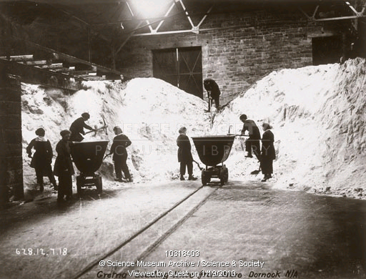
Organic nitrates and related agents

Slide 23
Organic nitrates molecular mechanisms
SNP
Non-enzymatic
Glutathione S-transferase
Organic
nitrate
(R-O-NO₂)
Non-enzymatic
R-OH-NO₂·
Cytochrome P450
NO
cGMP
Guanylate cyclase
vasodilation

Slide 24
Organic nitrates
Uses
Angina
Acute and chronic heart failure
BP control during anaesthesia
Mechanism of action:
Release nitric oxide (NO) in smooth muscle cells (nitrates) or stimulate guanylate cyclase (nicorandil) to cause vasodilation
Reduce preload (venous return)
Reduce afterload (peripheral resistance)
Minor effects:
  antiplatelet agents
  coronary artery vasodilators
Example: Glyceryl trinitrate, nicorandil

Slide 25
Nitrate pharmacokinetics & unwanted effects
Nitrates undergo extensive ‘first pass’ metabolism by the liver.
Glyceryl trinitrate is often given sublingually for rapid relief of angina - has a short half life (~5 mins).
Longer acting forms of nitrate (e.g. isosorbide mononitrate, or glyceryl trinitrate via a transdermal patch) are available for sustained actions
Nitrates can cause hypotension, headaches and flushing as a result of vasodilation
Excessive/prolonged use of nitrates is associated with tolerance

