Slide 1
NSAIDS
Non-Steroidal Anti-Inflammatory DrugS
Professor Sue Smith
National Heart and Lung Institute
sue.smith@imperial.ac.uk

Slide 2
Major Clinical Uses
  Relief of mild-to-moderate pain (Analgesic)
    Toothache, headache, backache
    Postoperative pain (opiate sparing)
    Dysmenorrhea (menstrual pain)
  Reduction of fever (antipyretic) e.g.
    Influenza
  Reduction of inflammation in many diseases e.g.:
    Rheumatoid arthritis
    Osteoarthritis
    Other forms of musculo-skeletal inflammation
    Soft tissue injuries (strains and sprains)
    Gout

Slide 3
Use of NSAIDS in the UK
NSAIDS are:
Available over the counter
Widely prescribed
Being taken by 15% of the elderly population at any one time
Responsible for 1200 deaths per year (mainly due to GI ulceration)

Slide 4
NSAIDS inhibit production of prostanoids
Inflammatory mediators
They are derived from arachidonic acid (lipids)
Prostaglandins and thromboxanes
Widely distributed
Not stored pre-formed
Actions receptor mediated

Slide 5
Prostanoid receptors
8 known receptors
All G protein coupled
DP, EP1, EP2, EP3, EP4, FP, IP, TP
Knock out mice show that prostanoid effects are extremely complex
Physiological and pro-inflammatory

Slide 6
Arachidonic Acid
(from phospholipid membranes)
NSAIDs inhibit
Cyclo-oxygenase
Prostaglandin H₂
Prostaglandin E₂
Prostaglandin F_{2α}
Prostacyclin
Prostaglandin I₂
Prostaglandin D₂
Thromboxane A₂

Slide 7
Two main isoforms of COX
Cox-1
Constitutive (made all the time)
Ubiquitous (found in nearly all cell types)
Physiological
Cox-2
Mainly inducible (made in response to specific stimuli)
Very widespread
Physiological and pro-inflammatory roles

Slide 8
Ibuprofen and Indomethacin
Typical non-selective NSAIDs
Inhibit cyclo-oxygenase REVERSIBLY
Inhibit both COX-1 and COX-2
Have anti-inflammatory, analgesic and anti-pyretic actions

Slide 9
Inhibition of prostanoid production can have complex consequences
We will look at PGE₂ as one example

Slide 10
4 Receptors
2 signalling pathways
Stimulatory and inhibitory

Slide 11
Prostaglandin E₂ lowers the pain threshold
Stimulation of PG receptors on nerve endings sensitizes nociceptors to chemical and thermal stimuli which cause pain
PGE₂
S. Ito et al. /Neuroscience Research 41 (2001) 299–332

Slide 12

Prostaglandin E₂ lowers the pain threshold
Therefore if we block production of PGE2, we will raise the pain threshold and thus, reduce the perception of pain
PGE2
S. Ito et al. /Neuroscience Research 41 (2001) 299–332

Slide 13
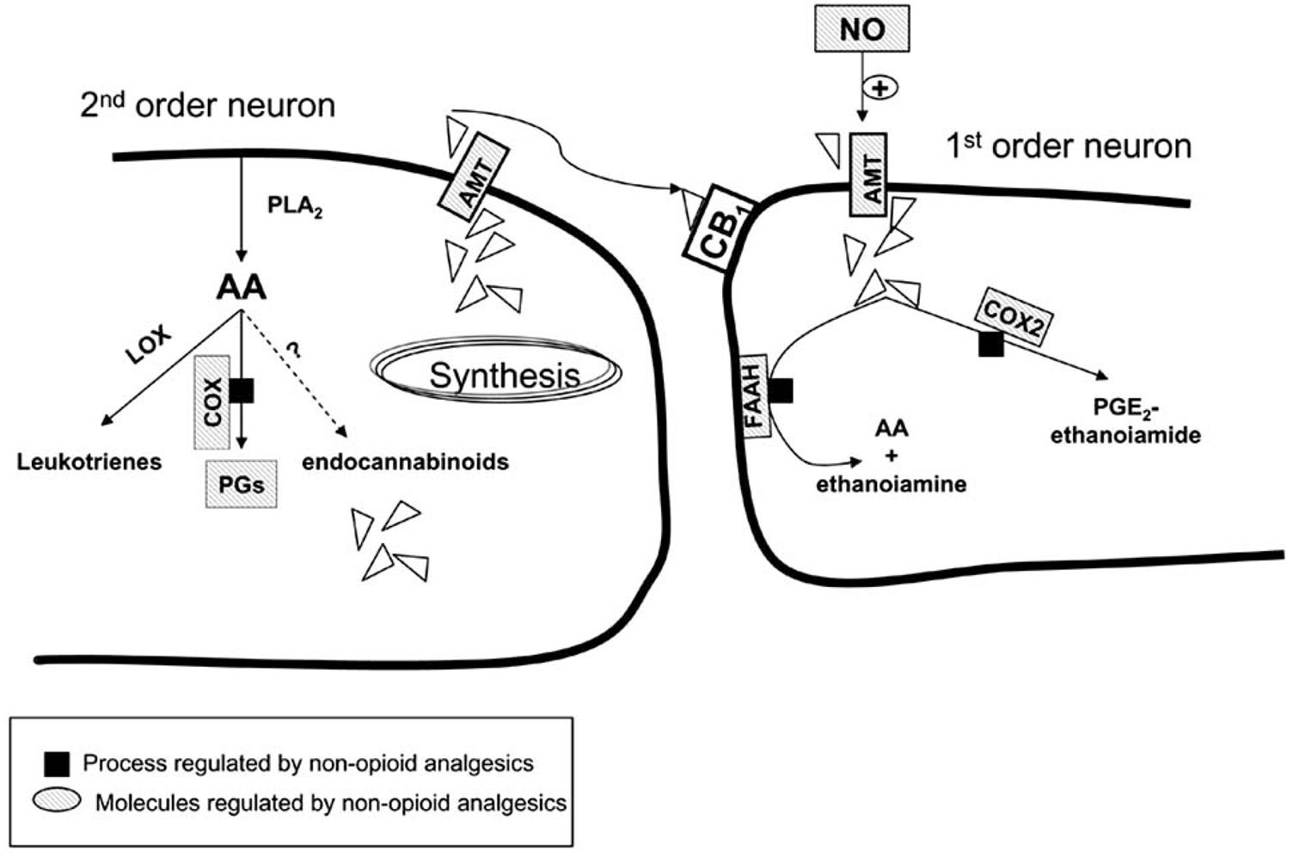
COX inhibitors increase levels of endocannabinoids
Post synaptic
Pre synaptic
Anandamide
Endocannabinoids are
neuromodulators in
thalamus, spine, periphery
Curr Mol Pharmacol. 2009 Jan;2(1):1-14

Slide 14
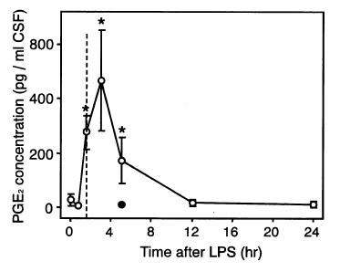
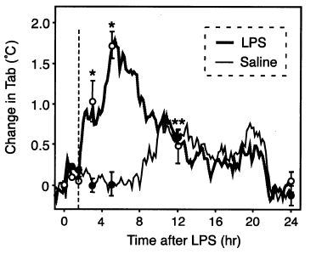
PGE₂ is pyrogenic
PGE₂ in
CSF
PGE₂ stimulates hypothalamic neurones initiating a rise in body temperature
Temp
W. Inoue et al. / Neuroscience Research 44 (2002) 51/61

Slide 15
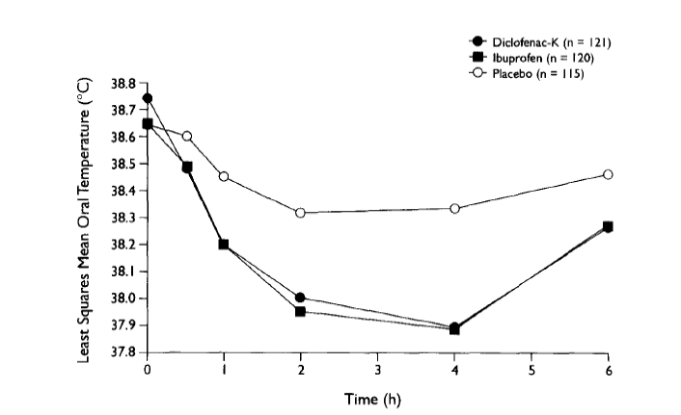
NSAIDS reduce raised temperature
Patients with flu

Slide 16
PGE₂ has complex effects on immune and inflammatory pathways

Slide 17
PGE₂ has complex effects on immune and inflammatory pathways e.g. PGE₂ and T cells

Slide 18
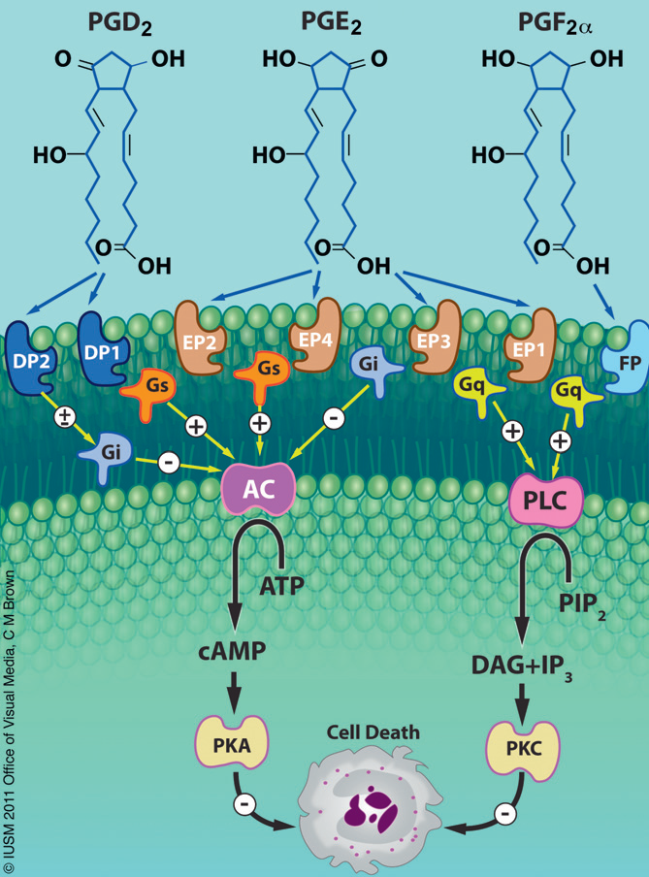
Anti-apoptotic actions of PGs
Brit J Pharmacol DOI:10.1111/j.1476-5381.2012.01900.x

Slide 19
Complex effects on inflammation
Acute effects
Evidence of gene modulation
May contribute to converting acute to chronic inflammation
FASEB J. 2011 Mar;25(3):813-8.

Slide 20
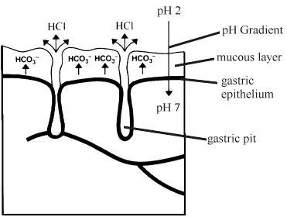
Role of PGE₂ in gastric cytoprotection
PGE₂ downregulates HCl secretion
PGE₂ stimulates
mucus and bicarbonate secretion
http://elfstrom.com/arthritis/nsaids/ulcers.html

Slide 21
NSAIDS inhibit cytoprotective mechanisms in the stomach
Increased HCl secretion
Reduction or loss of protective mucus and bicarbonate
http://elfstrom.com/arthritis/nsaids/ulcers.html
This can lead to gastric ulceration

Slide 22
The consequences of inhibiting all the prostanoids can be difficult to predict with accuracy: sometimes NSAIDS tilt the balance between mediators

Slide 23
Arachidonic acid in the airways
Cyclooxygenase 5 - Lipoxygenase
Prostanoids Leukotrienes
Bronchodilation Bronchoconstriction

Slide 24
Arachidonic acid
In some patients with asthma
+ NSAID
Cyclooxygenase 5 - Lipoxygenase
Prostanoids Leukotrienes
Bronchodilation Bronchospasm

Slide 25
Aspirin
Unique among the NSAIDS
Binds more avidly to COX-1 than COX-2
Binds IRREVERSIBLY to COX enzymes
Reduces platelet aggregation
Serious side-effects at therapeutic doses.

Slide 26
Effects of prostanoids on platelet aggregation
Platelets
Endothelial cells
Thromboxane A₂
Prostacyclin (PGI₂)
_
+
Platelet aggregation

Slide 27
Effect of aspirin on platelet aggregation
Platelets
Endothelial cells
Thromboxane
made by
COX-1
Aspirin
PGI₂ synthesis by
COX-1 and COX-2
Thromboxane A₂
Prostacyclin
_
+
Platelet aggregation

Slide 28
No nucleus: no resynthesis of COX-1
Nucleated: replenish COX-1 and COX-2
Endothelial cells
Platelets
Thromboxane A₂
Prostacyclin
_
Reduced platelet aggregation

Slide 29
Inhibition of PGI₂ is proportional to inhibition of COX-2
Patrono & Baigent, 2009, Mol Interactions 9, 31-39

Slide 30
Anti-platelet actions of Aspirin due to:
Very high degree of COX-1 inhibition which effectively suppresses TxA2 production by platelets
Covalent binding which permanently inhibits platelet COX-1
Relatively low capacity to inhibit COX-2

Slide 31
Major side-effects of Aspirin seen at therapeutic doses are:
Gastric irritation and ulceration
Bronchospasm in sensitive asthmatics
Prolonged bleeding times
Nephrotoxicity
Side effects are more likely with aspirin than other NSAIDS because it inhibits COX covalently

Slide 32
NSAID use
Analgesic use
  Usually occasional
  Relatively low risk of side effects
Anti-inflammatory use
  Often sustained
  Higher doses
  Relatively high risk of side effects

Slide 33
How can we reduce side-effects?
Once believed that:
COX-2 = pathological
COX-1 = physiological
Now know that this is not true
But this misconception was central to the development of selective COX-2 inhibitors

Slide 34
COX-1 and COX-2 superimposed
Journal of Molecular Graphics and Modelling 20 (2002) 359–371

Slide 35
Celecoxib
Despite structural similarities of COX-1 and COX-2, selective inhibitors exist
Celecoxib selectively inhibits COX-2
Less effect on COX-1-mediated processes than conventional NSAIDs such as ibuprofen and indomethacin

Slide 36
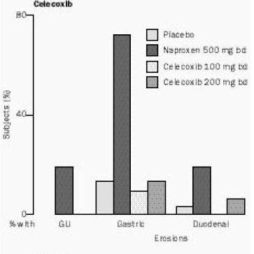
Fewer ulcers with Celecoxib
Non-selective
COX-2 selective
Lancet. 1999 Jan 23;353(9149):307-14.

Slide 37
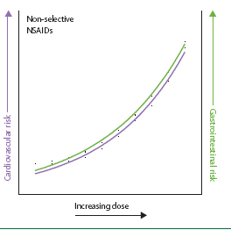
Relative CVS and GI
risk of NSAIDS
Risk to CVS
Risk to GI
Warner & Mitchell, 2008, Lancet,371, 270

Slide 38
COX-2 inhibitors :
Have a good GIT safety profile
Are well tolerated (but not recommended) for patients with asthma
BUT have unwanted CVS effects
  – increased risk of myocardial infarct in 5 out 8 trials when compared with non-selective NSAID

Slide 39
Cardiovascular effects of COX-2 inhibitors
May selectively inhibit PGI₂ production and spare TxA₂ production leading to more aggregation
Not the only mechanism since MIs occur even in patients taking aspirin
Also non-selective NSAIDS also inhibit COX-2

Slide 40
Cardiovascular effects of COX-2 inhibitors
Increasing evidence that COX-2 inhibitors pose higher risk of cardiovascular disease than conventional NSAIDS even though mechanism is unclear
Debate over the safety of the COX-2 inhibitors is continuing.
Watch the literature!

Slide 41
Other strategies for limiting side effects of NSAIDS
Topical application
Administration with omeprazole or other proton pump inhibitor

Slide 42
Paracetamol
Is a good analgesic for mild-to-moderate pain
Has anti-pyretic action
Does NOT have any anti-inflammatory effect
Therefore it is not a NSAID

Slide 43
Mechanism of action
Not understood, but probably central
? COX- 3
? Via Cannabinoid receptors
? Interaction with endogenous opioids
?interaction with 5HT and adenosine receptors
Toussaint et al J Clin Pharm Ther. 2010 Dec;35(6):617-38.
Liu J et al Neurosci Lett 2013

Slide 44
Side-effects of paracetamol
Paracetamol is generally a very safe drug
In overdose it may cause irreversible liver failure
  A reactive, but minor metabolite is normally safely conjugated with glutathione.
  If glutathione is depleted the metabolite oxidises thiol groups of key hepatic enzymes and causes cell death

Slide 45
Antidote for paracetamol poisoning
Add compound with –SH groups
Usually intravenous Acetylcysteine
Occasionally oral methionine
Far fewer successful suicides with paracetamol since purchase has been limited.

