Slide 1
The pharmacology of inflammatory bowel disease
Professor SF Smith
sue.smith@imperial.ac.uk

Slide 2
    "And after all this the LORD smote him in his bowels with an incurable disease. And it came to pass, that in process of time, after the end of two years, his bowels fell out by reason of his sickness: so he died of sore disease…"
    2 Chronicles 21:18-19.

Slide 3
Two Major Forms of Inflammatory Bowel Disease
Ulcerative Colitis (UC)
Crohn’s Disease (CD)
But the distinction can be incomplete in some patients

Slide 4
Autoimmune diseases
Pathogenesis incompletely understood
Defective interaction between mucosal immune system and gut flora
Genetic factors are important, especially in CD
CD more extensively studied than UC

Slide 5
Immune surveillance in the gut
2 x 10¹⁴ bacteria in gut
Immune system has to identify pathogenic
Complex and tightly regulated interplay between host and microbes
Disrupted innate immunity leads to uncontrolled inflammation
Physical damage to epithelium and leakiness of tight junctions

Slide 6
Comparison of CD and UC pathologies
 | Crohn’s Disease | Ulcerative Colitis
Autoimmune disease | Th1-mediated e.g. IFNγ, TNFα, IL-17, IL-23 Florid T cell expansion Defective T cells apoptosis 20 genes implicated | Th2- mediated .g. IL-13 Limited clonal expansion Normal T cell apoptosis 10 genes implicated
Gut layers affected | All layers | Mucosa /submucosa
Regions of gut affected | Any part of GI | Rectum, spreading proximally
Inflamed areas are | Patchy | Continuous
Abcesses/ fissures/ fistulae | Common | Not common
Surgery | Not always curative | Curative

Slide 7
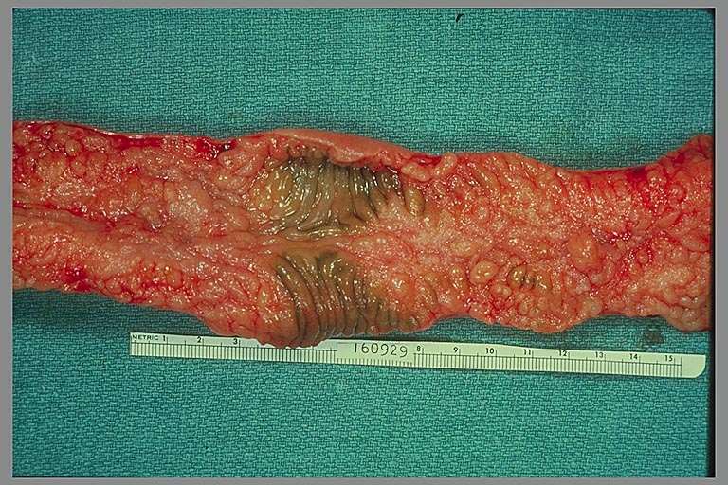
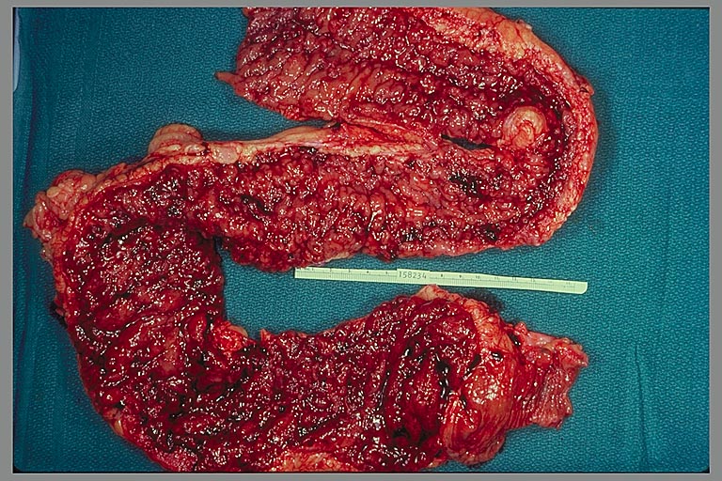
Ulcerative Colitis
Crohn’s disease
http://medlib.med.utah.edu/WebPath/TUTORIAL/IBD/IBD007.html

Slide 8
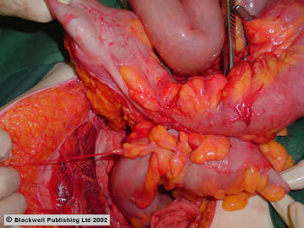
Fistula between ileum and sigmoid colon
http://www.gastrohep.com/images/image.asp?id=744

Slide 9
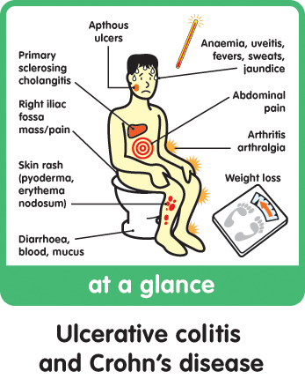
Clinical features of IBD
http://www.gutdoctor.com/Ulcerative-Colitis/

Slide 10
Medical Treatment of IBD (1)
1. Supportive therapies (acute) - Fluid/electrolyte replacement
- Blood transfusion/ oral iron
- Nutritional support
- Antibiotics (not clear whether any particular bacterial species are causative)

Slide 11
Medical Treatment of IBD (2)
2. Nutrition-based supportive therapies for maintenance of remission
- Current evidence base is weak
- Probiotics e.g. lactobacilli, bifidobacteria (“friendly bacteria”)
- Omega 3 fatty acids
J Parenter Enteral Nutr 2011 35: 571

Slide 12
Medical Treatment of IBD (3)
3. Treatment of symptoms: active disease and prevention of relapse
  Glucocorticoids eg Prednisolone
  Aminosalicylates eg Mesalazine
- Immunosuppressives eg Azathioprine

Slide 13
Medical Treatment of IBD (4)
4. Potentially curative therapies
- Anti-TNFα eg Infliximab
- Anti-α-4-integrin eg Natalizumab

Slide 14
Aminosalicylates
Ulcerative Colitis
  Useful in the treatment of active disease
  Useful for maintenance of remission
Crohn’s Disease
  Ineffective in active disease
  May help maintain surgically-induced remission
  Less clear cut than utility in UC

Slide 15
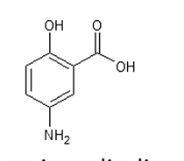
Aminosalicylates
Mesalazine or 5-aminosalicylic acid (5-ASA)
Olsalazine (2 linked 5-ASA molecules)
Anti-inflammatory
Campregher et al, Best Practice & Research Clinical Gastroenterology 25 (2011) 535–546

Slide 16
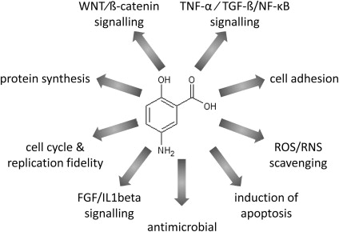
Mechanisms of anti-inflammatory action
Campregher & Gasche, Research Clinical Gastroenterology Volume 25, 2011; 535 - 546

Slide 17
Pharmacokinetics of 5-ASA derivatives:
Activation by gut flora

Slide 18
Topical 5-ASA superior to topical steroids in inducing UC remission
Cochrane Database Syst Rev. 2010 Jan 20;(1):
Combined oral and topical 5-ASA better at
inducing remission in UC than oral 5- ASA alone
Am J Gastroenterol 2012; 107:167–176; doi: 10.1038/ajg.2011.410;

Slide 19
Step-up approach to UC treatment
Dig Dis 2009;27:542–549

Slide 20
Use of Glucocorticoids in IBD
Ulcerative colitis
  Use of glucocorticoids in decline
  Can be used topically or iv if very severe
  Evidence that aminosalicylates superior
Crohn’s Disease
  GCs drugs of choice for inducing remission

Slide 21
Glucocorticoids
Examples: Prednisolone, Fluticasone, budesonide
Powerful anti-inflammatory and immunosuppressive drugs
Activate intracellular Glucocorticoid Receptors which can then act as positive or negative transcription factors

Slide 22
When given systemically, chronic glucocorticoid administration causes many unwanted effects.
You have covered the actions of GCs (wanted and unwanted) in other parts of the course

Slide 23
Strategies for minimising unwanted effects of GCs
Administer topically - fluid or foam enemas or suppositories
Use a low dose in combination with another drug
Use an oral or topically administered drug which is degraded locally e.g.Budesonide

Slide 24
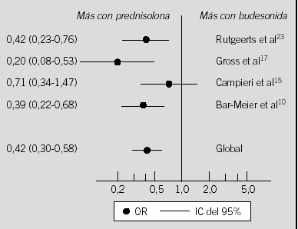
Comparison of side effects from treatment of CD with Prednisolone versus Budesonide
Aliment Pharmacol Ther 2002; 16: 1509–1517.

Slide 25
Immunosuppressive agents
A number of different drugs have been tried unsuccessfully
Only Azathioprine has demonstrated a significant degree of success in both Ulcerative Colitis and Crohn’s Disease
Cyclosporin useful in severe Ulcerative Colitis only

Slide 26
Azathioprine
Immunosuppressive
Mainly used to maintain remission in CD
Can be used to induce remission in CD – treatment >17 weeks
May enable reduction of glucocorticoid dose or postponement of colostomy
Useful for maintaining remission some patients with UC

Slide 27
Mechanism of immunosuppression (1)
Azathioprine is a pro-drug activated in vivo by gut flora to 6-mercaptopurine
Give 6-mercaptopurine directly
Interferes with purine biosynthesis
Interferes with DNA synthesis and cell replication

Slide 28
Mechanism of immunosuppression (2)
It impairs:
  cell- and antibody-mediated immune responses
  lymphocyte proliferation
  mononuclear cell infiltration
  synthesis of antibodies
It enhances
  T cell apoptosis

Slide 29
Unwanted effects
Bone marrow suppression
Metabolised by xanthine oxidase
Co-administration of drugs which inhibit xanthine oxidase e.g. allopurinol, cause build up of 6 –Mercaptopurine leading to blood disorders

Slide 30
Effectiveness of Azathioprine in CD

Slide 31
Biologic therapies
Approved for use in IBD
Anti- TNFα antibodies
  Infliximab (iv)
  Adalimumab (sc)
  Other antibodies effective but have more side-effects

Slide 32
Anti-Tumour Necrosis Factor α
Used successfully in the treatment of CD
Potentially curative rather than simply palliative
Successful in some patients with refractory disease and fistulae
Some evidence of effectiveness in UC

Slide 33
Mechanism of action
Anti- TNFα reduces activation of TNF α receptors in the gut
Production of other cytokines, infiltration and activation of leukocytes is reduced
Also binds to membrane associated TNFα
Induces cytolysis of cells expressing TNFα
Promotes apoptosis of activated T cells

Slide 34
Pharmacokinetics
Infliximab given intravenously
Very long half-life (9.5 days)
Benefits can last for 30 weeks after a single infusion
Most patients relapse after 8 – 12 weeks
Therefore repeat infusion every 8 weeks

Slide 35
Adverse effects
4x - 5x increase in incidence of tuberculosis and other infections
Increased risk of septicaemia
Worsening of heart failure
Increased risk of demyelinating disease
Increased risk of malignancy
Can be immunogenic – azothiaprine reduces risk, but raises TB /maligancy risk

Slide 36
Key findings from Sonic Trial
500 patients with Crohns.
30 weeks
Early use better than last resort
Combined infliximab and azathioprine therapy
C-reactive protein levels and endoscopy might allow identification of patients most likely to benefit (2 – 4% risk of life threatening side effects, so targeted use would be good)
Greater risk of infection or lymphoma.

Slide 37
Other possible targets
Alpha-4-integrin
  Cell adhesion molecule
Interleukin – 13
  Particularly in Ulcerative Colitis

