Slide 1
Anatomy of the orbit
Professor Steve Gentleman
Neuropathology Unit
Department of Medicine
09/11/12

Slide 2
The Orbit
Bones and foramina
Extrinsic eye muscles
Nerves
Blood vessels
Lacrimal system

Slide 3
Bones of the Orbit (1)
Roof
orbital plate of frontal bone
Floor
orbital plate of maxilla
Lateral wall
zygoma
greater wing of sphenoid

Slide 4
Bones of the Orbit (2)
Medial wall
Frontal process of maxilla
Lacrimal bone
Orbital plate of ethmoid
Lesser wing of sphenoid

Slide 5
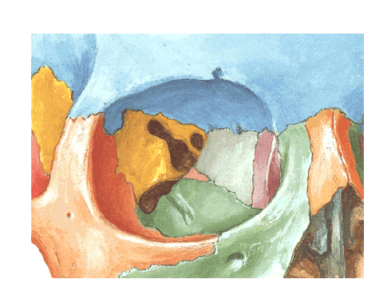
Greater wing
of sphenoid
Lesser wing
of sphenoid
Frontal
Ethmoid
Lacrimal
Frontal
process of
maxilla
Zygoma
Maxilla

Slide 6
Orbital foramina
Optic canal
Optic nerve (II)
Ophthalmic artery
Inferior orbital fissure
Maxillary nerve (V₂)
Infraorbital vessels
Superior orbital fissure
Ophthalmic nerve (V₁), Oculomotor (III), Trochlear (IV), Abducens (VI)
Ophthalmic vessels
Sympathetic fibres

Slide 7
Superior orbital fissure
Optic canal
Inferior orbital fissure

Slide 8
Extrinsic eye muscles: the recti
4 recti muscles
Inferior, superior, medial and lateral
Origin
Common tendinous ring
Insertion
Sclera, 5mm behind corneal margin
Nerve supply
Inferior, superior and medial (III)
Lateral (VI)

Slide 9
Extrinsic eye muscles: the obliques
2 oblique muscles
Inferior and superior
Origin
Inferior: orbital surface of maxilla
Superior: body of sphenoid
Insertion
Inferior: post/inferior quadrant
Superior: posterior/superior quadrant, via trochlea
Nerve supply
Inferior (III), superior (IV)

Slide 10
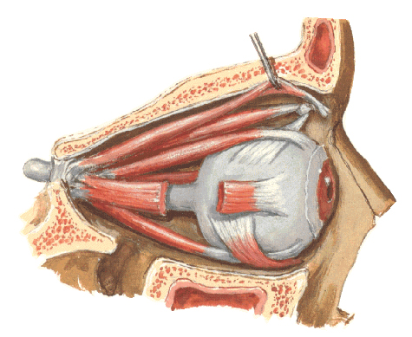
Common
tendinous
ring
Levator palpebrae
superioris
Trochlea
Superior
oblique
Medial
rectus
Superior
rectus
Lateral
rectus
Optic nerve
Inferior
rectus
Inferior
oblique

Slide 11
Levator palpebrae superioris
Muscle of upper eyelid
Origin
Lesser wing of sphenoid
Insertion
Superior tarsal plate and skin of eyelid
Nerve supply
III + sympathetic to smooth muscle

Slide 13
Isolated muscle actions (ANATOMY)
IO
SR
LR
MR
SO
IR

Slide 14
Testing muscle actions (CLINICAL)
SR
IO
LR
MR
IR
SO
Abducted
Adducted

Slide 15
Nerves of the Orbit (1)
Optic
Ganglion cell axons
Oculomotor
Two rami
Motor fibres to MR, SR, IR, IO & LPS
Parasympathetic fibres
Trochlear
Motor fibres to SO
Abducens
Motor fibres to LR

Slide 16
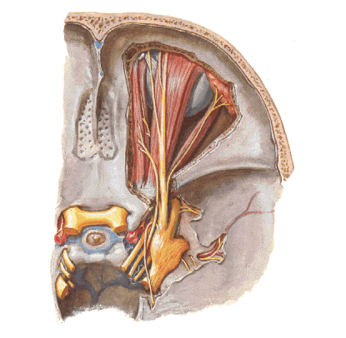
Trochlear (IV)
Lacrimal
Optic (II)
Frontal
Ophthalmic
Division (V1)
Trigeminal
ganglion
Oculomotor (III)
Abducens (VI)

Slide 17
Nerves of the Orbit (2)
Ophthalmic (V₁) branches
Lacrimal
Frontal
supratrochlear
supraorbital
Nasociliary
branch to ciliary ganglion
ethmoidal
infratrochlear

Slide 18
Nerves of the Orbit (3)
Ciliary ganglion
parasympathetic
preganglionic fibres in inferior ramus of oculomotor
postganglionic fibres in short ciliary nerves
sphincter pupillae & ciliary muscle

Slide 19
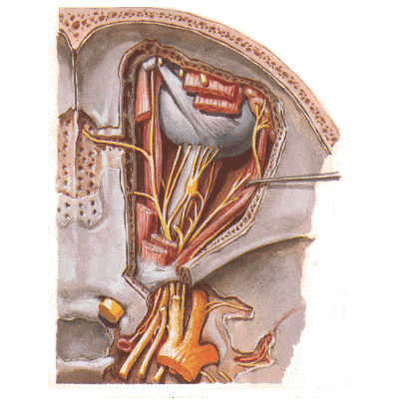
Nasociliary
Ciliary
ganglion

Slide 20
Blood vessels
Ophthalmic artery
central artery of the retina
muscular branches
ciliary
lacrimal
supratrochlear
supraorbital
Ophthalmic veins
superior (cavernous sinus)
inferior (pterygoid plexus)

Slide 21
Lacrimal system
Lacrimal gland
anterolateral superior orbit
parasympathetic secretomotor fibres (CNVII) from pterygopalatine ganglion via zygomaticotemporal and finally lacrimal nerves
Lacrimal sac
Nasolacrimal duct

