Slide 1
Anatomy of the neck
Dr Paul Strutton
Department of Surgery & Cancer
Faculty of Medicine
Friday 26 October 2012

Slide 2
Outline
Neck as a column
Triangles of neck
Root of neck
Lymphatic drainage

Slide 3
Functions of the neck
Structural – support and move head
inside prevertebral fascia
Visceral functions
inside or associated with pretracheal fascia
Conduit for blood vessels & nerves
inside or associated with carotid sheaths

Slide 4
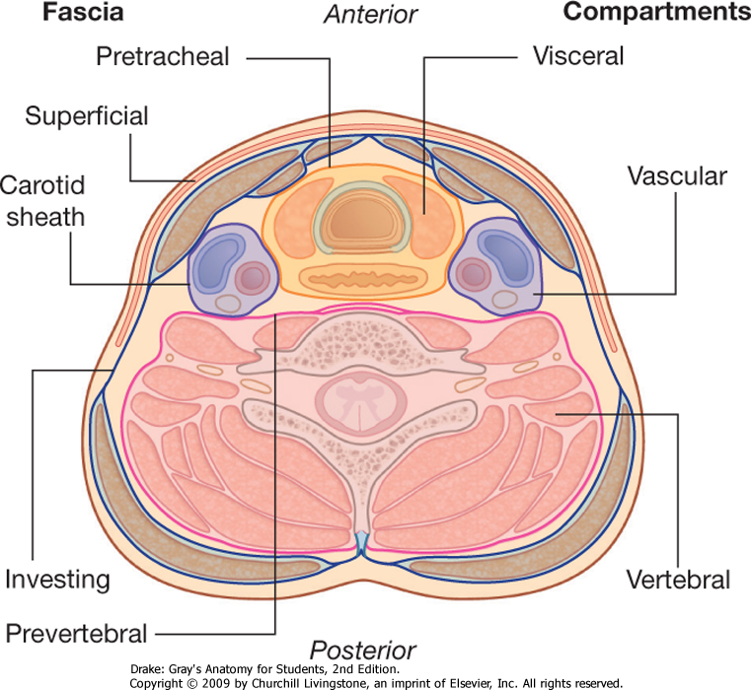
Transverse slice through neck

Slide 5
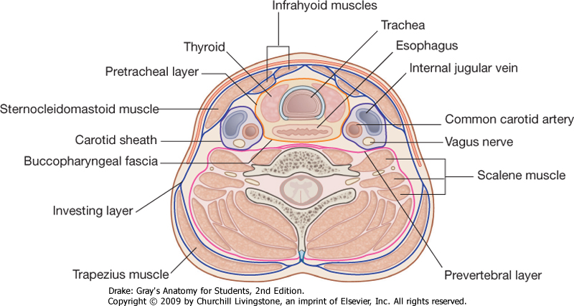
Transverse slice through neck

Slide 6
Levels of neck
C1 open mouth
C2 superior cervical ganglion
C3 body of hyoid
C4 upper border of thyroid cartilage
bifurcation of common carotid artery
C6 cricoid cartilage
middle cervical ganglion
C7 inferior cervical ganglion

Slide 7
Triangles of the neck

Slide 8
Triangles of the neck

Slide 9
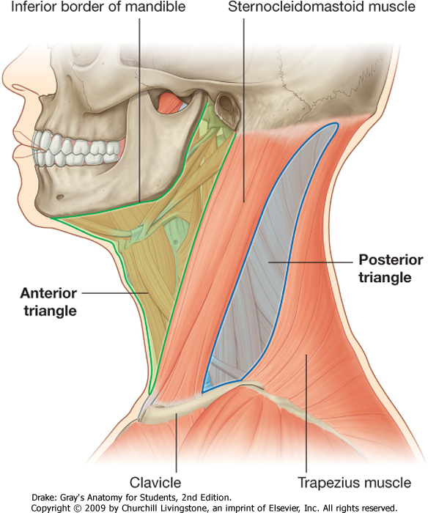
Triangles of the neck

Slide 10
Anterior triangle
Mainly muscles:
Platysma
Mylohyoid
Digastric
Infrahyoid (strap) muscles

Slide 11
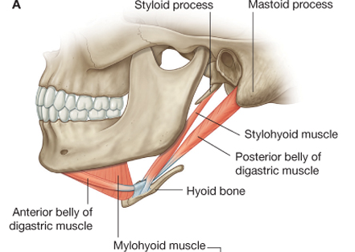
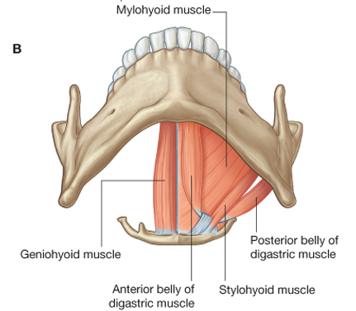
Anterior triangle

Slide 12
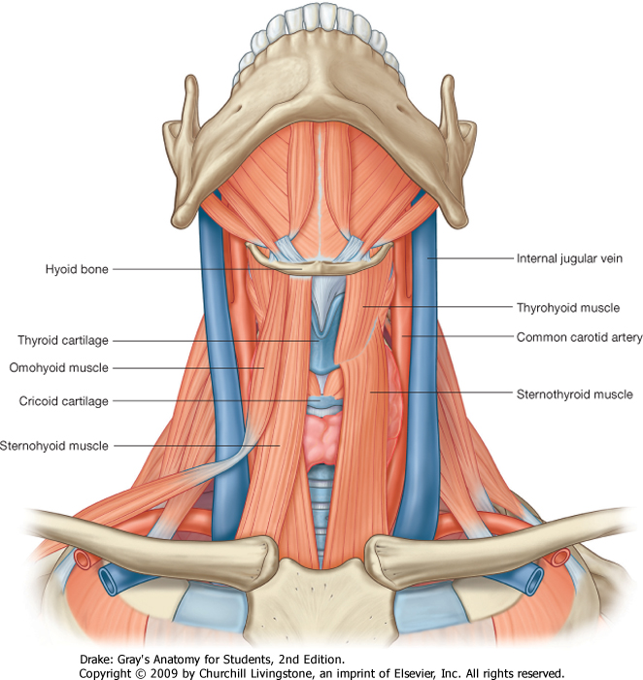
Anterior triangle

Slide 13
Posterior triangle
Mainly blood vessels and nerves:
External jugular vein
Internal jugular vein
Subclavian artery
Subclavian vein
Trunks of the brachial plexus
Phrenic nerve
Vagus nerve
Spinal accessory nerve

Slide 14
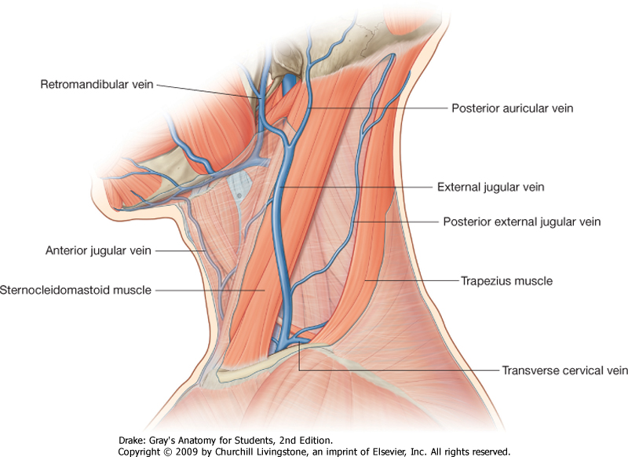
Posterior triangle

Slide 15
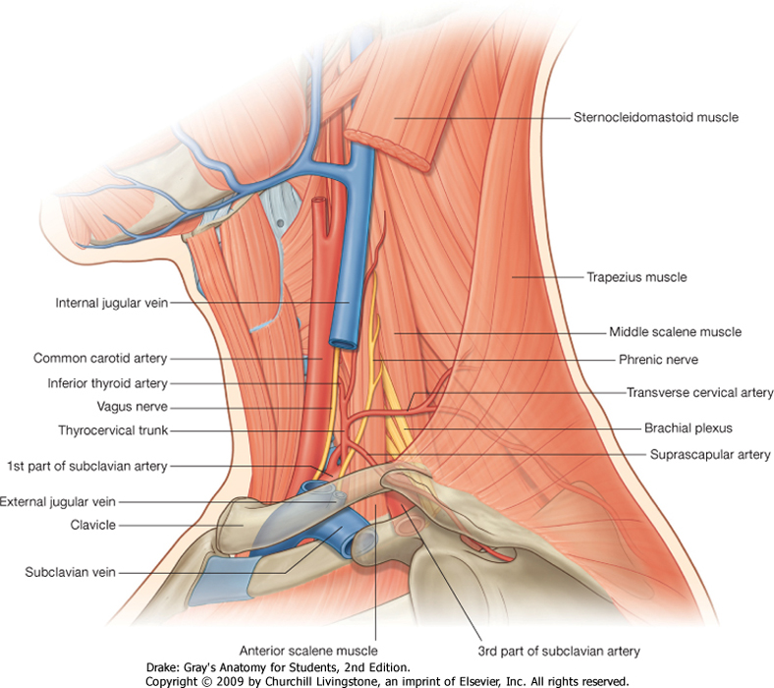
Posterior triangle

Slide 16
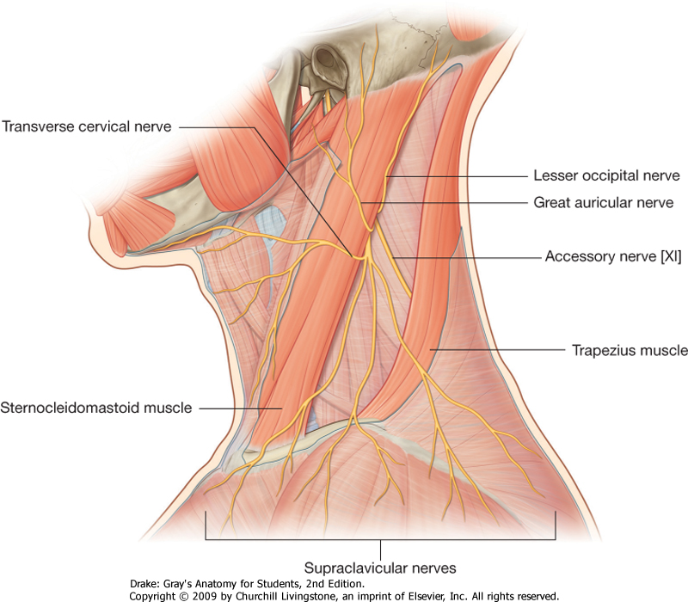
Posterior triangle

Slide 17
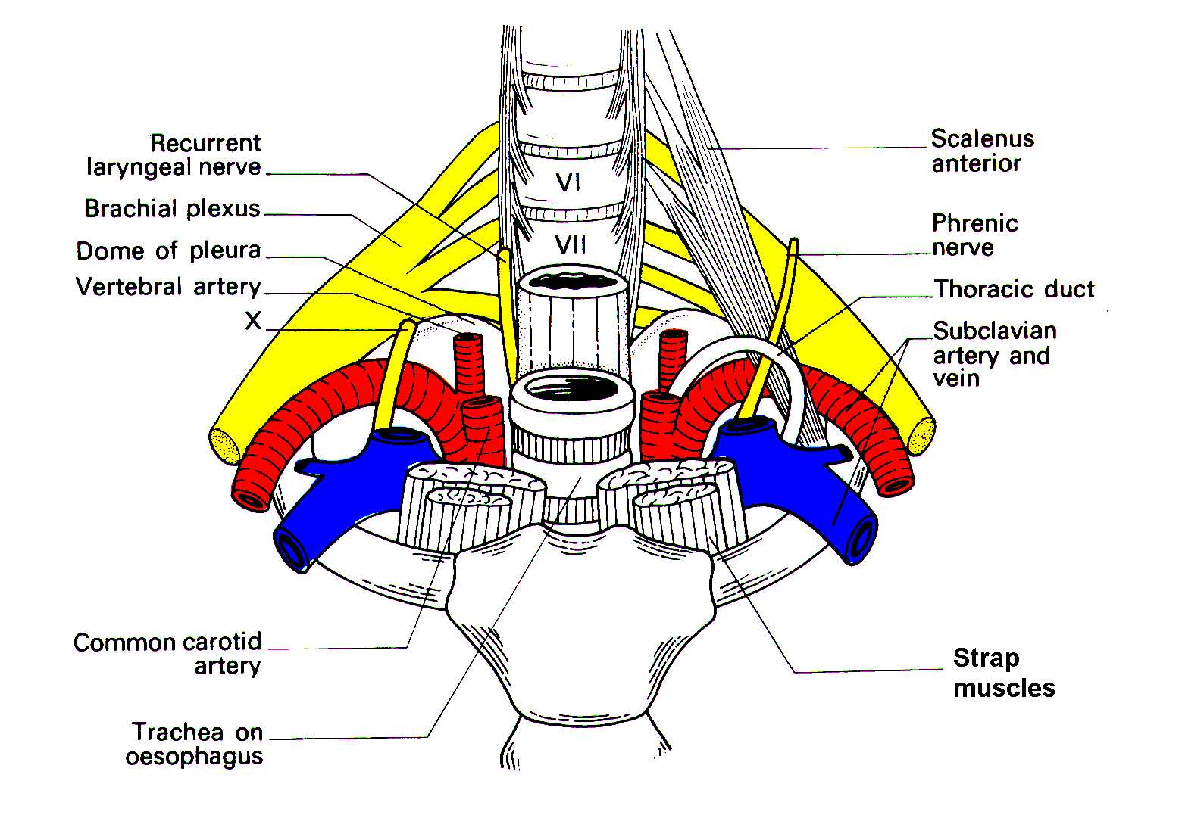
Root of neck

Slide 18
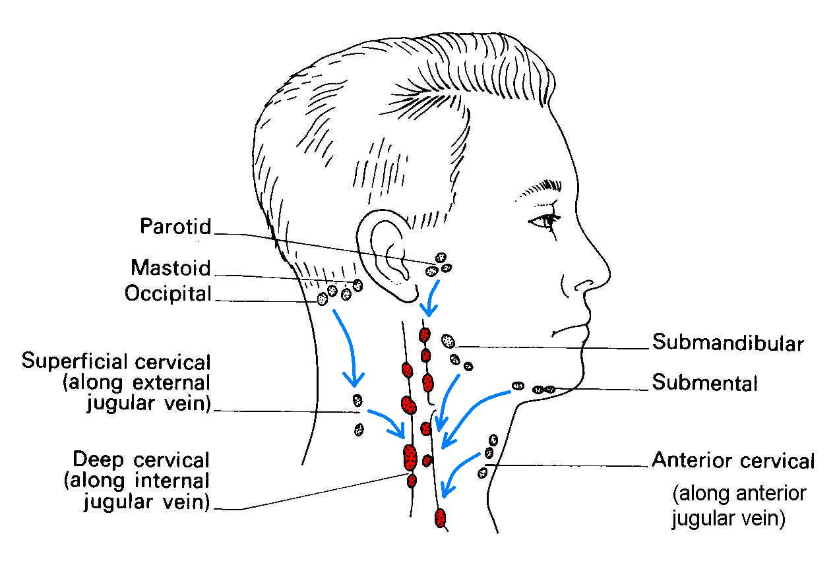
Lymphatic drainage

