Slide 1
The airway and its relations
Dr Paul Strutton
Department of Surgery & Cancer
Faculty of Medicine
Friday 2 November 2012

Slide 2
Outline
Upper respiratory tract
Facial nerve
Larynx
Protection of airway

Slide 3
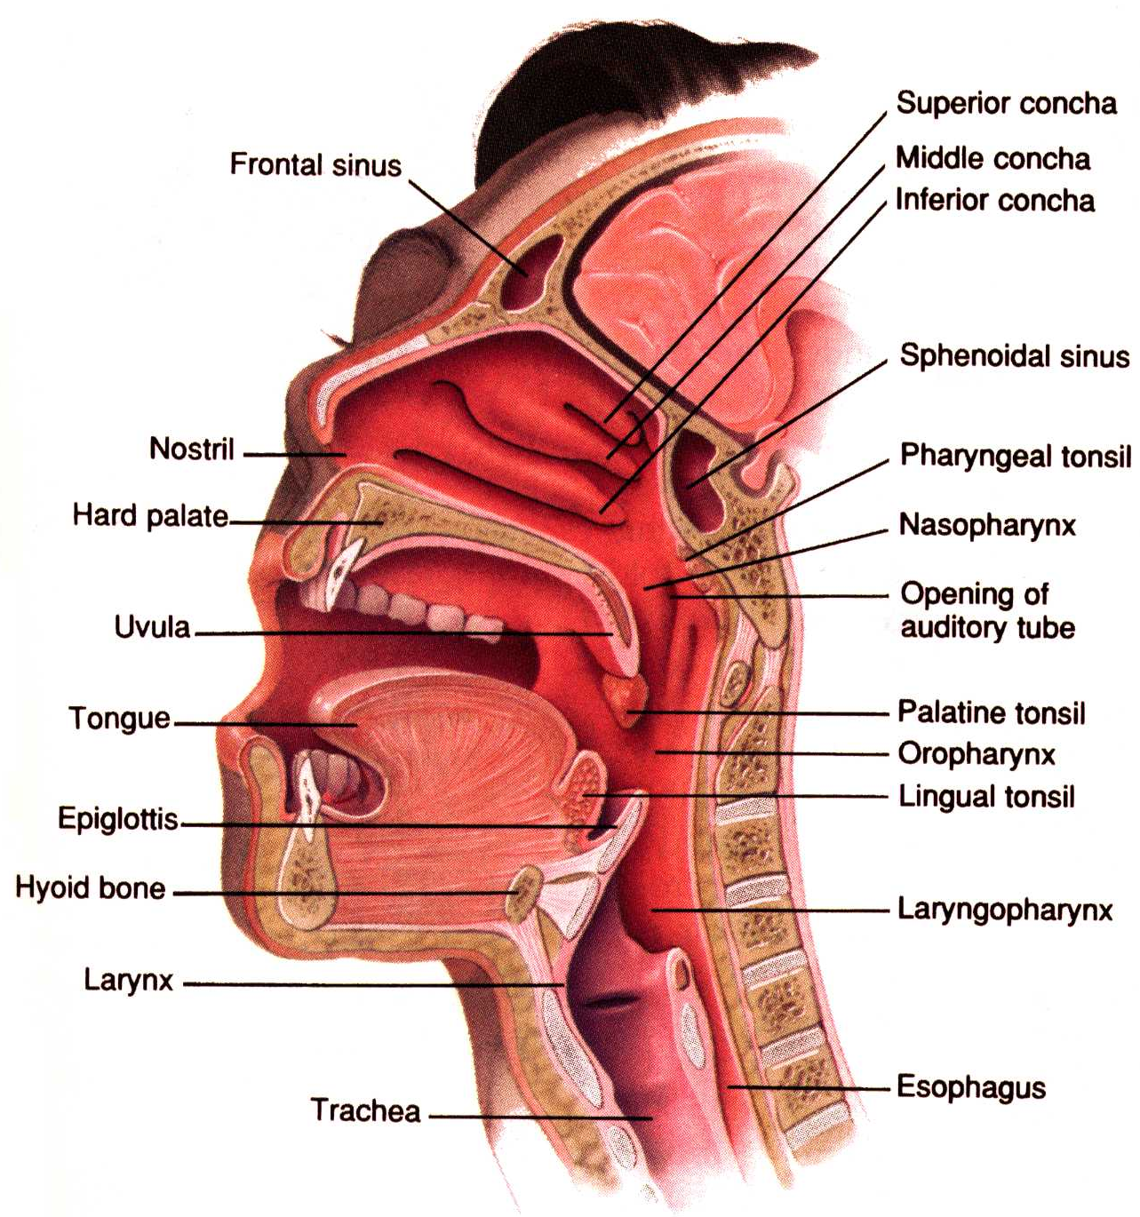

Slide 4
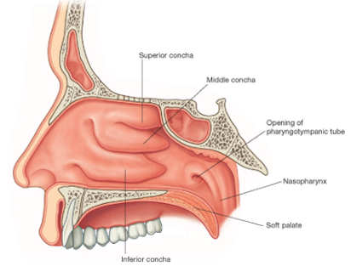
Nasal cavities
Upper part of respiratory tract
Anterior & posterior regions
Contain conchae
Warm and humidify air, help trap pathogens

Slide 5
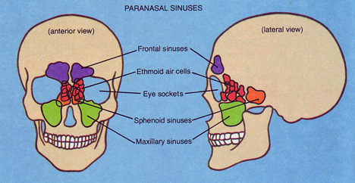
Paranasal sinuses

Slide 6
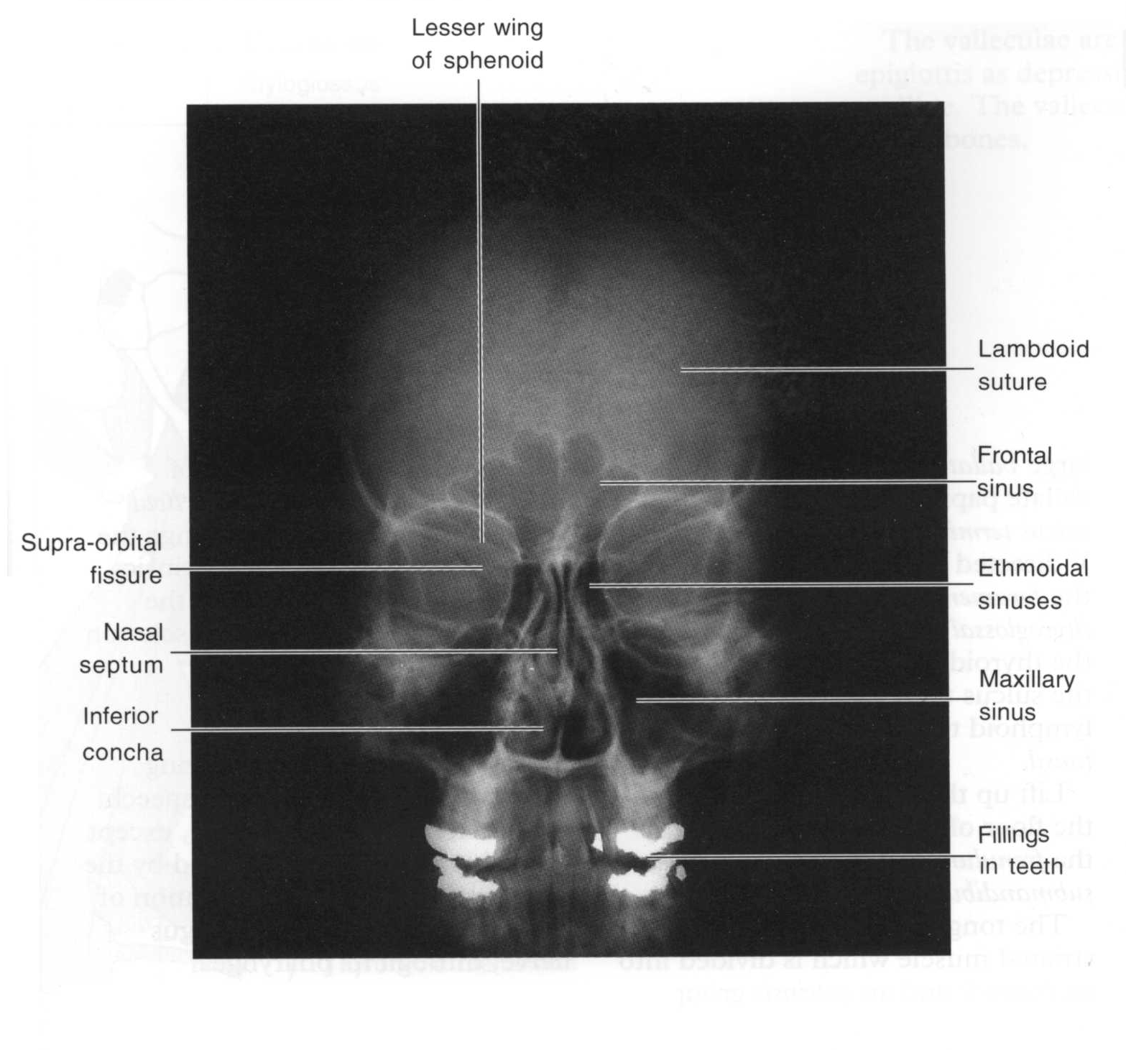

Slide 7
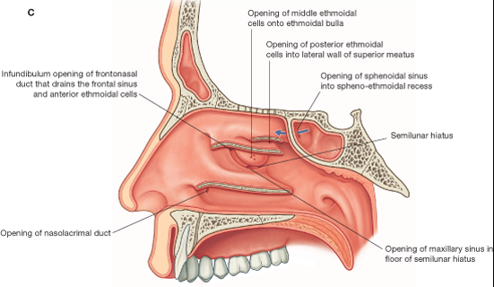
Sinus drainage

Slide 8
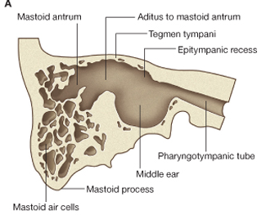
Coronal section through skull base
Middle cranial fossa

Slide 9
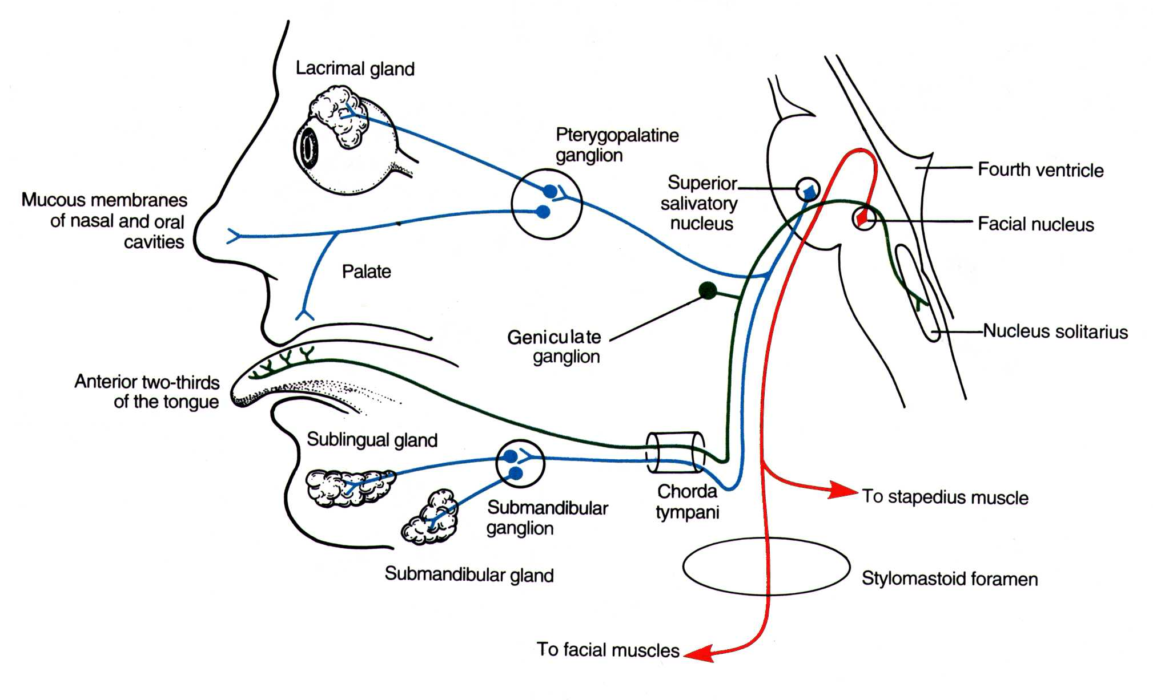
Route of facial nerve

Slide 10
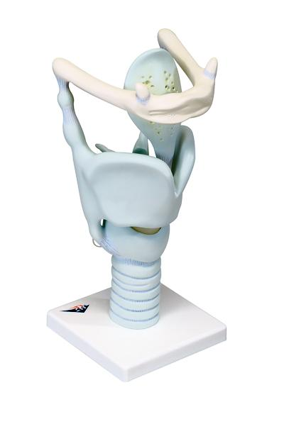
The larynx
Hollow structure
Composed of:
Cartilages
Membrane
Muscles
Acts as a:
Valve
Sound producer

Slide 11
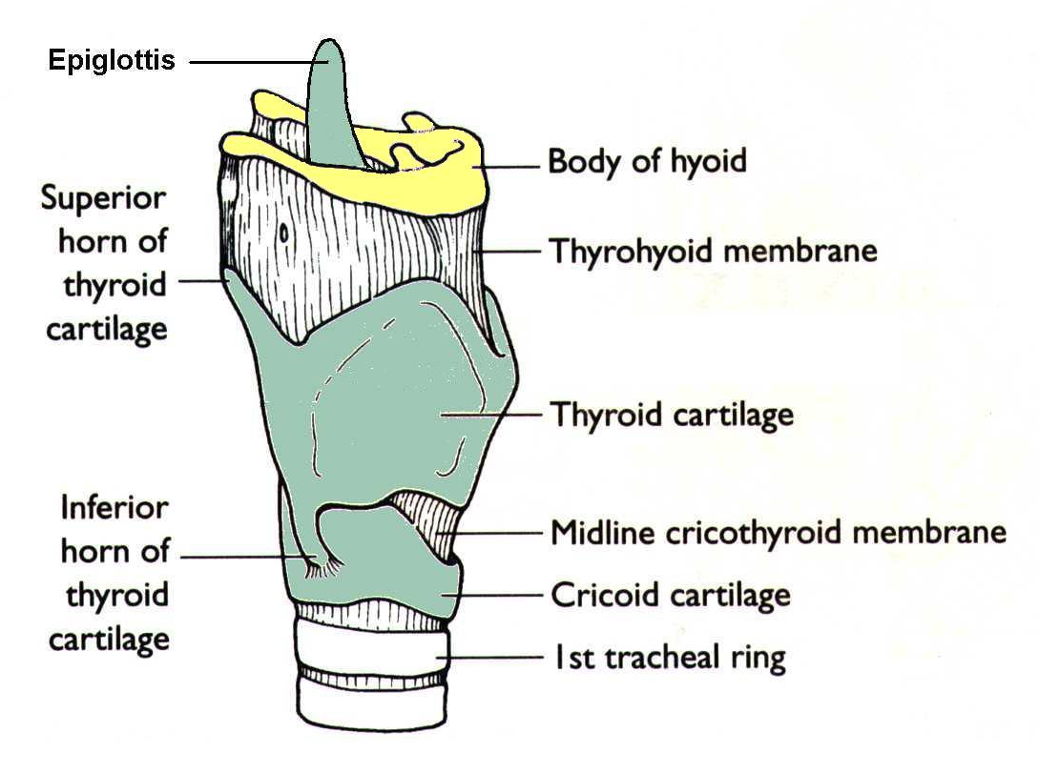
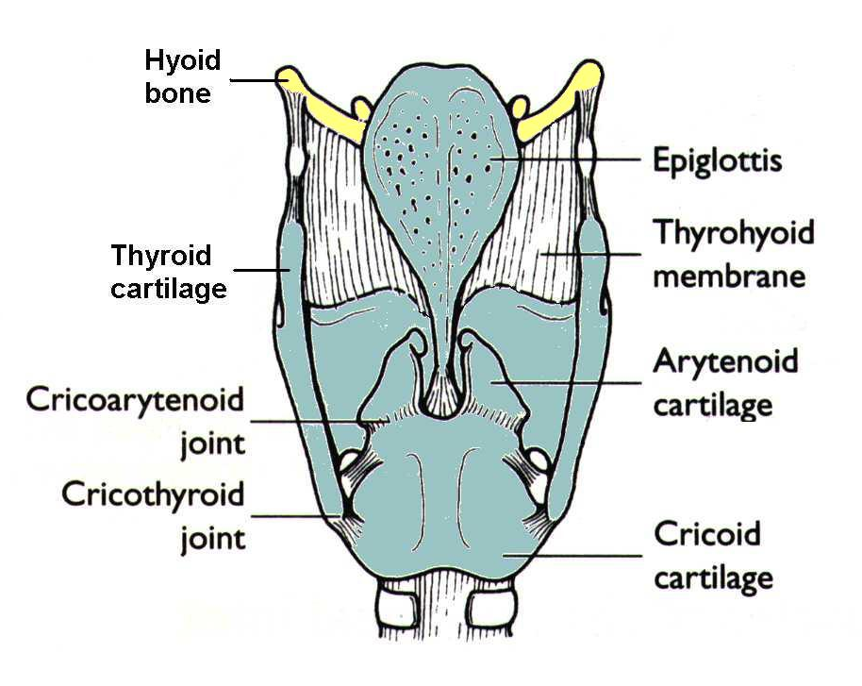
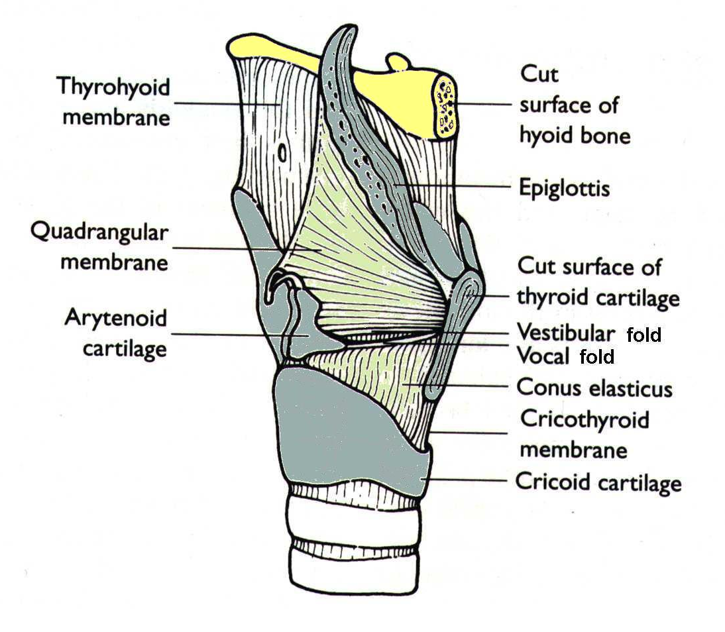

Slide 12
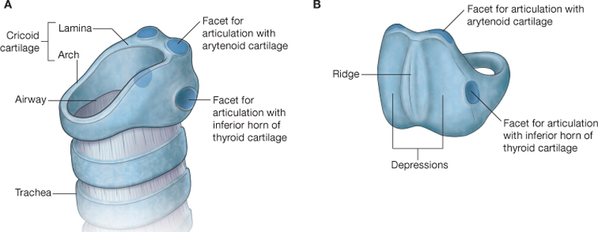
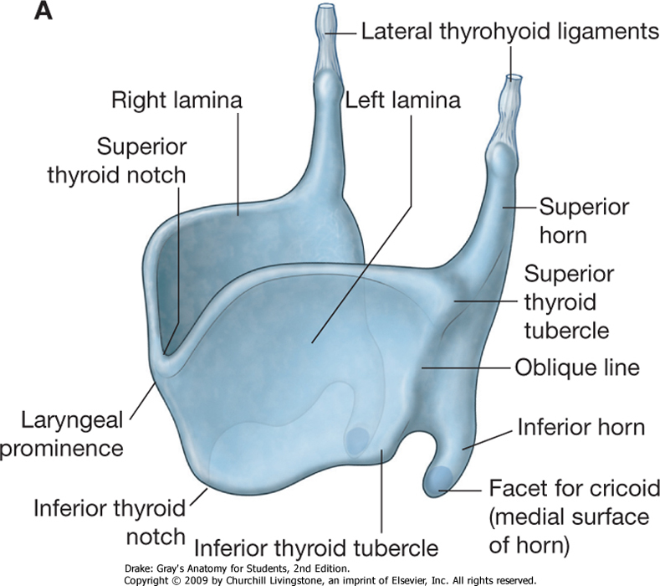
Laryngeal cartilages

Slide 13
Vocal folds

Slide 14
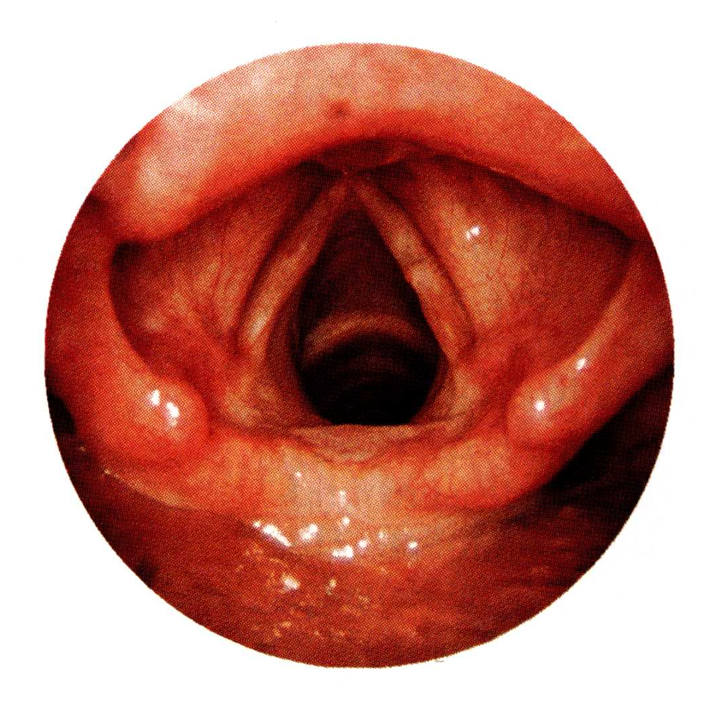
Endoscopic view

Slide 15
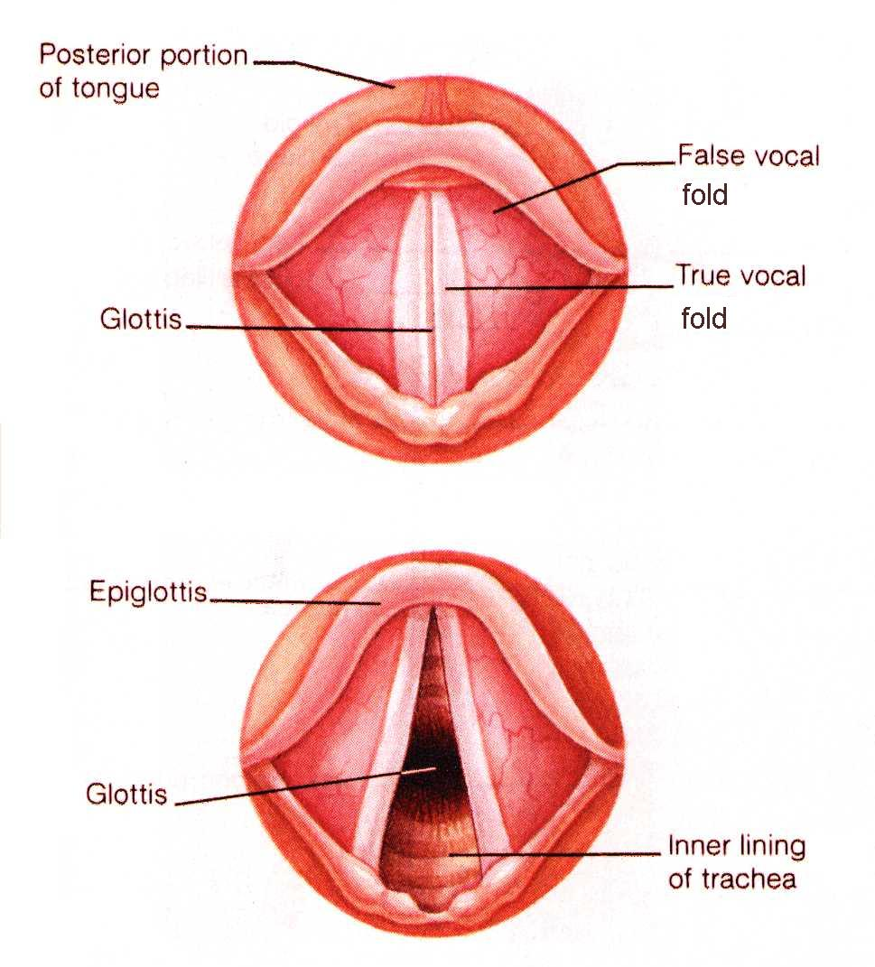

Slide 16
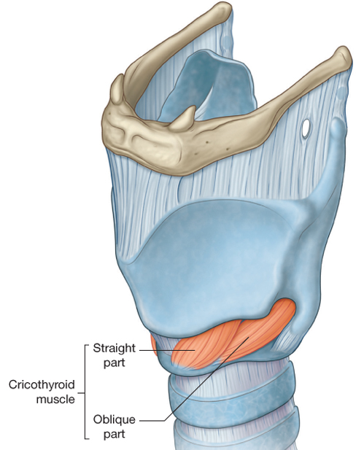
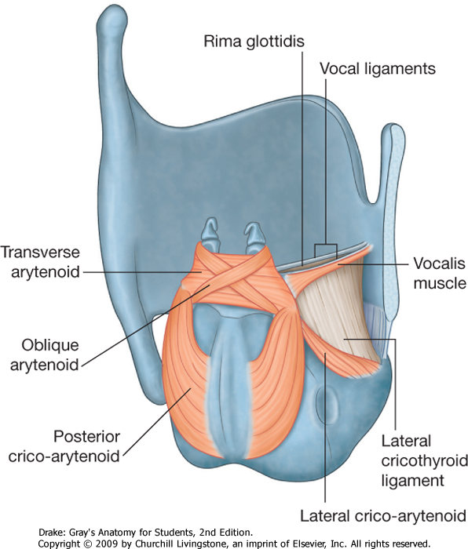
Muscles of the larynx

Slide 17
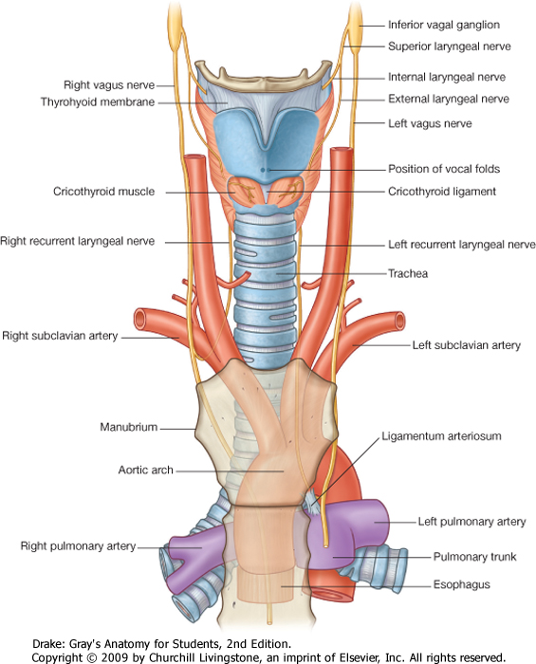

Slide 18
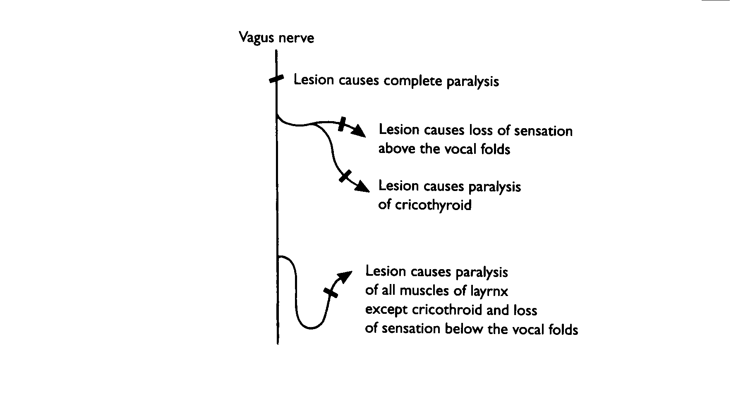

Slide 19
With superior thyroid artery
With inferior thyroid artery
LEFT: bronchial or oesophageal tumour/swollen mediastinal lymph nodes

Slide 20
Protective mechanisms for airway
Swallowing
Gag reflex
Sneezing
Coughing

Slide 21
SNEEZING
COUGHING
Afferents via V₂
Afferents via X
Inspiration
Intrathoracic pressure raised
(glottis closed, abdominal muscles contracted)
Soft palate raised and tensed against posterior wall of pharynx. (Levator veli palatini (X), tensor veli palatini (V₃), sup. Constrictor (X))
Soft palate depressed against tongue
(palatopharyngeus/palatoglossus (X))
Sudden abduction of vocal folds to release intrathoracic pressure through nose or mouth

Slide 22
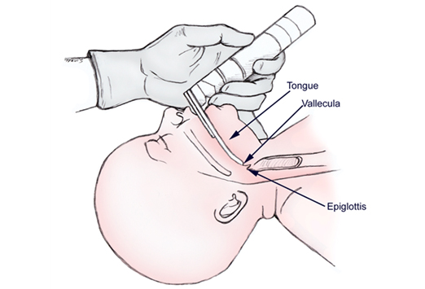
Management of airway
Chin lift/ jaw thrust
Oropharyngeal or nasopharyngeal airway
Endotracheal intubation
Cricothyroidotomy
Tracheostomy

