Slide 1
History-taking - Session 3
AKA
“Alcohol , drugs and sex”
Dr Joanne Harris
General Practitioner
Notes:
Welcome to this third session in the second year communication skills course.
You have now had the first session with the introduction to the content of the history
You have all interviewed a simulated patient and this is now the last session before your ward placement

Slide 2
The social history
Aims of this session:-
To discuss the ways to elicit the more sensitive areas of history taking
To suggest questions you can use to elicit this information
To discuss when it is appropriate to ask these questions
To observe a doctor taking a social history
Notes:
The idea of this session is to talk in more detail about how to ask some of the more sensitive questions in a history.
Some people in the SP sessions felt they did not have the skills to do this and embarassment was mentioned.
Remember that the consent that you all ask ( and sometimes rush through )at the start of the interview allows you to ask the pt these questions. They know they are not going to have a casual chat similar to one with their friends or work colleagues. So you may find the pt more ready to share things with you than you expect.
I will be taking a social history form this very difficult pt we have in today and hopefully demonstrating some of the points I will be making

Slide 3
Aspects of the social history
Alcohol
Smoking
Recreational drugs
Diet
Sexual history
Notes:
These are the main points we will be covering, alcohol and smoking that many of you did ask in the SP interviews and you need to ask ALL your pt, recreational drugs and diet that you may need to ask your patients and sexual history which I have Added into this lecture after last years lecture when about 10 people came down to the front afterwards and whispered “do we have to take a sexual history??” I think this was triggered by the HIV case that often comes up in the SP interviews

Slide 4
Other aspects of social history
Occupation (“Do you work?” Not “what’s your job?”)
Living arrangements ( Who’s at home)
Level of stress ( Do you enjoy your job?)
Exercise
Travel abroad
Pets
Notes:
These are additional points in the interview that we will not be covering in any depth but are part of a detailed social history
Remember what you are aiming to gain with a social history is how their lifestyle may be causing of affecting their illness and how their illness may curtail or cause problems for their lifestyle
So you want to know about occupation and my personal preference is to ask this in the SH if it hasn’t already come up in the HPC. I feel that name age and occupation is a bit like mastermind and can be a bit stark. The job can be a problem and people may not be ready to open up to you until you have developed some rapport.
We are going to talk some more about keeping questions open but remember don’t say what’s your job , they may not have one. And don’t be ageist . Even the elderly may be working, I have heard students say, what did you used to do or are you retired? And this very elderly man used to collect the trolleys in waitrose
Living arrangements again keeping questions open. These days people are as likely to have new partners and the partners children and their children and maybe a lodger.
Again keep the question open. Whose at home will cover every eventuality.
Level of stress – which is invariable related to the above two details, so its worth checking, people may say my job is incredibly busy, but I love being busy its not a problem for me
Exercise you may want to ask about how sedentary or fit they are to get more clues about their lifestyle
And sometimes it may be relevant to ask about travel abroad, such as diarrhoea type illness or pet ownership in for example allergies

Slide 5
Watch this demonstration
Notes:
Lets discuss what was happening here

Slide 6
Some general points
Do not be judgemental
“Do you drink alcohol?” NOT “Do you drink much?”
Keep the questions open
“Who’s at home with you” NOT “Are you married?”
Consider signposting
“ Would it be alright if I ask some questions about…”
“I hope you don’t mind me asking…”
But be careful of “ We ask all our patients this…”
Notes:
For some general points about taking this history
Do not be judgmental. Either good or bad, one student in the SP interviews said excellent when the pt said they didn’t drink alcohol. Is it excellent I’m not sure. I do reserve unqualified praise for the people who have managed to give up smoking.
I have a elderly gentleman who is an expert patient he comes to all my year 3 teaching and has a first year pair every year and I heard a student say “are you married at the moment” In fact his wife dies about 10 years ago and he rarely sees his sons and he is quite lonely and I could see his face falling at the question.
Consider signposting your sensitive questions, but be careful not to over use it., many students find all questions embarassing , so you cannot keep aying I hope you don’t mind me asking about your bowels or what your parents died of
And do be careful of we ask all our patients this. It usually gets trotted out when asking about recreational drugs or later on in your students career when talking to mental health patients. And a0 its usually not true and it sounds invariably false
In the body of the lecture I have tried to highlight things you should be asking everybody and things you should only ask certain groups and who they might be

Slide 7
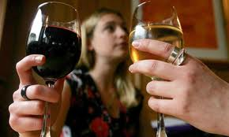
Alcohol

Slide 8
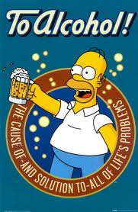

Slide 9
Alcohol
Who to ask? – everyone
Do you drink alcohol?
How much would you say in an average week (or per day?)
Is that every week/day?
Suggest a range “ Would that be 1-2 pints or 5-6?”
Ask separately about wine, beer and spirits
Better not to ask patients the number of UNITS they drink
Notes:
May need to move to per day with very heavy daily drinkers
Try to get a feeling of how often they drink this amount, may be just Fri/ Sat night, may be 5 nights per week
Suggest a range with a higher upper limit to show you are not shocked to hear they are drinking large amounts
Don’t forget to ask about other types of alcohol, You may get a very clear picture of 4 pints Fri and Sat and 2 pints a night during rest of the wek unless he goes out with his mates, butwill completely miss the whiskey that he pours himself before bed every night.
Be careful when talking to pts about units. Some pts will be very experienced with units. I had a pts last week when I asked how much he drank said 40 units per week, end of story as if closing the conversation and I ahd to delve into his pattern of pnts and vodka shots and I made a guessimate of nearere 60 per week

Slide 10
Alcohol - units
Patients find units hard to quantify - you may need to do this for them
Classically 1 unit = a glass wine, half pint beer, one measure spirits
BUT alcohol is becoming stronger and units often much higher
Units = alcohol by volume(ABV) x volume in ml.
1000
A small glass of 12.0% wine = 12 x 125 = 1.5 units
1000
But a large glass (250 ml) of 14% wine = 3.5 units
A pint of strong beer = 2.8 units

Slide 11
Alcohol – recommendations
Women < 14 units/week
Men < 21 units/week
Equivalent to:-
Women : 2-3 units per day
Men: 3-4 units per day
Recent evidence these guidelines “encourage” daily drinking?
What about “binge drinking”? ( drinking more than double the daily recommended amount)
For more information:- www.drinkaware.co.uk
Notes:
Evidence that problem drinkers are divided into the middle class daily drinkers who drink at home gradually drinking more and more and not realizing the effect on their health and the fri/ sat binge drinkers who cause huge health problems because they have accidents and end up in casualty and cause alcohol related crime, 20-40% of attendees at casualty are intoxicated

Slide 12
Alcohol- screening tools
Who to ask? - everyone
FAST – Fast Alcohol Screening Test
“ How often have you had EIGHT or more ( SIX or more for women) drinks on one occasion in the past year?”
Can classify more than 50% of people with one question.
High sensitivity and specificity
Score three or more for hazardous drinking
Audit-C
Similar screening tool asking about alcohol consumption in past year

Slide 13
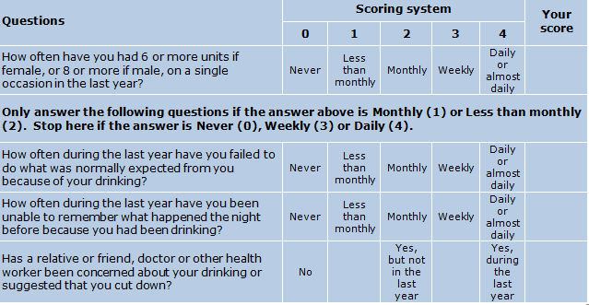
FAST

Slide 14
Alcohol- tools to assess misuse
Who to ask? - alcohol problem drinkers
CoNTROL
Can you always Control your drinking?
Has alcohol ever led you to Neglect your family or work?
What Time do you start drinking? Do you ever start before this?
Do friends comment on how much you drink or ask you to Reduce intake
Do you ever drink in the morning to Overcome a hangover
Go through an average days alcohol Leaving nothing out
CAGE ( prob less useful, low sensitivity)
Have you ever been advised to Cut down on your drinking?
Have you ever been Annoyed by people suggesting you drink less?
Have you ever felt Guilty about the amount you drink?
Do you ever have an Eye opener ( drink first thing in the morning)?

Slide 15
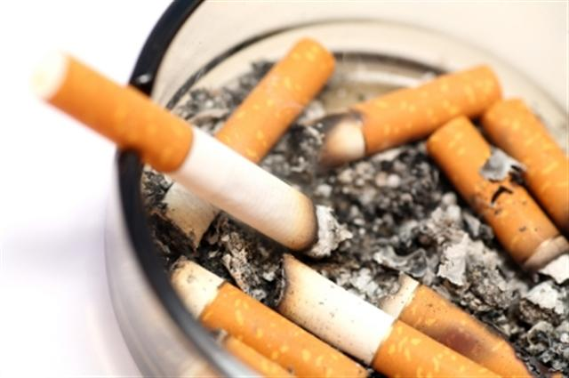
Smoking

Slide 16
Tobacco use
Who to ask ? – everyone
Do you smoke?
Have you ever smoked?
How many a day (or amount tobacco) do you smoke?
Have you always smoked this amount?
When did you begin smoking?
You can then assess an amount in terms of pack years e.g. if they smoke 10 per day( i.e. half a pack) for 20 years this is 10 pack years

Slide 17
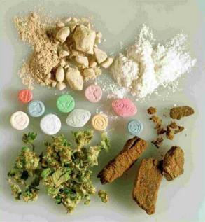
Recreational drugs

Slide 18
Drug Use
Can be as part of medication history or social history
D Doctor
R Recreational
U User – over the counter, alternative medicines
G Gynaecological pill or contraceptive patch
S Sensitivities – allergy or intolerance?
Notes:
This is an example of a mnemonic where it s used as part of the drug history . Personally I prefer to ask it as part of the social history. I think it fits better with drugs and smoking

Slide 19
Recreational drug use
Who to ask? - heavy drinkers, smokers, people who are stressed, tired or have mental health problems or unexplained symptoms
Becoming more common (25% of 16-29 year olds in England in a 2005 survey have tried Class A drugs)
Use of the term “recreational” less judgemental than “illicit” or “street”
e.g. “And do you mind me asking have you ever used recreational drugs?
What do you do with the information?
Is there a legal implication?
Notes:
In one of our large group sessions we had “do you do drugs”
When its appropraite you must ask. I had a young patient in the surgery who had come in three time with a chronic cough, and everyone had said its justa virus it will get better, but I asked him about recreational drugs and it turned out he has smoked some cannabis a few montsh before and was terrified he’s ruined his lungs
So the patient now says that he is using recreational dugs. What do you do with the information? They have just told you something illegal. Its one thing to be non judgmental about drinking and smoking but they may be taking cocaine 3 times per week

Slide 20
Recreational drugs
Class A
Heroin, ecstacy, LSD, cocaine and crack cocaine
( cocaine 3.2% adults)
Class B
Amphetamines , barbiturates, cannabis
(cannabis 6.8% of adults in past year – Statistics on Drug Misuse 2011)
Class C
Inhalants, Valium, GHB, ketamine
(ketamine 69% of UK clubbers 2009)
Notes:
Lifetime prevalence of cannabis about 45%

Slide 21
Recreational drugs – street names
Weed
Blunt
Grass
Herb
Pot
Reefer
Puff
Mary Jane
Skunk
Boom
Gangster
Kiff
Chronic
Ganja
Purple Haze
Dope
Nederweed
E
XTC
Adam
Hug
Beans
Clarity
Lover’s Speed
Love Drug
Speed
Meth
Crank
Tweak
Go-fast
Ice
Glass
Tina
Quartz
Poppers
Whippets
Laughing Gas
Rush
Horse
Skag
Smack
H
Junk
Brown Sugar
Coke
Flake
Rocks
Charlie
Uppers Downers
Kit Kat
Special K
Notes:
Be careful not to get into the street lingo with pts, we had Do you do drugs, you wont be able to keep up with the variety of names
I had a patient who when I asked how he was said he had been doing a bit of Charlie lately and I had to say and what is Charlie

Slide 22
Recreational drugs – further information
www.nhs.uk/Livewell/drugs - videos about effects of substance abuse
www.drugscope.org.uk – statistics and government reports
www.homeoffice.gov.uk/drugs - legal information
Notes:
Again if you know nothing about drugs then there are some good websites to look at.
The NHS site has videoes a bit like health talk online of how it has affected people.
Drugscope gives all the latest statistics and reports and you can see latests trends
And home office website for the legal information

Slide 23
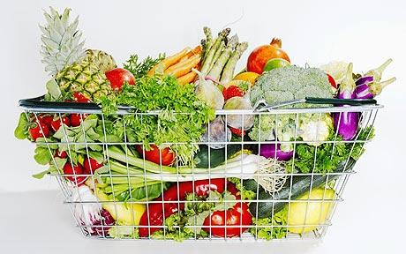
Diet

Slide 24
Taking a dietary history
Who to ask?
Could screen everyone but especially :-
People with illnesses known to be related to diet e.g heart disease, diabetes, stomach ulcers
People who look markedly over or underweight
Where exclusion diets may affect their illness e.g vegans in anaemia

Slide 25
Key screening questions about diet
Be careful of “Can I ask about your diet” – may be jargon to some patients
Can I ask you about your weight?
Do you have any concerns over your weight?
Can you take me through a typical day’s food and drink
Do you eat a special diet for any reason?
Notes:
Be careful of using the word diet, maybe jargon, we had an sp who was a farmer who said Ooh I’m not on a diet love

Slide 26
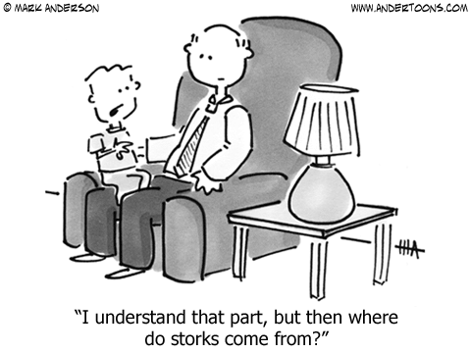
Sexual history

Slide 27
Taking a sexual history
Who to ask? – not many patients in 2nd or 3rd year!
A full sexual history is covered in the genito–urinary medicine attachment in year 5
This is a set formulaic history that you are unlikely to need at present
However - It may be appropriate to ask a patient about their sexuality if it is relevant in the history
e.g. “ Do you mind me asking, is your partner a man or woman?”
Notes:
Having said that if a patient mentions sex, such as chest pain that comes on during sex, its not a taboo subject
I want to tell you about how I fell flat on my face hen I was seeing a woman with period problems and I asked her what contraception she was using, none, was her partner using contraception, no, as she trying to get pregnant , no, My partner is a woman…
Similarly, I saw a man with rectal bleeding who was very camp and was his partner a man and had he been having anal intercourse

Slide 28
Further demonstration

Slide 29
Questions about the social history?

Slide 30
Reflect on the aims
You should now be able to:
Use a range of questions to explore aspects of social history in a non-judgemental way particularly focussing on:-
Alcohol
Smoking
Recreational drug use
Diet
Sexual history

