Slide 1
Viral evasion of the host immune response
Wendy Barclay
w.barclay@imperial.ac.uk

Slide 2
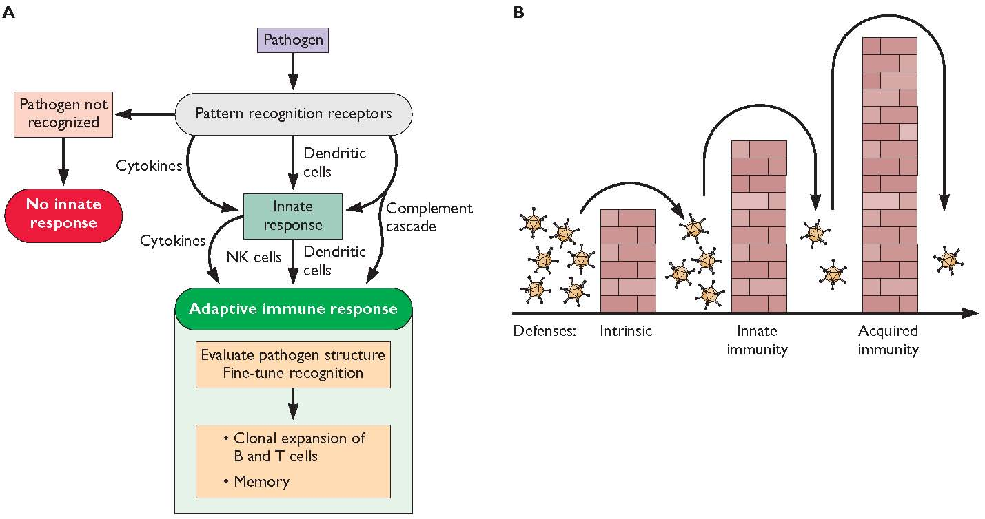
Pathogen sensing

Slide 3
Definitions
Pathogen Associated Molecular Patterns, PAMPs
Pattern Recognition Receptors, PRRs
Often sense foreign RNA
Cytoplasmic RIG-I like receptors RLRs, endosomal Toll like receptors TLRs
Cytoplasmic nucleotide oligomerization domain receptors NLRs

Slide 4
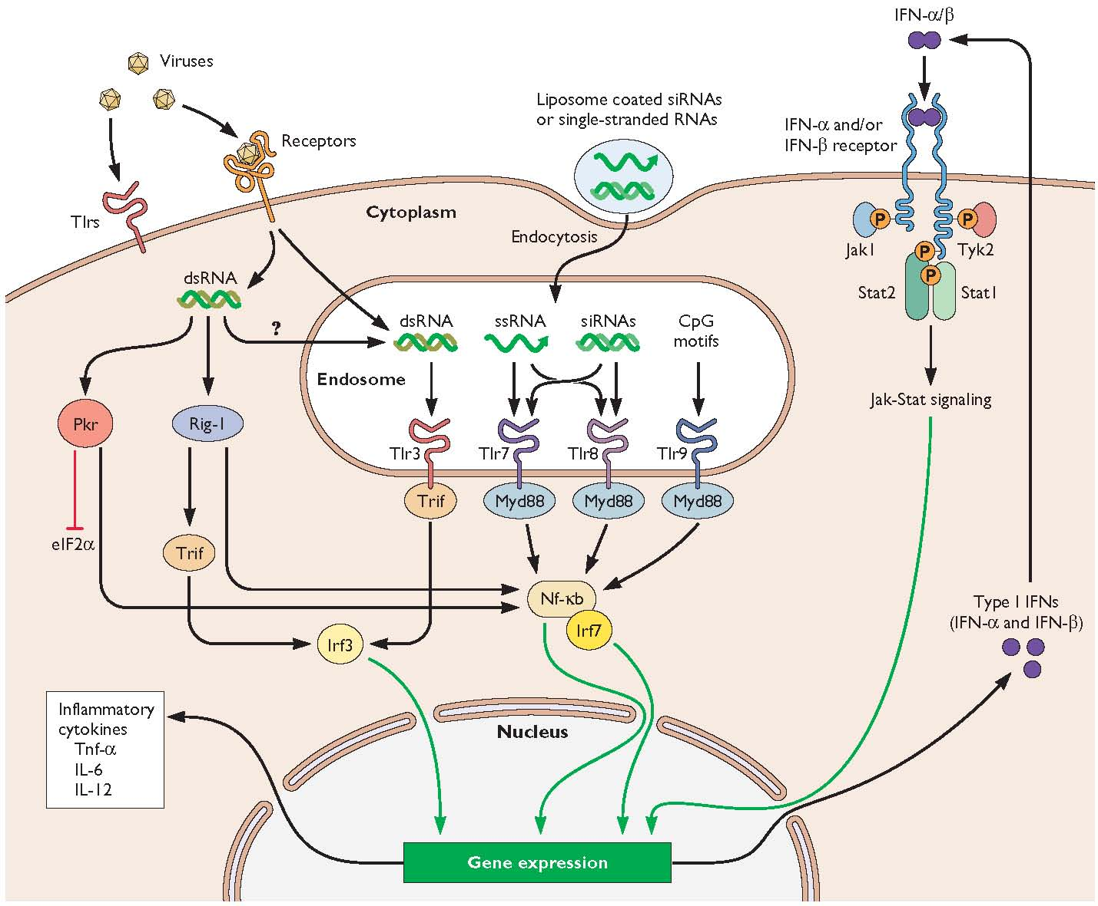
TLRs and cytoplasmic sensors of virus infection

Slide 5
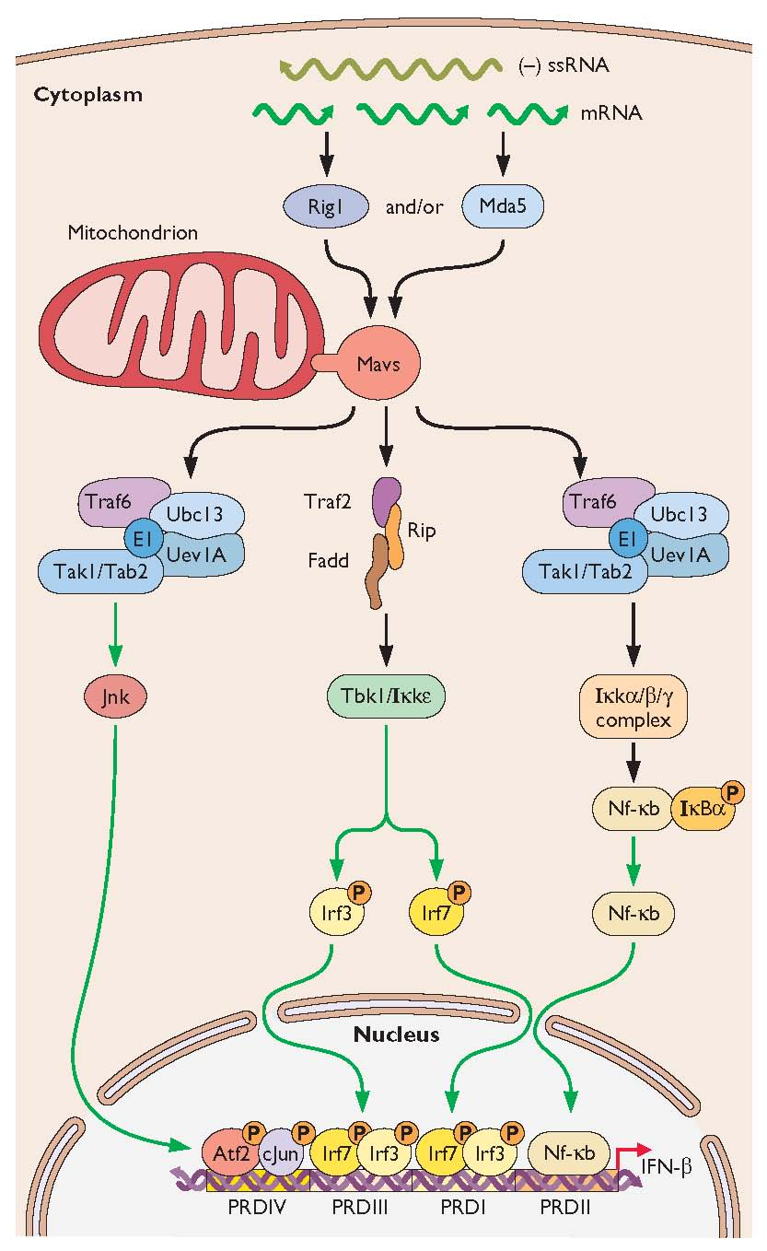
Interferon induction

Slide 6
Interferon
Discovered more than 50 years ago by Isaacs and Lindenmann
A transferable factor produced by exposure of eggs to heat inactivated influenza virus that protected new cells from infection.
Binds to specific receptors and signals activation of de novo transcription of hundreds of Interferon Stimulated Genes, ISGs

Slide 7
IFN is a soluble cytokine
IFN-β
IFN-β
IFN-β
IFN-β
Antiviral signals
IFN-β
IFN-β
promoter
IFN-β
IS genes
Cell 1
Cell 2

Slide 8
Type I, II and III interferons
Type I IFNs are IFN α and IFN β.
Secreted by all cells and IFNAR receptor is present on all tissues.
Plasmacytoid dendritic cells pdcs are specialist IFN secreting cells.
IFN β made first, many variants of IFNα.
Type II IFN is IFNγ.
Signals through a different receptor IFNGR.
Type III IFN is IFNλ.
Signals through receptors IL28R that are only present on epithelial surfaces.

Slide 9
Interferon as a master regulator of the immune response.

Slide 10
Signalling in response to IFN
IFN-β
IFN-β
Jak1
Tyk2
Jak1
Tyk2
STAT1
P
STAT2
STAT2
P
STAT1
cytoplasm
STAT1
P
nucleus
“ISGF3”
p48
STAT2
P
ISRE
IS gene
ISRE
= Interferon Stimulated Response Element

Slide 11
Interferon stimulated genes
PKR
2’5’OAS
Mx
ISG15, ISG54, ISG56
PML bodies
APOBECs and TRIMs
ADAR
Viperin
miRNAs
Apoptosis
Cell cycle arrest

Slide 12
The antiviral mediators:
1. PKR (protein kinase R)
N-terminal of the kinase binds dsRNA
Leads to activation of PKR
Thus dimerisation and autophosphorylation on Thr and Ser residues
PKR
P
PKR
PKR
P

Slide 13
The antiviral mediators:
1. PKR (protein kinase R)
A. Phosphorylates the α subunit of eIF2 and preventing translation
eIF2α
PKR
P
P
eIF2α
PKR
P
IKKβ
B. Activates IKKβ leading to release of NFκB.
NFκB is very important transcription factor for antiviral response!
NF-κB
IκB
NF-κB
IκB

Slide 14
Antiviral mediators:
2. 2’-5’ oligoadenylate synthetase
Induces the formation of an unusual form of ATP
This activates RNase L
RNase L cleaves ssRNA eg. mRNAs and prevents protein synthesis
A very local effect since 2’5’A is highly labile
RNase L
X
Protein

Slide 15
Antiviral mediators:
3. Mx
GTPase with homology to dynamin
Inhibits transcription of RNA especially for orthomyxoviridae (Mx1 in mice) and other negative strand RNA viruses (human MxA)
Mx can form multimers which wrap around the nucleocapsids of incoming viruses.

Slide 16
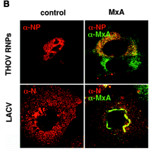
Mx binds to viral components and blocks their intracellular transport
Engelhardt et al.

Slide 17
APOBEC3G
Aka CEM-15
Apolipoprotein B mRNA-editing enzyme catalytic polypeptide like 3G
Human host cell protein
Involved in innate immune resistance to retroviruses and hepadnaviruses
Deaminates dC to dU in minus strand viral cDNA during reverse transription
Results in G to A hypermutation

Slide 18
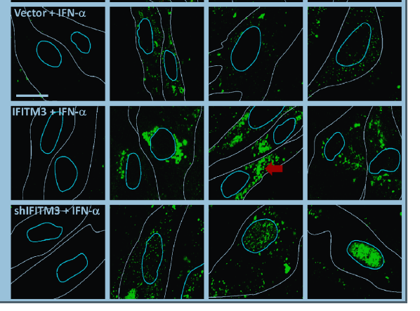
IFITM3 inhibits influenza virus entry
Feeley et al. PLOsPath2011

Slide 19
Antiviral state does not last
IFN response may only be maintained for several hours
Subsequently the ability to response to IFN is lost due to negative regulation
SOCS suppressor of cytokine signalling genes turn off the response.

Slide 20
Viral evasion of IFN response
Avoid detection by hiding the PAMP
Interfere globally with host cell gene expression and/or protein synthesis
Block IFN induction cascades by destroying or binding
Inhibit IFN signalling
Block the action of individual IFN induced antiviral enzymes
Activate SOCS
Replication strategy that is insensitive to IFN

Slide 21
Pathogen associated molecular patterns PAMPS

Slide 22
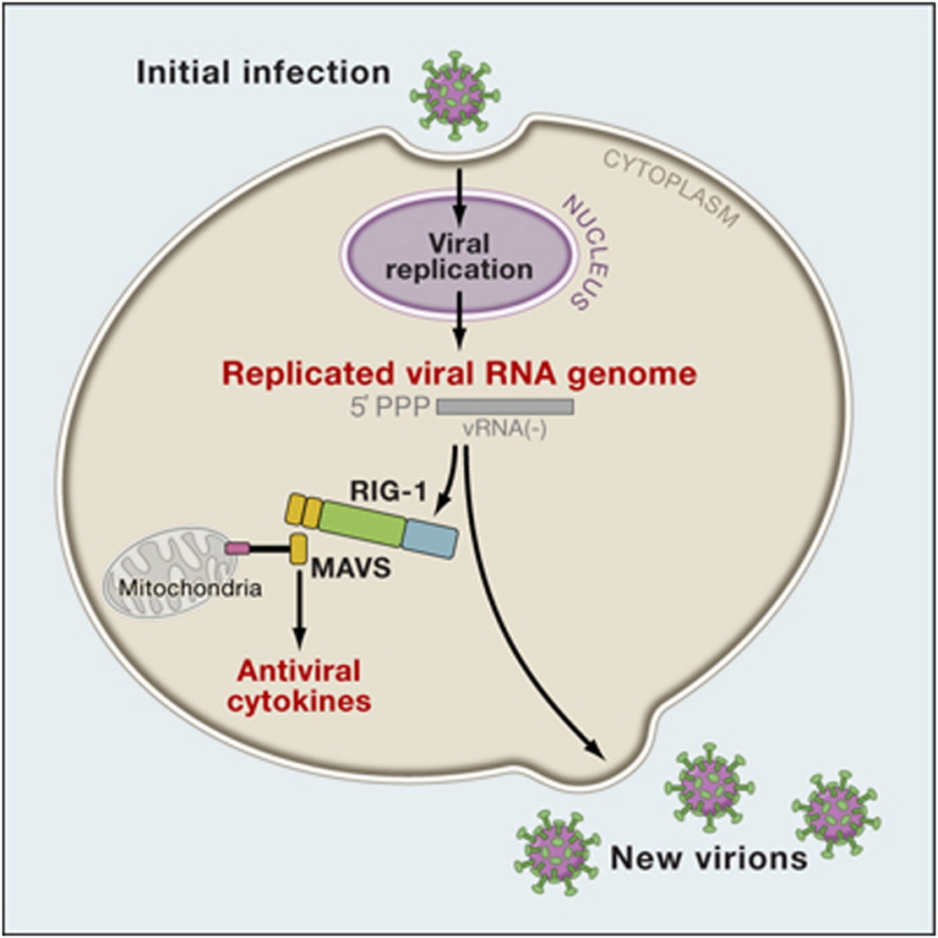
When is the PAMP seen?
Viruses that do not have 5’ monophosphate on their genome can evade RIG-I detection.

Slide 25
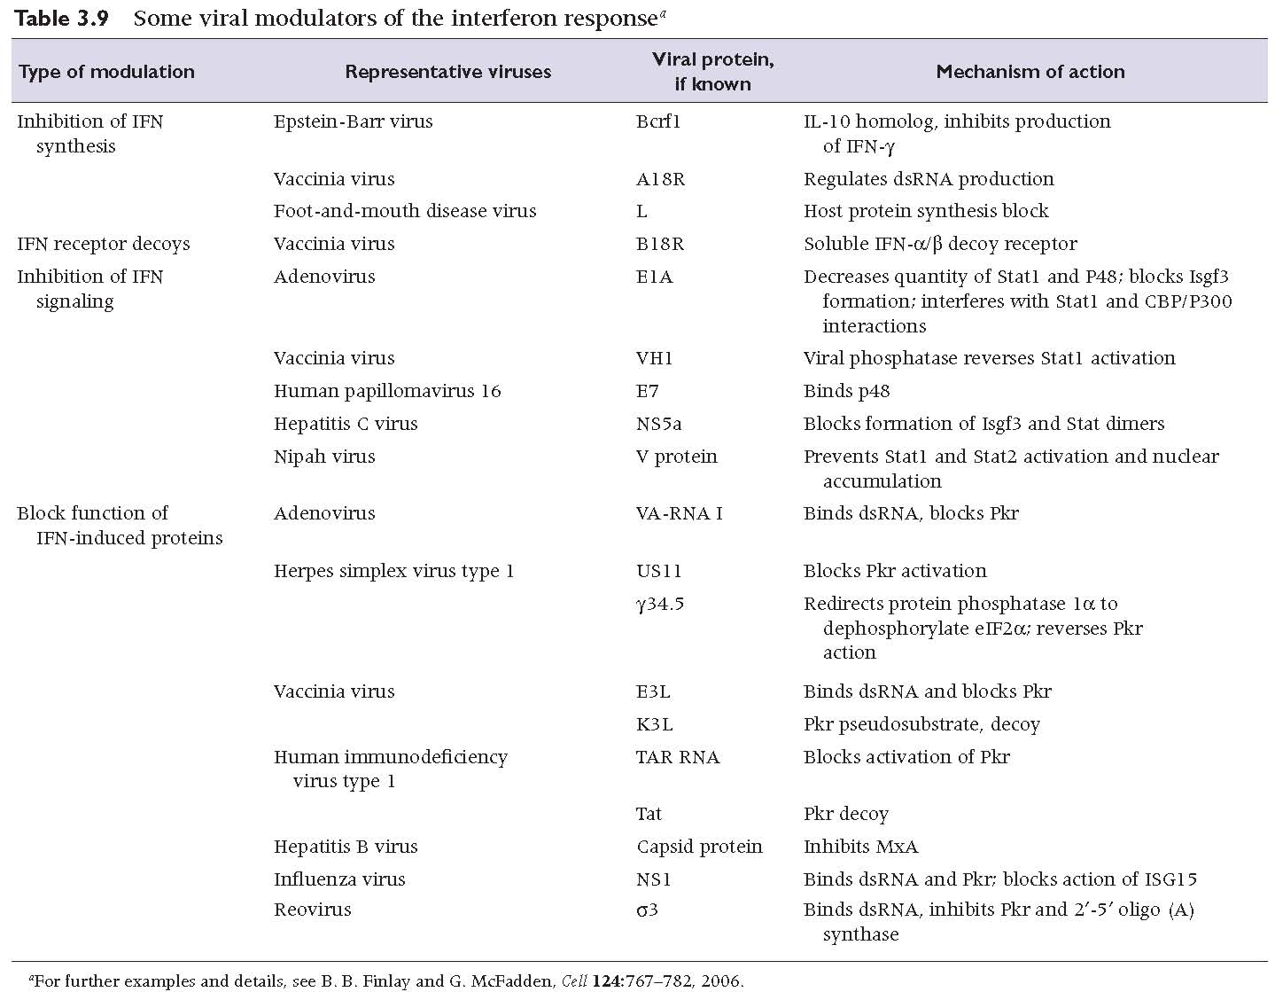

Slide 26
Influenza A Virus NS1 protein
Binds dsRNA
Binds RIG-I
NS1
X
PKR
IKKβ
NF-κB
IκB
IRF-3
X
IFN-β
IFN-β gene
nucleus
cytoplasm

Slide 27
Influenza A Virus NS1 protein
IFN-β
IFN-β
2. Stops export of antiviral mRNA
Jak1
Tyk2
Jak1
Tyk2
STAT1
P
STAT2
STAT2
P
STAT1
cytoplasm
STAT1
P
nucleus
p48
STAT2
P
ISRE
IS gene
NS1
AAA
X
AAA
AAA
Antiviral mRNAs
AAA

Slide 28
Consequences of innate immunity: Viral pathology
A combination of damage of infected cells by virus and
damage of infected and bystander cells by the immune response.

Slide 29
Skewing the immune response
Many viruses modulate the immune response, presumably to increase their own replication and transmission.
This can result in inadvertant pathology.

Slide 30
The cytokine storm.
IFN-β
IFN-β
IFN-β
IFN-β
IFN-β
IFN-β
IFN-β
IFN-β
IFN-β
IFN-β
IFN-β
IFN-β
IFN-β
IFN-β
IFN-β
IS genes
IFN-β
IFN-β
IFN-β
IFN-β
IFN-β
Cell 1
Cell 2
IFN-β

Slide 31
Immunopathology of H5N1 infection.
Virus replicates, induces high IFN resulting in massive TNFα and other cytokines.
Virus is resistant to inhibitory effects of cytokines and replicates unchecked, inducing higher cytokines and resulting in immune patholology.
Differences in clinical outcome may reflect vigour of innate immune system, which may vary with age.

Slide 32
Vaccines
Viruses deficient in control of IFN are attenuated in IFN competent cells
Cells deficient in IFN response grow more virus.

Slide 33
Antiviral drugs
IFN as a treatment (HCV)
Oncolytic viruses
NDV, mutants of HSV might lyse cells deficient in IFN but not normal cells.

Slide 34
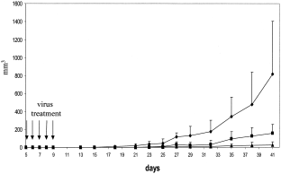
Del-NS1 influenza virus inhibits growth of tumour cells in mice
saline
NS1-99
Del-NS1

Slide 35
Suggested reading
Randall RE, Goodbourn S.
Interferons and viruses: an interplay between induction, signalling, antiviral responses and virus countermeasures. J Gen Virol. 2008 Jan;89(Pt 1):1-47. Review.

Slide 36
Evasion of antibody response
Continued rapid evolution driven by antigenic pressure from host e.g. influenza
Existing as many different genetically stable serotypes e.g. rhinovirus

Slide 37
Evolutionary pressure drives influenza antigenic change
mRNA
mRNA
cRNA
vRNA

Slide 38
Antigenic drift.
Vaccine updated every year to best represent the circulating strains.

Slide 39
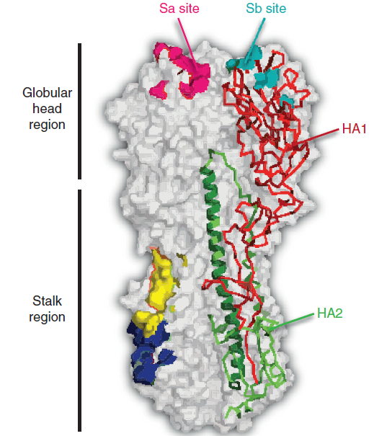
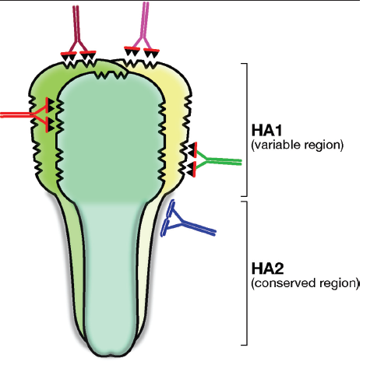
A universal influenza vaccine?

Slide 40
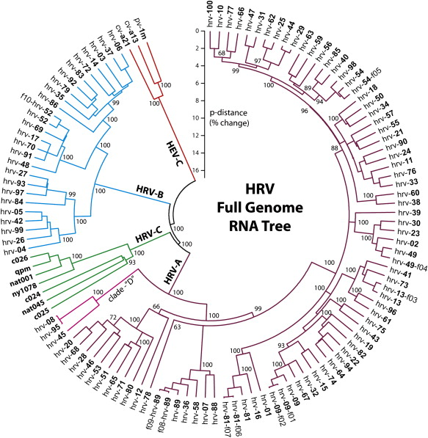
Human rhinovirus antigenic variation
Human rhinoviruses cause the common cold.
They exist as more than 120 antigenically distinct serotypes that co circulate.

Slide 41
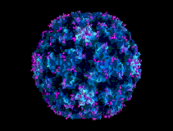
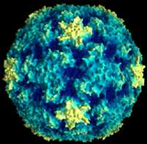
Rhinoviruses – Antigenic variation between serotypes yet they all still use the same ICAM-1 receptor.
5-fold axis
3-fold axis
Canyon

Slide 42
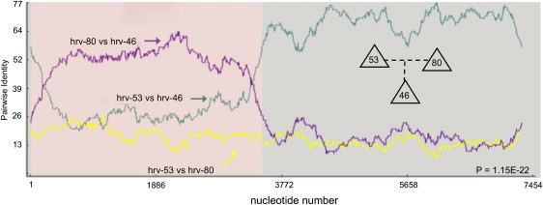
Rhinovirus recombination gives rise to new viruses

Slide 43
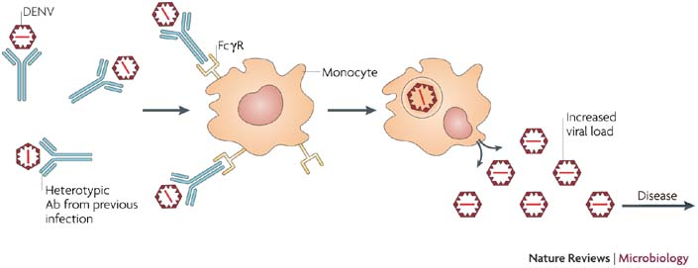
A consequence of antigenic variation: Antibody dependent enhancement of Dengue
Dengue Virus exists as 4 different serotypes.
Antibody generated against a previous infection can bind but not neutralize, and lead to ADE, causing Dengue Haemorrhagic Fever.

Slide 44
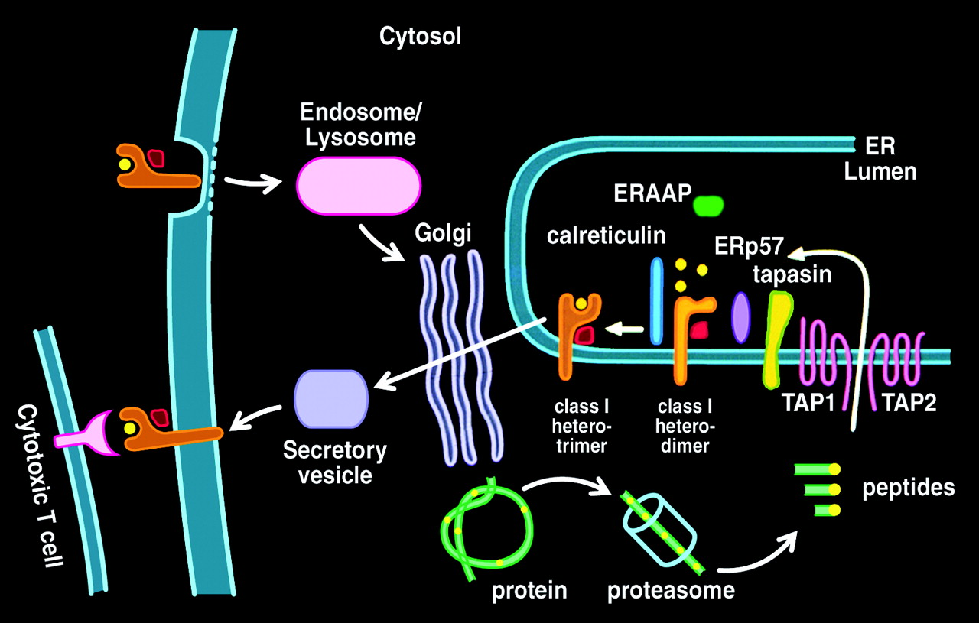
Presentation of viral proteins by MHC class I

Slide 45
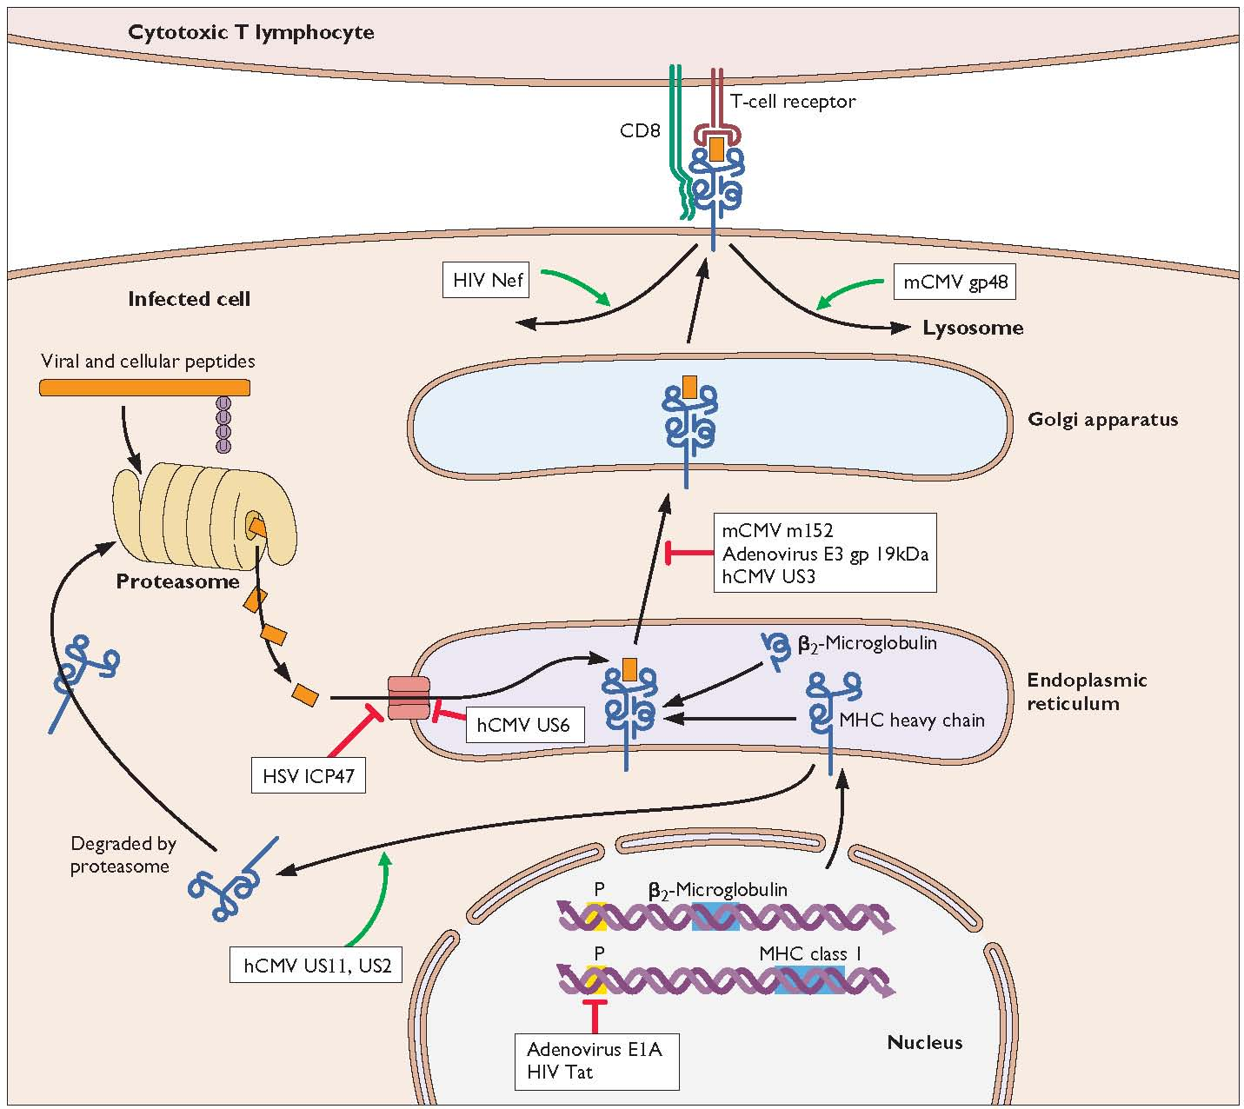
Viral regulation of MHC class I antigen presentation

Slide 46
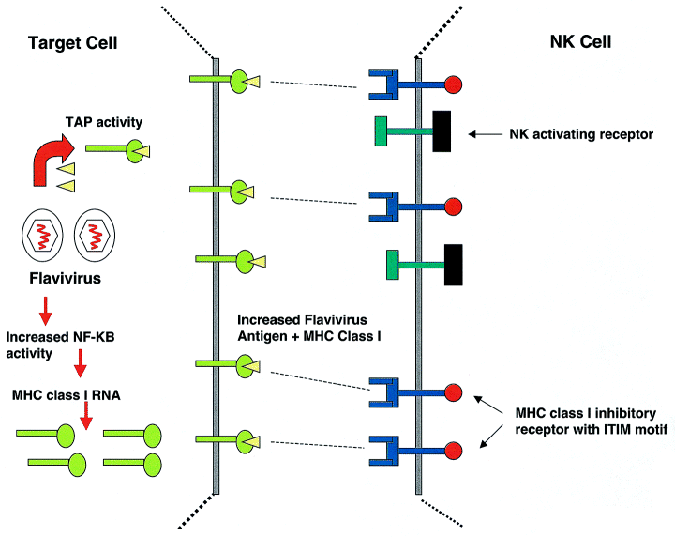
The balance between MHC expression and NK killing

Slide 47
Suggested further reading
The Journal of Immunology, 2003, 171: 4473-4478.
Virus Evasion of MHC Class I Molecule Presentation¹
Jason L. Petersen*, Chantey R. Morris* and Joyce C. Solheim^{2,*,†,‡}

