Slide 1
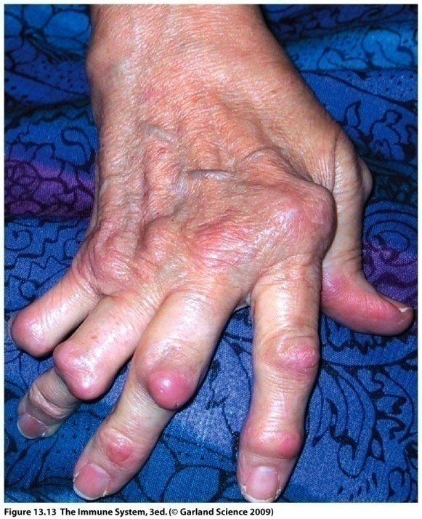
Tolerance and autoimmunity
Dr Keith Gould
k.gould@imperial.ac.uk

Slide 2
Learning objectives
To understand the concept of immunological tolerance
To understand the mechanisms underlying immunological tolerance
To understand how defects in tolerance lead to autoimmune diseases, and know examples of these

Slide 3
Topics to be covered:
The nature of autoimmunity and the impact of autoimmune diseases
Autoimmune reactions in humans
Evidence for the concept of immunological tolerance
Mechanisms of tolerance induction and maintenance:
central and peripheral tolerance
Evidence for a failure in central or peripheral tolerance
in human autoimmune diseases

Slide 4
Autoimmunity: adaptive immune responses with
specificity for self “antigens” (autoantigens)
genes infections environment
“normal
autoimmunity”
autoimmune
disease
breakdown of self tolerance

Slide 5
Mechanisms of autoimmunity
Adaptive immune reactions against self use the same mechanisms as immune reactions against pathogens (and environmental antigens)
Autoimmune diseases involve breaking T-cell tolerance
Because self tissue is always present, autoimmune diseases are chronic conditions
Effector mechanisms resemble those of hypersensitivity reactions, types II, III, and IV

Slide 6
The impact of autoimmune diseases
Approx 100 chronic disorders have been identified which relate to aberrant immune responses causing the body to attack it’s own tissues
Approx 5% of individuals in “developed” countries are affected by autoimmune disease (e.g. 23.5 million in USA)
Approx 75% of affected individuals are female
The incidence of autoimmune disease (and hypersensitivity) is increasing (hygiene hypothesis)

Slide 7
Major autoimmune diseases
NIH report of autoimmune diseases coordinating committee, USA 2000
Rheumatoid Arthritis: 1 in 100: 2.1 million cases, 30-50,000 children
Type I diabetes: 1 in 800: 300-500,000 cases, (123,000< 20yrs old)
Multiple Sclerosis: 1 in 700: 250-300,000 cases (25,000 hospitalisations per year)
Systemic Lupus Erythematosus (SLE): 240,000 cases
Autoimmune thyroid disease (ATD): including Hashimoto’s and Graves’ disease: 5 cases/ 1000 women, 0.8 cases per 1000 men.

Slide 8
Gender differences in autoimmune disease incidence

Slide 9
Description of autoimmune reactions in humans
Organs affected
Involvement of specific autoantigens
Types of immune responses

Slide 10
Autoimmune diseases affect a wide range of organs and tissues
Disease Target
Organ-specific autoimmune diseases
Graves’ disease Thyroid
Hashimoto’s thyroiditis Thyroid
Type I diabetes Pancreas
Goodpasture’s syndrome Kidney
Pernicious anaemia Stomach
Primary biliary cirrhosis Liver, Bile
Myasthenia gravis Muscles
Dermatomyositis/Polymyositis Skin/ Muscles
Vasculitis Blood vessels
Rheumatoid Arthritis Joints
SLE Multiple targets
Multi-systemic autoimmune diseases

Slide 11
Autoantigens have been identified in various autoimmune
diseases which play a direct role in the immunopathogenesis
Early experiments showed that autoantibodies against red blood cells
were responsible for autoimmune haemolytic anaemia in humans
-Result in the clearance or complement-mediated lysis of autologous erythrocytes
-Direct link between autoantibodies and disease (also antibody transfer experiments)

Slide 12
Immune reactions known to play a direct role in the pathology of human autoimmune disease:
Antibody response to cellular or extracellular matrix antigen (Type II)
Immune complex formed by antibody against soluble antigen (Type III)
T-cell mediated disease (Delayed type hypersensitivity reaction, Type IV)

Slide 13
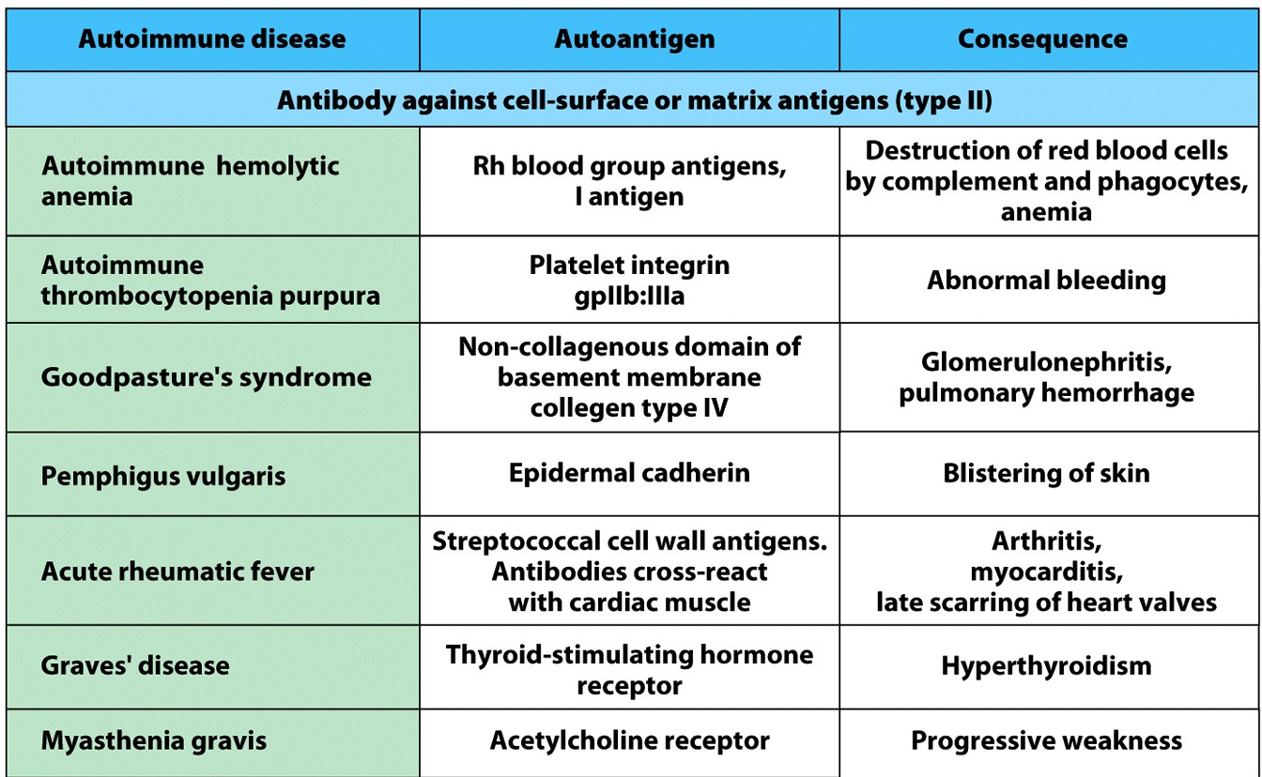
Type II, antibody to insoluble antigen

Slide 14
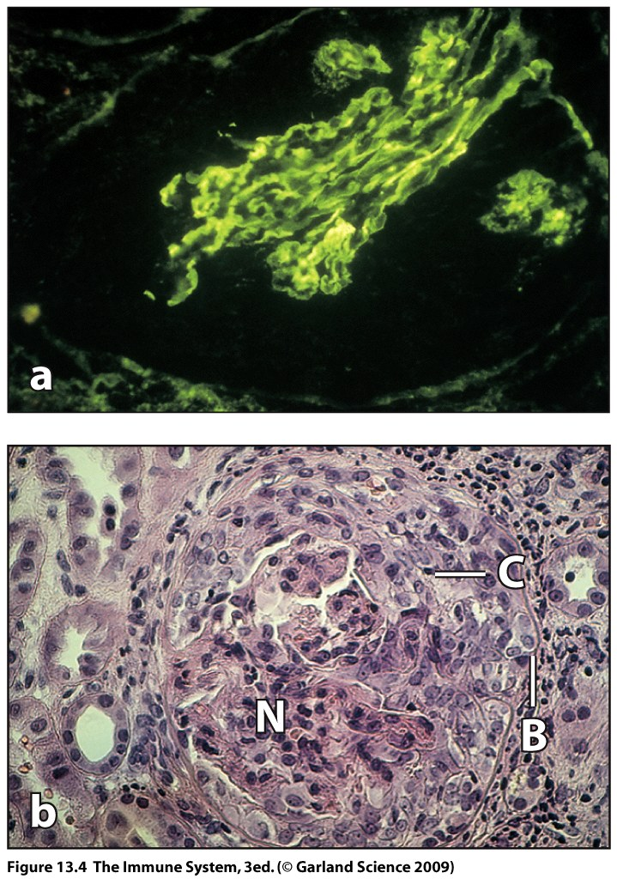
renal corpuscle
fluorescent
anti-IgG
stain
Goodpasture’s
syndrome
neutrophil
infiltration

Slide 15
Graves’
disease

Slide 16
Type III, immune complex disease
immune complex
deposition in
glomerulus

Slide 17
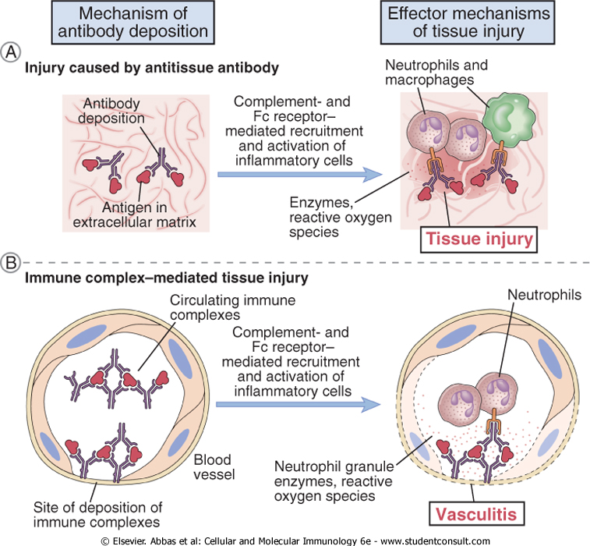
Type II
Type III

Slide 18
Type IV: T-cell mediated diseases
Disease | Autoantigen | Pathology
Insulin-dependent diabetes mellitus | Pancreatic β-cell antigen | β-cell destruction
Rheumatoid arthritis | Unknown synovial joint antigen | Joint inflammation and destruction
Multiple Sclerosis | Myelin Basic Protein Proteolipid protein | Brain degeneration (demyelination), weakness/paralysis
Cytotoxic (CD8⁺) and helper (CD4⁺) T cell responses
can be involved

Slide 19
The normal T-cell response to antigens
Antigen is presented to T-cells by MHC expressed on
the surface of antigen-presenting cells
T Cell
Antigen
Presenting
Cell
CD4
MHC II
T cell receptor
(TCR)
Response:
Proliferation
Function
MHC I
TCR
CD8
Peptide

Slide 20
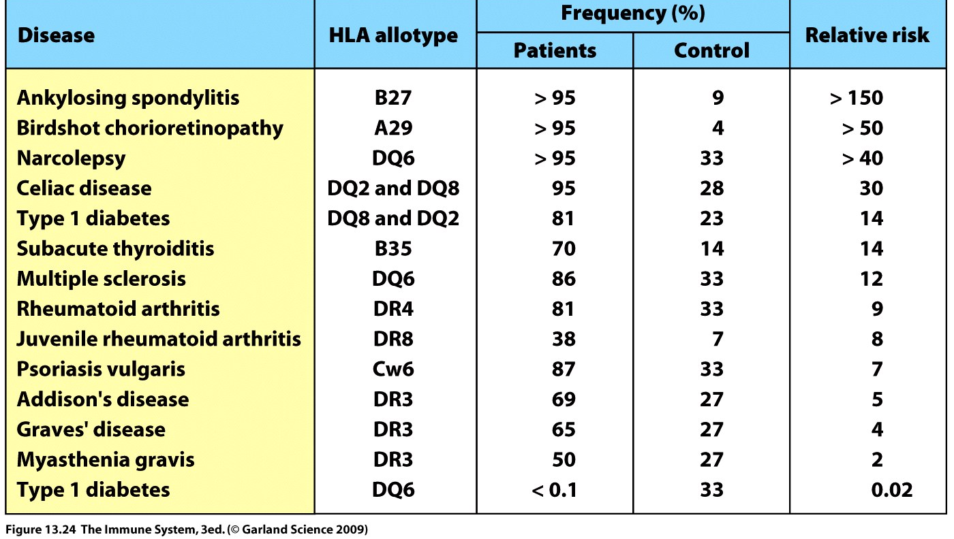
Human MHC (HLA) is the dominant genetic factor
affecting susceptibility to autoimmune disease

Slide 21
Summary: human autoimmune reactions
Mechanisms in autoimmunity are the same as in normal responses against foreign antigens
Immune responses to autoantigens (self) have a direct role in the pathology of autoimmune diseases
Both B cells (antibody) and T cells can be involved
HLA associations strongly imply a role for T cells in initiating autoimmune disease

Slide 22
Why are autoimmune diseases not even more
common if most people have lymphocytes capable
of recognising self?
What are the mechanisms which normally prevent our
immune system from attacking our own tissues?
What are the original causes (triggers) of autoimmunity?

Slide 23
Evidence for the concept of tolerance against self 1:
Freemartin cattle have fused placentas
and exchange cells and antigen in utero.
Non-identical twins have different sets of blood group antigens.
As these twins are non-identical, as adult cattle they would normally be expected to react to each others cells and tissues
However:
Adult cattle tolerate blood transfusions from a non-identical twin
They also accept skin grafts from each other

Slide 24
Evidence 2: timing is critical
Medawar et al. 1953
Donor
Spleen and
Bone marrow cells
Skin Graft
accepted
Recipients
Neonate
Adult
rejected
Adult
Adult

Slide 25
Evidence 3: tolerance has specificity
Donor
Spleen and
Bone marrow cells
Skin Graft
rejected
Neonate
Adult

Slide 26
Tolerance
Defined as the acquired inability to respond to an antigenic stimulus
‘The 3 As’
Acquired -involves cells of the acquired immune system and is ‘learned’
Antigen specific
Active process in neonates, the effects of which are maintained throughout life

Slide 27
How does self tolerance work and how does it fail?
Several mechanisms are involved in the generation and
maintenance of the tolerant state:
Central tolerance
Peripheral tolerance:
-anergy
-immune privilege (ignorance of antigen)
-regulation
Failure in one or more of these mechanisms may result
in autoimmune disease

Slide 28
Central tolerance
Lymphocyte development
Pre B-Cells
Lymphoid progenitors
Stem Cells
Pre T-Cells
B-cells
Thymus
Immunoglobulin-secreting
plasma cells
Export of T-cells to the periphery

Slide 29
T-cells recognise peptides presented on MHC in the thymus
Thymic epithelial cell (TEC)
or Dendritic cell (DC)
CD4
MHC II
TCR-CD3
Immature T-cell
MHC I
TCR-CD3
CD8

Slide 30
The Thymus: selection
Useless (can’t see MHC): die by apoptosis
Useful (see MHC weakly): receive signal to survive. “Positive selection”
Dangerous (see self strongly): receive signal to die by apoptosis. “Negative selection”
ONLY 5% OF THYMOCYTES SURVIVE SELECTION

Slide 31
B-Cell Tolerance
Stem Cells
Takes Place in the Bone Marrow
Immunoglobulin-secreting
plasma cells

Slide 32
Immature B- cells are deleted by polyvalent antigens
IgM
Bone Marrow Stromal Cell
No crosslinking
Immature
B-cell
Cell Survives
Self tolerant and
able to respond
to foreign pathogens
Apoptosis

Slide 33
Does central tolerance fail in autoimmune disease?
APECED
Autoimmune
PolyEndocrinopathy-
Candidiasis-
Ectodermal
Dystrophy
(autoimmune polyglandular disease, or APD)
Rare autoimmune disease which affects the endocrine glands
Thyroid
Kidneys
Chronic mucocutaneous candidiasis
Gonadal failure
Diabetes mellitus
Pernicious anaemia

Slide 34
APECED results from a failure to delete T-cells in the thymus
Caused by mutations in the transcription factor AIRE (autoimmune regulator)
gene
AIRE is important for the expression of “tissue-specific” genes in the thymus
Involved in the negative selection of self reactive T-cells in the thymus
MHC
TCR
Clonal deletion
or
Tolerance
AIRE
Autoreactive
Thymocyte
Persistence of autoreactive cells
Medullary Thymic Epithelial Cell (mTEC)

Slide 35
Most autoimmune diseases are associated
with multiple defects and genetic traits
SLE: Genes affecting multiple biological pathways
may lead to a failure of tolerance
(20-50 genes have been implicated in genetic susceptibility)
induction of tolerance (B lymphocyte activation: CD22, SHP-1): autoantibody production
apoptosis (Fas, Fas-ligand): failure in cell death
clearance of antigen (Complement proteins C1q, C1r and C1s): abundance/persistence of autoantigen

Slide 36
Summary: Central tolerance
T cell selection in the thymus
- Dependent on MHC: peptide: T-cell receptor (TCR) interaction
- Most cells die by neglect: no or very weak recognition
- Negative selection occurs for cells with high affinity TCRs, which die by apoptosis
- Surviving cells are MHC-restricted, with low/intermediate affinity for self-peptide
B-cell selection in the bone marrow
- Crosslinking of surface immunoglobulin by polyvalent antigens expressed on bone marrow stromal cells facilitates deletion
Failure in central tolerance can lead to autoimmunity. In most diseases, a complex interaction of multiple factors is usually involved.

Slide 37
Induction and maintenance of tolerance in the periphery
Some antigens may not be expressed in the thymus or bone marrow, and may be expressed only after the immune system has matured
Mechanisms are required to prevent mature lymphocytes becoming auto-reactive and causing disease
Anergy
Ignorance of antigen
Suppression by regulatory T cells

Slide 38
Anergy: absence of costimulation
Naïve T-cells require costimulation for full activation: CD80, CD86 and CD40 are examples of costimulatory molecules expressed on APC
These are absent on most cells of the body
CD4
Antigen Presenting
Cell (APC)
MHC II
TCR-CD3
T-Cell
CD80/86
CD28
APC
Without costimulation then cell proliferation and/or factor production
does not proceed.
Subsequent stimulation, even in the presence of costimulatory
molecules leads to a refractory state termed ‘ANERGY’

Slide 39
B-Cell Anergy
B Cells anergy is induced by high concentrations of soluble antigen
IgM
Surface IgM (sIgM)
Is down regulated
IgM
IgM
IgD
IgD

Slide 40
Immunological ignorance
Occurs when antigen concentration is too low in the periphery
Occurs when relevant antigen presenting molecule is absent: most cells in the periphery are MHC class II negative
Occurs at immunologically privileged sites where immune cells cannot normally penetrate: for example in the eye, central and peripheral nervous system and testes. In this case, cells have never been tolerised against the auto-antigens

Slide 41
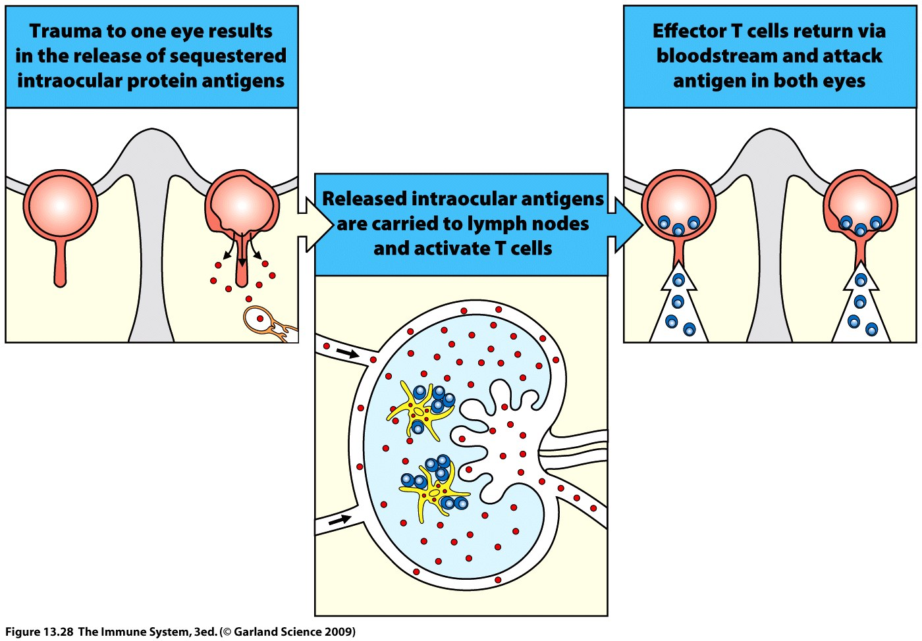
Failure of Ignorance
Example: sympathetic ophthalmia

Slide 42
Suppression/ Regulation
Autoreactive T-cells may be present but do not respond to autoantigen
Controlled by other cell types
Regulatory T-cells…..CD4⁺CD25⁺CTLA-4⁺FOXP3⁺
CD25 is the Interleukin-2 Receptor
CTLA-4 binds to B7 and sends a negative signal
FOX P3 is a transcription factor required for regulatory T-cell development

Slide 43
IPEX: a failure in the regulation of peripheral tolerance
Immune dysregulation, Polyendocrinopathy, Enteropathy and X-linked inheritance syndrome
Fatal recessive disorder presenting early in childhood
Mutation in the FOXP3 gene which encodes a transcription factor critical for the development of regulatory T-cells
Symptoms include:
early onset insulin dependent diabetes mellitus
severe enteropathy
eczema
variable autoimmune phenomena
severe infections
Accumulation of autoreactive T cells

Slide 44
Does infection ‘break’ peripheral tolerance?
Disease | Infection
Multiple sclerosis | Epstein-Barr virus (EBV), measles virus
Lyme arthritis | Borrelia burgdorferi
Type I diabetes | Coxsackie virus B4, rubella virus, cytomegalovirus (CMV), mumps virus
Rheumatoid arthritis | Escherichia coli, mycobacteria, EBV, hepatitis C virus (HCV)
Lupus erythematosus | EBV
Myocarditis | Coxsackie virus B3, CMV, chlamydia
Rheumatic fever/myocarditis | Streptococci
Chagas' disease/myocarditis | Trypanosoma cruzi
Myasthenia gravis | Herpes simplex virus, HCV
Guillain-Barré syndrome | CMV, EBV, Campylobacter spp.

Slide 45
How can infections affect the tolerant state?
Molecular mimicry of self molecules
Induce changes in the expression and recognition of self proteins
Induction of co-stimulatory molecules or inappropriate MHC class II expression: pro-inflammatory environment
Failure in regulation : effects on regulatory T-cells
Immune deviation: shift in type of immune response e.g. Th1-Th2
Tissue damage at immunologically privileged sites

Slide 46
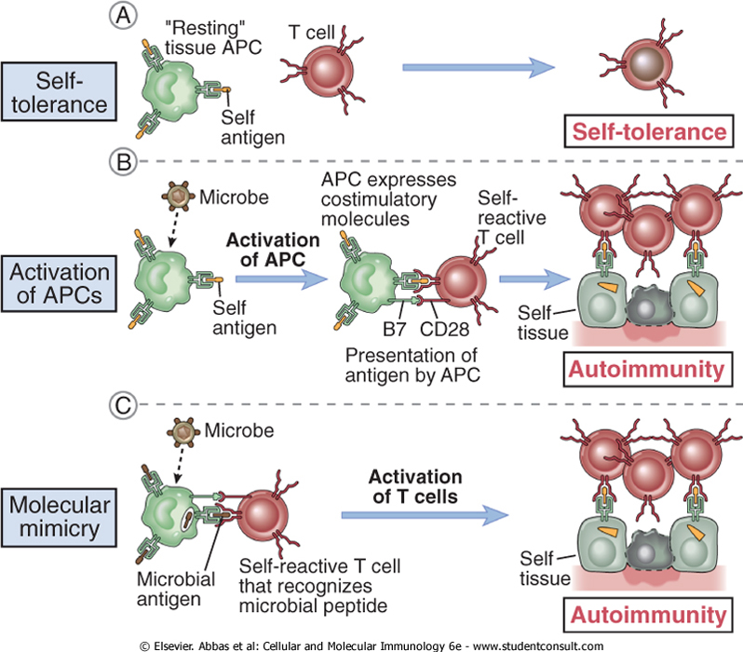

Slide 47
Peripheral Tolerance: Summary
Induction and maintenance of peripheral tolerance will depend on:
Site of antigen expression (MHC expression, immune privilege)
Timing of antigen expression
Amount of antigen expression
Costimulation
T cell help for B cell responses
Regulation
Infections may help break tolerance by a variety of mechanisms

Slide 48
Conclusions
Autoimmune disease pathology is caused by immune reactions against a wide range of tissues
The immune system is normally tolerised against responses to self antigens by mechanisms of both central and peripheral tolerance
Autoimmune diseases can result from a failure in the mechanisms of central or peripheral tolerance caused by genetic defects, or induced by tissue damage (e.g. smoking), or infection, or a combination of factors

Slide 49
Autoimmune disease | Autoantigen | Consequence | Disease type
Rheumatoid arthritis
Goodpasture’s syndrome
Graves’ disease
Type 1 diabetes
Systemic lupus erthyematosus
Myasthenia gravis
Autoantigens: pancreatic β-cell, synovial joint, type IV collagen, thyroid-stimulating
hormone receptor, acetylcholine receptor, DNA and histones
Consequences: muscle weakening, hyperthyroidism, glomerulonephritis, β-cell
destruction, joint inflammation/destruction, vasculitis

