Slide 1
Hypersensitivity and allergy
Sebastian L Johnston
Asthma UK Clinical Professor
National Heart and Lung Institute
St Mary’s Campus
Imperial College London
Notes:
We are allergic to many different proteins ranging from those in the diet, the air we breath to aspects of modern medicine such as antibiotics. Some of us will be affected transiently during our life time whereas to others it is a daily threat to life. There are many ways in which allergy is induced

Slide 2
Question 1
How many of YOU have allergic sensitisation (atopy)?
  A ~ 10%?
  B ~ 20%?
  C ~ 30%?
  D ~ 50%?
  E ~ 70%?

Slide 3
Question 2
How many of YOU have allergic disease/symptoms (allergy)?
  A ~ 10%?
  B ~ 20%?
  C ~ 30%?
  D ~ 50%?
  E ~ 70%?

Slide 4
Objectives 1
Outline mechanisms by which the four types of hypersensitivity
  IgE
  Antibodies
  Immune complexes
  T cells
Cause tissue damage and inflammation
Give examples of clinical syndromes associated with each

Slide 5
Objectives 2
Outline the factors underlying the development of atopic/allergic diseases
Describe the important clinical features of asthma, hay fever, allergic eczema and anaphylaxis
Briefly describe the approach to investigation and management of patients with these disorders

Slide 6
Appropriate Immune Reactions
Appropriate immune responses occur to foreign harmful agents such as viruses, bacteria, fungi, parasites
  Required to eliminate pathogens
  May be concomitant tissue damage as a side effect, but as long as pathogen is eliminated quickly will be minimal and repaired easily
Involve antigen recognition by antibodies and cells of the immune system
Notes:
This is one of two lectures on hypersensitivity.
The other lecture will concentrate upon the clinical consequences of hypersensitivity, while this lecture will explain the underlying mechanisms.

Slide 7
Appropriate Immune Reactions
Appropriate immune tolerance occurs to self, and to foreign harmless agents such as
  Food
  Harmless environmental proteins
    Pollens, other plant proteins, animal proteins
Also involves antigen recognition by antibody (IgG4) and regulatory T cells
  Antigen recognition in context of “danger” signals leads to immune reactivity, absence of “danger” to tolerance
Notes:
This is one of two lectures on hypersensitivity.
The other lecture will concentrate upon the clinical consequences of hypersensitivity, while this lecture will explain the underlying mechanisms.

Slide 8
Hypersensitivity Reactions
Hypersensitivity Reactions occur when immune responses are mounted against
  Harmless foreign antigens (allergy, contact hypersensitivity)
  Autoantigens (autoimmune diseases)
  Alloantigens (serum sickness, transfusion reactions, graft rejection)

Slide 9
Hypersensitivity Reactions
Classified by Gell & Coombs:-
Type I : Immediate Hypersensitivity
Type II : Antibody-dependent Cytotoxicity
Type III : Immune Complex Mediated
Type IV : Delayed Cell Mediated
Note: many diseases involve a mixture of types
Notes:
Gell and Coombs defined four types of hypersensitivity.
Types I, II and III depend upon the interaction of antigen with antibody.
Type IV involves T cell recognition and because of the longer time scale involved, this is referred to as “Delayed type hypersensitivity”
This is an incomplete classification a new Type V category has been proposed. This is Stimulatory Hypersensitivity.
These classifications are an aide to understanding, but what happens in practise is that the hypersensitivity reaction is a mixture of mechanisms, with one type usually progressing into the others.
However, a common feature of all hypersensitivity reactions is inflammation………

Slide 10
Type I
Immediate Hypersensitivity
Anaphylaxis
Asthma
Rhinitis
  Seasonal
  Perennial
Food Allergy

Slide 11
Type I
Immediate Hypersensitivity
1⁰ Antigen exposure
IgE antibody production
IgE binds to Mast Cells & Basophils
2⁰ Ag Exposure
More IgE Ab produced
Antigen cross-links IgE on Mast Cells/Basophils
Degranulation
Y
Y
Y
High Affinity
IgE Receptor
Y
Y
u
Y
u
Y
u
Degranulation
Mediators

Slide 12
Type II
Antibody-Dependent Hypersensitivity
Clinical presentation depends on target tissue
Organ-specific autoimmune diseases
  Myasthenia gravis (Acetylcholine R Ab)
  Glomerulonephritis (Anti-glomerular basement membrane [GBM] Ab)
  Pemphigus vulgaris (Ab - epithelial cell cement)
Autoimmune cytopenias (blood cell destruction)
  Haemolytic anaemia
  Thrombocytopenia
  Neutropenia
Haemolytic disease of the newborn (rhesus Ab)

Slide 13
Type II
Antibody-Dependent Hypersensitivity
Drug allergies
Hyper-acute graft rejection
Transfusion reactions
Pernicious anaemia (intrinsic factor blocking Abs)
Idiopathic urticaria (Abs against IgE receptor)

Slide 14
Type II
Antibody-Dependent Hypersensitivity
Killer Cell
Ab Interaction with Cell Surface Ag
Complement Activation
  cell lysis
  attraction of cytotoxic cells
  cell activation
Inflammation
  neutrophils
  monocytes
  killer cells
FcgR
Complement
U
Y
AutoAb/AlloAb
AutoAg/AlloAg
Tissue Damage / Altered Function

Slide 15
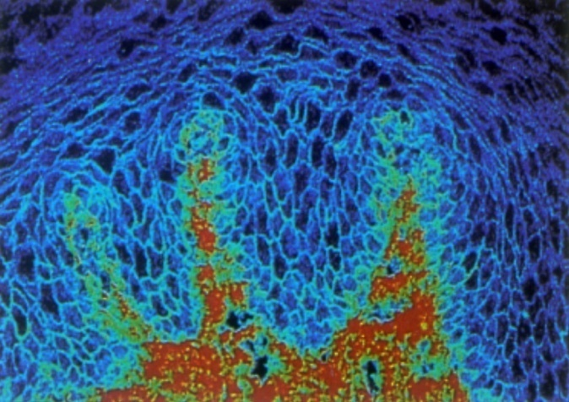
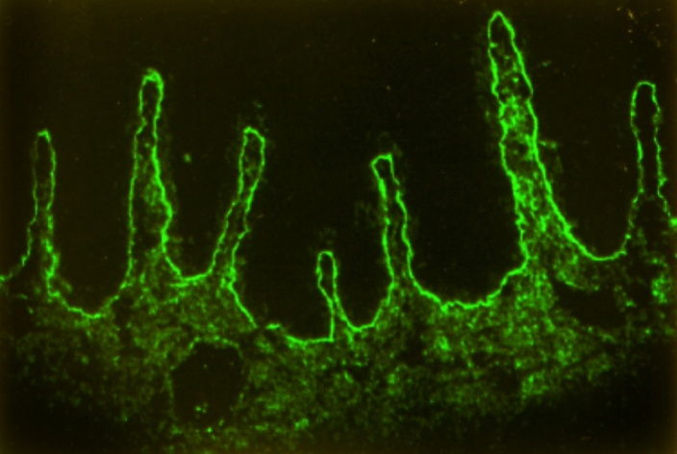
Type II
Antibody-Dependent Hypersensitivity
Tests for Ab-Dependent Hypersensitivity
Test for specific autoantibodies
  Immunofluorescence
  ELISA eg anti-CCP Abs for Rheumatoid arthritis
Pemphigus
Ab –Intercellular cement
Pemphigoid
Ab- basement membrane

Slide 16
Type II
Antibody-Dependent Hypersensitivity
Treatments for Ab-Dependent Hypersensitivity
Immunosuppressants - steroids/cyclophosphamide
Plasma exchange
Splenectomy (for autoimmune thrombocytopenia)
Anti-D (Rh) to deplete foetal RBCs in rhesus disease

Slide 17
Type III Immune Complex
Mediated Hypersensitivity
Formation of Antigen-Antibody complexes in blood
Deposition of complexes in a tissue
Complement & cell recruitment/activation
Activation of other cascades eg clotting
Tissue damage (vasculitis)
  Systemic lupus erythematosus (SLE)
  Vasculitides (Poly Arteritis Nodosum, many different types)

Slide 18
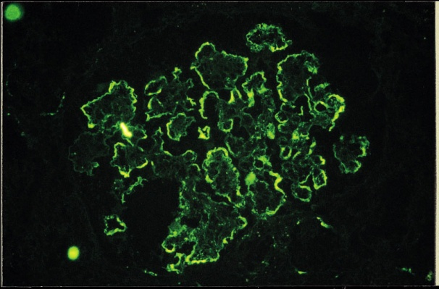
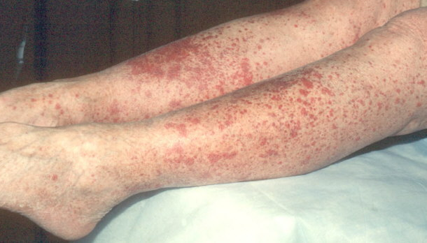
Type III Immune Complex
Mediated Hypersensitivity
Immune
Complex
Y
Y
Y
Y
Y
Y
Y
Y
Y
C3
PMN
Mo
Y
Y
Vasculitis:
Renal (glomerulonephritis)
Skin
Joints
Lung

Slide 19
Type IV
Delayed Hypersensitivity Responses
Chronic graft rejection
GVHD
Coeliac disease
Contact hypersensitivity
Asthma
Rhinitis
Eczema

Slide 20
Type IV
Delayed Hypersensitivity Responses
Antigen
Three Varieties
Th1
Cytotoxic
Th2
Mechanisms
Transient/Persistent Ag
T cell activation of macrophages, CTLs
Much of tissue damage dependent upon TNF
TNFα
IFN-γ
APC
Th1
Macrophage
IL-2
FGF
Fibroblast
Cytotoxic
T lymphocyte
(CTL)
Angiogenesis
Fibrosis

Slide 21
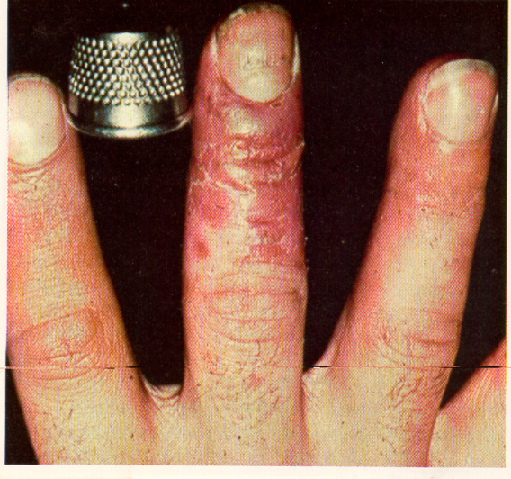
Type IV Delayed-Type
Cell-Mediated Hypersensitivity
Nickel
Contact Hypersensitivity

Slide 22
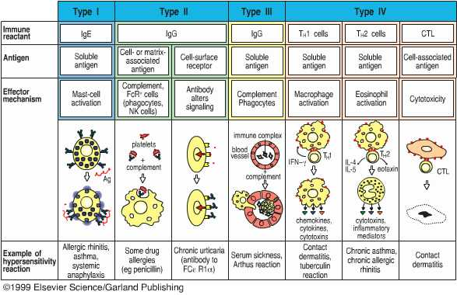
Hypersensitivity Reactions
Notes:
Allergy is one of a class of immune responses called hypersensitivity reactions. These were defined by Coombs and Gell.
Types I –III are mediated by antibody. Distinguished by the type of antigen that they recognise.
Type II are directed to cell surface or matrix bound antigens whereas type III is associated with recognition of soluble antigens.
A number of the allergies occur systemically such as that to penicillin, and immune complex deposition in the blood vessels. This lecture will focus on allergies that occur in the lung, specifically asthma which is caused by IgE binding to mast cells and by the induction of T cells producing Th2 type cytokines.

Slide 23
Inflammation
Common Feature – inflammation
  Immune cell
    recruitment to sites of injury and/or infection
    activation
  Inflammatory mediators – complement, cytokines, etc
      Redness
      Heat
      Swelling
      Pain
Features :-
Local dilatation, increased blood flow
Increased vascular permeability
Inflammatory mediators & cytokines
Inflammatory cells & tissue damage
Signs:-
Notes:
Inflammation is the body’s response to tissue injury
It is a rapid attempt to bring the body’s defences to the site of injury

Slide 24
Inflammation
Increased vascular permeability
    Caused by:- C3a, C5a, histamine, leukotrienes
Cytokines IL-1, IL-6, IL-2, TNF, IFN-γ
Chemokines IL-8/CXCL8, IP-10/CXCL10
Inflammatory cell infiltrate
    Cell trafficking – chemotaxis
    Neutrophils, macrophages, lymphocytes, mast cells
    Cell activation

Slide 25


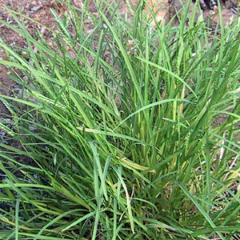
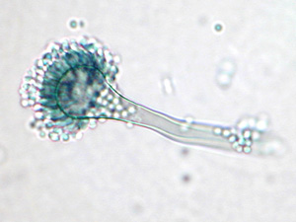
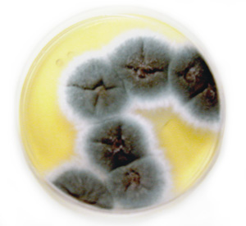
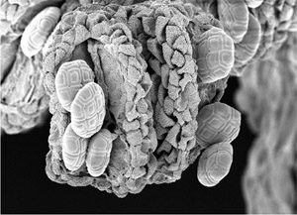
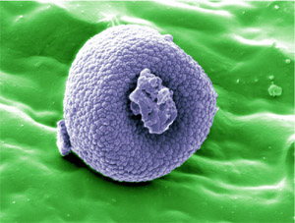
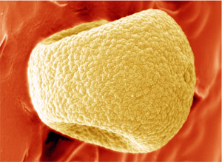
Allergy - common allergens

Slide 26
Allergy
Common - prevalence of atopy is 50% in young adults in UK
Severity varies -
  mild occasional symptoms
  severe chronic asthma
  life threatening anaphylaxis
Risk factors - genetic and environmental

Slide 27
Genetic risk factors
~80% of atopics have a family history
Polygenic
  50-100 genes linked to asthma/atopy
  genes of IL-4 gene cluster (chromosome 5) linked to raised IgE, asthma, atopy
  genes on chromosome 11q (IgE receptor) linked to atopy and asthma

Slide 28
Environmental risk factors
Age - increases from infancy, peaks in teens, reduces in adulthood
Gender - asthma more common in males in childhood, females in adults
Family size – more common in small families
Infections - early life infections protect
Animals - early exposure protects
Diet – breast feeding, anti-oxidants, fatty acids protect?

Slide 29
Allergies increasing in UK
Prevalence of disease (%)

Slide 30
Types of inflammation in allergy
Anaphylaxis, urticaria, angioedema
    type I hypersensitivity (IgE mediated)
Idiopathic/chronic urticaria
    type II hypersensitivity (IgG mediated)
Asthma, rhinitis, eczema:
  mixed inflammation
    type I hypersensitivity (IgE mediated)
    type IV hypersensitivity (chronic inflammation)

Slide 31
Expression of disease requires:
Sensitisation to allergens to sensitise (primary response - usually in early life)
Exposure to produce disease (memory response - any time after sensitisation)

Slide 32
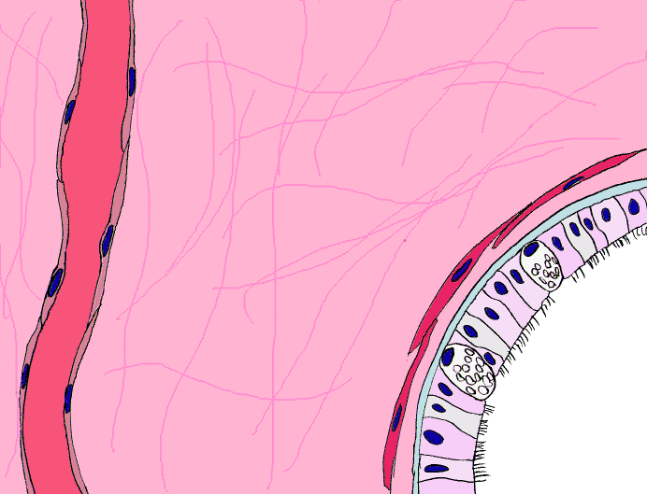
Sensitisation in Atopic Airway Disease
processed
allergen
IL-10
CD4⁺
memory
T cells
Th2
Th2
Treg
Th2
naïve
T cell
Th2
Th2
Th2
Th1
dendritic
cell
IFN-γ
IL-4
IL-13
B
proliferation
differentiation
allergen
IgE synthesis & release
plasma
cells

Slide 33
Subsequent exposure
processed
allergen
Th2
memory
T cells
Th2
Th2
Th2
Th2
Th2
IL-5
eosinophil
dendritic
cell
IL-4
IL-13
IL-5
plasma cell
allergen
mediators
IgE
mediators
mast cell

Slide 34
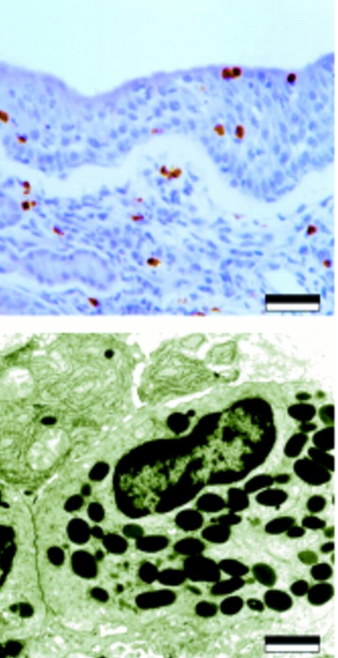
Eosinophils
2-5% of blood leukocytes
Present in blood, most reside in tissues
Recruited during allergic inflammation
Generated from bone marrow
Polymorphous nucleus - two lobes
Contain large granules
  toxic proteins
Lead to tissue damage

Slide 35
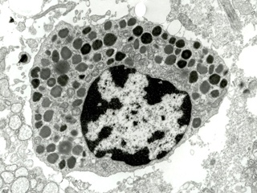
Mast cells
Tissue resident cells
IgE receptors on cell surface
Crosslinking of IgEs leads to
  Mediator release
    pre formed
      histamine
      cytokines
      toxic proteins
    newly synthesized
      leukotrienes
      prostaglandins

Slide 36
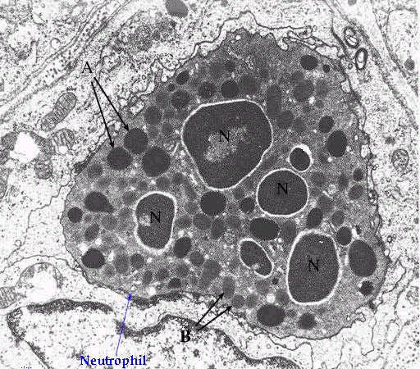
Neutrophils
Important in
  virus induced asthma
  severe asthma
  atopic eczema
55-70% of blood leukocytes
Nucleus contains several lobes
Granules contain
  digestive enzymes
Also synthesize
  oxidant radicals
  cytokines
  leukotrienes

Slide 37
Asthma - immunopathogenesis
Acute inflammation of the airways
  mast cell activation & degranulation
    Pre stored mediators
      histamine
    Newly synthesised mediators
      prostaglandins, leukotrienes
  acute airway narrowing
Vascular Leakage
Smooth muscle contraction
Airway Wall
Edema
Mucus
Secretion

Slide 38
Two-phase response to single allergen challenge
Inhaled
allergen
100%
PEF
Late response
Early
response
0 2h 4h 6h

Slide 39
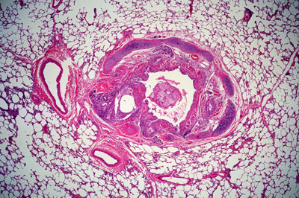
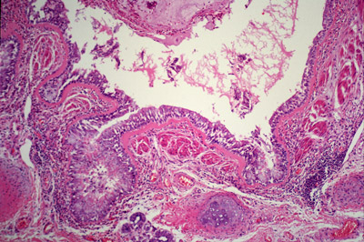
Asthma - immunopathogenesis
Chronic inflammation of the airways
  Cellular infiltrate
    Th2 lymphocytes, eosinophils
  Smooth muscle hypertrophy
  Mucus plugging
  Epithelial shedding
  Sub epithelial fibrosis

Slide 40
Important clinical features

Slide 41

Asthma
Reversible generalised airway obstruction
  Chronic episodic wheeze
Bronchial hyperresponsiveness
  Bronchial irritability
Cough
Mucus production
Breathlessness
Chest tightness
Response to treatment
Spontaneous variation
Reduced & variable peak flow (PEF)
Notes:
Asthma is a form of allergy that affects the respiratory tract and causes life long trauma in a large proportion of the population. Asthma is increasing in Westernised countries and the reasons for this are not fully understood.

Slide 42
Typical day for a poorly controlled
asthmatic
Ran for a lecture!!!
100%
Felt
fine
Woke up
wheezy ++
PEF
6am Noon 6pm Midnight

Slide 43
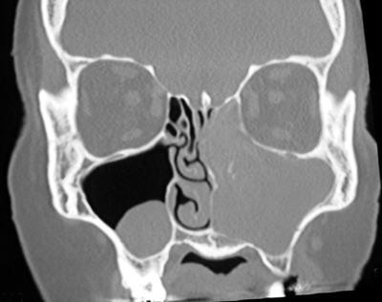
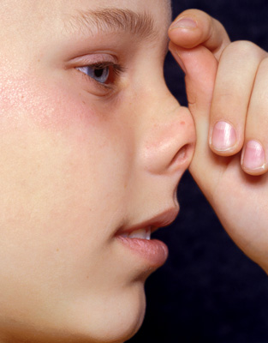
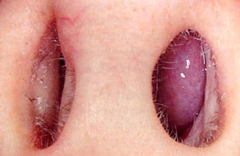
Allergic rhinitis
Seasonal - hay fever - grass, tree pollens
Perennial - perennial allergic rhinitis
  HDM, animal
Symptoms
  sneezing
  rhinorrhoea
  itchy nose, eyes
  nasal blockage, sinusitis, loss of smell/taste

Slide 44
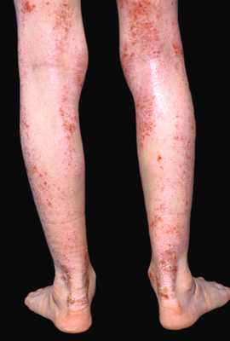
Allergic eczema
Chronic itchy skin rash
Flexures of arms and legs
HDM sensitisation and dry cracked skin
Complicated by bacterial and (rarely) viral infections (herpes simplex)
50% clears by 7 years
90% by adulthood

Slide 45
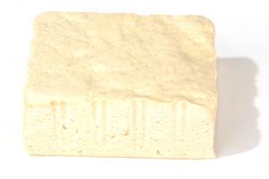
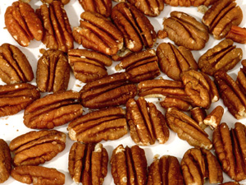

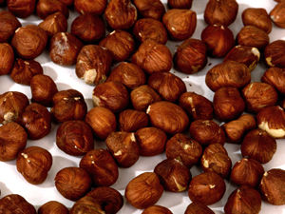
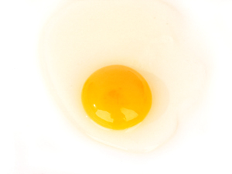
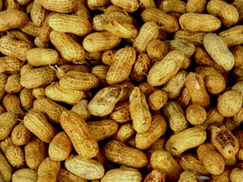
Food allergy
Infancy-3yrs
  egg, cows milk
Children/adults
  peanut, shell fish, nuts, fruits, cereals, soya
Mild
  Itchy lips, mouth, angioedema, urticaria
Severe
  Nausea, abdominal pain, diarrhoea
  Anaphylaxis

Slide 46
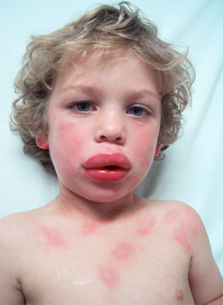
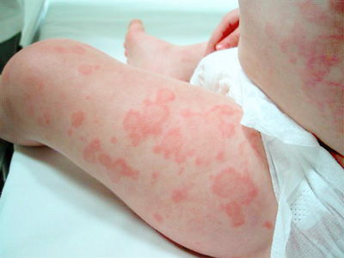
Anaphylaxis
Anaphylaxis: severe generalised allergic reaction
Uncommon, potentially fatal
Generalised degranulation of IgE sensitised mast cells
Symptoms:
  itchiness around mouth, pharynx, lips
  swelling of the lips, throat and other parts of the body
  wheeze, chest tightness, dyspnoea
  faintness, collapse
  diarrhoea & vomiting
  death if severe & untreated
Systems:
  Cardiovascular - vasodilatation, cardiovascular collapse
  Respiratory - bronchospasm, laryngeal oedema
  Skin - vasodilatation, erythema, urticaria, angioedema
  GI - vomiting, diarrhoea

Slide 47
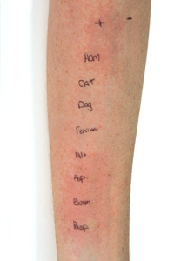
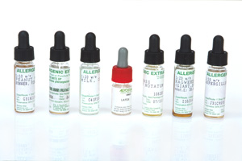
Investigation & diagnosis
Careful history essential
Skin prick testing
RAST (blood specific IgE):
Total IgE
Lung function (asthma)

Slide 48

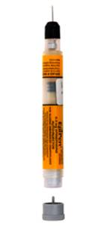
Treatment of anaphylaxis
Emergency Treatment
  EpiPen & Anaphylaxis kit
    adrenaline, antihistamine, steroid
  Seek immediate medical aid
Prevention
  Avoidance of the known allergy
  Always carry a kit & EpiPen
  Inform immediate family & caregivers
  Wear a MedicAlert® bracelet

Slide 49
Rhinitis & Eczema Treatment
Allergic rhinitis
  anti-histamines (sneezing, itching, rhinorrhoea)
  nasal steroid spray (nasal blockage)
  cromoglycate (children, eyes)
Eczema
  emollients
  topical steroid cream

Slide 50
Asthma Treatment
Step 1. Use short acting β₂ agonist drugs as required by inhalation
  Salbutamol
Step 2. Inhaled steroid low-moderate dose
  Beclomethasone/budesonide (50-800μg per day)
  Fluticasone (50-400μg per day)
Step 3. Add further therapy
  Add Long acting β₂ agonist, leukotriene antagonist
  High dose inhaled steroids - up to 2mg per day via a spacer
Step 4. Add courses of Oral Steroids
  Prednisolone 30mg daily for 7-14 days
  Anti-IgE mAb

Slide 51

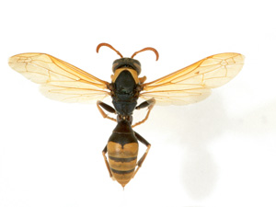
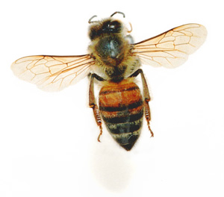
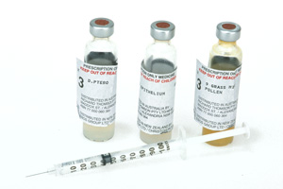
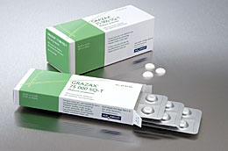
Immunotherapy
  Effective for single antigen hypersensitivities
  Venom allergy - bee or wasp stings
  Pollens
  HDM
  Antigen used is purified
  Subcutaneous immunotherapy (SCIT)
    3 years needed
    Weekly/monthly 2hr clinic visits
  Sublingual immunotherapy (SLIT)
    Can be taken at home
    2yrs possibly enough????

Slide 52
Thank You!!

