Slide 1
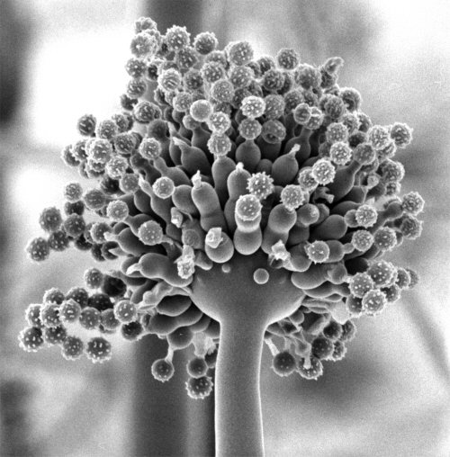
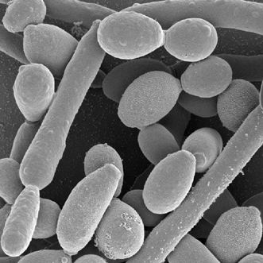
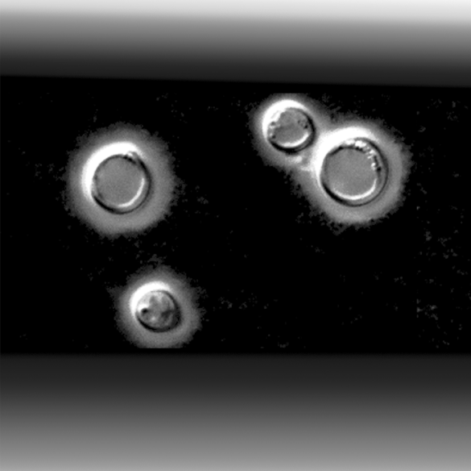
Immunity to fungal infections
Aspergillus fumigatus
Candida albicans
Cryptococcus neoformans
Dr Elaine Bignell
Microbiology Section
Department of Infectious Diseases
Faculty of Medicine
e.bignell@imperial.ac.uk
Luigina Romani (2004) Immunity to fungal infections Nat. Rev. Microbiol. 4:1-23

Slide 2
Learning objectives
Following this lecture you should be able to:
Understand how immune status determines risk of fungal infection
Name the major antifungal effector cells
Describe two mechanisms of cell-mediated antifungal defence
Summarise the sequence of events leading to successful clearance
of infectious fungal cells
Notes:
In year one we covered a range of ilnesses (including allergy, toxicoses and mycoses) caused by fungi. We will now study the immune mechanisms which protect healthy individuals from fungal infections.

Slide 3
Audience self-assessment exercise
[Raise your hand when correct answer is read out]
Q: What colour are bananas?
Black
Orange
Yellow
Blue

Slide 4
Structure of the lecture
Introduction: Fungal infections, morphotypes (growth forms) and routes of infection
Aspergillus species
Candida species
Cryptococcus species
2) Immunity to fungal infection (systemic perspective)
Risk factors for fungal infections
A damage-response framework to describe the host-pathogen interaction
Overview of mammalian immunity to fungi
3) Immunity to fungal infections (cellular perspective)
a) Major antifungal effector cells
b) Recognition of infectious fungal cells
c) Clearance of infectious fungal cells
d) Integration of innate and adaptive responses to fungal infection
4) Further reading

Slide 5
Audience self-assessment exercise
[Raise your hand when correct answer is read out]
Q: What is the collective noun for
fungal infections?
Mycotoxicoses
Mycoses
Allergies

Slide 6
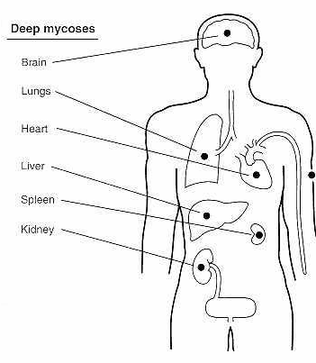
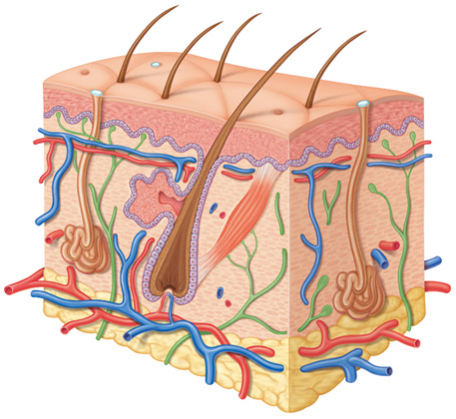
Mycoses (Fungal infections)
Mycoses are classified by the level of tissue affected
Systemic (deep)
Superficial
Cutaneous
Subcutaneous
Threaten quality of life
Threaten survival of the host
Notes:
A reminder that fungal infections (also called mycoses) are classified according to the level of tissue affected. Superficial mycoses are usually straightforward cosmetic infections of the skin or hair shaft which provoke little or no response from the human host.
More significant host responses are observed during cutaneous and subcutaneous infections.
The most life threatening infections, referred to as systemic or invasive fungal infections, can affect any or many organs of the human body.

Slide 7
Introduction
Fungal infections, morphotypes (growth forms) and routes of infection

Slide 8
Mycoses: The major causative organisms
Primary
Coccidioides immitis
Histoplasma capsulatum
Blastomyces dermatiditis
Paracocidioides brasiliensis
Opportunistic
Cryptococcus
Candida
Aspergillus
Penicillium marneffei
The zygomycetes
Trichosporon beigelii
Fusarium
Able to establish
infection in a
normal host
Well-defined
geographical areas
TRUE
PATHOGENS
Require a
compromised host
in order to establish
infection
Ubiquitous
OPPORTUNISTIC
PATHOGENS
Notes:
Fungal agents of infection can be classified into two groups: Primary and opportunistic pathogens.
The primary pathogens are able to infect immunocompetent hosts. Diseases caused by these organisms are endemic to certain geographical regions (mostly the South Americas) and usually arise as a result of inhaling fungal particles. The fungal particles originate from ecological niches, often soil and bird or bat droppings.
The opportunistic pathogens cause world wide disease burdens. Resultant infections vary in severity – dependent upon the immune status of the host. Some degree of immunocompromise is required to render human hosts susceptible to infection by these organisms. The host-pathogen interaction varies enormously, by individual and also by causative organism.
For the purposes of this lecture we will focus on three opportunistic fungal species: Candida species, Aspergillus species and Cryptococcus species.

Slide 9
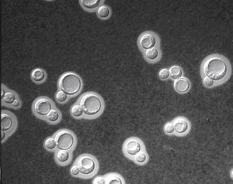
Shape-shifting fungi: Defining fungal morphotypes
Candida albicans
Each distinct growth form of a fungus is called a morphotype
Some fungi exist as multiple morphotypes and can switch between them
The term ‘yeast’ describes single-celled fungal morphotypes such as those exhibited by C. albicans and C. neoformans
Cryptococcus neoformans is described as an encapsulated yeast, which has a think polysaccharide cell wall referred to as the capsule
Cryptococcus neoformans
Notes:
Fungi are eukaryotic organisms which undergo developmental growth programmes. Each distinct growth form of a particular fungus is called a morphotype. Some fungi exist as multiple morphotypes and can switch between them in response to environmental conditions.
The term ‘yeast’ is used to describe single celled fungal morphotypes. Candida albicans is a budding yeast which can differentiate into elongated pseudohyphal forms in response to pH, nutrient limitation or serum. Pseudohyphal cells lack the dividing partitions known as septa which are found in true hyphae.
Cryptococcus neoformans is described as an encapsulated yeast, which has a think polysaccharide cell wall referred to as the capsule.
Sporulating fungi (those which produce spores) distribute spores via air currents to inhabit new food sources. Spores are also referred to as conidia.
A fungal colony composed of multiple branched hyphae is referred to as a mycelium

Slide 10
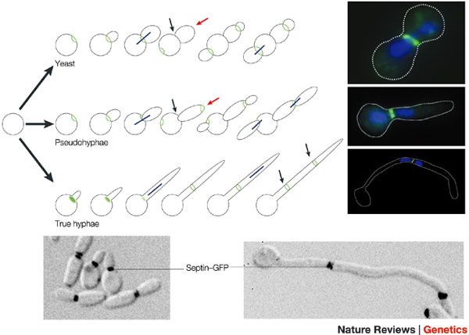
Shape-shifting fungi: Defining fungal morphotypes
Candida albicans is a budding yeast which can differentiate into elongated pseudohyphal and/or hyphal forms in response to environmental signals such as:
pH
nutrient limitation
serum
Pseudohyphal cells lack the dividing partitions known as septa which are found in true hyphae

Slide 11
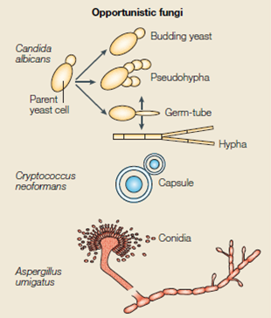
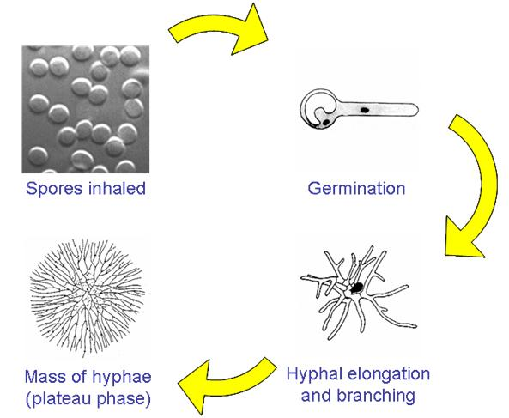
Shape-shifting fungi: Defining fungal morphotypes
Sporulating fungi (those which produce spores) distribute spores via air currents to inhabit new food sources
Aspergillus species undergo a developmental programme whereby spores are produced in high abundance from aerial hyphae (Aspergillus spores are also called conidia)
A fungal colony composed of multiple branched hyphae is referred to as a mycelium

Slide 12
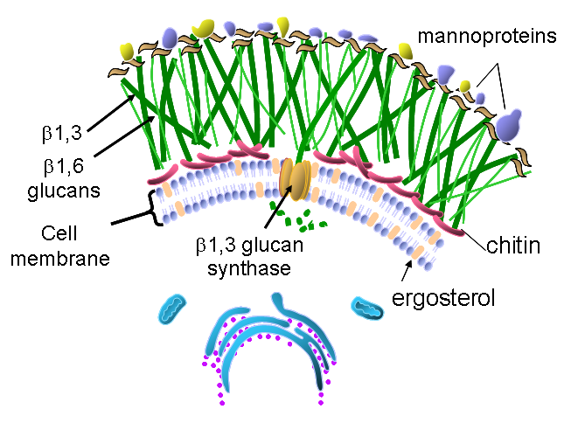
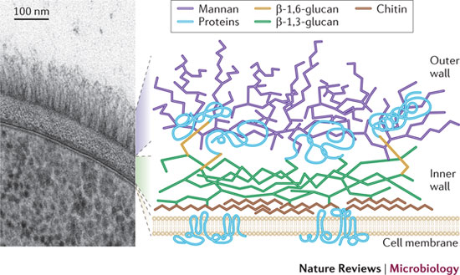
The fungal cell wall
The fungal cell wall is composed predominantly of glucans and chitin which provides physical protection. Many cell wall components are pathogen-associated molecular pattern molecules (PAMPs).
It is a fungal-specific organ and a premier target for antifungal drugs
Cell wall composition is in permanent flux, according to the environment and
morphotype of the organism.
Cell wall composition differs by species and also by morphotype

Slide 13
Audience self-assessment exercise
[Raise your hand when correct answer is read out]
Q: Which of these fungal pathogens
is NOT a yeast?
Aspergillus fumigatus
Candida albicans
Cryptococcus neoformans

Slide 14
Routes of infection [1]
Fungi infect humans via several different routes including:
Attachment and invasion of damaged skin/epithelia
[facilitated by human-human/animal contact] e.g. Candida infections
Inhalation and deposition in the respiratory tract
e.g. Cryptococcus infections, Aspergillus infections
Direct inoculation into deep tissues
[often during surgery/intubation/catheterisation]
e.g. Candida infections, Aspergillus infection.
Disease manifestation depends upon the route of infection which also dictates the nature of the initial host pathogen encounter.
Notes:
The route of infection depends upon the lifestyle of the infecting organism, life style of the patient, patient history.
Disease manifestation depends upon the route of infection and is often dictated by the nature of the first encounter between pathogen and host.
Often differs by individual...
It is useful to consider the nature of various host-pathogen interfaces when learning about relevant defences against infection. For the purposes of this lecture we will focus on three opportunistic fungal species: Candida species, Aspergillus species and Cryptococcus species.

Slide 15
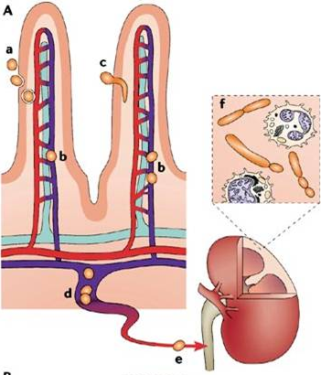
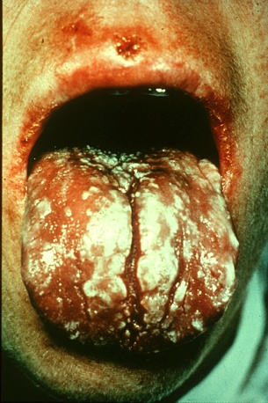
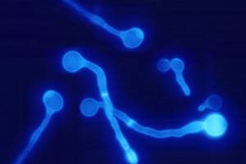
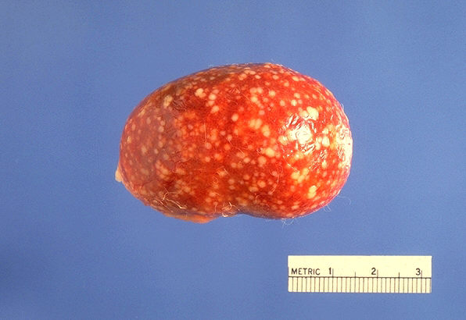
Routes of infection [2]
Candida species :
Opportunistic commensals of the gut, oral and
genitourinary tracts
Risk factors for infection:
Chemotherapy
Surgery
Catheterisation
AIDS
Disseminated canididiasis often originates at a
gastrointestinal site by entering the vasculature
via epithelial microvilli.
Mucosal disease at oral
and/or vaginal epithelia
(CD4 T cell deficiency)
Often follows changes in
resident microflora
Chauhan et al. Nature Reviews Microbiology 4, 435–444 (June 2006) | doi:10.1038/nrmicro1426
Notes:
Disseminated candidiasis can originate at a gastrointestinal site if Candida albicans enters epithelial microvilli. Having accessed the bloodstream via the vasculature C. albicans disseminates into tissues such as the kidney.
Typically, it localizes in the cortex where it grows as hyphae/pseudohyphae. A vigorous host response occurs at this site consisting of both mononuclear and polymorphonuclear leukocytes. Virulence factors (adhesins, morphogenesis, switch phenotypes, antioxidant proteins and invasive enzymes) promote the invasion of the organism.
A different host-pathogen interaction is observed during other mucosal infections, such as oropharyngeal candidiasis – which often arises during CD4 T cell deficiency (AIDS). Recent studies have attributed a role for Th-17 induced effector molecules in resistance to oral candidiasis.

Slide 16
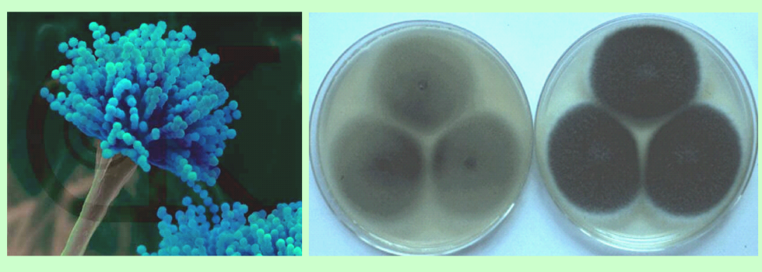
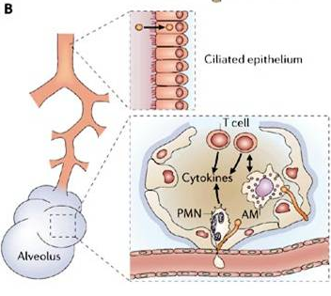
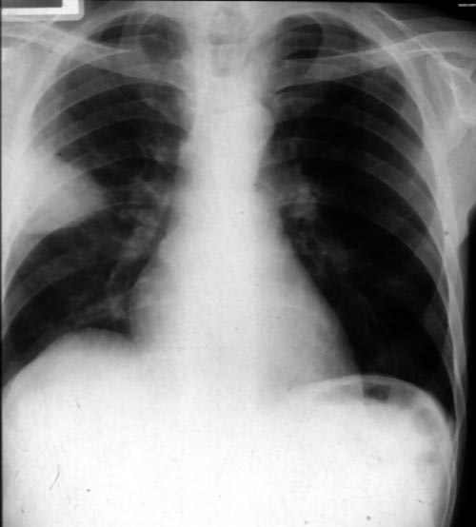
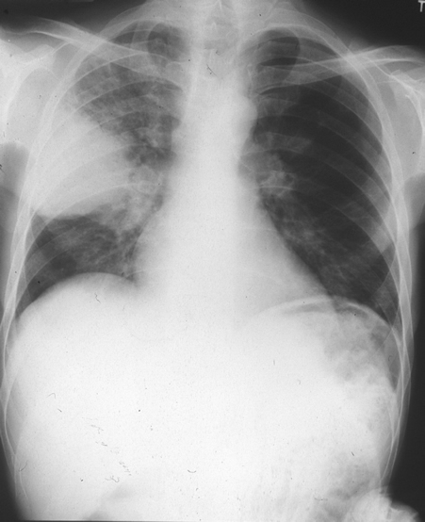
Routes of infection [3]
Aspergillus species:
Major components of the airborne microflora
Hundreds of spores inhaled on a daily basis
Ciliary clearance and pulmonary
polymorphonuclear leukocytes protect
effectively
Chauhan et al. Nature Reviews Microbiology 4, 435–444 (June 2006) | doi:10.1038/nrmicro1426
Notes:
Aspergillus spores (or conidia) are a common component of the airborne microflora. Human immunity serves a dual purpose in protecting against the negative effects of spore inhalation: a) clearing inhaled spores through physical and cell-mediated mechanisms b) preventing/tempering harmful inflammatory responses to non-threatening inhaled fungal spores.
Human alveolar macrophages (AMs) and polymorphonuclear leukocytes (PMNs) protect effectively against inhaled aspergillus spores.
In the absence of adequate immune challenge, spores persist in the lung alveoli, germinate and invade surrounding tissue and vasculature. Thus can lead to disseminated infection.
Chest X ray shows serial images from chemotherapy patient taken 4 days apart. Patient presented with chest pain and fever. The wedge shaped lesion is due to invasive growth of Aspergillus fumigatus. The growth of the organism is rapid within the human host.

Slide 17
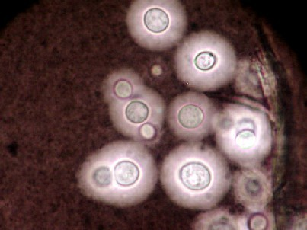
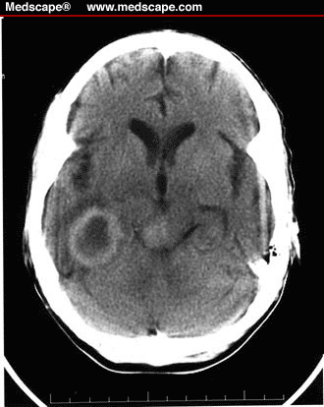
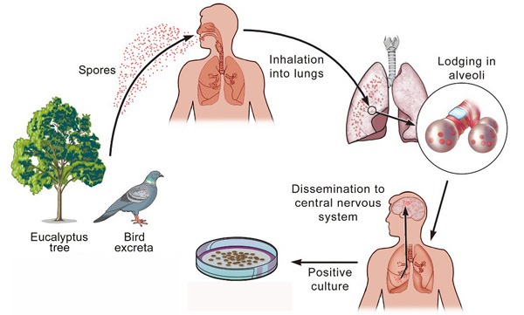
Routes of infection [4]
Crytpococcus species:
Encapsulated yeasts
Reservoirs exist in nature (commonly found in pigeon droppings)
Acquired via inhalation (evidence for early exposure)
Assumed to reside latently becoming pathogenic following subsequent
immune-suppression, particularly AIDS, CD4 T cells crucial
Notes:
Brain scan case study: The patient was a 34-year-old woman with AIDS who was brought in by a family member because "she had been demented for weeks." The patient had complained of headache, fever, unsteady gait, and blurred vision in her right eye. HIV infection had been diagnosed in 1992. Her initial CD4+ T-lymphocyte count was 490/mL, but by 1996, it had dropped to 36/mL. Four months before admission, her CD4+ cell count was 12/mL, with a viral load of 557,187 copies/mL. She was not receiving HAART, because it adversely affected her quality of life. She had no previous AIDS-defining illness.
On admission, she was febrile, with a temperature of 40°C (104°F). She had ataxia and reduced vision in her right eye. Ophthalmologic evaluation was unremarkable. A CT scan of the head revealed contrast-enhancing lesions with mass effect.
CNS fluid culture grew Cryptococcus neoformans.
C. neoformans infection remains a severe infectious threat among AIDS patients in e.g.subsaharan Africa where access to antiretroviral therapy is limited/impossible.

Slide 18
Audience self-assessment exercise
[Raise your hand when correct answer is read out]
Q: Which of these fungal pathogens
is a human commensal?
Aspergillus fumigatus
Candida albicans
Cryptococcus neoformans

Slide 19
Audience self-assessment exercise
[Raise your hand when correct answer is read out]
Q: Which of these fungal pathogens
latently colonises infected hosts?
Aspergillus fumigatus
Candida albicans
Cryptococcus neoformans

Slide 20
2) Immunity to fungal infection (systemic perspective)
Risk factors for fungal infections
b) A damage-response framework to describe the host-pathogen interaction
Overview of mammalian immunity to fungi

Slide 21
The risk for type of fungal infection differs, depending upon
which aspect of immunity is impaired
The immune response to fungi varies with respect to fungal species, morphotype
and site of infection
No standardised vaccines in existence
Fungal pathogen/infection | Host factor
Candida (Mucosal infection) | Impaired cell mediated immunity
Candida (Disseminated infection) | Impaired muscosa, breach of epithelial barrier, neutropenia, chronic granulomatous disorder (CGD)
Aspergillus | Neutropenia, high dose corticosteroids, chronic granulomatous disorder (CGD)
Cryptococcus | Impaired cell mediated immunity, corticosteroids
Defects in host defences that predipose patients to infections with specific fungi
Notes:
The immune response varies with respect to the fungal species encountered. The relative importance of specific innate and adaptive defence mechanisms differs, depending upon the organism and anatomical site of infection. No standardized vaccines exist for preventing any of the human infections caused by fungi — a situation that is attributable to both the complexity of the pathogens and their sophisticated strategies for surviving in the host and evading immune responses.

Slide 22
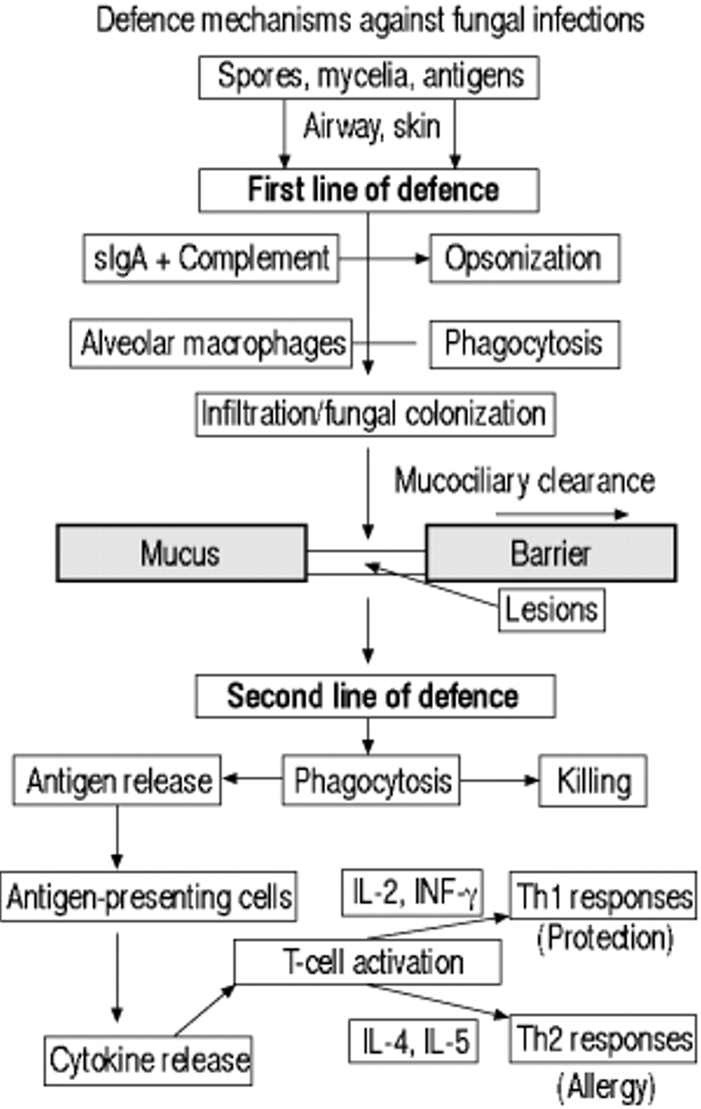
Overview of mammalian immunity to fungi
(Generalised scheme)
Antifungal defences are mediated by:
Cells (direct cytotoxicity)
Cellular receptors (Trigger inflammatory responses)
Several humoral factors
Professional phagocytes have an essential role
The first line of defence is physical, on the skin,
or oral, pulmonary or gastrointestinal mucosa.
If first lines of defence are breached, increased
exposure to fungal antigens follows, eliciting a
T-helper 1 type response in normal individuals
and a T-helper 2 type response in atopic
individuals
Notes:
This slide is intended to provide an overview of the sequence of events occurring during immune challenge with fungal components or soluble antigen.
It will help you to map the various events surrounding innate and adaptive responses to fungi within the context of a normal healthy response.
Protective immunity against fungal pathogens is achieved by the integration of two distinct arms of the immune system, the innate and adaptive responses. Innate and adaptive immune responses are intimately linked and controlled by sets of molecules and receptors that act to generate the most effective form of immunity for protection against fungal pathogens. The decision of how to respond will still be
primarily determined by interactions between pathogens and cells of the innate immune system, but the actions of T cells will feed back into this dynamic equilibrium to regulate the balance between tolerogenic and inflammatory responses.

Slide 23
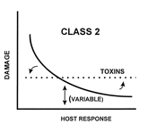
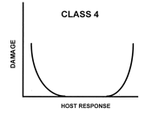
A damage-response framework to define
fungal pathogenesis
Both the host and the pathogen are responsible for
damage sustained during infection
IMPORTANCE OF TOLERANCE
Pathogens that cause damage either in hosts
with weak immune responses or in the setting of
normal host responses
e.g. Candida albicans and Cryptococcus neoformans
Pathogens that cause damage primarily at the extremes
of both weak and strong immune responses
Invasive disease versus allergy
e.g. Asperillus fumigatus
Casadevall and Pirofski (1999) Host-Pathogen Interactions: Redefining the basic concepts of virulence and pathogenicity Infect. Immun. 67:3703-3713
Notes:
Inflammation is a key feature of fungal infections and diseases. The inflammatory response may serve to limit infection but an overzealous or heightened inflammatory
response may contribute significantly to the histological patterns and pathogenicity. It is therefore important to consider the contribution of both host and pathogen to disease manifestation and outcome. In many instances both the host and the pathogen are responsible for damage to the host.
The damage-response continuum is a concept proposed by Arturo Casadevall (Bronx University, NY) to describe the relationship between host responses and disease outcome.
C. albicans causes damage in hosts with weak or normal immunity. Aspergillus fumigatus causes damage at the extremes of immunity (allergy versus invasive disease).

Slide 24
Audience self-assessment exercise
[Raise your hand when correct answer is read out]
Q: Immune responses to fungal pathogens, which
is the correct temporal sequence of events?
1.Breach of physical host defences
2. Phagocytosis
3. Cytokine-mediated T cell responses
4. Antigen presentation
1, 4, 3, 2
2, 4, 1, 3
1, 2, 4, 3
4, 2, 1, 3

Slide 25
3) Immunity to fungal infections (cellular perspective)
Major antifungal effector cells
b) Recognition of infectious fungal cells
c) Clearance of infectious fungal cells
d) Integration of innate and adaptive responses to fungal infection

Slide 26
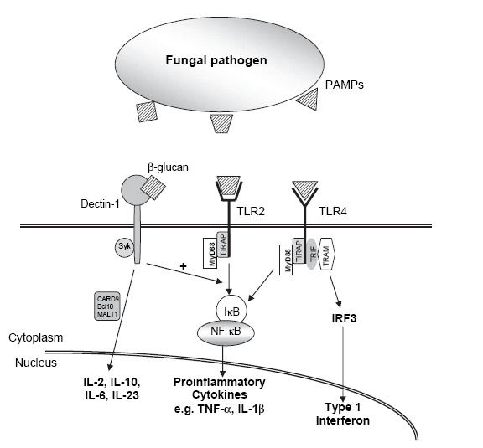
Dichotomous roles of innate immune recognition
and surveillance
Direct role = antimicrobial activity and fungal killing
2) Facilitative role = production of proinflammatory cytokines and chemokines
and antigen presentation

Slide 27
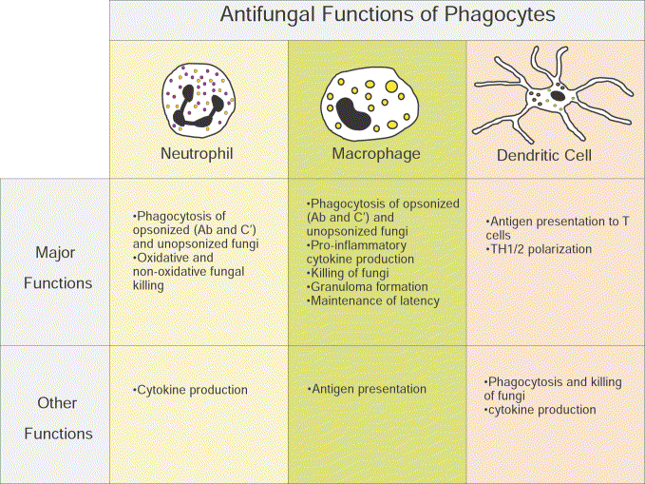
What are the major antifungal effector cells?
Notes:
Mammalian innate antifungal defences are mediated
by cells, cellular receptors and several humoral factors.
Professional phagocytes, consisting of neutrophils,
mononuclear leukocytes (monocytes and macrophages)
and dendritic cells (DCs) have an essential role.
The innate response to
fungi serves two main purposes: a direct antifungal effector
activity by carrying out pathogen destruction through
either a phagocytic process, which provides an immediate
innate cellular immune response against fungi residing
intracellularly, or through the secretion of microbicidal
compounds against uningestible fungal elements; and an
instructive role on cells of the adaptive immune system,
through the production of pro-inflammatory mediators,
including chemokines and cytokines, the induction of
co-stimulatory activity by phagocytic cells, and antigen
uptake and presentation.
Although a division of labour
exists among the cellular mediators of the innate system,
the perception is that they might share the ability to
serve both functions of the innate immune response.
This might allow for full use of redundancy and compensatory
mechanisms under specific conditions of
infection and disease.

Slide 28
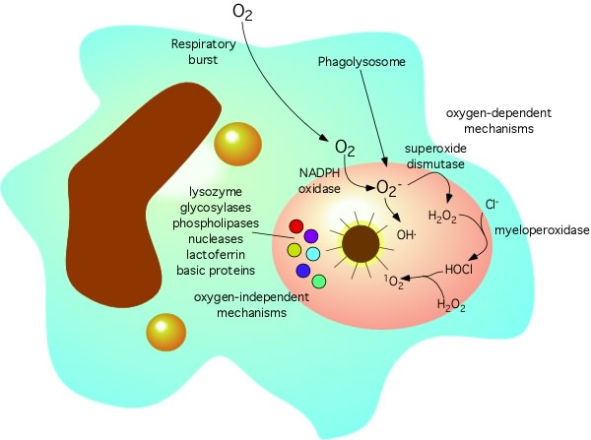
Fungal killing: mechanisms of phagocytic cells
Phagocytic cells kill internalized microbes by both oxidative and non-oxidative mechanisms
The NADPH oxidase enzyme complex is a multi-subunit enzyme complex which mediates the ‘respiratory burst’
During phagocytosis oxygen consumption is increased through the activity of NADPH-oxidase generating superoxide anion O₂₋ and hydrogen peroxide H₂O₂
These oxygen metabolites give rise to yet other reactive oxygen species that are strongly anti-microbial but which may also cause tissue damage and apoptosis, the role of ROS in fungal killing is recognised as essential, but the basis remains controversial.
Inherited mutations of NADPH oxidase enzyme subunits result in Chronic Granulomatous Disorder (CGD). Sufferers are highly susceptible to Aspergillus and Candida infections

Slide 29
Audience self-assessment exercise
[Raise your hand when correct answer is read out]
Q: Which cells play a direct role in presentation of fungal antigens to T cells?
Dendritic cells
Macrophages
Neutrophils

Slide 30
Audience self-assessment exercise
[Raise your hand when correct answer is read out]
Q: Which of these
entities are directly toxic to fungal cells?
Cytokines
Reactive oxygen species
Neutrophils

Slide 31
Neutrophil-mediated killing
of Aspergillus fumigatus

Slide 32
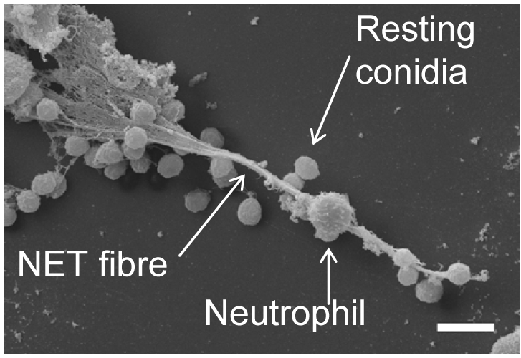
Neutrophil extracellular traps (NETs)
The production of ROI by the host might be important for the control of Aspergillus on a level distinct from direct killing.
NETs are extracellular fibres, derived from chromatin and coated with granule proteins
Produced as a final act of defence by dying neutrophils
NET production (NETosis) requires a ROI-mediated signalling cascade
Restoration of NADPH oxidase in CGD cells by gene transfer re-establishes NETosis
Bruns et. al. (2010) Production of neutrophil extracellular traps against A. fumigatus
http://www.ncbi.nlm.nih.gov/pmc/articles/PMC2861696/

Slide 33
Extraordinary interaction between
Cryptococcus neoformans and macrophages

Slide 34
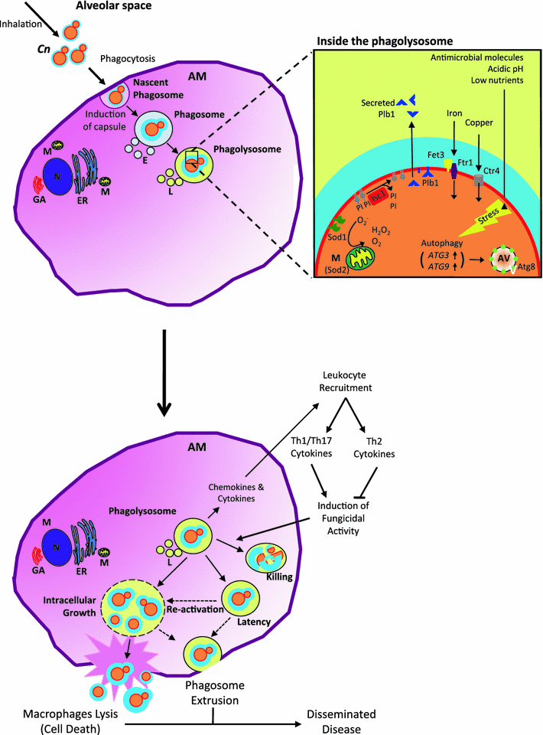
Roles of alveolar macrophages in the
host response to
Cryptococcus neoformans
Alveolar macrophages play an essential role in defence against cryptococcus infections
Internalisation by phagocytosis is an essential step which precedes chemokine and cytokine secretion, recruitment of other immune cells, killing of the pathogen and antigen presentation
A CD4+ Th1 response is essential for clearance of infecting fungal cells and suppression of invasive infection
Three possible outcomes of this interaction:
Clearance by collaborative innate and adaptive responses
Latency
Cn survival, CNS entry and infection
Paradoxical roles of alveolar macrophages in the host response
to C. neoformans J. Infect. Chemother. 2011

Slide 35
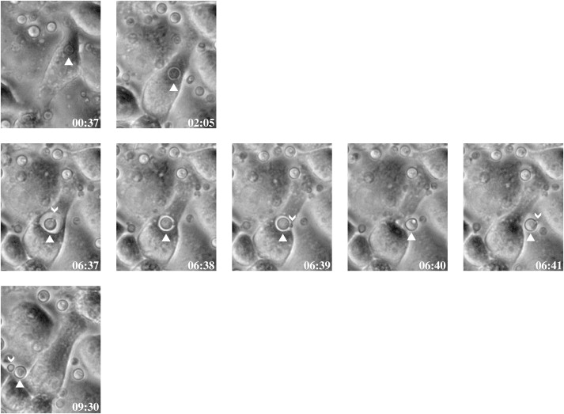
C. neoformans escape from macrophages (unofficially known as vomocytosis)
Curr Biol. 2006 Nov 7;16(21):2156-60.
Expulsion of live pathogenic yeast by macrophages.
Ma H, Croudace JE, Lammas DA, May RC.

Slide 36
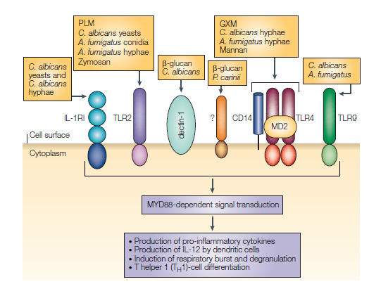
Recognition of fungal pathogens
A number of fungal cell wall components
may act through several distinct
pattern recognition receptors (PRRs).
Some fungal PAMPs are specific to
certain morphotypes.
Certain morphotypes may be able to evade
recognition by host cells.
TLRs are activators of innate and adaptive
immunity to fungi.
Notes:
A number of cell wall components of fungi may act through several distinct PRRs, each activating specific antifungal programmes on phagocytes and dendritic cells (DCs) but cooperating for full immune cell activation. The environmental set up probably affects PRR functioning, given that the optimal ability of cells to phagocytose fungi is observed
in the environment where a pathogen is naturally encountered.
TLRs might also promote the pathogenesis of infections.
PLM = phospholipomannan
GXM = galactoxylomannan

Slide 37
Dichotomous roles of innate immune recognition
and surveillance
Direct role = antimicrobial activity and fungal killing
2) Facilitative role = production of proinflammatory cytokines and chemokines
and antigen presentation

Slide 38
The fungal cell wall
The fungal cell wall is composed predominantly of glucans and chitin which provides physical protection. Many cell wall components are pathogen-associated molecular pattern molecules (PAMPs).
It is a fungal-specific organ and a premier target for antifungal drugs
Cell wall composition is in permanent flux, according to the environment and
morphotype of the organism.
Cell wall composition differs by species and also by morphotype

Slide 39
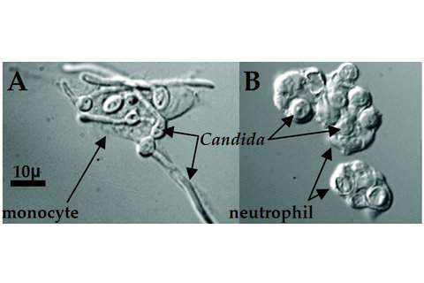
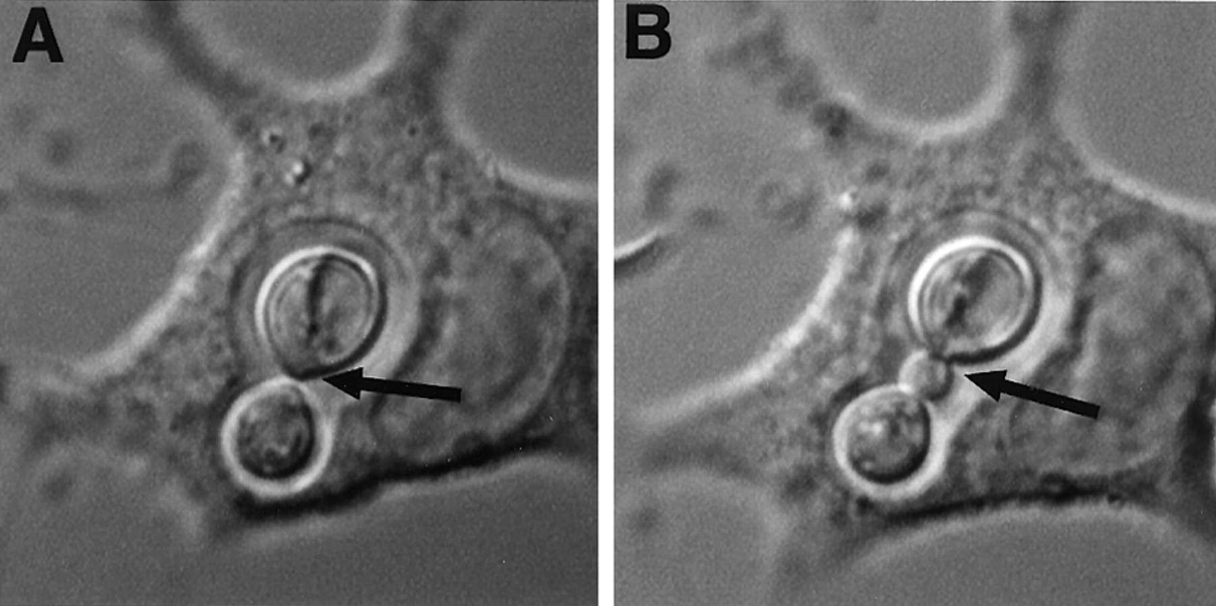
The immune response to fungi varies with respect
to the fungal species and morphotype encountered
Regardless of species and/or site
of infection professional phagocytes
are the major antifungal effector cells
Candida albicans experiences nutrient
starvation inside the macrophage
phagolysososome, prompting germination
and escape
Cryptococcus neoformans can mulitply
inside the macrophage phagolysosome
and subsequently escape.
Candida albicans
Cryptococcus neoformans
Notes:
Regardless of the route of infection, macrophages play a primary role in the initial interaction between host and pathogen. Other phagocytic cells, such as neutrophils and dendritic cells (DCs), are also intimately involved in the initial host–pathogen interaction. An understanding of the host response to these organisms is important in decisions regarding use of currently available antifungal therapies and in the design of new therapeutic modalities. Within a species, the fungal morphotype (e.g. yeast, pseudohyphae and hyphae of Candida albicans) may be an important determinant of the host response. Whereas yeasts and spores are often
effectively phagocytosed, the larger size of hyphae precludes effective ingestion.
For commensals: the highly effective strategies of immune evasion they must have
evolved to survive in the host environment and the prolonged antigenic stimulation of the host that can have marked immunoregulatory consequences.
So, in the context of the antagonistic relationships that characterize
host–pathogen interactions, the strategies used by the host to limit fungal infectivity are necessarily distinct and, in retaliation, fungi have developed their
own elaborate tactics to sidestep these defences. This highlights the complexity of the relative contributions of individual aspects of host defences in limiting fungal
infectivity.

Slide 40
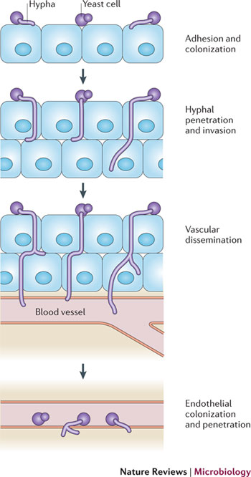
Fungal morphogenesis facilitates infection by:
Promoting tissue invasion
Masking pathogen associated molecular patterns (PAMPs) which are recognised by immune cells
3) Promoting escape from within immune cells following phagocytosis
Schematic view of Candida albicans tissue invasion

Slide 41
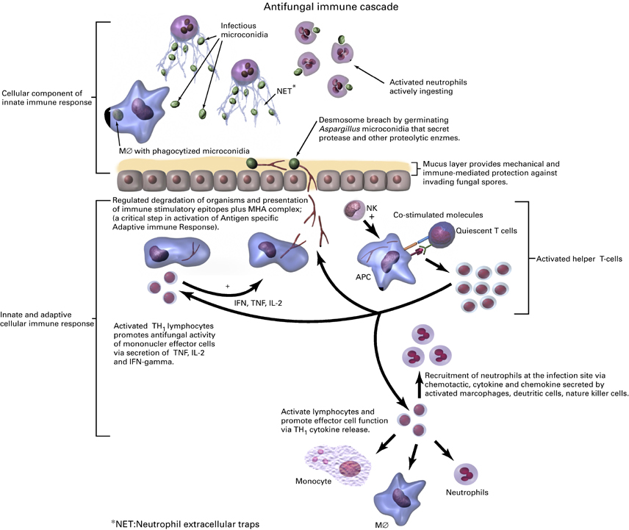
Putting it all together:
Several shared defence mechanisms are operative in response to a range of fungi
Neutrophils, macrophages and dendritic cells are fundamentally important antifungal effector cells
2) Damaged epithelial cells and activated phagocytes secrete cytokines which recruit neutrophils to the site of infection
3) Macrophages, dendritic cells and B cells process microbial antigens, and present them to T cells in an MHC-bound form at their own cellular boundary
4) The nature of the antigen presented, cytokine envronment determine Th1/Th2 polarisation
Notes:
The inflammatory response is initially mediated by cells of the innate immune system followed by a later
adaptive immune response, which responds to the signals originated by the innate immune system [26].
Most of the innate mechanisms are inducible upon infection and their activation requires specific recognition
of invariant evolutionarily conserved molecular structures shared by large groups of pathogens by a set
of pattern recognition receptors (PRRs), including Toll-like receptors (TLRs) and C-type lectins [2628].
Innate and adaptive immune responses are intimately linked and controlled by sets of molecules and receptors
that act to generate the most effective form of immunity for protection against fungal pathogens
The decision of how to respond will still be primarily determined by interactions between pathogens
and cells of the innate immune system, but the actions of T cells will feed back into this dynamic
equilibrium to suppress overzealous innate responses [11].
Antigen-independent recognition of fungi by the innate immune system leads to the immediate mobilization of
immune effector and regulatory mechanisms that provide the host with the rapid initiation of the immune
response and creation of the inflammatory and costimulatory environment for antigen recognition; establishment
of a first line of defense, which holds the pathogen in check during the maturation of the
adaptive immune response; and steering of the adaptive immune response towards the cellular or humoral
elements that are most appropriate for protection against the specific pathogen. Receptors on phagocytes
not only mediate downstream intracellular events related to clearance, but also participate in complex
and disparate functions related to immunomodulation and activation of immunity, depending on cell type.
Therefore, in order to achieve optimal activation of antigen-specific adaptive immunity, it is first necessary
to activate the pathogen-detection mechanisms of the innate immune response.

Slide 42
Further reading (Hyperlinked)
Crameri and Blaser (2002) Allergy and immunity to fungal infections and colonization
Eur. Respir. J. 19:151-157
2) Luigina Romani (2004) Immunity to fungal infections Nat. Rev. Microbiol. 4:1-23
3) Luigina Romani (2008) Cell mediated immunity to fungi: a reassessment
Med. Mycol. 46:515-529

