Slide 1
Year 2: Molecules Cells & Disease
Haematology
14 November Lectures:
Haematology 5 and 6
9 am Lecture: Haemostasis: Prof David Lane
Film
10 am Lecture: Abnormalities of Haemostasis: Dr Carolyn Millar
Department of Haematology
Hammersmith Hospital Campus
(d.lane@imperial.ac.uk; c.millar@imperial.ac.uk)

Slide 2
Learning Outcomes
The student should be able to:
1. Explain the normal haemostatic mechanisms including the
interaction of vessel wall, platelets and clotting factors
2. Describe the clinical features of bleeding due to
thrombocytopenia and coagulation disorders, respectively
3. Describe the use of laboratory tests to assess haemostasis
4. Know the principles of management of disorders of
haemostasis

Slide 3
Abnormal Haemostasis
What is abnormal bleeding?
Why do people have abnormal haemostasis?
Laboratory detection/prediction of abnormal haemostasis
Genetics of common bleeding disorders
Treatment of bleeding disorders

Slide 4
Minor bleeding symptoms are common
Easy bruising 12%
Gum bleeding 7%
Frequent nosebleeds 5%
Bleeding after tooth extraction 2.5%
Post operative bleeding 1.4%
In women
Menorrhagia 23%
Post partum bleeding 6%
Family history 44%

Slide 5
History and Bleeding after tonsillectomy
non bleeding
%(228)
Known bleeding disorder
%(31)
24
36
39
4
4.9
3.6
2.7
67
68
69
47
39
30
22
Easy bruising
Frequent bruising
Epistaxes
>10mins
Bruises >1 site
Large bruises
Haematomata
Nosek-Cenkowska 1991

Slide 6
A significant bleeding history: elements
Epistaxis not stopped by 10 mins compression or requiring medical attention/transfusion.
Cutaneous haemorrhage or bruising without apparent trauma (esp. multiple/large).
Prolonged (>15 mins) bleeding from trivial wounds, or in oral cavity or recurring spontaneously in 7 days after wound. Spontaneous GI bleeding leading to anaemia.
Menorrhagia requiring treatment or leading to anaemia, not due to structural lesions of the uterus.
Heavy, prolonged or recurrent bleeding after surgery or dental extractions.
Sadler 2005

Slide 7
Abnormal Haemostasis
What is abnormal bleeding?
Why do people have abnormal haemostasis?
Genetics of hereditary bleeding disorders
Laboratory detection/prediction of abnormal haemostasis
Genetics of common bleeding disorders
Treatment of bleeding disorders

Slide 8
Haemostatic Plug Formation: An Overview
Response to injury
Vessel constriction
Formation of an unstable platelet plug
-platelet adhesion
-platelet aggregation
Stabilisation of the plug with fibrin
-blood coagulation
Dissolution of clot and vessel repair
-fibrinolysis

Slide 9
Abnormal Haemostasis
Lack of a specific factor
Failure of production: congenital and acquired
Increased consumption/clearance
Defective function of a specific factor
Genetic defect
Acquired defect – drugs, synthetic defect, inhibition

Slide 10
Haemostatic Plug Formation: An Overview
Response to injury
Vessel constriction
Formation of an unstable platelet plug
-platelet adhesion
-platelet aggregation
Stabilisation of the plug with fibrin
-blood coagulation
Dissolution of clot and vessel repair
-fibrinolysis
Primary
haemostasis

Slide 11
Platelet adhesion
platelet
Von
Willebrand
factor
Endothelial
cells
or
platelet
GlpIb
GlpIa
collagen
Release of ADP
&
thromboxane
Platelet aggregation
GlpIIb/IIIa
platelet
platelet
platelet
Fibrinogen
+
Ca2+

Slide 12
Disorders of Primary Haemostasis
Platelets
Low numbers: “thrombocytopenia”
Bone marrow failure eg: leukaemia, B12 deficiency
Accelerated clearance eg: immune (ITP), DIC.

Slide 13
Auto-Immune Thrombocytopenic Purpura (auto-ITP)
Y
antiplatelet
autoantibodies
Y
Y

Slide 14
Auto-Immune Thrombocytopenic Purpura (auto-ITP)
Y
antiplatelet
autoantibodies
Y
Y
.
.
.
sensitised
platelet
Y
.
.
Y
.

Slide 15
Auto-Immune Thrombocytopenic Purpura (auto-ITP)
Y
antiplatelet
autoantibodies
macrophage
Y
Y
v
.
.
.
v
sensitised
platelet
Y
.
.
Y
.
.
.
sensitised
platelet
Y
.
v
.
.
.
.
.
Y
Y
Y
v
v
ITP is a very common cause
of thrombocytopenia
v

Slide 16
Mechanisms (and causes) of Thrombocytopenia
1. Failure of platelet production by megakaryocytes
2. Shortened half life of platelets
3. Increased pooling of platelets in an enlarged spleen
(hypersplenism) + shortened half life

Slide 17
Disorders of Primary Haemostasis
Platelets
Low numbers: “thrombocytopenia”
Bone marrow failure eg: leukaemia, B12 deficiency
Accelerated clearance eg: immune (ITP), DIC.
Pooling and destruction in an enlarged spleen
Impaired function
Hereditary absence of glycoproteins or storage granules

Slide 18
Hereditary Platelet defects
Microtubules &
actomyosin
Surface glycoproteins:
GpIa
GpIIb/IIIa
GpIb
X
X
Glycogen
X
Dense granules:
ADP
ATP
Serotonin
Ca2+
Phospholipid
membrane
α granules:
growth factors
fibrinogen
factor V
vWF
Open cannalicular
system
(Receptor
for
thrombin)
mitochondrion
Glanzmann’s thrombasthenia
Bernard Soulier syndrome
Storage Pool disease

Slide 19
Disorders of Primary Haemostasis
Platelets
Low numbers: “thrombocytopenia”
Bone marrow failure eg: leukaemia, B12 deficiency
Accelerated clearance eg: immune (ITP), DIC.
Pooling and destruction in an enlarged spleen
Impaired function
Hereditary absence of glycoproteins or storage granules
Acquired due to drugs: aspirin, NSAIDs, clopidogrel

Slide 20
Disorders of Primary Haemostasis
Platelets
Von Willebrand Factor
Von Willebrand disease
Hereditary decrease of quantity +/ function (common)
Acquired due to antibody (rare)

Slide 21
Von Willebrand disease: A disorder of primary haemostasis
VWF has two functions in haemostasis
Binding to collagen and capturing platelets
Stabilising Factor VIII
Factor VIII may be low if VWF is very low
VWD is usually hereditary
Deficiency of VWF (Type 1 or 3)
VWF with abnormal function (Type 2)

Slide 22
Disorders of Primary Haemostasis
Platelets
Von Willebrand Factor
The vessel wall
Inherited (rare) Hereditary haemorrhagic telangiectasia Ehlers-Danlos syndrome and other connective tissue disorders

Slide 23
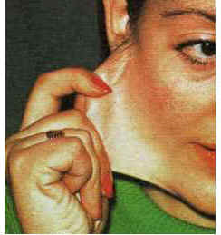
Ehlers Danlos syndrome

Slide 24
Disorders of Primary Haemostasis
Platelets
Von Willebrand Factor
The vessel wall
Inherited (rare) Hereditary haemorrhagic telangiectasia Ehlers-Danlos syndrome and other connective tissue disorders
Acquired: Scurvy, Steroid therapy, Ageing (senile purpura), Vasculitis

Slide 25
Disorders of Primary Haemostasis
Platelets
Thrombocytopenia
Drugs
Von Willebrand Factor
Von Willebrand disease
The vessel wall
Hereditary vascular disorders
Scurvy, steroids, age

Slide 26
lumen
platelet
platelet
platelet
platelet
platelet
platelet
Collagen
Tissue Factor
Primary Haemostasis: platelet plug

Slide 27
lumen
platelet
platelet
platelet
Collagen
Tissue Factor
VWD: failure of primary haemostasis

Slide 28
Bleeding in disorders of primary haemostasis
Typical primary haemostasis bleeding:
Immediate
Prolonged bleeding from cuts
Epistaxes
Gum bleeding
Menorrhagia
Easy bruising
Prolonged bleeding after trauma or surgery
Thrombocytopenia – Petechiae
Severe VWD – haemophilia-like bleeding

Slide 29
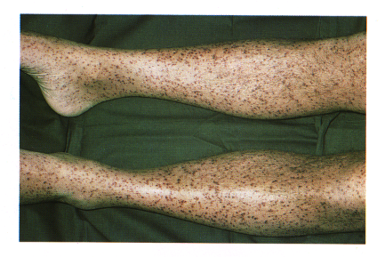
Purpura and petechiae

Slide 30
Tests for disorders of primary haemostasis
Platelet count
Bleeding time (PFA100 in lab)
Assays of von Willebrand Factor
Clinical observation

Slide 31
Haemostatic Plug Formation: An Overview
Response to injury
Vessel constriction
Formation of an unstable platelet plug
-platelet adhesion
-platelet aggregation
Stabilisation of the plug with fibrin
-blood coagulation
Dissolution of clot and vessel repair
-fibrinolysis
Secondary
haemostasis

Slide 32
Blood coagulation
XII
XIIa
XI
XIa
Tissue factor
VIIa
(vessel damage)
Ca
2+
IX
IXa
VIIa
EXTRINSIC
PATHWAY
INTRINSIC
PATHWAY
VIIIa
Ca
2+
Pl
Ca ²⁺
X
Xa
X
Va
Pl
Ca
2+
COMMON
PATHWAY
Prothrombin
thrombin (IIa)
Fibrinogen
Fibrin
thrombin
XIIIa
XIII
Crosslinked
fibrin

Slide 33
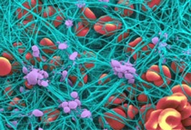
Fibrin mesh binds and stabilises platelet plug and other cells

Slide 34
Thrombin generation by the coagulation cascade
Normal
Haemophilia
Factor VIII <1%
TF trigger

Slide 35
Disorders of coagulation – bleeding pattern
The role of the coagulation cascade is to generate a burst of thrombin which will convert fibrinogen to fibrin
Deficiency of any coagulation factor results in a failure of thrombin generation and hence fibrin formation

Slide 36
Coagulation and secondary haemostasis
The primary platelet plug is sufficient for small vessel injury
In larger vessels it will fall apart
Fibrin formation stabilises the platelet plug
So -

Slide 37
lumen
Haemostasis: fibrin clot stabilising platelet plug

Slide 38
lumen
Haemophilia: failure to generate fibrin to stabilise platelet plug

Slide 39
Disorders of Coagulation
Deficiency of coagulation factor production
Hereditary
Factor VIII/IX: haemophilia A/B

Slide 40
Coagulation factor deficiencies
are not all the same
Factor VIII and IX (Haemophilia)
Severe but compatible with life
Spontaneous joint and muscle bleeding
Prothrombin (Factor II)
Lethal
Factor XI
Bleed after trauma but not spontaneously
Factor XII
No excess bleeding at all

Slide 41
Blood coagulation
XII
XIIa
XI
XIa
Tissue factor
VIIa
(vessel damage)
Ca
2+
IX
IXa
VIIa
EXTRINSIC
PATHWAY
INTRINSIC
PATHWAY
VIIIa
Ca
2+
Pl
Ca ²⁺
X
Xa
X
Va
Pl
Ca
2+
COMMON
PATHWAY
Prothrombin
thrombin (IIa)
Fibrinogen
Fibrin
thrombin
XIIIa
XIII
Crosslinked
fibrin

Slide 42
Disorders of Coagulation
Deficiency of coagulation factor production
Hereditary failure of production
Factor VIII/IX: haemophilia A/B
Acquired
Liver disease
Dilution
Anticoagulant drugs – warfarin

Slide 43
Acquired coagulation disorders (1)
More common in hospital practice
Liver failure – decreased production
Most coagulation factors are synthesised in the liver
Dilution
Red cell transfusions no longer contain plasma
Major transfusions require plasma as well as rbc and platelets

Slide 44
Disorders of Coagulation
Deficiency of coagulation factor production
Hereditary failure of production
Factor VIII/IX: haemophilia A/B
Acquired
Liver disease
Dilution
Anticoagulant drugs – warfarin
Increased consumption
Acquired
Disseminated intravascular coagulation (DIC)
Immune - autoantibodies

Slide 45
Acquired coagulation disorders (2)
Consumption
Disseminated intravascular coagulation
increased consumption
Generalised activation of coagulation – Tissue factor
Associated with sepsis, major tissue damage, inflammation
Consumes and depletes coagulation factors
Platelets consumed
Activation of fibrinolysis depletes fibrinogen
Deposition of fibrin in vessels causes organ failure

Slide 46
Bleeding in coagulation disorders
superficial cuts do not bleed (platelets)
bruising is common, nosebleeds are rare
spontaneous bleeding is deep, into muscles
and joints
bleeding after trauma may be delayed and is prolonged
frequently restarts after stopping

Slide 47
Haemarthrosis – hallmark of haemophilia

Slide 49
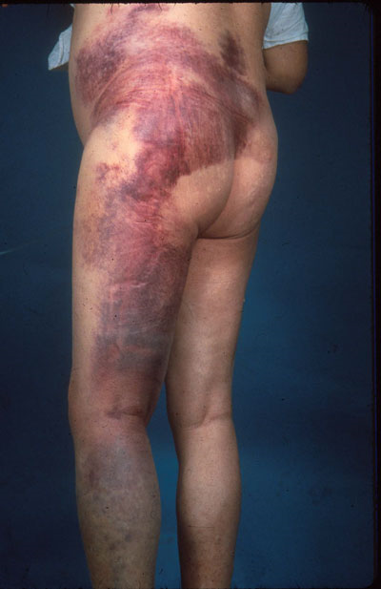
Intramuscular injections should be avoided

Slide 50
How serious is haemophilia?
Carol Birch 1937

Slide 51
Clinical Distinction Between Bleeding due to Platelet and Coagulation Defects
Platelet/Vascular
Superficial bleeding
into skin, mucosal
membranes
Bleeding immediate
after injury
Coagulation
Bleeding into deep
tissues, muscles,
joints
Delayed, but severe
bleeding after
injury. Bleeding
often prolonged
This is a simplistic distinction. Note that
either defect can be life threatening

Slide 52
Tests for coagulation disorders
Screening tests (‘clotting screen’)
Prothrombin time (PT)
Activated partial thromboplastin time (APTT)
Full blood count (platelets)
Factor assays (for Factor VIII etc)
Tests for inhibitors

Slide 53
HMWK
APTT
CONTACT
PK
XII
XI
VIIa
PT
TF
VIII
IX
V
X
TT
IIa
II
Fibrinogen
Fibrin

Slide 54
PROLONGED APTT in HAEMOPHILIA
APTT
(intrinsic)
XII
PT
(extrinsic)
XI
VIIa
VIII
IX
TF
PT 10.6s (9.6-11.6)
APTT 85s (26-32)
TT 16s (15-19)
V
X
II
Fibrinogen
Fibrin

Slide 55
Bleeding disorders not detected by
routine clotting tests
Mild factor deficiencies
von Willebrand disease
Factor XIII deficiency (cross linking)
Platelet disorders
Excessive fibrinolysis
Vessel wall disorders
Metabolic disorders (e.g. uraemia)
(Thrombotic disorders)

Slide 56
Haemostatic Plug Formation: An Overview
Response to injury
Vessel constriction
Formation of an unstable platelet plug
-platelet adhesion
-platelet aggregation
Stabilisation of the plug with fibrin
-blood coagulation
Dissolution of clot and vessel repair
-fibrinolysis
Fibrinolysis

Slide 57
Disorders of Fibrinolysis
Disorders of fibrinolysis can cause abnormal bleeding but are rare
Hereditary
antiplasmin deficiency
Acquired
drugs such as tPA
Disseminated intravascular coagulation

Slide 58
Abnormal Haemostasis
What is abnormal bleeding?
Why do people have abnormal haemostasis?
Laboratory detection/prediction of abnormal haemostasis
Genetics of common bleeding disorders
Treatment of bleeding disorders

Slide 59
Haemophilia: a sex linked recessive disorder
XY
XX
XX
XY
100%
95%
50%
120%
XY
XX
XX
XY
1%
65%
60%
110%
Unaffected female
Carrier female
Unaffected male
Affected male

Slide 60
Von Willebrand disease: an autosomal
dominant disorder
Unaffected female
Affected female
Unaffected male
Affected male

Slide 61
Genetics of common bleeding disorders
Haemophilia
Sex linked recessive (SLR)
Von Willebrand disease
Autosomal
Type 2, (Type 1) AD
Type 3 AR
All the rest (V, X etc.)
Autosomal recessive (AR)
And therefore much less common

Slide 62
Abnormal Haemostasis
What is abnormal bleeding?
Why do people have abnormal haemostasis?
Laboratory detection/prediction of abnormal haemostasis
Genetics of common bleeding disorders
Treatment of bleeding disorders

Slide 63
Treatment of abnormal haemostasis
Failure of production/function
Replace missing factor/platelets
Prophylactic
Therapeutic
Stop drugs
Immune destruction
Immunosuppression (eg prednisolone)
Splenectomy for ITP
Increased consumption
Treat cause
Replace as necessary

Slide 64
Factor replacement therapy
Principles of Treatment of Haemostatic
Disorders Causing Bleeding
Plasma
Contains all coagulation factors
Cryoprecipitate
Rich in Fibrinogen, FVIII, VWF, Factor XIII
Factor concentrates
Concentrates available for all factors except factor V.
Recombinant forms of FVIII and FIX are available.
Platelet replacement therapy
Pooled platelet concentrates available

Slide 65
Using factor replacement therapy
factor
level (%)
100
75
50
25
0
VIII
IX
0
12
24
24
36
48
96
60
time (hours)

Slide 66
Additional haemostatic treatments
DDAVP
Tranexamic acid
Fibrin glue/spray

Slide 67
Desmopressin (DDAVP)
Vasopressin derivative
2-5 fold rise in VWF-VIII (VIII>vWF)
Releases endogenous stores -
Hence only useful in mild disorders
Dose
Peak response
0.3µg/kg i.v
30-60 mins
300µg i.n.
60-90 mins

Slide 68
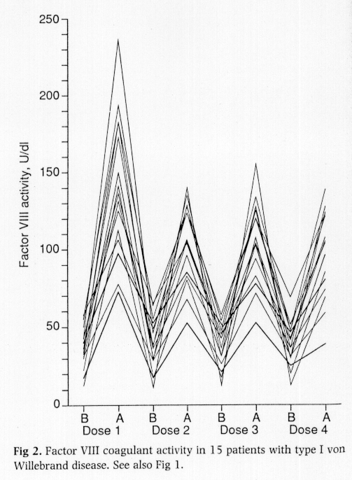
Repeated DDAVP doses and Factor VIII
Mannucci 1992

Slide 69
Tranexamic acid
Inhibits fibrinolysis
Widely distributed – crosses placenta
Low concentration in breast milk
Useful adjunctive therapy.
Intravenous: 0.5g tds
Oral: 1.5g tds
Mouthwash: 1g (10ml 5%) qds

Slide 70
Haemostasis and Thrombosis: a Balance
Normal haemostasis: a state of equilibrium
Fibrinolytic factors,
anticoagulant proteins
Coagulation factors,
platelets

Slide 71
Bleeding
Coagulation factors,
platelets
Fibrinolytic
factors,
anticoagulant
proteins

Slide 72
Thrombosis
Fibrinolytic factors,
anticoagulant proteins
Coagulation
factors,
platelets

