Slide 1
Neuromuscular and spinal cord control of movements
LIFE CYCLE AND REGULATORY SYSTEMS
Neuroscience and mental health
26 October 2011
Dr Paul Strutton
Department of Surgery & Cancer
Faculty of Medicine

Slide 2
Overview
Synapses and the neuromuscular junction
Alpha motor neurons
The motor unit
Regulation of muscle force
Trophism
Functional organisation of the spinal cord
Reflexes (including hypo & hyper-reflexia)
Descending (supraspinal) control of reflexes

Slide 3
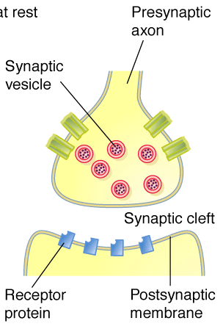
Synapses
Synapse - Greek word for “contact or junction”
Allows for contact from neurone to muscle or from neurone to neurone.
Basic structure is similar throughout the nervous system.
Arrangements can be simple or complex.
Contact ratio – ranges from 1:1 for muscle to 10³:1 in the CNS
Presynaptic
terminal
“BOUTON”
10 - 50 nm

Slide 4
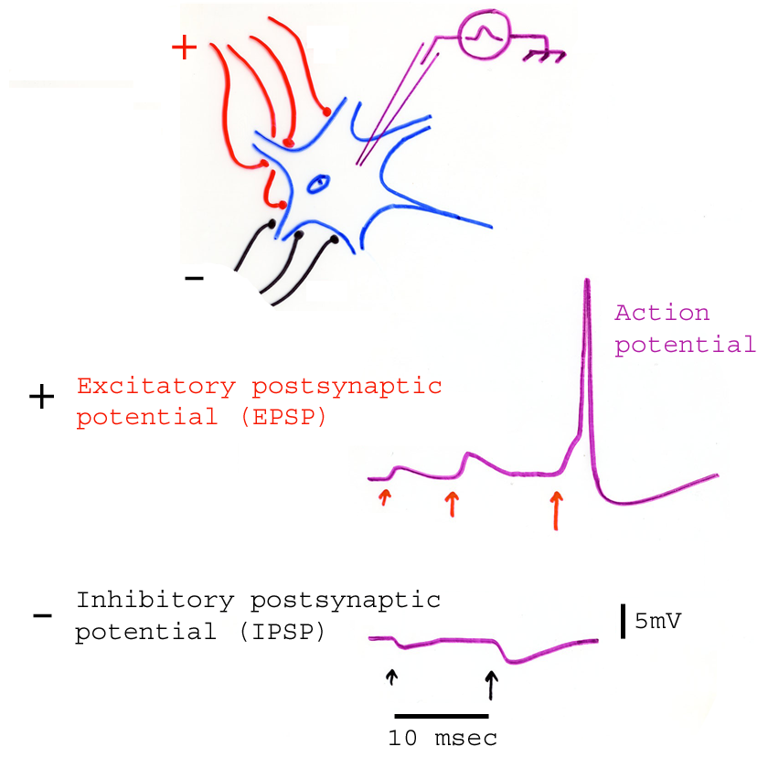
Transmission across synapses
The membrane potential of the post synaptic neurone can be altered in two directions by inputs.
It can be made less negative – i.e. be brought closer to threshold for firing; this is an excitatory post synaptic potential (EPSP)
OR
It can be made more negative – i.e. be brought further away from threshold for firing; this is an inhibitory post synaptic potentials (IPSP)
Graded effects = SUMMATION.
Record membrane potential

Slide 5
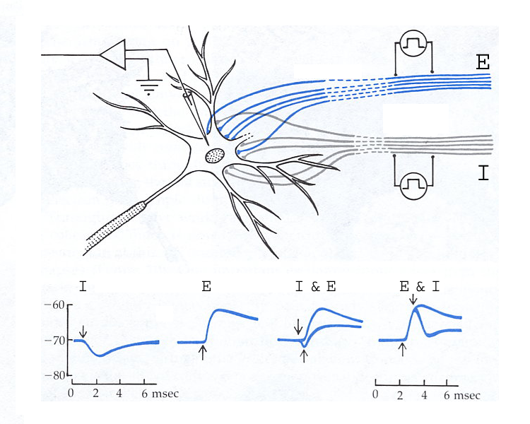
Transmission across synapses
EPSPs & IPSPs can also SUMMATE.
The degree of summation will
determine how readily a neuron
can reach threshold to produce an action potential.

Slide 6
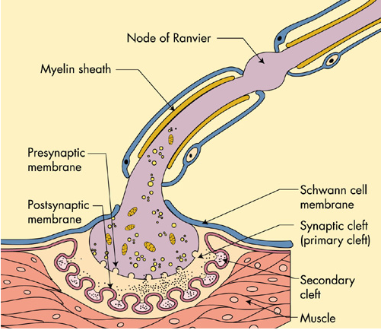
The neuromuscular junction
A specialised synapse between the motor neuron and the motor end plate, the muscle fibre cell membrane

Slide 7
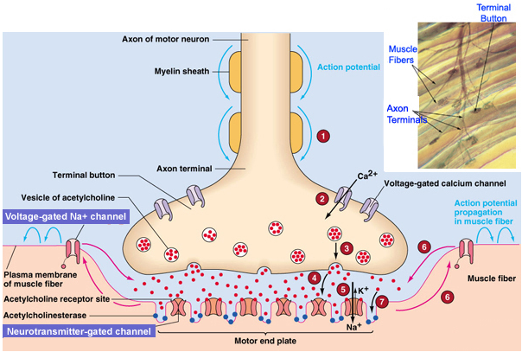
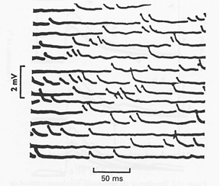
Activation of the neuromuscular junction
When an action potential arrives at the MNJ, Ca²⁺ influx causes ACh release. ACh binds to receptors on motor end plate.
Ion channel opens – Na⁺ influx causes action potential in muscle fibre.
Presynaptic
Postsynaptic
At rest, individual vesicles release ACh at a very low rate causing miniature end-plate potentials (mEPP)

Slide 8
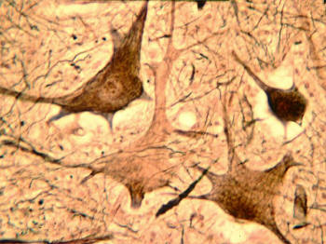
The alpha motor neuron
These are the lower motor neurons of the brainstem and the spinal cord
They innervate the (extrafusal) muscle fibres of the skeletal muscles
Their activation causes muscle contraction
The motor neuron pool contains all alpha motor neurons innervating a single muscle

Slide 9
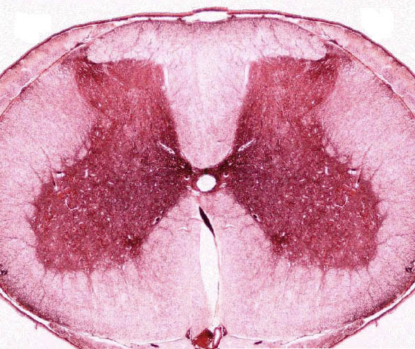
The alpha motor neuron
White matter
Flexors
Grey matter
Proximal
Distal
Extensors

Slide 10
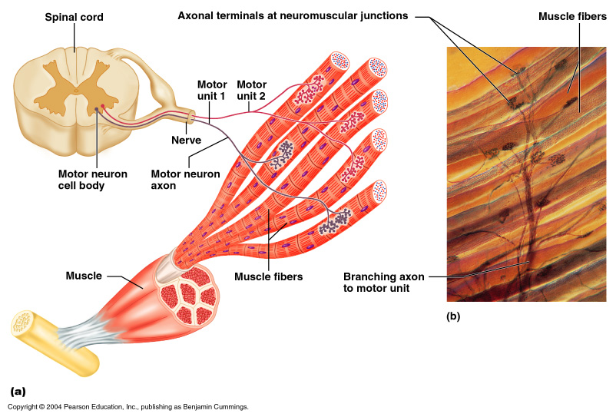
The motor unit

Slide 11
The motor unit
This is the name given to a single motor neuron together with all the muscle fibres that it innervates. It is the smallest functional unit with which to produce force.
Humans have approximately 420,000 motor neurons and 250 million skeletal muscle fibres.
On average each motor neuron supplies about 600 muscle fibres.
Stimulation of one motor unit causes contraction of all the muscle fibres in that unit.

Slide 12
Types of motor unit
Slow
(S, type I)
Fast, fatigue resistant
(FR, type IIA)
Fast, fatiguable
(FF, type IIB)
smallest diameter cell bodies
small dendritic trees
thinnest axons
slowest conduction velocity
larger diameter cell bodies
larger dendritic trees
thicker axons
faster conduction velocity
larger diameter cell bodies
larger dendritic trees
thicker axons
faster conduction velocity

Slide 13
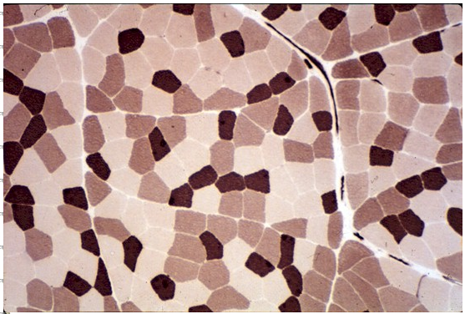
Distribution of fibre types

Slide 14
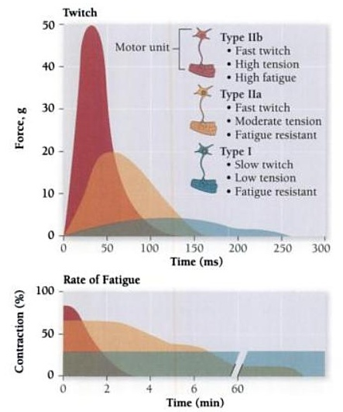
Properties of motor units
The 3 different motor unit types are classified by the amount of tension generated, speed of contraction and fatiguability of the motor unit.

Slide 15
Regulation of muscle force
Two mechanisms by which the brain regulates the force that a single muscle can produce.
Recruitment
Motor units are not randomly recruited. There is an order to this.
Governed by the “Size Principle”. Smaller units are recruited first (these are generally the slow twitch units).
As more force is required, more units are recruited.
This allows fine control (e.g. when writing), under which low force levels are required.
Rate coding
A motor unit can fire at a range of frequencies. Slow units fire at a lower frequency.
As the firing rate increases, the force produced by the unit increases.
Summation occurs when units fire at frequency too fast to allow the muscle to relax between arriving action potentials.

Slide 16
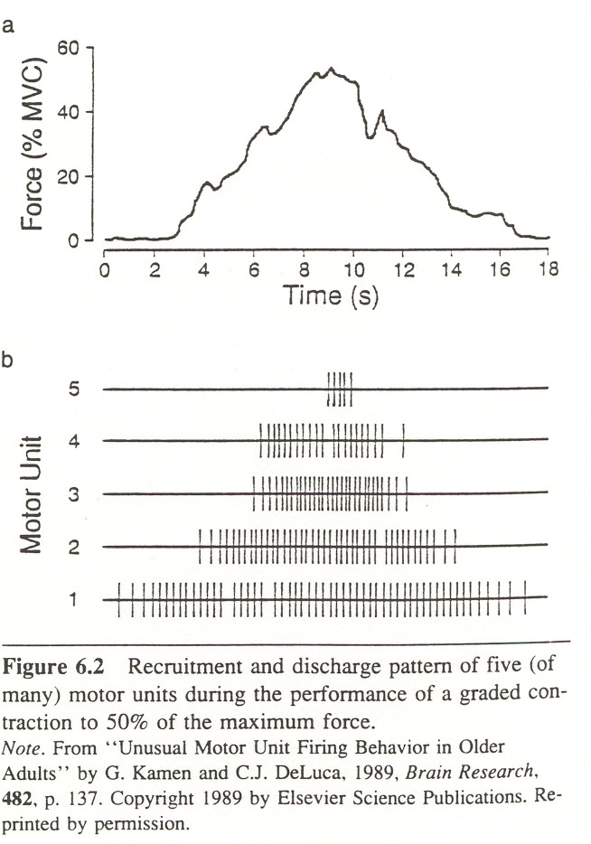
Recruitment
Slow
FR
FF
Muscle force can be regulated by the number of motor units recruited.

Slide 17
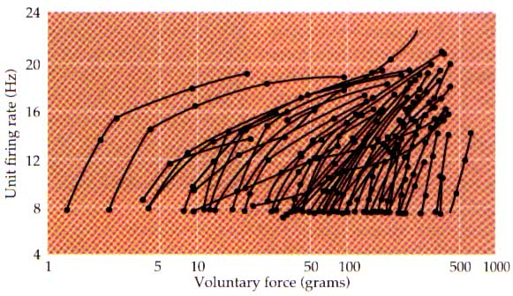
Rate coding
S
FFR
FF

Slide 18
Neurotrophic factors
Greek trophē, food
Are a type of growth factor
Prevent neuronal death
Promote growth of neurons after injury

Slide 19
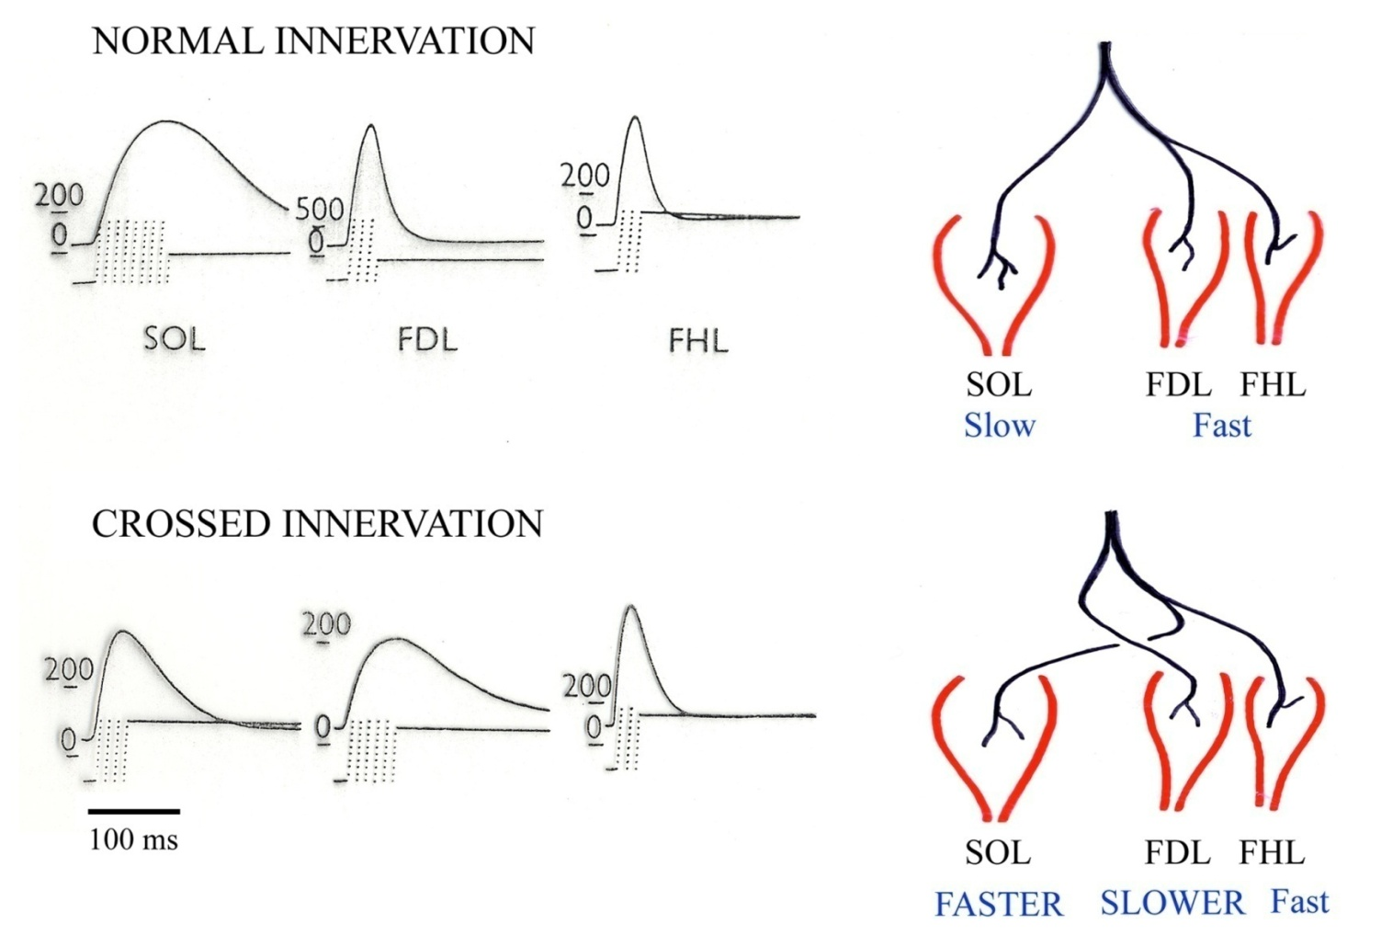
Effect of neurotrophic factors
Motor unit and fibre characteristics are dependent on the nerve which innervates them.
If a fast twitch muscle and a slow muscle are cross innervated, the soleus becomes fast and the FDL becomes slow.
The motor neurone has some effect on the properties of the muscle fibres which it.

Slide 20
Plasticity of Motor Unit/Muscle Fibres
Fibre types can change properties under many different conditions.
Type IIB to IIA most common following training
Type I to II possible in cases of severe deconditioning or spinal cord injury. Microgravity during spaceflight results in shift from slow to fast muscle fibre types
Ageing associated with loss of type I and II fibres but also preferential loss of type II fibres. This results in a larger proportion of type I fibres in aged muscle (evidence from slower contraction times).

Slide 21
Organisation of the spinal cord – motor tracts
Control voluntary movements
automatic movements of arm in response to posture/balance changes
coordinate automated movements of locomotion and posture (e.g. to painful stimuli)
regulates posture to maintain balance, and facilitates mainly α motoneurones of the postural, anti-gravity (extensor) muscles

Slide 22
Reflex function
What is a reflex ?
An automatic and often inborn response to a stimulus that involves a nerve impulse passing inward from a receptor to a nerve centre and then outward to an effector (as a muscle or gland) without reaching the level of consciousness.
An involuntary coordinated pattern of muscle contraction and relaxation elicited by peripheral stimuli.
“…….whose magnitude and timing are determined respectively by the intensity and onset of the stimulus”.
If the biceps is tapped, the reflex occurs quickly and is related in size to how hard the biceps was hit. Reflexes differ from voluntary movements in that once they are released, they can’t be stopped.

Slide 23
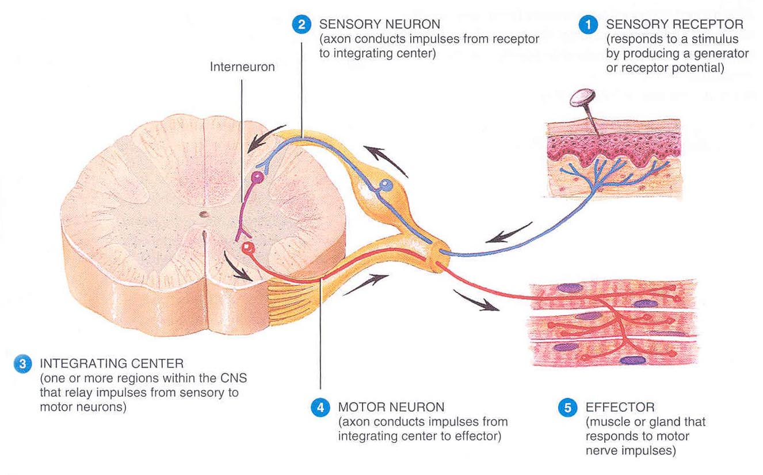
Components of a reflex arc

Slide 24
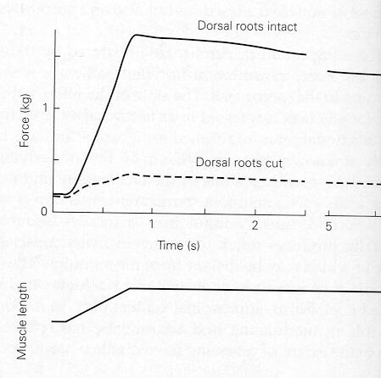
Reflex needs afferents

Slide 25
How many synapses are there ?

Slide 26
How many synapses are there ?

Slide 27
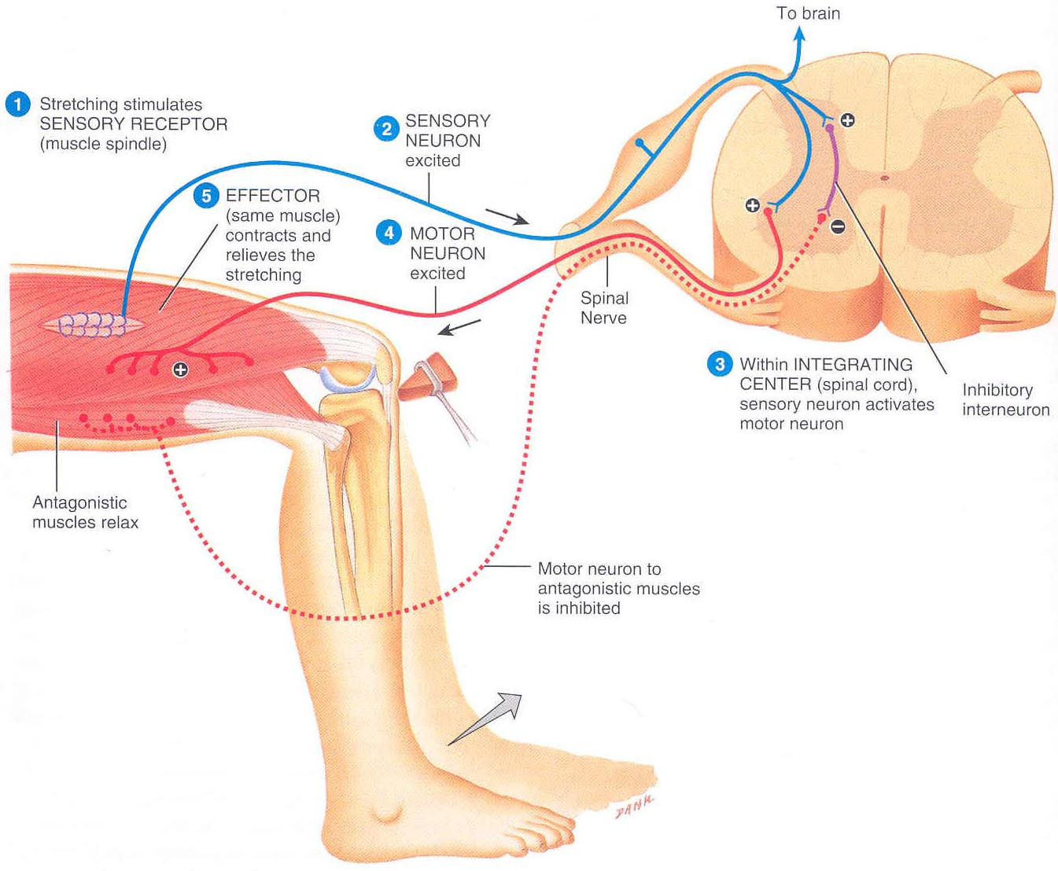
The monosynaptic (stretch) reflex

Slide 28
The monosynaptic (stretch) reflex

Slide 29
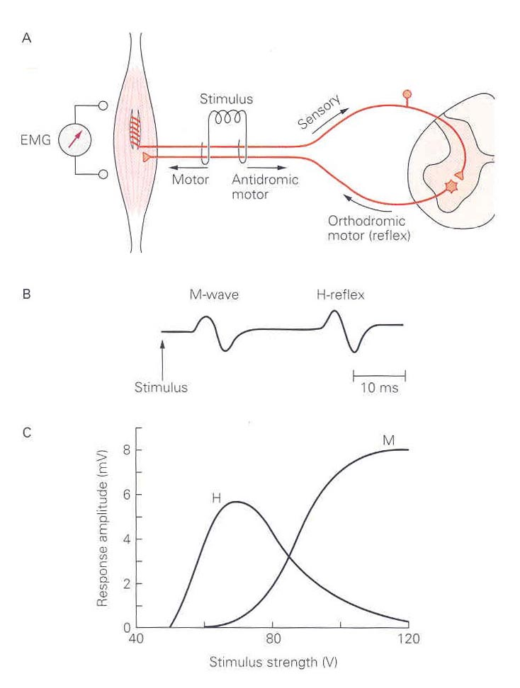
The Hoffman (H-) Reflex

Slide 30
Polysynaptic reflexes – flexion withdrawal

Slide 31
Flexion withdrawal (& crossed extensor)

Slide 32
Supraspinal control of reflexes
Traditionally we think of reflexes as being automatic (knee jerk) and stereotyped behaviours (sneeze, cough) in response to stimulation of peripheral receptors.
BUT can they be influenced?
Try clenching teeth or making a fist when having patellar tendon tapped.
What happens?
This is the “Jendrassik” manoeuvre.

Slide 33
Supraspinal control of reflexes
Higher centres of the CNS exert inhibitory and excitatory regulation upon the stretch reflex.
Inhibitory control dominates in normal conditions (N).
Decerebration reveals the excitatory control from supraspinal areas (D).
Rigidity and spasticity can result from brain damage giving over-active or tonic stretch reflex.

Slide 34
Supraspinal control of reflexes

Slide 35
Supraspinal control of reflexes
What if the knee is extended and the muscle goes slack?
The spindle is shortened to maintain its sensitivity
THIS IS THE GAMMA REFLEX LOOP

Slide 36
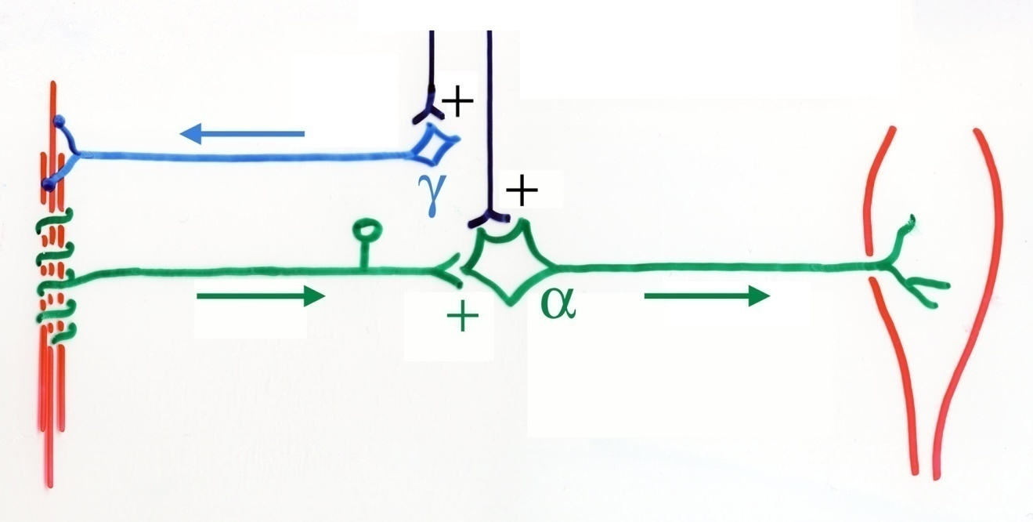
Supraspinal control of reflexes
Facilitation from higher centres acts:
On the motoneurone, increasing its sensitivity to afferent input, or
Indirectly via gamma motoneurones and the muscle spindle, increasing afferent input to the alpha motoneurones.
Higher centres & pathways involved are:
Cortex – corticospinal (fine control of limb movements, body adjustments)
Red nucleus – rubrospinal (automatic movements of arm in response to posture/balance changes)
Vestibular nuclei – vestibulospinal (altering posture to maintain balance)
Tectum – tectospinal (head movements in response to visual information).

Slide 37
Hyper-reflexia
Due to e.g. a stroke
Loss of descending inhibition

Slide 38
Hyper-reflexia - Biceps

Slide 39
Hyper-reflexia - clonus

Slide 40
Hyper-reflexia – Babinski sign

Slide 41
Hypo-reflexia
Below normal or absent reflexes
Mostly associated with lower motor neuron diseases

Slide 42
Overall lessions
Central synapses have excitatory and inhibitory inputs. Inputs can summate. Temporal and spatial summation.
NMJ specialized synapse connecting motoneurones to muscle fibres. Always excitatory.
A motor unit is a motor neuron and all the muscle fibres it innervates.
MUs are classified as S, FR & FF according to speed of contraction and fatigue resistance. Neurotrophic factors can influence MU properties.
Recruitment - S ➔ FR➔FF. De-recruitment in reverse order.
Stretch reflex is an example of a monosynaptic reflex. Is under CNS control from higher centres.
Flexion (withdrawal) and crossed extensor reflexes are examples of polysynaptic reflexes.

