Slide 1
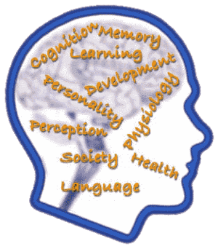
Neuroscience & Mental Health Psychology Module
Session 1 – Learning theory
David Murphy
Consultant Clinical Psychologist
& Hon. Senior Lecturer (Module Leader)
9 January 2012

Slide 2
Psychology
Medicine
Perception
Pain
Cognitive Psychology
Clinical
Decision
making
Coping
with
illness
Personality

Slide 3
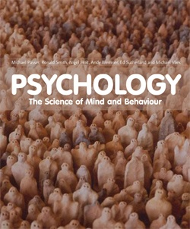
Textbooks
See handbook – for information on the many textbooks
available in Imperial libraries
You do NOT need to buy a textbook for this course but if you decide to,
I think Passer “Psychology - The science of Mind and behaviour” is very good.

Slide 4
1a - Learning objectives
Explain learning theory
Understand and be able to explain Classical Conditioning
Understand and be able to explain Operant Conditioning
Differentiate between positive reinforcement, negative reinforcement and punishment.
Define and describe the various schedules of reinforcement.
Describe how the two-factor theory combines escape and avoidance conditioning with classical conditioning to explain the maintenance of classically conditioned associations
Explain how research on conditioned taste aversions, variability of phobic stimuli, and instinctive drift supports the existence of biological preparedness.
Define observational learning, describe Bandura’s Social Learning theory, and outline the steps in the modeling process.
Understand and explain approaches to increasing the likelihood of desirable behaviours and decreasing the likelihood of undesirable behaviours.

Slide 5
Learning:
“a process by which experience produces a relatively enduring change in an organism’s behavior or capabilities.”
In other words it is a process by which we adapt to our environment

Slide 6
3 elements of a behaviour (..it’s as easy as ABC)
Antecedent (or cue): environmental conditions or stimulus changes that exist before the behaviour of interest, these may be either internal or external to the subject
Behaviour: the behaviour of interest emitted by the subject. Future instances of this behaviour will be influenced by both antecedents and consequences
Consequence: a stimulus change that follows the behaviour of interest

Slide 7
John Watson (1878-1958) - Founder of behaviourism
“Psychology as the behaviourist views it is a purely objective experimental branch of natural science. Its theoretical goal is the prediction and control of behaviour. Introspection forms no essential part of its methods.....”
“The behaviourist, in his efforts to get a unitary
scheme of animal response, recognizes no dividing line between man and brute.”
“Give me a dozen healthy infants, well-formed, and my own specialized world to bring them up in and I’ll guarantee you to take any one of them at random and train him to become any type of specialist I might select - doctor, lawyer, artist, merchant-chief, and, yes, even beggar-man and thief, regardless of his talents, penchants, tendencies, abilities, vocations, and race of his ancestors”
http://psychclassics.yorku.ca/Watson/views.htm

Slide 8
Four basic learning processes:
Habituation/Sensitization – Learning to notice or ignore
Classical conditioning – Learning what events signal
Operant conditioning - Learning one thing leads to another
Observational learning – Learning from others

Slide 9
Habituation – the simplest form of learning
Aplysia – A sea mollusc known as “Sea Slug” or “Sea Hare” often studied by neurobiologists because of large size of neurons. It has no brain or spinal cord but it is still capable of learning.

Slide 10
Habituation – the simplest form of learning
Rapidly repeated tactile stimulation of siphon reduces gill withdrawal both during the training and for a short period afterwards.
Habituation is due to reduced neurotransmitter release by the sensory neuron and by relevant interneurons in response to the tactile stimulus. i.e., the memory of habituation is distributed at various synapses in the circuit
Whereas a rapid series of stimuli induces short-term habituation, several sets of tactile stimuli distributed over several hours induces long-term habituation that lasts for weeks.

Slide 11
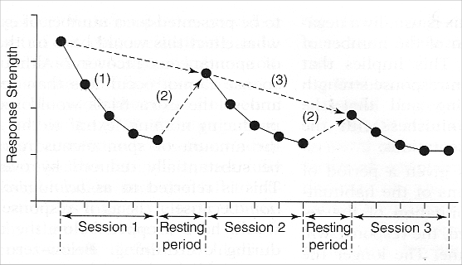
Habituation
Examples in humans – when you came back to your room after Christmas, did you notice it was more noisy, light, or your bed was uncomfortable? If so you probably lost some of your habituation.

Slide 12
Sensitization
Harmful stimulus sensitizes gill withdrawal response
to subsequent harmful or harmless stimuli given to
same or different body regions.
Sensitization occurs because tail shock
augments the release of neurotransmitter from the
sensory neuron

Slide 13
Habituation vs. Sensitization
Habituation
Sensitization
Decrease in strength of behaviour
Typically low-intensity stimuli
Stimulus-specific generalization
< neurotransmitter
Increase in strength of behaviour
Typically high-intensity stimuli
Nonspecific generalization
> neurotransmitter

Slide 14
Classical Conditioning terminology
Stimuli
Unconditioned stimulus (UCS): A stimulus that elicits a reflexive or innate response (the UCR) without prior learning
Conditioned stimulus (CS):
A stimulus that, through association with a UCS, comes to elicit a conditioned response similar to the original UCR
Responses
Unconditioned response (UCR): A reflexive or innate response that is elicited by a stimulus (the UCS) without prior learning
Conditioned response (CR):
A response elicited by a conditioned stimulus.
[Module Handbook pg – 8]

Slide 16
Classical conditioning is strongest when:
There are repeated CS-UCS pairings
The UCS is more intense
The sequence involves forward pairing (i.e. CS -> UCS)
The time interval between the CS and UCS is short

Slide 17
Extinction

Slide 18
Stimulus Generalization
A tendency to respond to stimuli that are similar, but not identical , to a conditioned stimulus. E.g. responding to a buzzer, or a hammer banging, when the conditioning stimulus was a bell

Slide 19
Stimulus generalization - contd
Similar stimuli will also elicit the CR, but in a weaker form
Eg, a 500Hz tone elicits the CR, tones of similar frequency will also elicit CR, the closer the tone to the original the stronger the response
Volume of
Saliva
200 450 500 700
Frequency (Hz)

Slide 20
Stimulus Discrimination:
The ability to respond differently to various stimuli.
E.g. A child will respond differently to various bells (alarms, school, timer)

Slide 21
Clinical example
A significant proportion (25-30%) of patients undergoing chemotherapy experience anticipatory nausea and vomiting.
Chemotherapy (UCS) Nausea (UCR)
Related cues e.g. Anticipatory
Sight of chemotherapy Nausea (CR)
Unit (CS)

Slide 22
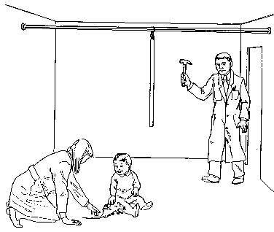
Classical conditioning and fear learning “Little Albert” Experiment (Watson & Raynor 1920)

Slide 24
Watch a video clip on the experiment: (warning - you may find it upsetting to watch)
http://uk.youtube.com/watch?v=LVJMhk4oANM (from 2:00)
If you are interested in what happened to Little Albert follow this link –
http://www.sussex.ac.uk/psychology/documents/harris_-1979.pdf

Slide 25
Learning Theory
Antecedents
Behaviour
Consequences

Slide 26
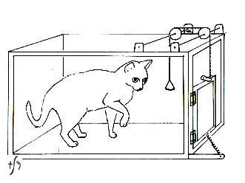
Thorndike’s Law of Effect:
Operant conditioning: the process by
which animals utilize trial and error to
achieve the desired outcome
Law of Effect:
A response followed by a satisfying consequence will be more likely to
occur.
A response followed by an aversive consequence will become less likely to occur

Slide 27
Reinforcement
Positive Reinforcement: occurs when a response is strengthened by the subsequent presentation of a reinforcer
Primary Reinforcers: such as food and water, that an organism naturally finds reinforcing because they satisfy biological needs
Secondary Reinforcers: stimuli that acquire reinforcing properties through their association with primary reinforcers e.g. money

Slide 28
Reinforcement
Negative Reinforcement: occurs when a response is strengthened by the removal (or avoidance) of an aversive stimulus
Negative Reinforcer: the aversive stimulus that is removed or avoided (e.g. speeding alert)
“Positive” and “Negative” refer to presentation or removal of a stimulus, not “good” and “bad”

Slide 29
Punishment
Aversive / Positive Punishment:
occurs when a response is weakened by the presentation of a stimulus
Negative Punishment / Response Cost: occurs when a response is weakened by the removal of a stimulus (e.g. “you’re grounded!”)

Slide 30
Shaping (aka The method of successive approximations)
Complex behaviours are learned in small steps.
Behaviours are rewarded that are increasingly similar to the desired behavior.

Slide 31
Application of shaping
Parent brushes teeth child holds brush
Child moves toothbrush up and down
Child places loaded toothbrush in mouth and moves up and down.
Parent hold toothpaste child squirts onto brush, puts in mouth and moves up and down.
Child opens toothpaste, squirts on brush, puts in mouth and moves up and down.

Slide 32
Operant conditioning (contd)
Operant Extinction: the weakening and eventual disappearance of a response because it is no longer reinforced
Resistance to Extinction: the degree to which non-reinforced responses persist

Slide 33
Operant Conditioning (contd)
Operant Generalization: an operant response occurs to a new antecedent stimulus or situation that is similar to the original one
Operant Discrimination: an operant response will occur to one antecedent stimulus but not to another

Slide 34
Reinforcement schedules
Fixed interval schedule: reinforcement occurs after fixed time interval
Variable interval schedule: the time interval varies at random around an average
Fixed Ratio Schedule: reinforcement is given after a fixed number of responses
Variable Ratio Schedule: reinforcement is given after a variable number of responses, all centered around an average

Slide 35
Reinforcement schedules
Continuous reinforcement produces more rapid learning than partial reinforcement
The association between a behaviour and its consequences is easier to understand
However, continuously reinforced responses extinguish more rapidly than partially reinforced responses
The shift to no reinforcement is sudden and easier to understand

Slide 36
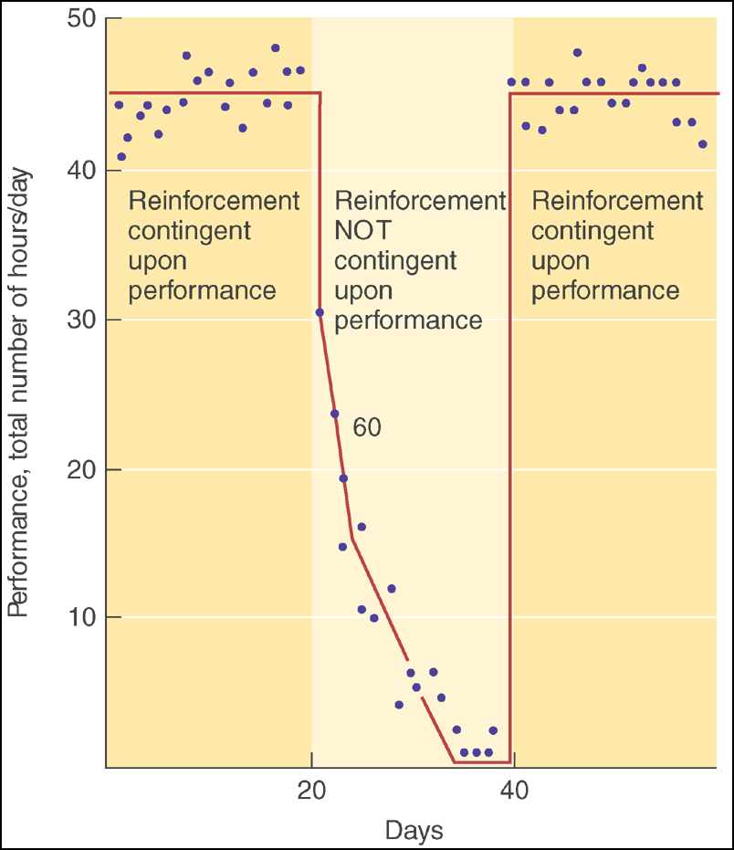
Application of Operant Conditioning - “Token Economy”
Reinforcement in a token economy. This graph shows the effects of using tokens to reward socially desirable behavior in a mental hospital ward. Desirable behavior was defined as cleaning, bed making, attending therapy sessions, and so forth. Tokens earned could be exchanged for basic amenities such as meals, snacks, coffee, game-room privileges, or weekend passes. The graph shows more than 24 hours per day because it represents the total number of hours of desirable behavior performed by all patients in the ward. (Adapted from Ayllon & Azrin, 1965.)

Slide 37
Biological preparedness
Biological preparedness in humans:
Seligman (1971): humans are biologically prepared to acquire certain fears more readily than others
Easier to condition a fear of snakes and spiders than a fear of flowers
Instinctive Drift: the tendency for a conditioned response to drift back toward instinctive behaviour

Slide 38
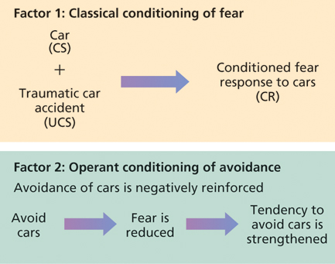
Two-factor theory of maintenance of classically conditioned associations e.g. fear

Slide 39
Albert Bandura’s Social Learning Theory
Observational (vicarious) learning - We observe the behaviours of others and the consequences of those behaviours.
Vicarious reinforcement - If their behaviours are reinforced we tend to imitate the behaviours

Slide 40
Modeling or Observational Learning (Albert Bandura)
Occurs by watching and imitating actions of another person, or by noting consequences of a person’s actions
Occurs before direct practice is allowed
Steps to Successful Modeling
Pay attention to model
Remember what was done
Must be able to reproduce modeled behavior
If successful or behavior is rewarded, behavior more likely to recur

Slide 41
Bobo Doll Experiment (Bandura 1961)
72 children (Mean aged 4yrs) recruited from Stanford University Nursery.
All children spent time in a playroom with an adult who modelled either non-aggressive (building tinker toy) or aggressive play (punching and striking the Bobo doll with mallet)
All children then spent a further 20 minutes in the room alone and their behaviour was observed. Aggressive behaviour both imitative and non-imitative was recorded.
Children who observed aggressive behaviour showed a much higher level of aggression towards the doll.
Watch a clip showing the experiment - http://uk.youtube.com/watch?v=IK4NPc7HCnY

Slide 42
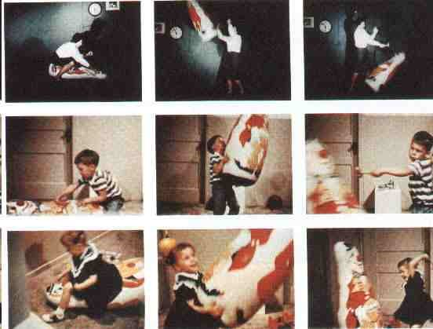
Bobo doll experiment

Slide 43
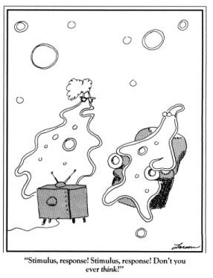
Learning theory
Four basic learning processes:
Habituation/Sensitization
Classical conditioning
Operant conditioning
Observational learning

