Slide 1
1b. Health beliefs and behaviour
David Murphy
Psychology Module Leader

Slide 2
Learning objectives
Discuss the role of behavioural factors in the aetiology of major diseases
Define “health behaviour”
Describe the role of health education in disease prevention
Discuss the role of learning and habit in health behaviour
Discuss the role of attitudes and beliefs in health behaviour
Discuss the influence of social environment on health behaviours
Define “self efficacy” and the factors which influence it
Outline the Health Beliefs Model and the Theory of Planned Behaviour
Describe effective approaches to modifying health behaviour

Slide 3
Causes of death
1900
2005

Slide 5
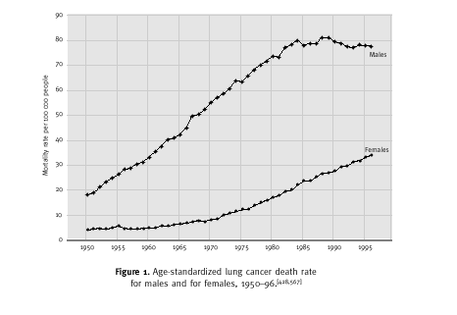

Slide 7
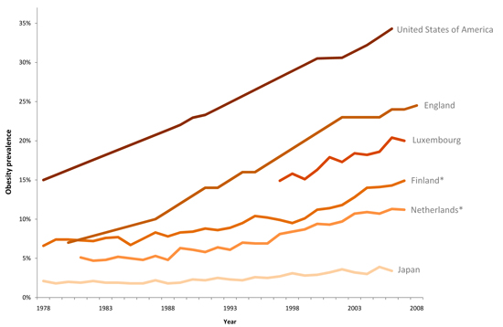
Does my BMI look big in this?
Prevalence of obesity (BMI>30) 1978-2008

Slide 8
Change in food consumption

Slide 9
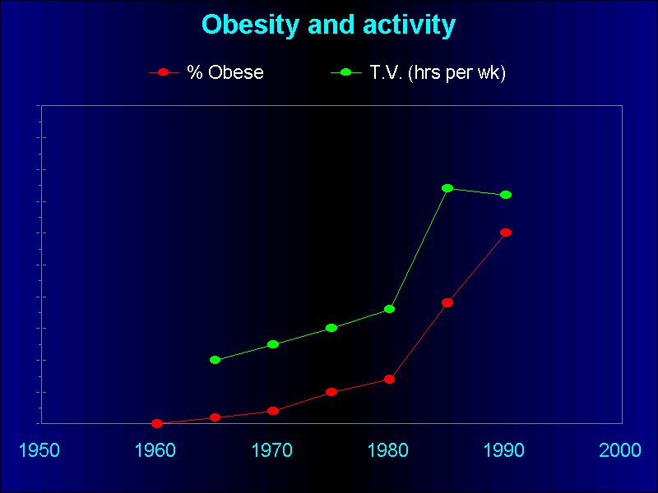

Slide 10
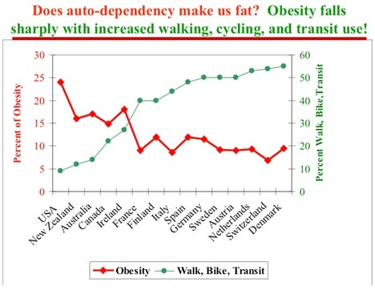

Slide 11
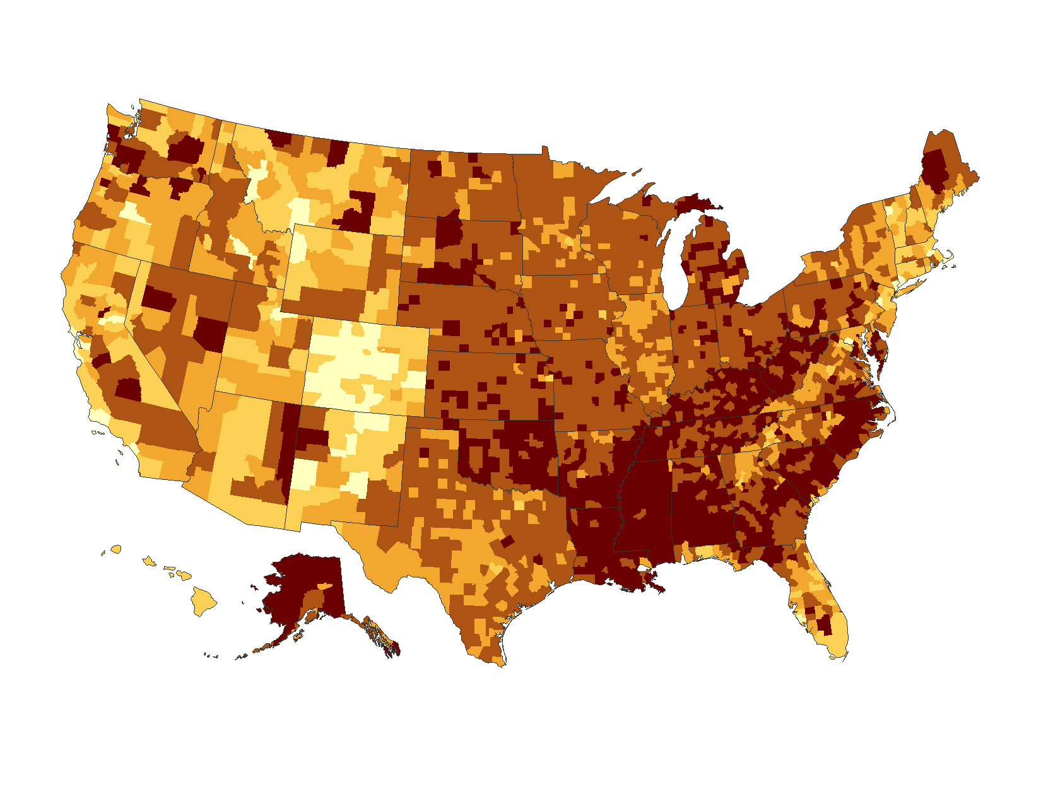
County-level Estimates of Obesity among Adults aged ≥ 20 years: United States 2008
Percent
www.cdc.gov/diabetes

Slide 12
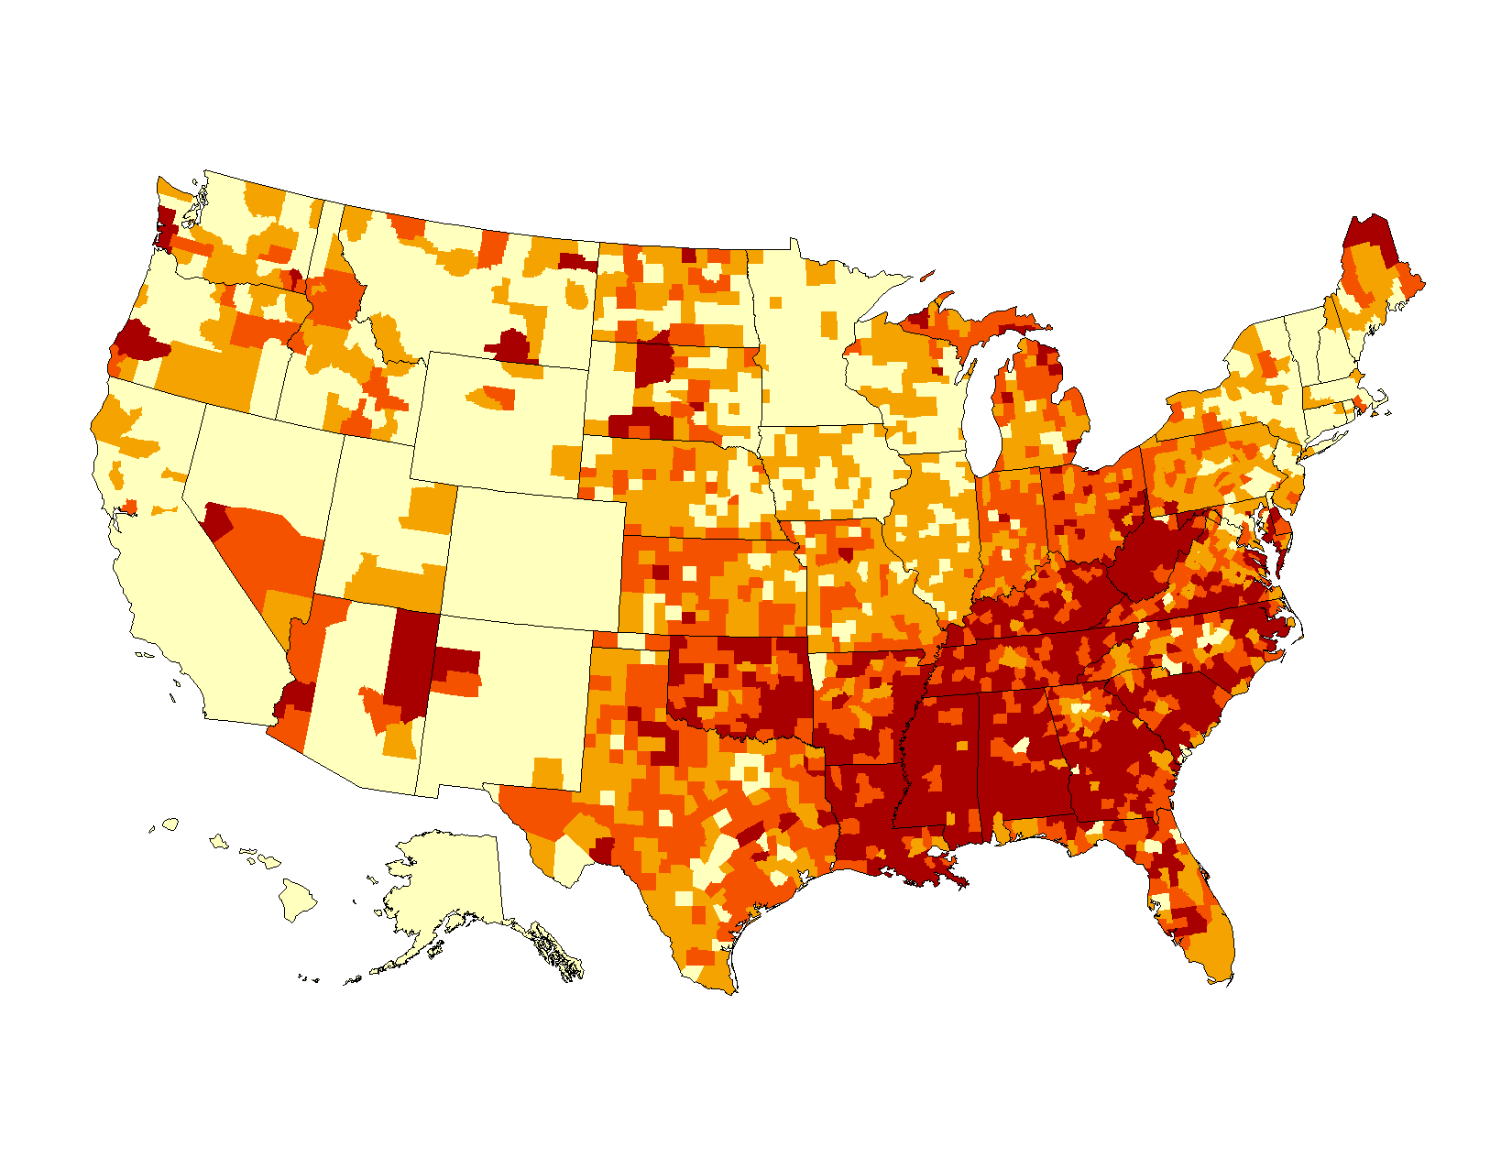
County-level Estimates of Diagnosed Diabetes among Adults aged ≥ 20 years: United States 2008
Percent
Quartiles
www.cdc.gov/diabetes

Slide 13
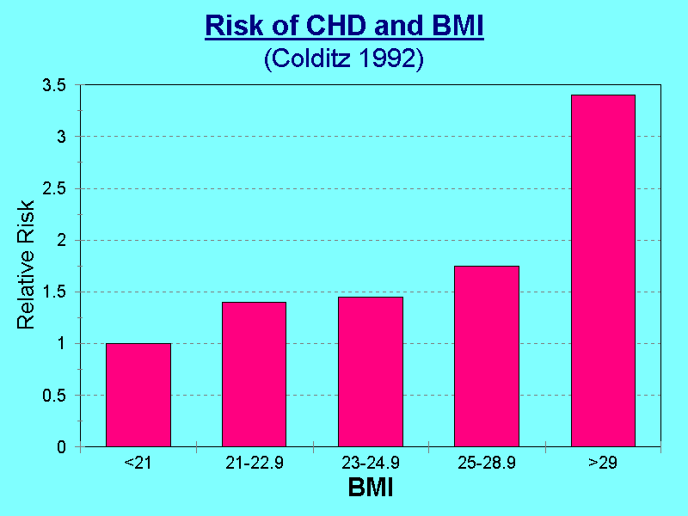

Slide 14
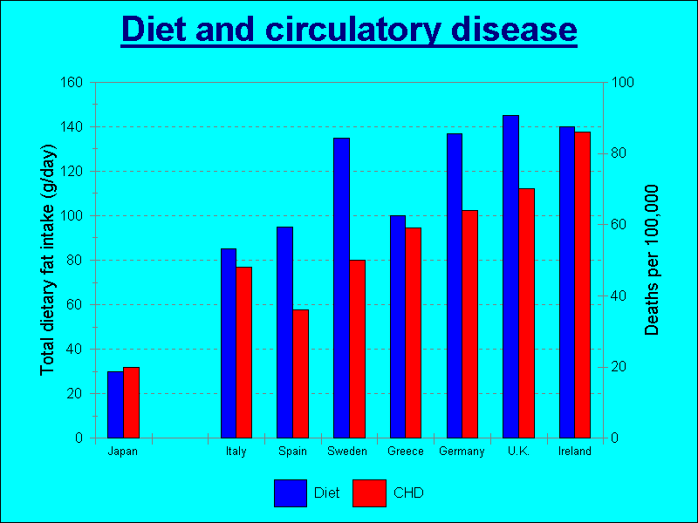

Slide 15

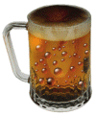

5 Modern day killers
Dietary excess
Alcohol
consumption
Lack of exercise
Smoking
Unsafe sexual behaviour

Slide 16
Tackling disease = Changing behaviour

Slide 17
But we all have to die of something don’t we?
Culmutive
mortality
0
120

Slide 18
Health behaviour
“Any activity undertaken by an individual believing himself to be healthy, for the purpose of preventing disease or detecting it at an asymptomatic stage”
Kasl & Cobb (1966)

Slide 19
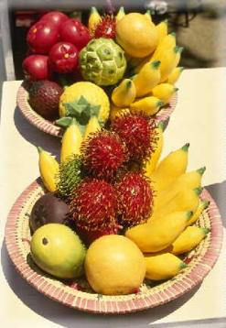
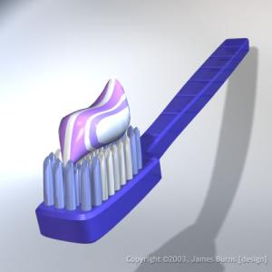

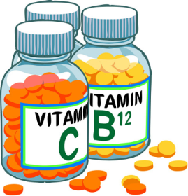
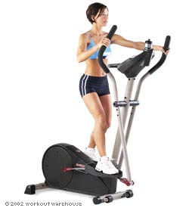
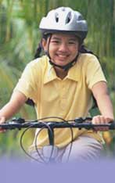
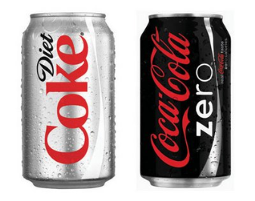

Examples of health behaviours

Slide 20

The Alameda Study
6,928 residents of Alameda county, CA, completed a list of 7 health behaviours they practised regularly including; not smoking, eating breakfast every day, taking regular exercise etc.
The sample was followed up nearly 10 years later. The mortality rate in individuals who practised all 7 behaviours was less than 1/4 of that in individuals who practised between 0-3.
Belloc & Breslow (1972), Breslow & Enstrom (1980)

Slide 21
What approaches are effective in encouraging people to adopt health behaviours?

Slide 22

Is increasing knowledge the key?

Slide 23
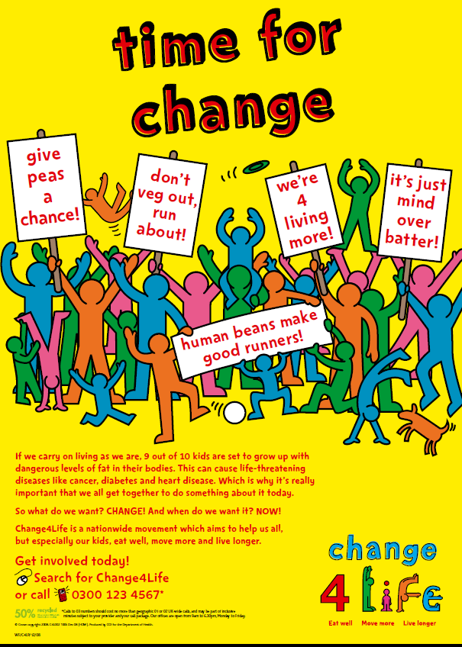
http://uk.youtube.com/watch?v=AH8zClozUV8&feature=PlayList&p=00CDFCE1A6996B45&index=0

Slide 24
Nutbeam et al (1993)
Evaluated a programme of education about the effects of smoking which was conducted in 39 comprehensive schools in England & Wales.
The programme involved specially trained teachers providing teaching sessions spread over a 3 month period. The outcome was evaluated using a self report questionnaire combined with a saliva test.

Slide 25
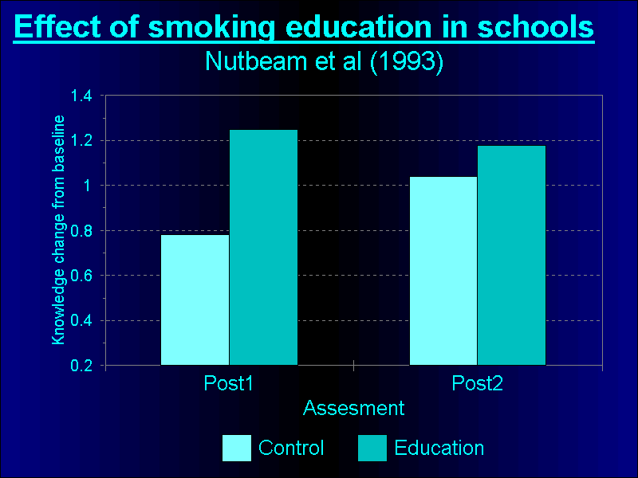

Slide 26
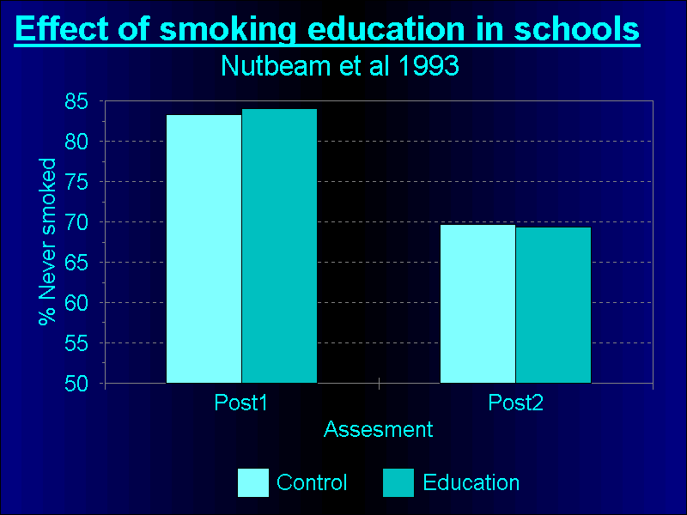

Slide 27
Maybe changing cues & reinforcement is the answer?

Slide 28
Stimulus control techniques
Examples of stimulus control techniques to change eating behaviour:
Don’t keep prohibited foods in the house
Don’t keep biscuits in the same cupboard as tea & coffee
Eat only at the dining table
When meal finished leave the table and put left over food away
Use small plates

Slide 29
Positive reinforcement intervention Kegels et al (1978)
Children given a talk on dental hygiene and then received one of three types of follow up:
No further input
Discussion session
Reward for compliance with programme
Compliance with mouthwash programme assessed over 20 weeks.

Slide 30
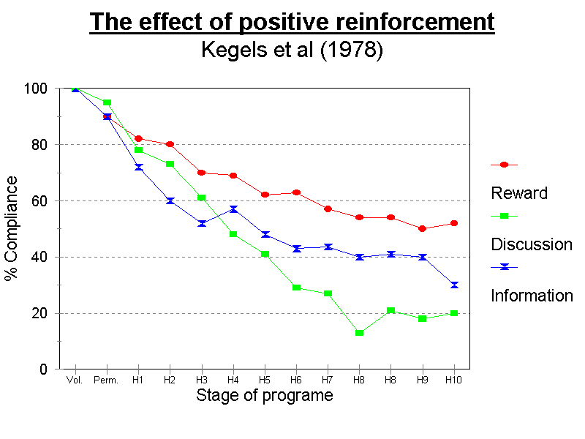

Slide 31
Problems with reinforcement programmes
Lack of generalization
Poor maintenance
Impractical, expensive

Slide 32
The effect of fear arousal
Janis & Fesbach (1953)
High school students given one of three different lectures on dental health.
Lectures designed to induce low, moderate or high fear.
Effect on subsequent behaviour measured.

Slide 33
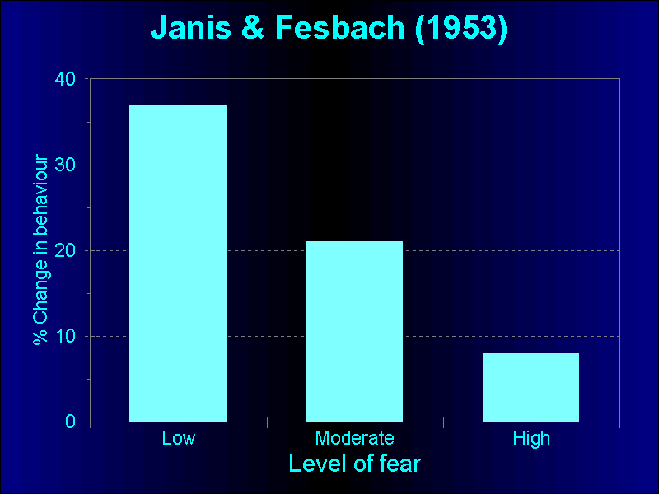

Slide 34
The role of social learning

Slide 35
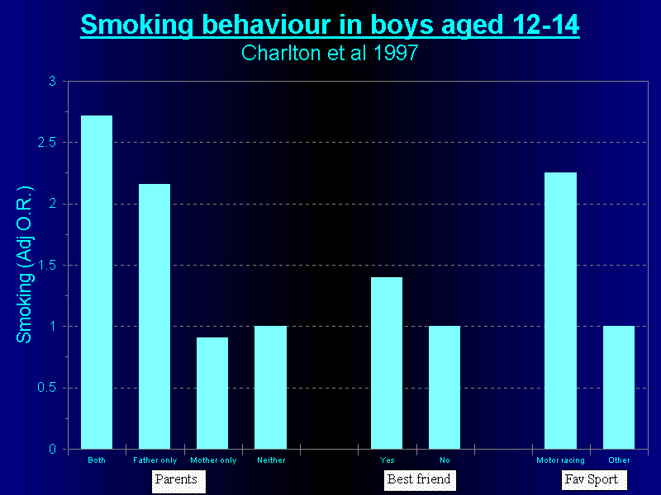

Slide 36
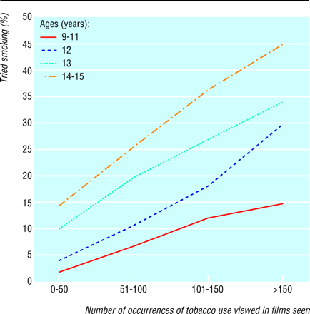
Smoking and watching movies
Sargent et al (2001) BMJ;323:1394

Slide 37
Social learning interventions
Epstein et al (1990)
76 Children aged 6-12 years >20% above ideal body weight.
One of three interventions:
Education only
Education & behavioural strategies
Education and social learning.

Slide 38
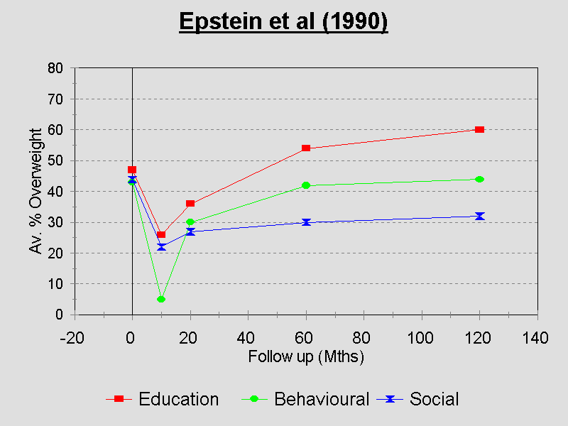

Slide 39
Attitudes and beliefs

Slide 40
Health Beliefs Model
(Rosentock 1966)
Demographic variables
Perceived Susceptibility
Perceived Seriousness
Perceived Benefits-
Perceived Costs/barriers
Cues to action
Likelihood of behaviour

Slide 41
Decision to get a flu vaccine
Susceptibility – “A lot of people of people I know have got flu symptoms”
Seriousness – “But it’s nothing to worry about”
Benefits – “Vaccination will stop me getting sick”
Costs/barriers “The injection will be painful, I might get side effects, I haven’t go time to go to my GP”

Slide 42
Expectancy-value theory
The potential for a behaviour to occur in any specific situation is a function of the expectancy that the behaviour will lead to a particular outcome and the value of that outcome”
Rotter (1954)

Slide 43
Outcome efficacy - Individuals expectation that the behaviour will lead to a particular outcome
Self Efficacy - Belief that one can execute the behaviour required to produce the outcome
Bandura (1977)

Slide 44
Factors influencing self efficacy
Mastery experience
Social learning
Verbal persuasion or encouragement
Physiological arousal

Slide 45
The Waterloo Smoking Prevention Project (Flay et al 1983)
High school students allocated to a smoking prevention or control condition.
The programme consisted of 6 sessions including rehearsing skills to build confidence in ability to resist peer pressure to smoke.
Significant effect in reducing number of children staring smoking, especially amongst those with family members who smoked.

Slide 46
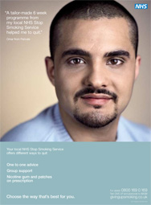
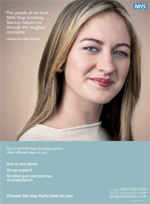
Advertising to increase self efficacy

Slide 47
Expectancy
Value

Slide 48
e.g. Self efficacy
e.g. Perceived costs/ barriers

Slide 49
http://www.people.umass.edu/aizen/tpb.html

Slide 50
Predicting exercise behaviour using the theory of planned behaviour
Beliefs about behaviour e.g. “Taking regular exercise increases agility”
Subjective norm e.g. “My friends exercise regularly”
Behavioural control beliefs e.g.“Lack of time would prevent me exercising”.
Norman & Smith 1985

Slide 51
Health Beliefs and Behaviour
Preventing the commonest diseases means changing behaviour.
Behaviour is determined by:
Knowledge
Learning
Beliefs

