Slide 1
Introduction to consciousness
Dr David Soto – Neurosciences ICL

Slide 2
Consciousness: processes that enable us to experience the world around us
Definitions
Distinct from automatic behaviours that occur in a rather unconscious manner.

Slide 3
Consciousness: Levels vs. Contents
Alertness vs. Subjective
experience

Slide 4
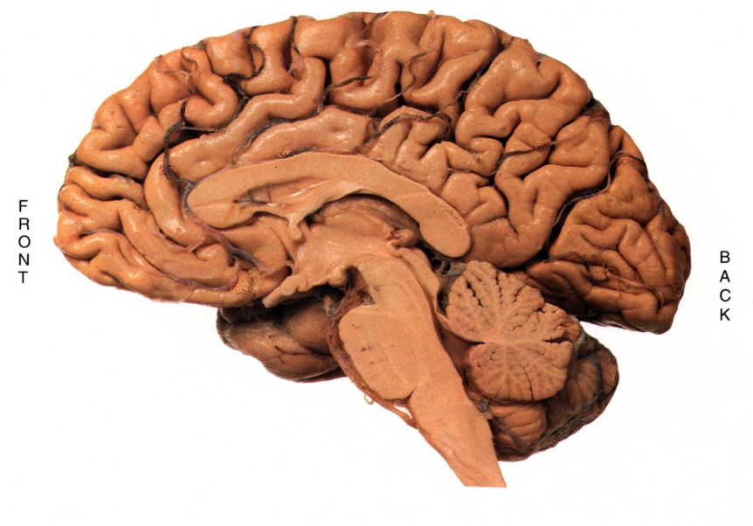
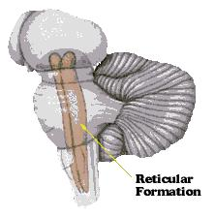
Levels of consciousness: Alertness
Reticular formation
Regulates many vital functions. It projects to the thalamus and the cortex, allowing it to ‘control’ whether or not sensory signals reach cortical sites of conscious awareness such as the posterior parietal cortex

Slide 5
Reticular Activating System
Locus coeruleus (NA)
The degree of activity in the reticular system is associated with alertness/levels of consciousness

Slide 6
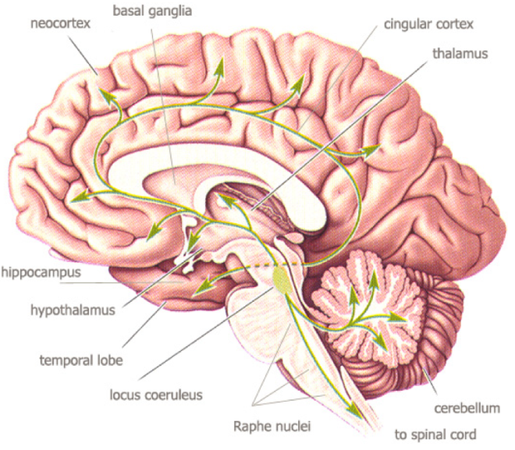
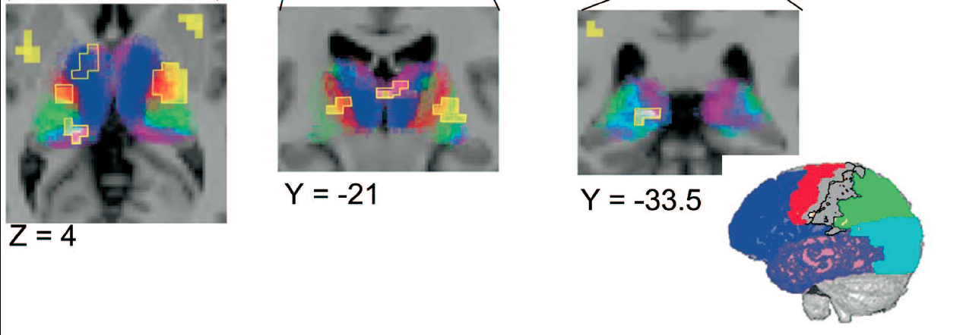
Cholinergic neurons in the reticular formation boost the level of activity in cerebral cortex via the thalamus

Slide 7
Damage to the reticular formation/thalamus can lead to coma - state of unconsciousness
- Persistent vegetative state
(due to disconnection of cortex from brainstem or widespread cortical damage)
- Brain death
(due to brainstem death)

Slide 8
Other causes of coma
Metabolic
Eg. hypoxia, hypoglycaemia, intoxication

Slide 9
Glasgow Coma Scale: (score of 3: severe brain injury and brain death)
Eyes open
none 1
in response to pain 2
in response to speech 3
spontaneous 4
Verbal responses
none 1
incomprehensible sounds 2
inappropriate words 3
disoriented speech 4
oriented speech 5
Motor responses
none 1
extensor response to pain 2
flexor response to pain 3
withdrawal to pain 4
localisation of pain 5
obeys commands 6

Slide 10
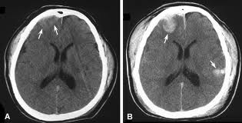
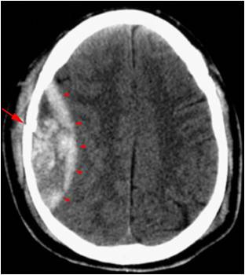
Altered states of consciousness
Contusion , concussion
Acute Confusion or delirium (dementias)
Stupor

Slide 11
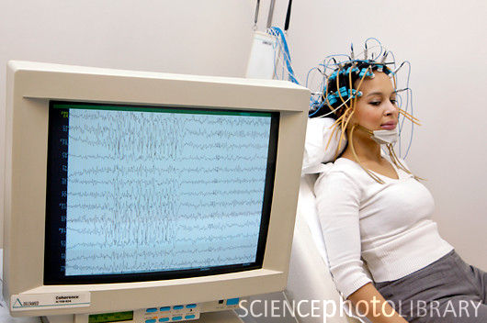
Monitoring level of arousal…
EEG rhythms: assessing alertness
Delta: Waves up to 4 Hz
Theta: 4-8 Hz
Alpha: 8-13 Hz
Beta; 13-30Hz
Sleep
Normal waking
consciousness
Higher frequency neural oscillations (gamma range: ~ 40 Hz associated with the creation of conscious contents in the focus of the mind’s eye, via recurrent thalamo-cortical feedback.

Slide 12
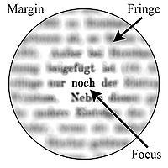
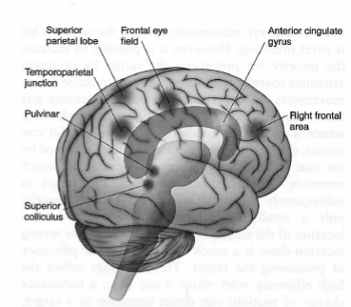
Consciousness: the role of attention in selecting the contents of awareness.
‘Orienting’ ‘Alerting’ & ‘Executive’ networks (Fan et al., 2000): moving the ‘spotlight’ of attention

Slide 13
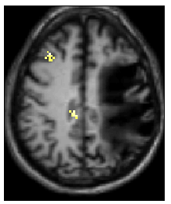
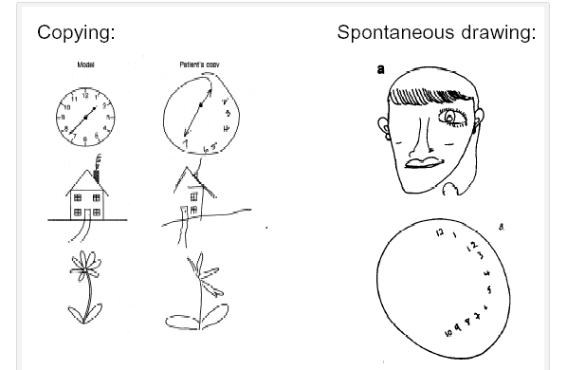
Breakdown of conscious awareness
after right brain damage.

Slide 14
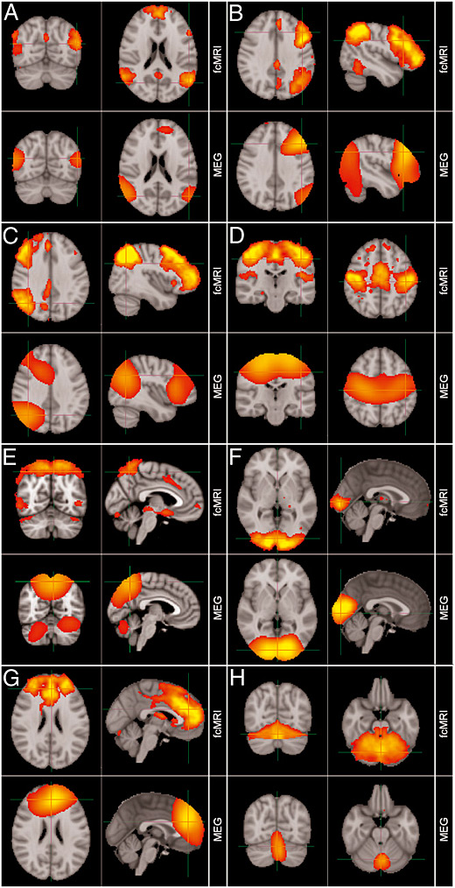
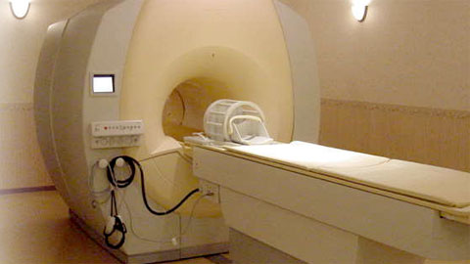
Using functional MRI
to study consciousness
in health and disease

Slide 15
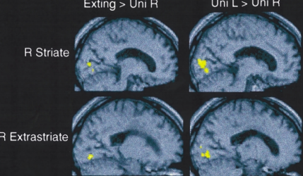
Brain activation for unconscious information in patients with visual neglect (Rees et al., 1993, Brain)
Patient performed a Face/house detection task inside the fMRI scanner
Activation of primary visual cortices may not be sufficient for consciousness -

Slide 16
‘Blindsight’: brain-damaged (occipital visual cortex) patients who are perceptually ‘blind’ of their visual field can however demonstrate some response to visual stimuli.

Slide 17
What is then the neural correlate of consciousness?
Beck et al (2001, Nature Neurosci)

Slide 18
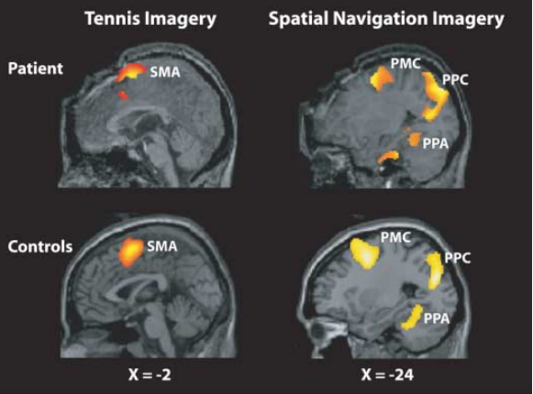
Detecting Awareness in the Vegetative State (coma ‘vigil’)
Owen et al. (2006, Science)

Slide 19
Thank you for your attention!

