Slide 1
Introduction to cognitive functions and their localisation: cognitive neurology
Barry Seemungal
[Richard Wise]
Imperial College London

Slide 2
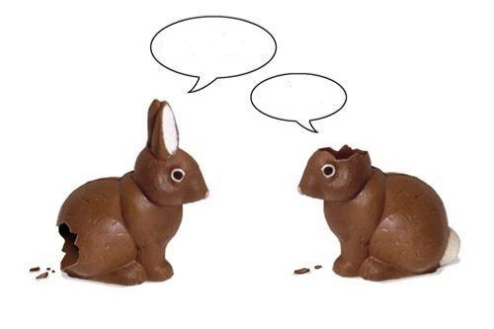
The Easter chocolate bunny card
My arse hurts
What?

Slide 3
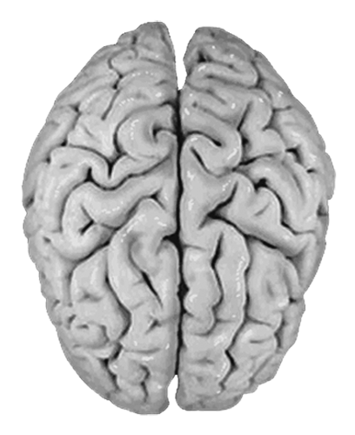
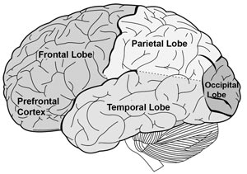
Dummies guide to cognitive neurology
6 things to localisation
Frontal
Temporal
Parietal
Occipital
Right
Left
Right
Left

Slide 4
Patient JP - History
52 year old man
Left-handed senior press officer
Referred by a local neurologist to the specialist cognitive neurology clinic
<1 year
worsening agraphia
word finding difficulties
intermittent disorientation in time and place
visuospatial difficulties (e.g organising the distribution of objects on the table)
driving accident
Able to read to understand, forever re-reading passages of text - “losing the plot”

Slide 5
Patient JP - Examination
OPD neuropsychological assessment:
MMSE* 22/30
ACE* 69/100
* Mini Mental Status Examination
* Addenbrooke’s Cognitive Examination

Slide 6
Neuropsychological Assessment
Verbal IQ (“left”) 87
Vocabulary 9
Similarities 10
Arithmetic 5
Digit span 7
Performance IQ (“right”) 55
Picture Completion 3
Block Design 1
Picture Arrangement 4
<4: extremely low, 5-6: borderline, 7-8: low-average, 9-11: average
National Adult Reading Test (NART) High average (~110)
Notes:
NART - low frequency irregular words - premorbid IQ

Slide 7
Block design

Slide 8
Neuropsychological Assessment - March 2009
Verbal memory - < 5th percentile
Language - 24/30 graded naming test
24/30 graded oral spelling
Calculation dyscalculia, with spatial difficulties
Visual perception - impaired fragmented letter identification
Visuospatial skills - impaired dot counting
Notes:
Graded naming - pictures become more and more low frequency (AD - frequent anomia)
Intersecting pentagons

Slide 9
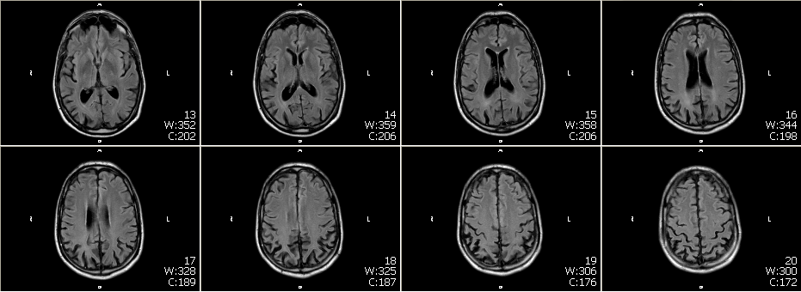
T₁-weighted MRI - axial sections

Slide 10
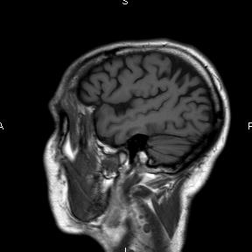
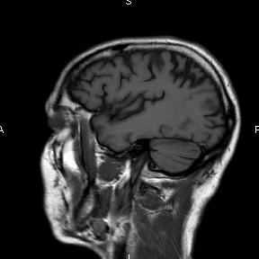
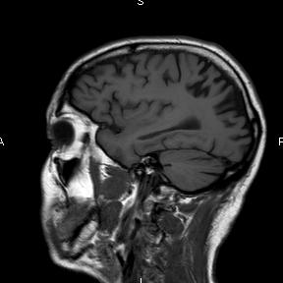
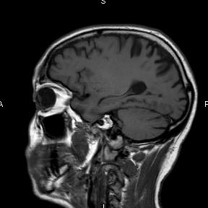
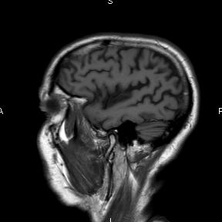
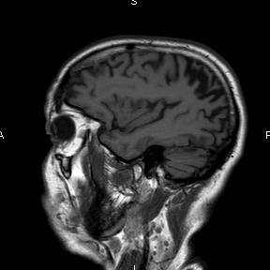
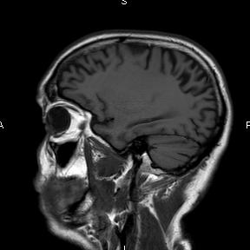
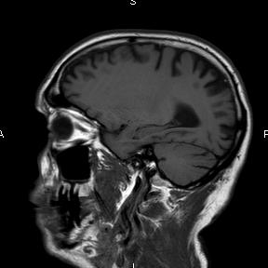
T₁-weighted MRI - sagittal sections

Slide 11
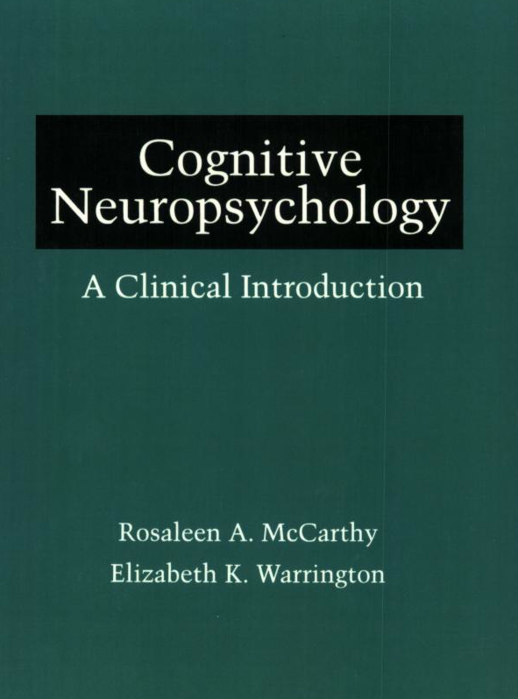

Slide 12
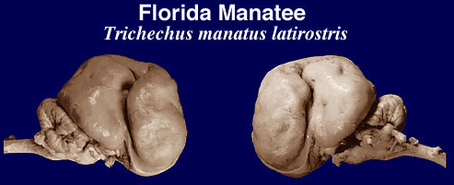

Slide 13
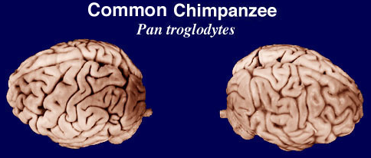

Slide 14
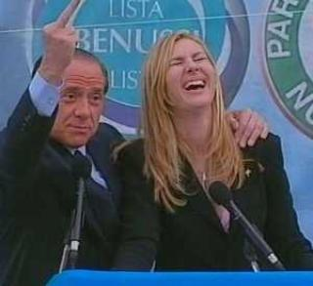
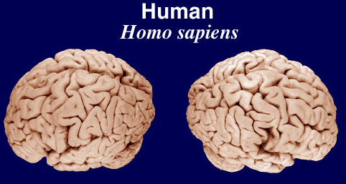

Slide 15
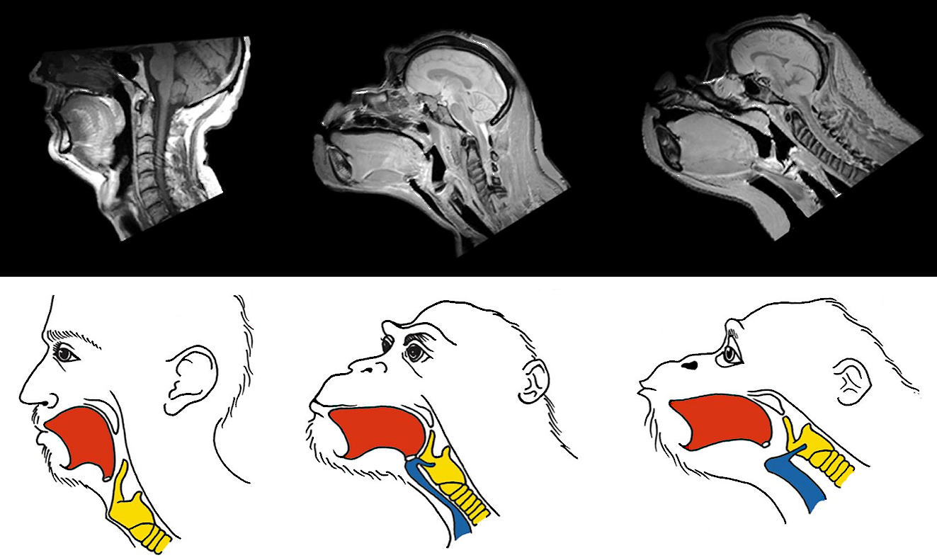
Fitch WT. The evolution of speech: comparative review. TICS (2000) 4:258-67

Slide 16
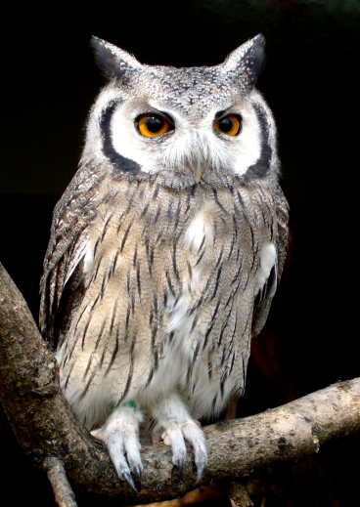
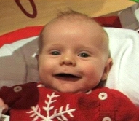
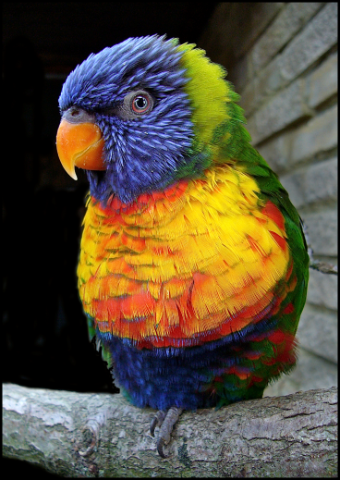

Slide 17
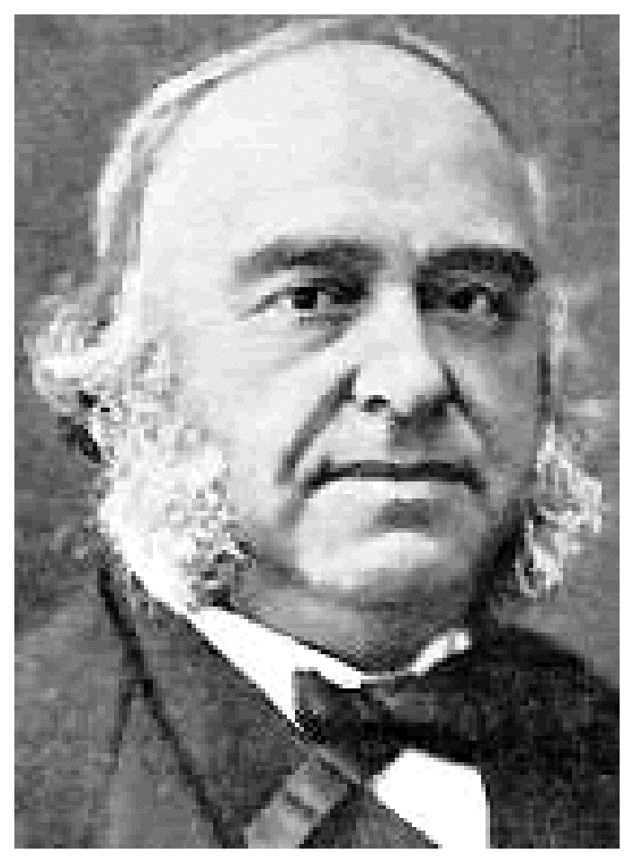
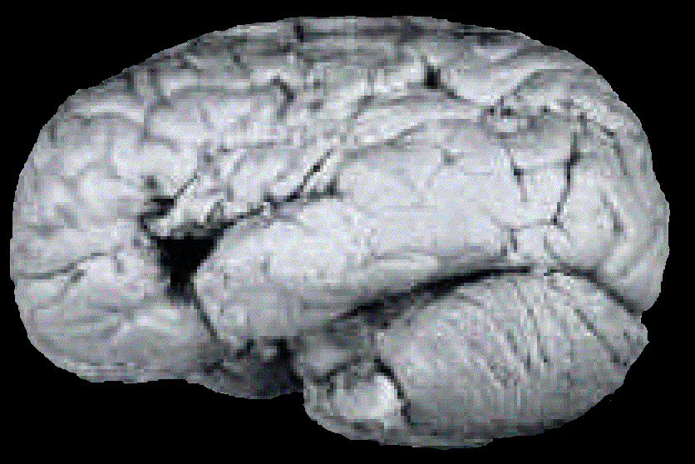
Paul Broca 1861 - patient Leborgne, or ‘Tan’

Slide 18
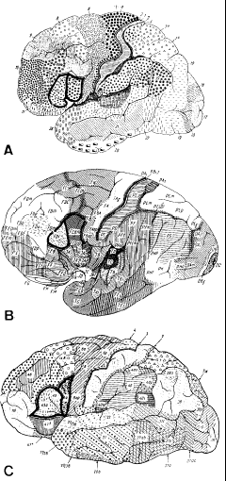
Cytoarchitectonics
Brodmann’s areas

Slide 19
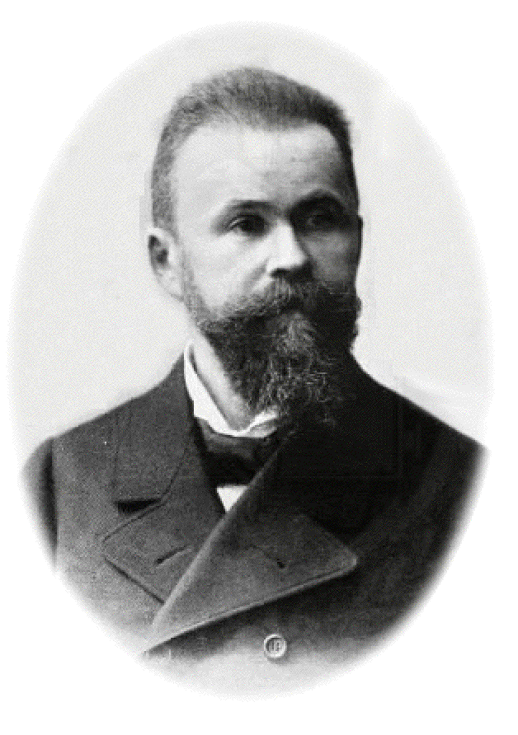
Wernicke (1874)
Broca’s area
Wernicke’s area
Speech out
Speech in

Slide 20
Wernicke (1874)
Broca’s area
Wernicke’s area
Speech out
Speech in

Slide 21
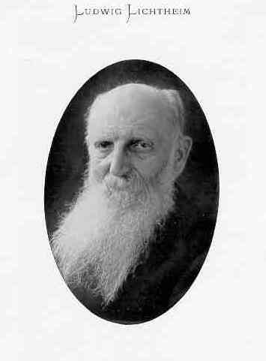
Lichtheim (1885)
‘Concept’ area
Broca’s area
Wernicke’s area
Speech out
Speech in

Slide 22
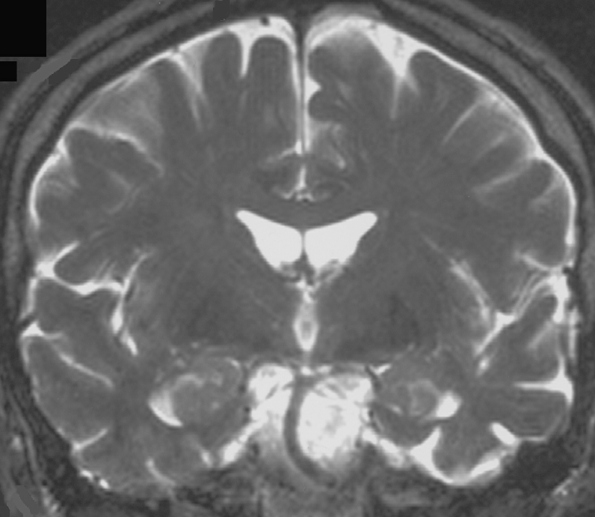
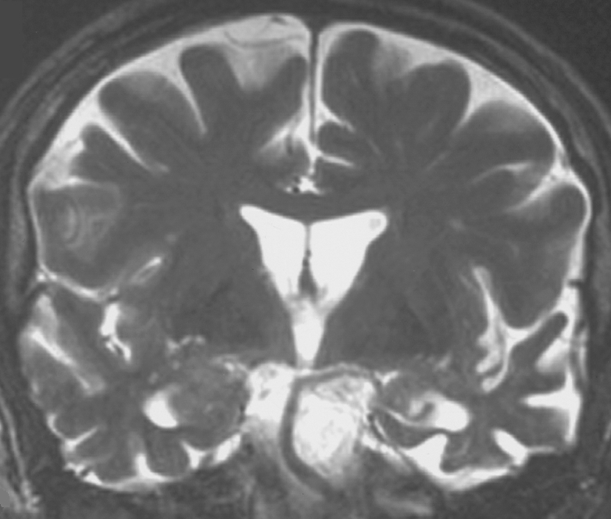
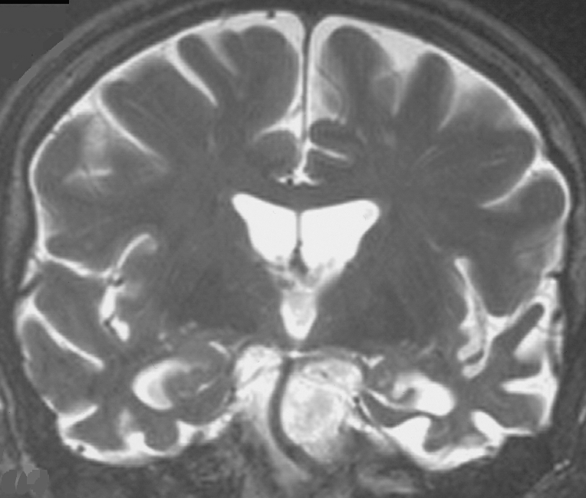
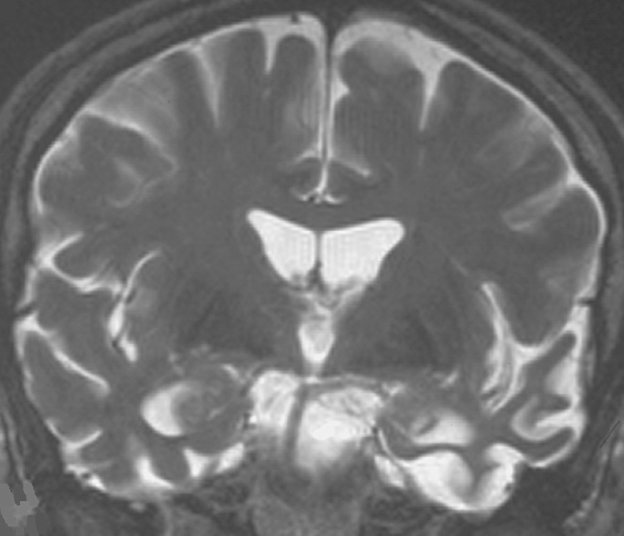
Semantic dementia
R
7/1998
R
6/2001
R
6/2002
R
9/2002
Progressive rostral temporal lobe atrophy

Slide 23
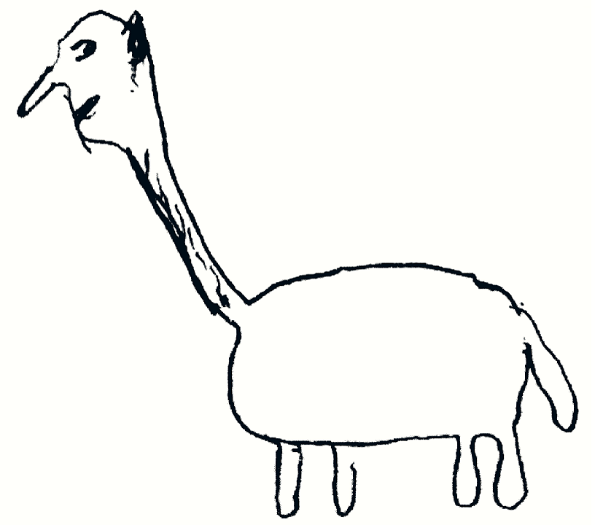
A swan

Slide 24
Evolution of the hand

Slide 25
Evolution of the hand

Slide 26
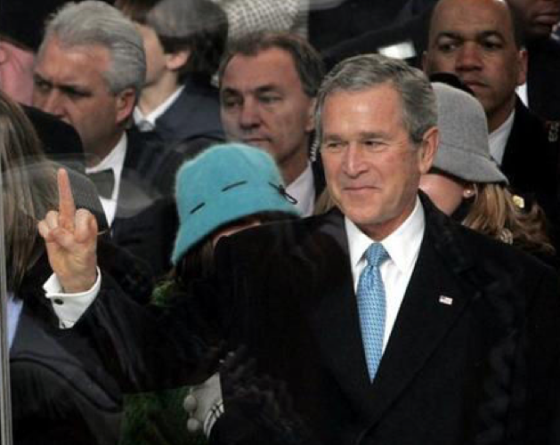
Intransitive

Slide 27
Transitive

Slide 28
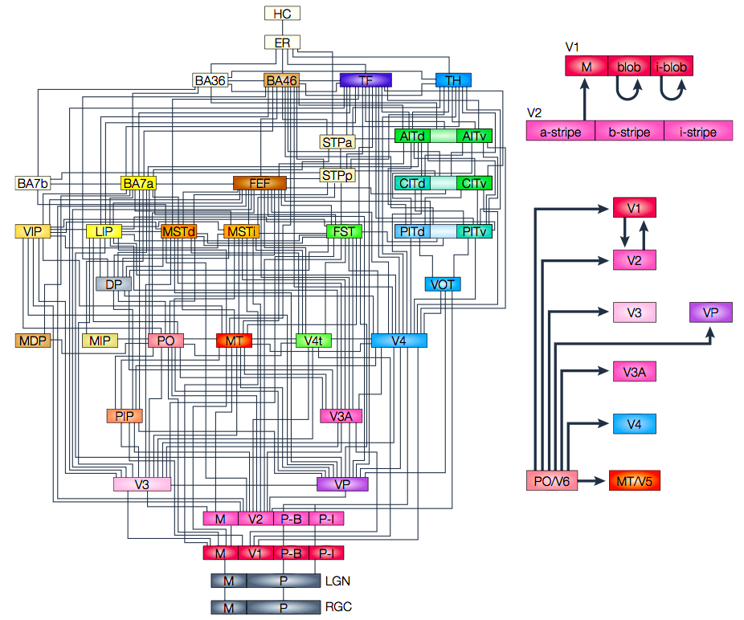
Dorsal and ventral visual streams
Notes:
28

Slide 29
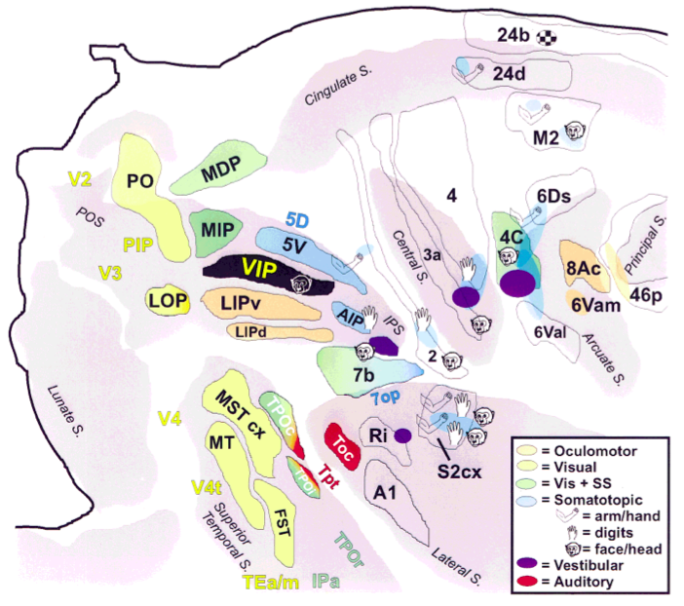
Connections with parietal areas in the monkey
Notes:
29

Slide 30
Parietal frontal connections in the monkey

Slide 31
Skilled movements are stored as ‘motor engrams’ in the posterior left hemisphere (parietal lobe) and are executed by the transfer of the ‘memory’ to the left frontal lobe (for the right hand) and thence to the right frontal lobe (for the left hand).

Slide 32
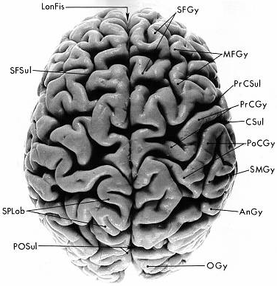
Role of the corpus callosum

Slide 33
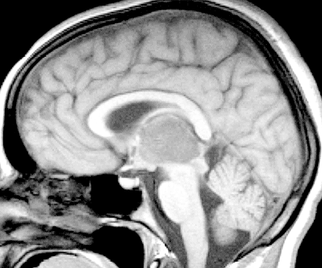
Role of the corpus callosum

Slide 34
Liepmann
Inability to perform acts to verbal commands, even though they might be performed spontaneously, or when aroused emotionally
An example of one of his cases:
A man with left hemisphere stroke tried to complete commands with his left hand.
Could not though it was not paralyzed (as right hand).
Right-handed patients with right hemisphere stroke did not show apraxia with their right hands.
Liepmann’s explanation:
left hemisphere was the “organizer” for skilled movements
suggested supramarginal gyrus of parietal lobe was necessary
a patient with the corresponding section of the corpus callosum damaged also showed left hand apraxia.

Slide 35
Apraxia
“… a neurological disorder of learned purposive movement skill that is not explained by deficits of elemental motor or sensory systems”
Rothi and Heilman (1997)
An impairment in “the purposeful organisation of voluntary actions, mostly but not necessarily represented by gestures”
Faglioni and Basso (1985)

Slide 36
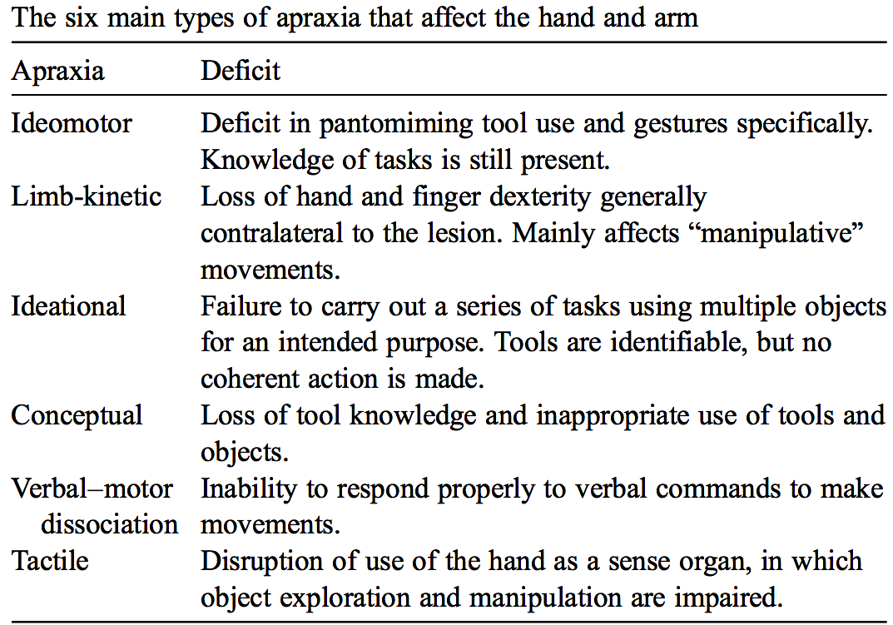
Notes:
36

Slide 37
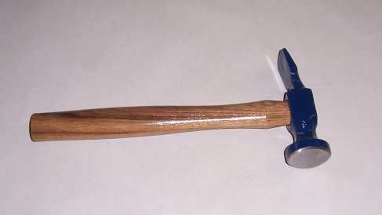
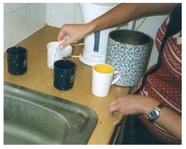
Ideomotor apraxia ‘How would you use this?’ (p.s. safer to use a comb) Ideational apraxia ‘Make a cup of tea’ [occupational therapy assessment!!]
Concept
Plan
Act

Slide 38
What are executive functions?
Umbrella term for processes that CONTROL behaviour.
Allow us to co-ordinate psychological processes (attention, memory, perception, etc.) in order to achieve goals

Slide 39
Executive Functions include:
Inhibition
Flexibility
Planning
Multi-tasking
Judgement

Slide 40
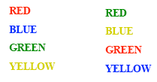
Executive functions include:
Inhibition
Read the colour of the words.
Stroop Task

Slide 41
Executive functions include:
Inhibition
Now try again!
Stroop Task

Slide 42
Executive functions include:
Flexibility
Wisconsin Card Sorting Test

Slide 43
Executive functions include:
Multi-tasking
Tasks
Buy 6 items (e.g. lettuce, a bar of soap)
Find out 4 pieces of information (e.g. coldest place in Britain yesterday)
Be outside travel agent shop in 15 minutes
Rules
Spend as little money and take as little time as possible
Don’t enter a shop except to buy something
Don’t use anything not bought on the street (except a watch)
Inform experimenter of purchases straight after leaving a shop
Multiple Errands Test

Slide 44
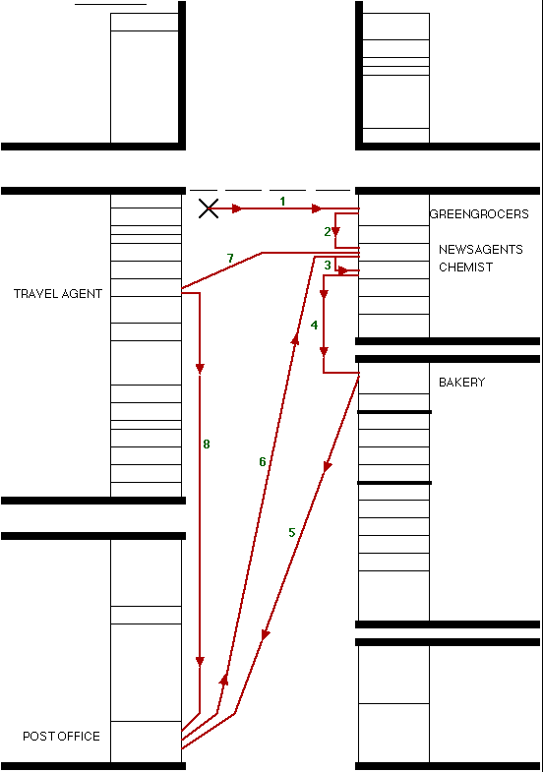
Healthy Volunteer

Slide 45
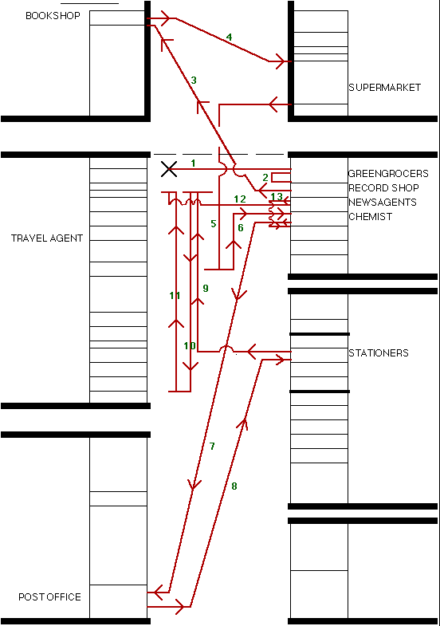
Healthy Volunteer
Patient

Slide 46
Examples of errors made only by patient
Recorded incorrect information
Ate purchase (chocolate) before test finished
Left boundaries of shopping centre
Jumped queue at payment point
Swore loudly
Removed shoes
Purchased pornographic magazine

Slide 47
Spatial Cognition
The neglect syndrome
Vestibular spatial cognition

Slide 48
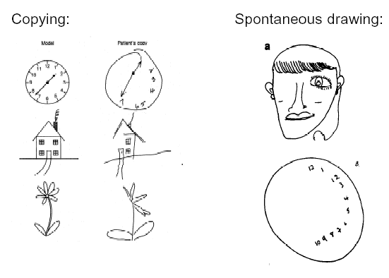
The Neglect Syndrome
Line bisection

Slide 49
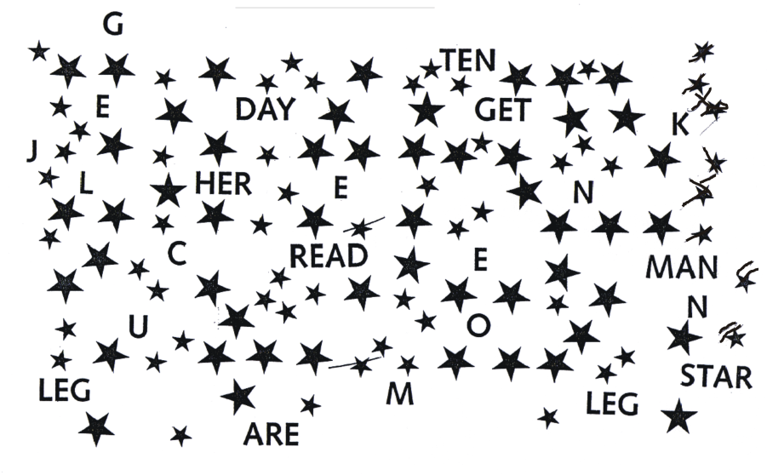
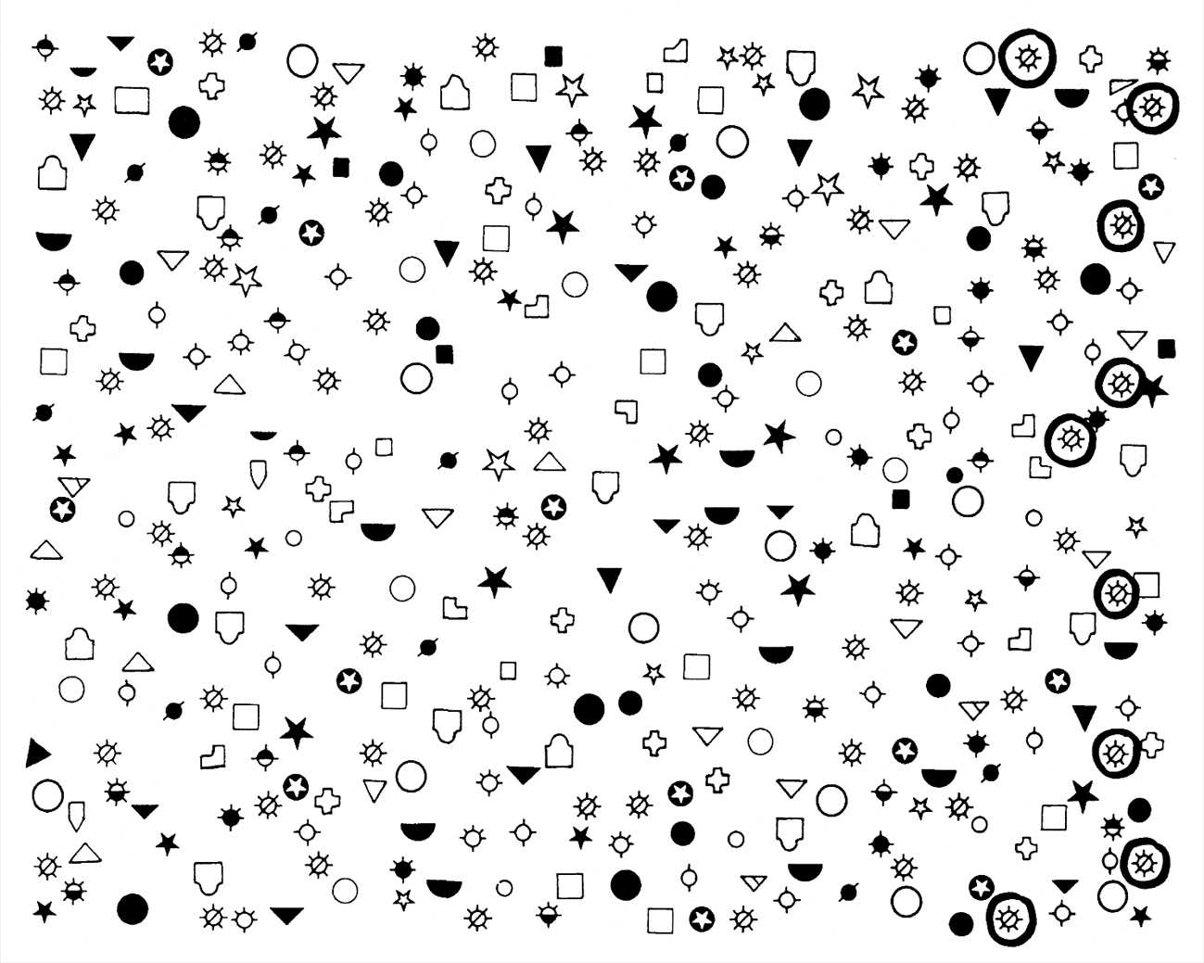
The Neglect Syndrome

Slide 50
Vestibular Spatial cognition
Moving in Space time

Slide 51
Dummies guide to cognitive neurology
Frontal
Control, Planning
Working memory, ‘Intelligence’
Language (‘output’)
Parietal
Spatial cognition
Language (‘input and analysis’)
Praxis [+ Frontal: ‘doing up button’s, cup of tea]
Temporal
Language [+ contiguous parietal]
Medial: memory [Alzheimer’s]
Occipital
Vision [V1 – V5]
Right – space
Left – language/praxia

