Slide 1
Safety Matters on the MBBS BSc course Dr Michael Barrett Head of Learning Resources School of Medicine
Undergraduate Medicine
October 2012

Slide 2
Who are we?
Dr Michael Barrett Head of Learning Resources, School of Medicine
Jon Avery College Fire Safety Officer

Slide 3
Safety in Undergraduate Medicine
Lecture Theatres/Seminar Rooms/Libraries
Practical Labs
PC cluster labs
Human Anatomy Unit
Clinical Skills Labs
Hospital placements
General Practices & Community Clinics
Electives

Slide 4
Responsibilities in College
Safety Department
Policy
Investigation
Reporting
Advice
Occupational Health
Surveillance
Immunisations
Investigation
Security
College & personal security also Police Liaison
First Aiders

Slide 5
Responsibilities in Undergraduate Medicine
Course organisers & Learning Resources (policies, procedures, facilities)
Heads of Year
NHS Trusts and General Practices
Head of Undergraduate Medicine
and yourselves
Campus Safety Managers
Student Welfare Committee
Faculty Health and Safety Forum

Slide 6
Finding information
Year guide
Medicine Intranet
College website

Slide 7
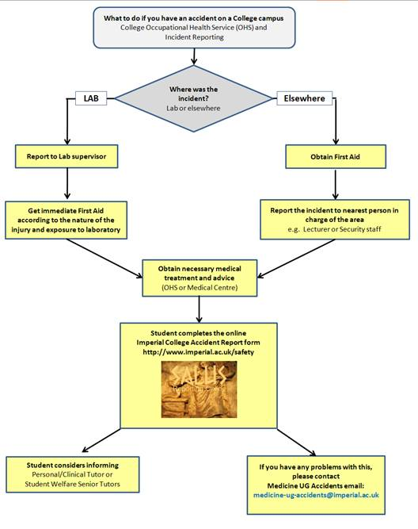
Injuries & Incidents
Report … but seek first aid/medical attention immediately
This ensures you are given the most appropriate treatment
We will investigate the event and take action to avoid or prevent recurrence
In the Year Guide and on Intranet - see Policies

Slide 8
Local emergencies
Call the College Emergency Number who will advise the relevant campus immediately 020 7589 1000
From Hospital Phones
CX & Hammersmith 3333
St Mary’s 2222
Please note there will be Fire Drills – these are arranged locally and details will be given by campus staff

Slide 9
Other Important contact details
Student matters see Year Guide
Teaching intranet https://education.med.imperial.ac.uk
Occupational Health 020 7594 9401
Security 020 7594 8910
Safety Dept 020 7594 9423
Estates helpdesk 020 7594 8000

Slide 10
Undergraduate Medicine
For general teachings areas, the Safety Officer is…
Dr Michael Barrett 020 7594 9823 email: mike.barrett@imperial.ac.uk
Campus specific details about buildings and evacuations is at https://education.med.imperial.ac.uk/Policies/Safety.htm

Slide 11
SAFB Facilities

Slide 12
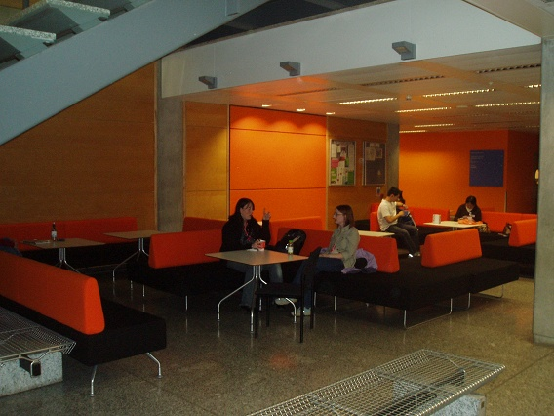
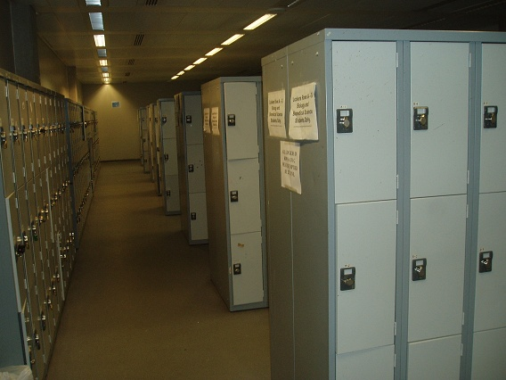
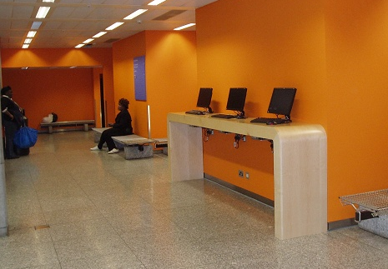
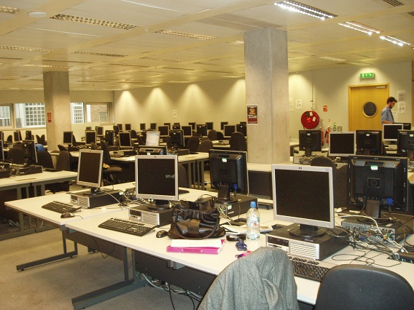
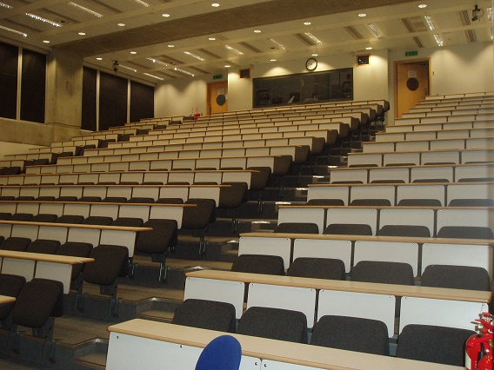
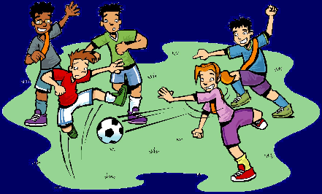
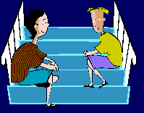
SAFB Facilities
Please look after the working areas and remember there are other users of the building

Slide 13
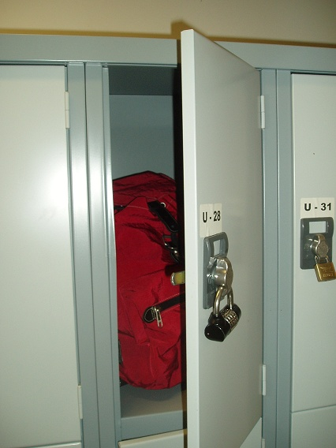
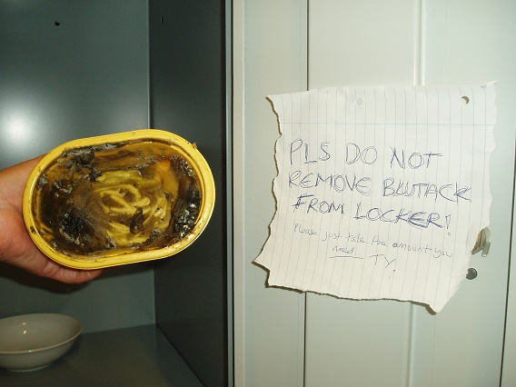
Keep possessions safe and protect others
It won’t fit!
I can’t believe it’s not butter

Slide 14
The worst hazards?
Freshers’ Week?
End of Year Exams?

Slide 15
Finally…
Work safe
Play safe
But do enjoy your time here!
mike.barrett@imperial.ac.uk

