Slide 1
Year 1: Medicine Self -Tests (2012 - 2013)
Professor Nancy Curtin
Emeritus Professor of Muscle Physiology
n.curtin@imperial.ac.uk
Dr James Pease
j.pease@imperial.ac.uk
Outline
What are Self-tests? & What is Certainty-Based-Marking?
How to find the Self-test and use them
Why use them?

Slide 2
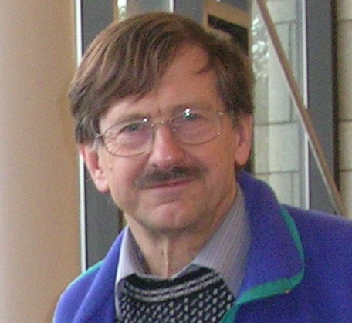
LAPT : web based learning tool developed by
Prof. Tony Gardner-Medwin, UCL
Widely used in medical schools, universities & colleges in UK and abroad where exercises have been written to suit specific courses. Have a look at the UCL site
http://www.ucl.ac.uk/lapt/

Slide 3
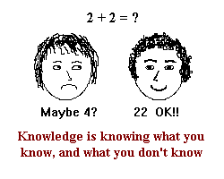
A key feature of LAPT: Certainty-based marking
Particularly important in medicine:
You must recognize when you are sure enough to act, and when you are only guessing and need more info or help.
Guessing can be fatal for your patients.
Certainty-based marking: you enter your answer and also a number (1, 2 or 3) indicating how sure you are about the answer. Mark depends of whether answer is correct or not, and also on your certainty...

Slide 4
The Yr1 Med Course at Imperial Self-tests:
A large set of exercises that run in LAPT
Use the features of LAPT such as Certainty-Based-Marking
Content of exercise maps onto the Yr1 Course
Restricted access to Self-tests via BlackBoardLearn & Imperial username
LAPT content available via http://www.ucl.ac.uk/lapt/
Yr1 Med Imperial
Self-tests

Slide 5
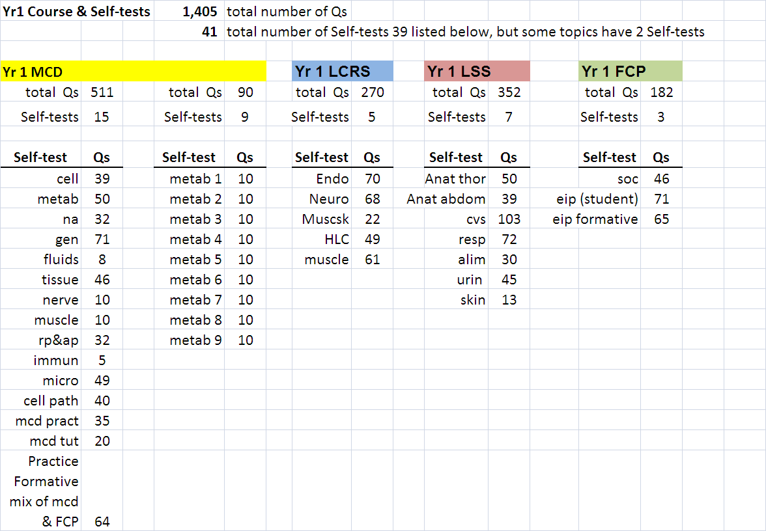
In the session on 11 Dec, a student asked about the number of Qs. Here is a summary

Slide 6
Many of the Imperial Self-tests were authored by Yr1 Med students , including…..
Xin-Ying
Mohsin Asharia
Tim Rawson
Samantha Thalayasingam
Mohsin Asharia
Danielle Lee
Kyung-Hoon Moon
Rahul Mudannayake
Kimme Khan
Mohsin Asharia
Xin-Ying Kowa
Rasheed Rabiu
Krishna Gayathri Rajasooriar
SanjeevRamachandran
James Cooper
Alan (King) Liu
Mohammed Jawad
Ankur Khajuria
Thank you!
Self-tests have been revised by Academic staff & also in response to student comments.
I curate the Self-tests, contact me if, for example, you cannot log on.

Slide 7
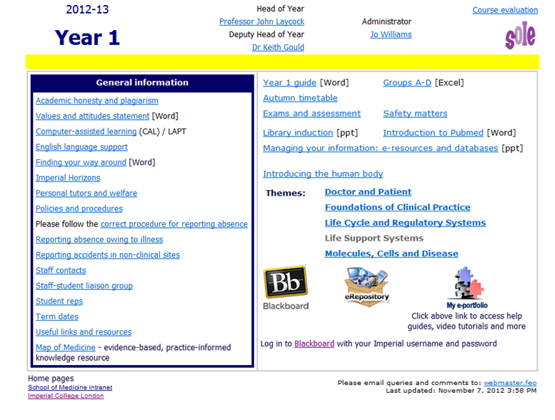
How to find the Self-test and use them
From Yr1 in the Intranet go to BlackBoardLearn

Slide 8
My Courses
Year 1 - Medicine - Self-Tests
Getting Started Read this first
Learning Materials Menu of exercises & link to Your report file

Slide 9
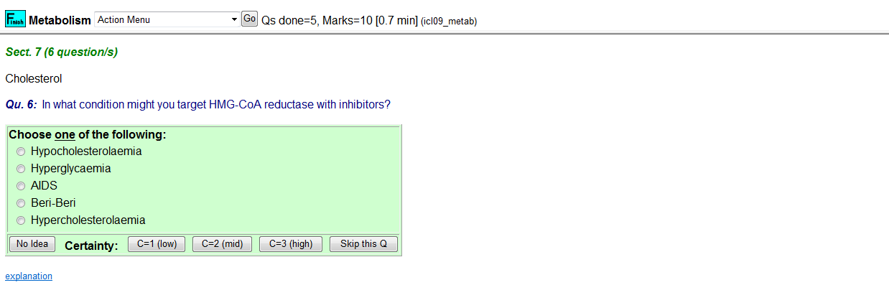
Enter your answer and your certainty

Slide 10
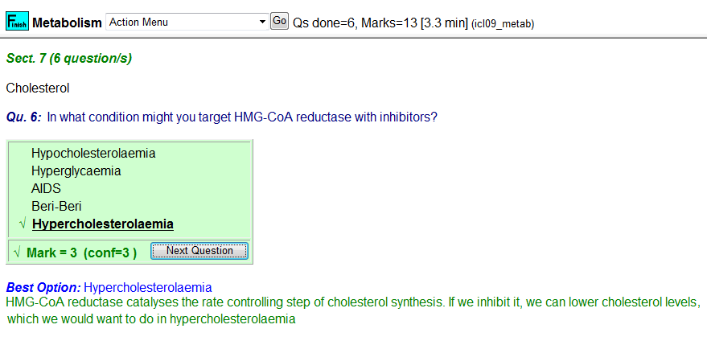
Your answer is Marked and Explanation, if available, is given

Slide 11
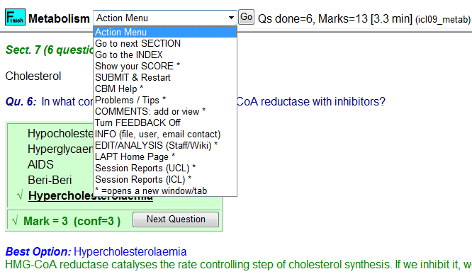
Breakdown of your score so far
Answer wrong? Explanation not clear?
Suggest an explanation if one is needed.
Your comment is E-mailed to me

Slide 12
Why use the Self-tests?

Slide 13
Performance on the Jan 2012 Formative of students who.....
Students who did not do the Self-tests were TWICE as likely to fail as students who did do the Self tests.

Slide 14
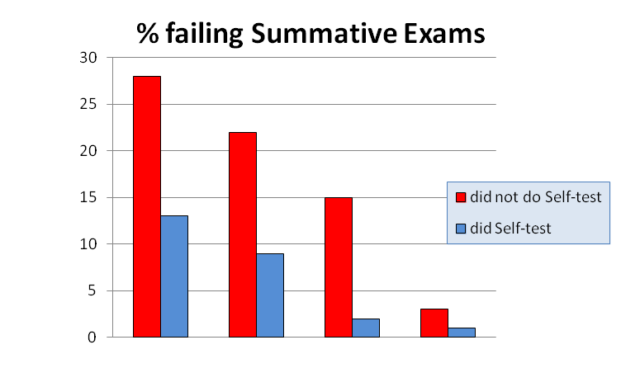
LSS
MCD
LCRS
FCP
For all the exams fail rate more than 2 times higher for students who did not do Self-tests

Slide 15
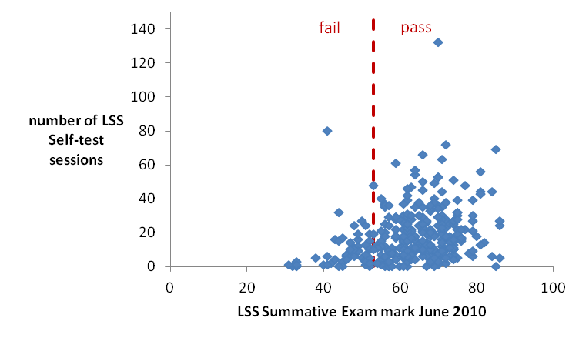
Association between Exam mark and Self-test use

Slide 16
There a strong association between doing Self-tests and good exam performance.
Where are you now?

Slide 17
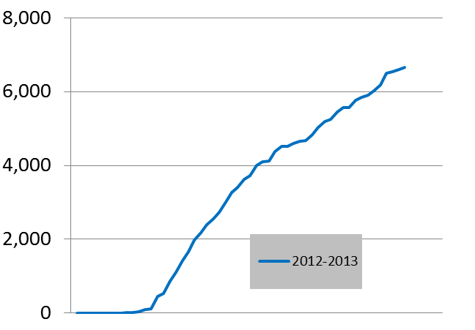
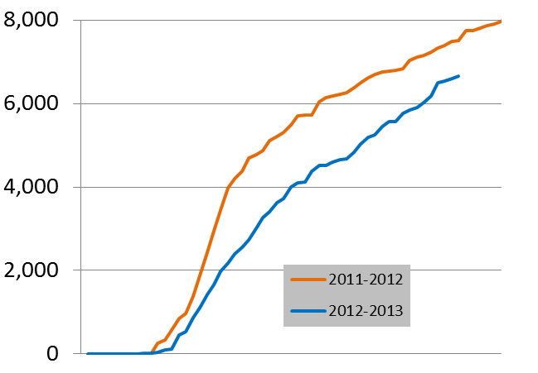
Self-tests for Term 1 Courses (Intro to cells, Nucleic acids & gene expression, Genetics, etc..) open from 1 Oct
Cumulative num. Qs done
date
date
1 Oct
1 Dec
1 Oct
1 Dec
112 students
(=34% of class)
527 sessions

Slide 18
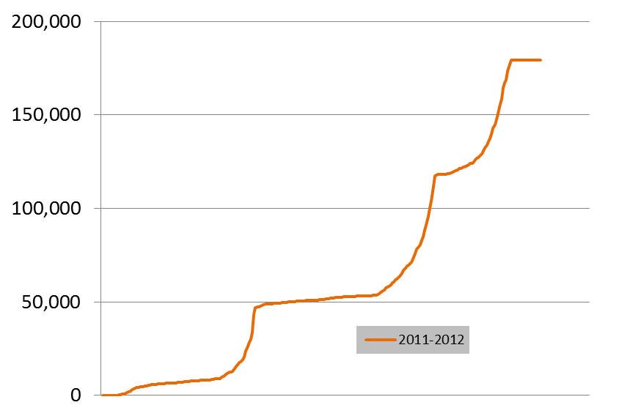
Self-test use during academic year 2011-2012
Cumulative number
of questions done
LSS, LCRS, FCP Summative
MCD
Summative
Jan Formative

Slide 19
Many of you have not done any Self-tests.
Past performance shows that students who did the Self-tests are much more likely to pass
than students who did NOT do the Self tests.
Where do you want to be?
Help yourself get there: Do the Self-tests!

