Slide 1
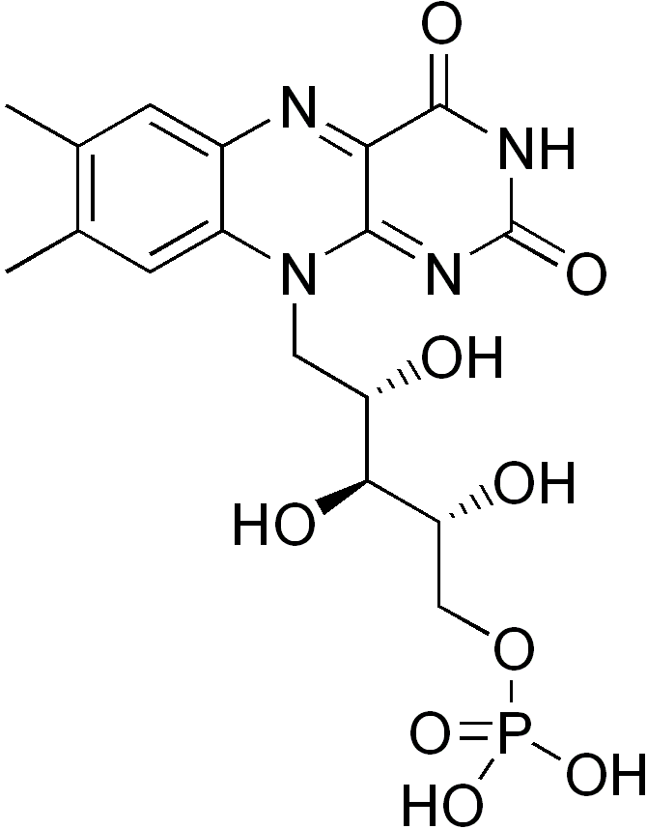
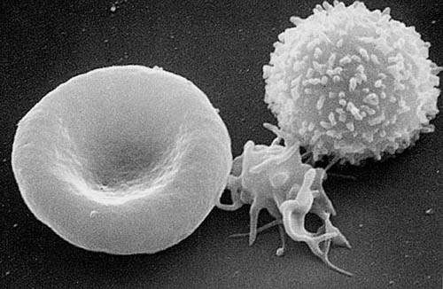
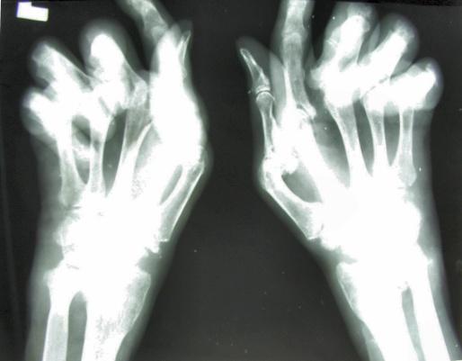
Year 1 Formative Examination
Feedback session
29 January 2013
Keith Gould
k.gould@imperial.ac.uk

Slide 2
Year 1 Formative Exams - 2009 to 2012
 | Jan-12 | Jan-11 | Jan-10 | Jan-09
total students | 282 | 325 | 303 | 294
students absent | 1 | 7 | 4 | 3
number pass | 165 | 187 | 175 | 171
number fail | 116 | 131 | 124 | 120
number absent | 1 | 7 | 4 | 3
fraction pass | 58.72 | 58.81 | 58.53 | 58.76
fraction fail | 41.28 | 41.19 | 41.47 | 41.24

Slide 3
2013 pass rate?

Slide 4
 | Jan-13 | Jan-12 | Jan-11 | Jan-10 | Jan-09
total students | 281 | 282 | 325 | 303 | 294
students absent | 3 | 1 | 7 | 4 | 3
number pass | 141 | 165 | 187 | 175 | 171
number fail | 137 | 116 | 131 | 124 | 120
number absent | 3 | 1 | 7 | 4 | 3
fraction pass | 50.72 | 58.72 | 58.81 | 58.53 | 58.76
fraction fail | 49.28 | 41.28 | 41.19 | 41.47 | 41.24

Slide 5
Structure of formative exam
S & H 20 minutes:
16 Single Best Answer (SBA) questions = 20 min, 1.25 min/Q
MCD 80 minutes:
12 Single Best Answer (SBA) questions = 15 min, 1.25 min/Q
12 Assertion Reason questions (ARQ) = 24 min, 2 min/Q
2 Extended Matching Questions (EMQ) = 10 min, 5 min/Q
3 Short Answer Questions (SAQ) = 30 min, 10 min/Q

Slide 6
S & H average raw marks (%)
16 SBA 68.14%
5 questions in which most people
were incorrect
4 questions in which >90% of students
were correct

Slide 7
Society & Health SBAs feedback
> 2/3 students:
Evidence on why mortality is higher in lower socioeconomic class/work grades
> ½ students:
How do we grade Deprivation/Socio-economic status?
> ½ students:
What are the characteristics of the local population you will be working with over the next few years (demographics etc..) ?
> ½ students:
What makes us healthier: access to medical care or improved social conditions? The mortality rate in England decreased dramatically1850s-1950s. How did Thomas McKeown explain this?

Slide 8
MCD average raw marks (%)
SBA 56.83
ARQ 53.96
EMQ 57.37
SAQ 45.88

Slide 9
Most poorly answered MCD SBA:
 | Influenza virus:
 | a) | Enters cells by fusion of the viral particle with the plasma membrane
 | b) | Is a single stranded DNA virus
 | c) | Binds to host cell sialic acid via haemagglutinin
 | d) | Does not undergo recombination
 | e) | Is stable in human populations over several years

Slide 10
Most poorly answered MCD SBA:
 | Influenza virus:
 | a) | Enters cells by fusion of the viral particle with the plasma membrane | 49.3%
 | b) | Is a single stranded DNA virus | 16.2%
 | c) | Binds to host cell sialic acid via haemagglutinin | 27.0%
 | d) | Does not undergo recombination | 2.5%
 | e) | Is stable in human populations over several years | 4.3%

Slide 11
Most poorly answered MCD SBA:
 | Influenza virus:
 | a) | Enters cells by fusion of the viral particle with the plasma membrane
 | b) | Is a single stranded DNA virus
 | c) | Binds to host cell sialic acid via haemagglutinin
 | d) | Does not undergo recombination
 | e) | Is stable in human populations over several years
27.0% got the right answer

Slide 12
Second most poorly answered MCD SBA:
 | In RNA spicing (mRNA processing), which statement best describes the function of the splice acceptor sequence?
 | a) | It promotes the degradation of lariat RNAs
 | b) | It acts to bind to the transcription factor TFIID
 | c) | It defines the 3’ end of the intron (intervening sequence)
 | d) | It is used to specify the cleavage site for the start of the intron
 | e) | It is a palindromic sequence that is targeted by restriction enzymes that cleave the RNA

Slide 13
Second most poorly answered MCD SBA:
 | In RNA spicing (mRNA processing), which statement best describes the function of the splice acceptor sequence?
 | a) | It promotes the degradation of lariat RNAs | 1.4%
 | b) | It acts to bind to the transcription factor TFIID | 5.4%
 | c) | It defines the 3’ end of the intron (intervening sequence) | 39.9%
 | d) | It is used to specify the cleavage site for the start of the intron | 35.3%
 | e) | It is a palindromic sequence that is targeted by restriction enzymes that cleave the RNA | 17.3%

Slide 14
Second most poorly answered MCD SBA:
 | In RNA spicing (mRNA processing), which statement best describes the function of the splice acceptor sequence?
 | a) | It promotes the degradation of lariat RNAs
 | b) | It acts to bind to the transcription factor TFIID
 | c) | It defines the 3’ end of the intron (intervening sequence)
 | d) | It is used to specify the cleavage site for the start of the intron
 | e) | It is a palindromic sequence that is targeted by restriction enzymes that cleave the RNA
39.9% got the right answer

Slide 15
The sequence of events in mRNA splicing
Exon
Intron
Exon
AGGU
Pyr15NCAGG
“Splice Donor”
site
“Splice Acceptor”
site
Pyr = Pyrimidine ( C or U)
N = any base
Introns start with the sequence “GU” and end with the
sequence “AG”

Slide 16
Two most poorly answered ARQs:
The presence of creatine kinase in the serum is diagnostic of myocardial infarction
BECAUSE
Creatine kinase is present in cardiac muscle
 | Assertion | Reason
a) | True | True | Reason is correct explanation
b) | True | True | Reason is NOT a correct explanation
c) | True | False
d) | False | True
e) | False | False

Slide 17
Two most poorly answered ARQs:
The presence of creatine kinase in the serum is diagnostic of myocardial infarction
BECAUSE
Creatine kinase is present in cardiac muscle
 | Assertion | Reason
a) | True | True | Reason is correct explanation | 45.7%
b) | True | True | Reason is NOT a correct explanation | 39.9%
c) | True | False |  | 4.3%
d) | False | True |  | 8.3%
e) | False | False |  | 0.7%

Slide 18
Two most poorly answered ARQs:
The presence of creatine kinase in the serum is diagnostic of myocardial infarction
BECAUSE
Creatine kinase is present in cardiac muscle
 | Assertion | Reason
a) | True | True | Reason is correct explanation | 45.7%
b) | True | True | Reason is NOT a correct explanation | 39.9%
c) | True | False |  | 4.3%
d) | False | True |  | 8.3% CORRECT
e) | False | False |  | 0.7%

Slide 19
Two most poorly answered ARQs:
The number of T lymphocytes in peripheral blood decreases substantially in old age
BECAUSE
Lymphocyte production by the thymus declines in old age
 | Assertion | Reason
a) | True | True | Reason is correct explanation
b) | True | True | Reason is NOT a correct explanation
c) | True | False
d) | False | True
e) | False | False

Slide 20
Two most poorly answered ARQs:
The number of T lymphocytes in peripheral blood decreases substantially in old age
BECAUSE
Lymphocyte production by the thymus declines in old age
 | Assertion | Reason
a) | True | True | Reason is correct explanation | 65.8%
b) | True | True | Reason is NOT a correct explanation | 4.0%
c) | True | False |  | 18.0%
d) | False | True |  | 8.3%
e) | False | False |  | 3.2%

Slide 21
Two most poorly answered ARQs:
The number of T lymphocytes in peripheral blood decreases substantially in old age
BECAUSE
Lymphocyte production by the thymus declines in old age
 | Assertion | Reason
a) | True | True | Reason is correct explanation | 65.8%
b) | True | True | Reason is NOT a correct explanation | 4.0%
c) | True | False |  | 18.0%
d) | False | True |  | 8.3% CORRECT
e) | False | False |  | 3.2%

Slide 22
EMQ Amino acids
For each statement below, choose the SINGLE most appropriate answer from the list of options above. Each option may be used once, more than once, or not at all.
A. | Cysteine | I. | Glutamate
B. | Glycine | J. | Tryptophan
C. | Alanine | K. | -
D. | Methionine | L. | -
E. | Tyrosine | M. | -
F. | Proline | N. | -
G. | Leucine | O. | -
H. | Asparagine | P. | -
6. | An amino acid which undergoes transamination in the malate-aspartate shuttle
7. | An amino acid which undergoes the post-translational modification of γ-carboxylation, as seen in proteins of the blood clotting cascade
8. | An amino acid which is normally negatively charged within proteins
9. | An amino acid which undergoes the post-translational modification of N-linked glycosylation
10. | An amino acid which typically introduces kinks into α-helices

Slide 23
EMQ Amino acids
For each statement below, choose the SINGLE most appropriate answer from the list of options above. Each option may be used once, more than once, or not at all.
A. | Cysteine | I. | Glutamate
B. | Glycine | J. | Tryptophan
C. | Alanine | K. | -
D. | Methionine | L. | -
E. | Tyrosine | M. | -
F. | Proline | N. | -
G. | Leucine | O. | -
H. | Asparagine | P. | -
6. | An amino acid which undergoes transamination in the malate-aspartate shuttle | I (67.3%)
7. | An amino acid which undergoes the post-translational modification of γ-carboxylation, as seen in proteins of the blood clotting cascade
8. | An amino acid which is normally negatively charged within proteins
9. | An amino acid which undergoes the post-translational modification of N-linked glycosylation
10. | An amino acid which typically introduces kinks into α-helices

Slide 24
EMQ Amino acids
For each statement below, choose the SINGLE most appropriate answer from the list of options above. Each option may be used once, more than once, or not at all.
A. | Cysteine | I. | Glutamate
B. | Glycine | J. | Tryptophan
C. | Alanine | K. | -
D. | Methionine | L. | -
E. | Tyrosine | M. | -
F. | Proline | N. | -
G. | Leucine | O. | -
H. | Asparagine | P. | -
6. | An amino acid which undergoes transamination in the malate-aspartate shuttle | I (67.3%)
7. | An amino acid which undergoes the post-translational modification of γ-carboxylation, as seen in proteins of the blood clotting cascade | I (29.1%)
8. | An amino acid which is normally negatively charged within proteins
9. | An amino acid which undergoes the post-translational modification of N-linked glycosylation
10. | An amino acid which typically introduces kinks into α-helices

Slide 25
EMQ Amino acids
For each statement below, choose the SINGLE most appropriate answer from the list of options above. Each option may be used once, more than once, or not at all.
A. | Cysteine | I. | Glutamate
B. | Glycine | J. | Tryptophan
C. | Alanine | K. | -
D. | Methionine | L. | -
E. | Tyrosine | M. | -
F. | Proline | N. | -
G. | Leucine | O. | -
H. | Asparagine | P. | -
6. | An amino acid which undergoes transamination in the malate-aspartate shuttle | I (67.3%)
7. | An amino acid which undergoes the post-translational modification of γ-carboxylation, as seen in proteins of the blood clotting cascade | I (29.1%)
8. | An amino acid which is normally negatively charged within proteins | I (27.7%)
9. | An amino acid which undergoes the post-translational modification of N-linked glycosylation
10. | An amino acid which typically introduces kinks into α-helices

Slide 26
EMQ Amino acids
For each statement below, choose the SINGLE most appropriate answer from the list of options above. Each option may be used once, more than once, or not at all.
A. | Cysteine | I. | Glutamate
B. | Glycine | J. | Tryptophan
C. | Alanine | K. | -
D. | Methionine | L. | -
E. | Tyrosine | M. | -
F. | Proline | N. | -
G. | Leucine | O. | -
H. | Asparagine | P. | -
6. | An amino acid which undergoes transamination in the malate-aspartate shuttle | I (67.3%)
7. | An amino acid which undergoes the post-translational modification of γ-carboxylation, as seen in proteins of the blood clotting cascade | I (29.1%)
8. | An amino acid which is normally negatively charged within proteins | I (27.7%)
9. | An amino acid which undergoes the post-translational modification of N-linked glycosylation | H (9.4%)
10. | An amino acid which typically introduces kinks into α-helices

Slide 27
EMQ Amino acids
For each statement below, choose the SINGLE most appropriate answer from the list of options above. Each option may be used once, more than once, or not at all.
A. | Cysteine | I. | Glutamate
B. | Glycine | J. | Tryptophan
C. | Alanine | K. | -
D. | Methionine | L. | -
E. | Tyrosine | M. | -
F. | Proline | N. | -
G. | Leucine | O. | -
H. | Asparagine | P. | -
6. | An amino acid which undergoes transamination in the malate-aspartate shuttle | I (67.3%)
7. | An amino acid which undergoes the post-translational modification of γ-carboxylation, as seen in proteins of the blood clotting cascade | I (29.1%)
8. | An amino acid which is normally negatively charged within proteins | I (27.7%)
9. | An amino acid which undergoes the post-translational modification of N-linked glycosylation | H (9.4%)
10. | An amino acid which typically introduces kinks into α-helices | F (35.3%)

Slide 28
MCD SAQs
Average | 6.8 | 4.4 | 2.6
Median | 7.0 | 4.0 | 2.0
SD | 2.0 | 2.2 | 2.1
Min | 1.0 | 1.0 | 0.0
Max | 10.0 | 10.0 | 10.0
 | SAQ 1 nuc | SAQ 2 data | SAQ 3 haem
No. of students failing | 46 | 176 | 233

Slide 32
A.
The protein haemoglobin serves to carry oxygen, and in humans may exist in normal (HbA) or sickle (HbS) forms, the latter resulting from a mutation at position 6 of the β-chain (glutamate to valine). With reference to these two amino acids, explain how this mutation results in the characteristic sickling of erythrocytes. (4 marks)

Slide 33
A.
The protein haemoglobin serves to carry oxygen, and in humans may exist in normal (HbA) or sickle (HbS) forms, the latter resulting from a mutation at position 6 of the β-chain (glutamate to valine). With reference to these two amino acids, explain how this mutation results in the characteristic sickling of erythrocytes. (4 marks)
The hydrophobic valine residue (1 mark) of HbS forms hydrophobic interactions (1 mark) with residues on the beta chain of another haemoglobin molecule. These interactions can rapidly give rise to polymers/aggregates of haemoglobin S (1 mark) which tend to precipitate/crystallise, thereby distorting the erythrocyte and leading to the characteristic "sickle" shape of the red cell (1 mark).

Slide 34
B.
How does the mutation described above allow HbA and HbS to be separated by electrophoresis?
(3 marks)

Slide 35
B.
How does the mutation described above allow HbA and HbS to be separated by electrophoresis?
(3 marks)
Glutamate is negatively charged (1 mark) whilst valine is uncharged (1 mark). Migration of HbS towards a positive electrode is impaired compared to that of HbA (1 mark).
(Note:haemoglobin electrophoresis is usually done under non-denaturing conditions at pH 8.6 on cellulose acetate. The students did this themselves in a practical).

Slide 36
C.
Haemoglobin can also exist in a methaemoglobin form. Describe how this differs from normal haemoglobin and name two common causes of methaemoglobin generation. (3 marks)

Slide 37
C.
Haemoglobin can also exist in a methaemoglobin form. Describe how this differs from normal haemoglobin and name two common causes of methaemoglobin generation. (3 marks)
In methaemoglobin, the Fe²⁺ (ferrous) ion is oxidised to Fe³⁺ (ferric) (1 mark).
This is occurs in some diseases (e.g. Cytochrome b5 reductase deficiency, G6PD deficiency, Pyruvate kinase deficiency)
It can also occur following exposure to some pharmaceuticals/environmental agents (e.g. Aromatic amines (e.g. p-nitroaniline, Arsine, Chlorobenzene, Chromates, Nitrates/nitrites)
(1 mark for any of these, up to a total of two).

Slide 38
SAQ advice
Try and answer every section!
Blanks mean zero marks!
Read the questions several times.
Think.
What would the question setter expect you to know?
There is no negative marking.
How will the question be marked?
Where will the marks go?
If you are asked for a list of items, ONLY provide the number requested. Marking will look at answers in sequence of presentation, and extra subsequent answers will not gain marks, even if correct.
Only use the space available.
Legibility is vital!

Slide 39
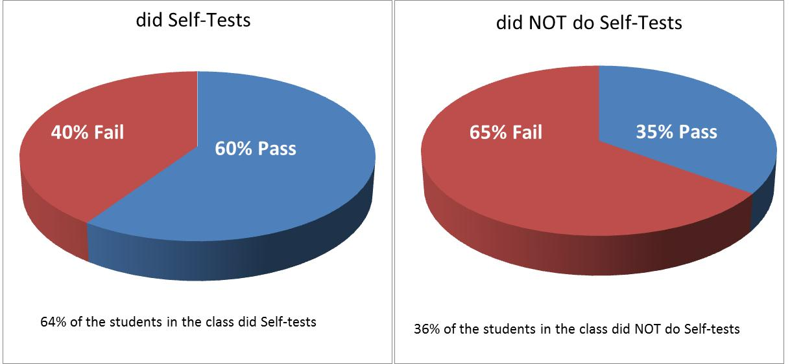
Performance in the Jan 2013 Formative for Students who…
Much more likely to FAIL if you have NOT done Self-tests!

Slide 40
MCD summative exam on 29th April 2013
Tests all the year’s material
2 hr 15 min long
36 SBAs (45 min), 10 ARQs (20 min), 7 SAQs (70 min)
MCD resit exam on 12th August 2013
Same format as April exam
ANY QUESTIONS?

