Slide 1
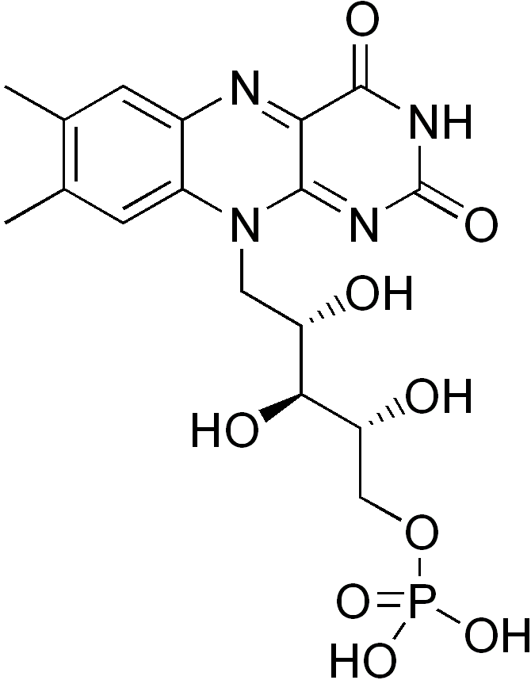
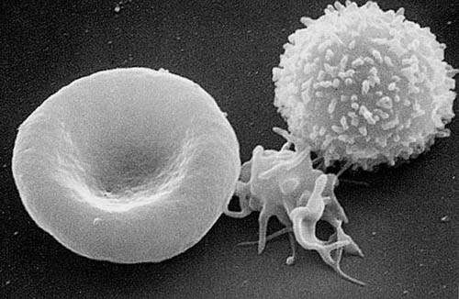
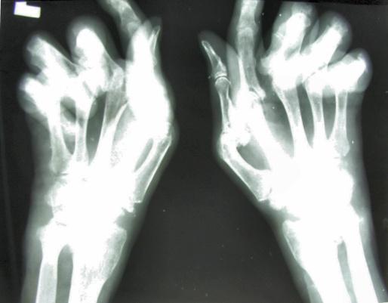
Year 1 formative examination
and exam question formats
Keith Gould
k.gould@imperial.ac.uk

Slide 2
Formative Examination
Monday 7th January 2013, 2 pm – 3.40 pm
(MCD and Society and Health)
Practice for the Formative Exam
tomorrow
Wednesday 12th December 2012, G16 LT 9.15 am
Peer Marked Self Assessment (PMSA) session
Exam conditions, 1 short answer question
+ 14 single best answer q’s + 7 assertion-reason q’s

Slide 3
Formative exam in January
Similar format to the summative exams
1 hour 40 minutes long
But it combines MCD and Society and Health (separate in summative assessment)
For MCD - 80 minutes:
12 Single Best Answer (SBA) questions = 15 min, 1.25 min/Q
12 Assertion Reason Questions (ARQ) = 25 min, 2 min/Q
2 Extended Matching Questions (EMQ) = 10 min, 5 min/Q
3 Short Answer Questions (SAQ) = 30 min, 10 min/Q
-drawn from the 8 subject lecture courses and the practicals/tutorials, weighted approximately according to teaching time
For Society and Health - 20 minutes:
16 SBA questions = 20 min, 1.25 min/Q

Slide 4
Single Best Answer (SBA)
Stem statement + FIVE completion words or statements
Only ONE combination of stem + completion is the Best Answer
Attempt all questions: no negative marking
Multiple attempts score zero, even if one answer is correct

Slide 5
SBA Which of the following best defines the term 'nucleic acids'?
Nucleic acids are double helical polymers of nucleosides
Nucleic acids are double helical polymers of nucleotides
Nucleic acids are linear polymers of nucleosides
Nucleic acids are linear polymers of nucleotides
Nucleic acids are triple helical polymers of nucleotides

Slide 6
SBA Which of the following best defines the term 'nucleic acids'?
Nucleic acids are double helical polymers of nucleosides
Nucleic acids are double helical polymers of nucleotides
Nucleic acids are linear polymers of nucleosides
Nucleic acids are linear polymers of nucleotides
Nucleic acids are triple helical polymers of nucleotides

Slide 7
Extended Matching Question (EMQ)
Some information +/- visual data
A list of options (usually 10)
A list of scenarios/statements/questions (usually 5)
For each scenario, select the one most appropriate option from the list
Each option may be used once, more than once, or not at all
Multiple answers to a question will score zero, even if one answer is correct

Slide 8
EMQ - Cells of the immune system
For each question, choose the SINGLE most appropriate answer from the list of options. Each option may be used once, more than once, or not at all
Plasma cell
CD4+ T lymphocyte
CD8+ T lymphocyte
Neutrophil
Mast cell
Natural killer cell
Monocyte
Macrophage
Dendritic cell
Eosinophil
Secretes large amounts of antibody
Contains granules of histamine and binds IgE
Recognises antigen presented by MHC class I molecules
Most efficient cell type at inducing primary adaptive immune responses

Slide 9
EMQ - Cells of the immune system
For each question, choose the SINGLE most appropriate answer from the list of options. Each option may be used once, more than once, or not at all
Plasma cell
CD4+ T lymphocyte
CD8+ T lymphocyte
Neutrophil
Mast cell
Natural killer cell
Monocyte
Macrophage
Dendritic cell
Eosinophil
Secretes large amounts of antibody A
Contains granules of histamine and binds IgE
Recognises antigen presented by MHC class I molecules
Most efficient cell type at inducing primary adaptive immune responses

Slide 10
EMQ - Cells of the immune system
For each question, choose the SINGLE most appropriate answer from the list of options. Each option may be used once, more than once, or not at all
Plasma cell
CD4+ T lymphocyte
CD8+ T lymphocyte
Neutrophil
Mast cell
Natural killer cell
Monocyte
Macrophage
Dendritic cell
Eosinophil
Secretes large amounts of antibody
Contains granules of histamine and binds IgE E
Recognises antigen presented by MHC class I molecules
Most efficient cell type at inducing primary adaptive immune responses

Slide 11
EMQ - Cells of the immune system
For each question, choose the SINGLE most appropriate answer from the list of options. Each option may be used once, more than once, or not at all
Plasma cell
CD4+ T lymphocyte
CD8+ T lymphocyte
Neutrophil
Mast cell
Natural killer cell
Monocyte
Macrophage
Dendritic cell
Eosinophil
Secretes large amounts of antibody
Contains granules of histamine and binds IgE
Recognises antigen presented by MHC class I molecules C
Most efficient cell type at inducing primary adaptive immune responses

Slide 12
EMQ - Cells of the immune system
For each question, choose the SINGLE most appropriate answer from the list of options. Each option may be used once, more than once, or not at all
Plasma cell
CD4+ T lymphocyte
CD8+ T lymphocyte
Neutrophil
Mast cell
Natural killer cell
Monocyte
Macrophage
Dendritic cell
Eosinophil
Secretes large amounts of antibody
Contains granules of histamine and binds IgE
Recognises antigen presented by MHC class I molecules
Most efficient cell type at inducing primary adaptive immune responses I

Slide 13
Assertion Reason Question (ARQ)
Assertion followed by a reason:
Assertion may be true or false
Reason may be true or false
If assertion and reason are both true, reason may or may not be a correct explanation of the assertion

Slide 14
Assertion Reason Question (ARQ)
 | Assertion | Reason
A | True | True | Reason is correct explanation
B | True | True | Reason is NOT a correct explanation
C | True | False
D | False | True
E | False | False
Select one option, A to E:
Question 1: Bananas are yellow
BECAUSE
Bananas grow in tropical countries

Slide 15
Assertion Reason Question (ARQ)
 | Assertion | Reason
A | True | True | Reason is correct explanation
B | True | True | Reason is NOT a correct explanation
C | True | False
D | False | True
E | False | False
Select one option, A to E:
Question 1: Bananas are yellow
BECAUSE
Bananas grow in tropical countries
Answer B

Slide 16
Assertion Reason Question (ARQ)
 | Assertion | Reason
A | True | True | Reason is correct explanation
B | True | True | Reason is NOT a correct explanation
C | True | False
D | False | True
E | False | False
Select one option, A to E:
Question 2: Bananas are always yellow
BECAUSE
Bananas grow in tropical countries

Slide 17
Assertion Reason Question (ARQ)
 | Assertion | Reason
A | True | True | Reason is correct explanation
B | True | True | Reason is NOT a correct explanation
C | True | False
D | False | True
E | False | False
Select one option, A to E:
Question 2: Bananas are always yellow
BECAUSE
Bananas grow in tropical countries
Answer D

Slide 18
Assertion Reason Question (ARQ)
 | Assertion | Reason
A | True | True | Reason is correct explanation
B | True | True | Reason is NOT a correct explanation
C | True | False
D | False | True
E | False | False
Select one option, A to E:
Question 3: Immunity to influenza is relatively short-lived
BECAUSE
New influenza virus variants arise regularly

Slide 19
Assertion Reason Question (ARQ)
 | Assertion | Reason
A | True | True | Reason is correct explanation
B | True | True | Reason is NOT a correct explanation
C | True | False
D | False | True
E | False | False
Select one option, A to E:
Question 3: Immunity to influenza is relatively short-lived
BECAUSE
New influenza virus variants arise regularly
Answer A

Slide 20
SBAs, ARQs and EMQs are machine marked: ‘objective marking’
The difficulty/importance of each question is assessed by a committee and given a score, before the exam
The overall pass mark is calculated on the basis of the score assigned to each question, generally 50-55%
Assigned 1.25 min per SBA, 2 min per ARQ, 5 min per EMQ (5 questions)

Slide 21
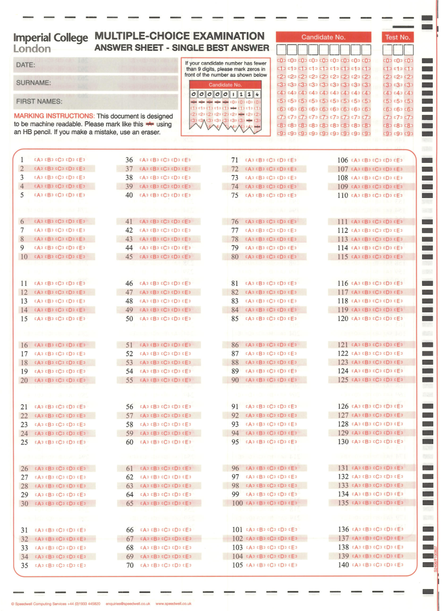
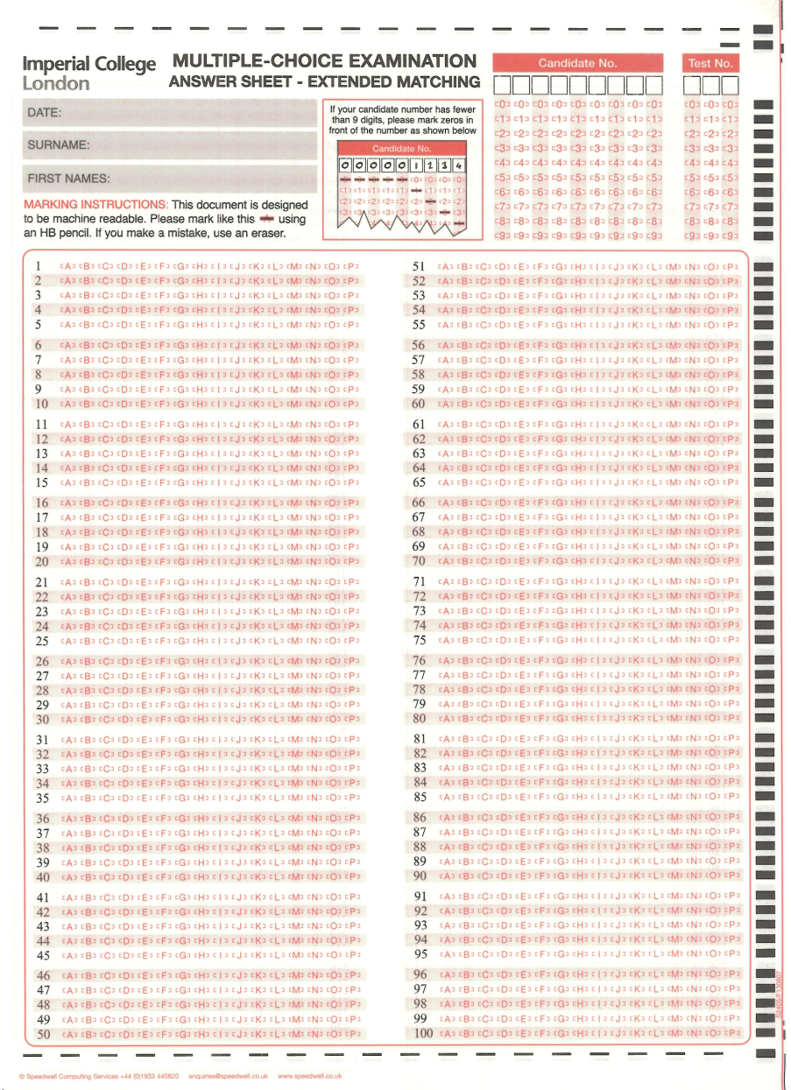
Answer Sheets

Slide 22
Answer Sheets
9th December 2008
SMITHSON
Andrew Tobias

Slide 23
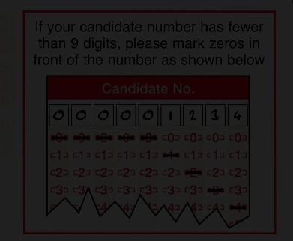
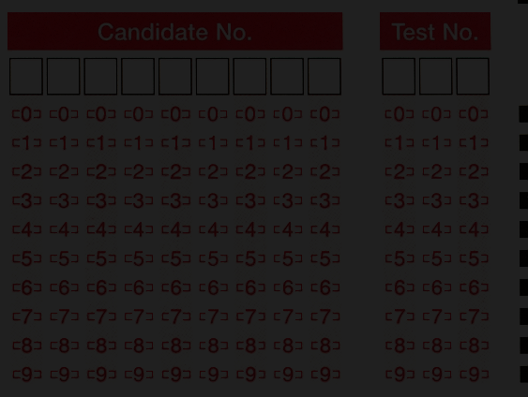
Making your Mark

Slide 24
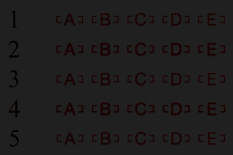
SBA and ARQ
Indicate which ONE of the five option letters A – E is the best answer to each question

Slide 25
EMQ
Indicate which of the Option Letters A – P is the best answer to each question
Options may be used once, several times, or not at all, as answers to questions on a theme

Slide 26
For all machine-marked answer sheets
Put name & candidate number on front page
Start at question 1 and tick off the questions as you attempt them
Attempt questions in number sequence
Answer against the same number on the answer sheet as the question in the question booklet!

Slide 27
Short answer questions (SAQs):
Structured – usually 2 to 5 sections
More synthetic knowledge is required
Can require knowledge to be drawn from several parts of the course
The format allows the use of diagrams or sketches
Marks are never taken away, even for unintelligent answers
Some sections may be relatively easy – everyone should get full marks
For some sections, it may be difficult to get full marks, to discriminate among the most able students
Pass mark is 50%

Slide 28
SAQ Example – Red shows the ‘model answer’ used in marking
A. What type of molecule is fibronectin, and where is it found? (2 marks)
A large, dimeric glycoprotein of extracellular matrices and body fluids.
B. Fibronectin is described as multi-domain molecule. Explain what this means. (3 marks)
It comprises a linear series of repeats (types I, II and III) which form a series of domains with the ability to interact with other extracellular molecules (e.g. collagens, fibrin, glycosaminoglycans such as heparan sulphate/heparin and cell surface receptors e.g. integrins and cell surface proteoglycans).
C. No naturally occurring mutations in the fibronectin protein have been found in man. How do you interpret this? (2 marks) Either the mutations are silent and have no effect, or they compromise the function so much that they are embryonic lethal.
D. What role does fibronectin have in wound healing? (3 marks)
Fibronectin derived from plasma and cells in the wound area becomes cross-linked to fibrin (from the cleavage of fibrinogen) to form a temporary matrix supporting cell migration, proliferation and tissue repair.

Slide 29
Advice
Try and answer every section!
Blanks mean zero marks!
Read the questions several times.
Think.
What would the question setter expect you to know?
There is no negative marking.
How will the question be marked?
Where will the marks go?
If you are asked for a list of items, ONLY provide the number requested. Marking will look at answers in sequence of presentation, and extra subsequent answers will not gain marks, even if correct.
Only use the space available.
Legibility is vital!

Slide 30
Marking SAQs
Marking SAQs
SAQs are marked by a ‘Marking College’ consisting of 12 to 20 academic staff around a table
Each question is marked in turn (SAQ1, then SAQ2 etc)
The marking college uses the model answers provided to them by the question setter, attributing marks as specified: Key words, key ideas. The question setter is usually a member of the Marking College
Questions are distributed randomly around the table: an individual student’s paper will be marked by more than one marker
Any problem or ambiguity is discussed openly across the table
SAQs of all borderline fail candidates are marked again by the Theme Leader and checked by the External Examiner

Slide 31
Formative exam in January
Half the mark for the MCD part of the exam will be obtained from SBAs + ARQs
The other half will be obtained from EMQs + SAQs
-i.e. marks proportional to time spent on the questions

Slide 32
Difficulty of examinations
The questions used in the Formative, Summative or Resit examinations are equivalent.
If you hear that one exam is more difficult than another, this is due to students’ perception, not to any intent by the exam setters.

Slide 33
Exam results - 2009 to 2012
 | 2009 | 2010 | 2011 | 2012
Formative exam % Pass | 58.8% | 58.5% | 58.8% | 58.7%
MCD summative exam % Pass | 91.3% | 89.0% | 94.4% | 92.1%

Slide 34
Further details
Further details of the arrangements for the January exam, including candidate numbers and venues for the written exam, will be e-mailed to students by the FEO
Good luck for the formative exam
Do some revision
Have a good holiday break!

