Slide 1
Introducing Anatomy Part 1
Professor D Ceri Davies
Department of Surgery and Cancer
Faculty of Medicine

Slide 2
Perceptions of Anatomy
Rite of passage
Too much information
Unclear what really matters
Usefulness not always evident
People’s bodies vary
Doctors treat living people
I don’t want to be a surgeon

Slide 3
All doctors need anatomy for:
Physical examination of patients
Interpreting imaging
Carrying out routine procedures safely
Effective use of emergency procedures
Basis for postgraduate learning

Slide 4
Do you know enough anatomy to explain why:
Pain from coronary heart disease may be felt in the arms and neck as well as the chest?
Patients with lung cancer may have a hoarse voice?
Bowel cancers often spread to the liver?
Broken ribs can be fatal?

Slide 5
The Imperial Approach
Relate to function in Systems Themes
Eliminate trivial facts
Relate to clinical skills
Relate to serious clinical problems
Taught by anatomists and clinicians

Slide 6
Main Learning Methods
Pre-dissected (prosected) specimens
Dissection
Skills-oriented living anatomy
Study of imaging
Osteology
Self-directed learning

Slide 7
Terminology
The Anatomical Position and its value
Positional terms
Names - Latin or English?
Widely understandable names for parts of the body

Slide 8
Human Evolution for Doctors
There is massive evidence that Darwinian evolution by natural selection generated all living organisms on this planet and continues with unabated force. Debate among biologists is about the details, not about the validity of the mechanism.

Slide 9
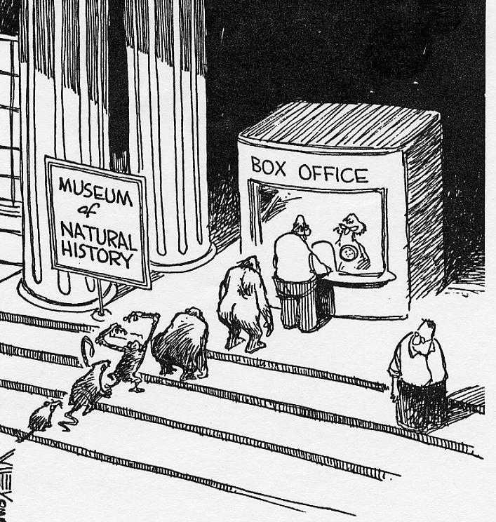
Human Origins: where did we come from – how have we evolved?
Down from the trees
Walk erect
Big brains
Cultural development
Pinnacle of evolution?

Slide 10
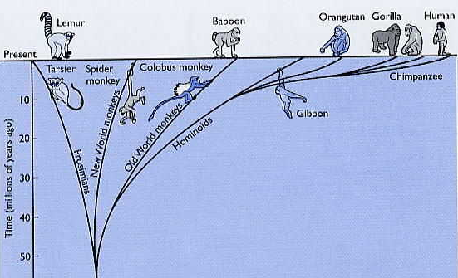
Our Relations (The Primate Order)

Slide 11
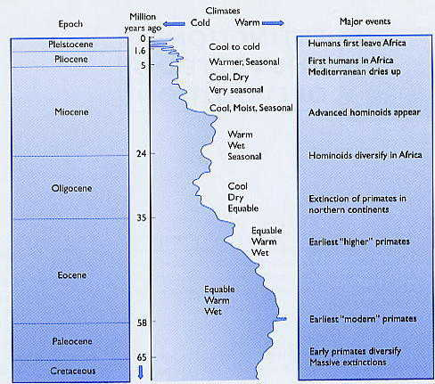
The Timescale

Slide 12
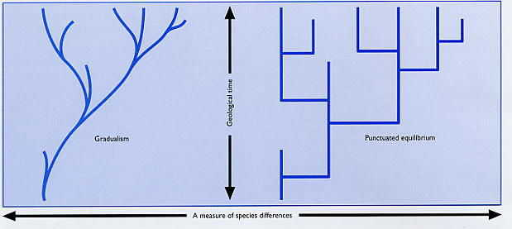
Primate evolution provides evidence for stability with sudden stepwise changes - ‘punctuated equilibrium’

Slide 13
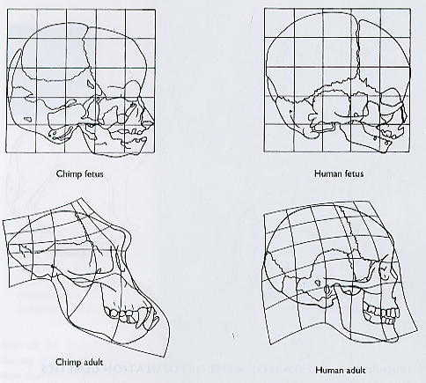
How a few genes slowing development could produce a step-like change: retention of a more infantile skull form could lead to less face and more brain

Slide 14
Erect Bipedal Gait

Slide 15
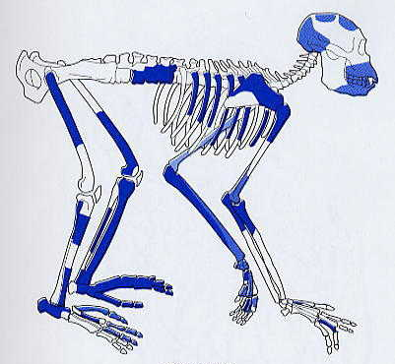
Proconsul A proto-ape from 18 M yr ago One of many species that were around

Slide 16
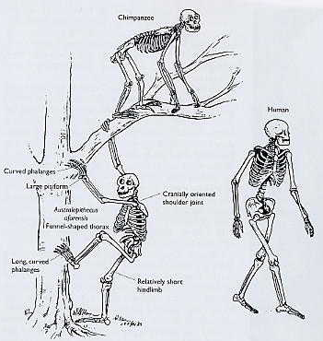
Down from the trees
Chimpanzees share 99% of our genes but are very different from us
The line branched into the chimp-like apes and “Hominin” apes such as the many species of Australopithecus – more erect but probably still handy tree-climbers

Slide 17
Curvier backbones for bipeds
The human spinal column has three antero-posterior curves, alternately forward and backward. Braced by ligaments and muscles, these produce springiness and shock-absorption in bipedal gaits such as walking and running

Slide 18
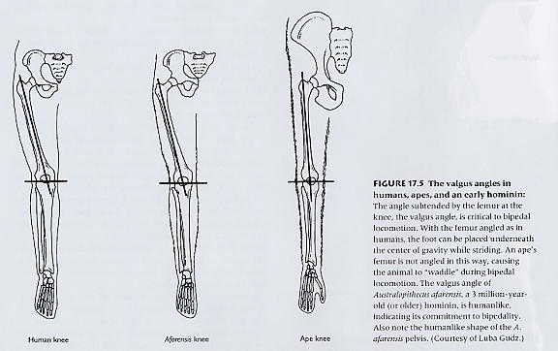
Australopithecus Between a waddle and a sprint

Slide 19
Australopithecus A grasping big toe
The opposable big toe of apes is still detectable in this Australopithecus foot from about 3.5 M Yr ago

Slide 20
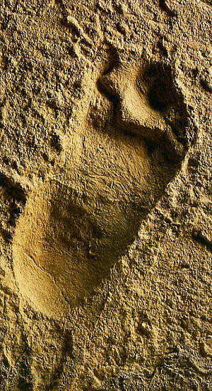
Ancient footprints
This Australopithecus footprint also shows the grasping big toe. These adult prints were paralleled by those of a child, possibly holding hands with the adult.
Australopithecines seem to have been more or less tree-climbing bipeds

Slide 21
The human foot does not have an opposable big toe, it is specialised for weight bearing

Slide 22
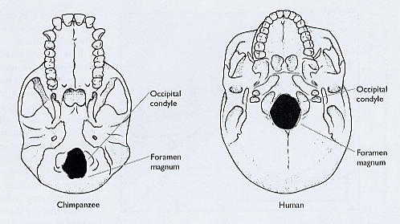
Balanced heads Agile bipedalism requires the head to be balanced on the neck. Compare the base of the chimp skull with the human skull

Slide 23
The physical penalties of human evolution
In evolutionary terms the transition from climbing ape to running biped was very quick. The anatomical adjustments work fairly well but tend to give way in middle life.
Think of a few examples and try to work out why these systems work less well after about 40 years of age.

Slide 24
The evolutionary penalties of modern medicine?

Slide 25
Introducing Anatomy Part 2
Professor D. Ceri Davies
Department of Surgery and Cancer
Faculty of Medicine

Slide 26
The Trunk and its contents

Slide 27
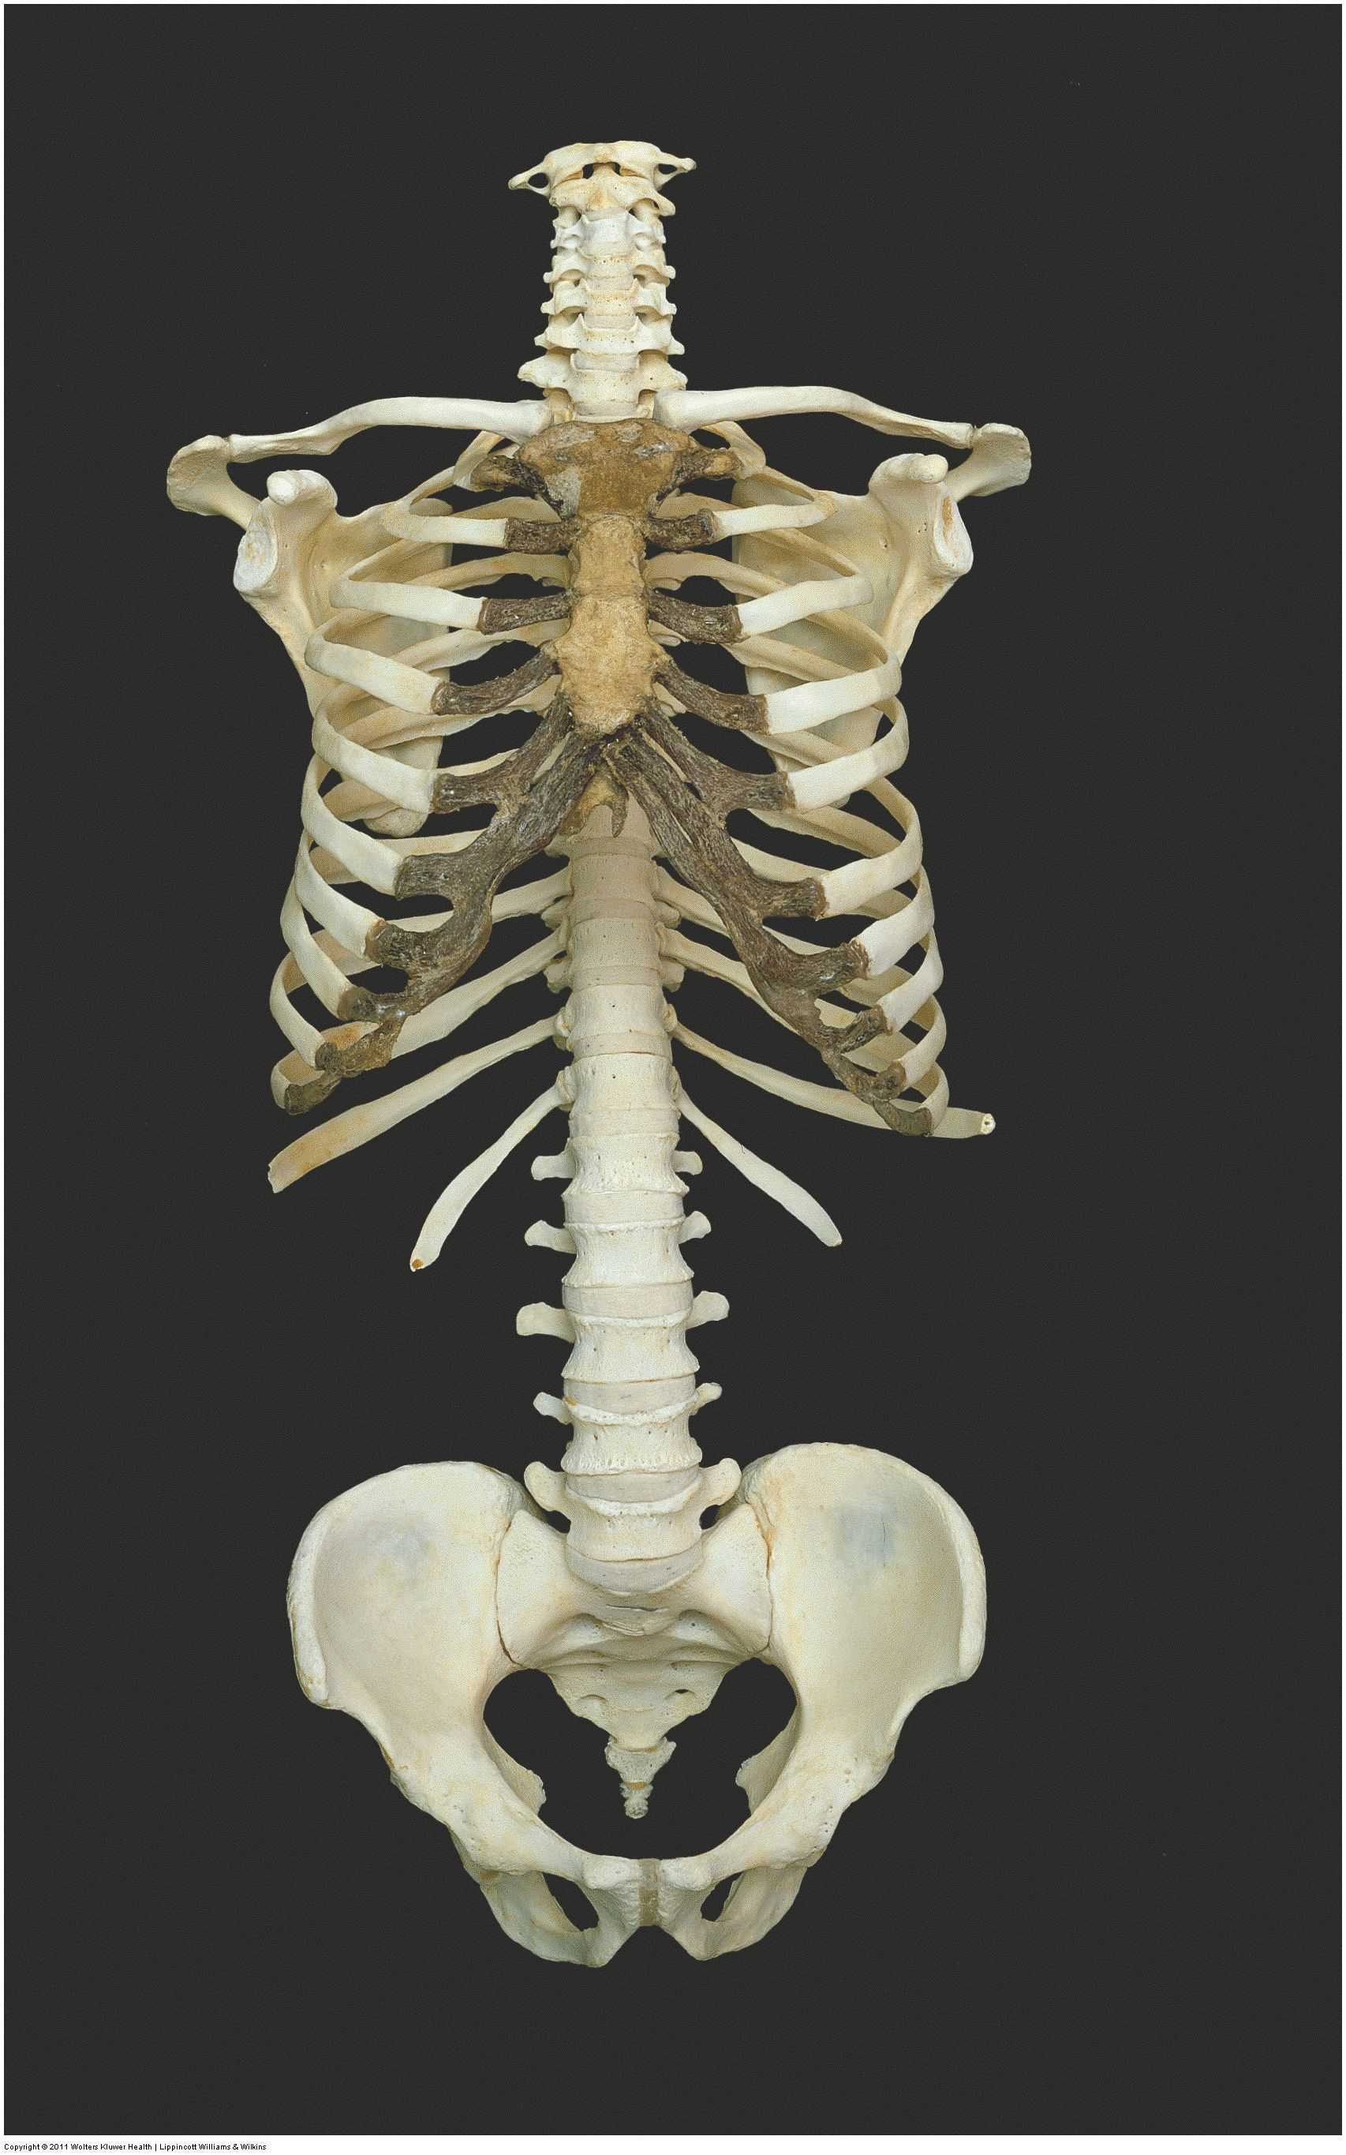

Slide 29
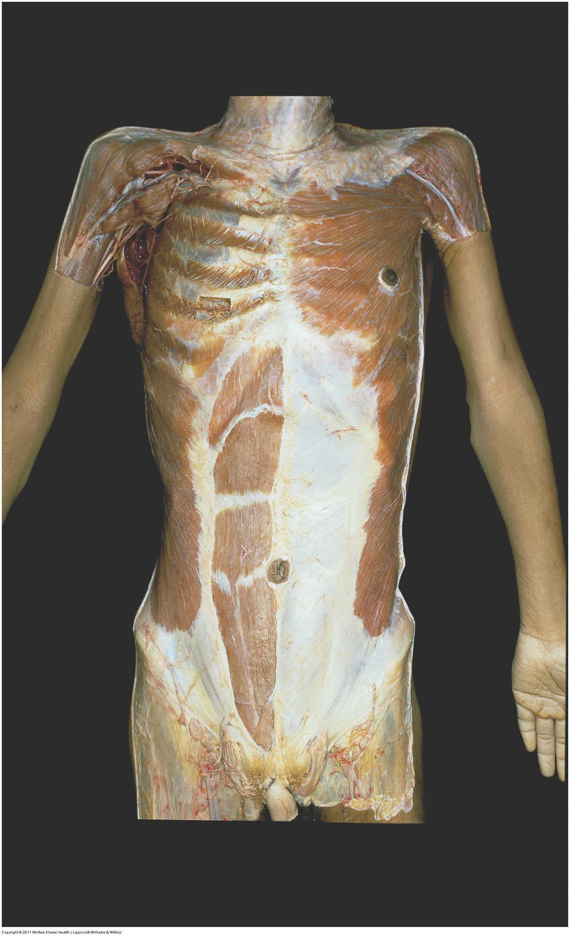

Slide 30
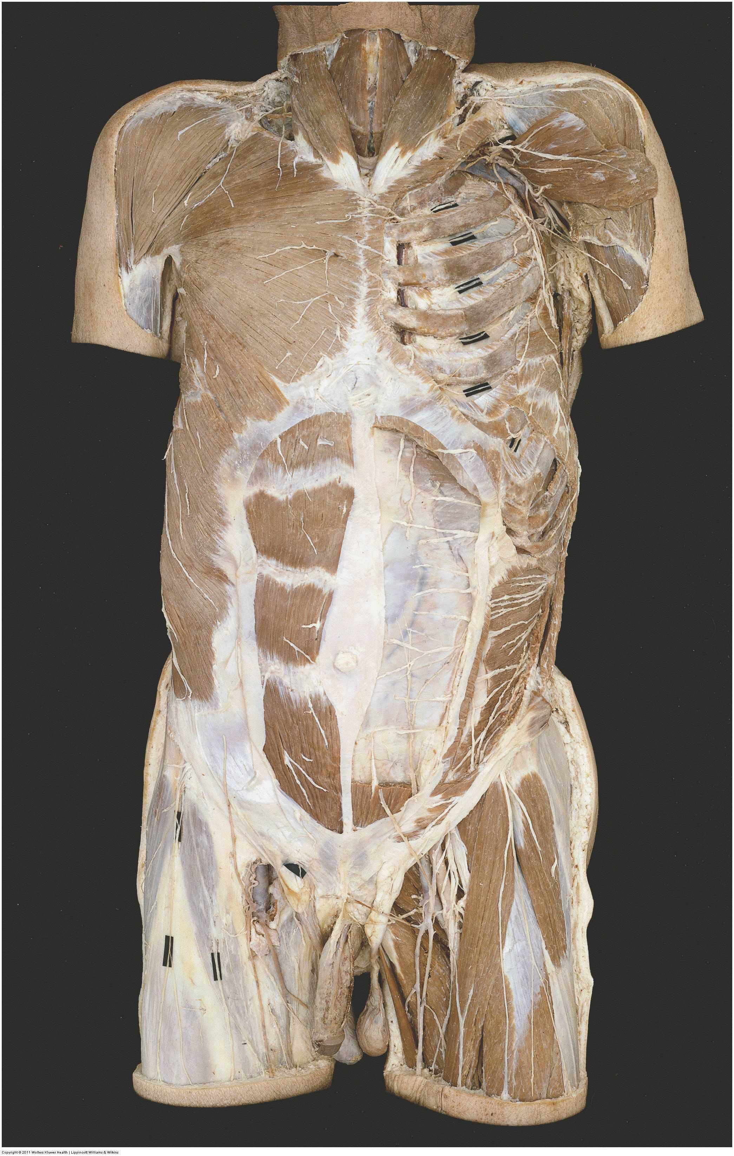

Slide 31
The Thorax

Slide 32
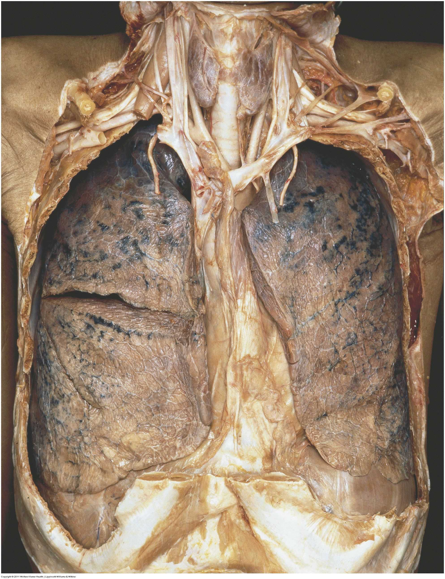

Slide 33
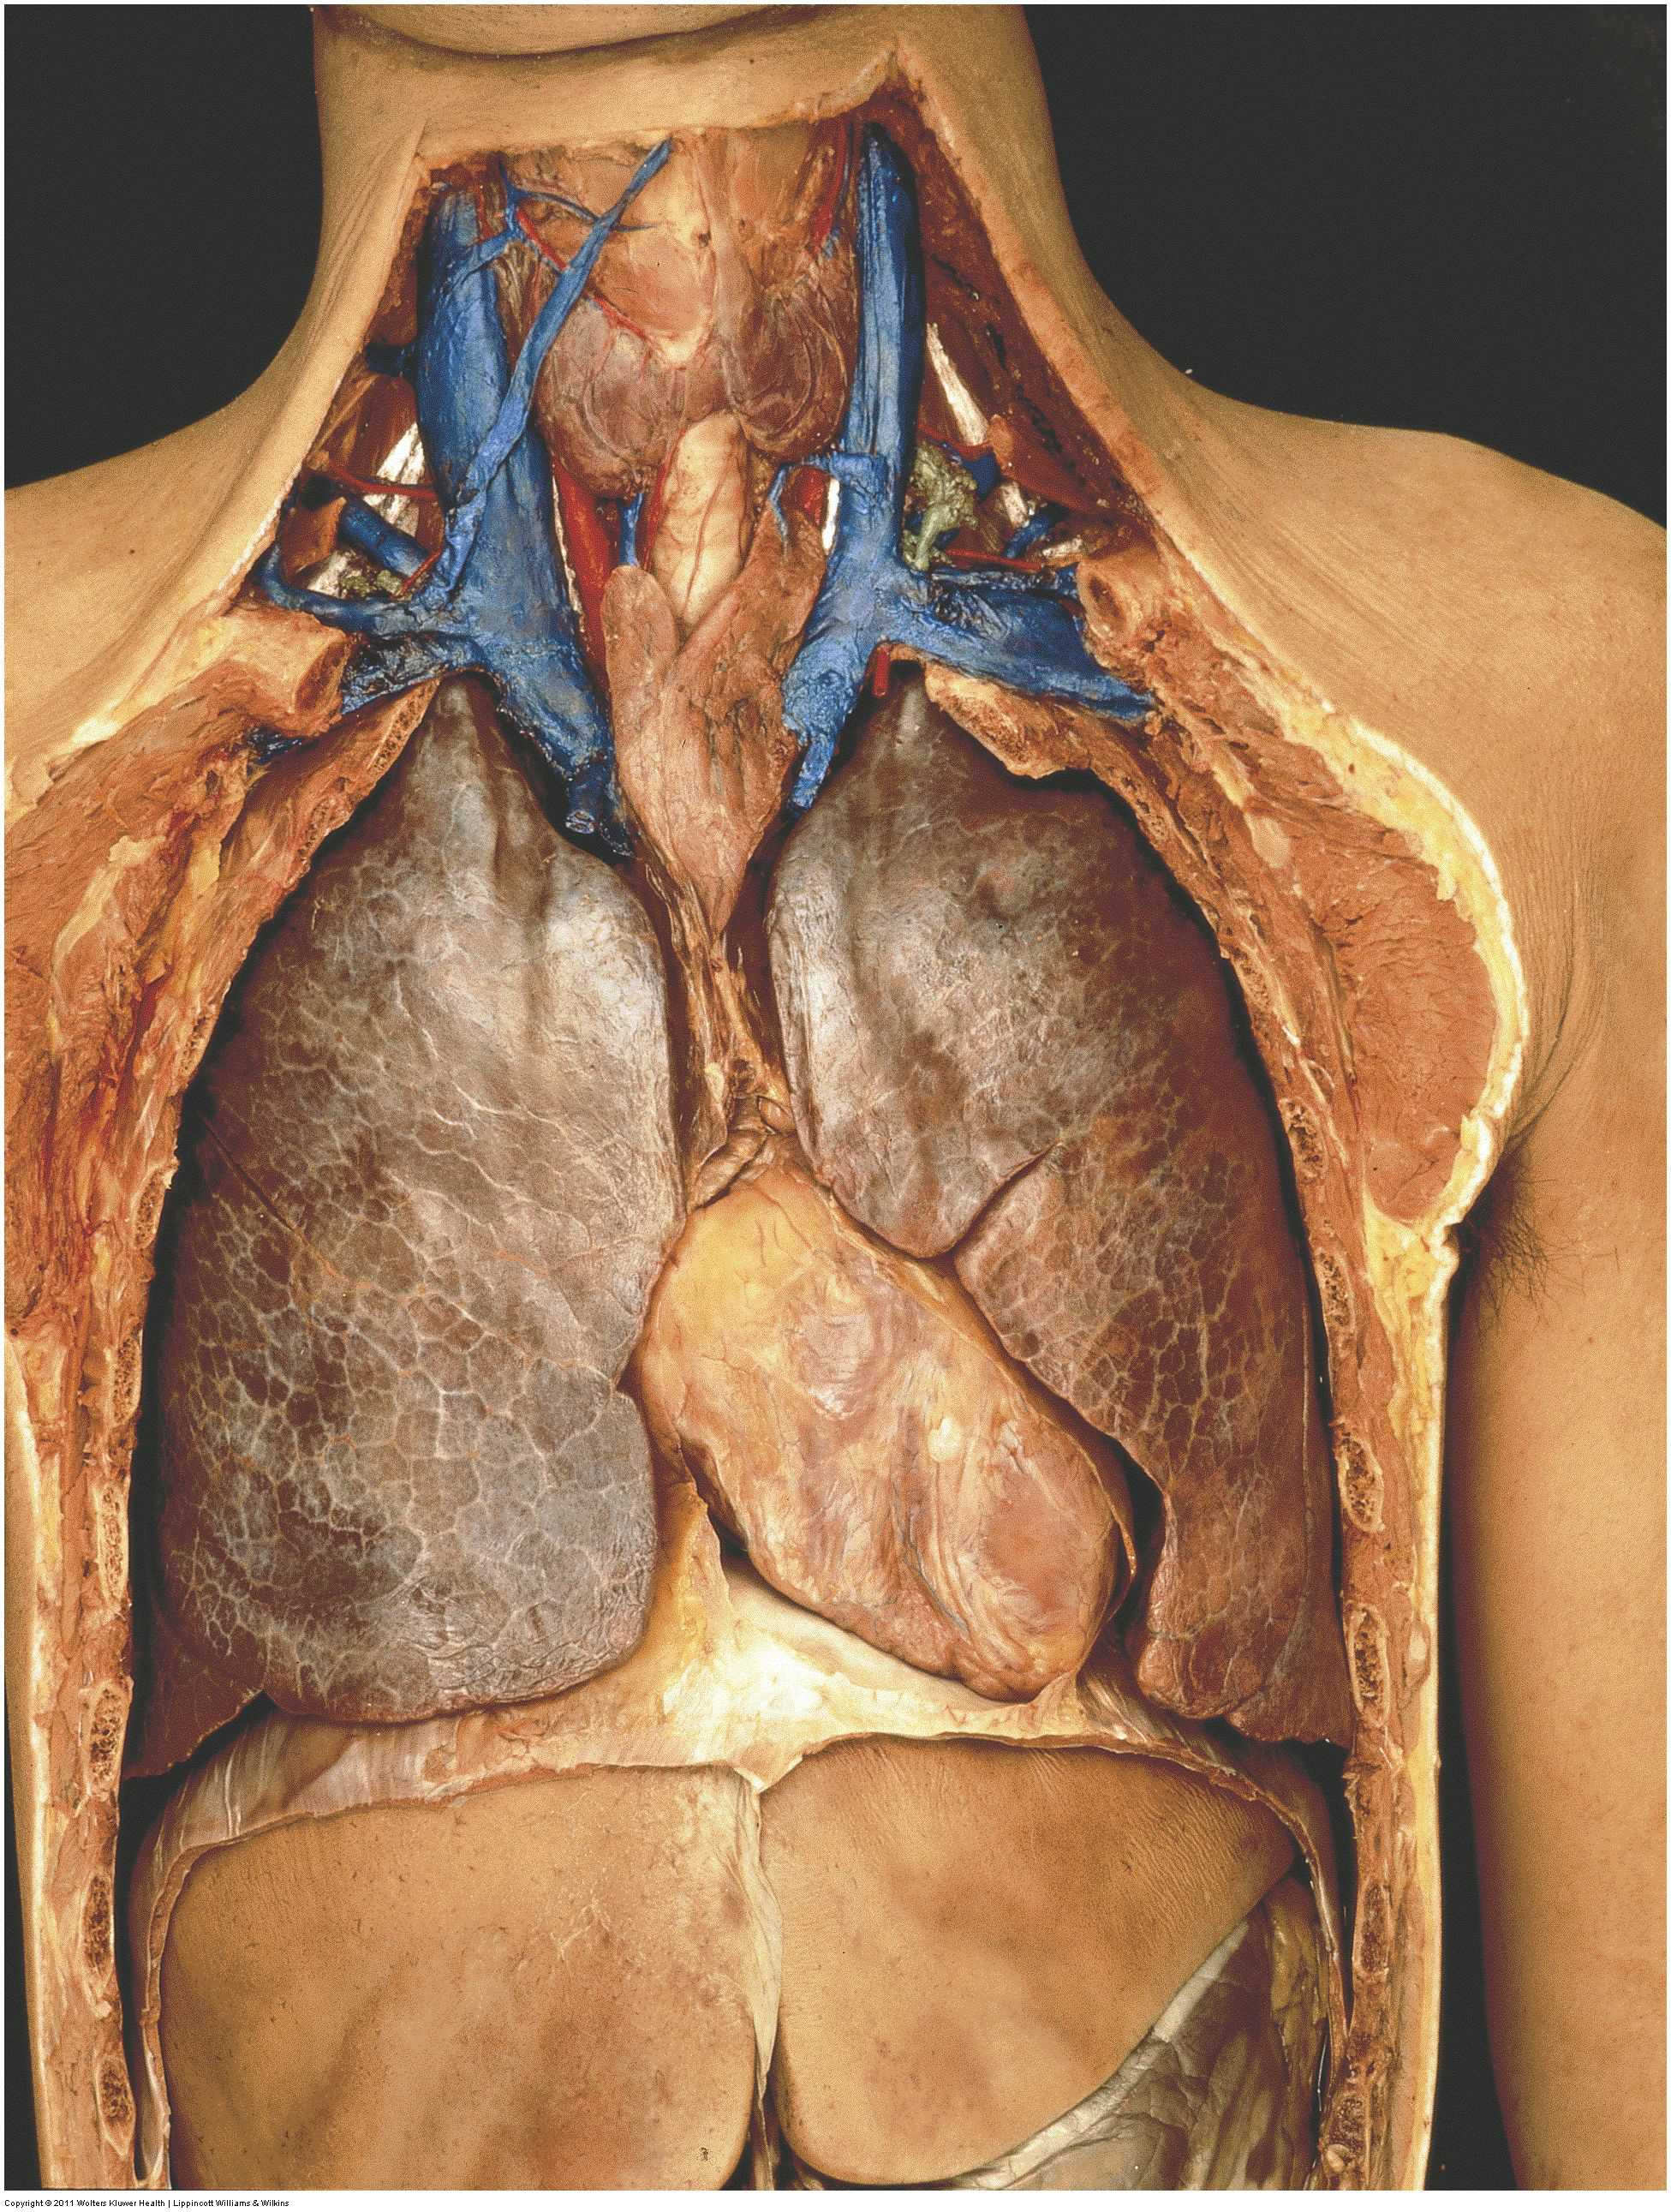

Slide 34
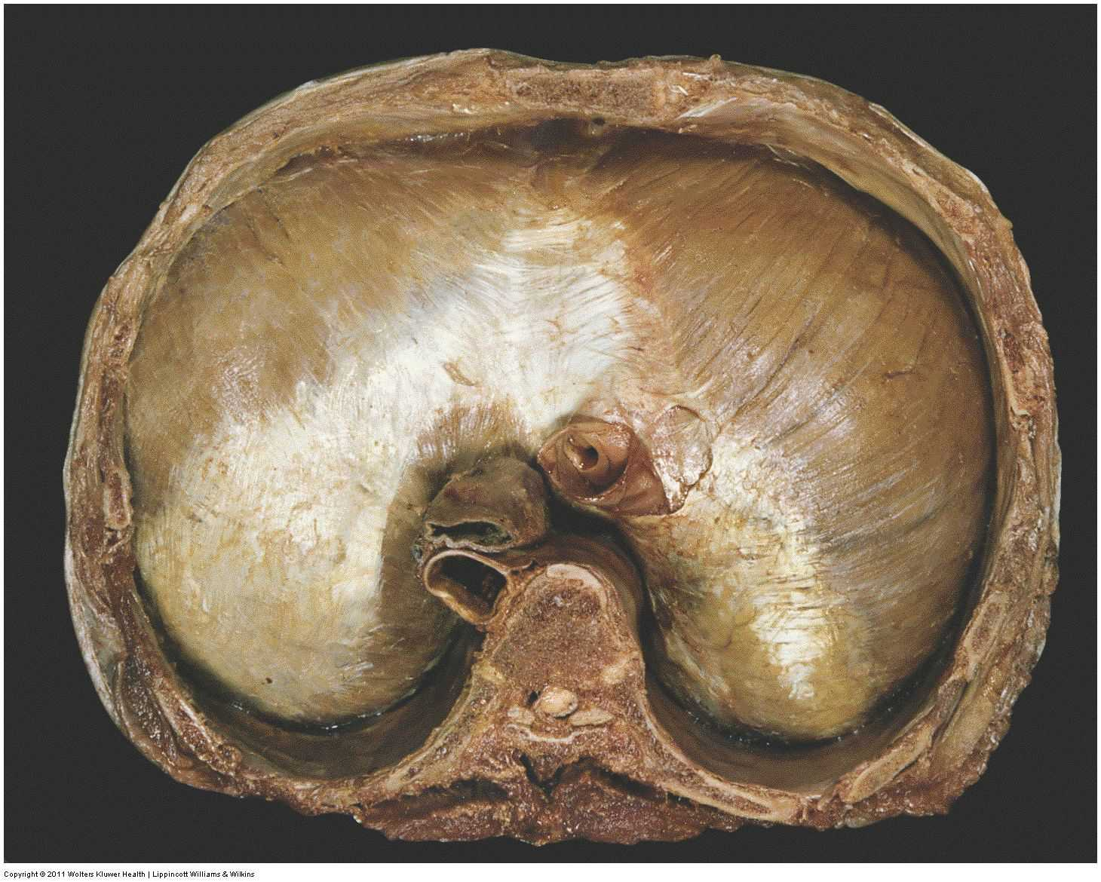

Slide 35
The Abdomen

Slide 36
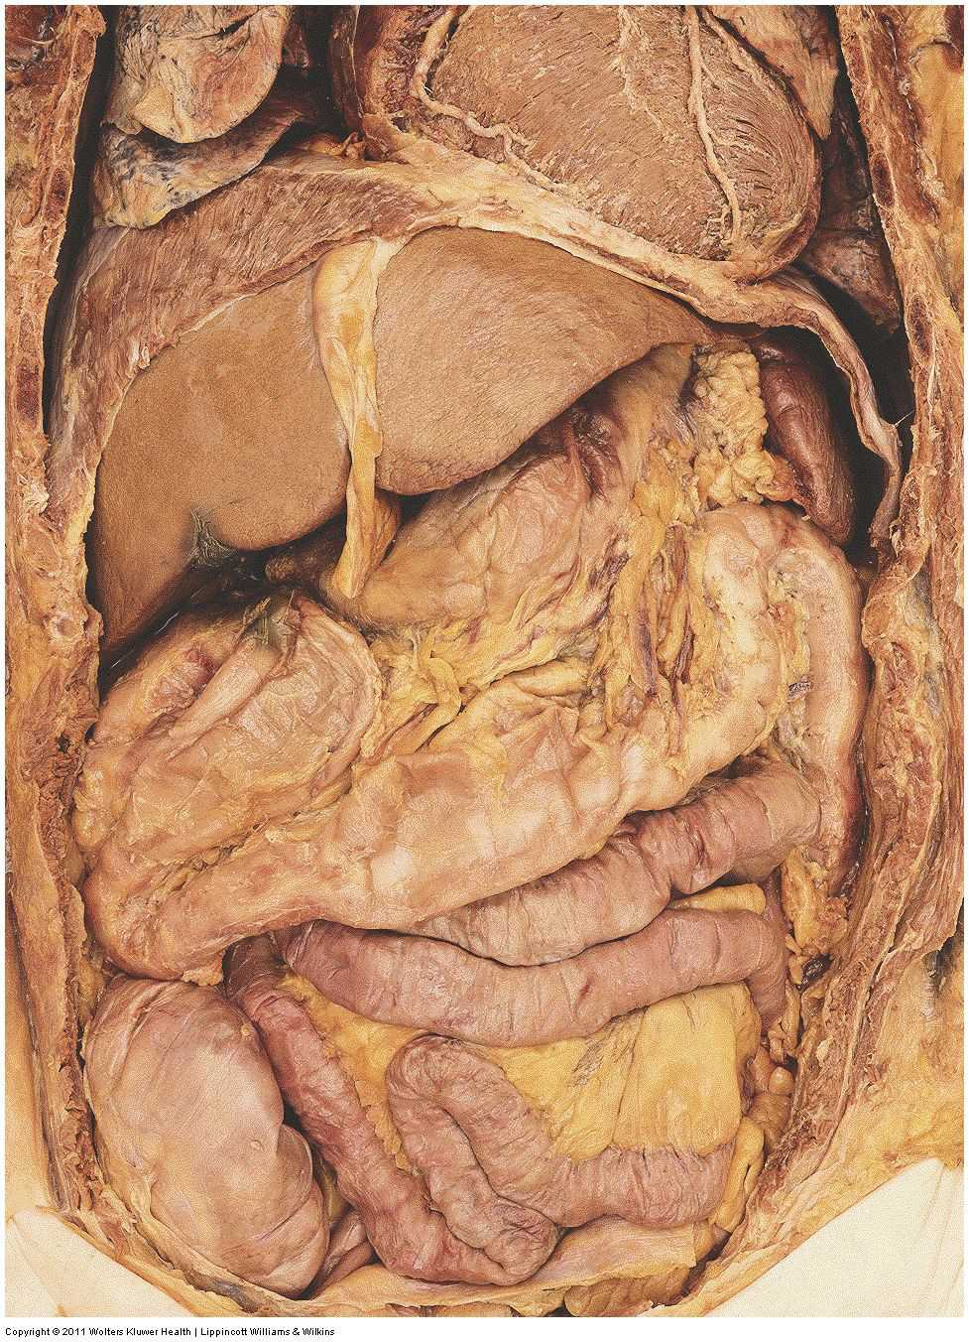

Slide 37
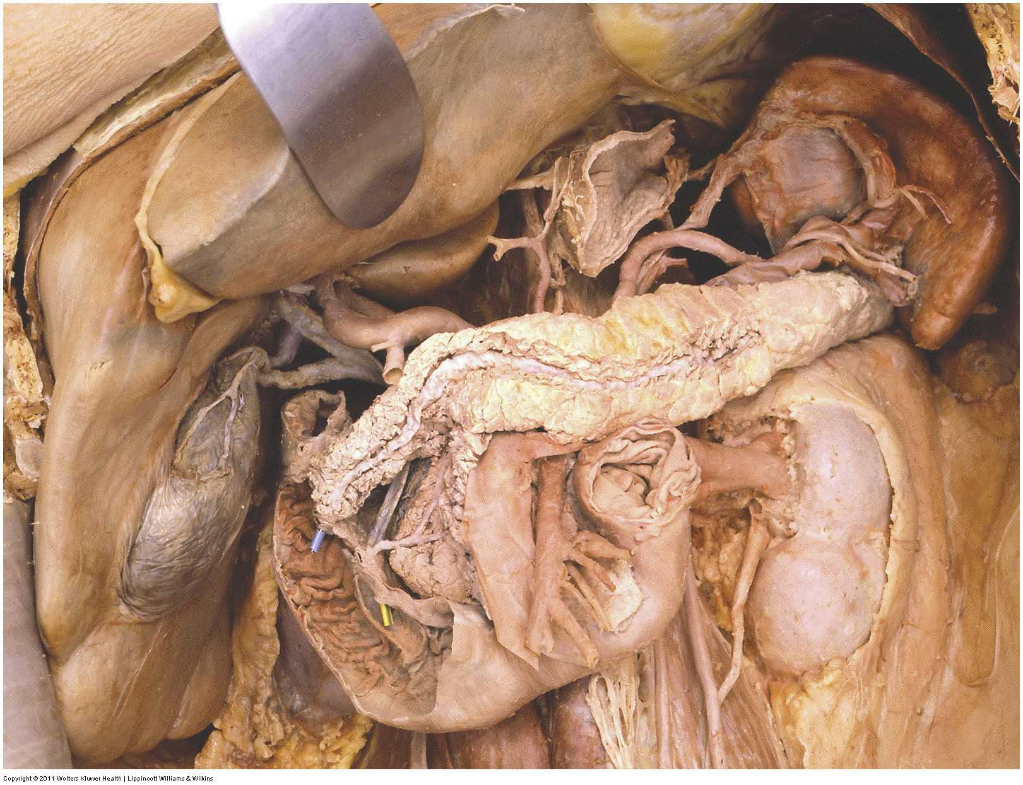

Slide 38
The Pelvis

Slide 39
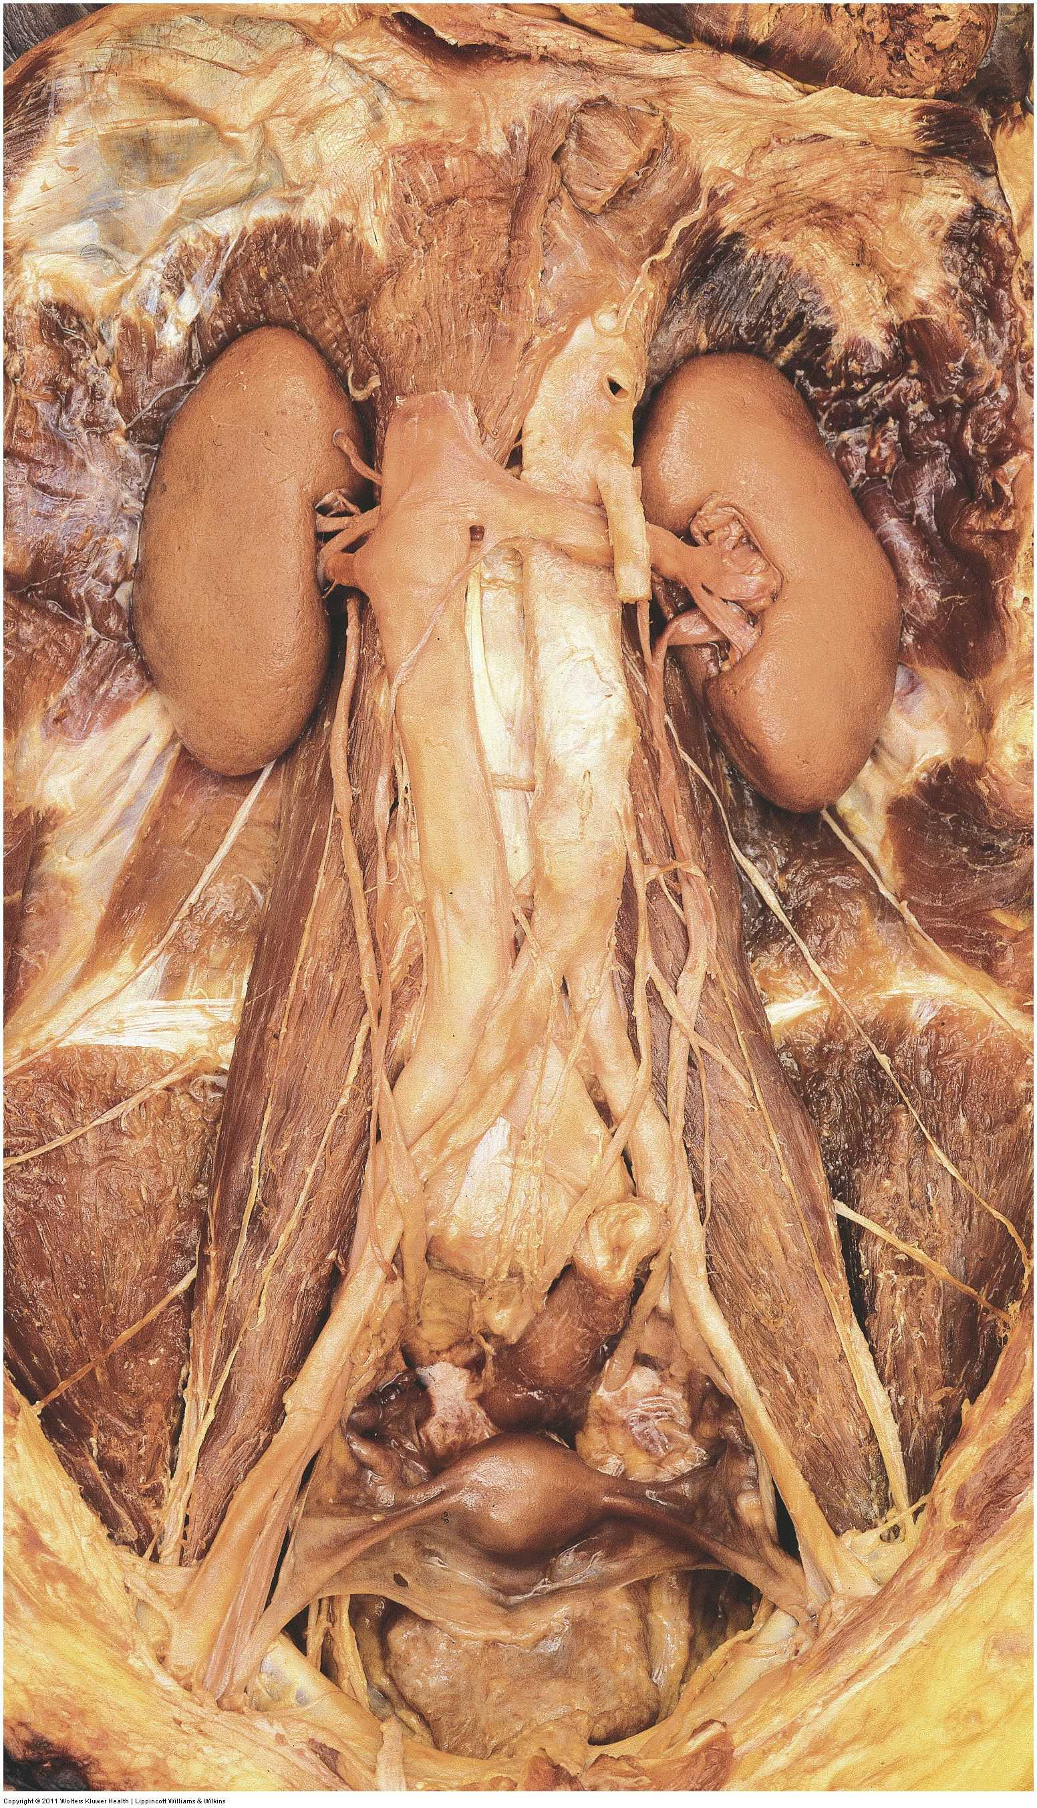

Slide 40
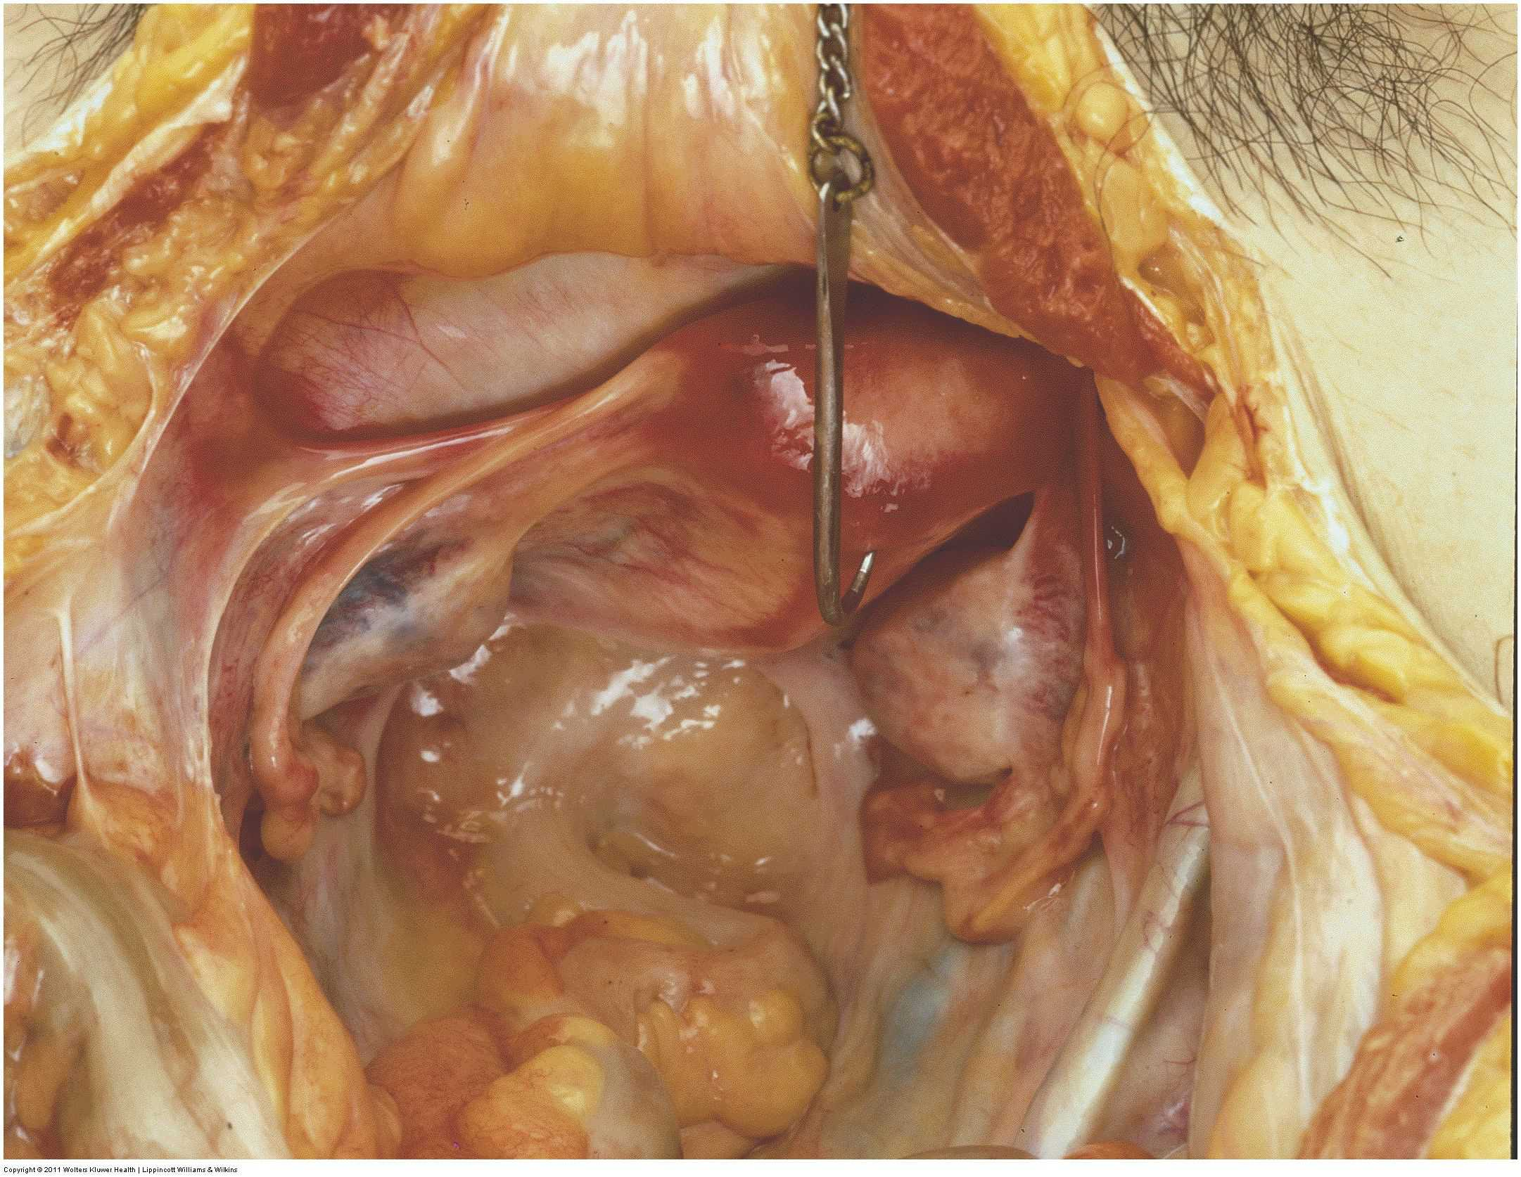

Slide 41
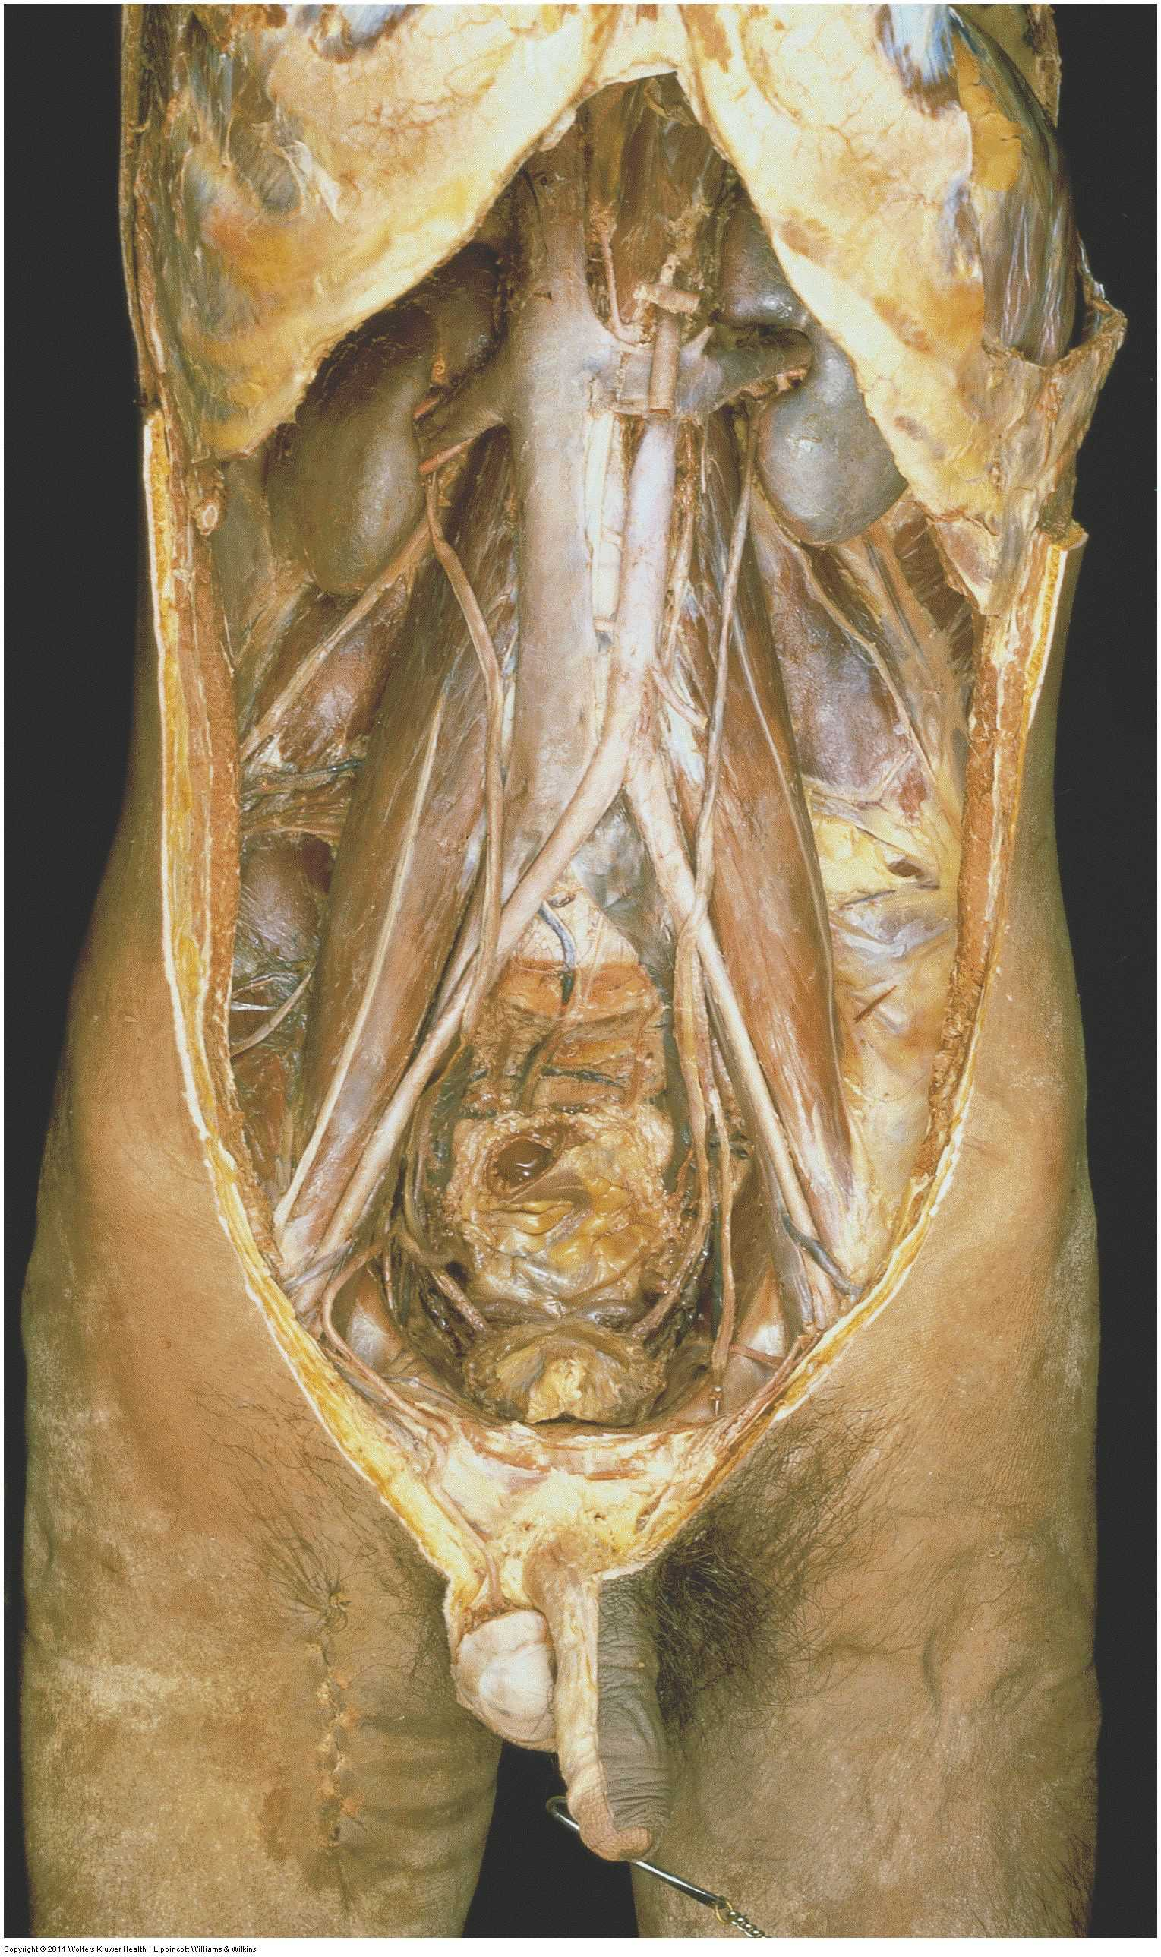

Slide 42
The Perineum

Slide 43
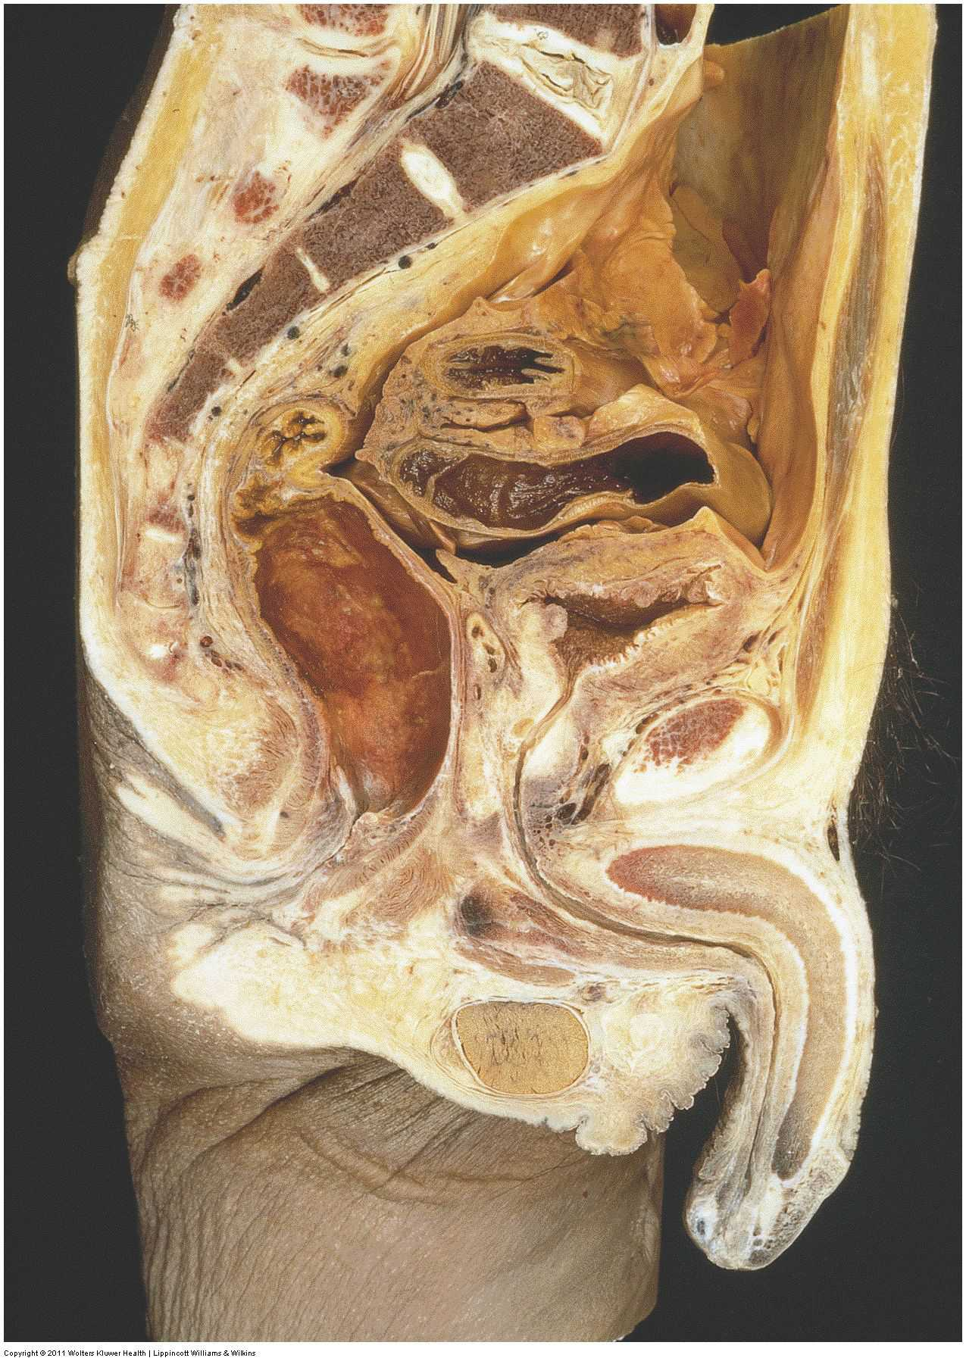

Slide 44
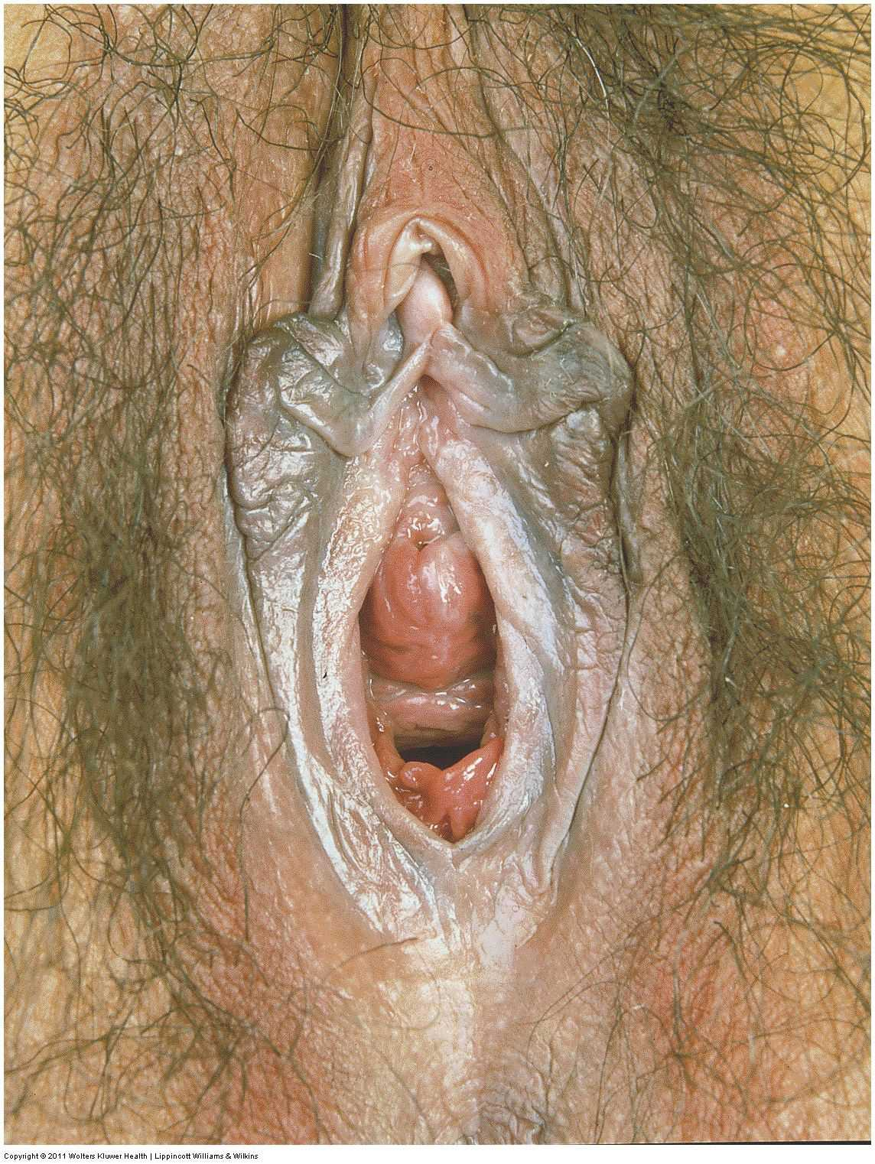

Slide 45
Rules of the Dissecting Room

Slide 46
The Law and Anatomy
The right to dissect cadavers
Anatomists and Resurrectionists
The Anatomy Acts (1832, 1871, 1984) and the Human Tissue Act (2004), introduced for Anatomy in 2006
Donations
Licences
Permitted uses

Slide 47
Conduct in the Dissecting Room
Respect the donors’ remains
Bring no visitors
Take no photographs
No mobile phones
Remove nothing
Do not detach labels from specimens
Behave professionally

Slide 48
Safety in the Dissecting Room
Wear gowns, gloves and safety glasses
Tie back long hair
Wear closed shoes to protect your feet
Put instruments in the steel tray when not in use
Dispose of sharps in the sharps containers
Wash any minor wound or contamination under the tap
Report any injury or contamination immediately
Don’t eat (includes chewing gum) or drink
Report any spillage of fluid onto the floor
If you feel faint, tell others, move away and sit on the floor
Leave the room at once if instructed to do so
Wash hands thoroughly before leaving

Slide 49
MBBS Yr 1 Introduction to the Human Body
Session Rotation Guide
 | 09.00 -10.15 | 10:25 -11:25 | 11:30 -12:30 | 13:55 -14:55 | 15:00 -16:00 | 16.15 -17.15
GROUP A | LECTURE | 13th Floor | Dissecting Room | Film |  | LECTURE
GROUP B |  | Film |  | Dissecting Room | 13th Floor
GROUP C |  | Film |  | 13th Floor | Dissecting Room
GROUP D |  | Dissecting Room | 13th Floor | Film

Slide 50
If you experience problems in the Dissecting Room
It happens!
Anatomy staff are here to help you deal with it – ask
You also have Personal Tutors

