Slide 1
Viral properties
Professor Wendy Barclay
Course code (MBBS) : Microbiology 4
Course code (BMS) : IIP-L14

Slide 2
Which of these diseases is not caused by a virus?
Smallpox
Chicken pox
cold sores
Poliomyelitis
colds and flu
cervical cancer
encephalitis
Diarrhoea and vomiting
Rabies
Haemorrhagic fevers
Warts
Hepatitis
Leukaemia
pneumonia

Slide 3
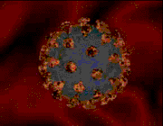
Infections of humans by viruses
10,000 nucleotides, 10 genes
3 billion nucleotides, 100,000 genes

Slide 4
The influenza pandemic of 1918 killed 40 million people.

Slide 5
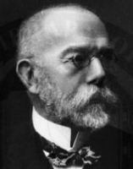
Proving a virus causes a disease: Koch’s Postulates
The microorganism must be found in large numbers in all diseased animals, but not in healthy ones.
The organism must be isolated from a diseased animal and grown outside the body in a pure culture.
When the isolated microorganism is injected into other healthy animals, it must produce the same disease.
The suspected microorganism must be recovered from the experimental hosts, isolated, compared to the first microorganism, and found to be identical.
Robert Koch

Slide 6
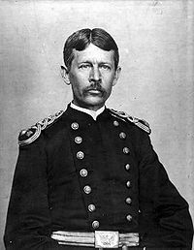
Yellow fever: spread by mosquitoes during the construction of the Panama Canal
Colonel Walter Reed 1901

Slide 7
Definition of a virus
Viruses are infectious OBLIGATE intracellular PARASITES.
A virus has a genome that comprises DNA or RNA.
Within an appropriate cell, the viral genome is replicated and directs the synthesis, by cellular systems, of more viral components and genomes.
The components effect the transport of replicated viral genomes through the environment to new host cells.

Slide 8
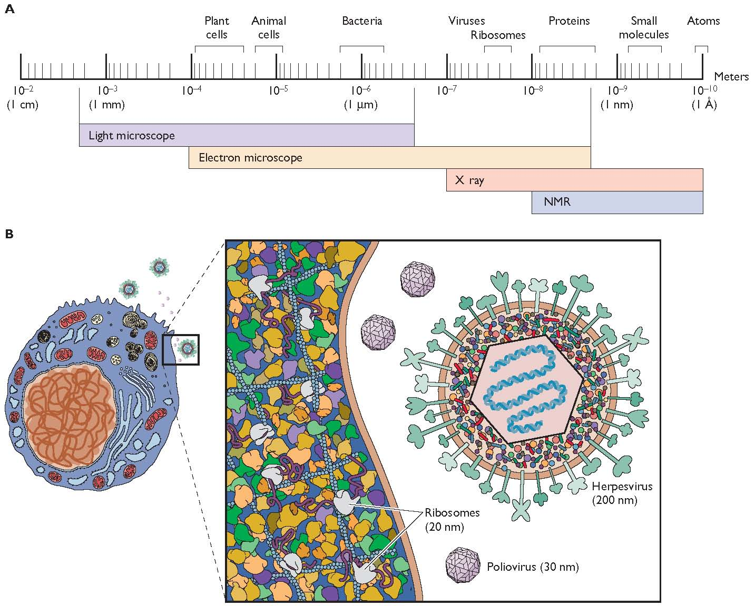
Viruses are small

Slide 9
Electron micrographs of negatively stained viruses
Bacteriophage T4 TMV Rhabdovirus, VSV Rotavirus

Slide 10
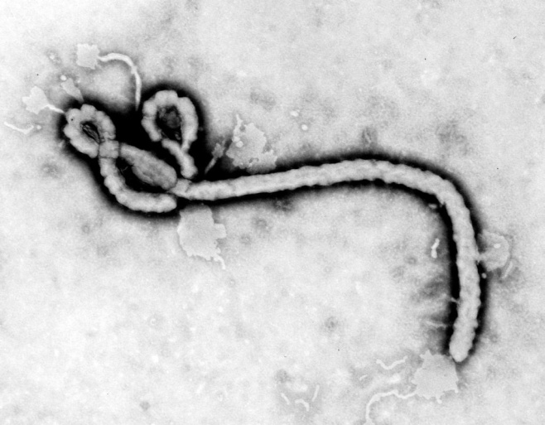
Virus Morphology
Symmetrical protein capsid
Adenovirus
Picornavirus
Calicivirus
Non-enveloped
Non enveloped
Enveloped
Lipid envelope derived from host membrane
Pleiomorphic: measles virus
Typical shape: Ebola virus
Combination of capsid
and envelope
Herpes virus
Enveloped

Slide 11
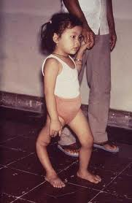
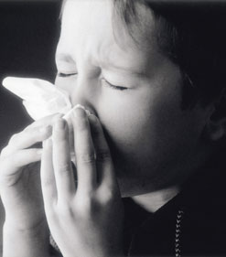
Naming a virus
The disease Poliovirus, rabies
The person who discovered it Epstein Barr virus
The place it was discovered Coxsackievirus
The part of the body affected Rhinovirus, Hepatitis virus
The way it was spread Dengue, Influenza

Slide 12
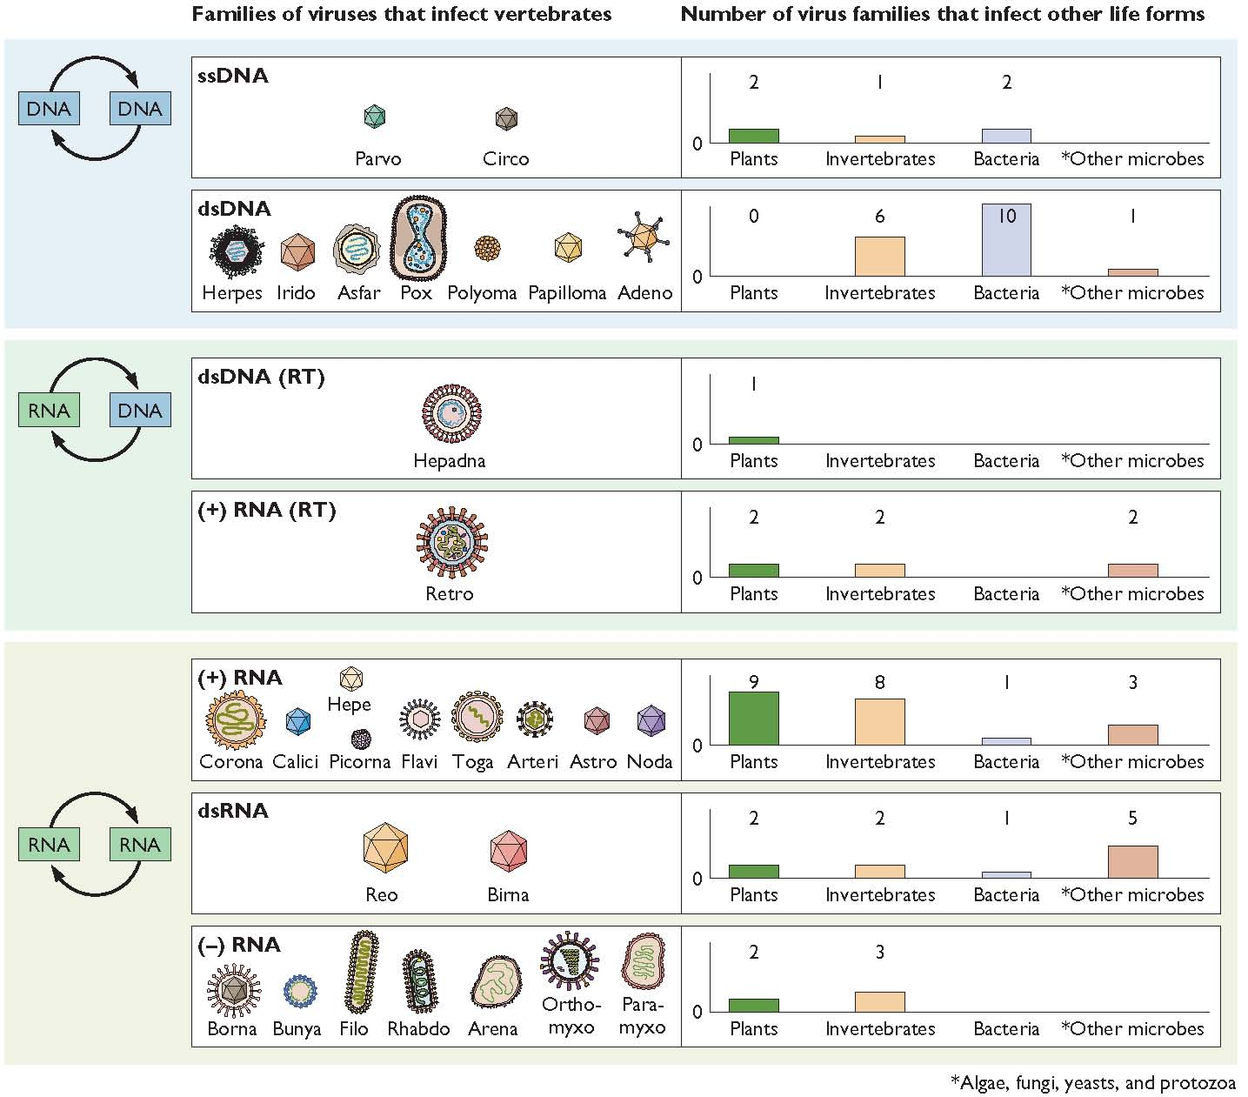
Viral families by nature of the genome
Examples of specific viruses and their disease
Parvovirus B19; fifth disease/Slap face
HSV1; cold sores, smallpox,
Papillomavirus; warts
Hepatitis B; hepatocellular carcinoma
HIV; AIDS
SARS, norovirus; winter vomitting disease, poliovirus; poliomyelitis, dengue virus; DHF,
Rotavirus; diarrhoea
Ebola, rabies, Lassa fever, Influenza, Measles, Mumps

Slide 13
The central dogma
DNA
RNA
protein
Genome 5’ ATG- CCG-,,,,,, GAG- AAT- TAG 3’
Negative sense RNA 3’ UAC-GGC-,,,,,,CUC-UUA-AUC 5’
mRNA 5’ AUG- CCG-,,,,,, GAG- AAU- UAG 3’
Met- Pro,,,,,Asp-Ile- STOP

Slide 14
Baltimore Classification

Slide 15
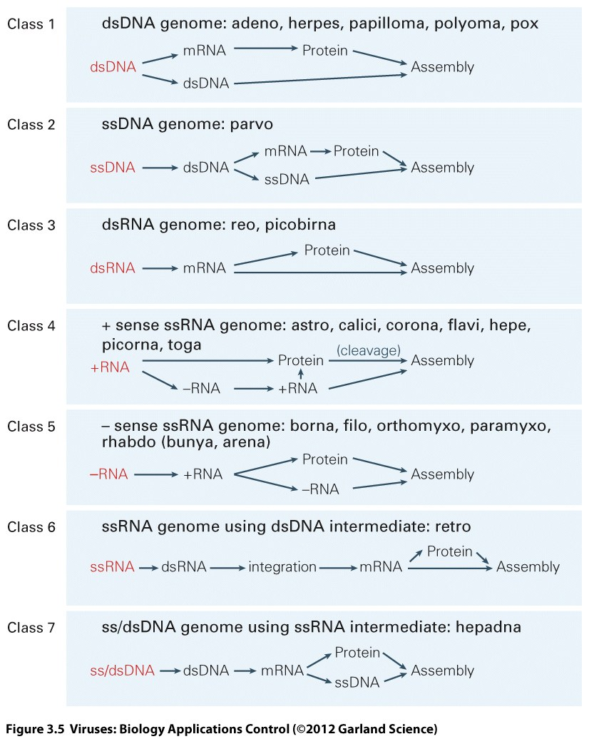
The Baltimore Classification System

Slide 16
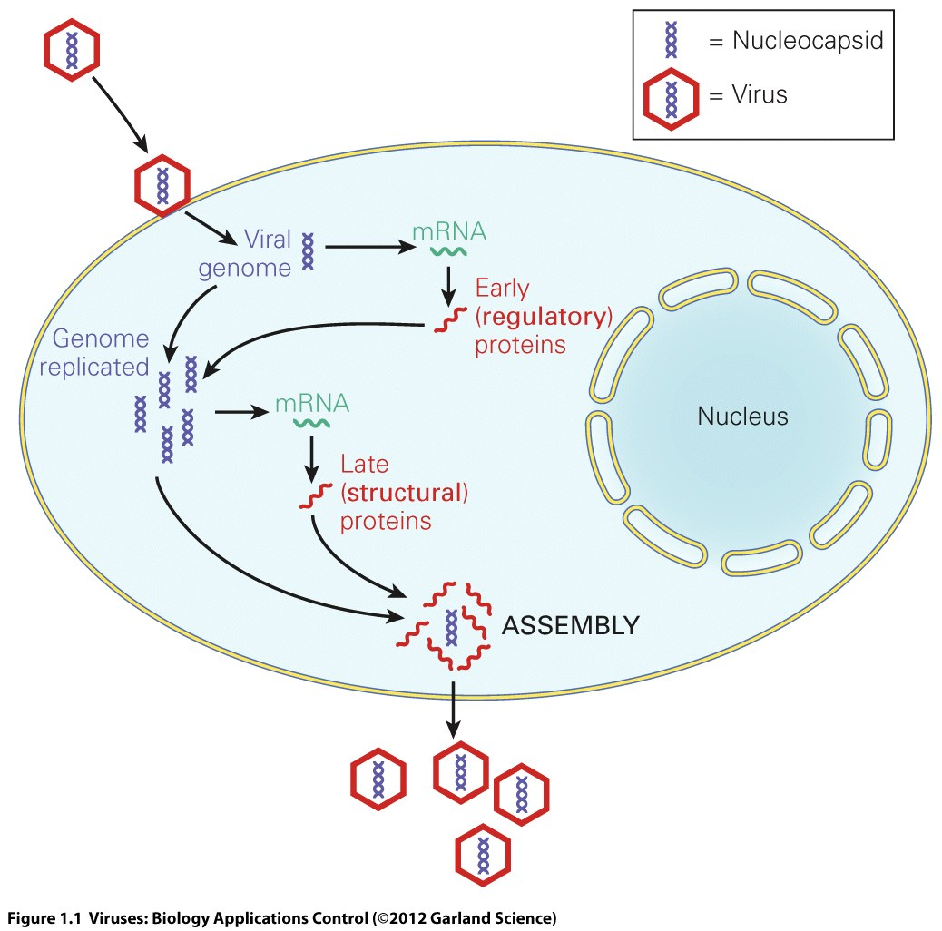
A generic virus replication cycle

Slide 17
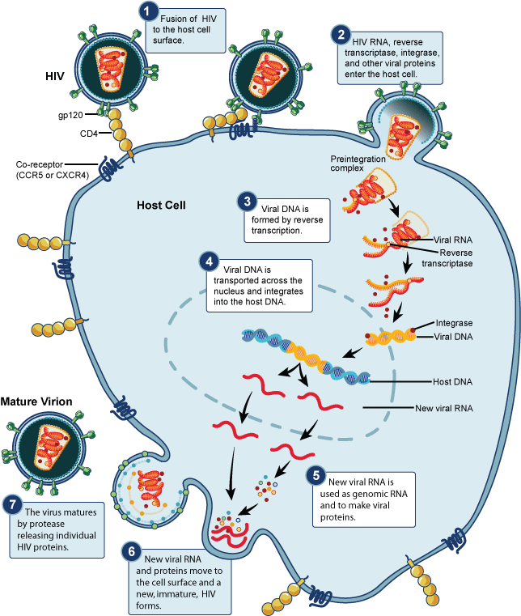
The replication cycle of HIV-1

Slide 18
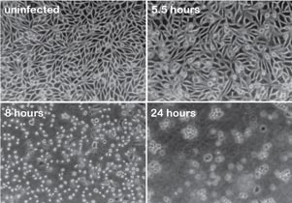
Investigating viruses in the laboratory
Cytopathic effect is usually a result of the virus lysing the cell.
This could be due to shut down of host protein synthesis or accumulation of viral proteins.

Slide 19
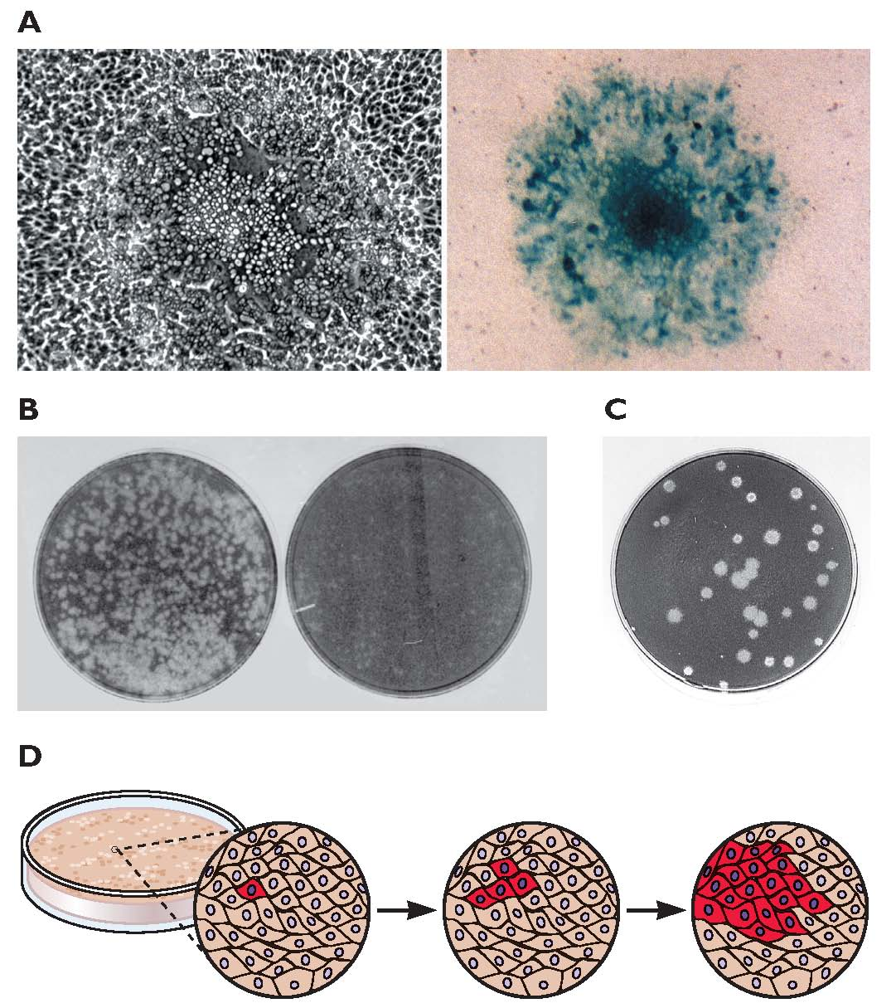
Viruses form plaques in cell monolayers

Slide 20
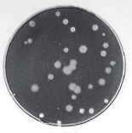
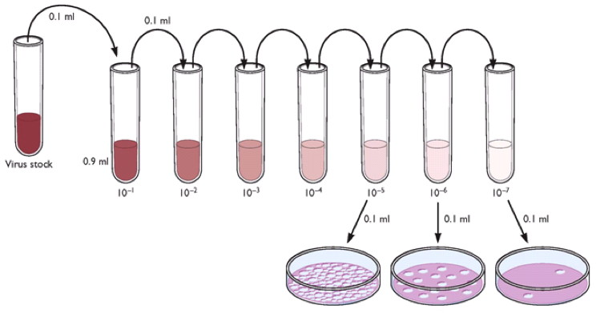
The plaque assay

Slide 21
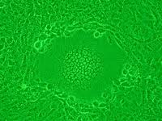
Syncytia
Viruses with surface proteins that can fuse at neutral pH often fuse cells together

Slide 22
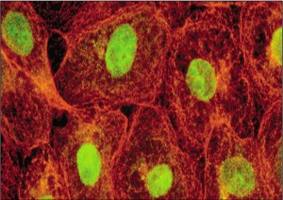
Immunostaining the infected cells

Slide 23
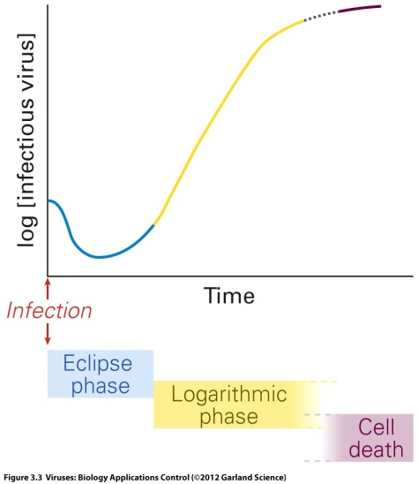
Single step growth kinetics of virus

Slide 24
Viral diagnosis
Detecting viral genome PCR
Detecting viral antigen IFA, ELISA
Detecting virus particles EM, HA
Detecting virus cytopathic effect in cultured cells (Virus isolation)
Detecting antibodies to virus (serology)

Slide 25
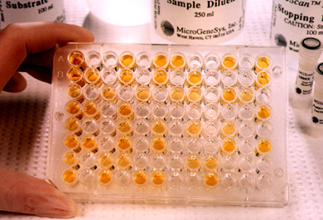
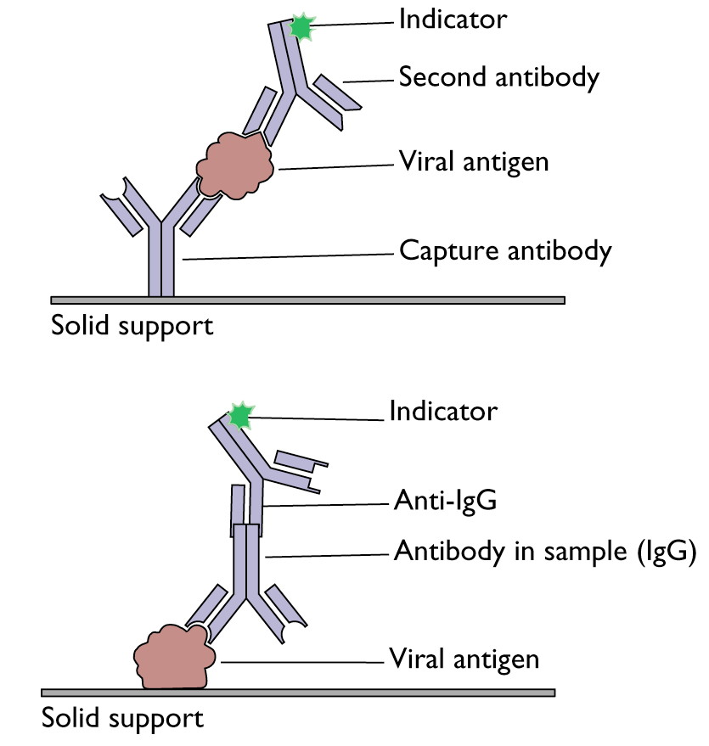
ELISA

Slide 26
Ways to ‘see’ a virus

Slide 27
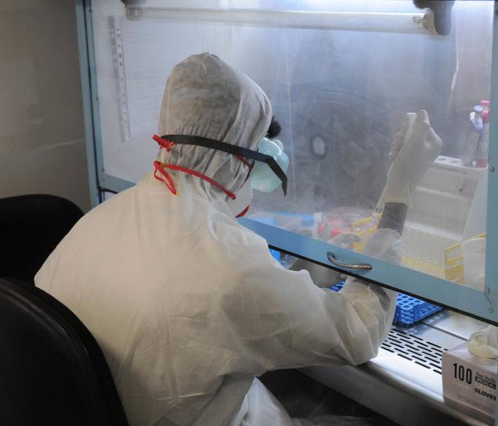
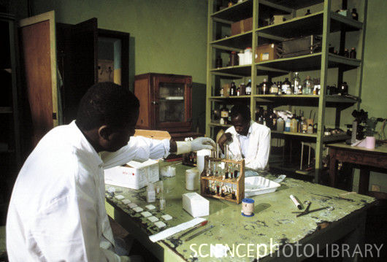
Diagnostic virology
Source of the specimen
Purpose of test (therapy or surveillance)
Who will use it and where
What stage is the disease (active replication or antibody response

Slide 28
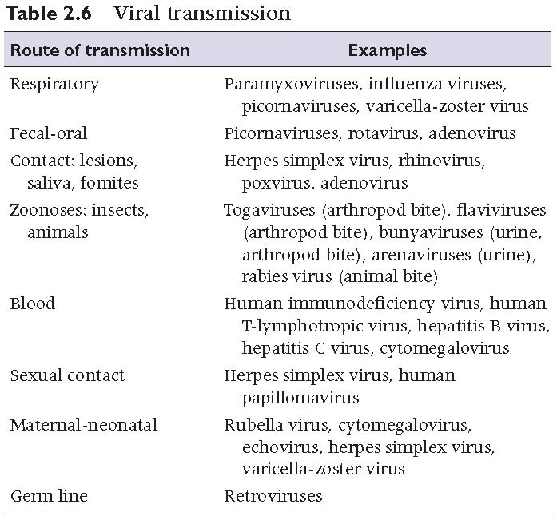
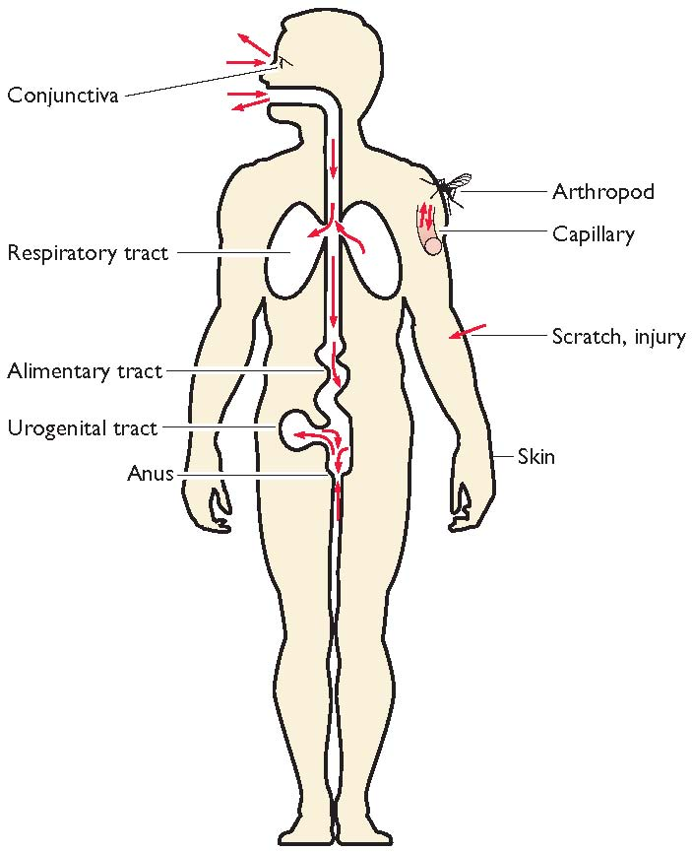
Transmission of viruses

Slide 29
Transmission terminology
Iatrogenic HCW eg contaminated needles
Nosocomial Acquired in hospital
Vertical From parent to offspring
Horizontal All other forms
Germ line Part of the host genome (eg intergrated retrovirus)

Slide 30
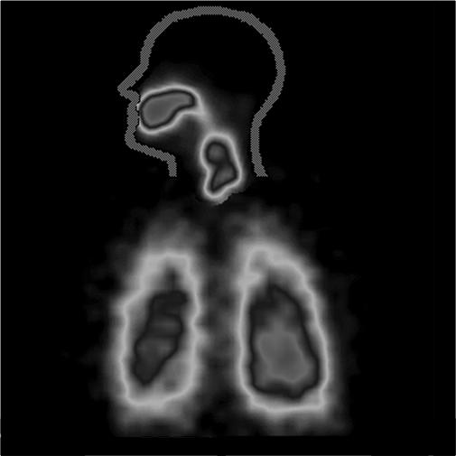
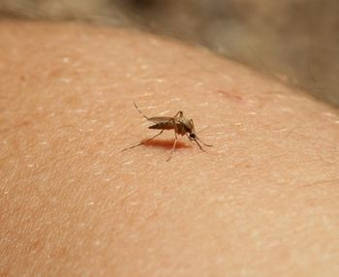
Virus routes of entry to the body
Skin
Mucosal surfaces (Respiratory,Enteric, Genital tract)
Conjunctiva
Blood
Bites

Slide 31
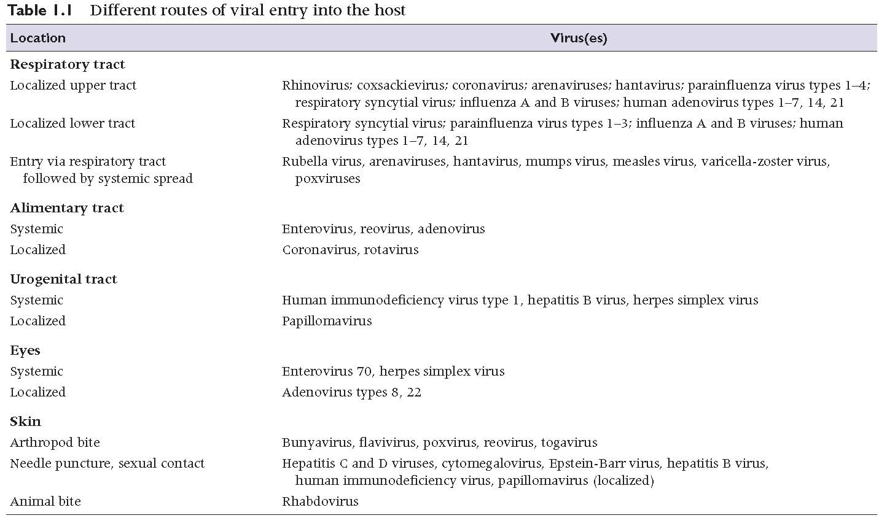
Different viruses enter through different routes

Slide 32
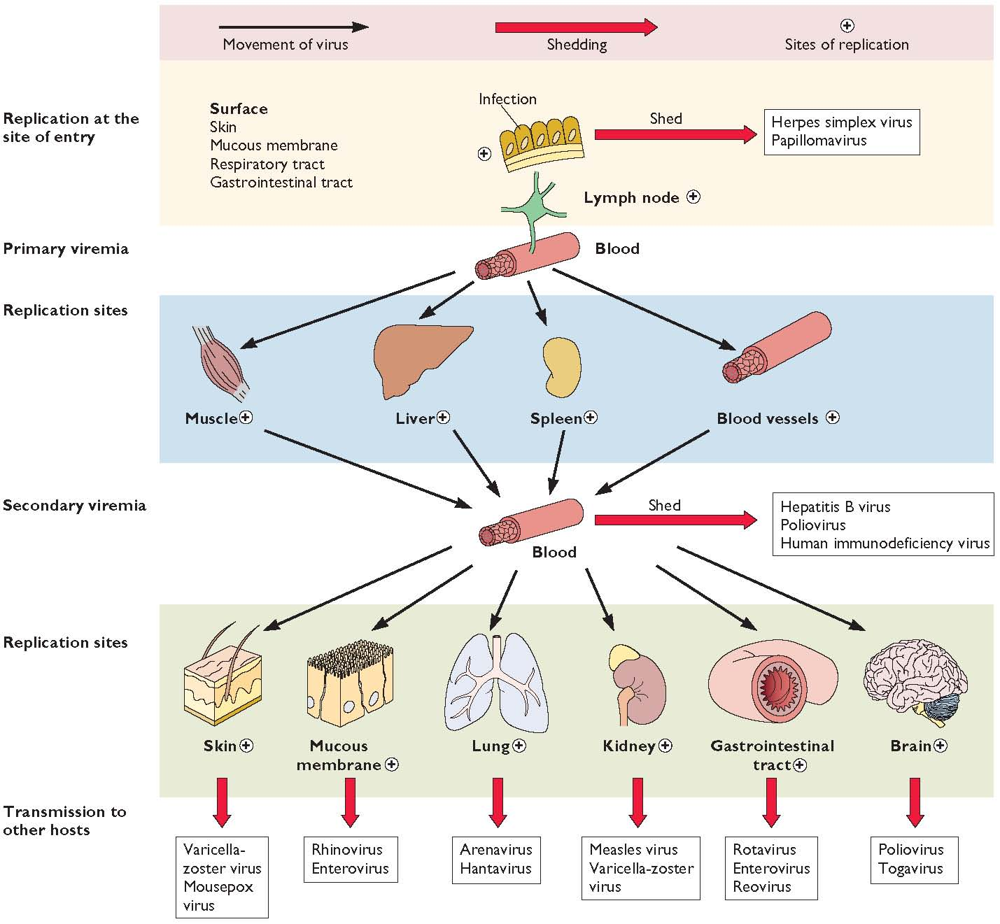
Viral dissemination

Slide 33
Dissemination from the site of entry
Local infection
Primary viraemia
Amplification
Secondary viraemia
Target organ
Local infection, apical release
Dissemination, basal release
Systemic, haematogenous spread or neural spread
Viraemia: Virus in the blood

Slide 34
Tropism
The predilection of viruses to infect certain tissues and not others.
Can be defined by receptor interactions (susceptibility) but also by ability to use the host cell to complete replication (permissivity) and whether the virus can reach a tissue (accessibility).

Slide 35
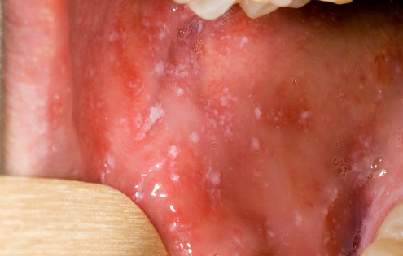
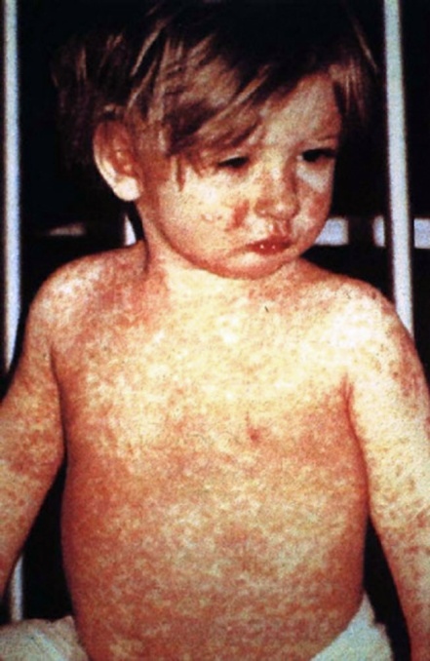
Viral Rashes
Systemic viral infection
Virus leaves blood and enters skin
Cells destroyed by virus replication
Koplik spots in the mouth from measles infection
Lesion on mucus membranes of soft respiratory tract tissues occur before skin rashes: Measles and chicken pox spread through the air before the rash is visible.

Slide 36
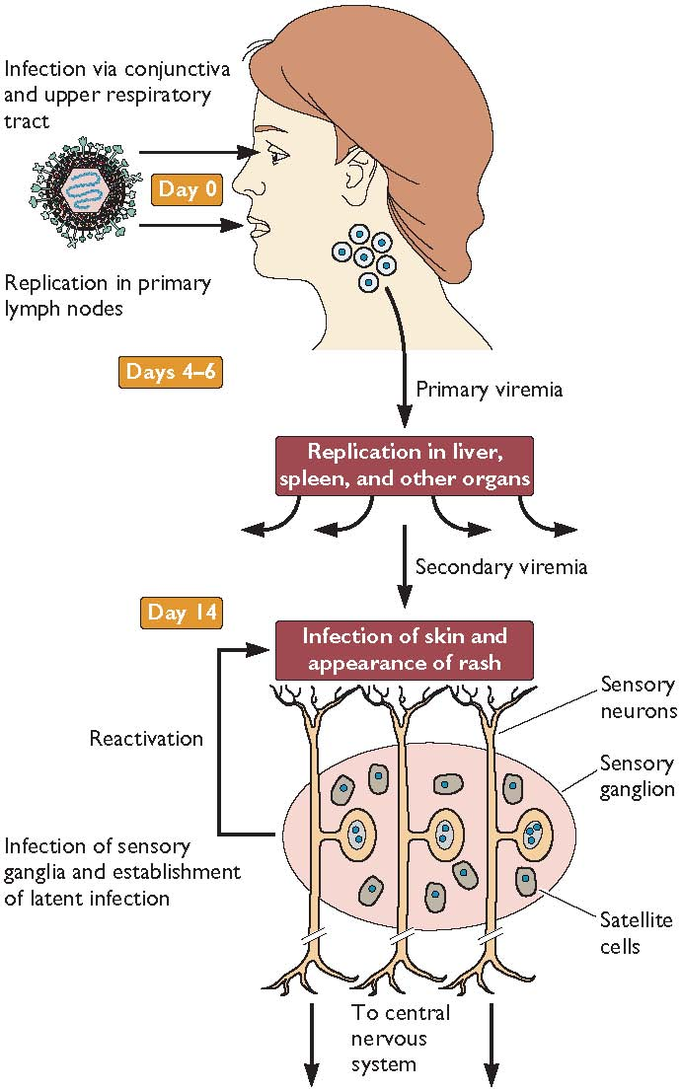
Varicella Zoster Virus chicken pox: symptoms after secondary viraemia
Virus enters body through respiratory route
VZV can infect many cell types including PBMCs and skin cells.
This leads to mild self limiting illness in most childhood cases.
From the skin site, it can infect sensory neurones where it remains latent.
In herpes zoster, or shingles, occurring in adulthood when cellular immunity is impaired, virus is reactivated in the sensory neurone and causes a painful rash at the nerve endings.

Slide 37
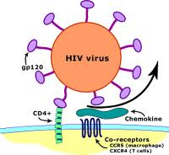
Tropism of HIV determined by receptor use
CD4
CCR5 or CXCR4
Viral attachment protein gp120

Slide 38
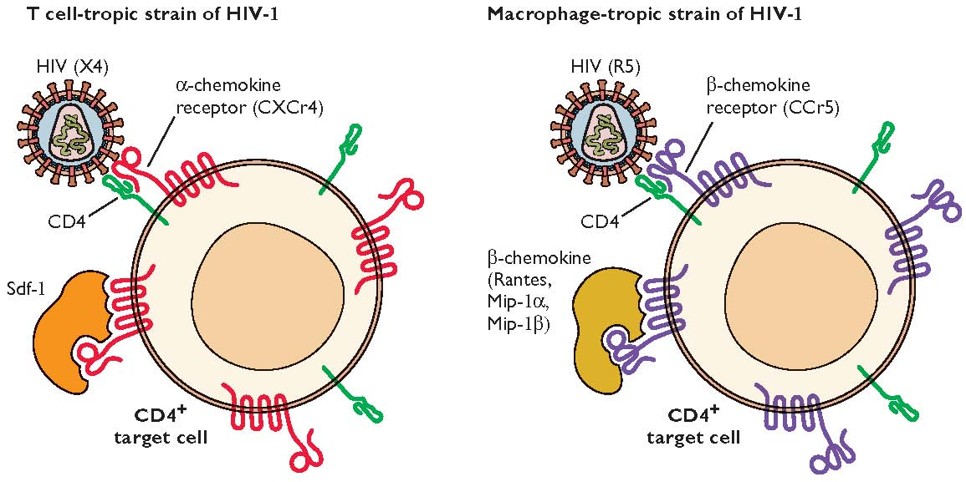
The tropism switch during HIV replication

Slide 39
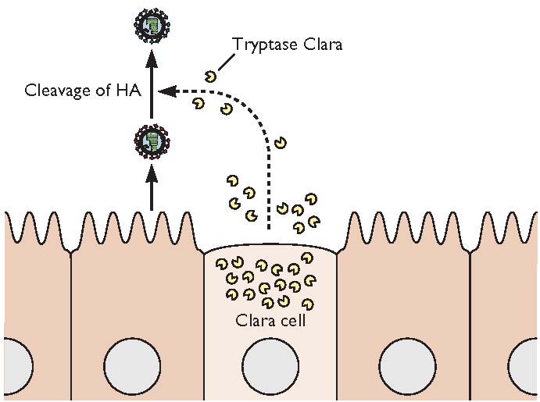
Influenza tropism is determined by availability of host proteases

Slide 40
Influenza tropism is extended by mutations in HA
Clara Tryptase
(respiratory tract secretions)
R
H5
H7
Furin
(ubiquitous)
KRRRRR

Slide 41
Pathogenicity and virulence
Pathogenicity is the ability of the virus to cause disease
Most commensal microbes are not pathogenic.
Ebola virus is more pathogenic than rhinovirus.
Virulence describes the capacity of a virus to cause disease.
Viral disease depends on how much replication the virus undergoes but is affected by other factors too such as the host response.

Slide 42
Sources of information

