Slide 1
Prevention and treatment of viral disease
Professor Wendy Barclay
Course code (MBBS) : Microbiology 7
Course code (BMS) : IIP-L20

Slide 2
Prophylaxis and Therapy
Prophylaxis is preventing disease before the aetiologic agent is acquired, by vaccination or giving drug before infection.
Therapy is treating the disease after the host has been infected.

Slide 3
Defending ourselves against viruses
Vaccines
Antiviral drugs
Prophylactic
Live or inactive
Herd immunity or defined target group?
Safety > efficacy (RSV vaccine in 1970s!)
Governments and WHO
Therapeutic
Random screen or rational design
Define target group: very sick or over the counter?
Individuals

Slide 4
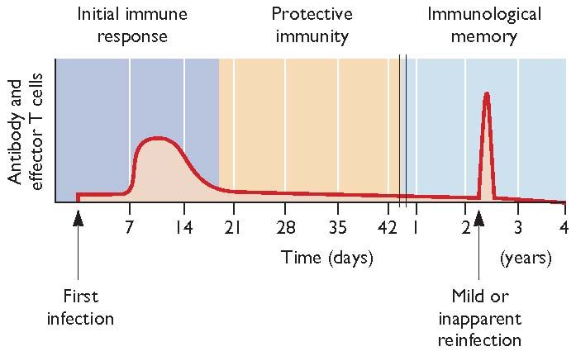
The immunological basis of protection after vaccination

Slide 5
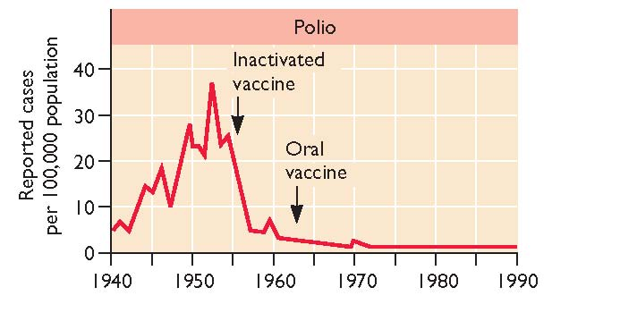
Successful virus vaccination

Slide 6
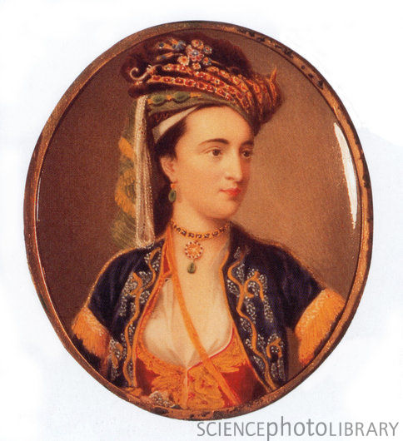
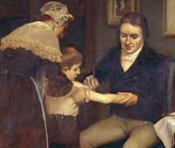
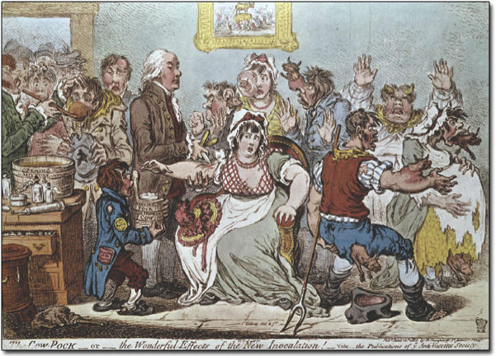
History of variolation and smallpox vaccination
Edward Jenner
and James Phipps
Lady Mary Wortley Montague

Slide 7
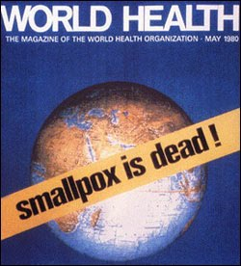
Eradication of a virus from the planet
No animal reservoir
No latent or persistent infection
Smallpox was an easily recognised disease
The vaccine was effective against all strains of virus
Vaccine properties. Potency, low cost, abundance, heat stability, easy administration
WHO determination
$250 million
1977

Slide 8
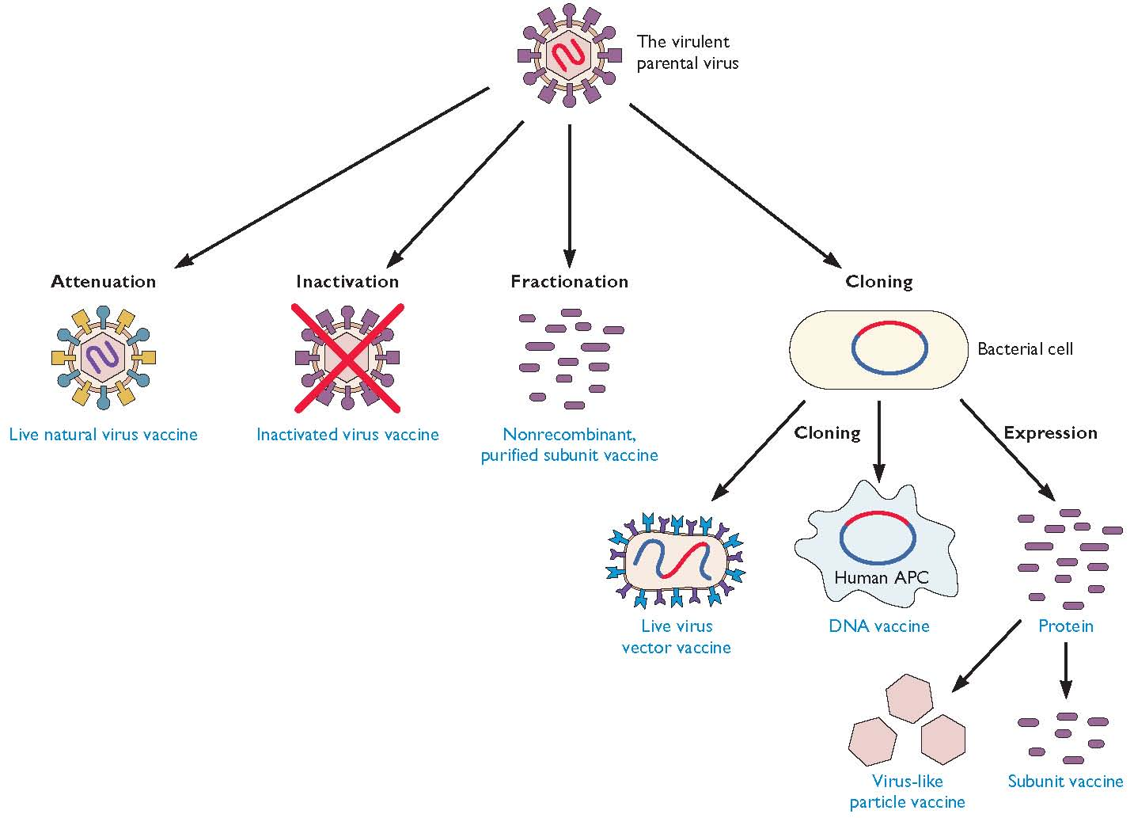
Different types of viral vaccines

Slide 9
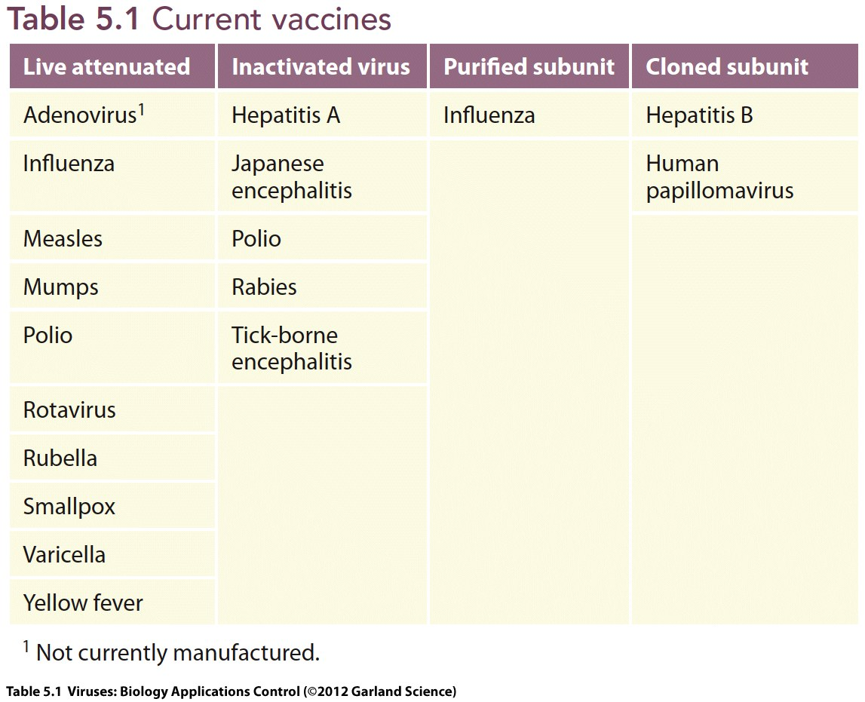
Human virus vaccines

Slide 10
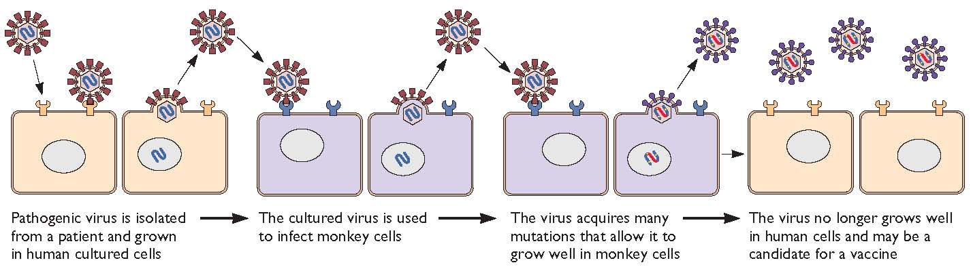
Attenuation of virus to make a live virus vaccine

Slide 11
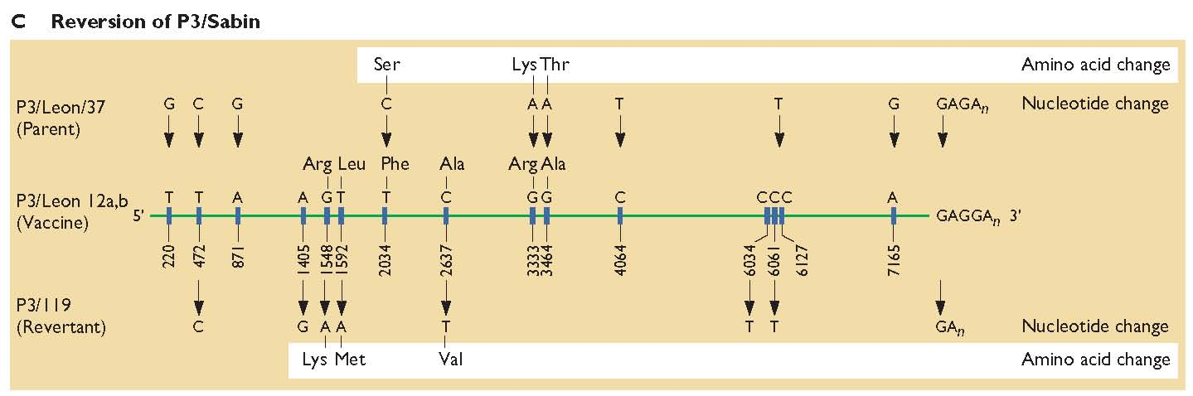
The genetic basis of poliovirus attenuation

Slide 12
Pros and cons of live vs inactivated vaccines
Live vaccine
Inactivated vaccine
Rapid broad, long lived immunity
Dose sparing
Cellular immunity
BUT
Requires attenuation
May revert
Safe
Can be made from wild type virus
BUT
Frequent boosting required
High doses needed

Slide 13
Examples of viruses for which both live and inactivated vaccines are available
Influenza
Poliovirus
Inactivated virus or HA subunit
Updated regularly
DOES NOT give the recipient the flu!!!
LAIV is cold adapted
FluMist delivered intranasally
Updated regularly
Salk inactivated vaccine
Sabin live attenuated vaccine
1 in 7 million vaccinations associated with poliomyelitis
Persisting in immunosupressed individuals
Salk will be required for the ‘end game’.

Slide 14
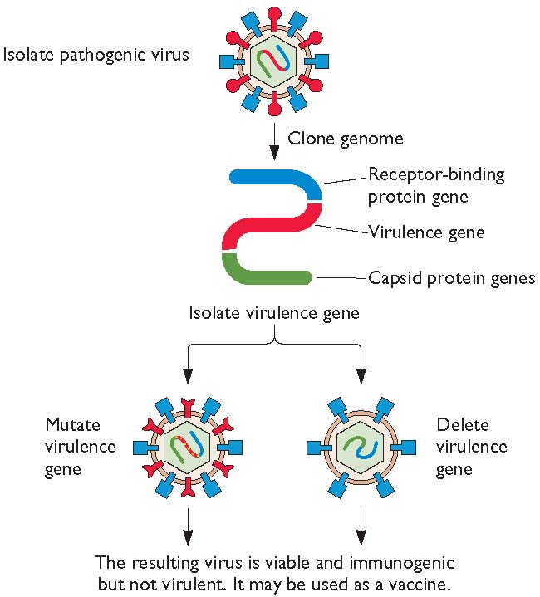
Recombinant attenuated virus vaccines

Slide 15
Engineering safe influenza H5 vaccine
HA
NA
Highly pathogenic virus
Vaccine virus

Slide 16
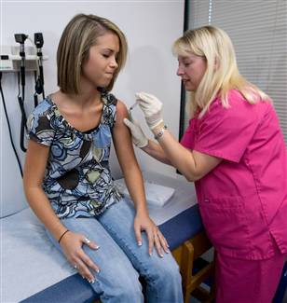
Subunit vaccines
Hepatitis B virus
sAg cloned and expressed in yeast
Papillomavirus
Virus Like Particles from recombinant coat proteins
Gardasil and Cervarix

Slide 17
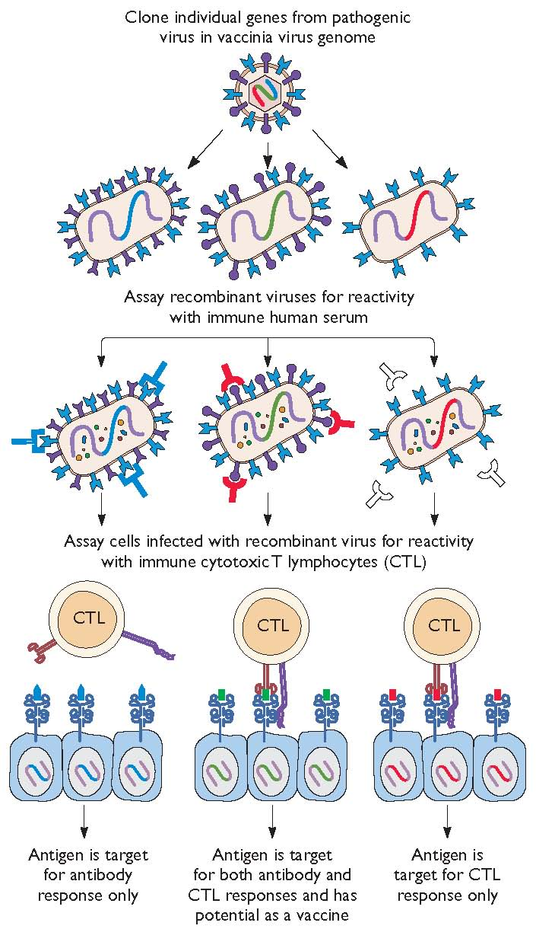
Viruses as vectors of pathogen subunits

Slide 18
The Thai trial RV-144 to test HIV vaccine
Combination of canary pox vector that delivers HIV antigens
Boosted with subunit gp120 of clade E
38% efficacy
But no one understands why!

Slide 19
Antiviral treatment
Interferons
Drugs with specific antiviral activity
Treatment that alleviate symptoms but do not inhibit virus replication

Slide 20
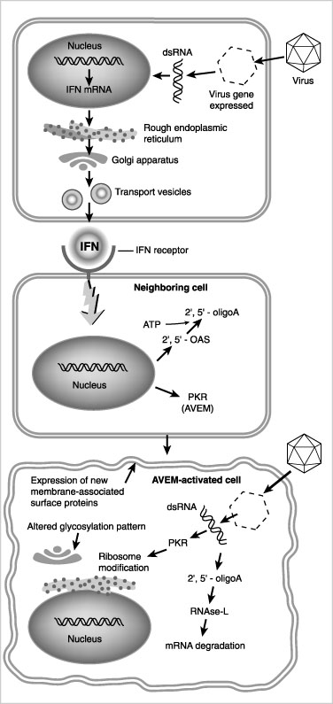
Interferons- the hosts natural antiviral system
Discovered by Isaacs and Lindemann. 1957.
Recombinant interferon 1981-1982
Side effects due to induction of cytokines and other ISGs
Some viruses are resistant; strains of hepatitis C virus.

Slide 21
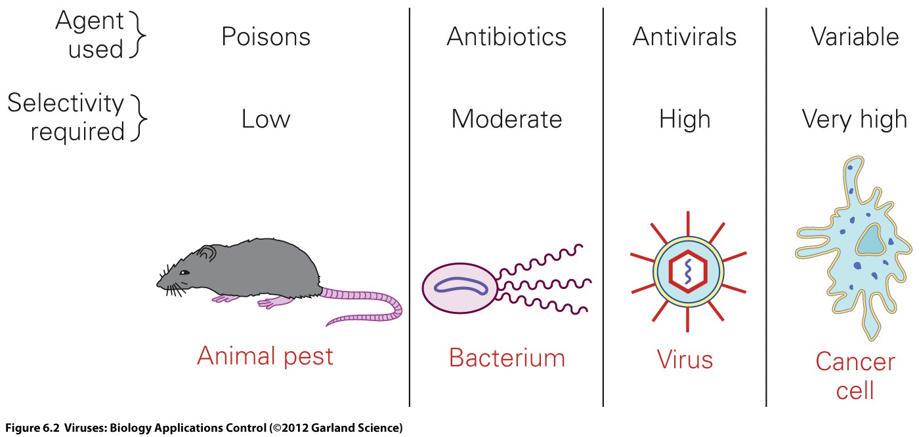
Antiviral Drugs

Slide 22
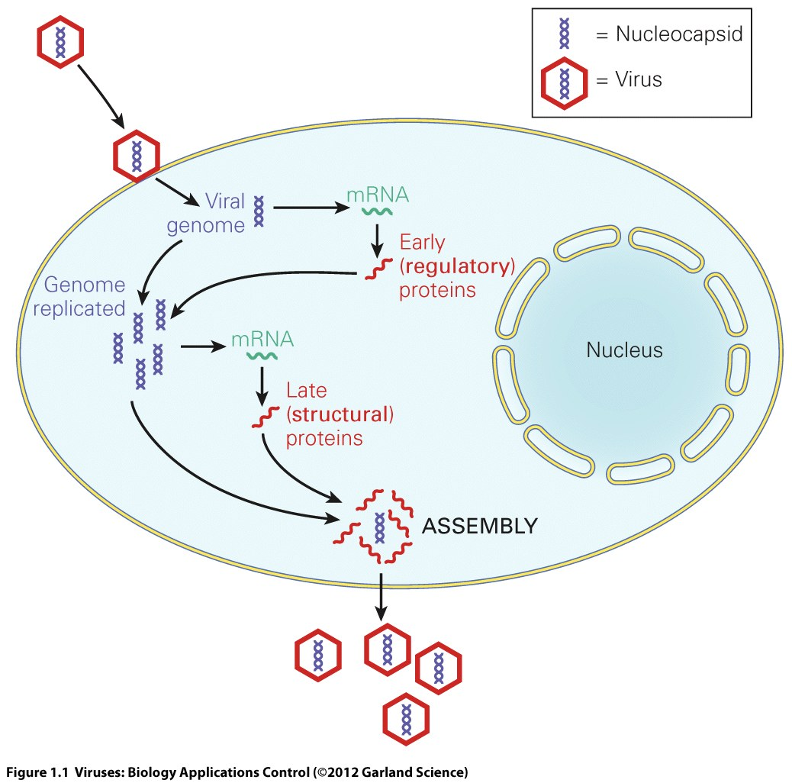
A generic virus replication cycle

Slide 23
Targets for antiviral drugs
In reality most antiviral drugs target viral enzymes.
Increased understanding of structure of viral components and enzymes can lead to rational drug design.

Slide 24
Structures of nucleoside analogues which inhibit viral replication.
3’ -OH

Slide 25
Chain termination
modified nucleoside incorporated into DNA
lack of 3’ -OH prevents phosphodiester bond formation
Notes:
3

Slide 26
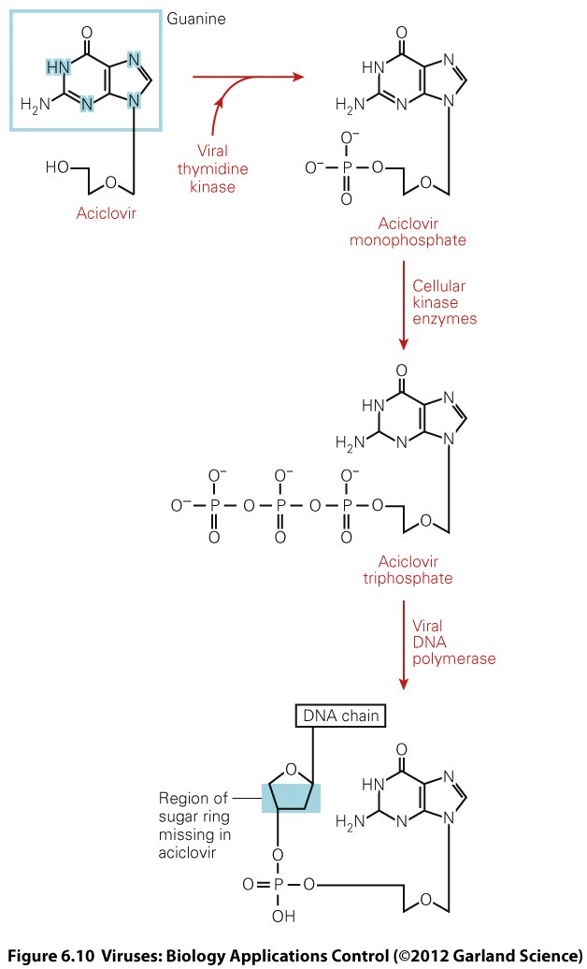
Acyclovir specificity
Only activated inside a virus infected cells
Higher affinity for viral DNA polymerase than for host cell polymerase
Resistance is rare but maps to thymidine kinase.

Slide 27
Influenza replication
mRNA
Notes:
6 hours 10,000 viruses per cell millions of cells
absolute parasite intimiate interaction inside the cell with factors that can be species specific

Slide 28
The role of M2

Slide 29
M2 the influenza virus ion channel

Slide 30
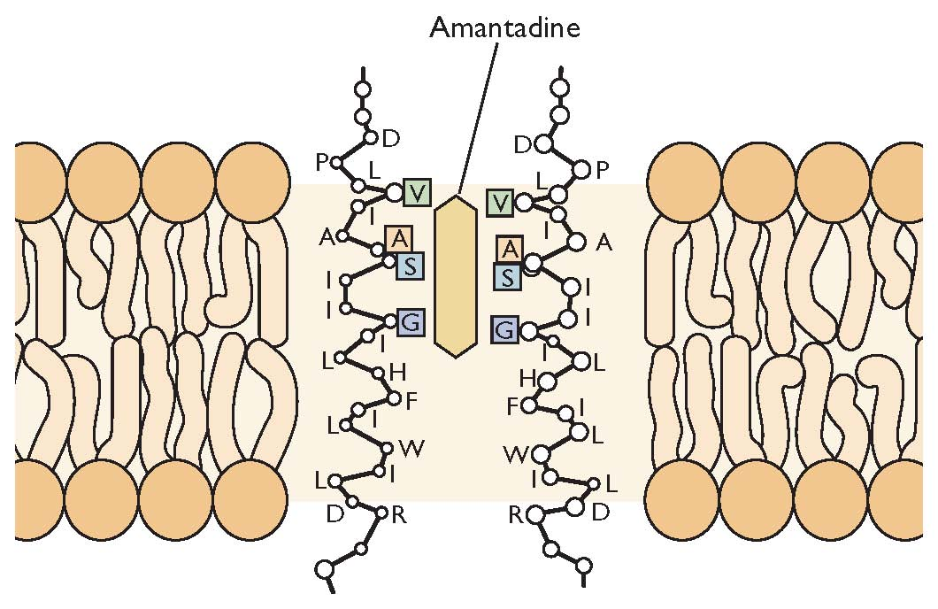
Adamantanes
Amantidine/Rimantadine
cyclic amines with bulky, cagelike structures
Byproducts of petroleum refinement
Active against influenza A virus only
Notes:
6

Slide 31
Resistance to amantadine
Single point mutations e.g. S31N
Little cost to fitness, resistant virus virulent and transmissible
Most H3N2 circulating viruses are amantadine resistant.
Many H5N1 strains are resistant due to overuse in poultry industry.

Slide 32
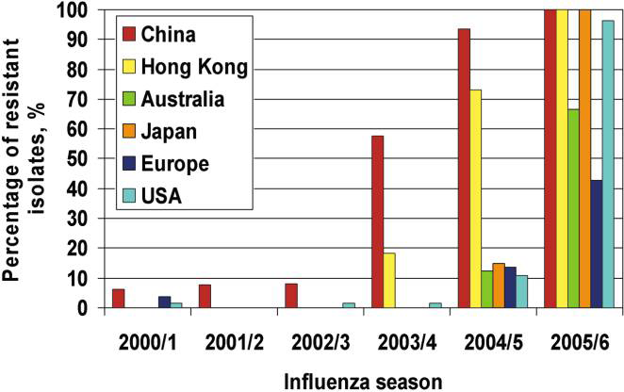
The predominance of amantadine resistance in H3N2 community isolates

Slide 33
The role of neuraminidase

Slide 34
The virus neuraminidase enzyme destroys cell surface receptor

Slide 35
Inhibiting NA inhibits virus spread

Slide 36
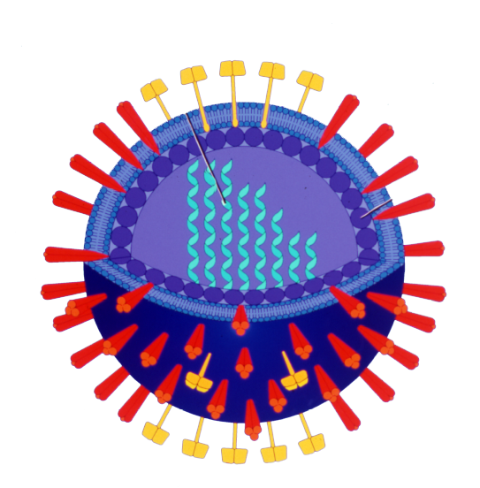
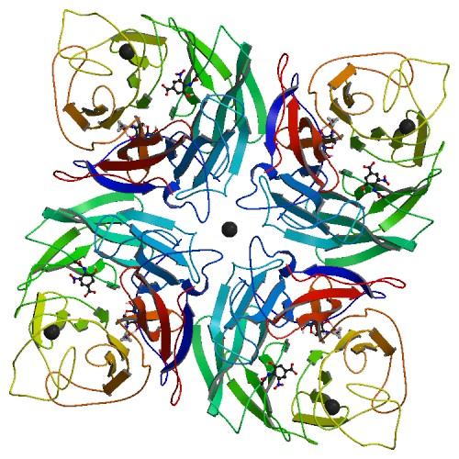
The crystal structure of the neuraminidase protein allowed rational drug design
RNA segments
NA
HA

Slide 37
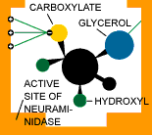
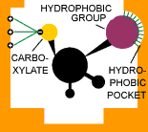
Neuraminidase inhibitors
Sialic Acid
Relenza
Tamiflu
zanamivir
oseltamivir

Slide 38
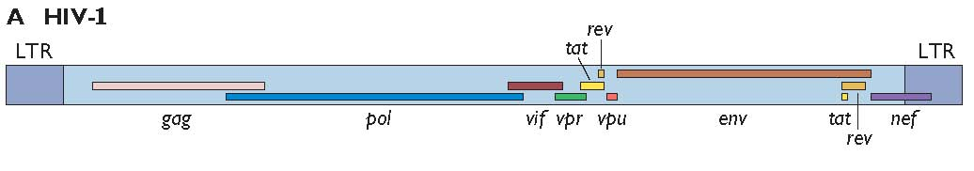
The genome of HIV-1

Slide 39
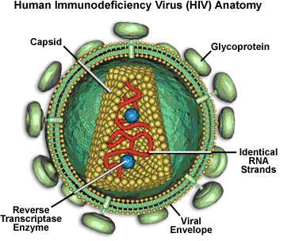
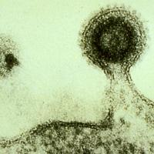
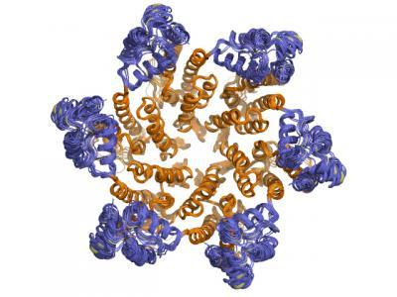
Entry Inhibitors
e.g. Enfuvirtide
Maraviroc
Protease Inhibitors
e.g. Atazanavir (with Ritonavir)
1. Binding and Entry
7. Budding
and
exit
Mature virion proteins
CCR5
CXCR4
CD4
HIV Protease
6. Virion Assembly
Virion Packaging
RNA
5. Transcription
Reverse
Transcriptase
2. Reverse Transcription
AAAAAAA
AAAAAAA
Genomic
RNA
Subgenomic
RNA
NRTI
e.g. Zidovudine
Stavudine
4. Transcription
DNA
Integrase
Provirus
NNRTI
e.g. Efavirenz
Viramune
3. Integration
Integrase
Inhibitors
e.g. Raltegravir

Slide 40
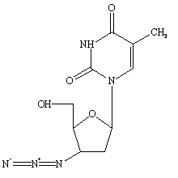
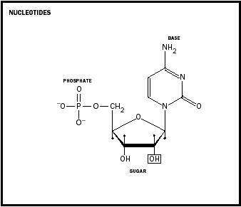
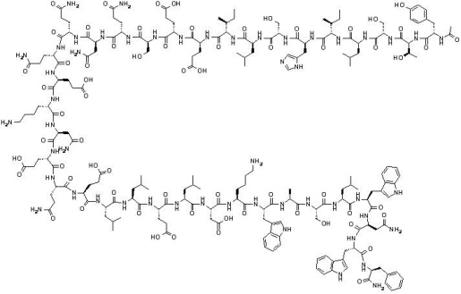
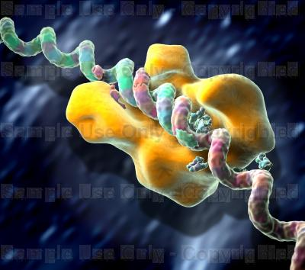
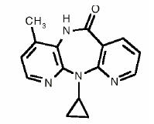
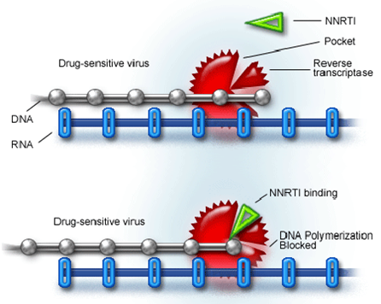
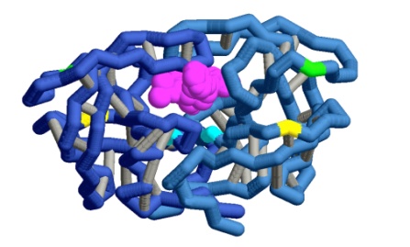
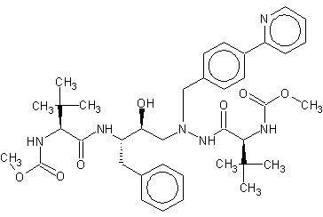
How do the HIV antiretrovirals work?
NRTI
Zidovudine
Stavudine
CCR5,CXCR4 inhibitors
e.g. Maraviroc
Blocks gp120/CXCR4
interaction
Entry Inhibitors
Normal nucleotide
T Helper cell
Looks like an Nucleotide
but doesn’t polymerise –
stops chain
CCR5
CXCR4
Reverse Transcriptase
generating DNA from RNA
CD4
Enfuvirtide
gp120
Binds HIV gp41 preventing
Membrane fusion
pore formation and entry
NNRTI
Efavirenz
Viramune
HIV
gp41
‘Allosteric
Inhibitor’
(binds enzyme but
not at the active site)
HIV Protease
Integrase Inhibitors
Raltegravir –
Blocks virus/host
DNA transfer
Viral DNA
Binds enzyme active site
and inhibits activity
Integrase
Protease Inhibitors
Atazanavir (generally taken with Ritonavir)
Integration
Host DNA

Slide 41
Antiviral therapy for hepatitis c virus
HCV is a hepatotropic flavivirus that was spread widely in the 1970s in blood products before screening was put in place.
170 million people are chronically infected and 4% will proceed to hepatocellular carcinoma.
For more than 20 years therapy relied on interferon treatment with ribavirin.
This was only effective (produced a sustained virological response SVR) in 50% patients infected with the most common genotype 1 of the virus, and carried unpleasant side effects.

Slide 42
Targets for antiviral drugs for HCV
NS3-4A is the virally encoded protease that processes the polyprotein.
NS5B is the viral polymerase that replicates the RNA genome.
NS5A is phosphoprotein required by the virus for replication.
The structure of these 2 targets has been solved by crystallography allowing rational based drug design of DAAs directly acting antivirals.
The first generation protease inhibitors were telaprivir and boceprivir.
Monotherapy results in rapid selection of resistant mutants.
They have been used successfully in combination with IFN and RBVN.

Slide 43
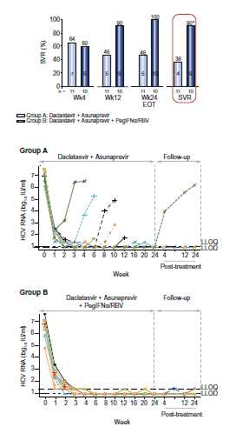
HCV antiviral therapy 2012
New generation therapy combines protease inhibitor asunaprevir with NS5A inhibitor daclastivir, either with or without IFN and RBVN.
Patients enroled in the trial had previously failed to respond to IFN and RBVN, but 36% of these showed SVR with the 2 DAAs (group A).
9/10 patients receiving the combination of 4 drugs had prolonged SVR. (group B).

Slide 44
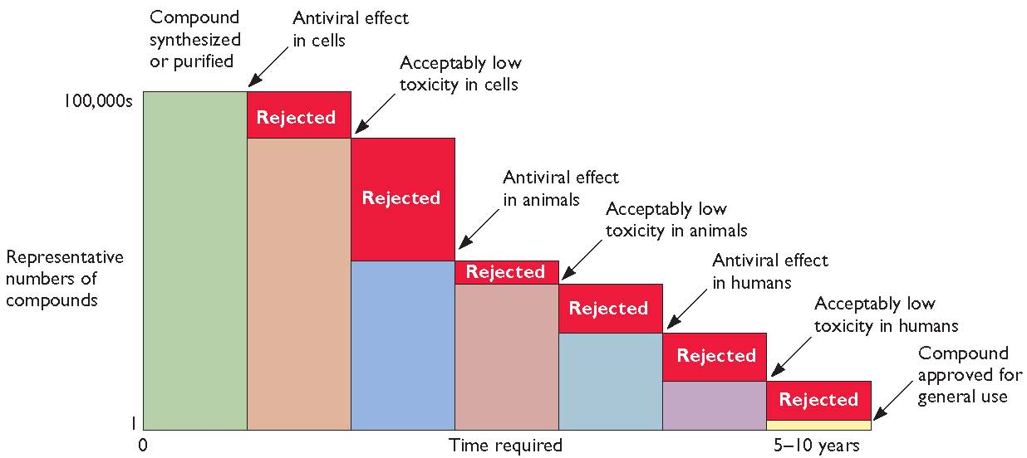
The search for new antivirals
Is there a need?
HSV helicase-primase inhibitors are better than acyclovir but not developed (Scahffer. Nat Med 2002)

Slide 45
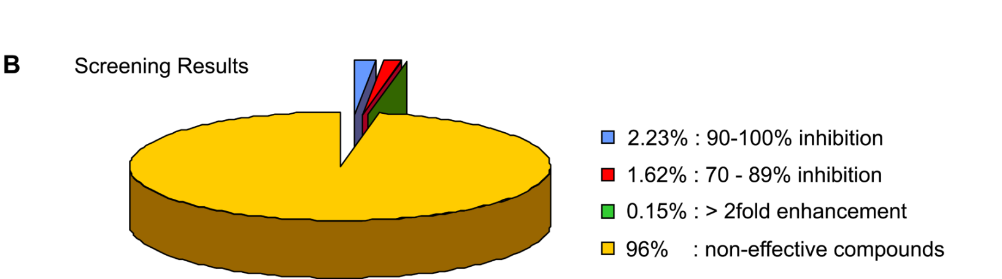
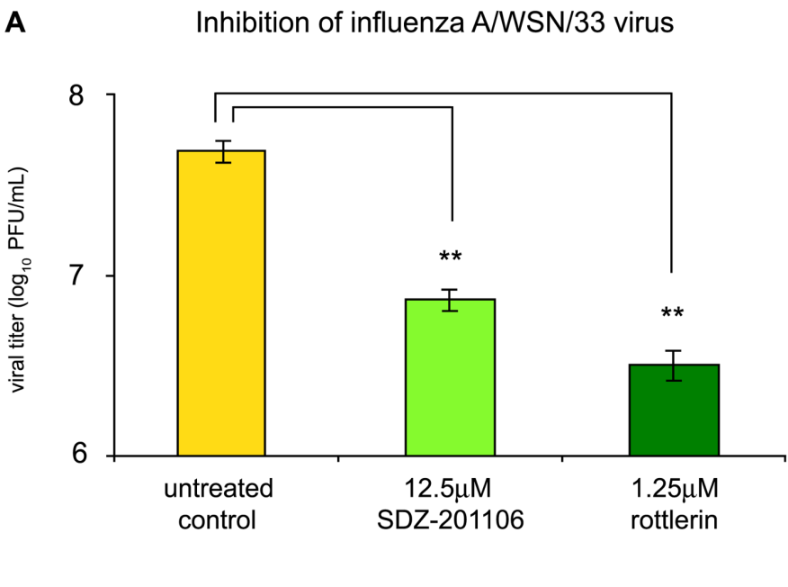
High throughput screen with drug libraries
Influenza inhibition by
NA channel opener
and PKC inhibitor

Slide 46
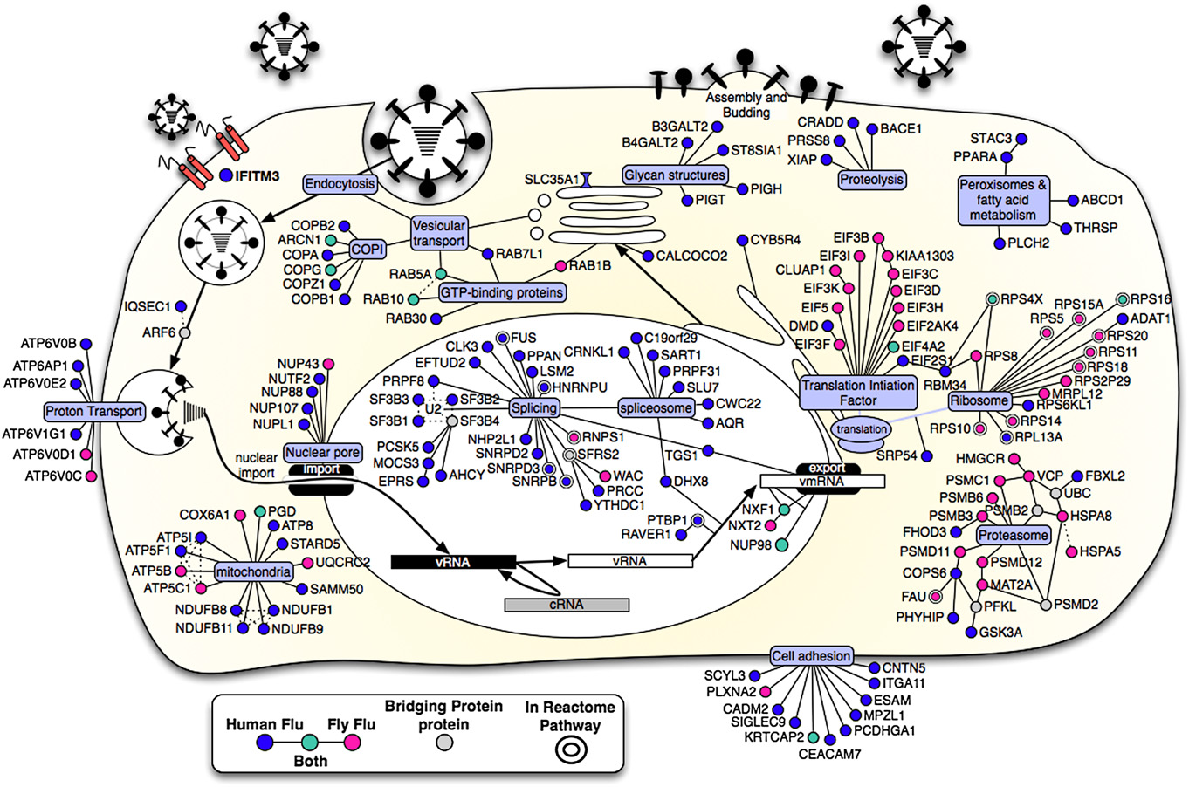
Genome wide screen to find new host targets

Slide 47
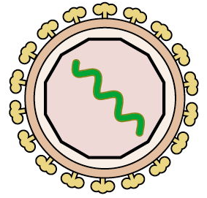
The future for broad spectrum antivirals
Inducing interferon like profiles
Affecting availability of nucleoside precursors
Affecting membranes: squalamine from the dogfish shark, LJ001
Inhibiting host cell functions that several different viruses use.
1
LJ001 (Wolf et al., 2010)

