Slide 1
Regulation of lymphocyte responses
Dr Ingrid Muller
Course code (MBBS) : Immunology 8
Course code (BMS) : IIP-L9

Slide 2
Objectives
• Outline T and B cell collaboration and the mechanisms governing the generation
of antibody classes
• Briefly describe how T lymphocytes and cytokines regulate macrophage
responses
• Describe how immune responses can be regulated (antigen-concentration, innate
immunity, cytokine cross-regulation, immune suppression, regulatory T cells)
• Appreciate importance of regulation of immune responses: prevent responses
against self (self-tolerance); avoid tissue damage and excessive lymphocyte
activation during immune responses

Slide 3
The importance of immune regulation
To avoid excessive lymphocyte activation and tissue damage during normal protective responses against infections
To prevent inappropriate reactions against self antigens (“self-tolerance”)
Failure of control mechanisms is the underlying cause of immune-mediated inflammatory diseases

Slide 4
Immune regulation is of paramount importance for protection from infection by pathogenic microorganisms and for survival of the infected mammalian organism.
Immune regulation is achieved by a complex interactive network of immune cells

Slide 5
General principles of controlling immune responses
Responses against pathogens decline as the infection is eliminated
  Apoptosis of lymphocytes that lose their survival signals (antigen, etc)
  Memory cells are the survivors
Active control mechanisms may function to limit responses to persistent antigens (self antigens, possibly tumors and some chronic infections)
  Often grouped under “tolerance”

Slide 6
Immunological tolerance
Definition:
  specific unresponsiveness to an antigen that is induced by exposure of lymphocytes to that antigen (tolerogen vs immunogen)
Significance:
  All individuals are tolerant of their own antigens (self-tolerance); breakdown of self-tolerance results in autoimmunity
  Therapeutic potential: Inducing tolerance may be exploited to prevent graft rejection, treat autoimmune and allergic diseases

Slide 7
How does the immune system prevent to respond against self and maintain at the same time reactivity to invading pathogens/non self?

Slide 8
Immunological tolerance
State of functional unresponsiveness
tolerance is an active process

Slide 9
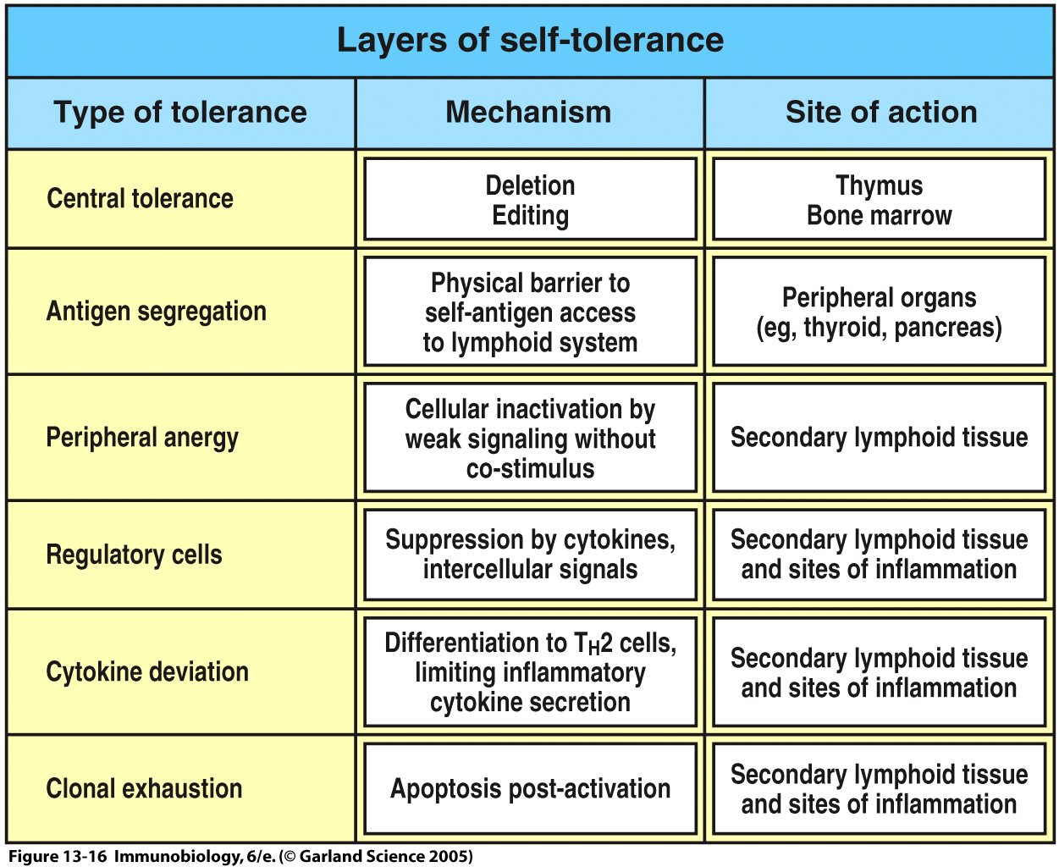
Figure 13-16

Slide 10
Autoimmunity
Definition: immune response against self (auto-) antigen = pathologic
  Disorders are often classified under “immune-mediated inflammatory diseases”
General principles:
  Pathogenesis: Susceptibility genes + environmental triggers
  Systemic or organ-specific

Slide 11
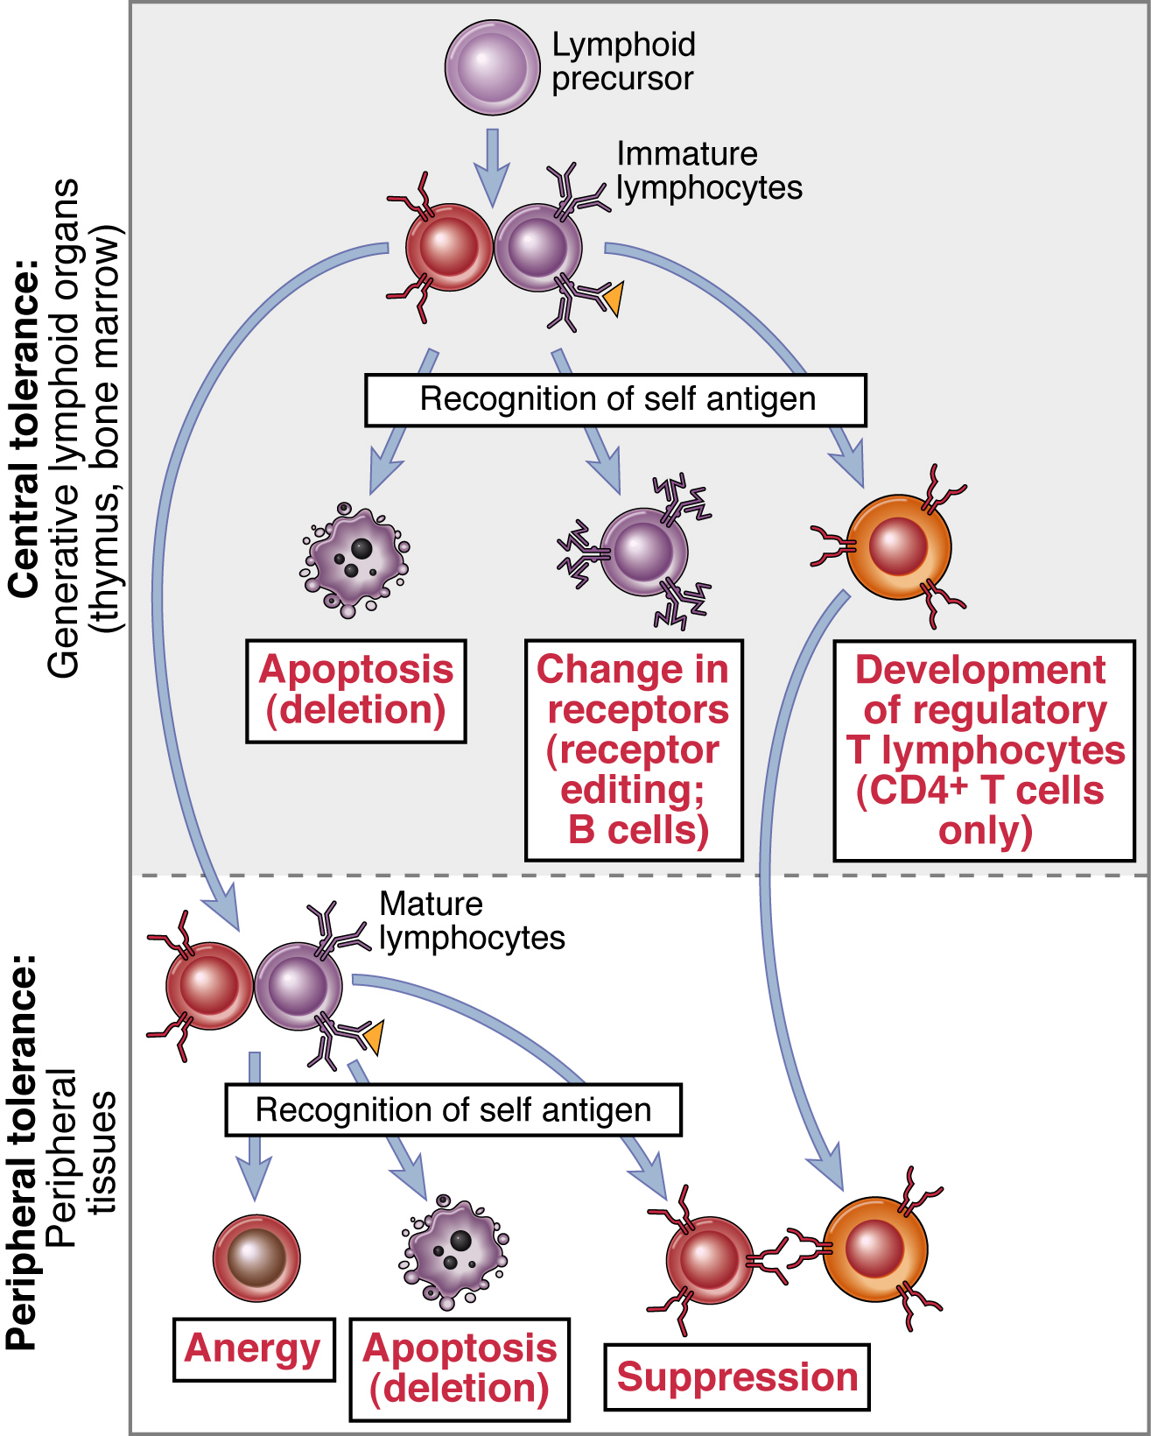
Central and peripheral tolerance
Lymphocytes that
recognise self antigens before
maturation in the generative
organs are eliminated (deletion)
or made harmless
Some B cells may change
their specificity and some T
cells develop into
regulatory (suppressive)
T lymphocytes
From Abbas, Lichtman and Pillai. Cellular and Molecular Immunology 6th ed, 2007

Slide 12
Peripheral tolerance
T cell
CD28
Normal T cell
response
Activated
T cells
APC
TCR
Anergy
Functional
unresponsiveness
Off signals
APC
TCR
Activated
T cell
Apoptosis
(activation-induced
cell death)
Deletion
APC
Suppression
Block in
activation
APC
Regulatory
T cell

Slide 13
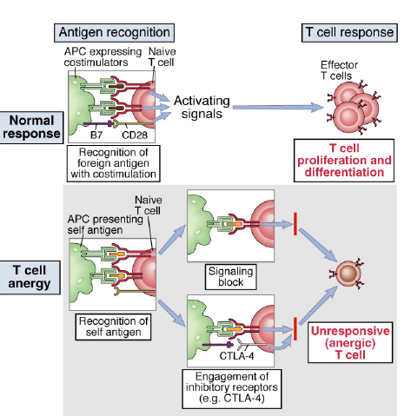
T cell anergy

Slide 14
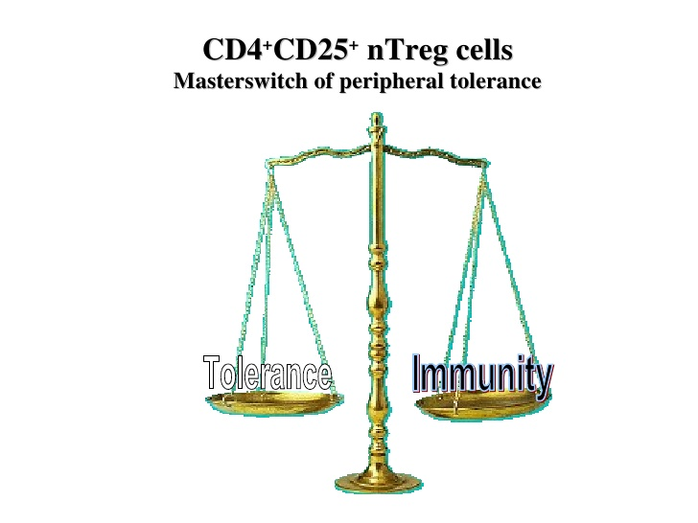

Slide 15
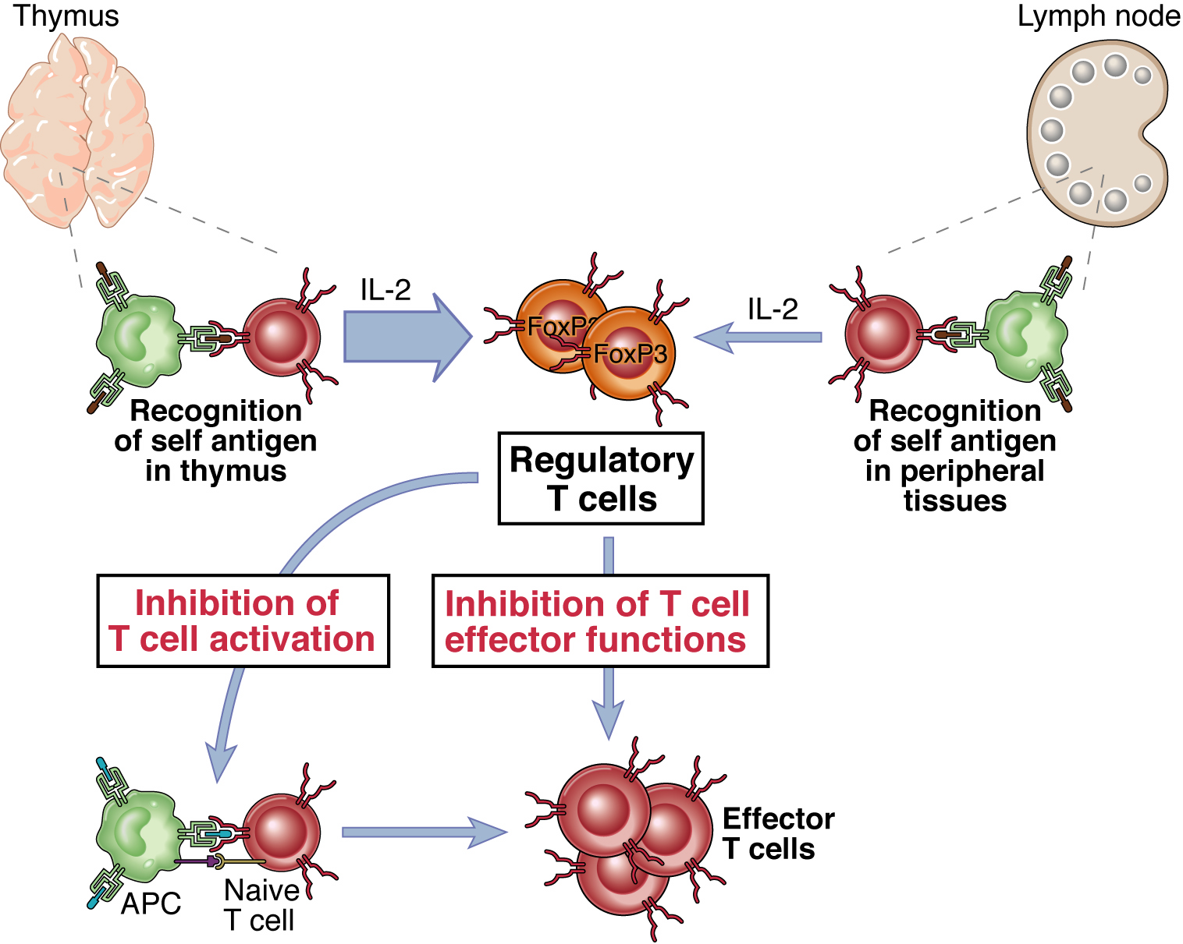
Regulatory T cells
From Abbas, Lichtman and Pillai. Cellular and Molecular Immunology 6th ed, 2007

Slide 16
Properties of regulatory T cells
Phenotype: CD4, high IL-2 receptor (CD25), low IL-7 receptor, Foxp3 transcription factor; other markers
Mechanisms of action: multiple
  secretion of immune-suppressive cytokines (TGFβ, IL-10, IL-35),
  inactivation of dendritic cells or responding lymphocytes

Slide 17
“natural” regulatory T cells (Treg)
Development (in thymus) requires recognition of self antigen during T cell maturation
Reside in peripheral tissues to prevent harmful reactions against self

Slide 18
Peripheral (adaptive, inducible) regulatory T cells
Develop from mature CD4 T cells that are exposed to persistent antigen in the periphery; no role for thymus
May be generated in all immune responses, to limit collateral damage
Can be induced in vitro (stimulation of CD4 T-cells in presence of TGFβ + IL-2)
What factors determine the balance of effector cells and Treg?

Slide 19
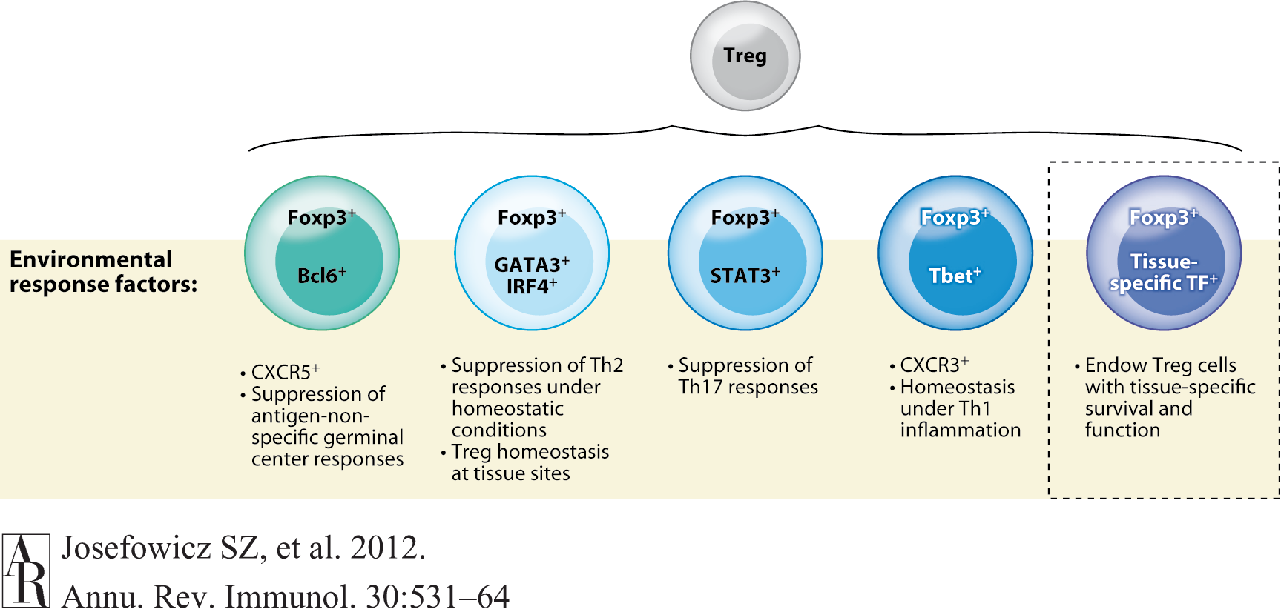
Heterogeneity and function of regulatory T cells
Annual Reviews
Notes:
Regulatory T (Treg) cell heterogeneity and suppression of distinct classes of the immune response. Treg cells generated in the thymus or extrathymically can further specialize through upregulation or activation of transcription factors in response to different environmental stimuli. These environmental response factors can cooperate with Foxp3 to confer to Treg cells a transient or lasting cell state, enabling their tailored function under particular environmental or inflammatory conditions; for example, STAT3 activation in response to IL-10 leads to the generation of pSTAT3⁺ Treg cells capable of suppressing Th17 responses, or activation of STAT1 in response to IFN-γ or other STAT1-signaling cytokines leads to generation of Tbet⁺ Treg cells. In a given tissue, Treg cells, upon instruction by the tissue environment, induce expression of tissue-specific transcription factors whose cooperation with Foxp3 results in a distinct tissue-specific Treg cell transcriptional signature and function, and also supports Treg cell subset homeostasis
Annual Review of Immunology, 2012 Vol. 30: 531-564

Slide 20
Immune-mediated inflammatory diseases
Chronic diseases with prominent inflammation, often caused by failure of tolerance or regulation
  RA, IBD, MS, psoriasis, many others
  Affect 2-5% of people, incidence increasing
May result from immune responses against self antigens (autoimmunity) or microbial antigens (Crohn’s disease?)
May be caused by T cells and antibodies
May be systemic or organ-specific

Slide 21
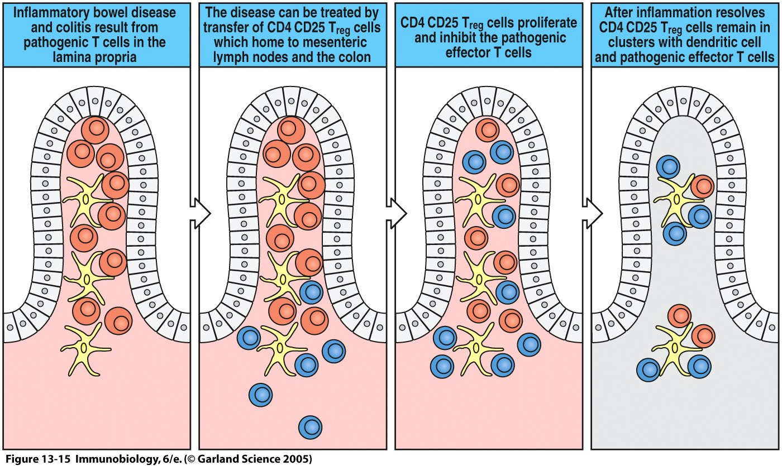
Figure 13-15

Slide 22
Features of autoimmune diseases
Fundamental problem: imbalance between immune activation and control
  Underlying causative factors: susceptibility genes + environmental influences
  Immune response is inappropriately directed or controlled; effector mechanisms of injury are the same as in normal responses to microbes
Many immunological diseases are chronic and self-perpetuating

Slide 23
Objectives
• Outline T and B cell collaboration and the mechanisms governing the generation
of antibody classes
• Briefly describe how T lymphocytes and cytokines regulate macrophage
responses
• Describe how immune responses can be regulated (antigen-concentration, innate
immunity, cytokine cross-regulation, immune suppression, regulatory T cells)
• Appreciate importance of regulation of immune responses: prevent responses
against self (self-tolerance); avoid tissue damage and excessive lymphocyte
activation during immune responses

Slide 24
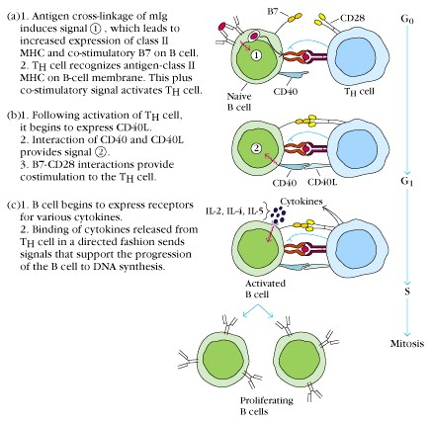
T-B cell collaboration
• ag-cross linking induces signal 1,
↑ MHC II, ↑ B7
• internalisation and presentation
• T cell recognises ag, + costimulation =>
activation of T cells
• activated T cell expresses CD40L
• interaction CD40L and CD40 provide
signal 2
• B7-CD28 interaction provide
costimulation for T h cells
• activated B cells express cytokine rec.
• T cell derived cytokines bind to receptors
on B cells
• B cells proliferate and differentiate in
antibody secreting plasma cell

Slide 25
T-B cell collaboration
• specific interaction of antigen-binding B cell with T cell has bidirectional
effects
T cells are induced to express the B cell stimulatory molecule CD40
ligand on their cell surface that binds to CD40 on the surface of B cells
and secrete cytokines
T cell derived cytokines drive proliferation and differentiation of B cells
into antibody secreting plasma cells
T cell derived cytokines direct the immunoglobulin class switching

Slide 26
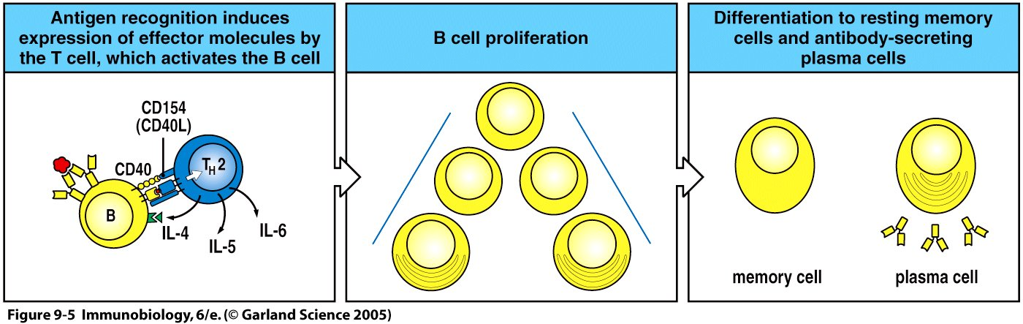
Figure 9-5
Cytokine production caused by T-B collaboration directs antibody type

Slide 27
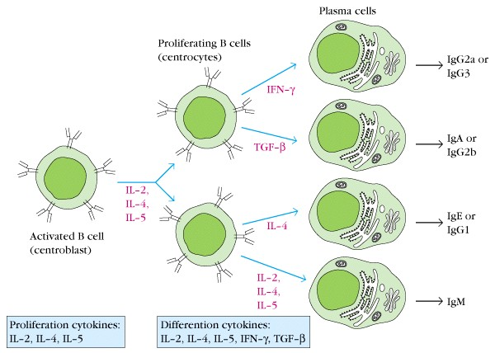
Cytokines direct Immunoglobulin-class switching

Slide 28
Objectives
• Outline T and B cell collaboration and the mechanisms governing the generation
of antibody classes
• Briefly describe how T lymphocytes and cytokines regulate macrophage
responses
• Describe how immune responses can be regulated (antigen-concentration, innate
immunity, cytokine cross-regulation, immune suppression, regulatory T cells,
regulatory B cells)
• Appreciate importance of regulation of immune responses: prevent responses
against self (self-tolerance); avoid tissue damage and excessive lymphocyte
activation during immune responses

Slide 29
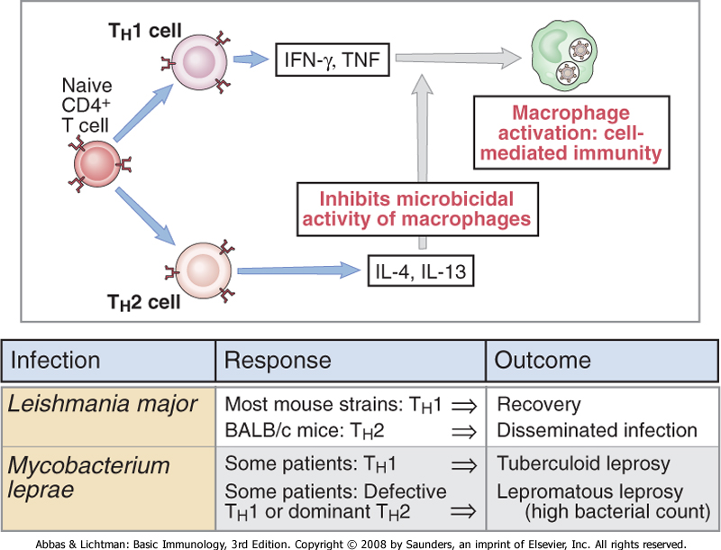
Regulation of macrophages by T cells and cytokines
Notes:
The balance between T_{H}1 and T_{H}2 cell activation determines the outcome of intracellular infections. Naive CD4⁺ T lymphocytes may differentiate into T_{H}1 cells, which activate phagocytes to kill ingested microbes, and T_{H}2 cells, which inhibit macrophage activation. The balance between these two subsets may influence the outcome of infections, as illustrated by Leishmania infection in mice and leprosy in humans. IFN, interferon; IL, interleukin; TNF, tumor necrosis factor.

Slide 30
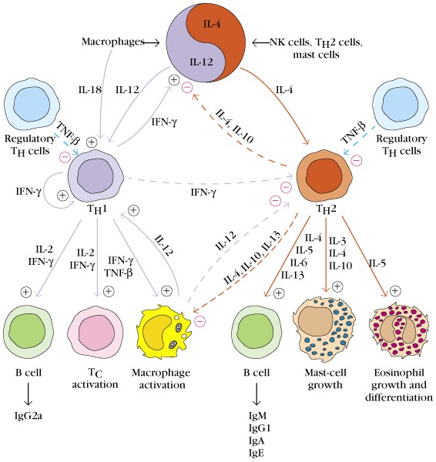
Lymphocyte regulation by cytokines

Slide 31
Cardinal feature of all immune responses: SELF-LIMITATION
Manifested by decline of immune responses
Principal mechanism: immune response eliminates antigen that initiated the response
=> first signal for lymphocyte activation is eliminated

Slide 32
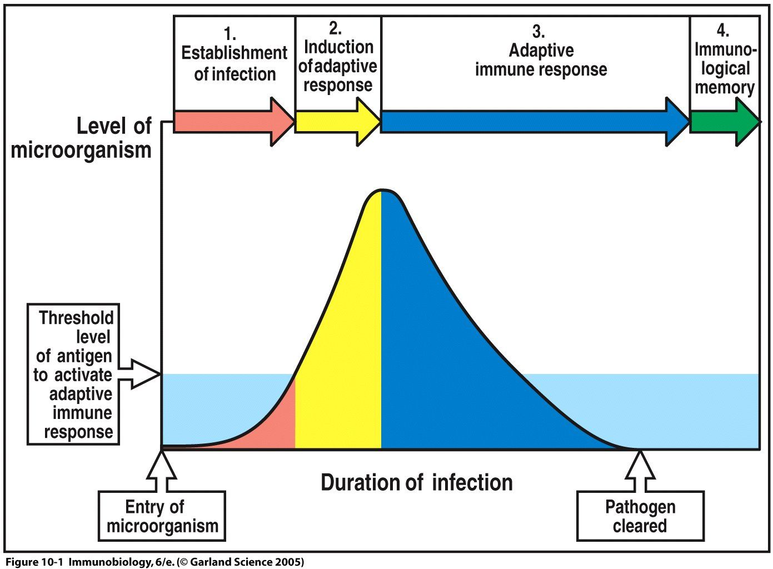
Figure 10-1

Slide 33
Regulatory B cells (Breg)
Contribute to maintenance of equilibrium required for tolerance
• CD40-CD40L interaction is required for Breg activation
Restrain excessive inflammatory responses (autoimmunity,
persistant infections)
IL-10 is important for Breg function, IL-10 inhibits proinflammatory
cytokines and supports differentiation of Tregs
Inhibit Th1-, Th17-, or Th2 mediated responses
convert effector T cells into (Foxp3⁻IL-10⁺CD4⁺ Treg cells = Tr1)
subsets of Bregs are derived from common progenitor – no master
regulator transcription factor identified

Slide 34
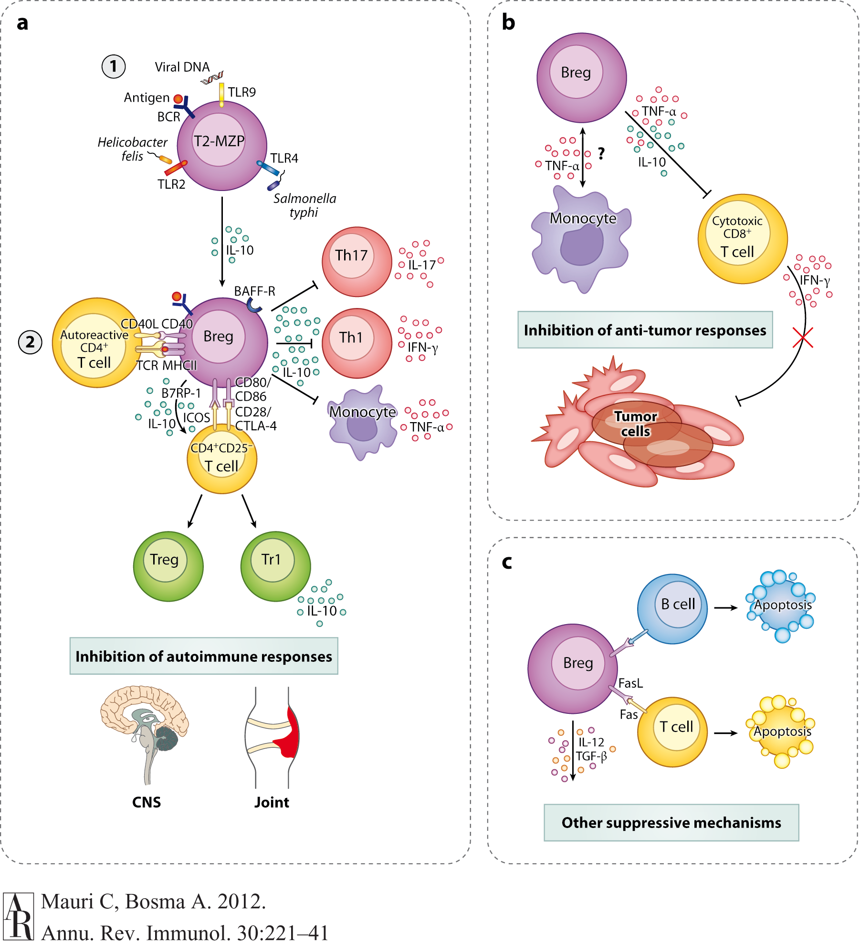
Annual Reviews
Notes:
Figure 1 Functional Breg effector differentiation and regulatory mechanisms. Modification of the two-step pathway for Breg development previously proposed in Reference 28. (a) Step 1: a common progenitor, namely autoreactive T2-MZP Bregs, produces IL-10 after TLR stimulation. Step 2: Bregs are further activated and release an optimal amount of IL-10 in response to CD154⁺CD4⁺ T cells. This step also requires antigen recognition. The chief mechanism of suppression is via the release of IL-10, leading to the suppression of Th1, Th17 responses, and TNF-α from monocytes. IL-10 released by Bregs is pivotal for the differentiation of Tr1 cells and Foxp3⁺ Tregs, resulting in immune regulation at the site of inflammation such as the joint and central nervous system. (b) Bregs can also inhibit cytotoxic CD8⁺ T cells, thereby impairing effective clearance of tumors. (c) Additional mechanisms of suppression are displayed. (Abbreviations: BAFF, B cell activating factor; BCR, B cell receptor; IFN-γ, interferon-γ; T2-MZP, transitional-2 marginal zone precursor; TGF-β, transforming growth factor-β; TLR, Toll-like receptor; TNF-α, tumor necrosis factor-α.)

Slide 35
Regulatory B cells
Studied primarily in autoimmune diseases (multiple sclerosis, systemic lupus erythematosus). Breg numbers are increased in SLE patients but fail to produce IL-10 in response to stimulation with CD40 (hypothetical model next slide)
Healthy Bregs suppress unwanted immune reactions and participate in the maintenance of tolerance via the production of IL-10

Slide 36
Regulatory Macrophages
Macrophages can change their physiology in response to signals provided by an on-going immune response
Regulatory macrophages are a distinct macrophage subsets with distinct physiological functions
Interaction of resident macrophages with Tregs or with a B cell subset induces regulatory macrophage phenotype
Produce high levels of IL-10 (2 signals required)
Normal function: reduce inflammatory immune response and thereby limit tissue damage
=> macrophages can modulate adaptive immune responses

Slide 37
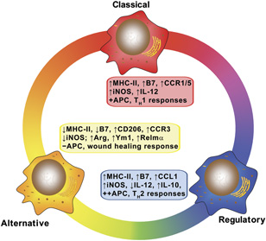
Regulatory macrophages: Setting the Threshold for Therapy
European Journal of Immunology
Volume 41, Issue 9, pages 2498-2502, 26 AUG 2011 DOI: 10.1002/eji.201141717
http://onlinelibrary.wiley.com/doi/10.1002/eji.201141717/full#fig1
Notes:
The three major macrophage subtypes and some of the biochemical and physiological properties of each. ↑↓ designates high or low expression in this subpopulation, relative to the other three; ++, +, − designates relative activity from high (++) to absent (−).
© This slide is made available for non-commercial use only. Please note that permission may be required for re-use of images in which the copyright is owned by a third party.

Slide 38
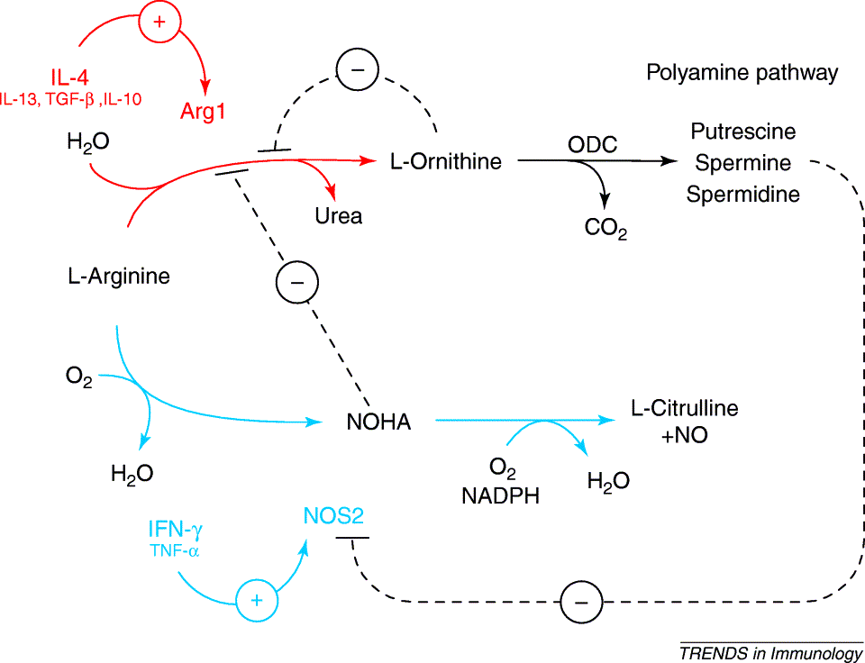
L-arginine catabolism by arginase and iNOS
Notes:
Fig. 1. L-arginine metabolism in myeloid cells. Unbroken lines indicate activation whereas broken lines indicate inhibition. Pathways activated by Th1-type cytokines are indicated in blue; in red are the Th2-dependent pathways. Abbreviations: Arg1, arginase 1; IFN-γ, interferon-γ; IL-4, interleukin-4; NO, nitric oxide; NOHA, N^{G}-hydroxyarginine; NOS2, inducible nitric oxide synthase; ODC, ornithine decarboxylase; TNF-α, tumor necrosis factor-α; TGF-β, transforming growth factor-β.
Trends in Immunology, 2003, vol 24, issue 6, p 301-305

Slide 39
Alternatively activated macrophages
Arginase expressing alternatively activated macrophages use another pathway to modulate adaptive immune responses

Slide 40
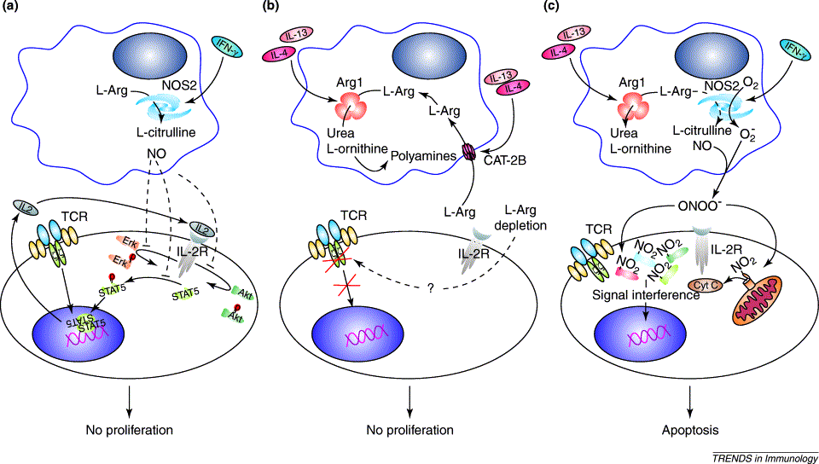
Effect of L-arginine metabolism on T cells
Notes:
Fig. 2. L-Arg metabolism in MSCs and regulation of T-lymphocyte activation. According to the prevailing cytokine response, NOS2, Arg1 or both enzymes are induced in myeloid cells and restrain T-lymphocyte activation. (a) IFN-γ released by Th1 lymphocytes induces NOS2 and its product, NO. By interfering with the IL-2R signaling pathway, NO prevents proliferation but does not block the initial TCR-dependent events of activation, such as CD69 expression and IL-2 release. This block is reversible within the first day or two of stimulation. (b) Th2 cells secrete IL-4 and IL-13, which induce in MSCs the expression of Arg1 and the transporter CAT-2B. MSCs then deplete the local environment of L-Arg, which results in an impaired expression of the CD3 ζ chain, particularly in CD8⁺T lymphocytes. The signal transduction from the TCR is thus altered leading to a proliferative arrest. (c) When both enzymes are activated, in addition to the previously described pathways, production of ONOO⁻ is also triggered. By nitrating tyrosines on several proteins, peroxynitrites induce T-lymphocyte apoptosis. Abbreviations: Arg1, type 1 arginine; CAT-2B, cationic amino acid transporter 2B; Cyt C, cytochrome C; IFN-γ, interferon-γ; IL-4, interleukin-4; IL-2R, IL-2 receptor; L-Arg, L-arginine; MSCs, myeloid suppressor cells; NO, nitric oxide; NOS2, inducible nitric oxide synthase; ONOO⁻, peroxynitrite; STAT5, signal transducer and activator of transcription 5; TCR, T-cell receptor.
Trends in Immunology, 2003, vol 24, issue 6, p 301-305

Slide 41
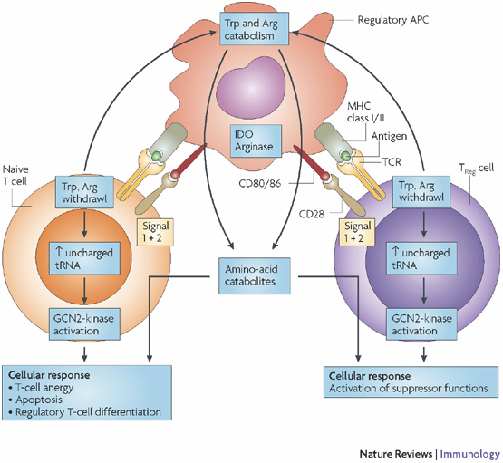
Regulatory macrophages
Notes:
Antigen-presenting cells (APCs) that express indoleamine 2,3-dioxygenase (IDO) or arginase deplete tryptophan (Trp) or arginine (Arg) in T cells, increasing uncharged tRNA levels, which then activate the ribosomal stress-response kinase GCN2 (general control non-derepressible 2) in naive or forkhead box P3 (FOXP3)⁺CD4⁺CD25⁺ regulatory T (T_{Reg}) cells that recognize antigen on APCs. Together with antigen-specific activation signals via the T-cell receptor (TCR) and co-stimulatory molecule CD28 (signal 1 and signal 2), induced metabolic stress responses may cause naive and T_{Reg} cells to undergo the regulatory cellular responses indicated in the text boxes. Additionally, amino-acid catabolites may alter T-cell and T_{Reg}-cell responses to antigen-specific activation⁷⁰. APCs themselves might undergo similar stress responses, which could alter their phenotypic and functional characteristics⁷⁰.
Nature Reviews Immunology 8, 74-80 (January 2008)

Slide 42
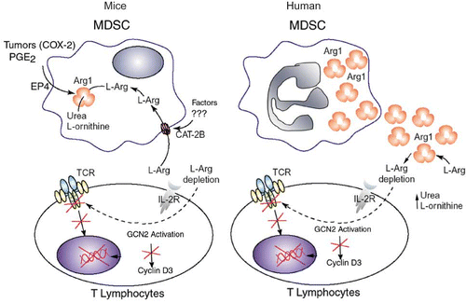
T cell suppression by arginase-mediated L-arginine starvation
Notes:
Figure 3: T cell dysfunction induced by arginase I. Tumor cells expressing COX-2 and releasing PGE2 induces the expression of arginase I and CAT-2B in MDSC. This leads to a reduction of extra cellular levels of L-Arg, which finally activates GCN2 and blocks the expression of multiple genes including CD3 z, cyclin D3 and cdk4. A similar reduction occurs in patients with cancer, but through the release of arginase into the extracellular environment.
Raber, Ochoa, Rodriguez, Immunological Investigation 2012, Vol. 41, No. 6-7 , Pages 614-634 (doi:10.3109/08820139.2012.680634)

Slide 43
Regulation of T cells by L-arginine
T cell suppression by amino acid starvation has been described in:
  Pregnancy: suppression of maternal T cell responses against the semi-allogeneic fetus; contributes to materno-fetal tolerance (peripheral tolerance)
  Some types of cancer: prostate cancer, breast cancer,, renal cell carcinoma, melanoma, Hodgkin’s disease, ovarian cancer, colon carcinoma, and cervical cancer among others
  Some infectious diseases: HIV, active pulmonary tuberculosis, leishmaniasis,

Slide 44
