Slide 1
Prenatal diagnosis of genetic disease
Course code (MBBS) : Genetics 5
Course code (BMS) : NAGE-L12
Ruwan Wimalasundera
Consultant Obstetrician & Lead for Fetal Medicine
Imperial College Healthcare Trust

Slide 2
Aims
Indications for Prenatal Diagnosis
Ultrasound detection of anomalies
Antenatal Screening for Aneuploidy (Down Syndrome)
Prenatal Testing
    Amniocentesis
    Chorionic Villus Sampling
Cytogenetic Techniques
Non-Invasive prenatal testing

Slide 3
Indications for Prenatal Testing
High Risk of Aneuploidy
    High risk on Down Syndrome screening
    Previous aneuploid fetus
    Maternal request eg.Age
Known Genetic Disorder
    Achondroplasia
    Cystic Fibrosis
    Haemoglobinopathies
    X Linked disorder
    Parental Balanced Translocation
Structural Anomaly detected in Fetus on Routine Ultrasound Screening

Slide 4
Downs Syndrome Screening

Slide 5
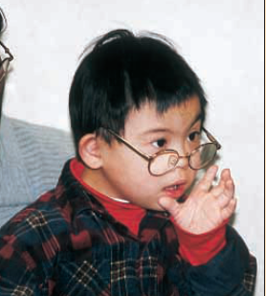
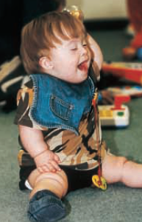
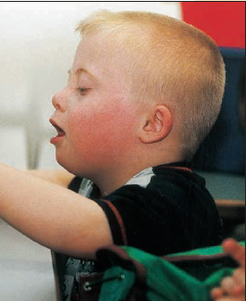
Down Syndrome

Slide 6
Down Syndrome
Most common form of mental retardation (1:800), not inherited
Often associated with birth defects
    Cardiac
    Renal
    Gastro-intestinal
Variable severity, not predictable
Due to extra chromosome: Trisomy 21
    Standard trisomy 21 - 95%
    translocation - 4%
    mosaic - 1%
Risk increases with woman’s age

Slide 7
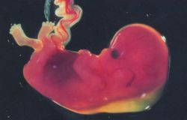
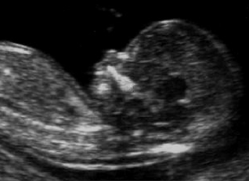
Down Screening
Maternal age
Nuchal Translucency
%
8
6
9-14 wks
15-20 wks
live births
4
Snijders
et al 1994
2
0
10
20
30
40
50
Serum screening
Unconjugated estriol
AFP
Inhibin
Total hCG
Free β hCG
0.2 0.5 1.0 2.0 5.0
Multiples of the median
After Wald et al 1998

Slide 8
Down Screening Tests –Current Standard
Combined test
  11-14² weeks (CRL 45-84mm) : NT measurement with free β-HCG, PAPP-A and maternal age
  90% Detection Rate for 5% False Positive Rate
Correction factor for Monochorionic or Dichorionic twins

Slide 9
Ultrasound Detected Anomaly

Slide 10
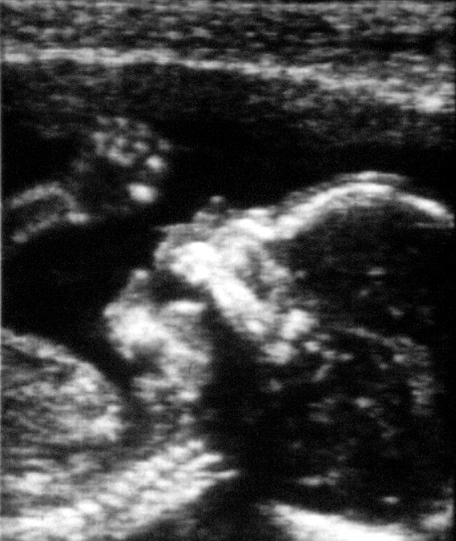
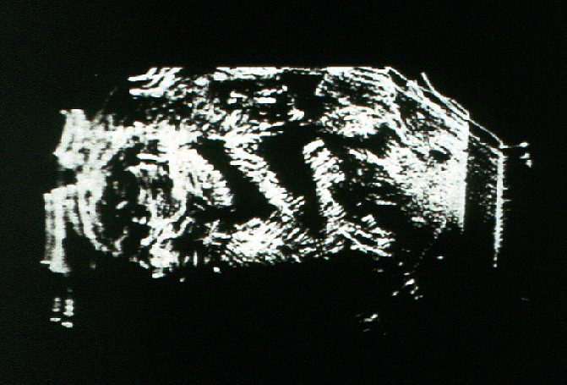
Early 1970s
Late 1980s

Slide 11
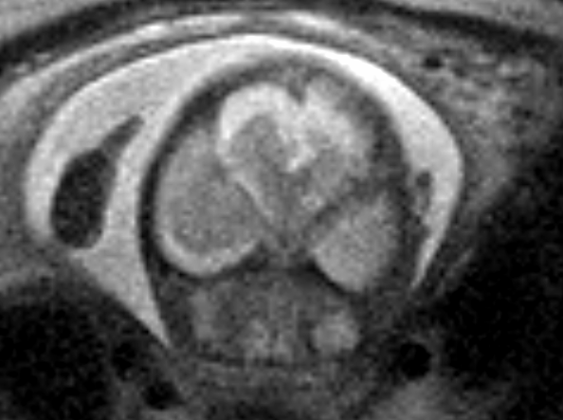
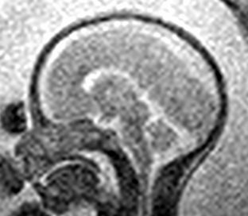
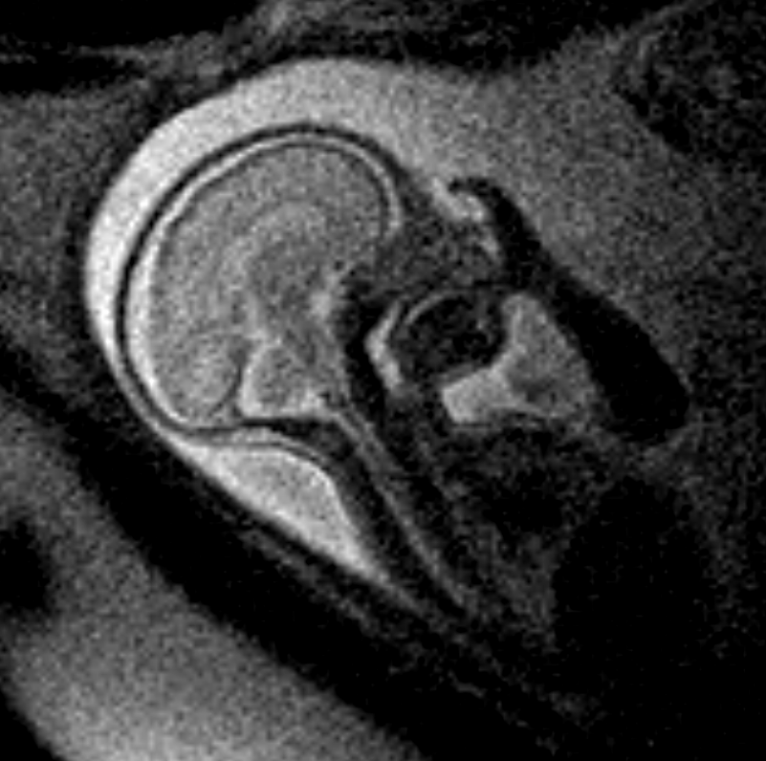
Fetal MRI

Slide 12
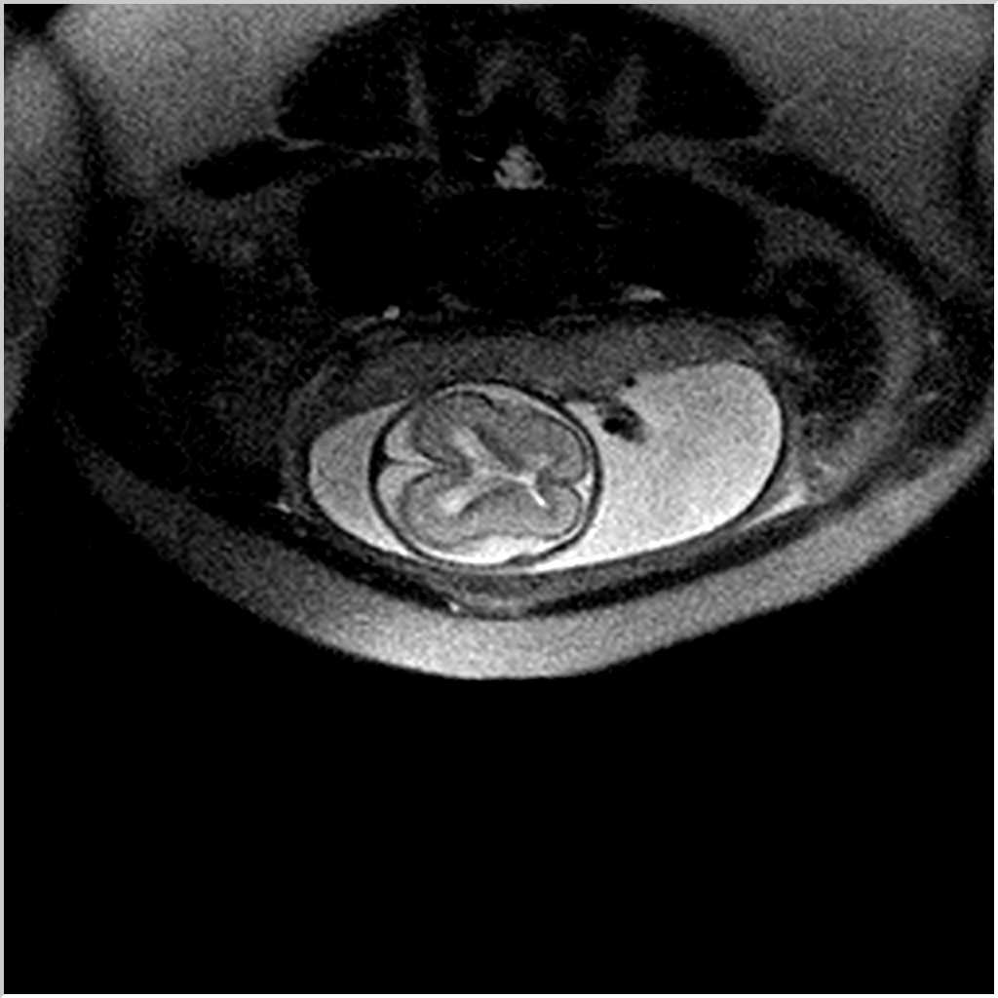
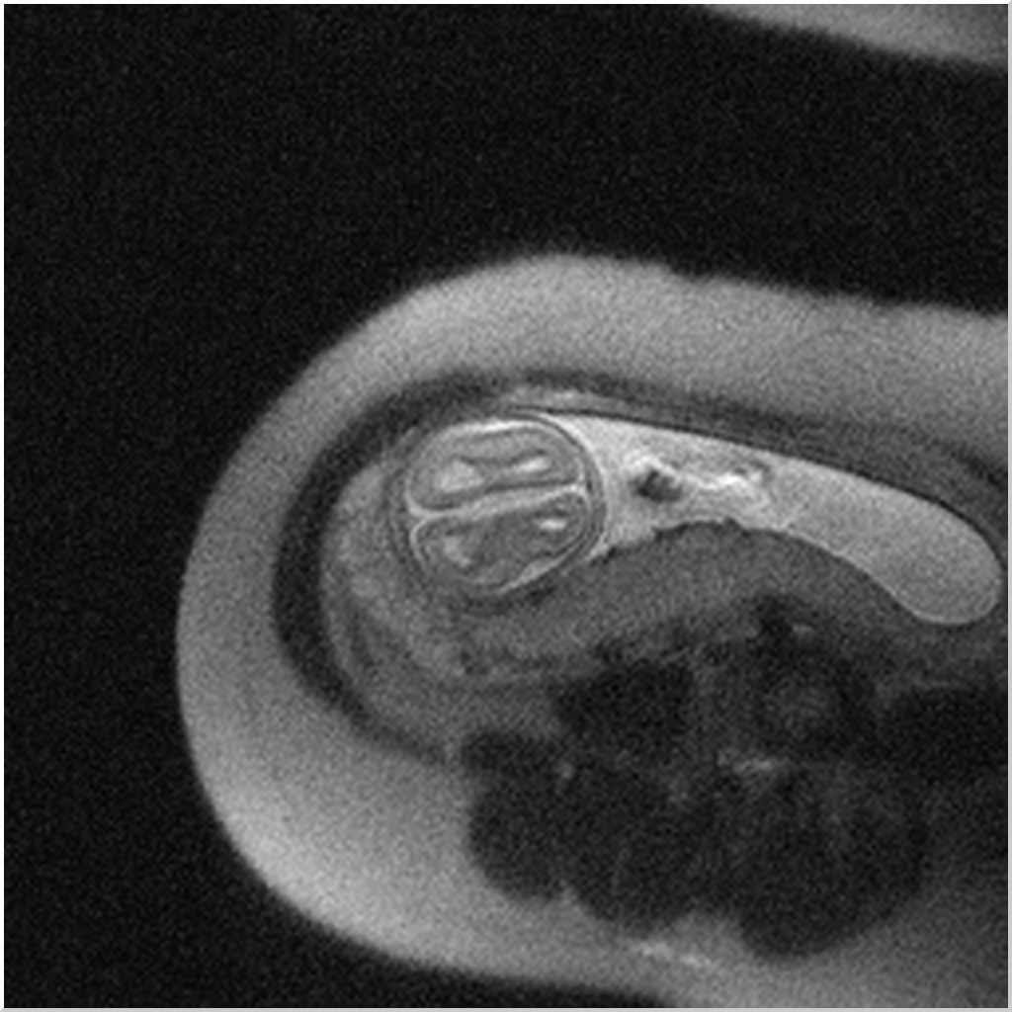
Absent Corpus Callosum
Corpus callosum
Absent corpus callosum

Slide 13
Invasive Prenatal Testing

Slide 14
Prenatal diagnosis
Chorionic villi
Amniotic fluid
Fetal Blood Sample
Karyotype
DNA analysis
Biochemical analysis

Slide 15
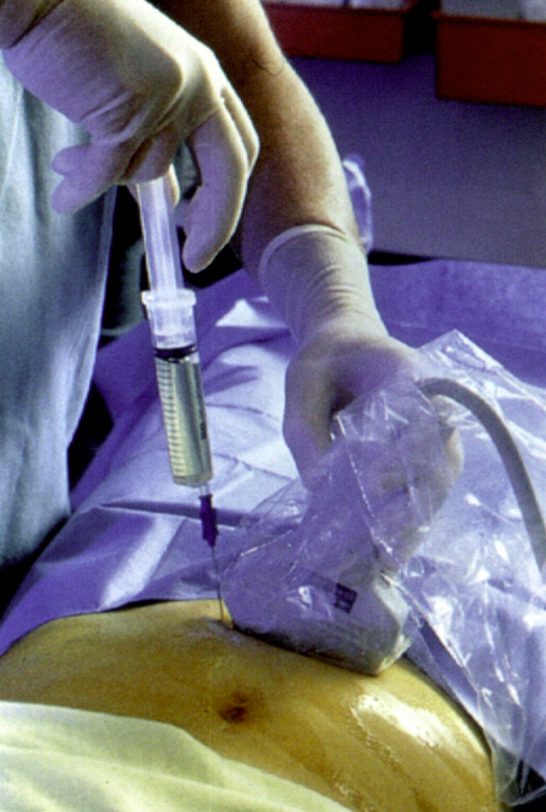
Amniocentesis
Performed >15 weeks
Aseptic technique - gloves, no touch
Continuous US guidance
Avoid placenta
22G needle with stylet
Discard first 2ml
Aspirate 15-20ml

Slide 16
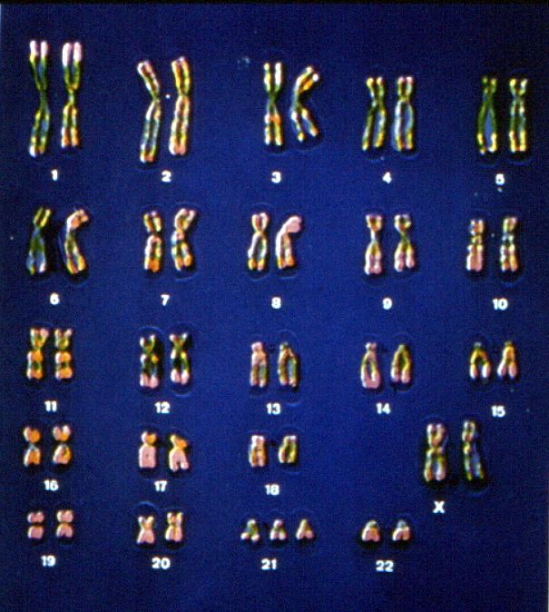
Cytogenetic Analysis
Fetal cells concentrated in centrifuge (skin, pulmonary, urogenital, extra-embryonic membrane cells)
Cells cultured in multiple cultures (14 days)
Culture failure rate 0.5% (1:200)
Maternal contamination rare
Human error
Culture Artifact
Mosaicism

Slide 17
Quantitative Fluorescent PCR
Normal
Triallelic
trisomy
Diallelic
trisomy
Non-
informative
Intensity
Verma et al
Lancet 98
N = 2083
1.5ml amniotic fluid
1.3% blood stained
3 STRs
99.6% informative
Size (bp)

Slide 18
Amniocentesis Complications
Pregnancy loss rate:
  1% procedure-related miscarriage
  Only 1 RCT (Tabor 1986), control 0.7% miscarriage, amnio 1.7%
  Fetal Medicine Units 0.5% (1:200)
Rhesus sensitisation
  All Rhesus Negative women get Anti D within 72h
late diagnosis / TOP

Slide 19
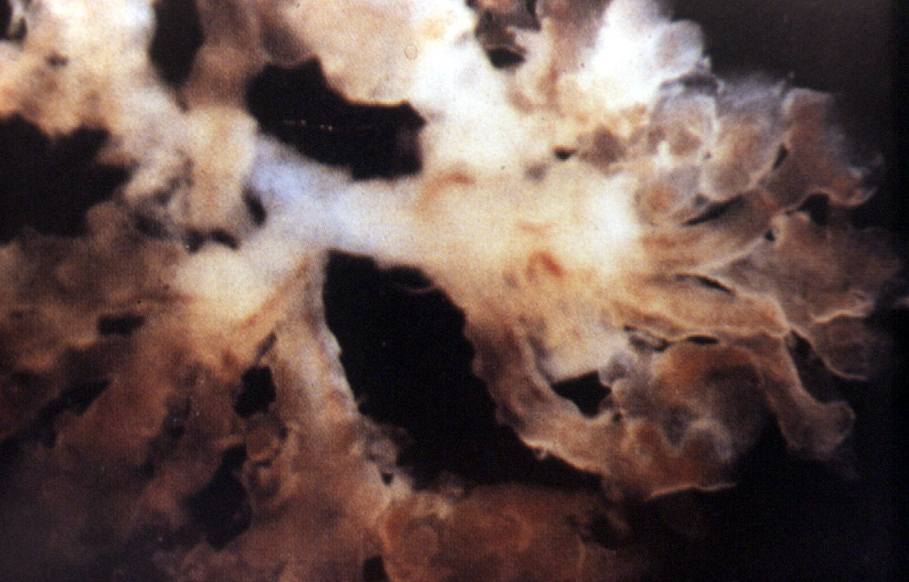
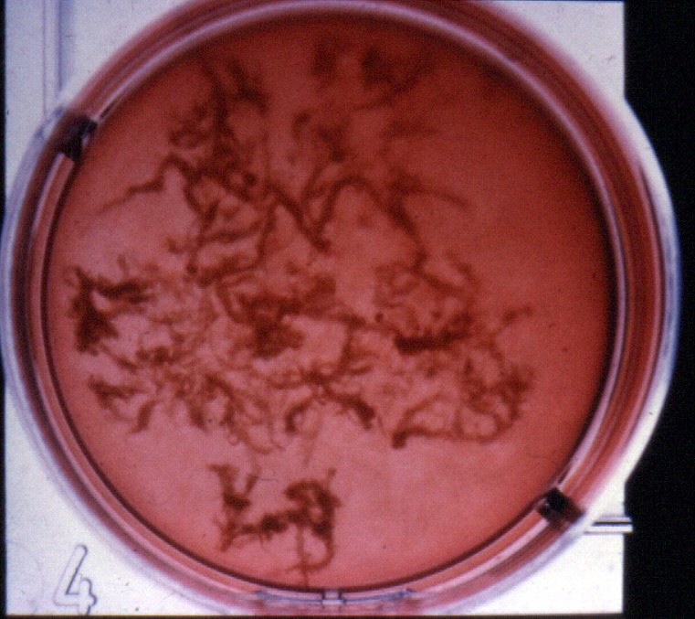
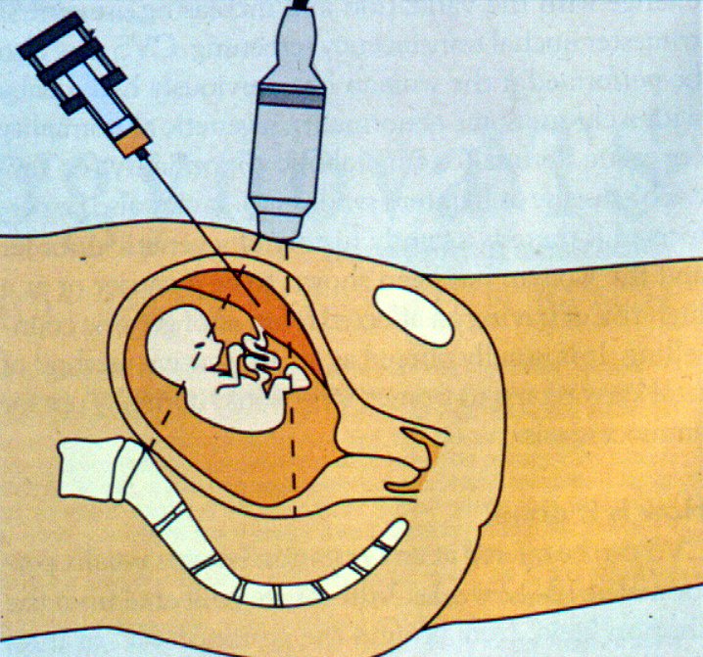
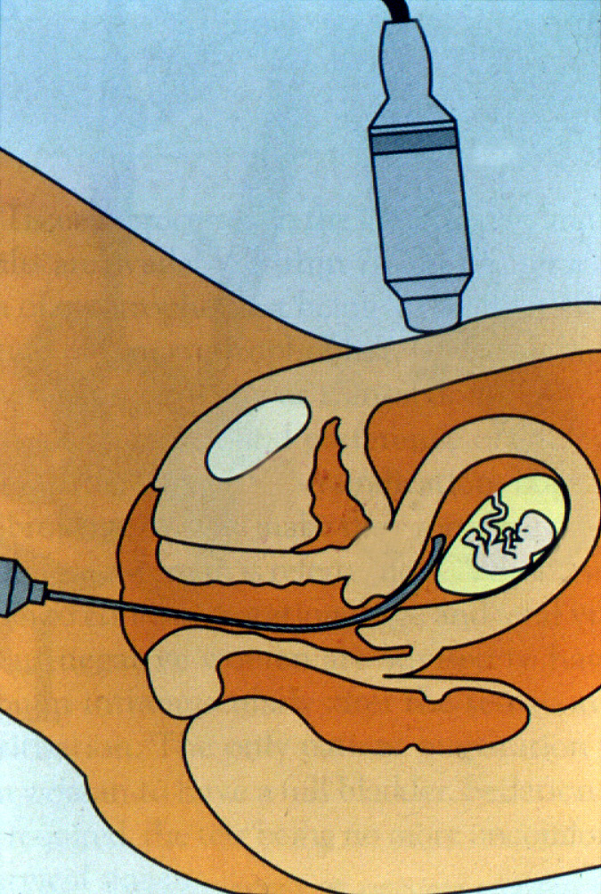
Chorionic Villus Sampling

Slide 20
CVS Complications
Pregnancy loss rate:
  1% procedure-related miscarriage
  Background miscarriage rate higher 2%
  Fetal Medicine Units 0.5% (1:200)
  Clear learning curve - Should only be done in FMU
Rh sensitisation
  All Rh Negative women get Anti D within 72h
Bleeding/ ROM/ Infection rare
Fetal anomaly

Slide 21
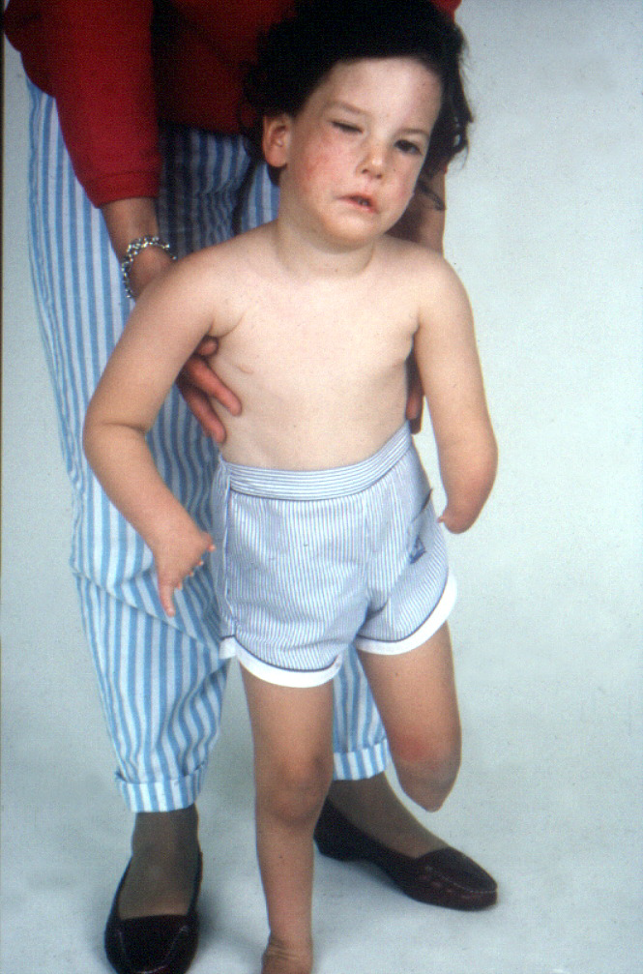
Limb Defects & CVS
CVS <10/40 5/289 limb defects (2%)
1:1692 background incidence
  1,213,000 British Columbian registry
1:1878 incidence after CVS (>10/40)
  138,000 cases in WHO CVS register
  unrelated to gestation
  severity and pattern similar to background
Froster & Jackson, Lancet 1996

Slide 22
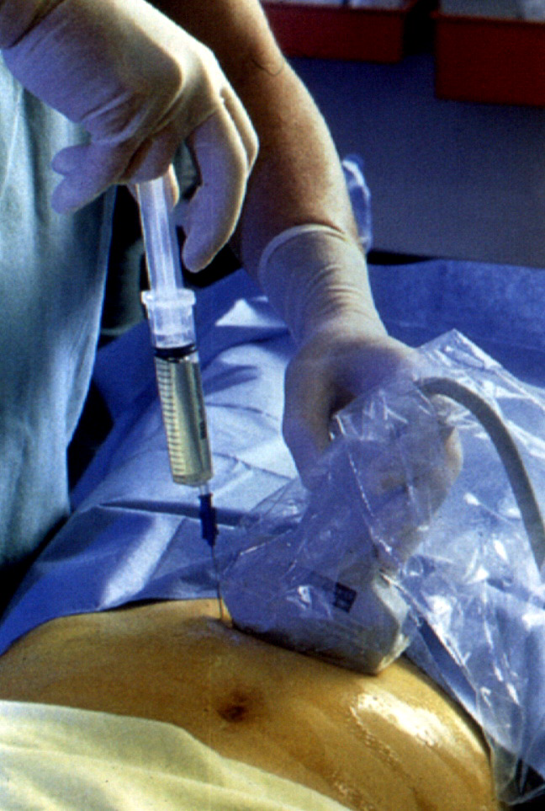
??? Genetic prenatal diagnosis ????
Risk of
procedure
Risk of
condition

Slide 23
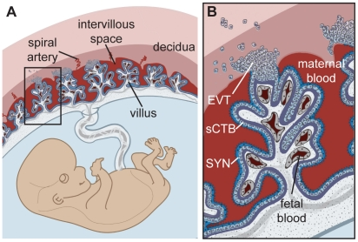
Fetal Cells in Maternal Blood

Slide 24
Cell Free Fetal DNA (cffDNA)
cffDNA is derived from placental tissue and found in maternal circulation >5 weeks gestation, accounts for 5-10% of total free DNA
cffDNA rapidly cleared from maternal circulation within 30min of delivery
cffDNA is made up of short fragments of DNA
The whole of the fetal genome is represented in cffDNA (Lo et al 2010)
If fetal DNA could be studied from maternal circulation:
    No risk of miscarriage
    Reduced Maternal anxiety
    Performed early

Slide 25
Problems of cffDNA
Difficult to extract pure cffDNA from maternal cell free DNA
Unreliable in Multiple pregnancies
Can give false results in early pregnancy if “Vanishing Twin”
Rarely placental tissue different from fetal DNA (Mosaicism)

Slide 26
cffDNA in Rhesus Disease

Slide 27
Rh CcEe gene
C D e most common 45%
15% Caucasian Rh d
2% Asian Rh d
5% Afro-Caribbbeans Rh d
<1% Chinese Rh d
Erythrocyte membrane protein ? function

Slide 28
Mechanism of Red Cell Alloimmunization
Transplacental Bleed
1st Trimester 3%
2nd Trimester 43%
3rd Trimester 64%

Slide 29
Subsequent Pregnancy
IgG

Slide 30
Routine Management Rhesus Negative women
All RHD Negative Women
Antibodies detected
No antibodies detected
28 weeks
34 weeks
40 weeks
Anti D
Monitored with scans and blood tests weekly to look for anaemia and fetal blood transfusion as required
Anti D
Anti D

Slide 31
C
E
D
COOH
Pro
Ser
Cys
NH2
COOH
NH2
COOH
Ser
Ile
Pro
COOH
Ala
??
Trp
COOH
Asn
Leu
NH2
NH2
c
e
d

Slide 32
Clinical use for RhD Genotyping
Fetal Rh D Genotyping possible from maternal blood
If RhD gene is found in RhD Negative maternal blood, then it must have come from RhD Positive Fetus
If no RhD gene found in maternal blood and other fetal specific genes found then fetus must be RhD Negative
Large scale studies show 97% accuracy, 2.4% inconclusive results (Finning et al 2008)
Now all RhD negative women with antibodies are tested at 12 weeks – Only pregnancies with RhD positive fetus need monitoring

Slide 33
Other Uses of cffDNA

Slide 34
Other Uses for NIPT in UK
Identification of fetal genes not found in maternal circulation
Fetal Sex Determination- Looking for DNA found on the Y chromosome
  New gene mutations – Achondroplasia, Huntington’s Disease
  Dominant mutations carried by the Father
  Recessive mutations where mother’s and father’s genes are different (Cystic Fibrosis)

Slide 35
NIPT for fetal sex determination
Fetal sex determination can be performed using cffDNA targeting Y chromosome material - DYS14 or SRY.
Conditions that are X-linked - Duchene muscular dystrophy (DMD) and fragile X syndrome
    Reduce invasive testing by up to 50%
Endocrine conditions associated with ambiguous genitalia Congenital adrenal hyperplasia (CAH): female fetuses at risk of virilisation of external genitalia and require steroid treatment
    Reduce invasive testing by up to 50%
    Allows early cessation of dexamethasone treatment

Slide 36
cffDNA for Down Syndrome Screening

Slide 37
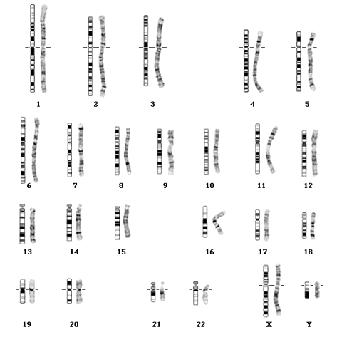
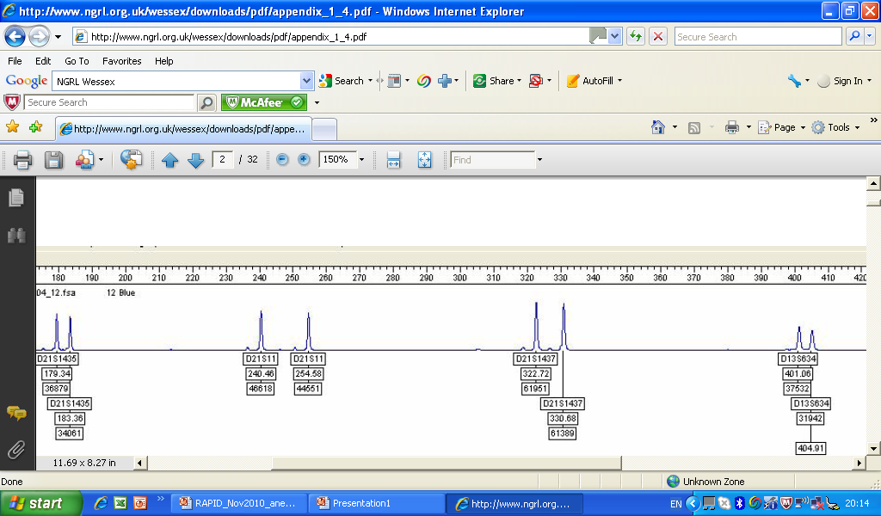
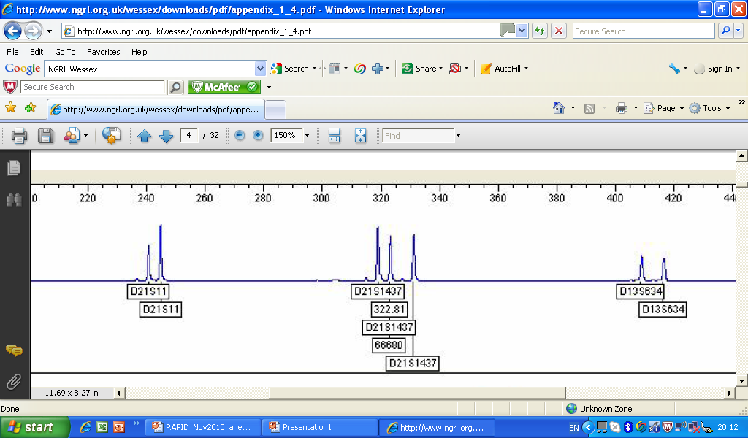

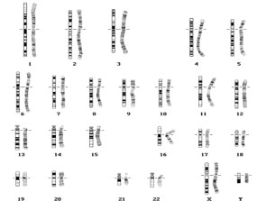


NIPT for Down Syndrome
Invasive test (1:2 ratio)
Normal
Trisomy 21
Maternal Ch 21 cfDNA same as Fetal cfDNA- Non-invasive test (1:1.03 ratio)
Normal
Trisomy 21

Slide 38
Next Generation Sequencing
Technologies that enable extremely accurate and high copy number ‘counting’ -Massively parallel sequencing
Generate large amounts of sequencing data - 10 million short reads across all chromosomes
Compare to published sequences to localise to chromosomes
Determine amount of chromosome 21 relative to chromosome 9
Large amount data means you can detect small differences

Slide 39
NIPD for Down Syndrome
Study | Total | T21 | Detection rate | False Positive
Chui et al 2011 | 232 | 86 | 100% (86/86) | 2.1% (143/146)
Sehnert et al 2011 | 47 | 13* | 100% (13/13) | 0% (34/34)
Ehrich et al 2011 | 449 | 39 | 100% (39/39) | 0.3% 409/410
Palomaki et al 2011 | 1683 | 212 | 98.6% (209/212) | 0.2% (1468/1471)
Lau et al 2011 | 108 | 11* | 100% (11/11) | 0% (97/97)
Sparks et al 2012 - Targeted sequencing | 167 | 36* | 100% (36/36) | 0% (123/123)
Overall |  |  | 99% | 1%

Slide 40
Concerns of NIPT for Down Screening
All studies to date are performed on “High Risk Women”- Results in “Low Risk” population may be less accurate
Cost of Next Generation Sequencing still high
NIPD doesn’t look for other Chromosomal anomalies: Even if NIPD normal and structural anomaly in fetus still needs Amnio
Ethical issues:
    Informed Consent
    Social pressure to have test as no risk
    Social pressure to abort

Slide 41
Conclusion
Identify structural anomalies
Exclude Chromosomal anomaly by karyotyping
Multidisciplinary approach to diagnosis
    Geneticist
    Surgeons
    Cardiologist
If possible genetic diagnosis then analysis of DNA
    FGFR3 mutation for Skeletal Dysplasias
    Cystic Fibrosis mutation analysis
Counselling on continuation of pregnancy or Termination of Pregnancy
Organise Neonatal Follow-up of Postmortem to make diagnosis
Genetic Follow-up and pre-pregnancy or early pregnancy review
Can we now use NIPT to make a diagnosis in subsequent preg

