Slide 1
MCD Tissues 7 BCT L13 Muscle
Dr Sohag Saleh

Slide 2
Learning objectives
Understand the ultrastructure of skeletal muscle and general functional characteristics
Understand the process of excitation-contraction coupling in skeletal muscle
Be able to name all the major structural features of a sarcomere
Understand the ‘sliding filament’ theory of muscle contraction
Understand the basics of cardiac muscle and how it differs from skeletal muscle
Be aware of the characteristics that distinguish smooth muscle from striated muscle

Slide 3
Lecture structure
Skeletal muscle
Function
Microscopic structure
Excitation contraction coupling
The sarcomere
Sliding filament theory
Cardiac muscle
Function & structure
Excitation contraction coupling
Smooth muscle
Function & structure
Excitation contraction coupling

Slide 4
Skeletal muscle: function
Skeletal muscle
Is attached to the bone and produces movement of the body relative to the external environment
Antagonist muscle pairs consist of a flexor (e.g. bicep) and an extensor (e.g. quadricep)
Isometric contraction: tension develops but the muscle does not change length
Isotonic contraction: the muscle changes length while the tension remains the same
Concentric: shortening
Eccentric: lengthening
Humerus
Quadricep
Bicep
Tendon
Quadricep
Bicep

Slide 5
Skeletal muscle: structure
Bicep
Skeletal muscle consists of a bundle of muscle cells known as myofibres
A myofibre is large, has a cylindrical shape, is multinucleate and is packed with myofibrils
Quadricep
Myofibre bundles
TRANSVERSE SECTION
Myofibres
Connective tissue
LONGITUDINAL SECTION
Myofibrils have light and dark bands giving them a ‘striated’ appearance
A-band: Dark bands that are intersected by a darker region known as the H-zone
I-band: Light bands that are intersected by a dark line known as the Z-line (Z-disc)
Sarcomere: the functional unit of muscle that lies between two Z-lines
Z-line: made up of α-actinin and CapZ
Myofibril
Nuclei
Blood vessel
Nerve
Myofibril
H-ZONE
SARCOMERE
I-BAND
A-BAND
Z-LINE

Slide 6
Excitation-contraction coupling
SR
The cell membrane of a myofibre bundle has invaginations, known as T-tubules, which contact to the extracellular fluid
Each myofibre also has an extensive network of Ca²⁺-containing sarcoplasmic reticulum (SR) surrounding each myofibril
Excitation-contraction (E-C) coupling
The action potential propagates along the myofibril membrane (sarcolemma) and the T-tubules
Depolarisation activates dihydropyridine receptors (DHPR) causing a conformational change in the channel protein
This conformational change is transmitted to ryanodine receptors (RyR) on the SR, resulting in their opening and Ca²⁺ release from intracellular stores
Thus depolarisation leads to an increase in intracellular Ca²⁺
T-tubule
EXTRACELLULAR
INTRACELLULAR
Sarcolemma
T-tubule
RyR
Ca²⁺
SR
Ca²⁺
Ca²⁺
DHPR
Ca²⁺
Ca²⁺
Ca²⁺
Ca²⁺
Ca²⁺
Ca²⁺
Ca²⁺
Ca²⁺
Ca²⁺
Ca²⁺
Ca²⁺
Ca²⁺
Ca²⁺
Ca²⁺

Slide 7
Summary slide 1
Skeletal muscle
Function
Interaction with external environment. Force generation, isometric & isotonic contraction
Microscopic structure
Myofibres: long, multinucleate cells, T-tubules, extensive SR
Myofibrils: A-band, I-band, Z-line, H-zone
Excitation contraction coupling
AP propagates along T-tubules→ change in conformation of DHPR→ RyR opening → Ca²⁺ efflux from SR into cytoplasm
The sarcomere
Sliding filament theory
Cardiac muscle
Function & structure
Excitation contraction coupling
Smooth muscle
Function & structure
Excitation contraction coupling

Slide 8
The sarcomere
A-BAND
Z-LINE
I-BAND
H-ZONE
SARCOMERE
Z-line
Defines the lateral boundaries of a sarcomere
Actin
A polymeric thin filament protein that is composed of two twisted α-helices and displays polarity
Myosin
Thick filaments that are the ‘motor proteins’ of the sarcomere.
Contain numerous ‘globular heads’ that interact with the actin filaments
Titin
Very large ‘spring-like’ filaments connecting the myosin to the Z-line
Nebulin
Large filaments associated with actin
Tropomyosin
An elongated accessory protein that binds to actin
CapZ and Tropomodulin are associated with the +ve and –ve ends of actin, respectively
Myofibril
SARCOMERE
Actin filament
Myosin heads
Titin
Nebulin
Myosin
Titin
CapZ
Tropomodulin
Tropomyosin
Z-line
Z-line

Slide 9
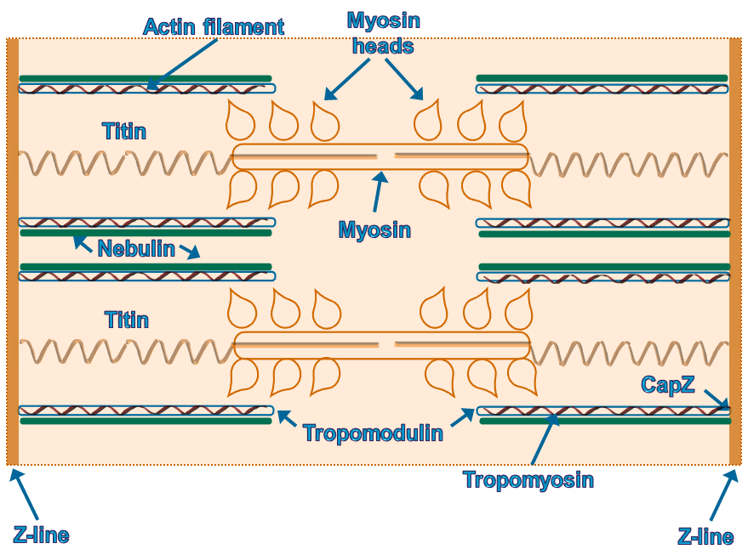
E-C coupling & the sarcomere
Sarcomere
EXTRACELLULAR
INTRACELLULAR
SARCOMERE
Sarcolemma
T-tubule
RyR
Ca²⁺
SR
Ca²⁺
Ca²⁺
Ca²⁺
Ca²⁺
Ca²⁺
Ca²⁺
Ca²⁺
Ca²⁺
Ca²⁺
Ca²⁺
Ca²⁺
Ca²⁺
Ca²⁺
Ca²⁺
Troponin
Ca²⁺
Ca²⁺
Tropomyosin

Slide 10
The sliding filament theory
The sliding filament theory
In the presence of Ca²⁺, there is a slight movement of the troponin molecule from the tropomyosin chain
This movement exposes a myosin binding site on the surface of the tropomyosin chain
The ‘charged’ myosin heads bind to the tropomyosin on the actin filament
This binding and subsequent discharge of ADP causes the myosin head to pivot (the ‘power stroke’), pulling actin filament towards the centre of the sarcomere
Binding of ATP then releases the myosin head from the actin filament
Hydrolysis of the ATP molecule provides the energy to ‘recharge’ the myosin head
Ca²⁺
Ca²⁺
Ca²⁺
Ca²⁺
Ca²⁺
Ca²⁺
Ca²⁺
Ca²⁺
Ca²⁺
Ca²⁺
Myosin head
ATP
ADP

Slide 11
Excitation-contraction coupling
Excitation
An action potential (AP) propagates along the muscle membrane and through the T-tubule system of the myofibres
Dihydropyridine receptors located on the T-tubule membrane are activated by the AP and bring about the opening of ryanodine receptors (RyRs)
The RyRs are located on the membrane of the sarcoplasmic reticulum (SR) and opening allows Ca²⁺ efflux from the SR into the myofibre
Contraction
The rise in Ca²⁺ within the myofibre initiates contraction
At the sub-cellular level the Ca²⁺ binds to troponin located on the actin fibres
Ca²⁺ binding to troponin allows the myosin heads to bind to tropomysin (also bound to the filaments)
ADP phosphorylation and dephosphorylation subsequently allows the myosin heads to pivot and pull the actin filaments towards the centre of the sarcomere
This sliding of actin along myosin is known as the sliding filament theory
IN ISOMETRIC CONTRACTION THERE IS NO MUSCLE SHORTENING, HOW DOES THIS FIT IN WITH THE SLIDING FILAMENT THEORY?

Slide 12
Tension- load relationship
Isotonic contraction
Muscle tension greater than the force exerted by the load
Muscle contracts, fibres shortens
Energy expenditure (ATP) during the ‘recharging’ of myosin heads
TENSION
LOAD
Isometric contraction
Muscle tension equal to the force exerted by the load
Muscle does not contract but myosin heads reattach to the same point on the actin filament
TENSION
LOAD

Slide 13
Practice SBAs
Which one of the following proteins is a spring like filament connecting myosin to the Z-line?
Tropomyosin
Tropomodulin
Titin
Nebulin
CapZ
In the sliding filament model of muscle contraction what causes the myosin head to pivot and bring about the ‘power stroke’
Ca²⁺ binding to troponin
ADP dissociating from the myosin head
ATP binding to the myosin head
Hydrolysis of the bound ATP molecule
Movement of the tropomyosin chain

Slide 14
Summary slide 2
Skeletal muscle
Function
Interaction with external environment. Force generation, isometric & isotonic contraction
Microscopic structure
Myofibres: long, multinucleate cells, T-tubules, extensive SR
Myofibrils: A-band, I-band, Z-line, H-zone
Excitation contraction coupling
AP propagates along T-tubules→ change in conformation of DHPR→ RyR opening → Ca²⁺ efflux from SR into cytoplasm
The sarcomere
Z-line defining boundaries. Actin (thin filaments) associated with nebulin, tropomyosin, tropomodulin & CapZ
Sliding filament theory
Ca²⁺ allows myosin head to bind to actin→ ADP removal allows head to pivot→ ATP mediates dissociation of myosin head from actin filament
Cardiac muscle
Function & structure
Excitation contraction coupling
Smooth muscle
Function & structure
Excitation contraction coupling

Slide 15
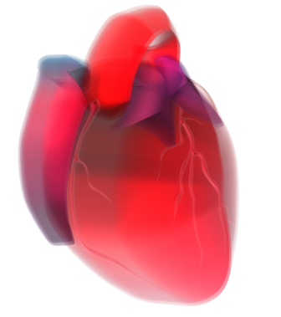
Cardiac muscle: background
Sarcomere
Nucleus
Cardiac muscle
The walls of the heart (myocardium) are primarily made up cardiac muscle
The cardiomyocytes are also striated muscle.
Individual cardiomyocytes are connected to each other at specialised regions known as intercalated disks
At these disks numerous gap junctions allow action potentials to spread rapidly from cell to cell.
The contractile units of cardiomyocytes are also sarcomeres and the mechanism of contraction is the same as skeletal muscle.
Intercalated disk
Cardiomyocyte
Intercalated disk
Desmosomes
Gap junctions

Slide 16
Cardiac muscle: E-C coupling
Excitation-contraction coupling
The action potential propagates along the cardiomyocyte membrane and the T-tubules
Depolarisation opens voltage-gated Ca²⁺ channels (VGCCs) allowing Ca²⁺ influx
Within the cardiomyocyte the Ca²⁺ has three main effects:
Causes further depolarisation
Initiates contraction by binding to troponin
Causes Ca²⁺ induced Ca²⁺ release (CICR) by binding to ryanodine receptors (RyR) on the SR.
Thus depolarisation leads to increased intracellular Ca²⁺ and muscle contraction
EXTRACELLULAR
INTRACELLULAR
Cardiomyocyte membrane
T-tubule
RyR
Ca²⁺
SR
Ca²⁺
Ca²⁺
Ca²⁺
Ca²⁺
VGCC
Ca²⁺
Ca²⁺
Ca²⁺
Ca²⁺
Ca²⁺
Ca²⁺
Ca²⁺
Ca²⁺
Ca²⁺
Ca²⁺
Ca²⁺
Ca²⁺
Ca²⁺
Ca²⁺
Ca²⁺
Ca²⁺
Ca²⁺

Slide 17
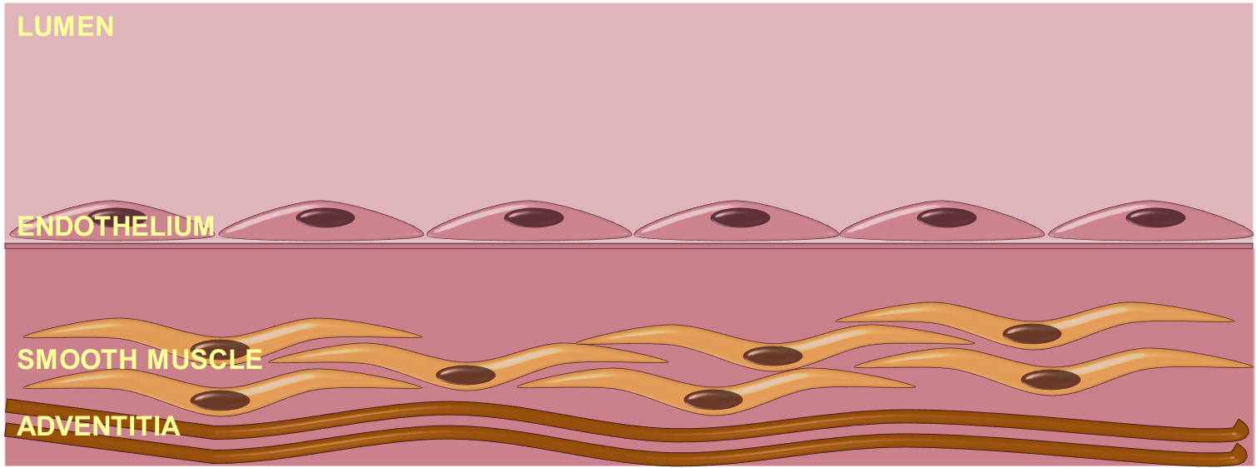
Smooth muscle: background
Blood vessel
Smooth muscle
Found within the walls of blood vessels, the gastrointestinal tract, the trachea and other hollow organs.
Do not contain a regular arrangement of actin and myosin filaments.
Voltage-gated Na⁺ channels not usually found on smooth muscle
An action potential is entirely dependent on Ca²⁺ entry.

Slide 18
Smooth muscle: E-C coupling
Excitation-contraction coupling
Depolarisation activates VGCCs
Ca²⁺ enters the cell and binds to calmodulin (CaM) forming a complex
This Ca²⁺-CaM complex activates myosin light chain kinase (MLCK)
MLCK phosphorylates the myosin light chains allowing them to form cross-bridges with the actin filaments
This results in smooth muscle contraction
EXTRACELLULAR
INTRACELLULAR
Ca²⁺
Ca²⁺
Ca²⁺
CaM
CaM
Myosin Light Chain
MLCK
MLCK
Actin

Slide 19
Practice SBAs
Which one of the following receptors is activated by calcium in cardiac muscle?
Ryanodine receptor
Voltage-gated calcium channel
Dihydropyridine receptor
Voltage-gated sodium channel
IP₃ receptor
In smooth muscle, which activated enzyme initiates the formation of actin and myosin cross-bridges?
Calmodulin
Myosin light chain kinase
Myosin light chain phosphatase
Troponin
Tropomyosin

Slide 20
Summary slide
Skeletal muscle
Function
Interaction with external environment. Force generation, isometric & isotonic contraction
Microscopic structure
Myofibres: long, multinucleate cells, T-tubules, extensive SR
Myofibrils: A-band, I-band, Z-line, H-zone
Excitation-contraction (E-C) coupling
AP propagates along T-tubules→ change in conformation of DHPR→ RyR opening → Ca²⁺ efflux from SR into cytoplasm
The sarcomere
Z-line defining boundaries. Actin (thin filaments) associated with nebulin, tropomyosin, tropomodulin & CapZ
Sliding filament theory
Ca²⁺ allows myosin head to bind to actin→ ADP removal allows head to pivot→ ATP mediates dissociation of myosin head from actin filament
Cardiac muscle
Function & structure
Pumps blood around the body. Cardiomyocytes connected at intercalated discs
E-C coupling
Ca²⁺ entry through VDCCs induces CICR and contraction
Smooth muscle
Function & structure
Spindle-shaped cells. Line hollow organs
E-C coupling
Ca²⁺ entry through VDCCs, binds to CaM and activates MLCK causing contraction

Slide 21
Learning objectives revisited
Understand the ultrastructure of skeletal muscle and general functional characteristics
Skeletal muscles connect the bones and antagonist muscle pairs consist of a flexor and an extensor.
They consist of a bundle of cylindrical, multinucleated myofibres. Further bundles of filaments (myofibrils) extend across the length of the cell. Myofibrils can also be further subdivided into alternating light and dark bands
Understand the process of excitation-contraction coupling in skeletal muscle
An impulse causes a change in the membrane potential and the action potential propagates along the myofibril membrane (sarcolemma) and the T-tubules. The depolarisation activates dihydropyridine (DHP) receptors. The DHP receptors open ryanodine receptors (RyR) on the SR causing Ca²⁺ release from intracellular stores

Slide 22
Learning objectives revisited
Be able to name all the major structural features of a sarcomere
Actin: thin filaments associated with tropomyosin, troponin, nebulin, CapZ and tropomodulin
Myosin: thick filaments that contain numerous ‘globular heads’ and associated with Titin
Understand the ‘sliding filament’ theory of muscle contraction
In the presence of Ca²⁺, there is a slight movement of the troponin molecule from the tropomyosin chain. This movement exposes a myosin binding site allowing the ‘charged’ myosin heads bind. The binding and subsequent discharge of ADP causes the myosin head to pivot (the ‘power stroke’), pulling actin filament towards the centre of the sarcomere.
Binding of ATP then releases the myosin head and hydrolysis of the ATP provides the energy to ‘recharge’ the myosin head

Slide 23
Learning objectives revisited
Understand the basics of cardiac muscle and how it differs from skeletal muscle
Cardiomyocytes are connected to each other at specialised regions known as intercalated disks, containing numerous gap junctions.
Depolarisation activates voltage-gated Ca²⁺ channels (VGCCs) which allows the influx of Ca²⁺ . The Ca²⁺ binds to ryanodine receptors (RyR) on the SR, causing CICR
Be aware of the characteristics that distinguish smooth muscle from striated muscle
Irregular arrangement of actin and myosin filament; no VGSCs; contraction involves Ca²⁺ , CaM & MLCK

