Slide 1
Mrs Jones’ first consultation
Dr Andrew Walley
Dept of Genomics of Common Disease
School of Public Health
Course code (MBBS): Genetics 1
Course code (BMS): NAGE-L7

Slide 2
Learning Outcomes
Congenital Abnormalities
Chromosomes
Chromosome Banding Nomenclature
Chromosomal Abnormalities
Trisomy 21 – Down Syndrome
Monosomy X – Turner Syndrome
Polysomy X
Sex Determination
Microdeletion Syndromes

Slide 3
Mrs Jones First Consultation
She is pregnant
She has heard that 1 in 50 babies born have a congenital malformation
Her uncle has haemophilia
Her husband’s first cousin has a child with Cystic Fibrosis
Should I have genetic tests?
proband

Slide 4
Mrs Jones First Consultation
She is pregnant
She has heard that 1 in 50 babies born have a congenital malformation
Her uncle has haemophilia
Her husband’s first cousin has a child with Cystic Fibrosis
proband

Slide 5
Mrs Jones First Consultation
What else do we need to know?
She is 35
This is her first pregnancy
She is 7 weeks pregnant
Her mother had 4 miscarriages and 4 unaffected children
x4
proband

Slide 6
Mrs Jones First Consultation
Possibilities to explore:
Congenital Abnormalities
Chromosomal Abnormalities
x4
proband

Slide 7
Congenital Abnormalities

Slide 8
Congenital abnormalities
Congenital abnormalities are apparent at birth in 1 in 50 of all newborn infants
20-25% of all deaths during perinatal period and childhood up to the age of 10 years
Genetic factors contribute to about 40% of all congenital abnormalities

Slide 9
Classification of Congenital Abnormalities or Birth Defects
Malformation – primary structural defect e.g. atrial septal defects, cleft lip.
Usually involves a single organ showing multifactorial inheritance.
ASD
VSD

Slide 10
Classification of Congenital Abnormalities or Birth Defects
Disruption – secondary abnormal structure of an organ or tissue e.g. amniotic band causing digital amputation.
Caused by ischaemia, infection, trauma. Not genetic, but genetic factors can predispose.

Slide 11
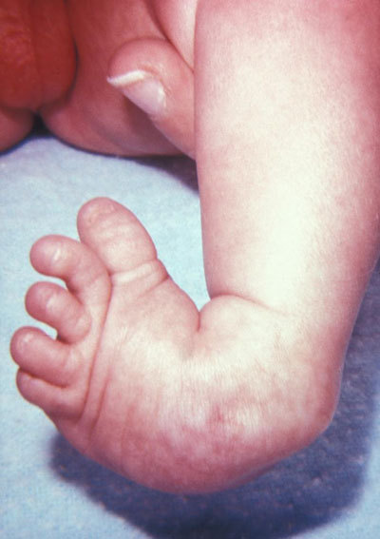
Classification of Congenital Abnormalities or Birth Defects
Deformation –abnormal mechanical force distorting a structure e.g. club foot, hip dislocation.
Occurs late in pregnancy and has a good prognosis as the organ is normal in structure.

Slide 12
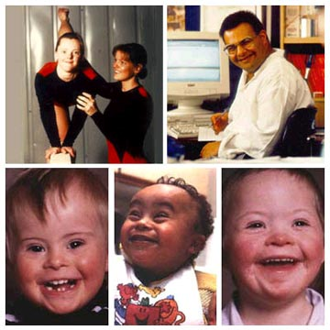
Classification of Congenital Abnormalities or Birth Defects
Syndrome –consistent pattern of abnormalities with a specific underlying cause, e.g. Down syndrome.
Chromosomal abnormalities

Slide 13
Classification of Congenital Abnormalities or Birth Defects
Sequence –multiple abnormalities initiated by primary factor e.g reduced amniotic fluid leads to Potter sequence.
Could have genetic component as initial factor.
Oligohydramnios – reduced volume of amniotic fluid due to failure to produce urine
Classically, due to bilateral renal agenesis (Potter, 1946)

Slide 14
Classification of Congenital Abnormalities or Birth Defects
Dysplasia –abnormal organisation of cells into tissue e.g thanatophoric dysplasia
Caused by single gene defect
High recurrence risk for siblings/ offspring
1:60,000 incidence
FGFR3 mutations
Short flat bones, small thorax, large head

Slide 15
Classification of Congenital Abnormalities or Birth Defects
Association –non-random occurrence of abnormalities not explained by syndrome. Cause is typically unknown. e.g. VATER association.
Vertebral, Anal, Tracheo-Esophageal, Renal
Classification is not mutually exclusive e.g a primary malformation of kidneys can lead to the same sequence of events as Potters syndrome – risk estimates therefore a problem
Notes:
From OMIM
VATER is a mnemonically useful acronym for the nonrandom association of vertebral defects (V), anal atresia (A), tracheoesophageal fistula with esophageal atresia (TE), and radial or renal dysplasia (R). This combination of associated defects was pointed out by Quan and Smith (1972). Nearly all cases have been sporadic

Slide 16
Chromosomes and Genetics

Slide 17
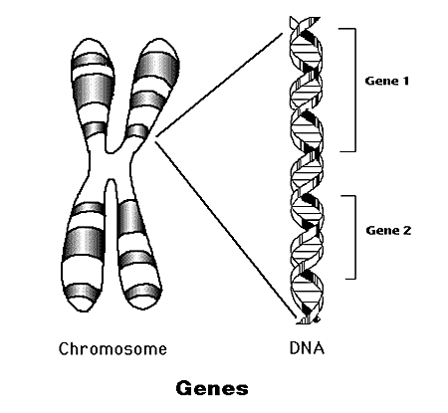
Inheritance
How are physical characteristics inherited?
DNA Sequence
Gene
Chromosome
Genome

Slide 18
Chromosome Numbers
From one parent you inherit:
Twenty-two autosomes
One sex chromosome (X or Y)
This is the haploid number (23)
You inherit one set of chromosomes from each parent:
The total number of chromosomes is 46
This is the diploid number

Slide 19
The DNA Packing Problem

Slide 20
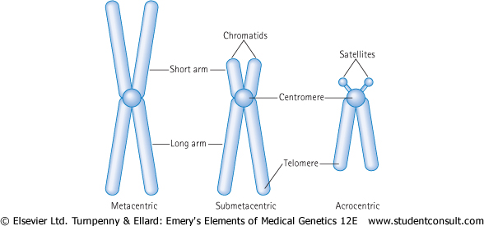
The Chromosome

Slide 21
Human Karyotype
46,XY - M
46,XX - F
DIPLOID
46 chromosomes
Somatic
HAPLOID
23 chromosomes
Ova/sperm
Visualised by staining with Giemsa

Slide 22
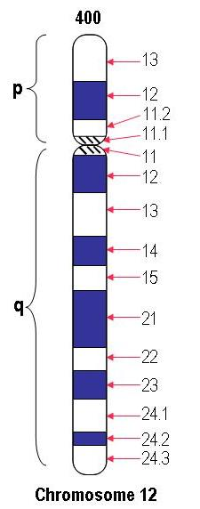
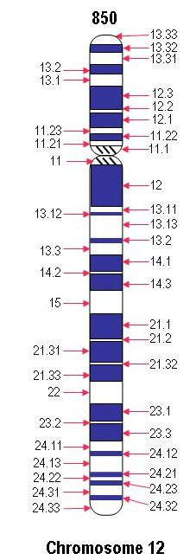
Chromosome Banding Nomenclature
Bands are labelled according to the chromosome
number, short (p) or long (q) arm and numbered out
from the centromere
= 12q21

Slide 23
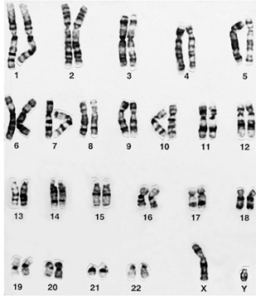
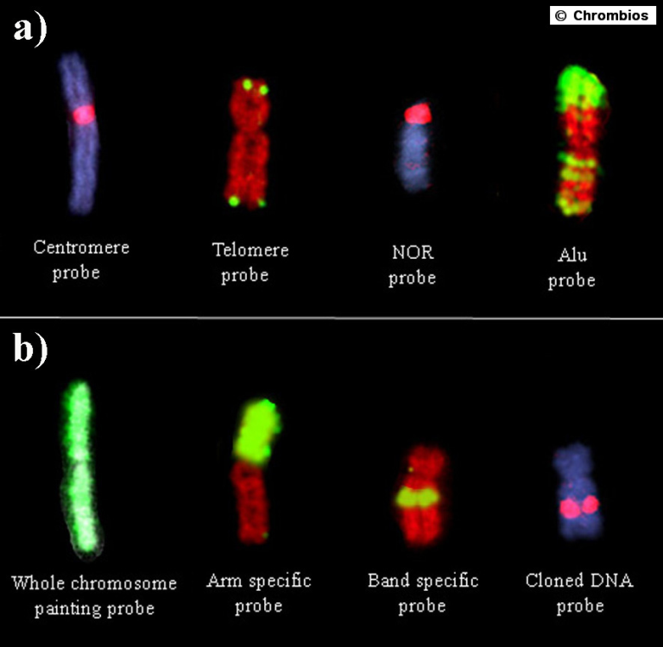
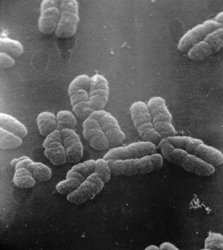
Chromosome Images
FISH – Fluorescent in-situ hybridisation

Slide 24
Chromosome Abnormalities

Slide 25
Chromosome abnormalities
Numerical – aneuploidy, loss or gain
Structural – translocations, deletions, insertions, inversions, rings
Mosaicism – different cell lines
Chromosome abnormalities are present in:
60% of early spontaneous miscarriages
4-5% of still births
7.5% of all conceptions, 0.6% of live births

Slide 26
Autosomal Aneuploidy

Slide 27
What is aneuploidy?
Numerical abnormalities involving the loss or gain of one or more chromosomes
Monosomy - loss of a single chromosome is almost always lethal
Trisomy - gain of one chromosome can be tolerated
Tetrasomy - gain of two chromosomes can be tolerated

Slide 28
Dosage Compensation
Loss of a chromosome gives a reduction of 50% of all fully expressed gene products
Gain of one chromosome gives an increase of 33% of all fully expressed gene products
Gain of genetic material is better tolerated

Slide 29
Partial Aneuploidy - Translocations
Parental Chromosomes
Normal
25%
Balanced
25%
Unbalanced
50%

Slide 30
Cytogenetics report from
Regional Genetics Service
Each chr 3 is normal
One chr 2 is normal
One chr 2 is a derivative
der (2) was inherited from father
who has a balanced reciprocal
translocation
Trisomy 3 (p24.2→pter)
Monosomy subtelomeric Chr 2
46,XX,der(2)t(2;3)(p25.3;p24.2)pat
3
3
2
der(2)
3
3

Slide 31
Trisomy

Slide 32
Trisomy 21: Down syndrome
Described by Langdon Down in 1866
Lejeune found chromosomal defect in 1959
Overall incidence at birth is approx 1 in 700
Strong association between incidence and maternal age

Slide 33
Increasing risk of Down syndrome with maternal age

Slide 34
Clinical Features of Down syndrome
Newborn period - severe hypotonia, sleepy, excess nuchal skin
Craniofacial - macroglossia, small ears, epicanthic folds, upward sloping palpebral fissures, Brushfield spots
Limbs – single palmar crease, wide gap between first and second toes
Cardiac - A and V septal defects
Other - short stature, duodenal atresia
Notes:
Nuchal is back of neck
Macroglossia is the medical term for unusual enlargement (hypertrophy) of the tongue.
Palpebral fissue is the gap between upper and lower eyelids
Brushfield spots are characteristic white spots in iris
Atresia is a condition in which a body orifice or passage in the body is abnormally closed or absent

Slide 35
13 week sonogram in normal (L) and Downs (R) fetus
Nuchal thickness
Palmar crease
Epicanthic folds
Broad nasal bridge
Small sloping palpebral fissures
Protruding tongue

Slide 36
Natural history of Down’s
IQ scores ranging from 25-75
Most children are happy and
affectionate
Relatively advanced social skills
Adult height around 150 cm
Cardiac anomaly causes early death in 20%
Increased risks of leukaemia and Alzheimer’s

Slide 37
Trisomy 21
95% of all Down cases
90% maternal origin of extra chromosome
Non-disjunction in meiosis I (75%) or II (25%)
MEIOSIS
I
Non-disjunction
MEIOSIS
II
Disomic gametes
Nullisomic gametes

Slide 38
Translocations
4% of all Down cases
Robertsonian - breakage of acrocentric chromosomes (13,14,15,21,22) and fusion of their long arms (1:1000 incidence)
2/3 de novo translocation in child
1/3 of parents are carriers of translocation
High risk of further Down syndrome babies
13q21q and 14q21q - 10% risk of Down
21q21q - all offspring will have Down

Slide 39
Mosaicism
1% of all Down cases
Children less severely affected
Caused by mitotic non-disjunction
1 cell zygote
1st mitotic division
2nd mitotic division
non-disjunction
4 cell zygote
Normal disomy
trisomy
monosomy
(33% mosaicism)

Slide 40
Monosomy

Slide 41
Monosomy X: Turner’s syndrome
1 in 3000 live female births
Generalised oedema and swelling in neck region can be detected in 2nd trimester
Can look normal at birth or have puffy extremities
Low posterior hairline, short 4th metacarpals, webbed neck, aorta defect in 15% of cases
Normal intelligence

Slide 42
- Ovarian failure
- Renal problems in 30-50%
- Short stature due to loss
of SHOX gene

Slide 43
Turner’s syndrome (45,X)
In adults:
short stature - 145 cm without GH treatment
ovarian failure - primary amenorrhoea and infertility
Treatment -oestrogen replacement for secondary sexual characteristics and prevention of osteoporosis
80% due to loss of X or Y chromosome in paternal meiosis
Also ring chromosome, single arm deletion, mosaicism

Slide 44
Ring Chromosome
Breaks occur on the ends of the two arms of a chromosome and the sticky ends are then joined and the fragments are lost
Often unstable at mitosis and so mosaicism is frequent
Some cells have the ring and the rest are monosomic
Ring Chr 9

Slide 45
Sex Chromosome Aneuploidy

Slide 46
Dosage Compensation
Loss of a chromosome gives a reduction of 50% of all fully expressed gene products
Gain of one chromosome gives an increase of 33% of all fully expressed gene products
However, for sex chromosomes, only one X is required so the other is randomly switched off in females (X-inactivation)

Slide 47
Polysomy X in females
1:1000 have 47,XXX karyotype
10-20 point decrease in IQ
No physical abnormalities
95% have extra maternal X arising in meiosis I
Normal fertility
48,XXXX and 49,XXXXX karyotypes show mental retardation

Slide 48
Polysomy X in males
Klinefelter’s syndrome (47,XXY)
1 in 1000 male live births
clumsiness, verbal learning disability ↓10-20 pts
taller than average (long lower limbs)
30% - moderately severe gynaecomastia
all infertile
increased risk of leg ulcers, osteoporosis and breast carcinoma in adult life
X chromosome from either Male or Female
48,XXXY and 49,XXXXY are rare

Slide 49
Chromosomal Sex and Gender
Females are X,X
Males are X,Y
However, it is possible to be chromosomally one gender and phenotypically the opposite.

Slide 50
SRY gene activated at 6 wks post-conception
signalling the development of the testes

Slide 51
Chromosomal Microdeletion Disorders

Slide 52
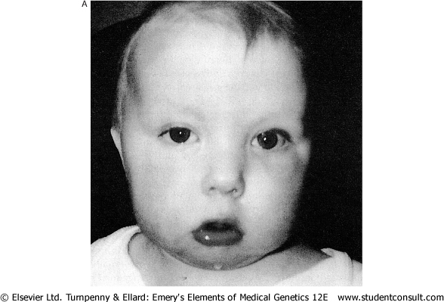
Di George Syndrome
Velocardiofacial (VCFS)/Sedlackova syndrome
Variable symptoms
Congenital Heart Disease
Palatal abnormalities
Thymic/Parathyroid Hypoplasia
Characteristic Facies
Learning Difficulties
Commonest microdeletion disorder
Approx 1/4000 live births

Slide 53
Di George Syndrome
Hemizygous Microdeletion of 1.5-3 Mb of 22q11
Detect using TUPLE1 gene probe and FISH

Slide 54
Mrs Jones First Consultation
She has elevated risks of miscarriage and congenital abnormalities because of her age and family history
We need to further investigate the fact that she has mentioned haemophilia and cystic fibrosis within her family

Slide 55
Mrs Jones First Consultation
She is pregnant
She has heard that 1 in 50 babies born have a congenital malformation
Her uncle has haemophilia
Her husband’s first cousin has a child with Cystic Fibrosis
proband

Slide 56
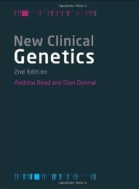
Reference Textbook
Read and Donnai
“New Clinical Genetics”
Scion Publishing Ltd

