Slide 1
Mrs Jones (2) – Risk of transmission of genetic disease
Dr Andrew Walley
Dept of Genomics of Common Disease, School of Public Health
Course code (MBBS): Genetics 2
Course code (BMS): NAGE-L8

Slide 2
Mrs Jones First Consultation
She is pregnant
She has heard that 1 in 50 babies born have a congenital malformation
Her uncle has haemophilia
Her husband’s first cousin has a child with cystic fibrosis
proband
Notes:
In genetics 1 you heard about congenital abnormalities and the risk of Mrs Jones having an affected pregnancy. In this lecture, we will look at her other concerns – both haemophilia and CF are examples of monogenic genetic conditions.

Slide 3
Risk of transmission of genetic disease
Genetic disease
Pedigree diagrams
Modes of inheritance
Mechanisms of genetic disease
Estimating genetic risk
proband
Notes:
Before we can assess Mrs Jones’ risk of having a baby affected by either CF or haemophilia, we need know how to take a full family history, and more about the inheritance patterns and mechanisms of these conditions

Slide 4
What is genetic disease?

Slide 5
Genetic Disease
Monogenic
Clear inheritance
No environment
Rare
Huntington disease
Cystic fibrosis
Haemophilia
Complex disorders
No clear inheritance
Environment essential
Common
Type 2 diabetes
Obesity
Parkinson’s disease
Notes:
This lecture will focus on monogenic, or single gene disorders – frequencies can vary from 1/500 to less than 1/50,000.

Slide 6
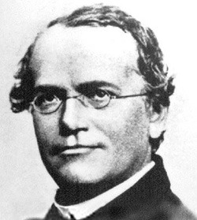
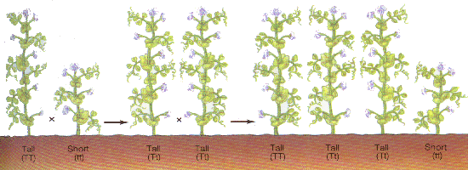
Mendelian Inheritance
The process whereby individuals inherit and transmit to their offspring one out of the two alleles present in homologous chromosomes.
Notes:
So named after Austrian monk Gregor Mendel, who studied inheritance of traits in peas – but we are interested in people, not peas – so we need to do is take family history to work out risk of genetic disease. First some definitions…

Slide 7
What is an allele?
Alleles: Alternate forms of gene or DNA sequence at the same chromosome location (locus)
Homologous chromosomes are a matching (but non-identical) pair, one inherited from each parent
Different alleles may be described as mutations or polymorphisms
Allele ‘A’
Allele ‘a’
Homologous chromosomes
Notes:
First need to define what we mean by alleles and homologous chromosomes.

Slide 8
Mutation vs polymorphism
A mutation is any heritable change in the DNA sequence
Polymorphisms at >1% frequency in a given population
Usually still called mutations if they cause monogenic disease
Polymorphisms may contribute to complex diseases
Notes:
Preferred term when talking to patients is ‘altered form of gene that causes disease’

Slide 9
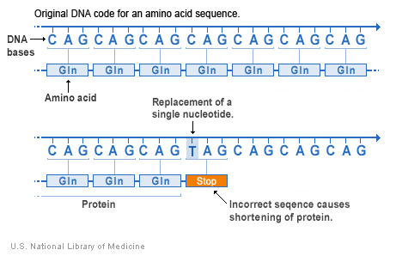
Types of mutation
Missense
Nonsense
Both are also point mutations
Notes:
This type of mutation is a change in (usually) one DNA base pair that results in the substitution of one amino acid for another in the protein encoded by a gene

Slide 10
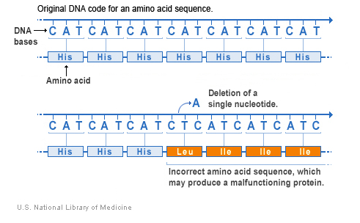
More types of mutation
Insertion Deletion
InDel
Both can be frameshift mutations
Notes:
These types of mutations involved the insertion or deletion of one or more base-pairs of DNA into the gene – depending on how many, they can disrupt all the following genetic code (a frameshift mutation)

Slide 11
Pedigree diagrams

Slide 12
Taking a genetic family history: Why?
To identify genetic disease in a family
To identify inheritance patterns
To aid diagnosis
To assist in management of conditions
To identify relatives at risk of disease
Notes:
Complex disease eg some cancers, asthma, diabetes

Slide 13
Drawing a family pedigree
Build up the tree from the ‘bottom’
starting with affected child and siblings
Record names, dates of birth
III:1
III:2
III:3
Kirsty
Stephen
Richard
16/3/1980
20/3/1982
5/8/1984
I:3
I:4
Norman
Elsie
Pugh
Choose one parent Ask about sibs and their children, then parents
II:2
II:3
II:4
Judith
Howard
Judy
21/2/1951
Pugh
III:1
III:2
III:3
III:4
III:5
Kirsty
Stephen
Richard
Duncan
Mark
16/3/1980
20/3/1982
5/8/1984

Slide 14
Add information on other side of family
Use clear symbols: circles for females squares for males
Put a sloping line through the symbol (from the bottom left hand corner) if the person has died
I:1
I:2
I:3
I:4
Arthur Smith
Elizabeth
Norman
Elsie
18/3/1918
27/6/1918
Pugh
Colour in the symbol if the person is affected
II:1
II:2
II:3
II:4
Peter Smith
Judith
Howard
Judy
1/10/1950
21/2/1951
Pugh
III:1
III:2
III:3
III:4
III:5
Kirsty
Stephen
Richard
Duncan
Mark
16/3/1980
20/3/1982
5/8/1984
Record names, dates of birth and maiden names
Ask for miscarriages, stillbirths or deaths in each partnership

Slide 15
Ask about children with other partners
I:1
I:2
I:3
I:4
Arthur
Elizabeth
Norman
Elsie
Smith
Pugh
18/3/1918
27/6/1918
II:1
II:2
II:3
II:4
II:5
Ann
Peter
Judith
Howard
Judy
Smith
Smith
Pugh
3/9/1953
1/10/1950
21/2/1951
III:1
III:2
III:3
III:4
III:5
III:6
Julian
Kirsty
Stephen
Richard
Duncan
Mark
Smith
14/11/1969
16/3/1980
20/3/1982
5/8/1984

Slide 16
Pedigree diagrams: more symbols
male
female
sex unknown
affected
unaffected
carriers
deceased
consanguineous marriage
twins
Notes:
Taking a family history very important – to make best use of genetic testing services and accurately assess potential risk to other family members

Slide 17
Mendelian Inheritance patterns
Autosomal Dominant
Autosomal Recessive
X-linked dominant – Rare – Rett Syndrome
X-linked Recessive
Mitochondrial – Genetics 3
Complications….

Slide 18
Autosomal Dominant
At least one affected parent
Transmitted by M or F
Vertical transmission
M or F affected
50% affected
Notes:
NB. 50% chance of EACH child being affected

Slide 19
An autosomal dominant disease: Huntington disease
First described by Dr George Huntington in 1872
Motor, cognitive, and psychiatric dysfunction: ‘hyperkinesia’
Mean age of onset is 35 to 44 years
Median survival time is 15 to 18 years after onset
Treatment can ease symptoms, but no cure
Notes:
Chorea is jerky movements

Slide 20
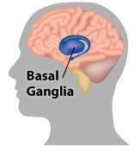
Huntington disease
The HTT gene on encodes a protein called huntingtin
HD patients inherit one copy of a mutated form of the huntingtin gene
Altered gene encodes a toxic form of the protein that forms ‘clumps’
Cell death in basal ganglia of brain, leading to symptoms
Notes:
Autosomal, because its on autosome (chr 4). Dominant because only 1 copy of mutation required to cause symptoms. Note symptoms are dependent on expression pattern of gene – in this case specific area of brain that controls movement - as well as effect of mutations

Slide 21
Genetic Anticipation
Down the generations:
Age of onset decreases
Severity increases
Huntington Disease
Myotonic dystrophy
Type of mutation?
Mechanism?
50
44
41
30
Notes:
Anticipation is the increase in severity and/or earlier onset of symptoms in each generation seen in some genetic diseases eg. Huntington, myotonic dystrophy

Slide 22
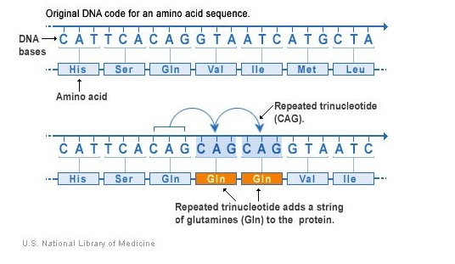
Molecular basis of HD
Huntington Disease is caused by an unstable triplet repeat: the number of repeats may expand with each generation
10-35 CAG repeats: unaffected
35-40 sometimes affected, sometimes not
40-120 repeats: affected
27-35 repeats: unaffected, but at risk of having affected child

Slide 23
Autosomal Recessive
No affected parent
Transmitted by M or F
Usually no family history
M or F affected
25% affected
(50% inherit one copy of
defective gene)
Notes:
These types of diseases often appear ‘out of the blue’, ie no previously affected relatives

Slide 24
Autosomal Recessive
Carriers
consanguinity
Notes:
Another feature of autosomal recessive conditions is that they appear more frequently in consanguinous families

Slide 25
An autosomal recessive disease: Cystic Fibrosis
A chronic, life-threatening condition
Thick mucus in lungs causes breathing problems and repeated infections
Blockages in pancreas affect digestive enzymes
Treatment consists of daily enzymes and physiotherapy
In the UK, 1 person in 22 is a CF carrier (no symptoms)
Notes:
Cystic fibrosis is a multi-system, progressive and variable condition and individuals are differently affected by the severity of its symptoms. Cystic fibrosis affects many of the glands in the body that secrete fluid. Secretions may be thick and cause blockages in the pancreas, intestines and lungs and excess salt in the secretions from the sweat glands. Mucous blockage also provides places for bacteria to multiply, increasing the chance of infection in the lungs.

Slide 26
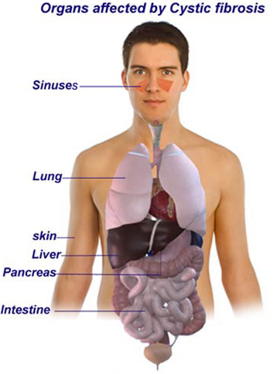
Cystic fibrosis
The CFTR gene encodes a protein called the CF transmembrane conductance regulator
CF patients inherit two copies of a mutated form of the CFTR gene
Absence of functional CFTR protein affects chloride ion channel function in epithelial cells
Disruption of salt /water regulation causes thick mucus and leads to symptoms
Notes:
Autosomal, because its on autosome (chr 7). Recessive because 2 copies of mutation required to cause symptoms. Again, note symptoms are dependent on expression pattern of gene – in this case all organs with epithelium that is usually coated in watery mucus

Slide 27
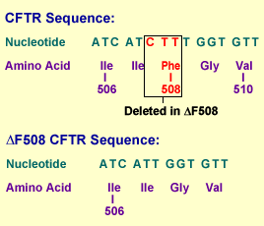
Molecular basis of CF
Affects folding of CFTR protein and prevents it from moving to its correct place (the cell membrane)
Over 1000 different mutations identified
Most common mutation is delta F508
CF testing part of UK newborn screening programme

Slide 28
Same gene, different symptoms
Congenital absence of the vas deferens (CAVD) is a condition in which the vasa deferentia fail to form properly
Causes infertility (azoospermia)
Affects around 1 in 2500 men
Most cases of CAVD are caused by mutations in the CFTR gene

Slide 29
X-Linked Recessive
No affected parents
M affected
Transmitted by carrier F
50% sons affected
50% daughter carriers

Slide 30
An X-linked disease: Haemophilia
A blood-clotting disorder
Affected people bruise easily and bleed for longer
Two main types, A and B, which together affect about 6500 people in the UK
Can be successfully treated with injections of clotting factor
Notes:
Bleeding can occur into joints and muscles, or be prolonged at wound sites. Haemophilia used to be treated with clotting factors from donated blood, but in early 1980s over 1200 men infected with HIV in this way, also other viral infections eg. hepatitis. Since 1986 patients treated with recombinant or “GM” clotting factors, made by bacteria, which do not carry this risk.

Slide 31
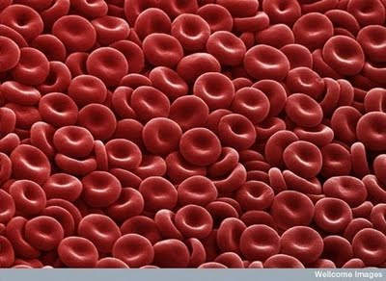
Haemophilia A
The F8 gene encodes a protein called coagulation factor VIII
Boys with Haemophilia A inherit one copy of a mutated form of the F8 gene
Lack of functioning Factor VIII causes symptoms of disorder
Notes:
X-linked because the genes involved are located on the X-chromosome, recessive because carrier females are unaffected (they have a working F8 or F9 gene on their other X-chromosome

Slide 32
Same disease, different genes…
Haemophilia B is caused by mutations in the F9 gene, also on the X chromosome
F9 gene codes for coagulation factor IX
Symptoms are identical to those of Haemophilia A
Haemophilia B is much rarer than Haemophilia A

Slide 33
Genetic heterogeneity
Same gene, different mutations, different symptoms - eg. cystic fibrosis and CAVD are both caused by mutations in the CFTR gene
Same disease, different genes – eg. Bardet-Biedl Syndrome caused by defects in 15 different genes
Same disease, different genes, different inheritance patterns – eg. different forms of epidermolysis bullosa can be autosomal dominant or autosomal recessive
Notes:
Both previous slide and CF/CAVD are illustrations of genetic heterogeneity

Slide 34
‘Simple’ Mendelian inheritance patterns can get complicated…
Penetrance – frequency with which symptoms are present in an individual who inherits a disease-causing mutation.
Variable expressivity – degree of severity in an individual who inherits a disease-causing mutation
Phenocopy - having the same disease but with a different underlying cause
Epistasis – interaction between disease gene mutations and other modifier genes can affect phenotype
Notes:
Incomplete penetrance and variable expressivity are phenomena associated only with dominant inheritance, never with recessive inheritance. Incomplete penetrance – eg, if an obligate carrier of a dominant disease does not show symptoms (eg HTT gene with intermediate number of CAG repeats (25-30) sometimes does/not cause symptoms of HD). Not to be confused with variable expressivity – in which patients with same genotype have different severity of symptoms. One example of variable expressivity is Marfan syndrome. Phenocopy –eg. Common Obesity has a high frequency in the general populaiton and may complicate looking for inheritance patterns for rare monogenic obesity. Epistasis, eg. modifier genes that affect the severity of CF

Slide 35
Mechanisms of genetic disease

Slide 36
Dominant vs recessive: molecular mechanisms
Dominant conditions usually caused by gene mutations that results in a toxic protein (eg. HD) – ie. effects of mutated gene ‘mask’ normal copy
Recessive conditions: Caused by absence of a working protein (eg. CF, haemophilia) – ie. effects of mutated gene only seen when normal copy is absent
Co-dominant conditions: Effects of both mutated and normal genes apparent in people with both, eg. sickle cell trait

Slide 37
Dominant vs recessive: implications for therapy
Dominant conditions – need to neutralise the effects of the toxic protein or ‘switch off’ the mutant gene, “unmasking” the normal gene
Recessive conditions – need to restore the activity of the missing protein, by replacing the gene or protein product, or even affected tissues
Notes:
Dominant – require drug therapies, perhaps one day possible to use RNAi to block expression of mutant gene. Recessive – need to replace missing gene (gene therapy, eg. SCID, best for diseases where just one or two easily accessible tissues affected) or protein (eg. enzyme replacement therapy) or cells (eg. bone marrow transplants for SCID, other blood diseases)

Slide 38
Back to Mrs Jones: risk of haemophilia
Her uncle has haemophilia
BUT it is her paternal uncle
Chance of a son with haemophilia= new mutation only
Had it been her maternal uncle she could have been a carrier
h
x4
proband

Slide 39
Back to Mrs Jones: risk of cystic fibrosis
Her husbands first cousin has a child with CF
Mrs Jones’ husband has a 1:8 chance of being a CF carrier
Mrs Jones has a 1:22 chance of being a CF carrier
if both are carriers there is a 1:4 the child is affected
Overall chance of affected foetus = 1:704
x4
proband
CF
Notes:
The overall chance that foetus is affected by CF is based on chance that both parents are carriers – without genetic testing we cannot tell if the husband is a carrier or not – multiplied by the individual risk to each child

Slide 40
Mrs Jones Risks
Specific risks
Low risk of Haemophilia – 1/5000
1/704 chance of Cystic Fibrosis
N.B. Miscarriage rate of her mother is a concern

Slide 41
Find out more
Websites:
National Genetics Education and Development Centre http://www.geneticseducation.nhs.uk/
Textbook:
“New Clinical Genetics” Read and Donnai , Scion Publishing

