Slide 1
Cell membranes
Professor Tony Magee
Course code (MBBS) : Cells 4
Course code (BMS) : BCT-L4

Slide 2
MCD – Introduction to Cells 3
Cell membranes – a broad overview
Tony Magee
Learning objectives
Explain the formation of phospholipid bilayers in an aqueous environment.
Draw the structure of phosphatidylcholine and identify the component parts.
Describe the permeability properties of a phospholipid bilayer with respect to macromolecules, ions, water and organic compounds (including drugs).
Distinguish simple diffusion, facilitated diffusion and active transport of ions and molecules across cell membranes.
Understand the picket and fence model of membrane proteins.
Categorise the functions of membrane proteins.
Explain the movement of Na⁺ and K⁺ ions across the cell membrane against a concentration gradient and the consequences of failure of such a movement.
Explain how the entry of glucose and amino acids into the cell against a concentration gradient is coupled to ATP dependent Na⁺ transport.
Explain how external chemical signals can be sensed at the interior of a cell.
Be able to calculate the membrane potential from the Nernst equation.
Understand the role of membranes in synaptic transmission, using the neuromuscular junction as an example.

Slide 3
Introduction to Cells – The cell is a bag
A living system MUST be separated from its environment if it is to maintain complex order in a chaotic physical world
Cell is a “bag” containing chemicals:
genetic material (nucleic acids)
functional macromolecules (proteins)
synthetic machinery
protein subunits
machinery for making ATP, NADH, etc
metabolic intermediates
etc.
What is the “bag” made of?

Slide 4
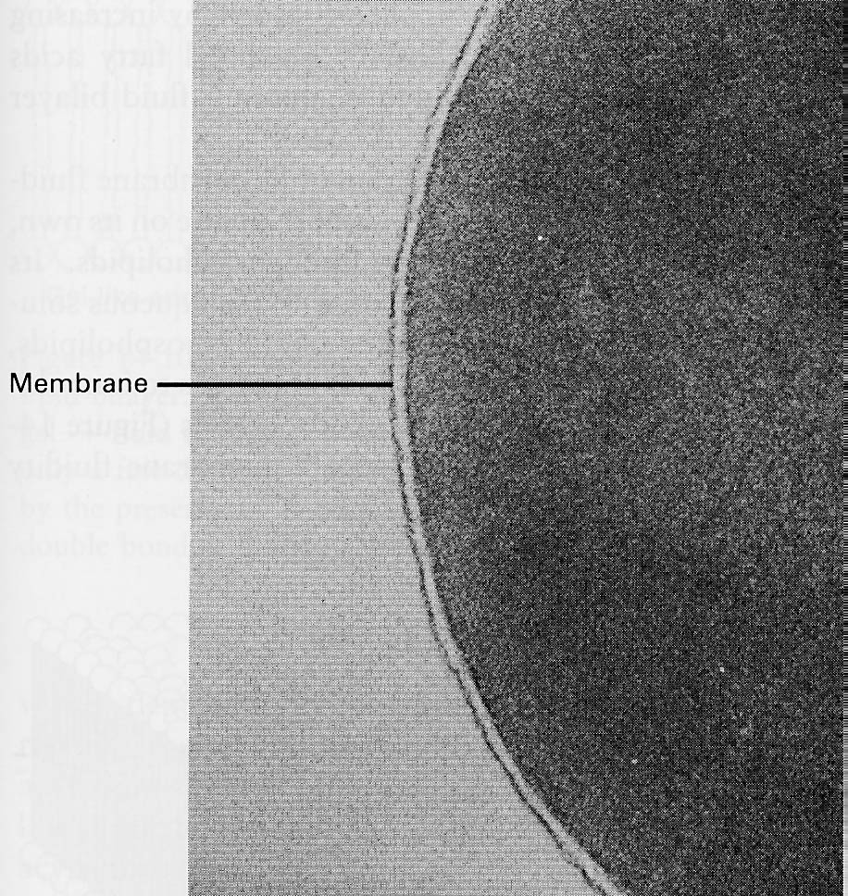
Introduction to Cells – The cell membrane
Dimensions ?

Slide 5
Introduction to Cells – The cell membrane
Dimensions ?
~10nm
= 2 x 5nm

Slide 6
Properties of biological membranes
Biological membrane
forms the limit of the cell (= plasma membrane or cell membrane)
surrounds intracellular compartments (organelles)
Properties required:
selective permeability
impermeable to macromolecules, biochemical intermediates
permeable to nutrients, waste products
transfer of information (= signal transduction)

Slide 7
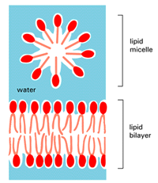
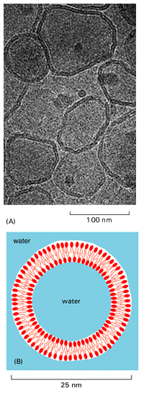
Membrane constituents – the lipid bilayer
Explain the formation of phospholipid bilayers in an aqueous environment
Lipids have a hydrophilic head (polar) and hydrophobic tail (apolar). To avoid water, the tails pack together.
Suspended in water they form micelles or droplets. They can also arrange themselves into bilayers (a layer two molecules thick), called “liposomes”.

Slide 8
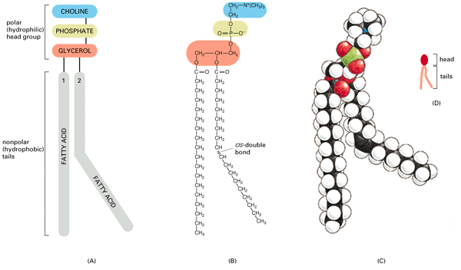
Membrane constituents – Phospholipids
Draw the structure of phosphatidylcholine and identify the component parts.
Phosphatidylcholine
Unsaturated =
double bond(s)
Saturated =
no double bonds
Phospholipids are amphiphilic - contain both hydrophobic and hydrophilic groups. Hydrophilic head groups contain anionic and cationic charges, and can be net anionic or neutral.

Slide 9
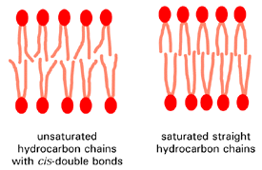
Membrane constituents – Un/Saturated
Sparsely packed More densely packed

Slide 10
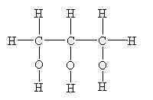
Membrane constitutents –
common phospholipids
glycerol
Notes:
10

Slide 11
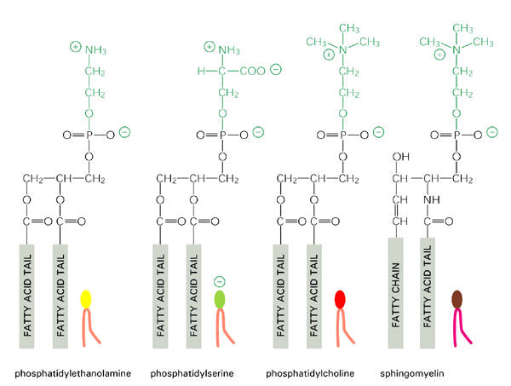
Membrane constituents – Common phospholipids
Glycerol-3-phosphate
Phosphatidylcholine is also called lecithin

Slide 12
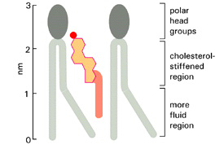
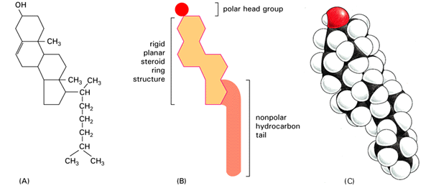
Membrane constituents – Cholesterol
Cholesterol is a steroid
can increase or decrease membrane stiffness, depending on temperature and nature of membrane.
Decreases membrane permeability

Slide 13
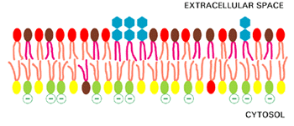
Membrane constituents – Asymmetry
Glycolipids (with sugar headgroups, blue) on the extracellular side of the membrane – based on similar structure to sphingomyelin
Negative charges (e.g. phosphatidylserine) mainly inside the cell

Slide 14
Lipid diffusion
How dynamic is a lipid bilayer?
Can lipids switch sides in the bilayer?
This process, called "flip-flop," occurs less than once a month for any individual molecule.
Can lipids move (diffuse) within a monolayer?
Lipid molecules readily exchange places with their neighbours within a monolayer (~10⁷ times a second). This gives rise to a rapid lateral diffusion, with a diffusion coefficient (D) of about 10⁻⁸cm²/sec, which means that an average lipid molecule diffuses the length of a large bacterial cell (~2 µm) in about 1 second.
Cell membranes are much more fluid than calculations for simple artificial lipid bilayers would predict. Why?
Cell membranes are dynamic
Membranes are:
Permeable to small neutral molecules
Impermeable to large, hydrophilic or charged molecules

Slide 15
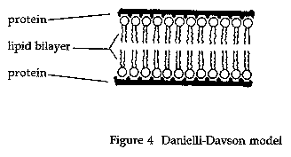
Characterisation of biological membranes
Early in the 20th century it was realised that lipids could form bilayers composed of 2 monolayers or ‘leaflets’, and it was known that cells were surrounded by phospholipids and cholesterol and that phospholipids were amphiphilic.
Artificial membranes could be created and tested.
However:
Cell membranes are more flexible than artificial lipid bilayers
Cell membranes let water through more than lipid bilayers
1934: Hugh Davson and James Danielli suggested that membranes were coated with components (e.g. Proteins, sugars) giving water-absorbing properties.

Slide 16
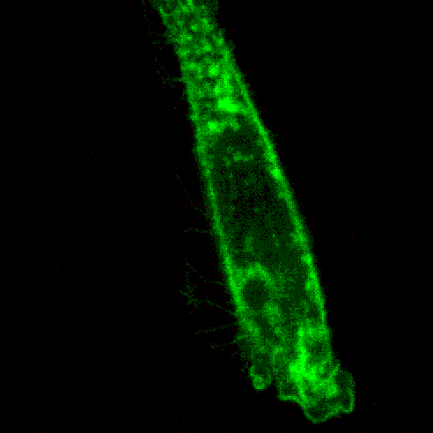
Membrane ruffling
The Davson-Danielli model remained valid until the 1970s when it was found that membrane flexibility as observed in movements such as ‘ruffling’ could not be explained.

Slide 17
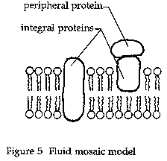
The fluid mosaic model
In the 'fluid mosaic model’, proteins float in either leaflet of a sea of lipids, or spanning the lipids that form the bilayer (Singer and Nicolson 1972).

Slide 18
Permeability
Lipid bilayers are permeable to:
water molecules and a few other small, uncharged, molecules like oxygen (O₂) and carbon dioxide (CO₂) which diffuse freely in and out of the cell.
Diffusion of water across membrane is called osmosis.
Diffusion down the concentration gradient is possible.
Diffusion against the concentration gradient requires energy or exchange and is called active transport. What is the energy source ?
Facilitated diffusion is movement of hydrophilic (charged) molecules down their concentration gradient through protein pores that hide the ionic charges from the hydrophobic core of the lipid bilayer. Proteins (or protein assemblies) offer a water-filled channel. The channel can be ‘gated’.
Lipid bilayers are not permeable to:
Cations (K⁺, Na⁺, Ca²⁺) but some do leak through, down the concentration gradient
Anions (Cl⁻, HCO³⁻)
small hydrophilic molecules like glucose
macromolecules like proteins and RNA
Distinguish simple diffusion, facilitated diffusion and active transport of ions and molecules across cell membranes

Slide 19
Membrane transport 1: pores
Protein-mediated permeability - pores
The protein provides a route for a substance to move down its concentration gradient.
Coupled transporters: 1. symporters and 2. antiporters
Sugars and amino acids can be dragged into the cell with Na⁺, as it moves down its concentration gradient, or
other molecules can move in the opposite direction to Na⁺ (e.g. H⁺ ; Na⁺-H⁺ exchanger for intracellular pH regulation)
Describe the permeability properties of a phospholipid bilayer with respect to macromolecules, ions, water and organic compounds (including drugs).

Slide 20
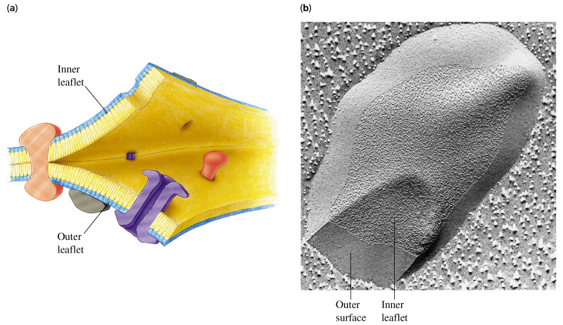
Integral membrane proteins
Freeze-etched replica of a red blood cell: http://cwx.prenhall.com/horton/medialib/media_portfolio/text_images/FG09_25aC.JPG. Principles of Biochemistry; Horton et al., Prentice-Hall

Slide 21
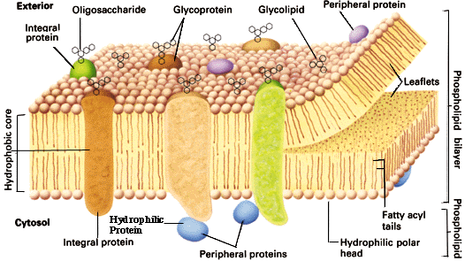
The fluid mosaic model
The protein regions in the core of the lipid bilayer have a predominantly α–helical conformation – hydrophobic amino acids.
Secondary structures of proteins ?

Slide 22
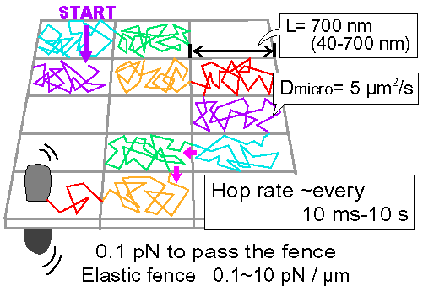
Fluid?
Membrane proteins diffuse freely within small compartments
Membrane proteins hop between compartments - Kusumi
singlemolecules111<at>kusumi.frontier.kyoto-u.ac.jp

Slide 23
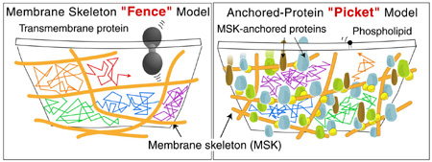
Fluid?
Membrane proteins appear to be constrained by fences
Some membrane proteins are less mobile: attached to fences
singlemolecules111<at>kusumi.frontier.kyoto-u.ac.jp

Slide 24
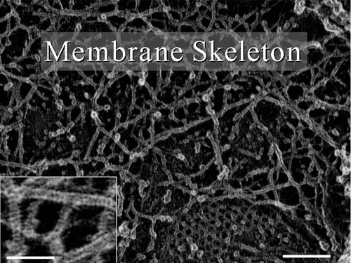
A fence? What fence?
What do the intracellular fences consist of?
A fence? What fence?
singlemolecules111<at>kusumi.frontier.kyoto-u.ac.jp

Slide 25
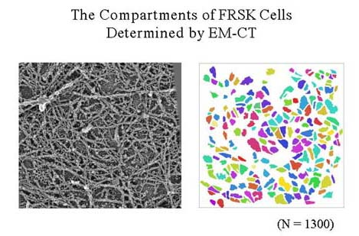
Fluid?
What do the intracellular fences consist of?
The actin cytoskeleton
singlemolecules111<at>kusumi.frontier.kyoto-u.ac.jp

Slide 26
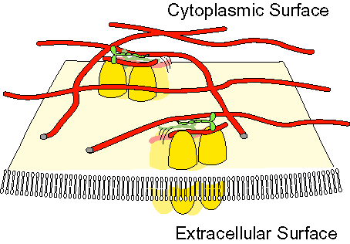
Fluid?
Some membrane proteins are moved in the membrane along actin filaments by myosin motors, e.g. cadherins
singlemolecules111<at>kusumi.frontier.kyoto-u.ac.jp

Slide 27
Membrane proteins
Cell membranes and organelle membranes contain proteins.
These proteins increase membrane fluidity.
They confer new properties to the membranes.
Many membrane proteins are involved in transport and in the transmission of signals.
The proportion of protein to lipids varies between cell types. The protein composition is different in the inner and outer leaflets of the lipid bilayer. The protein composition also depends on the organelles.
Membrane
Lipid
Protein
Myelin Sheath
80%
20%
insulator
Plasma membrane
50%
50%
Protein complexes -electron transport
Mitochondrial inner membrane
25%
75%

Slide 28
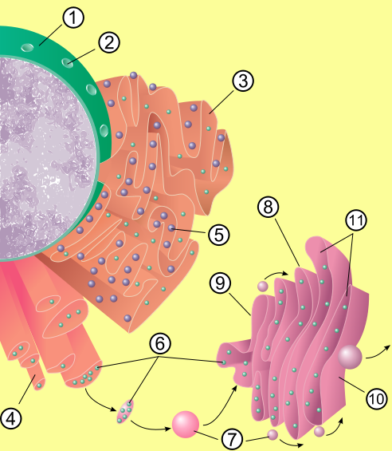
The endoplasmic reticulum and Golgi apparatus
Nucleus
Rough and smooth endoplasmic reticulum (ER)
Nuclear pore
Rough endoplasmic
reticulum (RER)
5 Ribosome on the rough ER (3)
6 Proteins that are transported
7 Transport vesicle
8 Golgi apparatus
9 Cis face of the Golgi apparatus
10 Trans face of the Golgi apparatus
11 Cisternae of the Golgi apparatus
Smooth endoplasmic
reticulum (SER)

Slide 29
Chloride ions contribute to membrane potential
High [Na⁺] (135 mM)
Low [K⁺] (5 mM)
High [Cl⁻] (95-107 mM)
Chemical concentration gradient tends to move ions down this gradient (chemical potential).
Electrostatic force due to the charge separation across the membrane tends to move ions in a direction determined by its particular charge.
Chloride ions tend to move inward down the concentration gradient through chloride channels.
Low [Na⁺] (18 mM)
High [K⁺] (166 mM)
Low [Cl⁻] (10-20 mM)
High [protein⁻]
Excess negative charge inside the cell (from non-diffusible proteins and lipids) tend to push chloride ions back out of the cell.
Equilibrium can be reached so that the actual ratio of intracellular and extracellular concentration ultimately depends on the existing membrane potential.
Dissipation of ionic gradients is ultimately prevented by Na⁺-K⁺ pumps

Slide 30
The Na⁺-K⁺ ATPase
The Na⁺-K⁺ ATPase
The high concentration of fixed anions inside cells (the proteins) and their accompanying cations means that water is drawn into the cells by the resulting osmotic gradient.
The high concentration of ions in the extracellular space means that there is an opposing osmotic gradient due to (Na⁺ and Cl⁻⁻) ions.
However, Na⁺ will tend to move down its concentration gradient into the cell.
The Na⁺-K⁺ ATPase maintains the osmotic balance and stabilises the cell volume by exporting Na⁺.
The Na⁺ gradient is thus maintained.
The Na⁺ gradient is also used to drive the transport of sugars and amino acids (i.e. Symport).

Slide 31
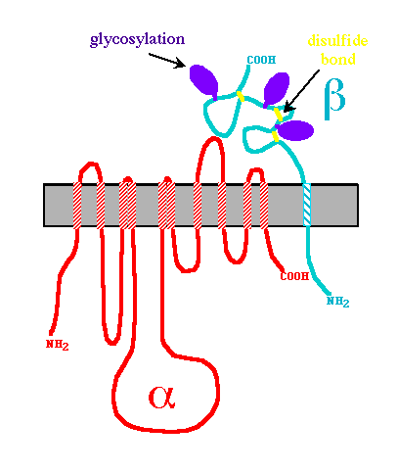
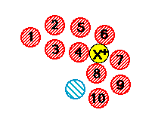
The sodium-potassium pump
High [Na⁺] (135 mM)
Low [K⁺] (5 mM)
High [Cl⁻]
Low [Na⁺] (18 mM)
High [K⁺] (166 mM)
Low [Cl⁻]
High [protein⁻]
The sodium-potassium pump is found in the plasma membrane of all cells and consists of two polypeptide chains, alpha and beta, with 1000 and 300 amino acids, respectively. The alpha chain spans the membrane 10 times, forming a hydrophilic pore.
The beta chain spans only once – controller.
http://www.bio.davidson.edu/courses/Molbio/26aa/alphabeta.html

Slide 32
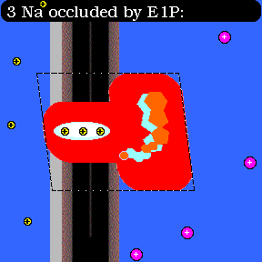
The sodium-potassium pump cartoon
Animated cartoon of the sodium-potassium pump:
Transport of 2K⁺ from left (extracellular) to right (intracellular) in exchange for 3Na⁺. It is electrogenic.
mediated by successive conformational transitions of the pump molecule
driven by phosphorylation of an aspartyl residue (red explosion)
followed by hydrolysis of the aspartylphosphate (blue explosion). The changing color and shape is meant to indicate the changing "conformational energy state" of the pump molecule relative to its substrates: red > orange > pink
outside
inside
Explain the movement of Na⁺ and K⁺ ions across the cell membrane against a concentration gradient and the consequences of failure of such a movement.

Slide 33
Membrane potential
Membrane potential
Due to a difference in electric charge on the two sides of a membrane.
Can result from activity of electrogenic pumps, e.g. Na⁺-K⁺ pump.
Main contributor to potential across mitochondrial inner membrane (electrogenic H⁺ pump)
Can result from passive ionic diffusion.
Main contributor across plasma membrane of animal cells.
K⁺ inside the cells is high, to balance the fixed anions, and is pumped into the cell by the Na⁺-K⁺ ATPase. K⁺ also can travel through K⁺ leak channels.
Near equilibrium for K⁺: attracted into the cells by fixed anions, and moving out of the cells down the concentration gradient.
This imbalance gives rise to a membrane potential: of ~-70mV
[K⁺]_{i} = 166 mM; [K⁺]_{o} = 5 mM

Slide 34
The electrochemical potential
The Na⁺-K⁺ pump exchanges 3 Na⁺ ions from inside the cell for two K⁺ ions on the outside.
There are two consequences:
Ionic gradients are created: less Na⁺ and more K⁺ inside the cell than outside.
A charge gradient is created, as more positive charges are pushed out than are coming in. This results in the inside of the cell being at a more negative potential than the outside.
Nernst Equation:
(A-level physics ?)
Where E is the membrane potential in V
R = Gas constant, 8.135 J K⁻¹ mol⁻¹
F = Faraday’s constant, 9.684 x 10⁴ C mol⁻¹
T = absolute temperature; –273.15 °C is absolute zero.
At 25°C, T= -273.15+25 °K = 298.15 °K
z = valence of the ion X; 1 for Na⁺ or K⁺
What is the membrane potential at 25 °C for:
[K⁺]_{i} = 166 mM and [K⁺]_{o} = 5 mM ?

Slide 35
Action potentials
Action potentials
Action potentials occur in elongated cells (nerves, muscle) when the membrane potential is disrupted by a brief pulse of current which briefly opens voltage-gated Na⁺ channels.
Na⁺ ions enter the cell and cause depolarisation, from –70 mV to about +50 mV.
Na⁺ channels become inactivated locally because of the voltage reversal, preventing further Na⁺ entry.
Voltage-gated K⁺ channels open, resulting in K⁺ efflux and help to restore the resting membrane potential.
The process propagates down the nerve/muscle

Slide 36
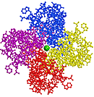
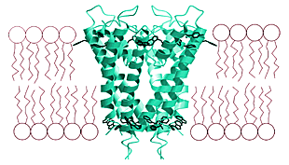
The potassium channel
The potassium channel consists of four subunits, with a pore in the middle.
Membrane channels are targets for plant and animal toxins (scorpion toxin for K⁺-channel).
It is highly specific - the toxin in the channel environment mimics the water molecules that K⁺ is normally surrounded by.

Slide 37
Specific ion pumps
There are specific pumps for Na⁺, Ca²⁺ and H⁺, which use ATP hydrolysis to provide the energy. There are also Cl⁻ pumps in some cells.
Some pumps can work in reverse and generate ATP from an ion gradient, e.g. the F1-ATPase using H⁺ in the mitochondria.
Other mechanisms exist for other substances that need to cross the membrane.

Slide 38
More about transport
More about transport

Slide 39
Glucose transport
Na⁺
OUT
IN
ATP
ADP +
phosphate
Na⁺

Slide 40
Pinocytosis and phagocytosis
Other transport mechanisms:
Pinocytosis: engulfment by the membrane of extracellular solute and small molecules which end up in small intracellular membrane-bound vesicles.
Phagocytosis: engulfment by the membrane of extracellular objects such as bacteria, cell debris, other cells. Again these end up in intracellular membrane-bound vesicles.
Exocytosis: Movement of proteins and other molecules (e.g. hormones, blood clotting factors) from intracellular vesicles towards the extracellular space by fusion with the cell membrane.

Slide 41
Information transfer across membranes
Cell signalling:
It is not only substances that need to cross membranes. Signals need to cross membranes too.
Some use exocytosis, e.g. hormones.
Others use lipid-soluble molecules that cross membranes.
But other signals rely on trans-membrane receptors.
External messenger (e.g. hormone)
Ca²⁺
Ca²⁺
substrate
Second messenger
inside cell

Slide 42
Thank you!
Pinocytsis and phagocytosis

