Slide 1
The future of genomic medicine
Dr Jess Buxton
Course code (MBBS) : Genetics 6
Course code (BMS) : NAGE-L13

Slide 2
The Future of Genomic Medicine: facts and fiction

Slide 3
The future: fiction
X
X
Designer babies chosen for ‘brains and beauty’?
DNA technology used to determine social class?

Slide 4
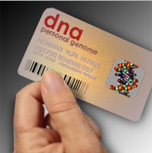
The future: fact
✓
Personalised healthcare based on genetic information?

Slide 5
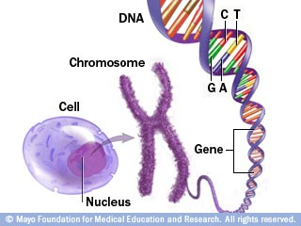
What we do know:
Chromosome abnormalities that cause disorders
Many of the genetic mutations that cause monogenic diseases
antenatal screening for all pregnant women
genetic tests/counselling for affected families
newborn screening programmes
Entire DNA sequence of the ‘reference’ human genome
Extensive genetic variation between people identified
Common and rare genetic variants that contribute to risk of complex diseases and drug responses

Slide 6
What we don’t (yet) know:
What all DNA in human genome codes for
Causes of some rare monogenic diseases
Most of genetic variation that affects drug responses and risk of complex disease
How genetic and environmental factors interact to affect risk of complex disease and drug response

Slide 7
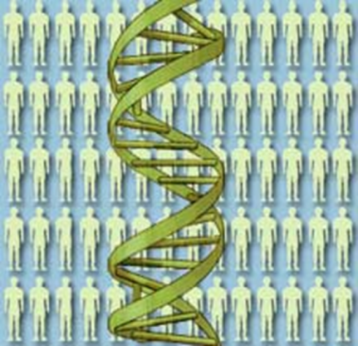
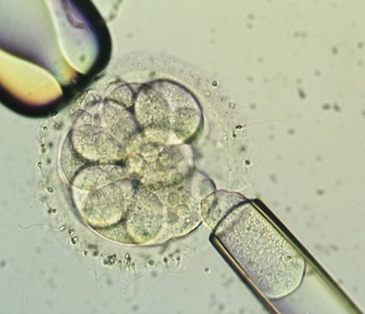
Outline
Advances in genomic medicine
‘Next generation’ DNA sequencing
Finding the causes of monogenic disease
Pharmacogenetics
Risk of common, complex diseases
Personalised healthcare
Direct-to-consumer genetic testing
Ethical issues
Future perspectives
Embryo testing
Preimplantation genetic diagnosis (PGD)
Uses and limitations
Ethical issues

Slide 8
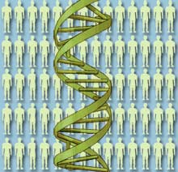
Advances in genomic medicine
Technology
Knowledge

Slide 9
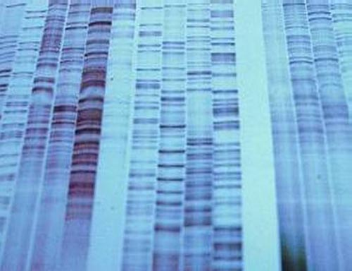
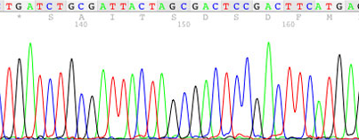
Advances in genomic medicine: DNA sequencing

Slide 10
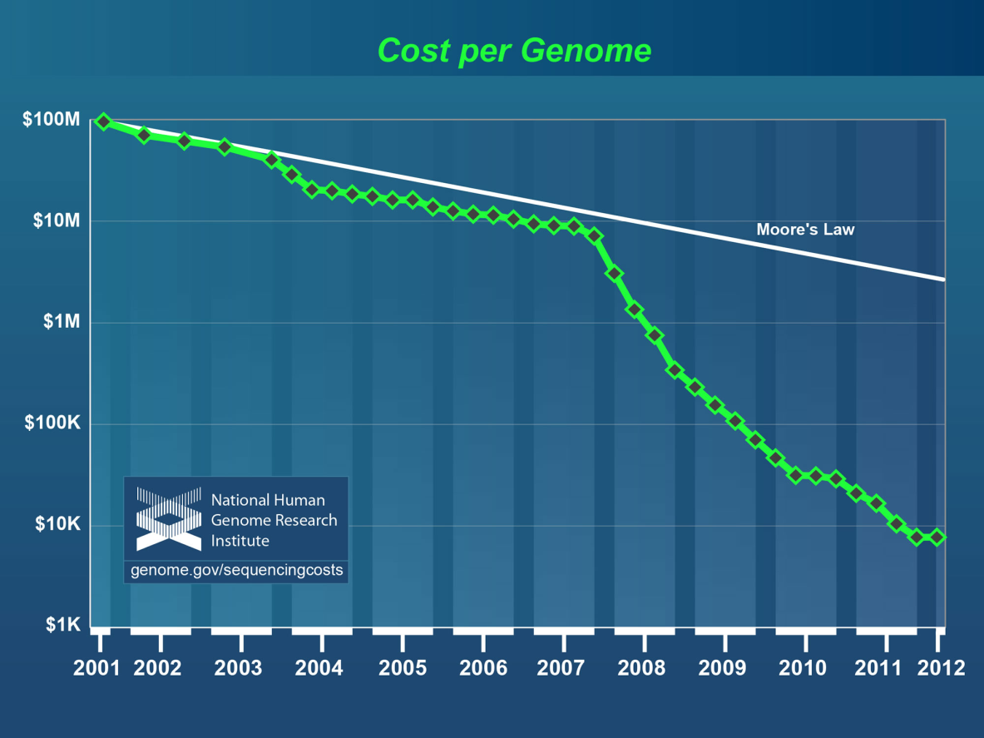
The cost of DNA sequencing
Entire human genome is made up of 2.9 billion base-pairs of DNA
First human genome cost $3 billion to sequence
Now less than $10,000
‘$1000 genome’ very soon?

Slide 11
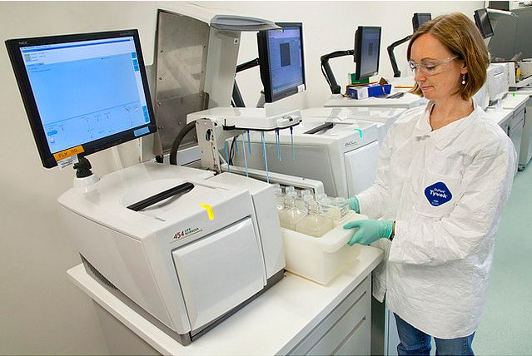
Applications of whole genome (or whole-exome) sequencing
- Identify genetic changes in cancer cells
- Identify novel gene mutations in monogenic disease
- Catalogue all genetic variation in populations

Slide 12
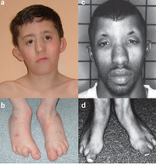
Miller syndrome
Multiple malformation syndrome
Characteristic facial features, including ‘cupped’ ears
Absent toes
Caused by mutations in DHODH gene (Ng et al 2010)

Slide 13
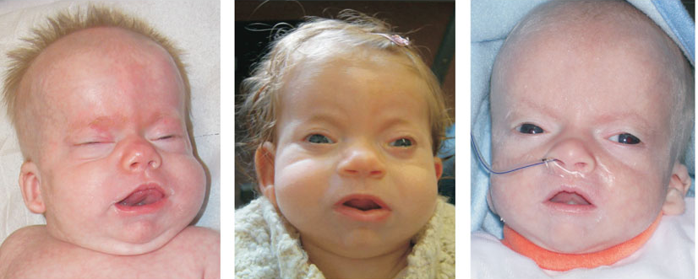
Schinzel-Giedion syndrome
Severe mental retardation
Multiple congenital abnormalities
Characteristic facial features
Life-limiting
Caused by mutations in SETBP1 gene (Hoischen et al, 2010)

Slide 14
Advances in genomic medicine: pharmacogenetics
Studying the genetic basis for the difference between individuals in response to drugs:
“right drug, right dose, right patient”

Slide 15
Pharmacogenetics : getting the dose right
Variants in TPMT gene affect metabolism of 6-mercaptopurine
NIGMS website

Slide 16
Pharmacogenetics example 2: getting the drug right
Maturity onset diabetes of the young (MODY):
Usually childhood onset
Monogenic disease
Some types can be treated with oral sulfonylurea drugs
Type 1 diabetes:
Usually childhood onset
Autoimmune disease
Must be treated with daily insulin injections
Can be misdiagnosed

Slide 17
Advances in genomic medicine: Risk of common disease
Many genetic variants that affect risk of common, complex traits and diseases identified through:
Genome Wide Association Studies = GWAS
Eg. Type 2 diabetes, schizophrenia, obesity, blood pressure.....

Slide 18
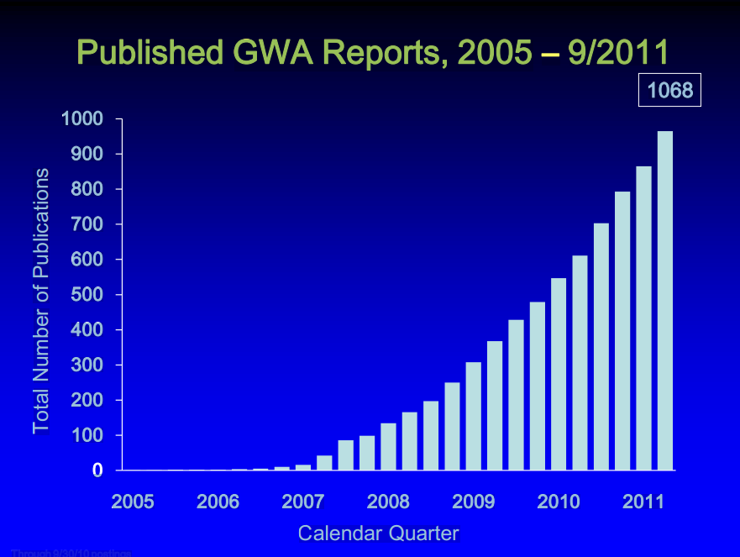
Published GWAS for common traits
NHGRI GWA Catalog
www.genome.gov/GWAStudies

Slide 19
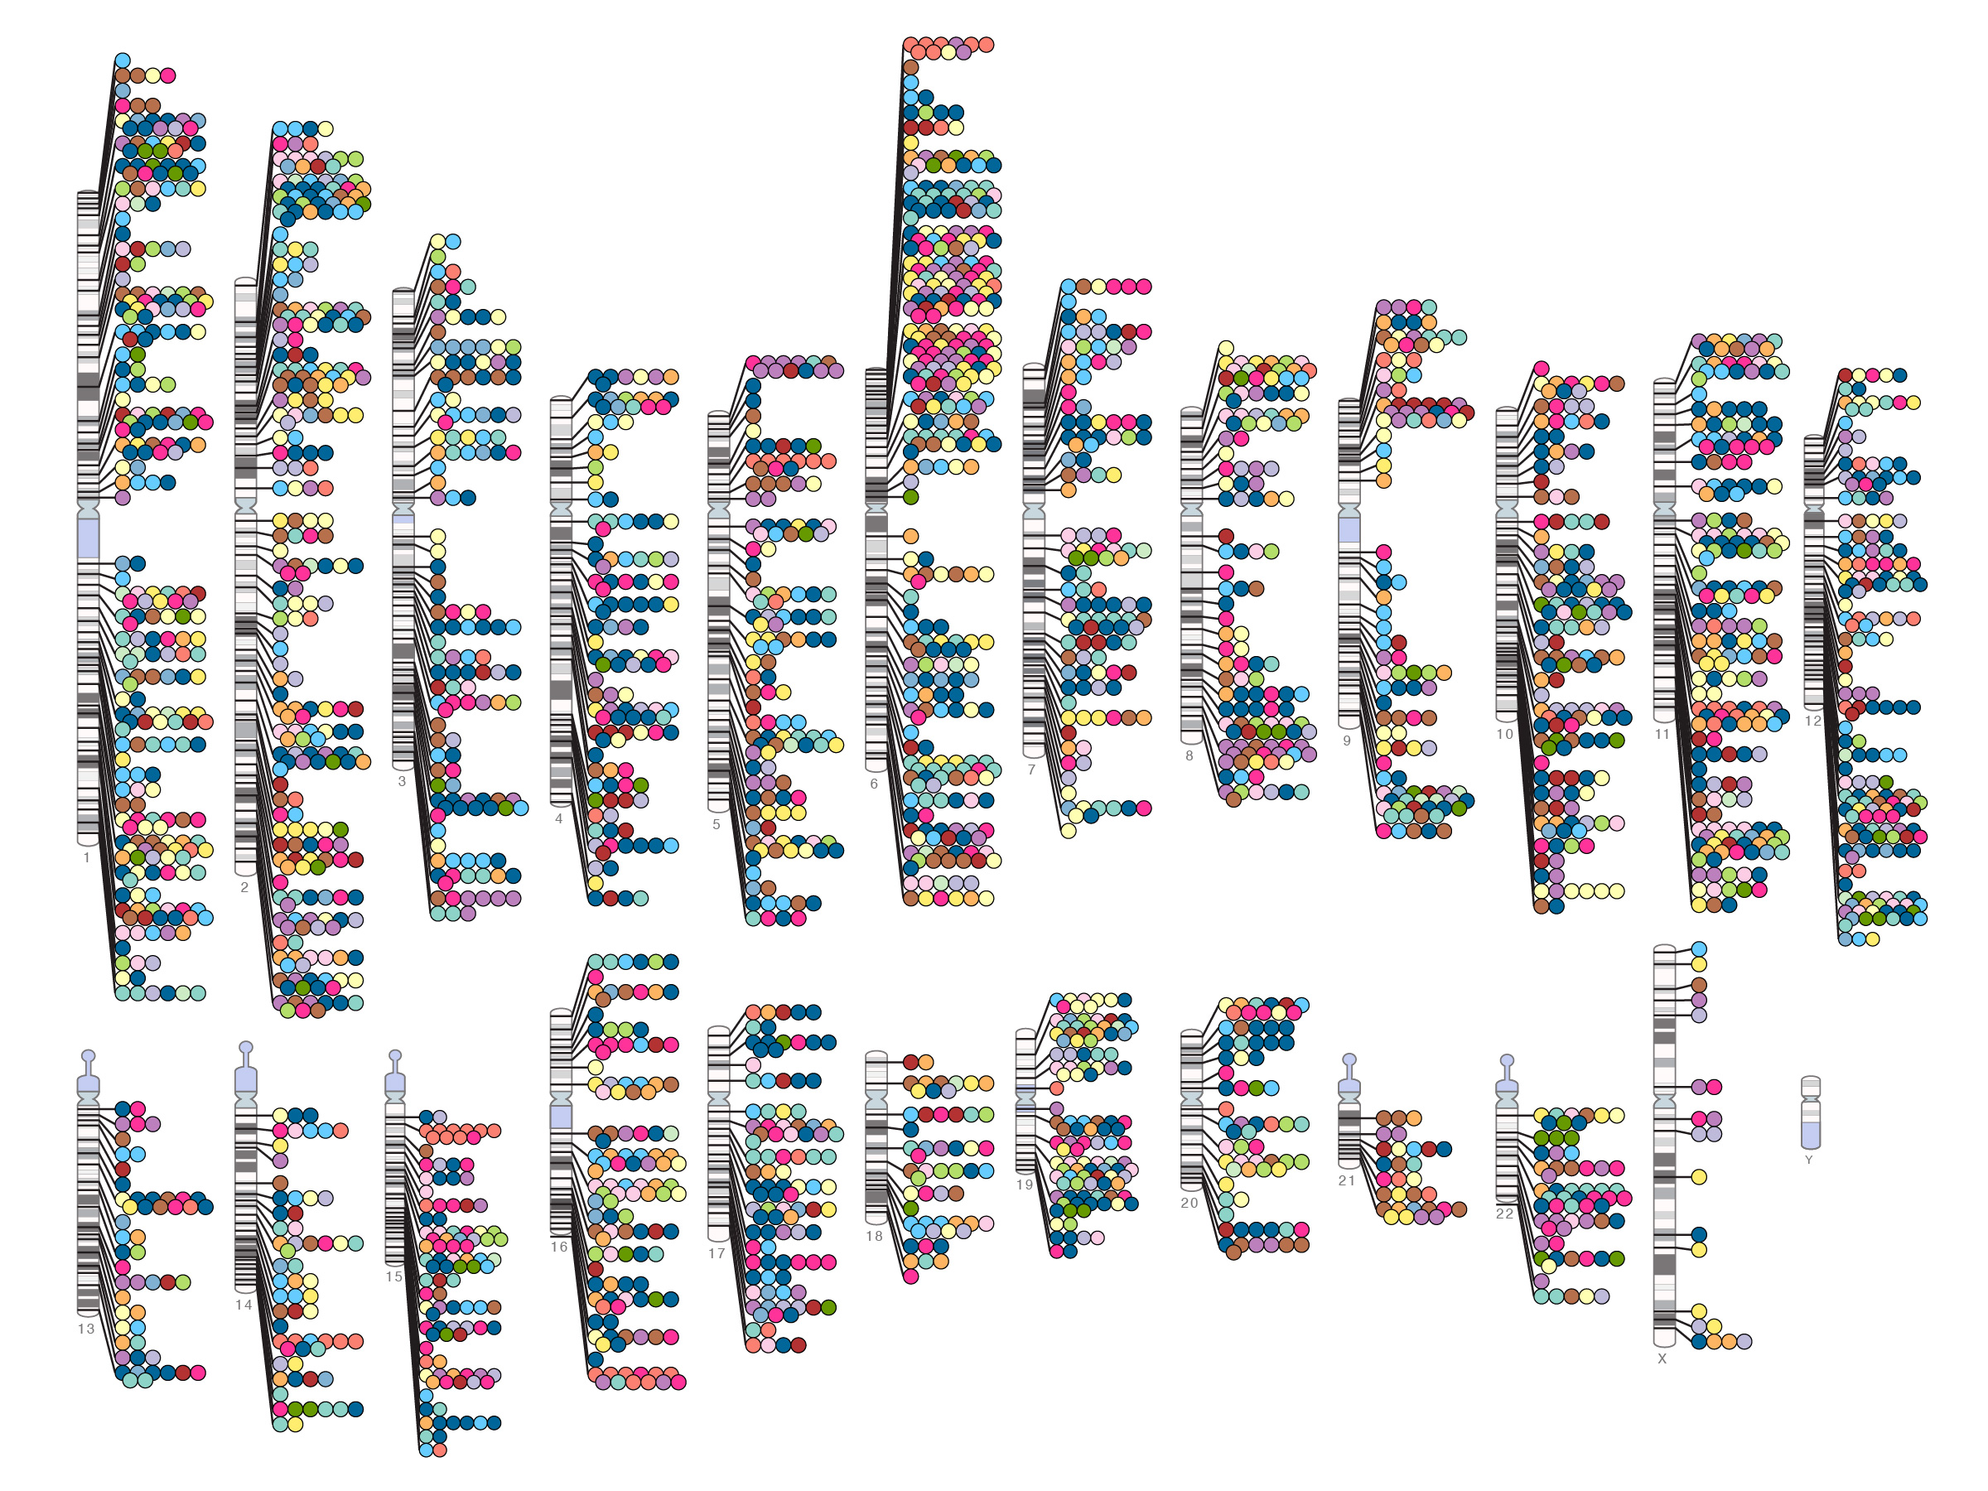
Published Genome-Wide Associations through 07/2012
NHGRI GWA Catalog
www.genome.gov/GWAStudies
www.ebi.ac.uk/fgpt/gwas/

Slide 20
Selling genetic information
Disease-specific tests already offered directly to consumers

Slide 21
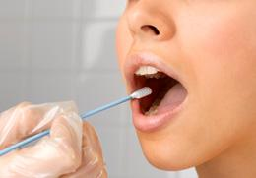
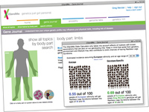
Direct to consumer (DTC) genetic tests
For monogenic disease
Can provide carrier status information
Can predict risk of late-onset disease
Essential that service includes genetic counselling
For complex disease
Often have limited clinical utility
May cause undue alarm
May offer false reassurance
Data privacy concerns

Slide 22
Predicting risk of common disease: type 2 diabetes (T2D) as an example…
T2D currently affects 285 million adults worldwide, predicted to rise to 439 million by 2030
Caused by complex interaction of non-genetic (eg diet) and genetic factors: sibling relative risk is ~3 in Europeans
Over 60 confirmed T2D genes so far, which explain just ~10% of estimated genetic contribution

Slide 23
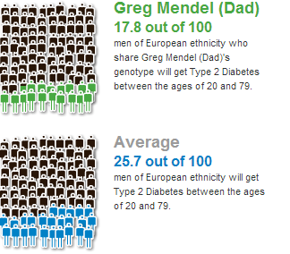
Example results from 23and Me
“The 23andMe Odds Calculator only takes into account effects of markers with known associations that are also on our genotyping chip.
Keep in mind that aside from genetics, environment and lifestyle may also contribute to one's chances of developing type 2 diabetes”.

Slide 24
DTC genetic tests for common disease: concerns
Tests of dubious clinical benefit may be offered
Test results may cause false alarm/provide false reassurance
Complex results may not be explained fully, or with appropriate genetic counselling
Data protection (especially if company ceases trading)

Slide 25
Consumer genetic tests for common disease: benefits?
Even if the information provided by some commercial genetic tests is of limited clinical value, it may still spur some customers to make lifestyle changes…..

Slide 26
The future: Genetic profiles for all?

Slide 27
Personal genomes
Whole genome sequencing:
All variants (common and rare) identified in one analysis
Individual genetic
tests for variants
associated with:
Monogenic disease
Drug response
Disease ‘sub-type’
Future risk of
common disease
May one day all be replaced by
May one day all be replaced by

Slide 28
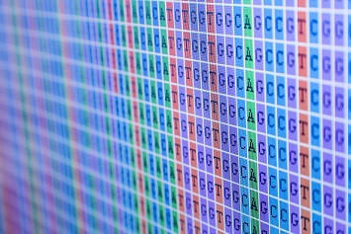
Personalised medicine: practical issues
HUGE amount of information to sift through – expensive and time-consuming
How to decide which information is clinically relevant…

Slide 29
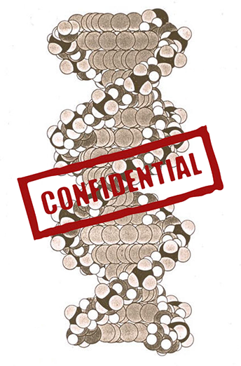
Personalised medicine: ethical issues
Commercial genetic testing for common disease risk based on incomplete information
Right ‘not to know’ (particularly children) – ‘incidental’ findings
Protection of data, right to ‘genetic privacy’
Equality of access to genetic information

Slide 30
Embryo testing (PGD)

Slide 31
PGD – genetic testing of embryos
What is PGD?
PGD (preimplantation genetic diagnosis) is a genetic test carried out on IVF embryos, usually to ensure that only embryos free from a particular genetic condition are returned to the woman's womb
Who uses it?
PGD is an option for some families at risk of having a child affected by a serious genetic condition, offered as an alternative to prenatal testing
PGD is NOT a technique for ‘designing’ babies…

Slide 32
PGD: a brief history
July 1990: First twin girls born after PGD, at Hammersmith Hospital
Licensed on a case-by-case basis in the UK
Just a few 1000 babies born after PGD worldwide (compared to over 5 million IVF babies)

Slide 33
PGD: genetic testing of IVF embryos

Slide 34
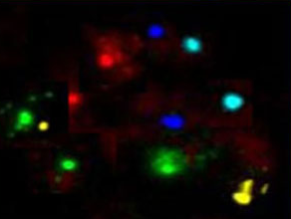
PGD: types of genetic test
Fluorescent in situ hybridisation (FISH) – to detect chromosomal conditions, eg. Down syndrome
Polymerase chain reaction (PCR) and DNA sequencing – to detect mutations in single genes

Slide 35
PGD: Ethical issues
PGD (like all IVF procedures) involves discarding unused embryos
Disability rights arguments
‘Slippery slope’ – designer babies?
Eugenics

Slide 36
PGD: what is permitted in UK?
✓
✓
✓
✓
✗
Severe early onset genetic disease, eg. Tay Sachs
Severe late onset conditions, eg. Huntington disease
Disease with incomplete penetrance, eg. hereditary breast cancer (BRCA1/2 mutations)
To choose a tissue-matched baby that can provide umbilical cord blood to treat a sick sibling
To choose a boy/girl for non-medical reasons

Slide 37
PGD for hereditary breast cancer
PGD for BRCA1 mutation to avoid risk of hereditary cancer in baby provoked ‘slippery slope’ concerns

Slide 38
PGD for ‘saviour siblings’
PGD can be used to select an embryo that is both free from disease, and HLA tissue-matched for a sibling affected by a disease that may be treatable using stem cells from umbilical cord blood.

Slide 39
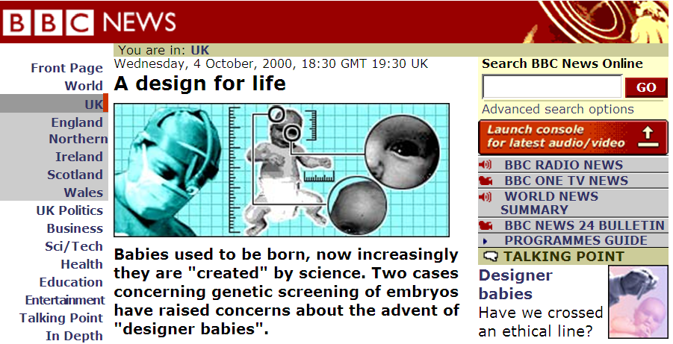
Saviour siblings: ethical issues
Nash case sparked concerns over ‘commodification’ of children

Slide 40
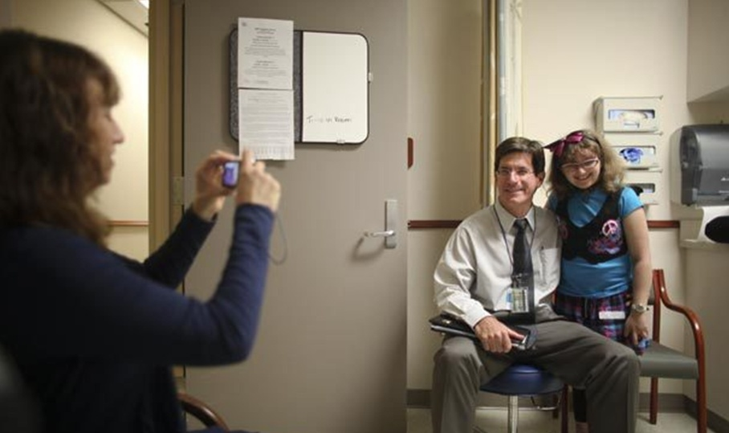
The first child with a ‘saviour sibling’ selected using PGD: 10 years later…
Lisa Nash, left, snaps a photo of her daughter, Molly, 16, right, and her doctor, John Wagner. (Seattle Times, 28/9/10)

Slide 41
Limitations of PGD
It requires use of in vitro fertilisation (IVF): physically and emotionally demanding - and expensive
Only suitable for diseases where genetic/chromosome abnormality is known
Can only select for traits that are present/absent in embryos obtained (can’t ‘design’!)

Slide 42
Summary (1)
PGD likely to remain an important reproductive option for a small number of families affected by serious genetic disease

Slide 43
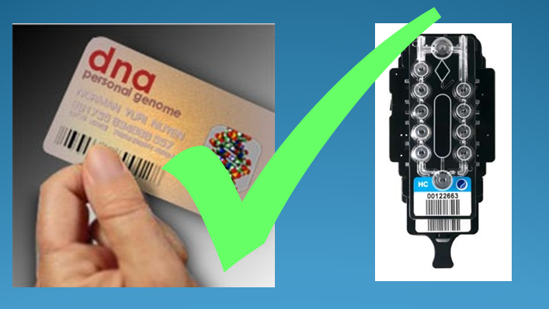
Summary (2)
Technological advances may one day mean that everyone’s genome is sequenced as part of routine healthcare
Personalised medicine based on genetic information raises concerns over privacy, autonomy and equality of access, but also has great potential to improve healthcare

Slide 44
Find out more
House of Lords Science and Technology Committee: Genomic Medicine Inquiry
An assessment of genome technologies and their actual and potential impact on clinical practice in the post-genome era
http://www.parliament.uk/business/committees/committees-archive/lords-s-t-select/genomic/
A Common Framework of Principles for direct-to-consumer genetic testing services
http://www.hgc.gov.uk/Client/Content.asp?ContentId=816
Medical profiling and online medicine: the ethics of 'personalised healthcare' in a consumer age
http://www.nuffieldbioethics.org/personalised-healthcare-0
BioNews – online news and comment on developments in human genetics and assisted reproduction
http://www.bionews.org.uk/
Blogs, eg: Genomes Unzipped
http://www.genomesunzipped.org/
j.buxton@imperial.ac.uk

