Slide 1
More stories from the genetics clinic
Dr Jess Buxton
Course code (MBBS) : Genetics 3
Course code (BMS) : NAGE-L9

Slide 2
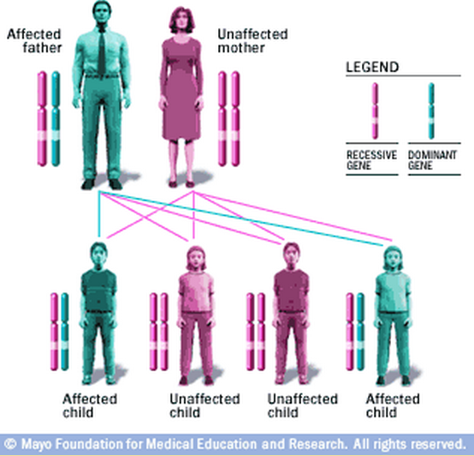
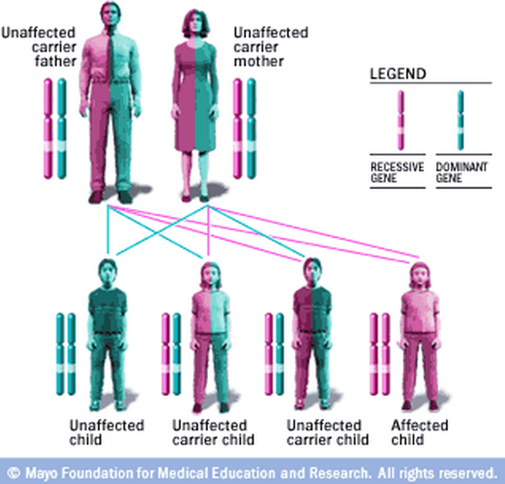
Genes, chromosomes and disease: summary so far..
Chromosomal disorders
Diseases with ’Mendelian’ inheritance patterns:

Slide 3
More Stories from the Genetics Clinic
Imprinting Disorders
Prader-Willi
Angelman
Mitochondrial Disorders
MELAS
LHON
Inborn Errors of Metabolism
Phenylketonuria
MCAD deficiency

Slide 4
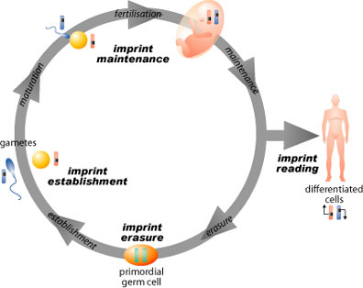
Imprinting Disorders

Slide 5
Imprinting
Parental origins of chromosomes are important
46,XX where genome is only from one parent
Maternal – Ovarian Teratoma
Paternal – Hydatidiform Mole
The genome carries an imprint of its parental origin
Imprinting is a reversible epigenetic effect
DNA Methylation is the mechanism

Slide 6
Prader-Willi/Angelman Syndromes
Two distinct clinical syndromes
Same chromosomal region involved on Chr15
Result from loss of function of one of the two parental chromosomes
Paternal = Prader-Willi
Maternal = Angelman

Slide 7
Prader-Willi Syndrome

Slide 8
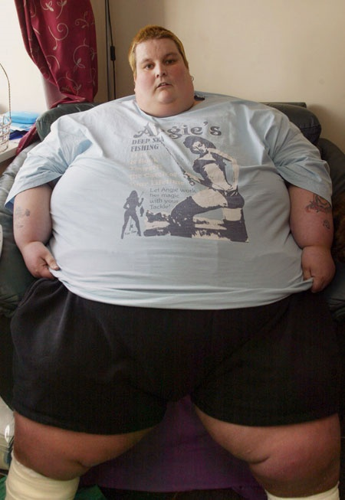
Prader-Willi Syndrome
Symptoms include
Muscle hypotonia
Hyperphagia
Obesity/Diabetes
Mental retardation
Short stature
Small hands and feet
Delayed/Incomplete Puberty
Infertile

Slide 9
Prader-Willi Syndrome
Prevalence
1:10,000 to 1:25,000 for birth incidence
Management
Hyperphagia managed by diet restriction
Exercise to increase muscle mass
Growth Hormone treatment for short stature
Hormone replacement at puberty

Slide 10
Genetic Mechanisms of PWS
Lack of a functional paternal copy of the PWS critical region on 15q11-q13
~70% Deletion of the critical region on the paternal chromosome
~25% Inheritance of two maternal copies by uniparental isodisomy
~5% due to translocations, point mutations

Slide 11
Uniparental Isodisomy
Non-Disjunction in Meiosis II
Fertilisation of normal monosomic gamete
Loss of chromosome from parent contributing the single chromosome

Slide 12
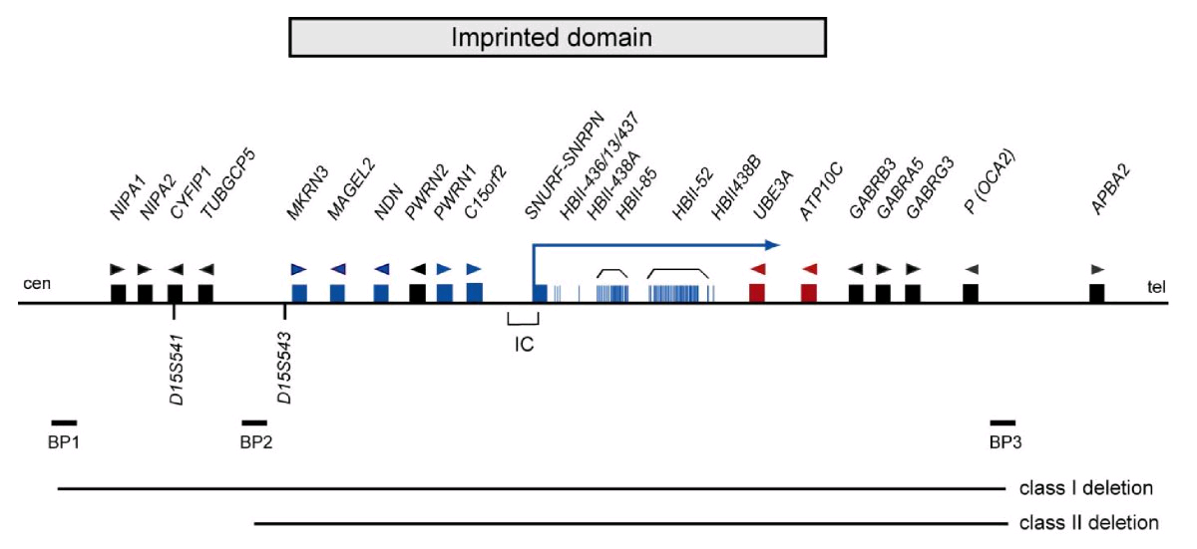
The PWS Critical Region
Ramsden et al. BMC Medical Genetics 2010 11:70

Slide 13
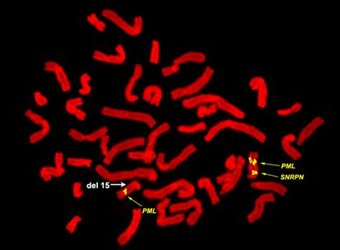
Molecular Diagnosis
http://www.mgm.ufl.edu/faculty/DDriscoll.htm

Slide 14
Angelman Syndrome

Slide 15
Angelman Syndrome
Severe developmental delay
Poor or absent speech
Gait ataxia
“Happy demeanour”
Microcephaly
Seizures
http://kirstiespage.net

Slide 16
Angelman Syndrome
Diagnosis
Clinical Features and Molecular Diagnostics
Prevalence
1:10000
Treatment
Symptomatic – anti-convulsant, physiotherapy, communication therapy
Normal life span

Slide 17
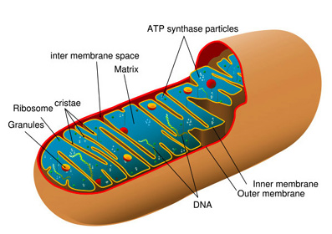
Mitochondrial Disorders
http://biology.about.com/od/cellanatomy/ss/mitochondria.htm

Slide 18
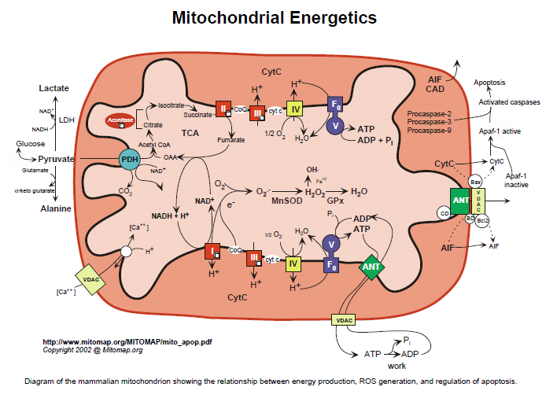
The Mitochondrion

Slide 19
Mitochondrial Inheritance
Transmission is exclusively through females
Affects both males and females
Cells vary in their number of mitochondria depending on energy requirements
Numbers from 1 to>1000 per cell
Disease can be very variable because of heteroplasmy

Slide 20
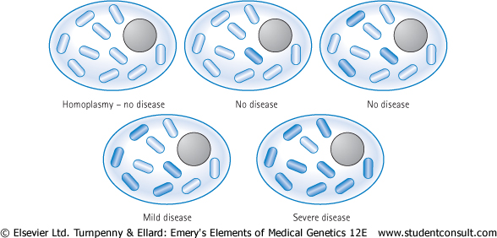
Heteroplasmy

Slide 21
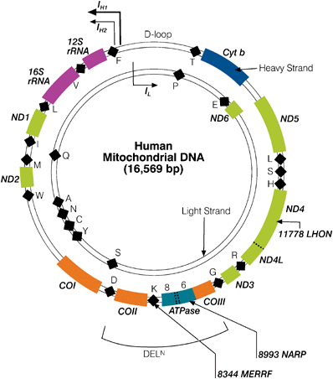
The Mitochondrial Genome
~16kb
37 genes
13 for respiratory chain complexes
22 for tRNA
2 for rRNA
2-10 copies per mitochondrion

Slide 22
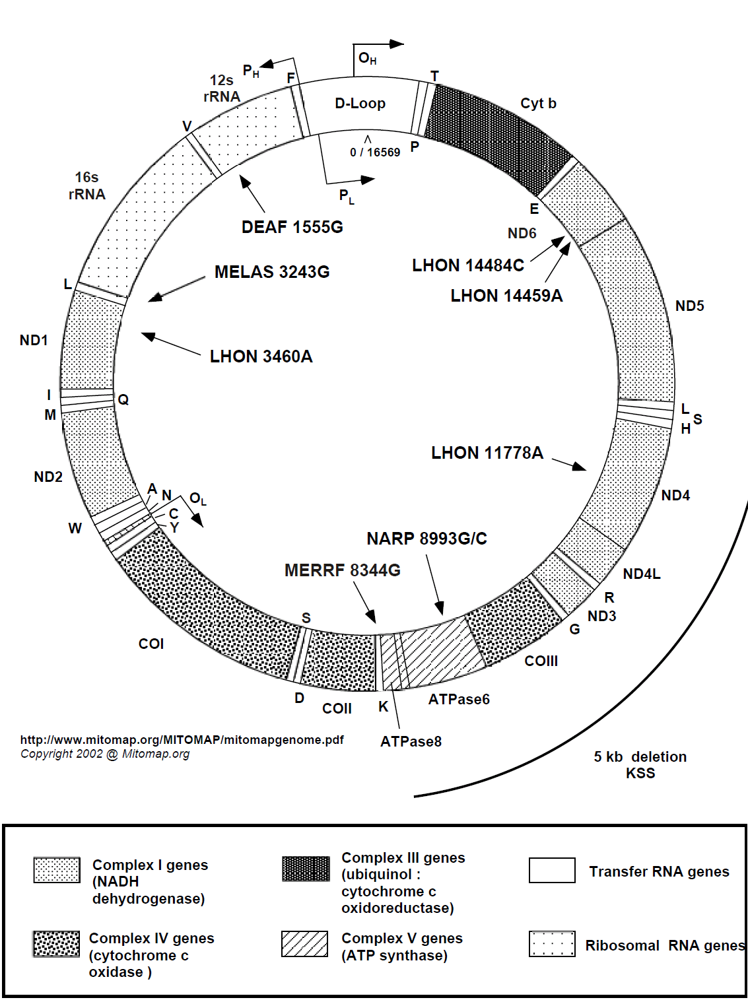
Mitochondrial Disorders
MELAS
LHON
MERRF – Myoclonic Epilepsy with
Ragged Red Fibres
DEAF – Non-syndromic hearing loss
NARP – Neuropathy, Ataxia and Retinitis Pigmentosa
www.mitomap.org

Slide 23
MELAS

Slide 24
MELAS
Mitochondrial myopathy, Encephalopathy, Lactic Acidosis and Stroke
Progressive neurodegenerative disorder
Muscle Weakness
Episodic Seizures and headache
Hemiparesis
Vomiting
Dementia

Slide 25
MELAS
Estimated prevalence of 1:13 000
Symptomatic Treatment
Diagnosis by muscle biopsy
Genetics
Single point mutations in several genes
MTTL1 – tRNA translates codon as Phe instead of Leu during mitochondrial protein synthesis
MTND1, MTND5 – NADH dehydrogenase (Complex 1)

Slide 26
LHON

Slide 27
LHON
Leber’s Hereditary Optic Neuropathy
For unknown reasons, this is much commoner in males
Average age is mid-twenties to mid-thirties
Age range is wide though (6-62yrs)
Bilateral, painless, loss of central vision and optic atrophy
Most will become blind

Slide 28
LHON
Estimated prevalence of 1:50 000
Symptomatic Treatment
Diagnosis is on the basis of opthalmological findings and a blood test for mtDNA mutations
>90% of the mutations are in
MTND1, MTND4, MTND5, MTND6 and MTCYB
NADH dehydrogenase subunits 1,4,5 and 6
Cytochrome B

Slide 29
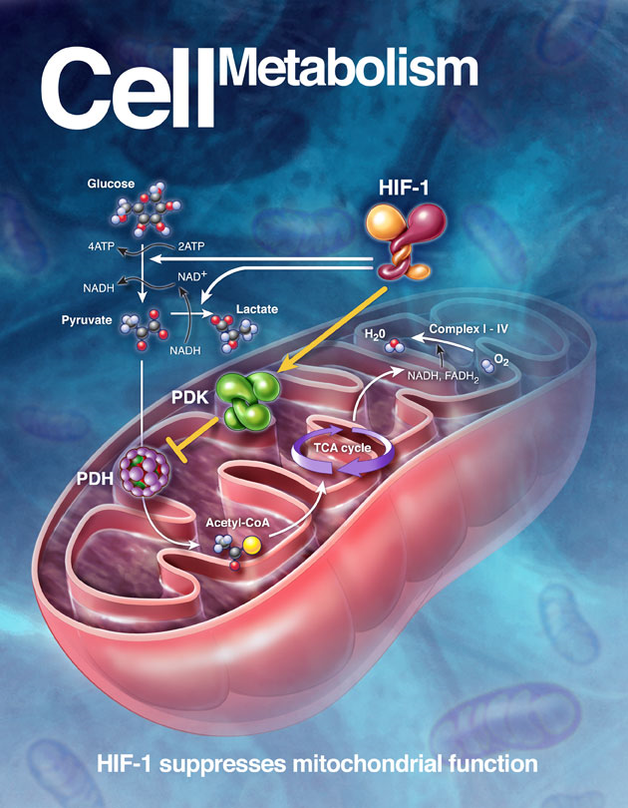
Inborn Errors of Metabolism

Slide 30
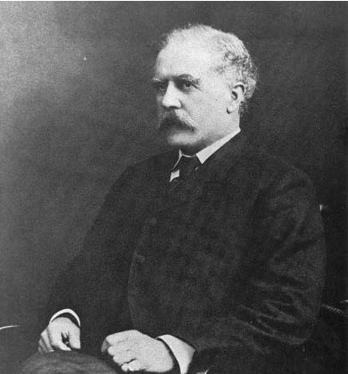
Inborn Errors
“one gene-one enzyme” concept
More than 200 diseases known
Mostly autosomal recessive or X-linked
A few are dominant (rate-limiting step or part of a multimeric complex)
The defective proteins are mainly enzymes
Garrod’s book was published in 1909

Slide 31
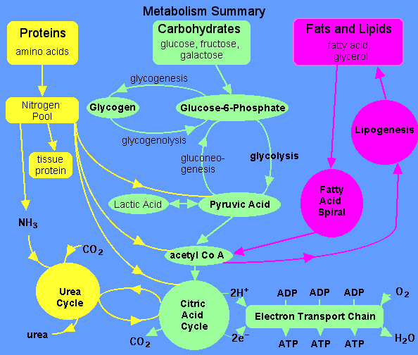

Slide 32
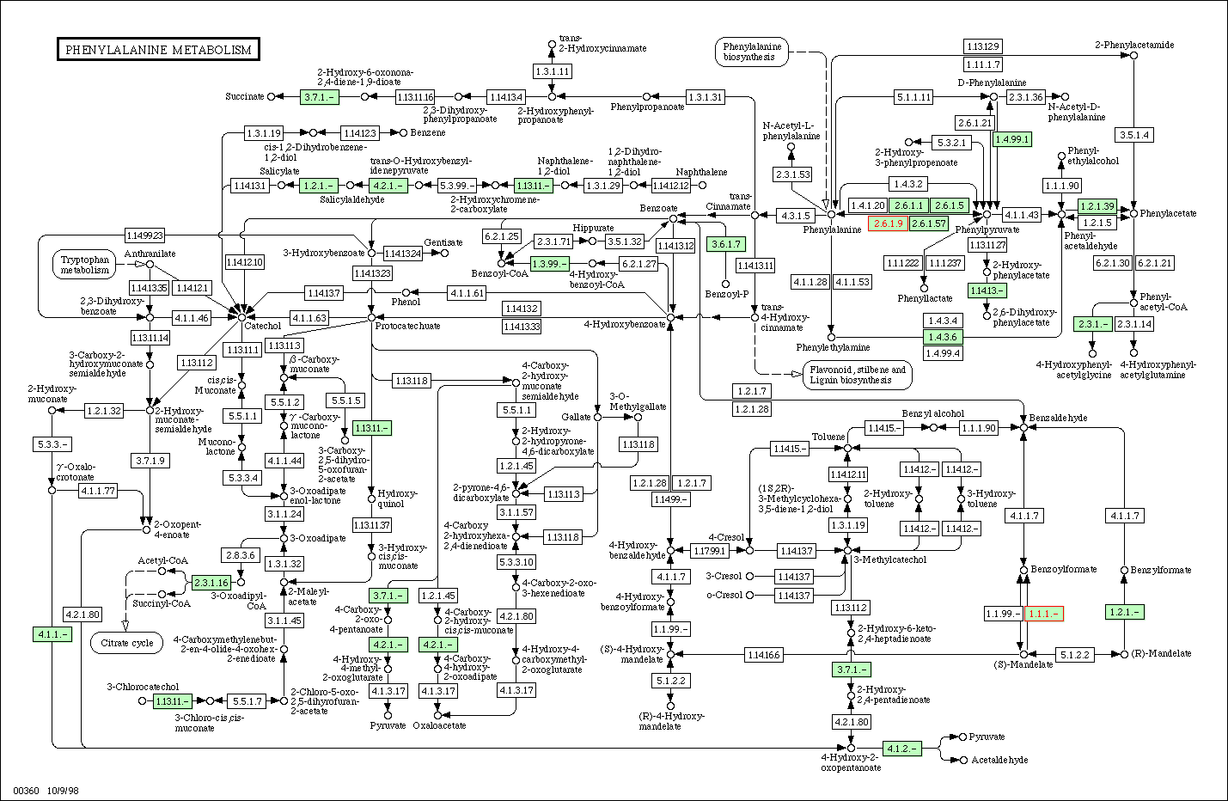

Slide 33
Mrs Jones
She has just had her baby
Screen for common diseases
proband

Slide 34
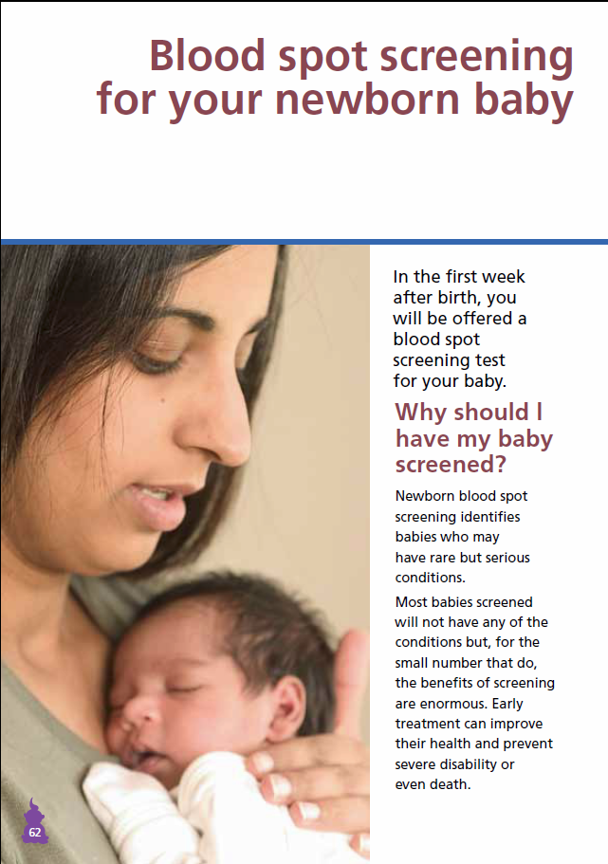
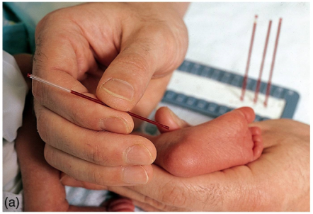
UK Newborn Screening Program
Screen newborns for
Phenylketonuria
Congenital Hypothyroidism
Sickle Cell Disorders
Cystic Fibrosis
Medium-Chain Acyl-CoA Dehydrogenase Deficiency
http://newbornbloodspot.screening.nhs.uk/

Slide 35
Phenylketonuria (PKU)
Severe mental retardation and convulsions
Blond hair/blue eyes; eczema
Phenylalanine hydroxylase deficiency
Phenylalanine accumulates and is converted to phenylpyruvic acid - excreted in urine
Tyrosine deficiency - reduced melanin

Slide 36
DIET
THYROXINE
1
2
PHENYLALANINE
TYROSINE
DOPA
3
PHENYLPYRUVIC
ACID IN URINE
HOMOGENTISIC
ACID IN URINE
MELANIN
4
1 - PKU
2 - THYROXINE
DEFICIENCY
ACETOACETIC ACID
3 - ALBINISM
4 - ALKAPTONURIA
C0₂ + H₂0

Slide 37
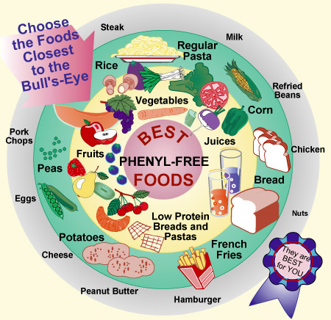
Treatment for PKU
Early detection - no mental retardation
Newborn screening for elevated levels of phenylalanine in blood
Remove phenylalanine from diet
Difficult diet to stick to
Aspartame contains phenylalanine
Pregnant women need to go back on diet

Slide 38
MCAD Deficiency
Commonest disorder of fatty-acid oxidation
Episodic hypoketotic hypoglycaemia
Commonly presents > 3 months
Can present as coma, metabolic acidosis, encephalopathy
Sudden death can occur, with a 25% mortality rate in undiagnosed cases
MCAD is Medium-Chain Acyl-CoA Dehydrogenase
MCAD gene is called ACADM

Slide 39
MCAD Function
VLCAD
LCAD
MCAD
SCAD
SBCAD
Acetyl CoA
TCA Cycle
NADH
Oxidative
Phosphorylation
FADH2
Oxidative
Phosphorylation
http://blobs.org

Slide 40
MCAD Deficiency Management
Frequency of 1:8000 to 1:15000 births
Early detection using bloodspot now routine
Maintenance of adequate calorie intake to prevent switch to fatty acid oxidation
Avoidance of fasting (<12 hrs in adults), which can be difficult in children who become ill – teaspoon of honey or glucose drip

Slide 41
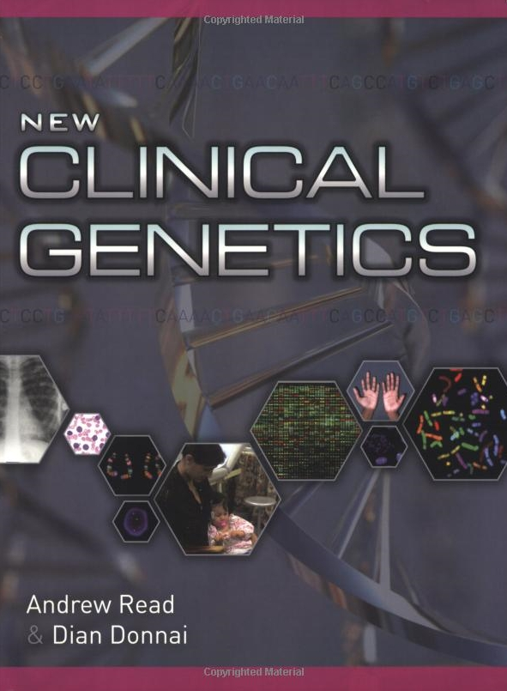
Reference Textbook
Read and Donnai
“New Clinical Genetics”
Scion Publishing Ltd

