Slide 1
Fungal infections
Dr Elaine Bignell (e.bignell@imperial.ac.uk)
Lecturer, Microbial Genetics and Pathogenicity
Section of Microbiology
Course code (MBBS) : Microbiology 5
Course code (BMS) : IIP-L15

Slide 2
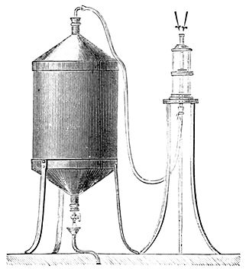
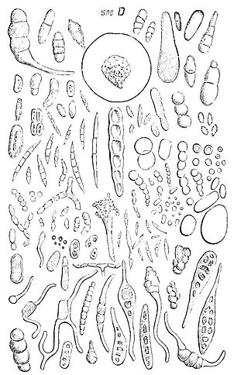
Popular Science Monthly Volume 23 (1883)
Microscopic Life in the Air
“The molds form a part of the class of parasites which are ready to take possession of our organism whenever it presents a vulnerable point or a point of weak resisting power”

Slide 3
Human fungal infections
Disease Most common species | Location | Estimated Life-Threatening Infections / Year at that Locationª | Mortality Rates (% in infected populations)ª
Opportunistic Systemic Mycoses
Aspergillosis Aspergillus fumigatus | worldwide | >200,000 | 30 - 95%
Candidiasis Candida albicans | worldwide | >400,000 | 46 - 75%
Cryptococcosis Cryptococcus neoformans | worldwide | >1,000,000 | 20 - 70%
Mucormycosis Rhizopus oryzae | worldwide | >10,000 | 30 – 90%
Pneumocystis Pneumocystis jirovecii | worldwide | >400,000 | 20 - 80%
Endemic Dimorphic Mycoses^{a,b}
Blastomycosis Blastomyces dermatitidis | Midwestern and Atlantic U.S. | ~3,000 | <2% - 68%
Coccidioidomycosis Coccidioides immitis | Southwestern U.S. | ~25,000 | <1% - 70%
Histoplasmosis Histoplasma capsulatum | Midwestern U.S. | ~25,000 | 28 – 50%
Paracoccidioidomycosis Paracoccidioides brasiliensis | Brazil | ~4,000 | 5 – 27%
Penicilliosis Penicillium marneffei | SouthEast Asia | >8,000 | 2 – 75%
Human fungal infections: the hidden killers
Brown, Denning, Gow,, Levitz, Netea and White (2012) Sci. Trans. Med.

Slide 4
FUNGI
The largest group of organisms on
the planet
70,000 species described
1.5 million likely to exist
~ 200 human pathogens
http://www.mycolog.com

Slide 5
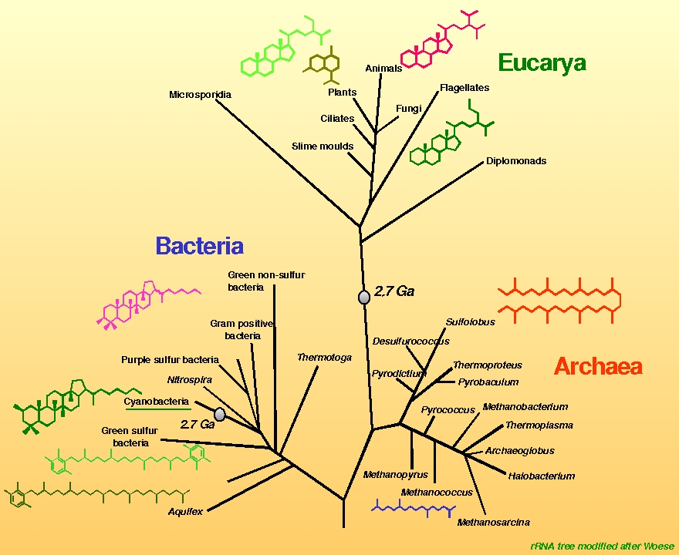
Fungi are part of the
eukaryotic crown group
An independent group
of organisms equal
in rank to that of
plants
and animals

Slide 6
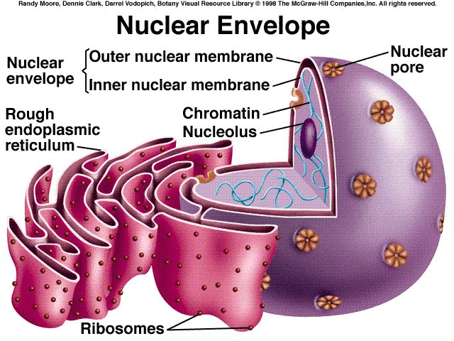
The word 'eukaryote' means 'true nuclei'
Eukaryotic organisms
have complex cells
Genetic material is
organised into a
membrane-bound
nucleus

Slide 7

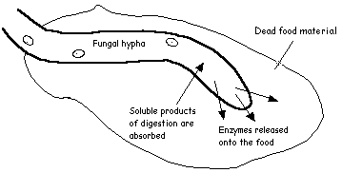
Fungi digest their food extracellularly
Fungi secret hydrolytic enzymes which can break
down biopolymers to be absorbed for nutrition
Fungi do not require stomachs to
accomplish digestion!
Fungi live suspended in their own food source

Slide 8
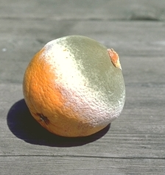
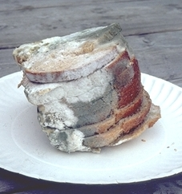
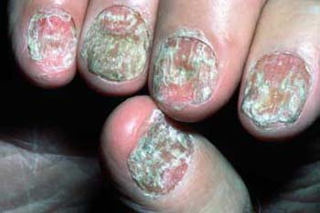
Real-life images of fungi growing in their
own food

Slide 9

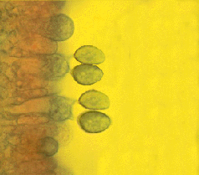
Spore dispersal in fungi
Fungi produce large numbers
of spores
These are dispersed over large
distances
An air sample may contain as
many as 200,000 spores/meter³
Humans are constantly exposed
to fungal spores
Commensal organisms &
skin colonisers
transmitted by contact

Slide 10
Map of Lecture
Fungal illness
Allergies
Mycoses
Mycotoxicoses
Candida
infections
and
virulence factors
Superficial
Cutaneous
Systemic
Diagnosis
of fungal
infections
Antifungal therapy
Aspergillus
infection
Case study

Slide 11
Learning Objectives
Name, and distinguish between, the three major types of
human illness caused by fungi
Summarise briefly the ecology and epidemiology
of infectious fungi
Define the terms superficial mycoses and deep mycoses,
giving appropriate examples of each type of infection
Describe briefly the main classes of antifungal agents

Slide 12
Types of illness caused by fungi
Allergies
Mycotoxicoses
Mycoses

Slide 13
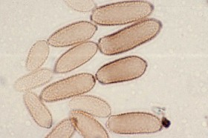
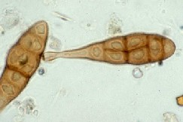
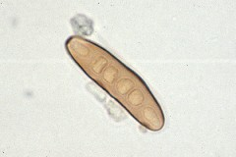
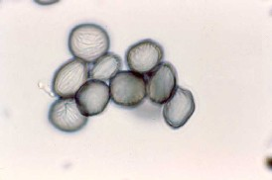
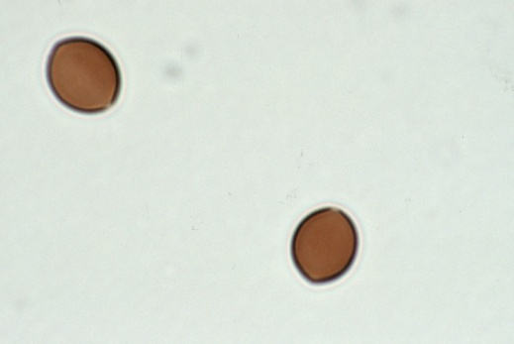
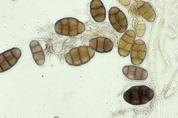
Fungal allergies: a worldwide problem
Fungal spores are among the
most numerous and diversified
airborne micro-organisms that
we breathe/contact
Chladosporium
Alternaria
Inhalation of/contact with fungal spores may induce a wide range of allergic diseases:
Rhinitis
Dermatitis
Asthma
Allergic broncho-pulmonary aspergillosis (ABPA)
Allergic responses differ by individual and by species
Drechstern
Rhizopus
Chaetomiun
Pithomyces

Slide 14
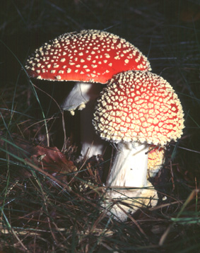
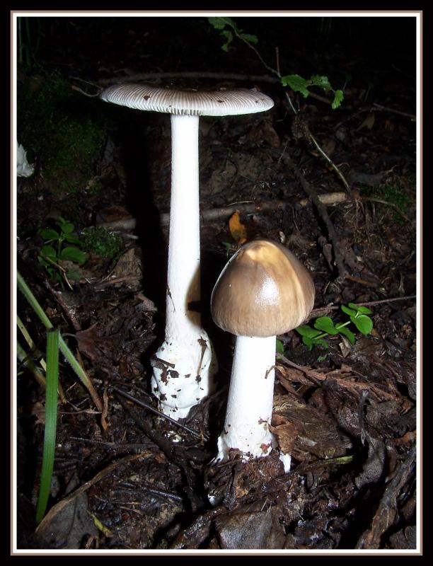
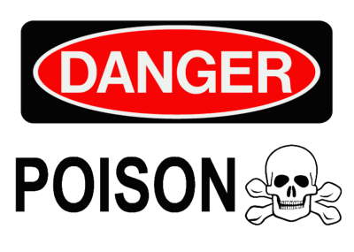

Mycotoxicosis
A toxic reaction caused by ingestion or inhalation of a mycotoxin
Mycotoxins are secondary metabolites of moulds that exert toxic
effects on animals and humans
28,018 since 1951
Amanita species
Symptoms
Breathing problems, dizziness, severe vomiting, diahorrea, dehydration,
Hepatic and renal failure 6 days later
Therapy:
Gastric lavage and charcoal, liver transplant
Berger and Guss (2005) Mycotoxins revisited:
Part I. J Emerg Med. 28:53-62.
Part II J Emerg Med. 2005 Feb;28(2):175-83.

Slide 15
Map of Lecture
Fungal illness
Allergies
Mycoses
Mycotoxicoses
Superficial
Cutaneous
Systemic

Slide 16
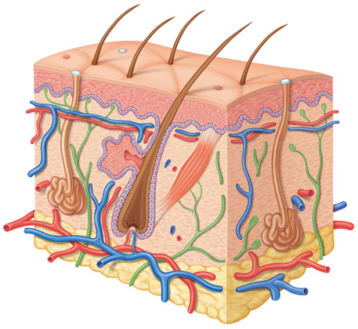
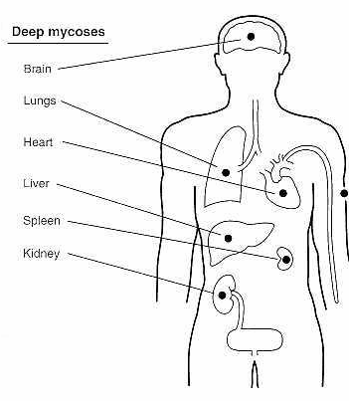
Mycoses
Mycoses are classified by the level of tissue affected
Systemic (deep)
Superficial
Cutaneous
Subcutaneous

Slide 17
Superficial Mycoses
Superficial cosmetic fungal infections
of the skin or hair shaft
No living tissue is invaded and there
is no cellular response from the host
INFECTION CAUSATIVE ORGANISM
Black piedra (Piedraia hortae)
White piedra (Trichosporon beigelii)
Pityriasis versicolor (Malassezia furfur)
Tinea nigra (Phaeoannellomyces werneckii)
Schwarze (2004) Superficial fungal infections Lancet. 364:1173-82

Slide 18
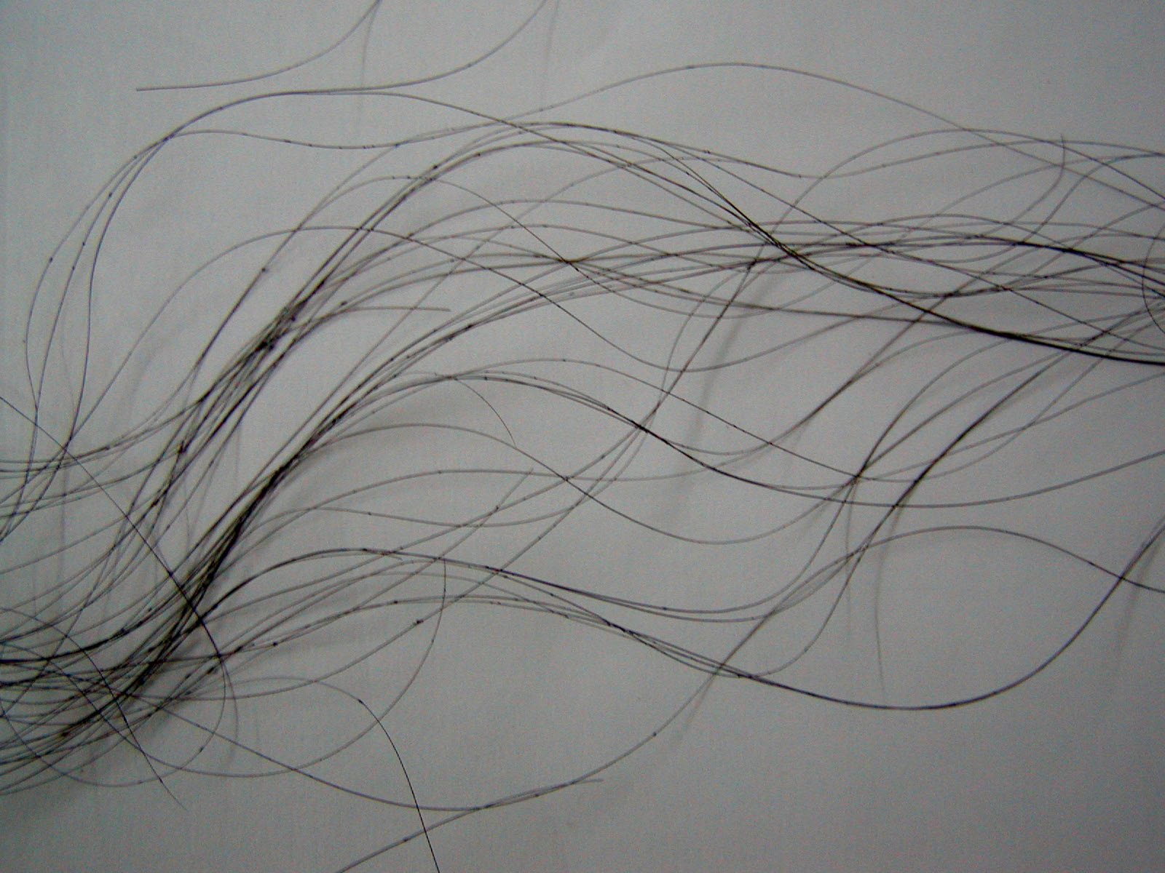
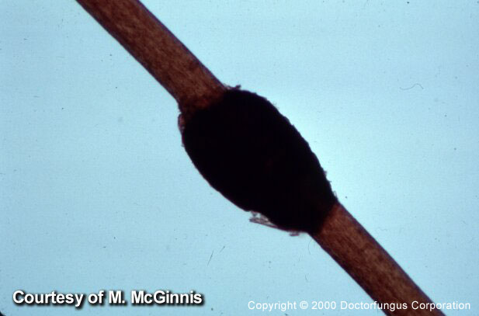
Black Piedra
Pedraia hortae
http://images.google.co.uk/

Slide 19
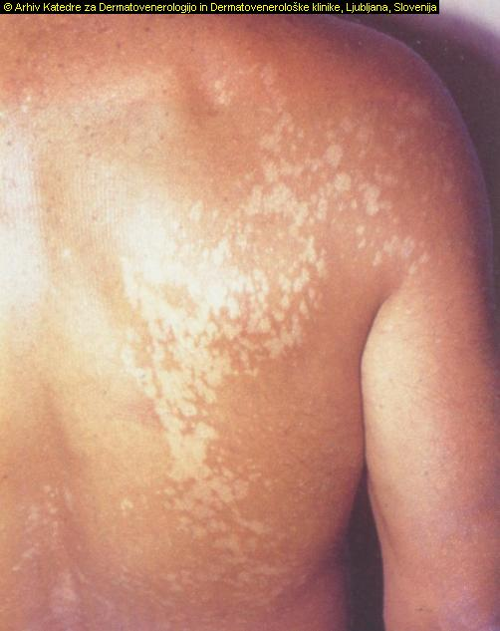
Pityriasis versicolor
Malassezia furfur

Slide 20
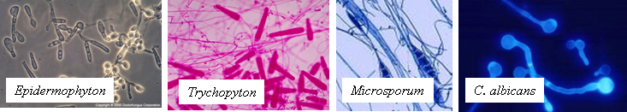
Cutaneous mycoses
Dermatophytes, or keratinophilic fungi.
Produce extracellular enzymes (keratinases) which are capable of hydrolyzing keratin.
Inflammation is caused by host response to metabolic
by-products
Dermatophytoces/ dermatomycoses

Slide 21
Dermatophytoces/dermatomycoses
Tinea = latin for worm
Tinea Capitis (head/neck)
Tinea Pedis (feet)
Tinea Corporis (body)
Tinea Cruris (groin)
Tinea Unguium (finger/toenails)
Accounts for 10 – 20% of visits to dermatologists

Slide 22
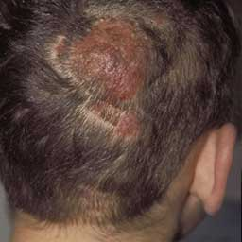
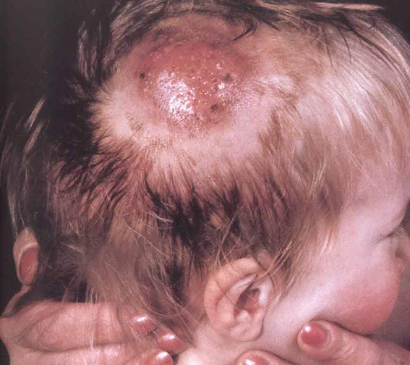
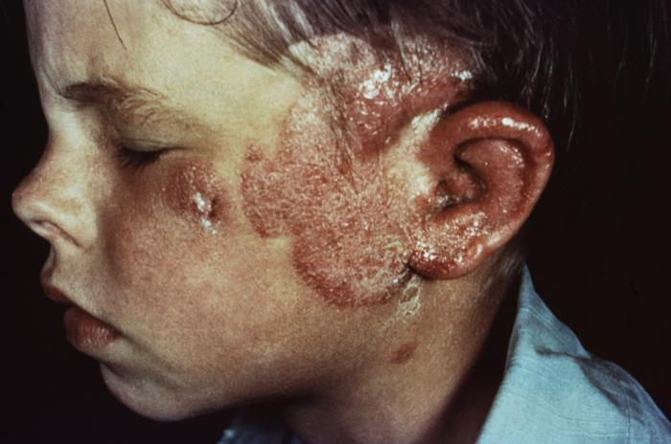
Tinea capitis
Superficial fungal infection of the skin of the scalp, eyebrows, and eyelashes,
with a propensity for attacking hair shafts and follicles
The most common paediatric dermatopyhte infection
http://www.emedicine.com/DERM/topic420.htm

Slide 23
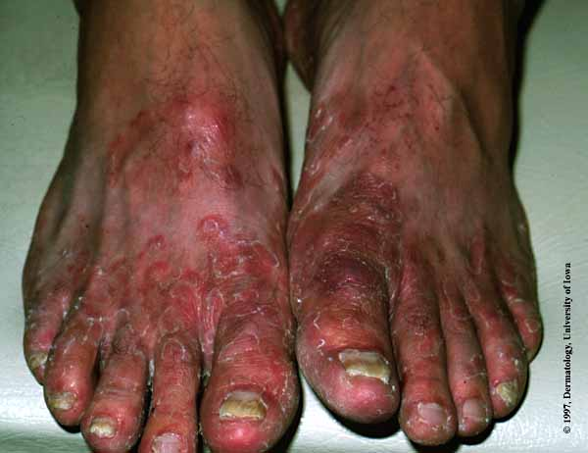
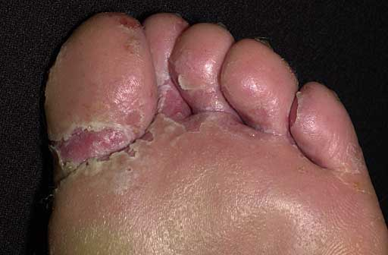
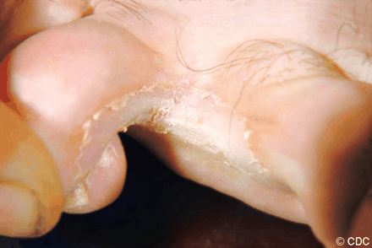
Tinea pedis
ATHLETE’S FOOT
Trichophyton rubrum the world's most prevalent dermatophyte
70% of the population will be infected with tinea pedis at some time

Slide 24
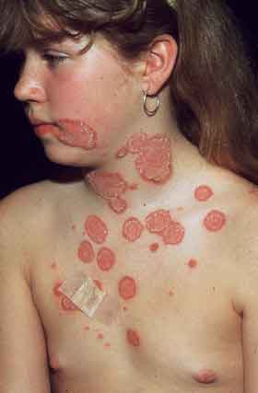
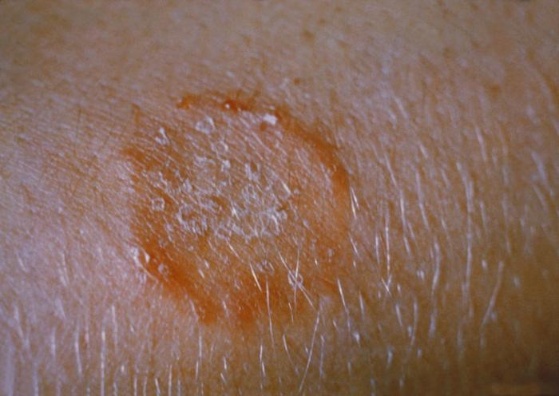
Tinea corporis
‘ring worm’

Slide 25
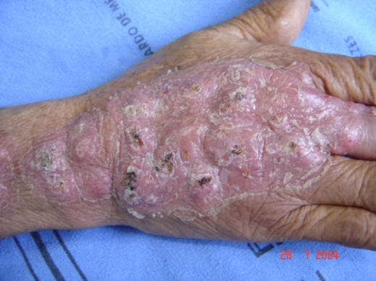
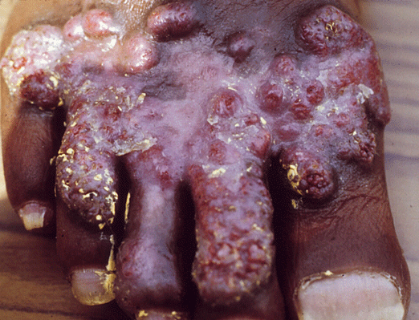
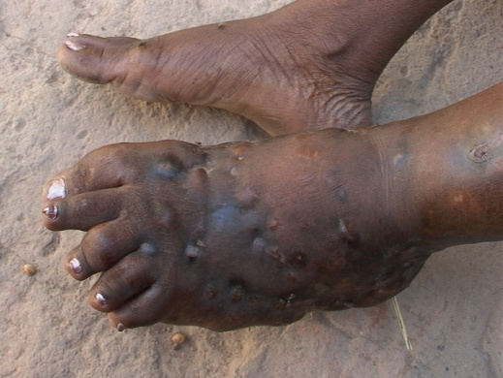
Subcutaneous mycoses
Chronic, localized infections of the skin and
subcutaneous tissue following traumatic
implantation of the aetilogic agent
Sporotrichosis
Chromoblastomycosis
Mycetoma
RARE
Minotto et. al., (2001) Chromoblastomycosis: a review of 100 cases in the state of
Rio Grande do Sul, Brazil. J Am Acad Dermatol. 44:585-92

Slide 26
Mycoses
Mycoses are classified by the level of tissue affected
Systemic (deep)
Superficial
Cutaneous
Subcutaneous
Notes:
26

Slide 27
Deep/systemic mycoses
Primary
Coccidioides immitis
Histoplasma capsulatum
Blastomyces dermatiditis
Paracocidioides brasiliensis
Opportunistic
Cryptococcus neoformans
Candida
Aspergillus
Penicillium marneffei
The zygomycetes
Trichosporon beigelii
Fusarium
Able to establish
Infection in a
normal host
Require a compromised host
In order to establish infection

Slide 28
Map of Lecture
Fungal illness
Allergies
Mycoses
Mycotoxicoses
Candida
infections
and
virulence factors
Superficial
Cutaneous
Systemic
Aspergillus
infection

Slide 29

Trend in hospital-acquired fungal infections in US hospitals, 1980 - 1990
Rate per 1000 discharge
AIDS, solid organ or hematopoietic stem cell transplants (HSCTs)
ICU: Invasive monitoring, aggressive therapeutics
Beck-Sague et al, (1993) Secular trends in the epidemiology of nosocomial fungal infections
In the United States 1980-89 J Infect Dis 1993 167: 1247

Slide 30
Human fungal infections
Disease Most common species | Location | Estimated Life-Threatening Infections / Year at that Locationª | Mortality Rates (% in infected populations)ª
Opportunistic Systemic Mycoses
Aspergillosis Aspergillus fumigatus | worldwide | >200,000 | 30 - 95%
Candidiasis Candida albicans | worldwide | >400,000 | 46 - 75%
Cryptococcosis Cryptococcus neoformans | worldwide | >1,000,000 | 20 - 70%
Mucormycosis Rhizopus oryzae | worldwide | >10,000 | 30 – 90%
Pneumocystis Pneumocystis jirovecii | worldwide | >400,000 | 20 - 80%
Endemic Dimorphic Mycoses^{a,b}
Blastomycosis Blastomyces dermatitidis | Midwestern and Atlantic U.S. | ~3,000 | <2% - 68%
Coccidioidomycosis Coccidioides immitis | Southwestern U.S. | ~25,000 | <1% - 70%
Histoplasmosis Histoplasma capsulatum | Midwestern U.S. | ~25,000 | 28 – 50%
Paracoccidioidomycosis Paracoccidioides brasiliensis | Brazil | ~4,000 | 5 – 27%
Penicilliosis Penicillium marneffei | SouthEast Asia | >8,000 | 2 – 75%
Human fungal infections: the hidden killers
Brown, Denning, Gow,, Levitz, Netea and White (2012) Sci. Trans. Med.

Slide 31
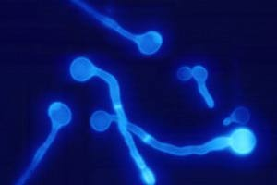
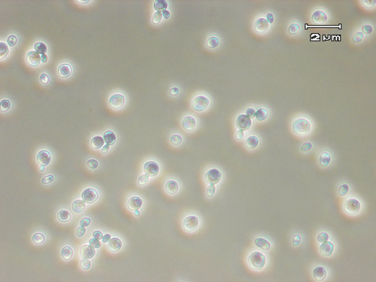
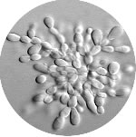
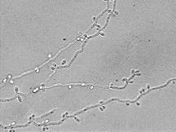
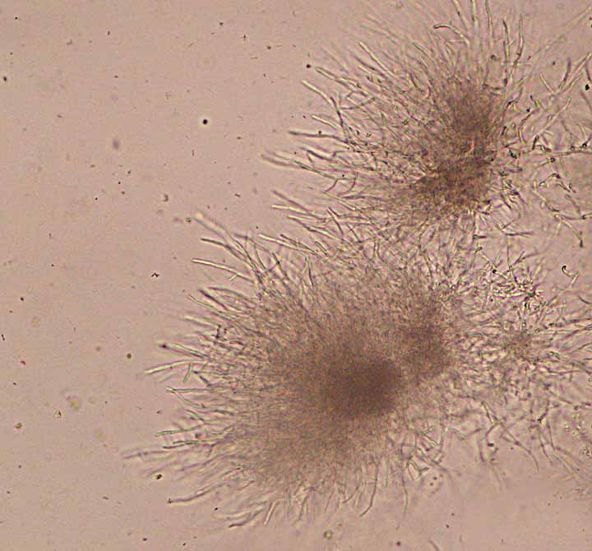
Pathogenic Candida species
> 100 identified Candida species
Six species predominate as pathogens
Colonise humans: (20-25%) oral colonisation of healthy subjects
Gastrointestinal tract
Respiratory tract
Vagina
Urethra
Skin
Fingernails
Candida albicans
Hospital environment
Floors
Food
Hands
Candida krusei
Candida tropicalis
Candida parapsillosis
C. glabrata

Slide 32
Candida infections
Candida albicans is an opportunistic commensal
Gastrointestinal
Genitourinary tract
Skin
HEALTHY
Superficial
Mucosal
Systemic
IMMUNO
COMPROMISED
Colonisation and invasion of host tissues

Slide 33
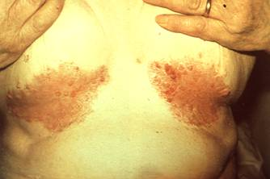
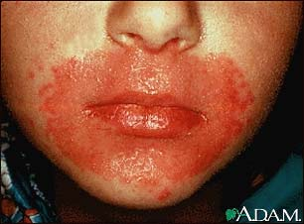
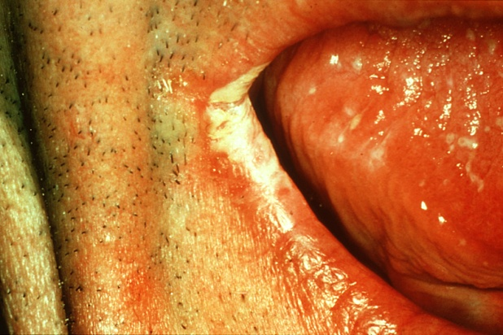


Superficial Candida infections
Mouth, throat, skin, scalp, vagina, fingers, nails,
bronchi, lungs, or the gastrointestinal tract
Usually due to impaired epithelial barrier functions
Occur in all age groups
Most common in the newborn and the elderly
Respond readily to treatment.

Slide 34
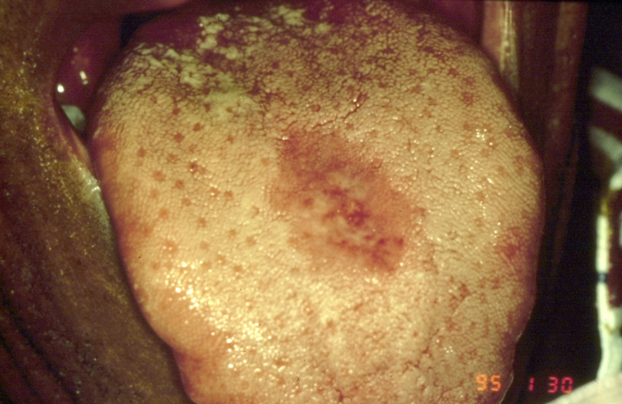
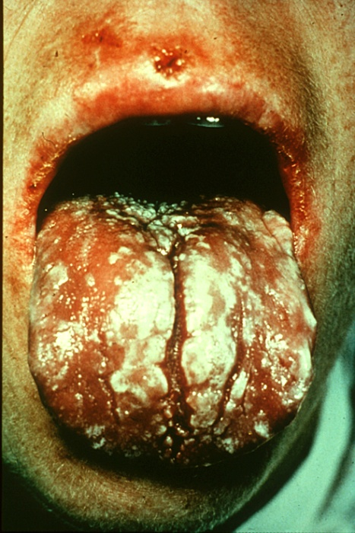
Candida Infections
Mucosal infections
Symptomatic infection
Occurs at extremes of life
(elderly and neonates)
HIV:
Oropharyngeal
Esophagal
Vulvovaginal
Frequently seen

Slide 35
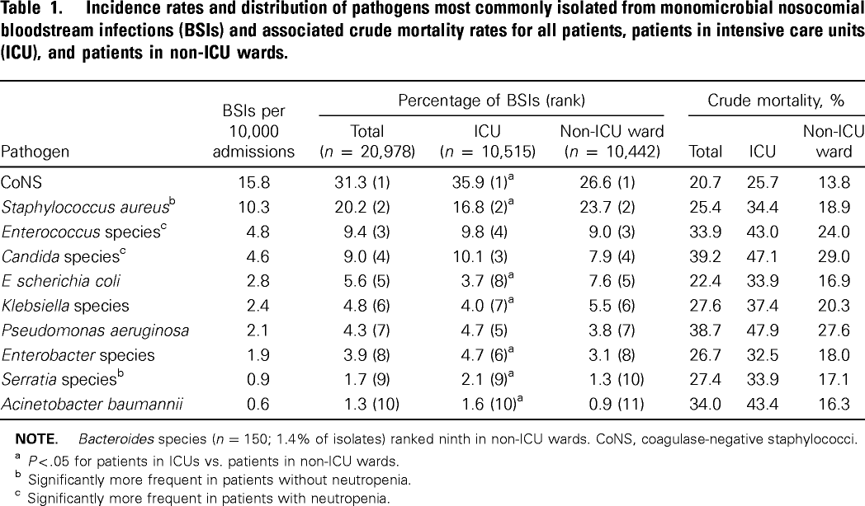
Hospital-acquired blood stream infections in US Hospitals
7.5 year study period, 24,179 infections were reported
50%
Wisplinghof et al., (2004) Nosocomial bloodstream infections in US Hospitals: Analysis of 24,179
cases from a prospective national surveillance study Clin. Inf. Dis. 39:309-17

Slide 36
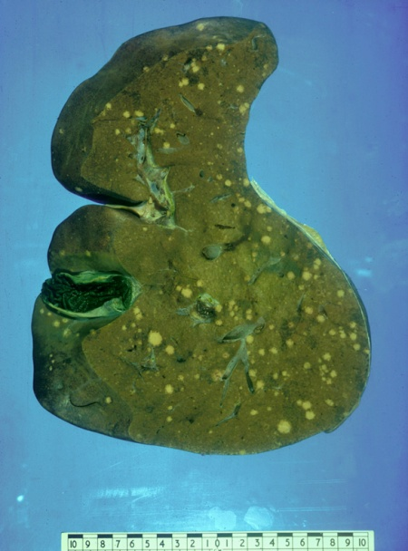
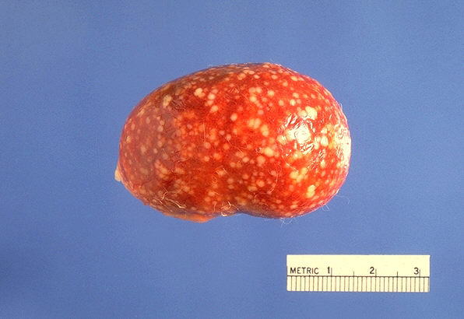
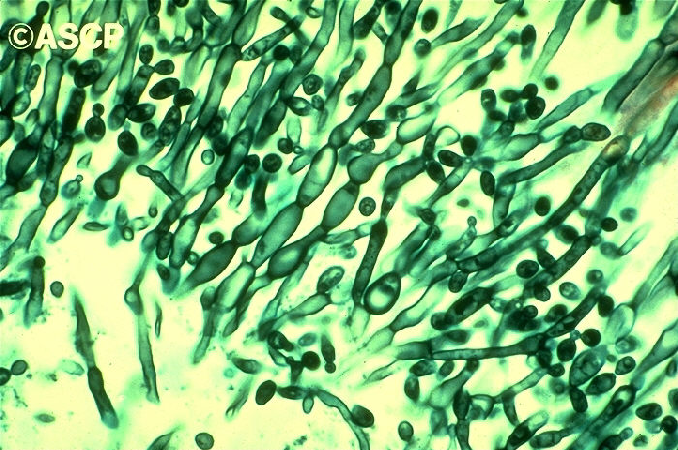

Candida Infections
Systemic infections
Not seen in normal healthy individuals
Well characterised risk factors:
Chemotherapy
Gut-related surgery
CATHETERS

Slide 37
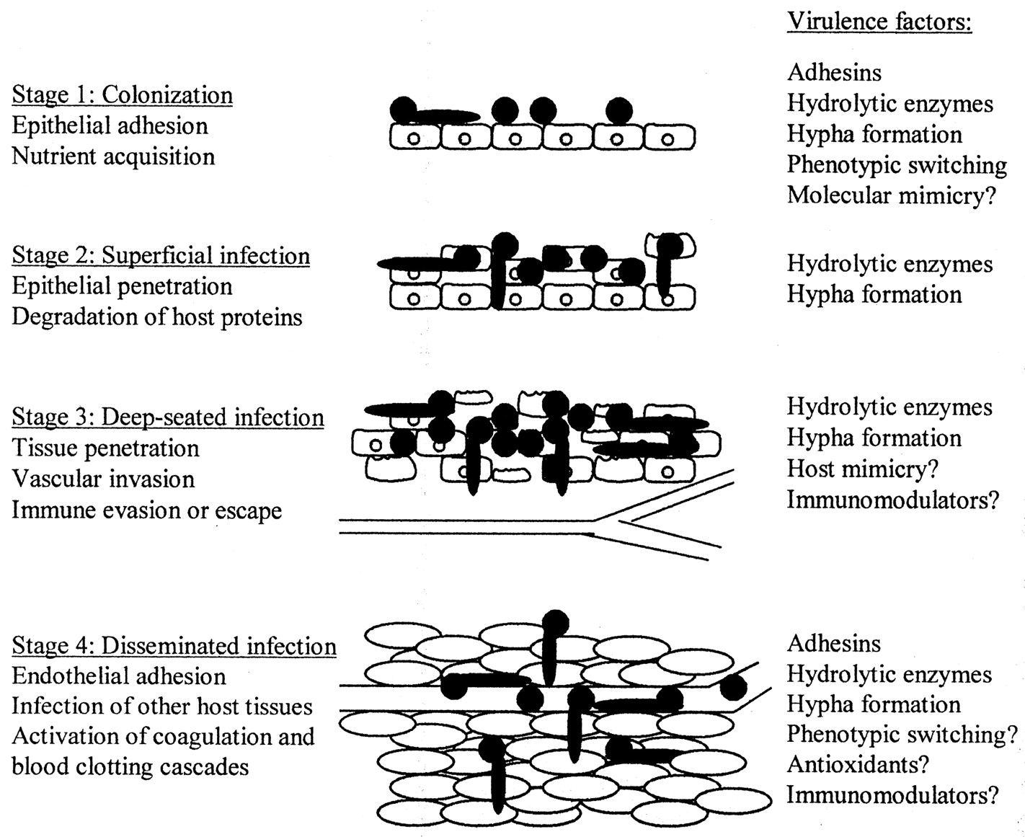
Candida virulence
Asymptomatic colonisation
Superficial infection
Deep -seated infection
Disseminated infection
Notes:
37

Slide 38
The growth environment affects C. albicans
cell shape
Low growth temperature
pH 4.0
pH 6.0
Nitrogen starvation
SERUM
pH 7.0
CANDIDA ALBICANS: A MOLECULAR REVOLUTION BUILT ON LESSONS FROM BUDDING YEAST
Berman and Sudbury (2002) Nature Rev. Genetics 3 918

Slide 39

Aspergillus fumigatus
Aspergillus nidulans
Aspergillus flavus
Aspergillus niger
Aspergillus clavatus
Aspergillus glaucus
Aspergillus oryzae
Aspergillus terreus
Aspergillus ustus
Aspergillus versicolor
“In this new millennium, invasive aspergillosis (IA)
has emerged as the major clinical problem of modern
mycology”
(Kontoyiannis and Bodey Eur J Clin Microbiol Infect Dis. 2002 Mar;21(3):161-72. )

Slide 40






Invasive pulmonary aspergillosis (IPA)
Lung
Brain
Kidney
Heart
Incidence by underlying condition
Organ or stem cell transplant 15%
Myeloid and lymphatic leukaemia 10%
AIDS 3%
Implications (U.S.A)
$633 million
1970 deaths
60,000 deaths/year worldwide
(Cornet, 2002; Grow, 2002; Marr, 2002; Minari, 2002; Singh, 2003; Duchini, 2002; Libanore, 2002)

Slide 41
Map of Lecture
Fungal illness
Allergies
Mycoses
Mycotoxicoses
Candida
infections
and
virulence factors
Superficial
Cutaneous
Systemic
Diagnosis
of fungal
infections
Antifungal therapy
Aspergillus
infection
Case study

Slide 42
There are few signs and symptoms
in patients that are specific for
systemic fungal infection
Begin with a high index of suspicion

Slide 43












Diagnosis of Fungal Infections
microscopy
culture
sample acquisition
identification

Slide 44




Diagnosis of fungal infections
Sample aquisition
Skin
Sputum
Bronchoalveolar lavage
Blood
Vaginal swab/smear
Spinal fluid
Tissue biopsy
http://jac.oxfordjournals.org/cgi/reprint/49/suppl_1/11

Slide 45


Microscopy
Seeing is believing
The gold standard for diagnosis
Rapid
Cheap

Slide 46
Pathogenic Candida species
Candida tropicalis
Candida krusei
C. glabrata
Candida albicans
Candida parapsillosis

Slide 47





Culture
Slow
Prone to contamination
Requires skilled
Sample collection
Positive ID
Allows susceptibility testing

Slide 48
Non-culture methods
Antibody- and antigen-based assays
Detect:
Glucan
Mannan
Enolase
Proteinase
PCR

Slide 49

What are the targets for antifungal therapy?
Cell membrane
Fungi use principally ergosterol instead of cholesterol
DNA Synthesis
Some compounds may be selectively activated by fungi, arresting DNA synthesis.
Cell Wall
Unlike mammalian cells, fungi have a cell wall
Atlas of fungal Infections, Richard Diamond Ed. 1999
Introduction to Medical Mycology. Merck and Co. 2001

Slide 50
Medical Mycology:
The Last 50 Years
Anidulafungin
Caspofungin
# of drugs
XMP
Ravucon
Sordarins
Micafun
L-AmB
ABCD
ABLC
Voricon
Posacon
Terbinafine
Amphotericin B (1958)
Itraconazole
Griseofulvin
Fluconazole
Ketoconazole
Nystatin
Miconazole
5-FC

Slide 51
Cell Membrane Active Antifungals
Cell membrane
• Polyene antibiotics
- Amphotericin B, lipid formulations
- Nystatin (topical)
• Azole antifungals
- Ketoconazole
- Itraconazole
- Fluconazole
- Voriconazole
- Miconazole, clotrimazole (and
other topicals)
Inhibit synthesis of ergosterol the main sterol in the fungal membrane
Act upon fungal cytochrome P450 enzymes

Slide 52
DNA RNA SYNTHESIS
DNA/RNA synthesis
• Pyrimidine analogues
- Flucytosine

Slide 53
Cell Wall Active Antifungals
Cell membrane
• Polyene antibiotics
• Azole antifungals
DNA/RNA synthesis
• Pyrimidine analogues
- Flucytosine
Cell wall
• Echinocandins
-Caspofungin acetate (Cancidas)
Atlas of fungal Infections, Richard Diamond Ed. 1999
Introduction to Medical Mycology. Merck and Co. 2001

Slide 54
The Fungal Cell Wall
The most overt distinction between mammalian and fungal cells
mannoproteins
Premier target of
antifungal therapy
Major components are
glucans and chitin
Non-specific inhibition
Of β 1,3 glucan synthase
β1,3
β1,6
glucans
Cell
membrane
β1,3 glucan
synthase
chitin
ergosterol
Atlas of fungal Infections, Richard Diamond Ed. 1999
Introduction to Medical Mycology. Merck and Co. 2001

Slide 55
Sporotrichosis of the finger
Healthy adult rose gardener
Progressive suppuration of a finger, Oct -99
Grew S. schenckii
Here’s how it looked at the start.

Slide 56

A biopsy of this area grew Sporothrix schenckii

Slide 57


Slide 58


Slide 59


Slide 60


Slide 61


Slide 62

2-Nov-99, two weeks of itraconazole

Slide 63

16-Nov-99, 4 wks of itraconazole

Slide 64

16-Dec-99, 8 wks of itraconazole

Slide 65

22-Mar-00. Has had 6 mos itraconazole
This is the site of an original lesion. He still scratches it. There is a very small amount of induration under it, but it is vastly better.

Slide 66

22-Mar-00. Has had 6 mos itraconazole
The little finger itself is almost normal.
There is a defect in the nail
The finger is overall a little thicker than the contra-lateral finger, but no edema, skin creases are visible, no pain.

Slide 67

1 Jun 00: Off itraconazole x 11 weeks
The lesions continue to fade. Although they are slightly visible, they are no longer palpable at all. The skin of the finger just proximal to the nail is a little thin, but really quite unremarkable otherwise.

Slide 68

1 Jun 00: Off itraconazole x 11 weeks
The lesion of the mid fore-arm is likewise no longer perceptible. He appears cured!
Spring 2001: The hand remains well!

Slide 69
Routes to Sporotrichosis Diagnosis
Sporotrichosis is a thermally dimorphic fungus that can be grown from infected tissues.
S schenckii is easy to grow and is not sensitive to cycloheximide, which is often added to fungal culture media to inhibit growth of saprophytes and to promote growth of dermatophytes.
At 25°C on Sabouraud agar, the fungus forms a white-to-cream–colored mold that turns dark brown or black as it ages, often forming a leathery, wrinkled surface.
Microscopic examination of a cotton blue or Scotch tape preparation reveals long and slender septate hyphae with hyaline pyriform conidia, often forming flowerlike arrangements.
In tissue at 37°C, S schenckii takes on an elongated yeast form, approximately 6-8 mm in length, with rounded ends resembling cigars. Budding from the main yeast bodies may be observed in the tissues.
To confirm the identity of this fungus, the hyphal form may be converted into the yeast phase. This is often best achieved by growing the fungus on brain-heart infusion agar supplemented with sheep's blood then raising the temperature from 25°C to 37°C.
Fine-needle aspiration of lymphocutaneous sporotrichosis can be followed by periodic-acid Schiff (PAS) and Grocott's methenamine silver (GMS) method.
Further laboratory studies (eg, tuberculosis test, antinuclear antibody test) may be needed to identify other potential infectious or noninfectious causes that may mimic sporotrichosis.

