Slide 1
Evolution and emergence of new viruses
Professor Wendy Barclay
Course code (MBBS) : Microbiology 8
Course code (BMS) : IIP-L22

Slide 2
Viruses evolve quickly

Slide 3
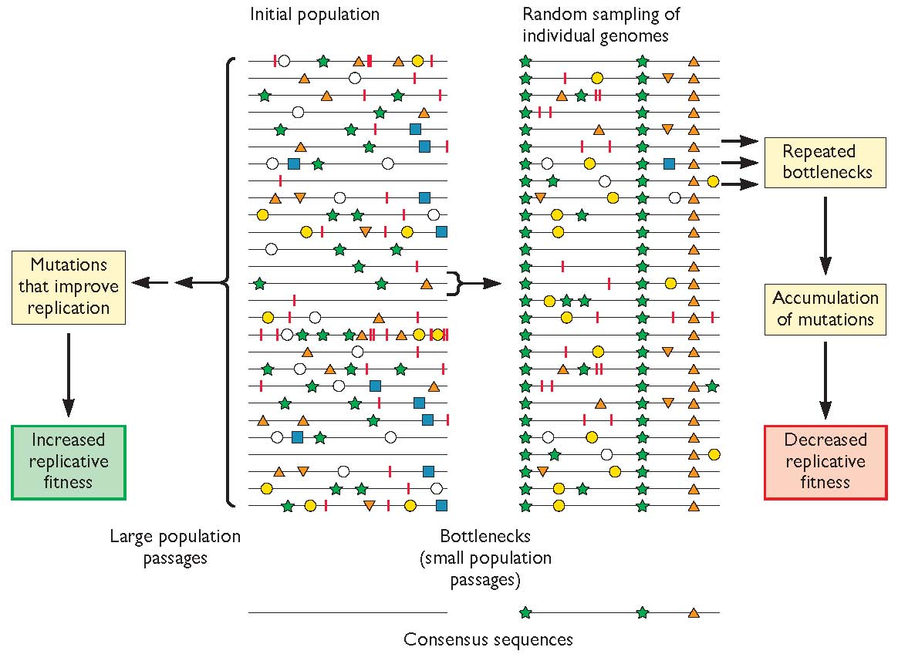
Evolution of human viruses during human circulation
Within host evolution of HIV. The quasispecies that exists within a single infected person contains every single mutation at every single position in the genome.

Slide 4
Antiviral drug resistance
High mutation rate and large progeny numbers make viral evolution in response to selective pressure very fast.
Relative fitness of drug resistant virus vs wild type virus in vivo can influence whether drug resistant viruses proliferate.

Slide 5
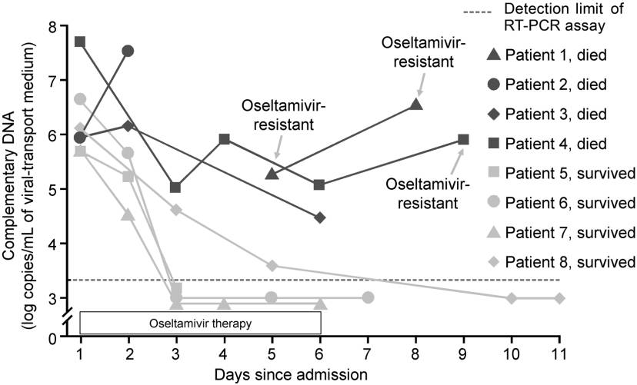
Oseltamivir resistance during H5N1 hospitalization

Slide 6
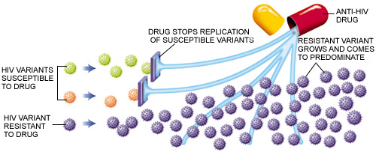
Emergence of drug resistance

Slide 7
Rationale for multidrug therapy.; HAART for HIV
Error rate 1 in 10⁴
10kb genome

Slide 8
Antibody as the selection pressure for evolution
mRNA
mRNA
cRNA
vRNA

Slide 9
Antigenic drift.
Vaccine updated every year to best represent the circulating strains.

Slide 10
Viral genetic evolution studied by phylogenetic trees

Slide 11
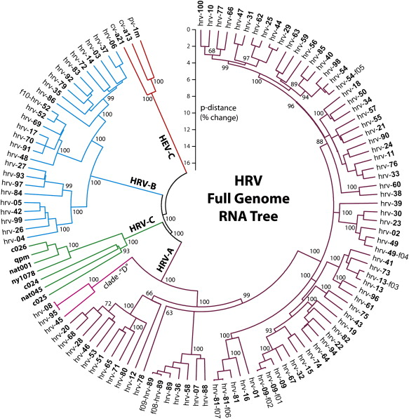
The rhinovirus phylogeny shows simultaneous circulation of many seroptypes

Slide 12
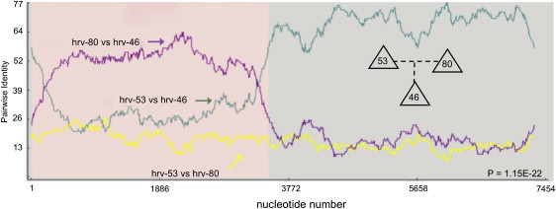
Intervirus recombination gives rise to new viruses

Slide 14
Reassortment leading to antigenic shift
H3N2
H5N1

Slide 15
The pandemic potential of influenza virus
Haemagglutinin
Neuraminidase
H16

Slide 16
Influenza Pandemics in the 20th Century.
H5N1, H7N7
1900 1910 1920 1930 1940 1950 1960 1970 1980 1990 2000
H1N1
H2N2
H3N2
Avian circulating
viruses

Slide 17
Influenza viruses circulate in pigs
H16

Slide 18
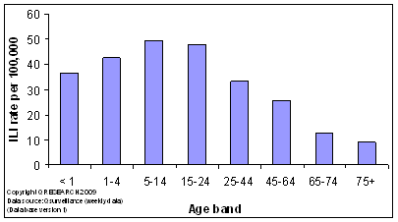
How did H1N1 swine flu cause a pandemic when H1N1 human influenza was already circulating?
1910 1920 1930 1940 1950 1960 1970 1980 1990 2000 2009
H1N1
1918
Classical
swine flu

Slide 19
How do new viruses emerge?
Zoonosis
Genetic variation
Increased exposure- travel or world population
Increased exposure- spread of vector
New discoveries

Slide 20
Global influences on emerging infections
Environmental modification; demographics
World population
Climate change
Travel
Farming practises; monocultures
Immunosuppressed humans due to HIV
Medical progress

Slide 21
Arboviruses
Yellow fever; Dengue; West Nile
Flaviviruses
Mosquito host
Global warming, decrease in mosquito control, imports, stagnant water in large cities, dams

Slide 22
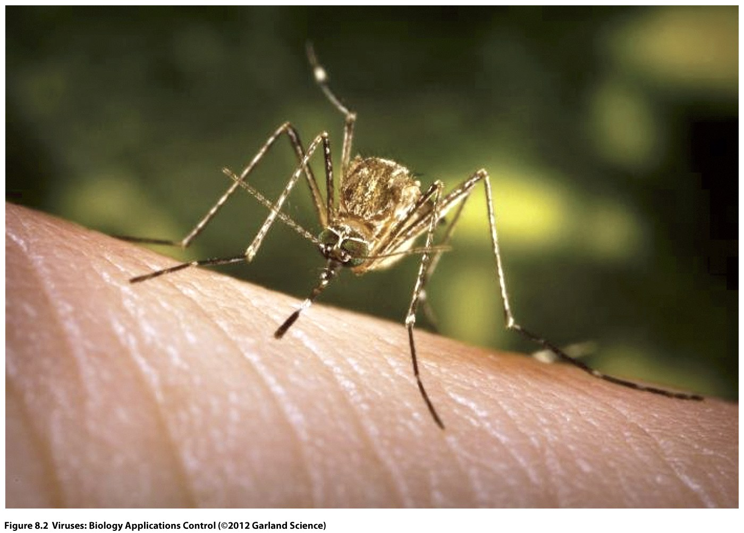
Culex tarsalis the vector for West Nile Virus

Slide 23
Horses and humans are dead end hosts

Slide 24
West Nile fever in New York
West Nile Virus belongs to Japanese encaphalitis group of flaviviruses
WNV discovered in 1937, but mild disease
1956 outbreak in Eastern Europe with symptoms of increased severity
1999 in New York 61 cases, 7 deaths all > 50 years of age
Concurrently, birds in Bronx Zoo and wild crows became ill

Slide 25
Origins of WNV in New York
Subtractive differential analysis used to diagnose a human brain sample revealed WNV DNA
RT-PCR showed sequence identity with a virus circulating in Israel
Illegally imported bird?
Viraemic human?
Infected mosquito?

Slide 26
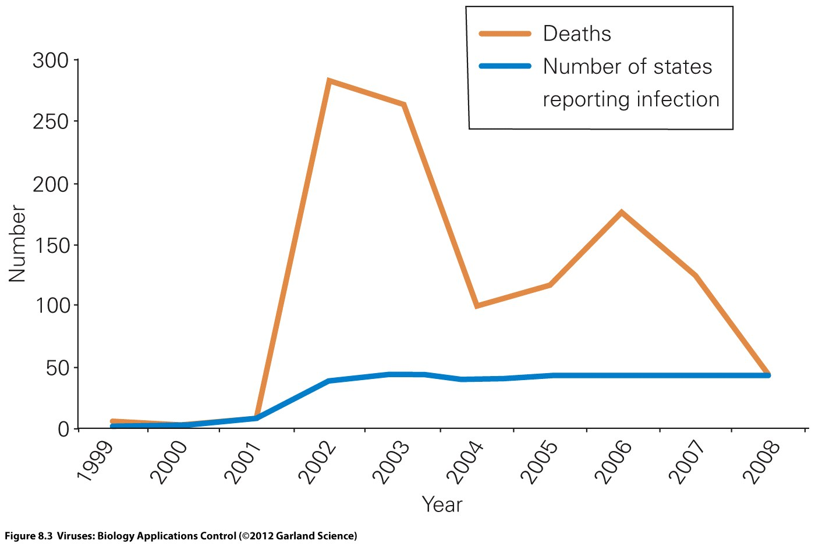
West Nile Virus arrived in the USA 2002

Slide 27
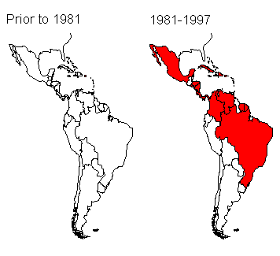
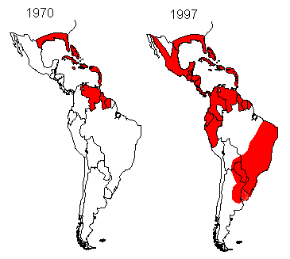
Spread of DHF correlates with upsurge in mosquito population
Areas with DHF
High population of Aedes aegypti

Slide 28
Dengue Haemorrhagic fever
3 billion people live in at risk areas
50-100 million cases of DF each year; 300 000 cases of DHF
DHF case fatality 5%
4 serotypes of DV cross reactivity but no cross protection

Slide 29
Risk Factors Reported for DHF
Virus strain
Pre-existing anti-dengue antibody
previous infection
maternal antibodies in infants
Age
Higher risk in secondary infections
Higher risk in locations with two or more serotypes circulating simultaneously at high levels (hyperendemic transmission)

Slide 30
Dengue antibodies can either
neutralize infection or enhance infection

Slide 31
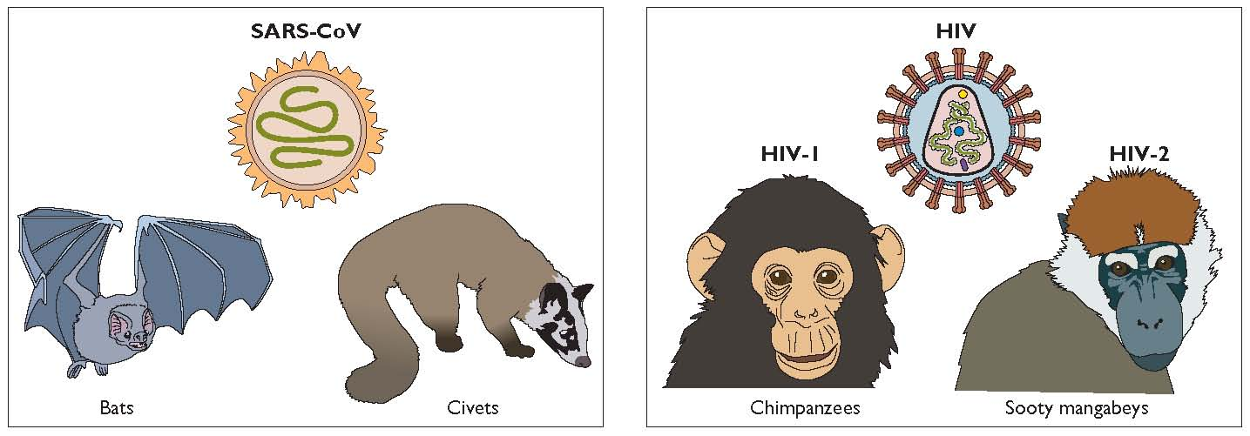
Human viruses from animal sources
Vs Ebola, Hendra, Nipah which spill over but does not transmit

Slide 32
Severe Acute Respiratory Syndrome SARS
Chain of human transmission began November 2002, Guandong province China.
Late February 2003 international spread.
July 2003 last chain of human transmission broken.
8422 cases in 29 countries, 916 total fatalities, 908 of them in China, Singapore, Canada, and Vietnam.

Slide 33
Transmission and clinical epidemiology
Infected respiratory droplets; concentrated virus sources on lift buttons and in bathroom drains.
Amplified by use of nebulizers in hospitals.
Children experienced mild disease, patients over 60 years have 55% mortality.
Patients most infectious at 10 days post infection, when also symptomatic.
Destruction of lung tissue from overexuberant immune response.
Emergency response coordinated, international, rapid.

Slide 34
The SARS virus.
Coronavirus; Large (30kb) positive sense RNA genome.
Envelope spike protein.
Receptor is human ACE-2 protein.
A virus almost identical isolated from masked palm civets and raccoon dogs in wet markets.
29 amino acid deletion in S separates human and animal SARS viruses.

Slide 35
Coronaviruses as a threat to human health
In March 2003, a novel coronavirus (SARS-CoV) was discovered in association with cases of severe acute respiratory syndrome (SARS).
There are three groups of coronaviruses; groups 1 and 2 contain mammalian viruses, while group 3 contains only avian viruses
Human coronaviruses (HCoVs) are found in both group 1 (HCoV-229E) and group 2 (HCoV-OC43) and are responsible for ~30% of mild upper respiratory tract illnesses.

Slide 36
The latest coronavirus scare

Slide 37
Another coronavirus

Slide 38
Adaptation of a novel respiratory virus to man

Slide 39
Emerging viruses as a result of a change in man’s behaviour

Slide 40
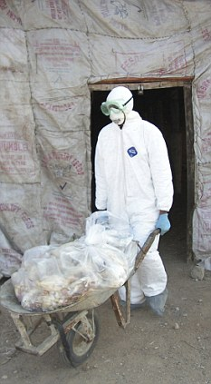
Man’s intervention as the cause of emerging viruses
Myxoma Virus released for rabbit control is Australia
Genetic manipulation creates a transmissible H5N1 influenza virus

Slide 41
‘New’ viruses can be those that are only recently discovered or detected
‘Non A non B’ hepatitis caused by hepatitis C virus
Human papillomaviruses 16 and 18 as cause of cervical cancer
HHV8 as cause of Kaposi’s Sarcoma noticed during the AIDS pandemic
Merkel cell polyoma virus

