Slide 1
Epithelial tissues
Dr Peter Clark
Course code (MBBS) : Tissues 2
Course code (BMS) : BCT-L5

Slide 2
The Organisation and Functions of Epithelia
Dr Peter Clark, NHLI, SAFB, SK

Slide 3
Lecture Content
Describe the classification of epithelia
Understand the polarity of epithelia
Describe the role of cell-cell junctions in epithelial polarity
Describe the relationships between cellular organisation and epithelial function
Describe patterns of cell division in the turnover of epithelia

Slide 4
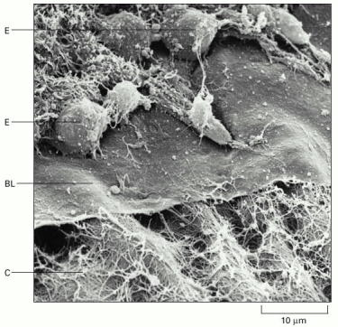
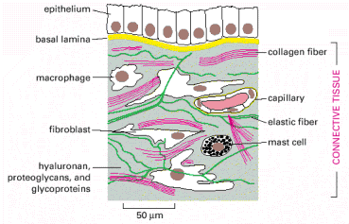
Epithelium
Epithelial organs always have associated ECM and connective tissue cells.

Slide 5
Epithelial organisation
epithelial cells make organised, stable cell-cell junctions to form continuous, cohesive layers
epithelial layers line internal and external body surfaces and have a variety of functions, e.g. transport, absorption, secretion, protection

Slide 6
Epithelia are classified by
their shape, e.g. cuboidal or columnar
their layering, e.g. single layer = simple; multi-layered = stratified

Slide 7
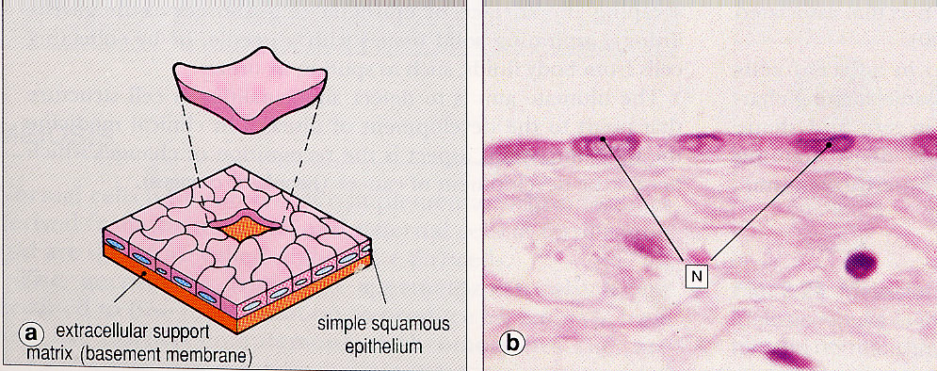
Classification of epithelia: simple squamous e.g. lung alveolar, mesothelium, endothelium

Slide 8
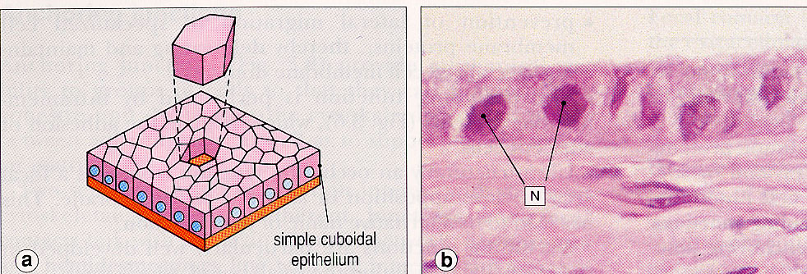
Classification of epithelia: simple cuboidal e.g. kidney collecting duct

Slide 9
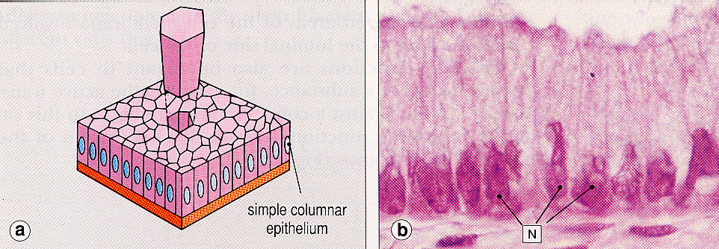
Classification of epithelia: simple columnar e.g. enterocytes (intestinal absorptive)

Slide 10
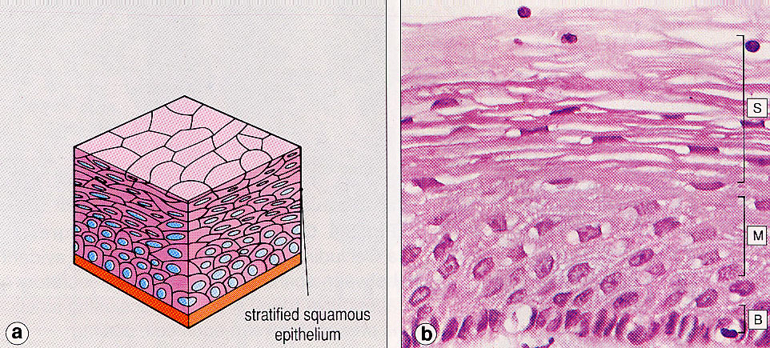
Classification of epithelia: stratified squamous (a) keratinizing:epidermis (skin) (nuclei not visible in surface layer cells) (b) non-keratinizing: linings of mouth, oesophagus, anus, cervix and vagina (nuclei are visible in surface layer cells)

Slide 11
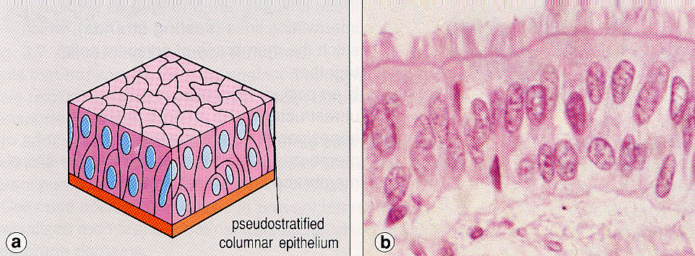
Classification of epithelia: pseudostratified e.g. upper airway (bronchi) epithelium

Slide 12
Epithelial polarity
secretion, transport, absorption etc. must usually be unidirectional
polarity is required to give directionality to epithelial function
membrane polarity is key to epithelial polarity
junctions separate membrane into two biochemically and functionally distinct domains: the apical and basolateral domains

Slide 13
Epithelial polarity
epithelial layers have a distinct polarity, with an apical surface at the lumenal (open) surface, and a basal surface in contact with the extracellular matrix
the membrane between these two surfaces, where adjacent membranes oppose each other, is the lateral membrane
basal and lateral membranes are usually grouped as one membrane domain, the basolateral membrane

Slide 14
Epithelial membrane polarity
apical domain
Junctions
basal lamina
basolateral domain

Slide 15
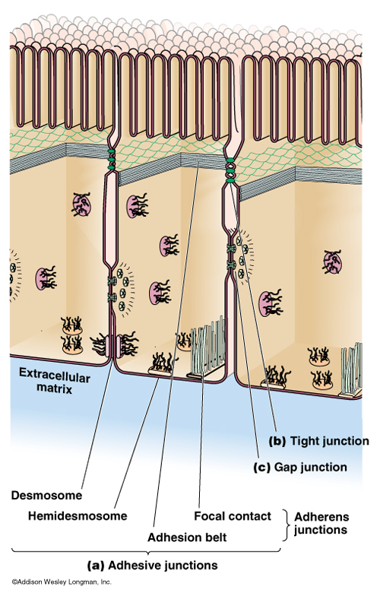
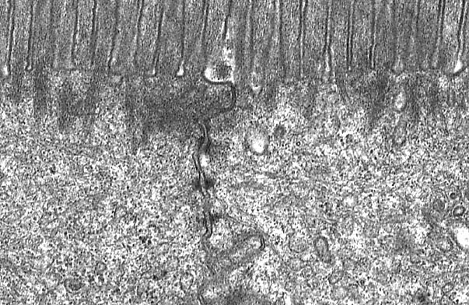
Cell-Cell Junctions in Epithelia
Junctions are usually arranged as continuous belts (zonula) or as discrete spots (macula)
TJ
AJ
Des

Slide 16
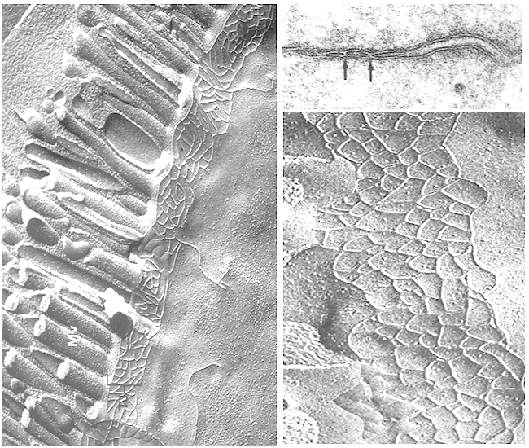
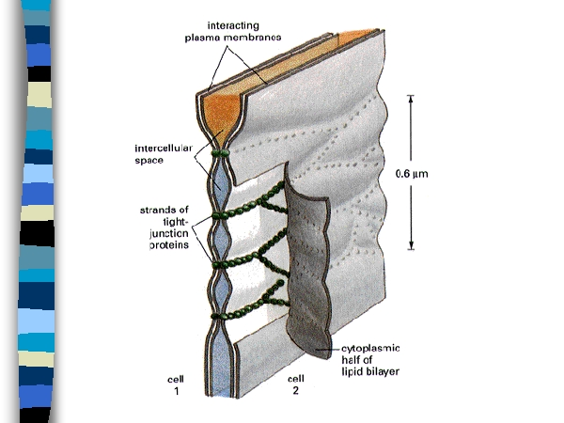
Tight junctions

Slide 17
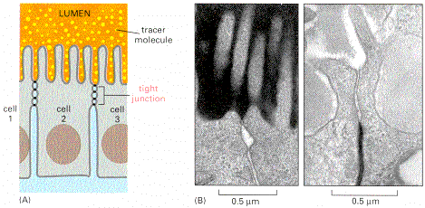
Tight Junctions Restrict Paracellular Permeability

Slide 18
Epithelial Polarity - transport
Transporter not polarised: no net directional flow
Transporter polarised: directional flow

Slide 19
Epithelial Polarity - secretion
Unpolarised Polarised
Secretion is polarised to ensure that the secreted products are delivered to the correct tissue compartment.

Slide 20
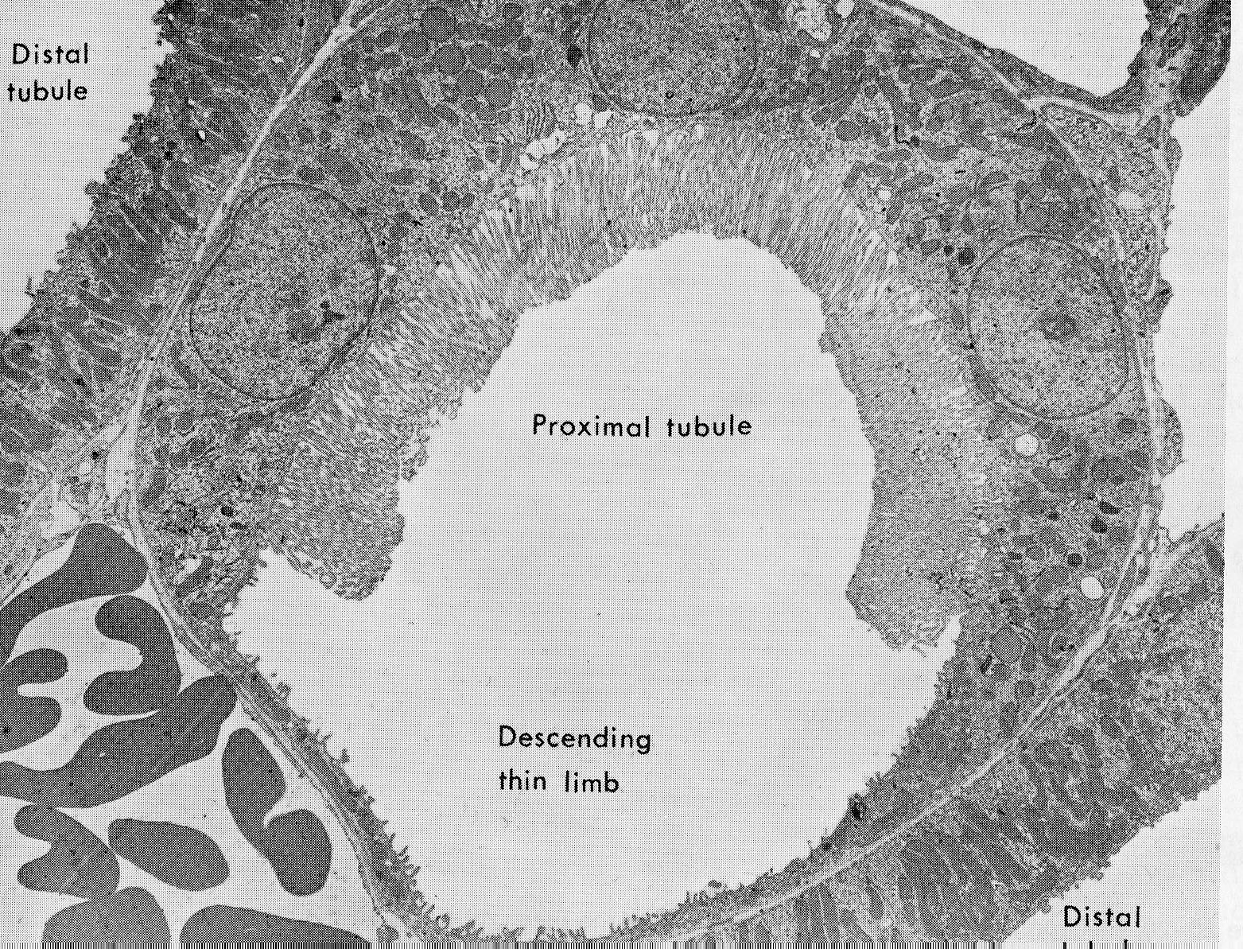
Absorptive and transporting epithelia: Junction of proximal tubule and decending thin limb of loop of Henle
Vessel
containing RBCs

Slide 21
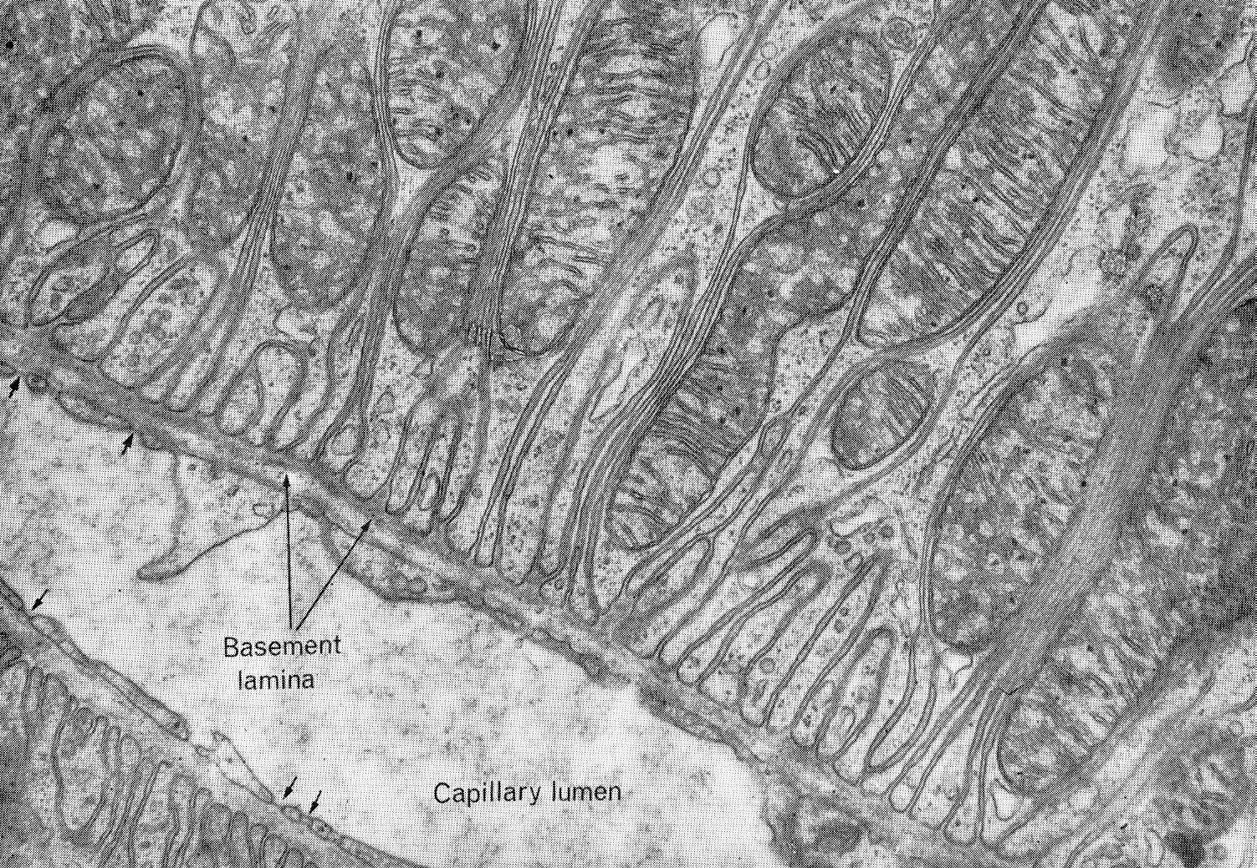
Transporting epithelium: mitochondria, associated with basal membrane in-foldings, providing energy for active transport

Slide 22
Epithelium Transporting Ions and Fluid
Microvillous brush border
(passive transport of water and ions)
}
Direction of transport
Mitochondria at basal membrane infoldings
(membrane transporters for active transport)
}
Basal Lamina
capillary

Slide 23
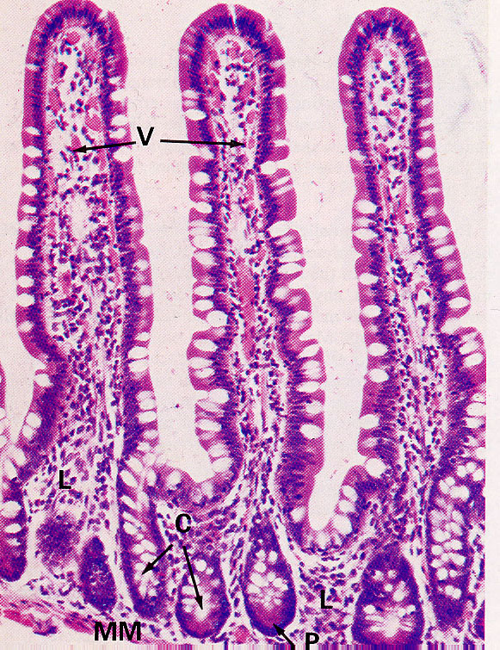
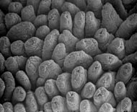
The intestinal epithelium is simple columnar, with both absorptive and secretory cells
Villus epithelium
The darker cells are the enterocytes (absorptive) and the cells with pale apical cytoplasm are Goblet cells (secrete mucus)
SEM of intestinal villi

Slide 24
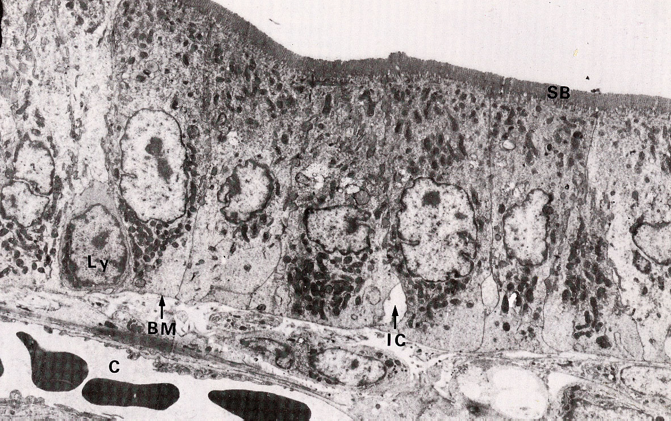
Absorptive epithelium: carriers transporting nutrients etc. are found on the brush-border membranes, e.g. absorptive intestinal cells (enterocytes); kidney proximal tubule cells.

Slide 25
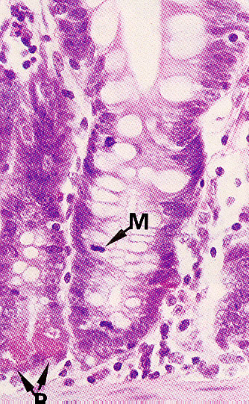
Cell division, for the renewal of the surface epithelial cells, is by stem cells in the intestinal crypts
Base of villus
Crypt with mitotic cell, “M”

Slide 26
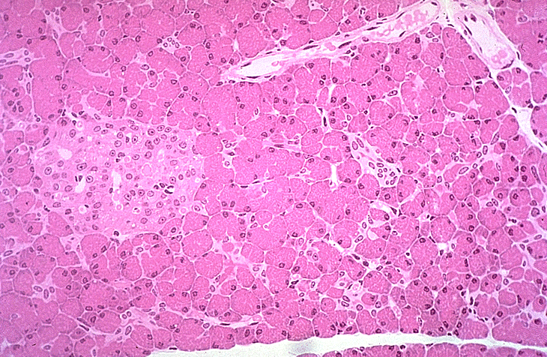
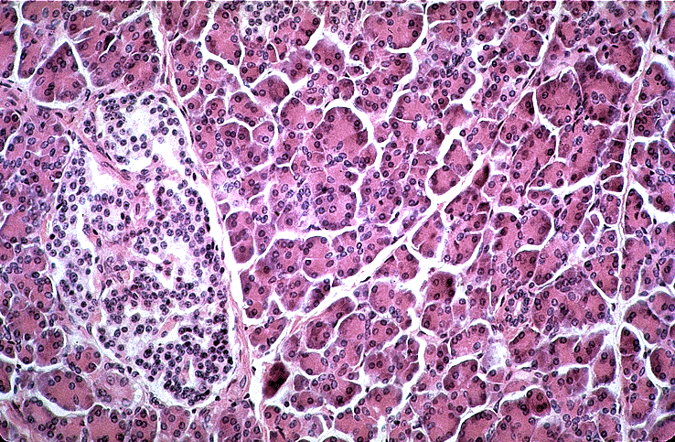
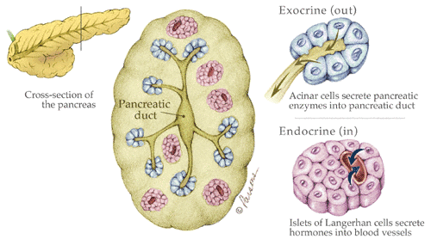
Secretory Tissues: the pancreas
The pancreas has both exocrine (into a duct or lumen) and endocrine (into the bloodstream) secretory functions

Slide 27
Secretory Epithelial Cell (exocrine: secretes into lumen or duct)
Secretory granules in the apical cytoplasm
Direction of Secretion
Golgi Apparatus
Granular ER in the basal cytoplasm
Basal Lamina

Slide 28
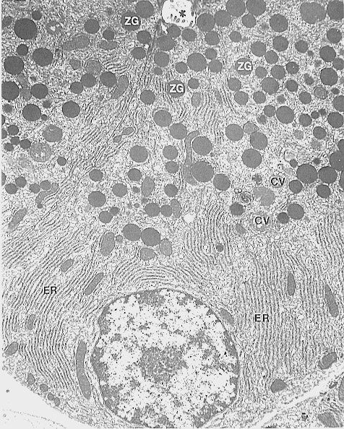
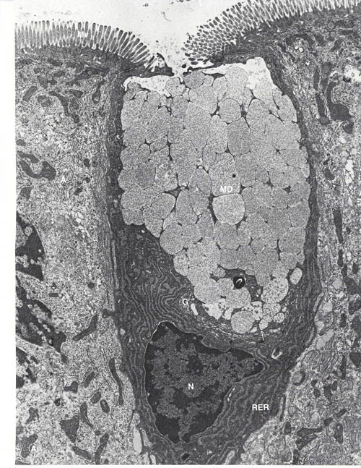
Secretory Cells
secretory granules (mucous or zymogen)
ER
Goblets cell
(secretes mucous)
Pancreatic acinar cell (secretes digestive enzymes)

Slide 29
Secretory Epithelial Cell (endocrine: secretes into bloodstream)
Granular ER in the apical cytoplasm
Direction of Secretion
Golgi Apparatus
Secretory granules in the basal cytoplasm
Basal Lamina

Slide 30
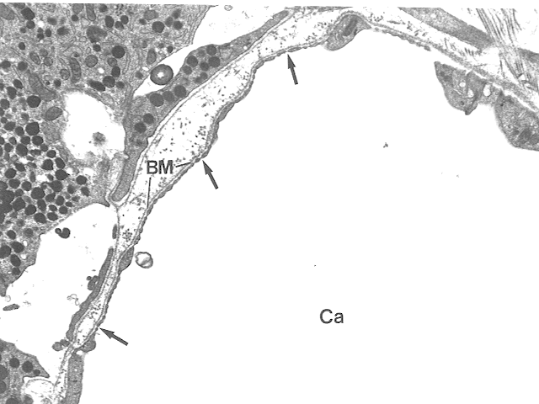
Endocrine cells secrete their contents to the basal aspect
Secretory granules
Basal lamina
Capillary lumen

Slide 31
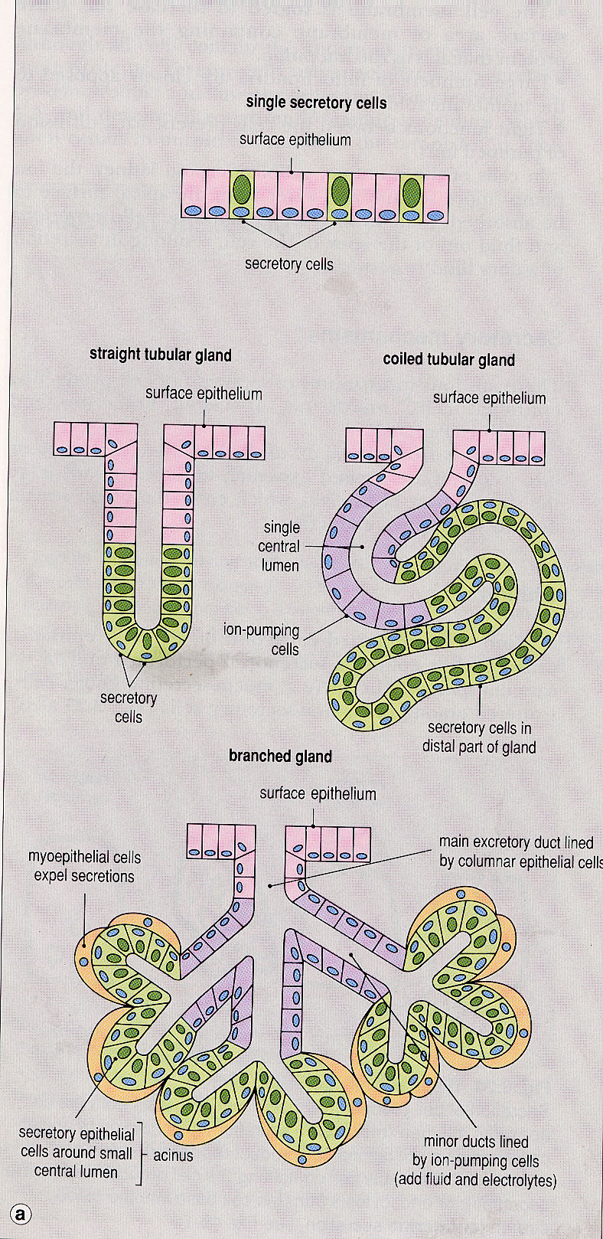
Organisation of secretory epithelia in glandular tissues
In tissues whose main purpose is secretion, the epithelium is arranged into tubules and ducts of varying complexity

Slide 32
Secretion
As well as exocrine and endocrine secretion, the way cells secrete can be classified as:
Constitutive – secretory vesicles, as they are formed, move directly to the plasma membrane and release their contents, e.g. production of plasma proteins by hepatocytes (constitutive endocrine secretion)
Stimulated – secretory vesicles are stored in the cytoplasm and only fuse with the plasma membrane to release their contents, e.g. the release of adrenaline from cells of the adrenal medulla after a fight-or-flight stimulus (stimulated endocrine secretion); when stomach contents enter the duodenum, pancreatic acinar cells are stimulated to release their digestive enzymes into ducts (stimulated exocrine secretion)

Slide 33
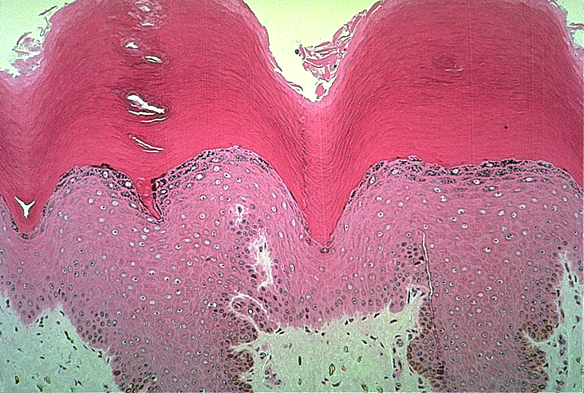
Protective epithelia: thick skin
The skin comprises three main layers: epidermis, dermis, and hypodermis.
The epidermis is the keratinizing stratified squamous epithelial layer. Its main function is to act as a barrier to the environment, but some appendages have other functions (e.g. hair, nails).

Slide 34
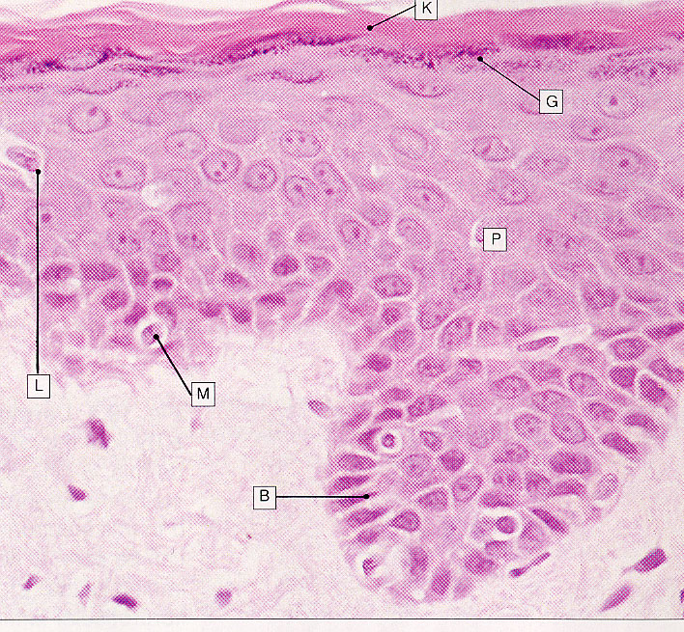
Protective epithelia are usually stratified-squamous (e.g. skin)
Squamous surface cell layers
(protective surface)
Cuboidal basal cell layer
(stem cells for the renewal of upper layers)

Slide 35
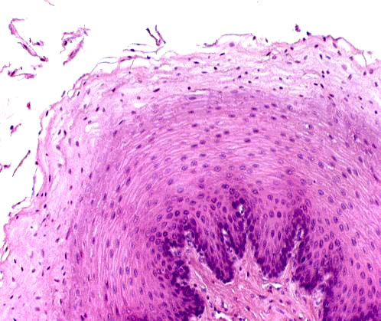
Protective epithelia: keratinizing vs non-keratinizing
Keratinizing: no nuclei visible in surface cell layers
Non-Keratinizing: nuclei are visible in surface cell layers
Oesophagus
Epidermis

Slide 36
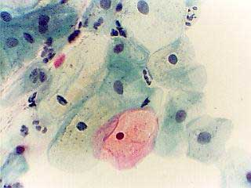
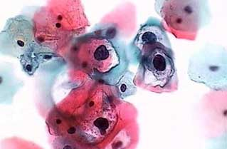
Protective epithelia: Cervical smear tests sample the surface cells of the uterine cervix epithelium.
Normal Pap smear
Abnormal Pap smear

Slide 37
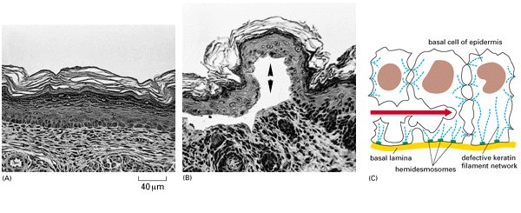
Defects in cytokeratins or cell junctions lead to blistering diseases as a result of epidermal damage

