Slide 1
Epithelial cells
Dr Peter Clark
Course code (MBBS) : Tissues 1
Course code (BMS) : BCT-L4

Slide 2
Tissues 1: Cellular Organisation of Tissues
Dr Peter Clark, NHLI, SAFB, SK
Multicellular organisms are made up of a wide variety of different cell types.
This variety arises as a result of differentiation of precursor cells.

Slide 3
Lecture content
This lecture provides the background for understanding the structure/function relationships of epithelia. It will…..
review the structure and function of the major organelles in cells
examine the main components of the cytoskeleton
introduce main cell types making up tissues
examine cell-cell junctions

Slide 4
Cellular organelles
Organelles are membrane-bound or membrane-associated structures within the cell.
Most cell biology and histology textbooks will have micrographs and diagrams showing these structures

Slide 5
Eukaryotic cells have a highly compartmentalised cytoplasm

Slide 6
Structure and function of organelles
A diagram of an epithelial
cell showing major
compartmentalistion of cell
cytoplasm.
Membrane-bound organelles
carry out specific functions in
the cytoplasm.
Bacterium
(prokaryote)

Slide 7
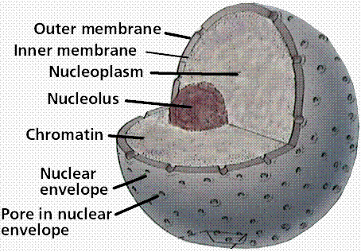
The Nucleus

Slide 8
Nucleolus

Slide 9
The nucleolus is the site of production of the subunits of the ribosomes
The nucleolus contains ~200 clusters of rRNA genes on 5 pairs of chromosomes.

Slide 10
Nuclear pore complexes

Slide 11
Relationship between the nuclear envelope and the endoplasmic reticulum

Slide 12
Endoplasmic reticulum (ER)
Rough
(Granular)
ER
Smooth
(Agranular)
ER

Slide 13
Rough endoplasmic reticulum
Often arranged as stacks of membrane leaflets (cisternae)
Transmission electron micrograph

Slide 14
Golgi apparatus

Slide 15
Golgi Apparatus

Slide 16
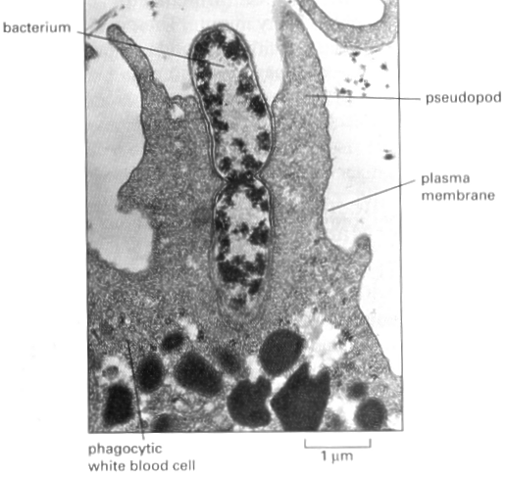
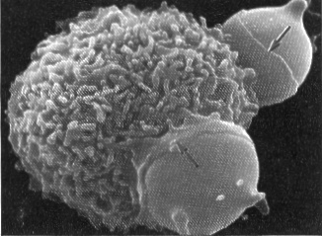
Phagocytosis

Slide 17
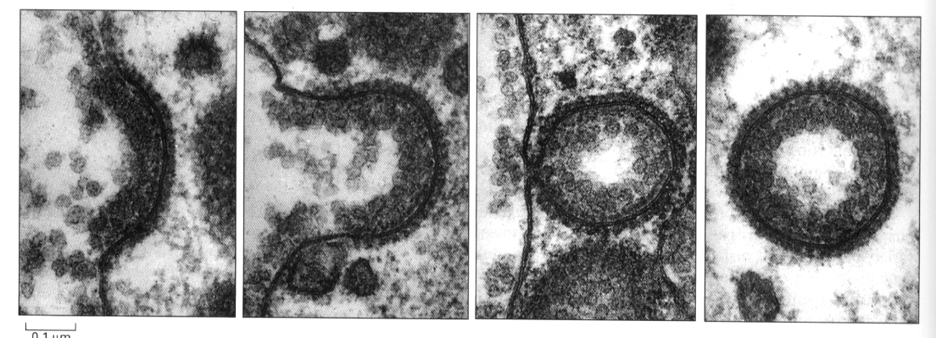
Coated vesicle formation

Slide 18
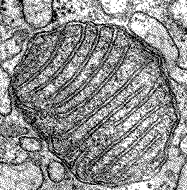
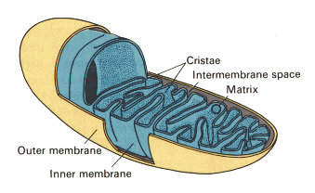
Mitochondrion

Slide 19
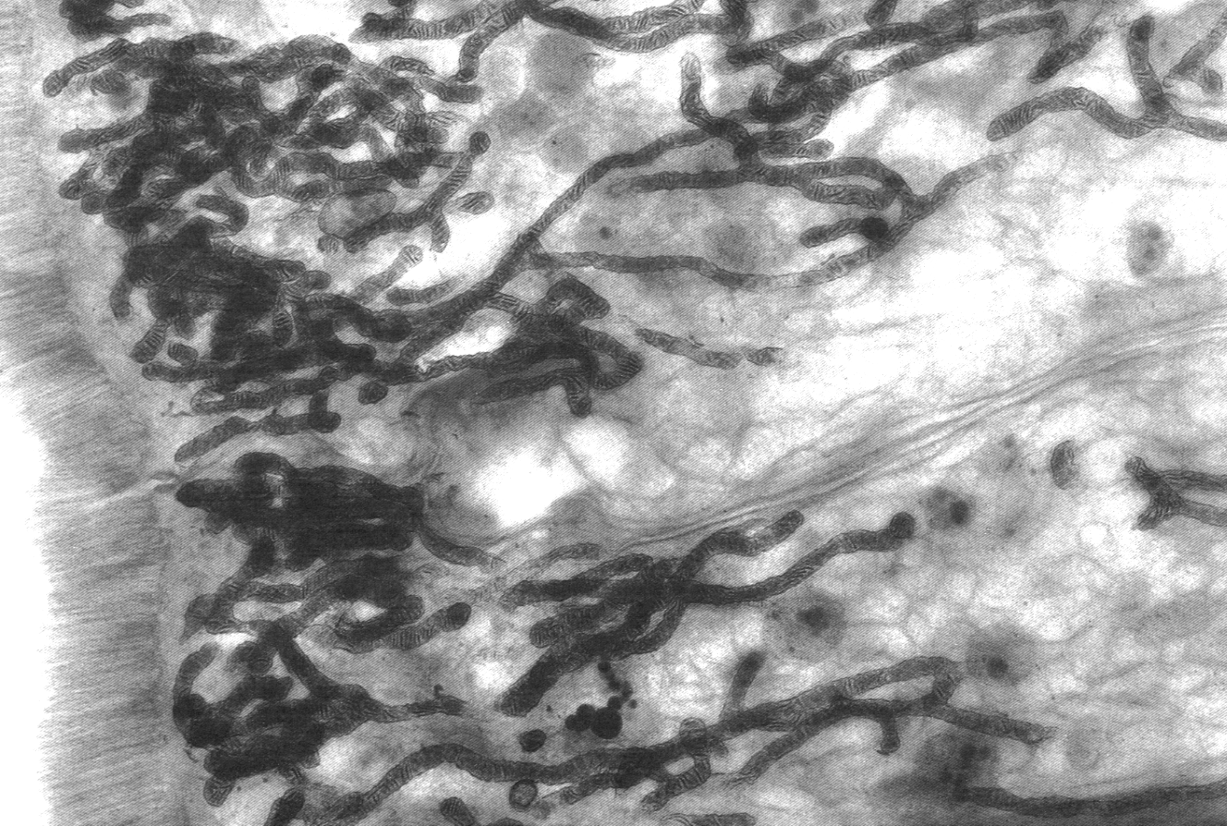
Mitochondria

Slide 20
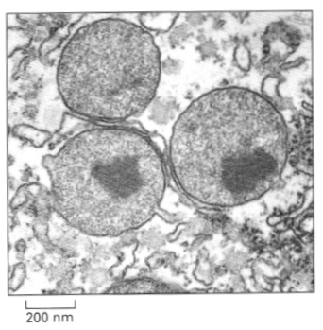
Peroxisome

Slide 21
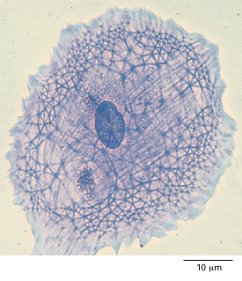
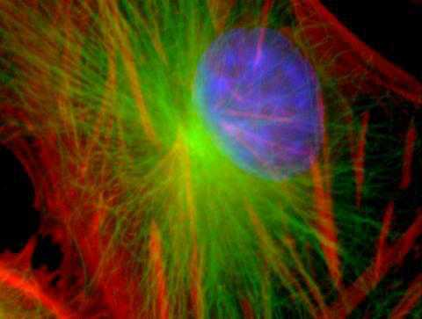
Cytoskeleton

Slide 22
Microtubules: polymers of α and β tubulin, ~20nm diam. Involved in cell shape, and act as “tracks” for the movement of other organelles and cytoplasmic components within the cell. Many accessory proteins involved in these functions. The major component of cilia and flagellae.

Slide 23
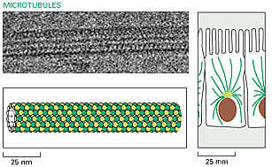
Microtubules

Slide 24
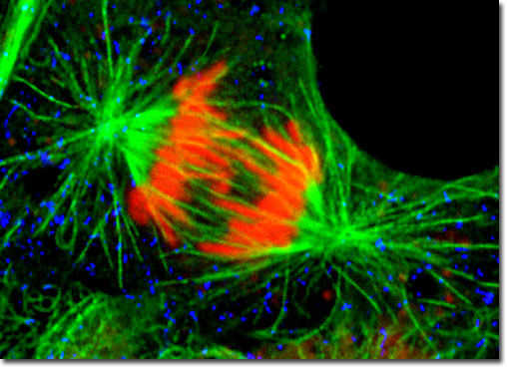
Microtubules form the mitotic spindle

Slide 25
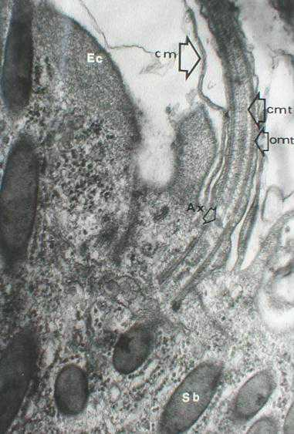
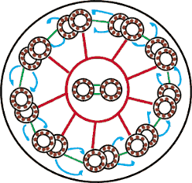
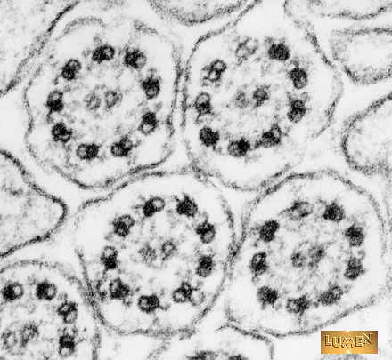
Microtubules are structural and motor components of cilia and flagellae

Slide 26
Intermediate filaments (IF): a group of polymers of filamentous proteins which from rope-like filaments, with diameter in the range 10-15 nm.
The type of IF a cell has is characteristic of cell type, e.g. Epithelia have cytokeratins; mesenchymal cells have vimentin; neurones have neurofilament protein. IFs give mechanical strength to cells. Desmosomes are connected by cytokeratins.
Nuclear lamins are intermediate filaments found forming a network on the internal surface of the nuclear envelope, being involved in stabilising the envelope.

Slide 27
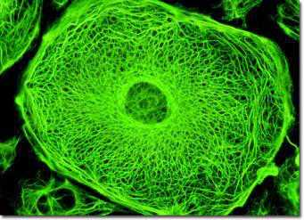
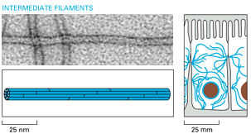
Intermediate Filaments

Slide 28
Microfilaments: polymers of actin associate with adhesion belts in epithelia and endothelia, and with other plasma membrane proteins. Involved in cell shape and cell movement (crawling of cells; cell contractility esp. muscle). Accessory proteins, e.g. myosin, act with actin to control actin organisation and cell movement.

Slide 29
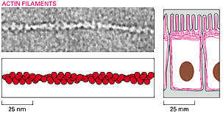
Actin Microfilaments
Monomer=globular actin; G-actin
Microfilaments=filamentous actin; F-actin

Slide 30
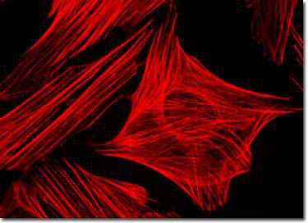
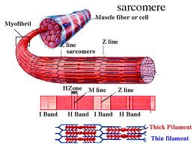
Actin Microfilaments
Actin in non-muscle cells
Muscle
= actin filament

Slide 31
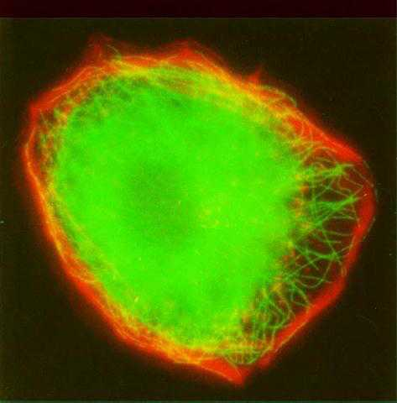
Double fluorescence labelling of microtubules and microfilaments
An epithelial cell labelled with rhodamine-conjugated phalloidin (red) which labels F-actin, and immuno-stained with antibodies against tubulin (microtubules) (green).

Slide 32
Cytoskeleton
The cytoskeleton is not a fixed set of sturctures. The various elements of the cytoskeleton are subject to rapid re-modelling by a variety of biochemical and bio-mechanical signals

Slide 33
Main Cell Types
epithelial cells: cells forming continuous layers, these layers line surfaces and separate tissue compartments
mesenchymal cells: cells of the connective tissues, e.g. fibroblasts (many tissues), chondrocytes (cartilage), osteocytes (bone), muscle cells (skeletal, cardiac, smooth)
haematopoietic cells: blood cells and the cells of the bone marrow from which they are derived.
neural cells: cells of the nervous system having two main types; neurones (carry electrical signals) and glial cells (support cells)

Slide 34
Tumours retain characteristics of the cell type from which they originate
epithelial cancers are carcinomas
mesenchymal cancers are sarcomas
haematopoietic cancers are leukaemias (from bone marrow cells) or lymphomas (from lymphocytes)
neural cell cancers are neuroblastomas (from neurones) or gliomas (from glial cells)

Slide 35
Multicellular organisation
Organism
Organ systems
Organs
Tissues
Cells

Slide 36
Tissue
a group or groups of cells whose type, organisation and architecture are integral to its function
tissues are made up of cells and extracellular matrix

Slide 37
Extracellular matrix
material deposited by cells which forms the “insoluble” part of the extracellular environment
generally composed of fibrillar (or reticular) proteins (e.g. collagens, elastin) embedded in a hydrated gel (proteoglycans or “ground substance”)
may be poorly organised (e.g. loose connective tissue) or highly organised (e.g. tendon, bone, basal lamina)

Slide 38
Epithelial organisation
epithelial cells make organised, stable cell-cell junctions to form continuous, cohesive layers
epithelial layers line internal and external body surfaces and have a variety of functions, e.g. transport, absorption, secretion, protection

Slide 39
Cell-cell junctions
continuous epithelial layers can form because cells form stable cell-cell junctions which give the epithelia mechanical integrity and act to seal the intercellular pathways.
in many epithelia these are found at the apical region of cell-cell contact as a junctional complex.
generally in 2 forms: zonulae (belts) or maculae (spots)

Slide 40
Cell-cell junctions in epithelia
typically arranged as an apical junctional complex containing a tight junction nearest the apex, then an adhesion belt, then, scattered throughout the lateral membrane, desmosomes (spot adhering junctions)
other important junctions are gap junctions, which act as regions of direct communication between adjacent cells

Slide 41
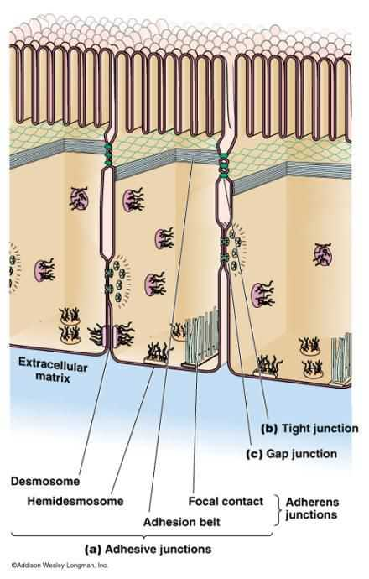
Cell-Cell Junctions in Epithelia
Junctions are usually arranged as continuous belts (zonula) or as discrete spots (macula)

Slide 42
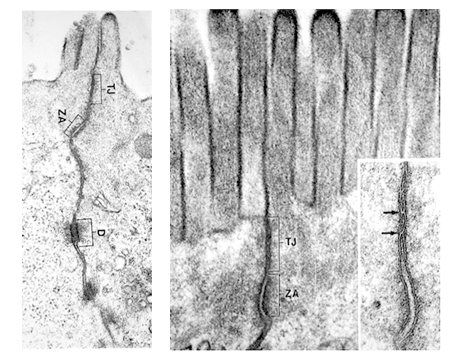
Junctional Complex

Slide 43
Tight junctions
(occluding junction)
zonula occludens (belt junction)
points on adjacent membranes form close contacts at apical lateral membranes
form a network of contacts, the more elaborate the network, the tighter the seal
act to seal paracellular pathways (i.e. between cells)
segregates apical and basolateral membrane polarity

Slide 44
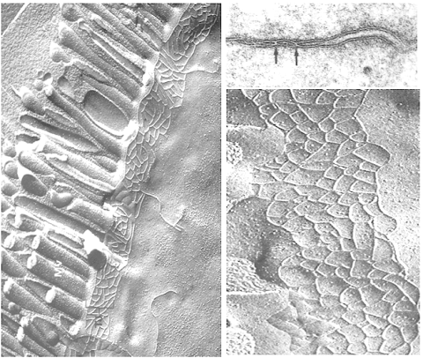
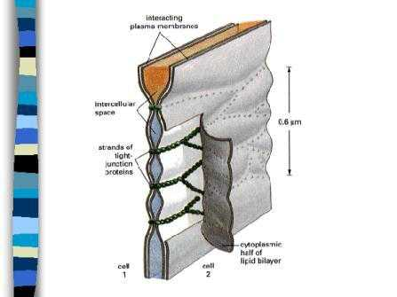
Tight junctions

Slide 45
Adhesion belt
zonula adherens (belt junction, adherens junction (AJ))
usually formed just basal to the apical tight junction
transmembrane adhesion molecule is cadherin (family of Ca²⁺ ion-dependent cell adhesion molecules)
cadherins associate with the microfilament (actin) cytoskeleton
this junction controls the stability of the other junctions (“master junction”)

Slide 46
Desmosome
(spot junction)
macula adherens (spot desmosome)
found at multiple spots between adjacent cell membranes
transmembrane cell adhesion molecule is a cadherin-like molecule
linked to the intermediate filament cytoskeleton
provides good mechanical continuity between cells

Slide 47
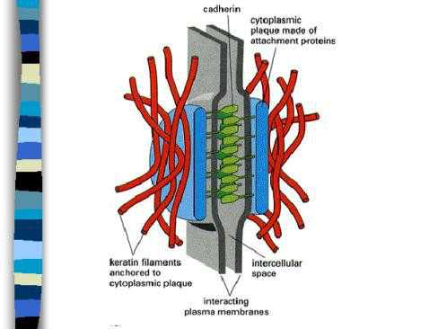
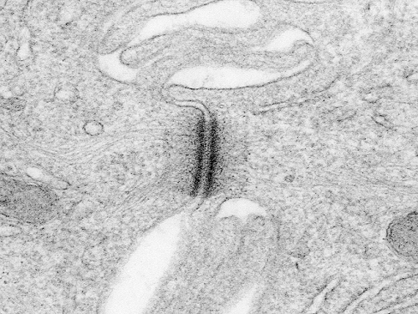
Desmosome

Slide 48
Gap junction
(communicating junction)
macula communicans (spot junction)
made up of clusters of pores formed from 6 identical subunits in the membrane - these pores are continuous with pores in adjacent cell membrane
allows passage of ions and small molecules between cells
pH, Ca2+ conc, voltage, and some signalling molecules can affect passage, i.e. can open and close pores thereby controlling intercellular communication

Slide 49
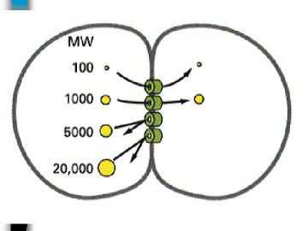
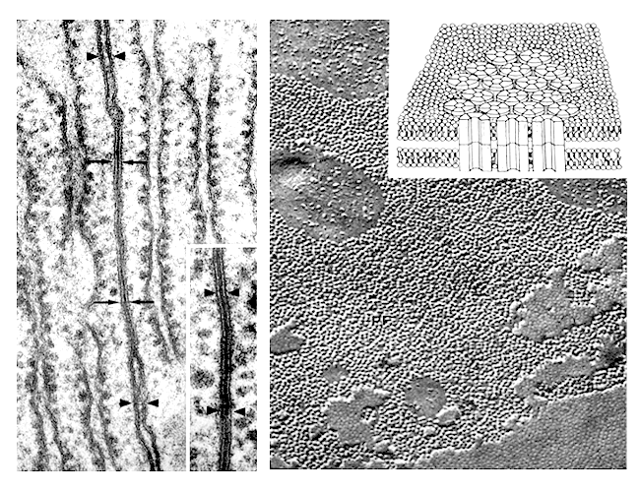
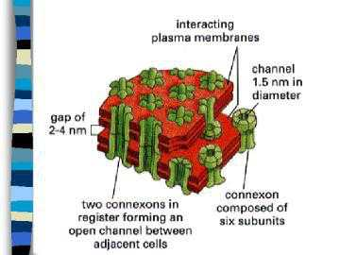
Gap Junction

Slide 50
Synapse
(communicating junction)
synapses mainly in neural tissue (i.e. not epithelial)
button-like junctions formed between neurones or between neurones and target cells (e.g. muscle)
information passed one-way via a chemical signalling system
a variety of chemical signals and receptors are utilised at synapses

Slide 51
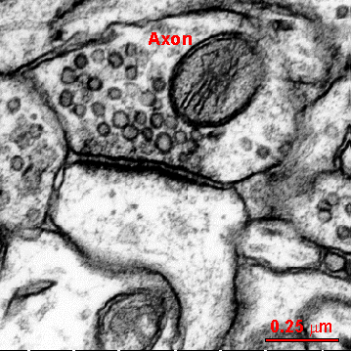
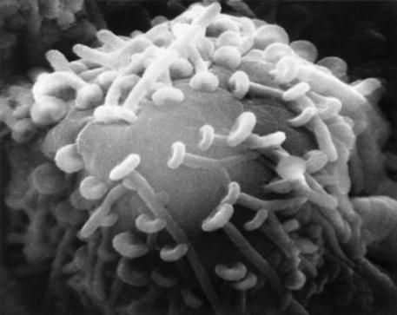
Synapse

Slide 52
Cell-cell junctions
Cell-cell junctions are labile (capable of changing their assembly and organisation). The dynamic assembly and disassembly of junctions are controlled by a variety of factors in health and disease.

