Slide 1
Complex genetic diseases: can genes make us fat?
Dr Alexandra Blakemore
Course code (MBBS) : Genetics 7
Course code (BMS) : NAGE-L14

Slide 2
outline
Introduction to genetics of obesity
  Syndromic
  Monogenic
  Common obesity
Identification of GSVs in “obesity-plus” patients
Implications for common obesity
Prospects for personalised medicine

Slide 3
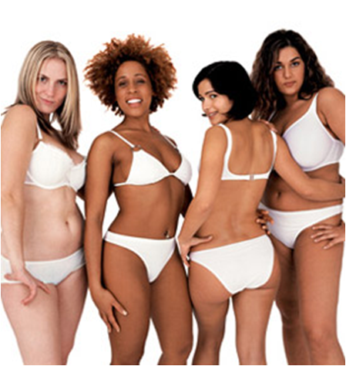
fat is necessary for health
Storage of food and water
Insulation
Support and protection of vital organs
Source of hormones – regulator of reproduction
Sexual signalling
Regulator and fueller of the immune system
Source of new immune cells
Aids wound healing……
Notes:
Fat isn’t bad! Only too much is!!

Slide 4
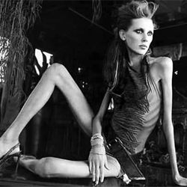
Not having enough fat is a bad thing…….
Infertility
Miscarriage
Death from infections
Higher suicide rate
Osteoporosis

Slide 5
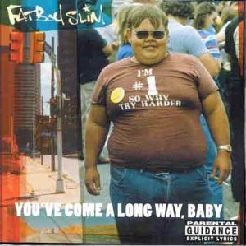
We have a complex system to regulate our body fat levels…….
But it can go
wrong……

Slide 6
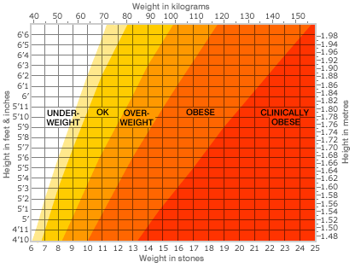
Adult BMI Ranges

Slide 7
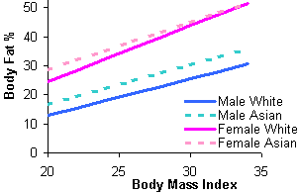
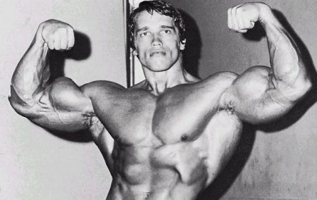
The problem with BMI
Ethnicity is important
Asians have a lower BMI but higher percent body fat compared to white subjects
Body weight is affected by muscle/fat ratio as muscle is heavier than fat
For example:
For a person 1.87m tall and 113kg
BMI = 32.3 = Obese
Am J Clin Nutr (1994) 60(1):23-8

Slide 8
Obesity
Obesity defined as BMI ≥30 kg/m²
Morbid obesity BMI ≥40 kg/m²
Syndromic, monogenic and common forms
In 2005, WHO projected >400 million obese individuals
By 2030, will increase to >1.1 billion obese individuals
Impact on global health (disease + costs)

Slide 9
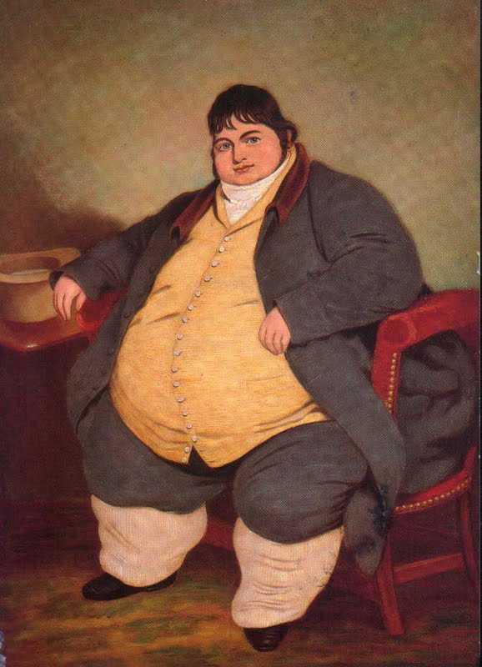
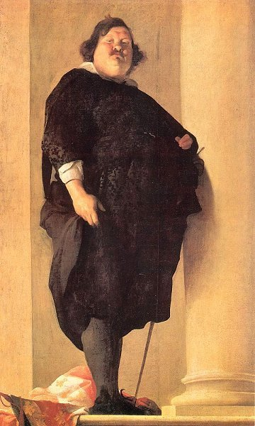

Slide 10
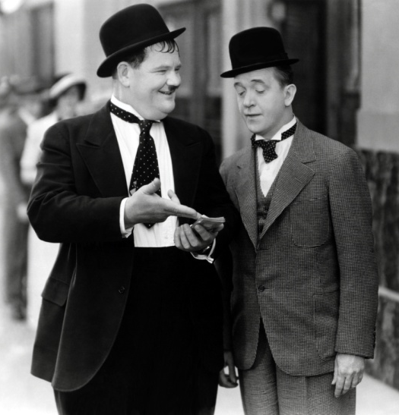
Obesity epidemic
BUT not everyone is overweight....
Genetics affects individual responses to the obesogenic environment
    Heritability of obesity estimated at up to 0.77 from twin and family studies (Maes et al 1997, Wardle et al 2008)
Notes:
…who puts on weight is largely due to their genetic make-up
i.e. 70% of a child’s obesity can be explained by their genetics

Slide 11
Lack of Physical Activity
High density calorie diet
Stress
Obesity
Gene Variations

Slide 12
BMI in the general population
To gain 1lb of fat requires about 3,500 excess calories
So to gain 1lb every year (eg about 2 stone between the ages of 20 and 50) requires only around 10 extra calories a day
one excess slice of cucumber per day
one extra biscuit per week
one extra Mars bar per month
Not exactly gluttony!
Our appetites are very tightly regulated
ALL MONOGENC FORMS OF OBESITY KNOWN SO FAR AFFECT APPETITE REGULATION

Slide 13
How do we get fat?
  behaviours (feeding and physical activity)
  physiology (resting metabolism and energy expenditure when active)
  all are controlled or affected by genes

Slide 14
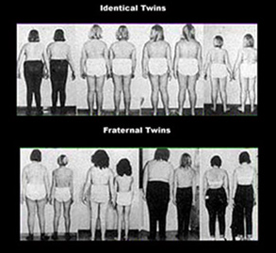

Slide 15
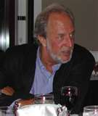
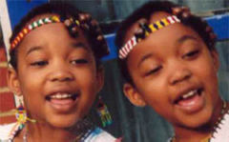
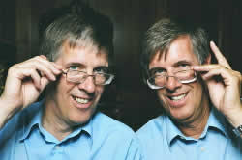
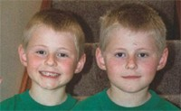
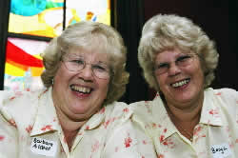
Identical twins
differences all environmental
Non-identical twins
have both genetic and
environmental differences
Over 5,000 same-sex twin pairs
Robert Plomin
Heritability in children:
BMI 77%
Waist circ. 77%

Slide 16
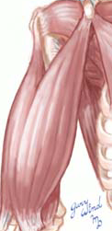
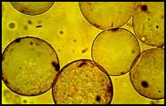
Ravussin & Bogardus. BJN 2000

Slide 17
Syndromic obesity
There are around 30 known syndromic forms of obesity (ie usually accompanied by mental retardation and particular dysmorphic or clinical features)

Slide 18
Syndromic obesity
Prader-Wili syndrome is the most common – imprinting defect, paternal deletion or maternal isodisomy
Careful examination of the underlying mutations can help us to pinpoint previously un-recognised mechanisms (eg. snoRNAs in PWS)
Also BDNF in WAGR syndrome:
http://www.ncbi.nlm.nih.gov/pmc/articles/PMC2553704/
And cilia in Bardet-Beidl syndrome
http://www.ncbi.nlm.nih.gov/bookshelf/br.fcgi?book=gene&part=bbs

Slide 19
Monogenic obesity
Dominant or recessive single gene disorders

Slide 20
1994 - leptin, the first “obese” gene

Slide 21
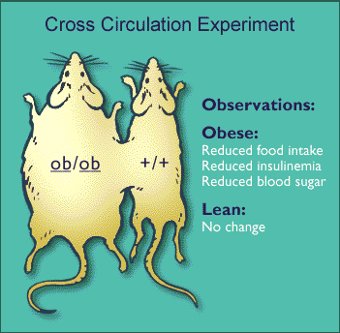

Slide 22
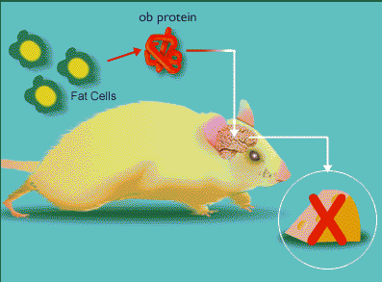
Leptin – the “ob” protein

Slide 23
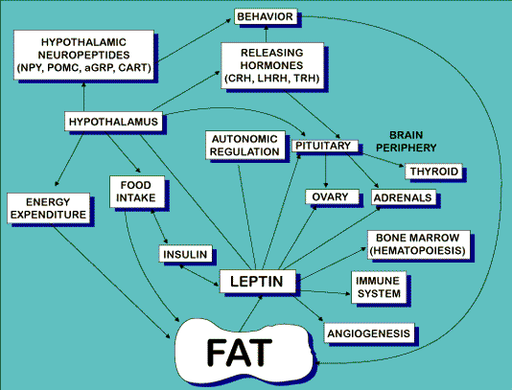

Slide 24
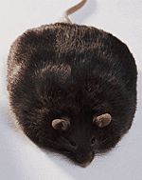
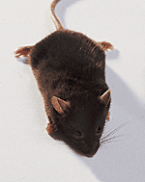
Ob/Ob mouse
Overeating leading to severe obesity
Infertile
Immune problems

Slide 25
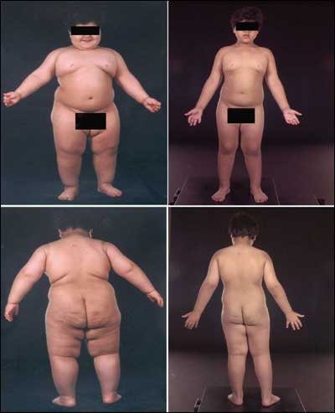
Leptin deficiency
Hunger
Obesity
No puberty
Poor growth
Low thyroid
Immune problems
NO LEPTIN

Slide 26
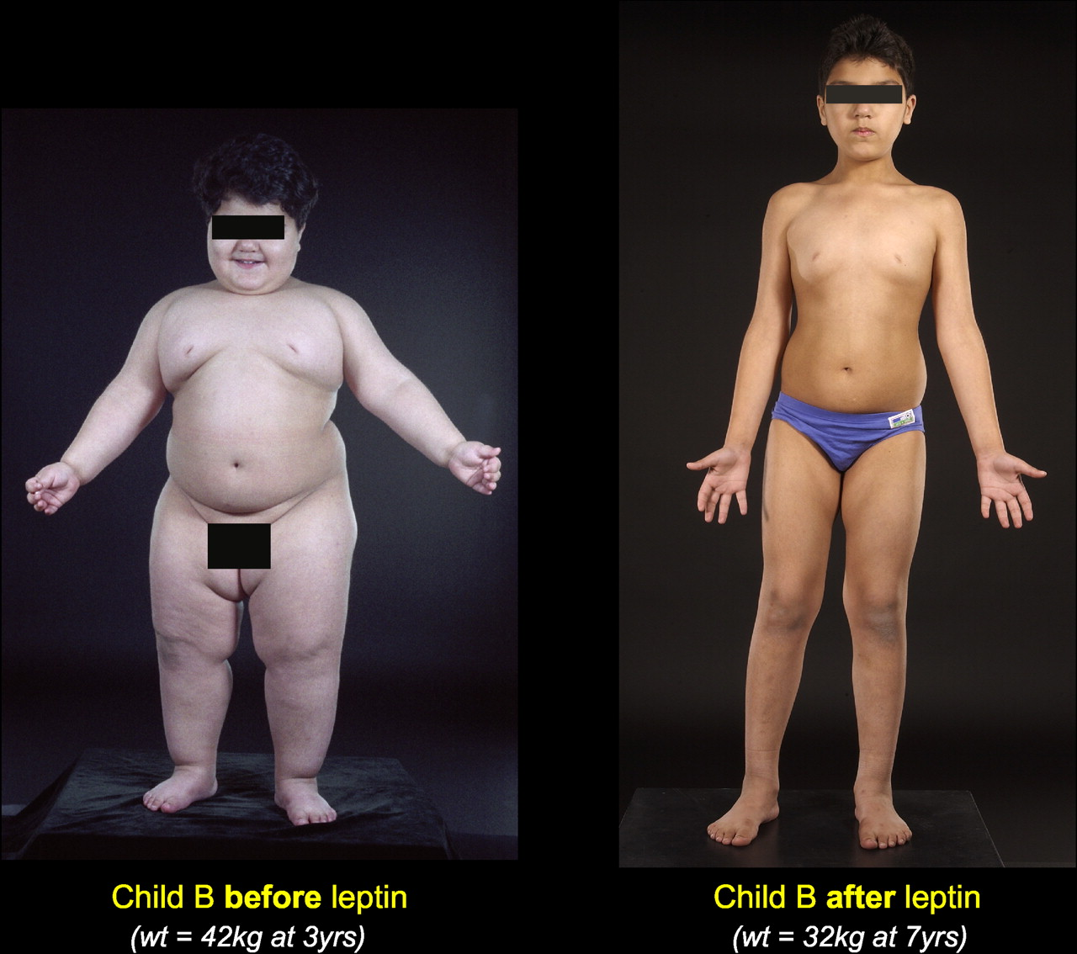

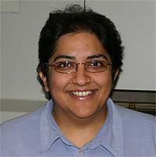
Child with monogenic leptin deficiency
Steve O’Rahilly
Sadaf Farooqi

Slide 27
Most fat people have lots of leptin!
me

Slide 28
Leptin receptor-deficient mouse

Slide 29
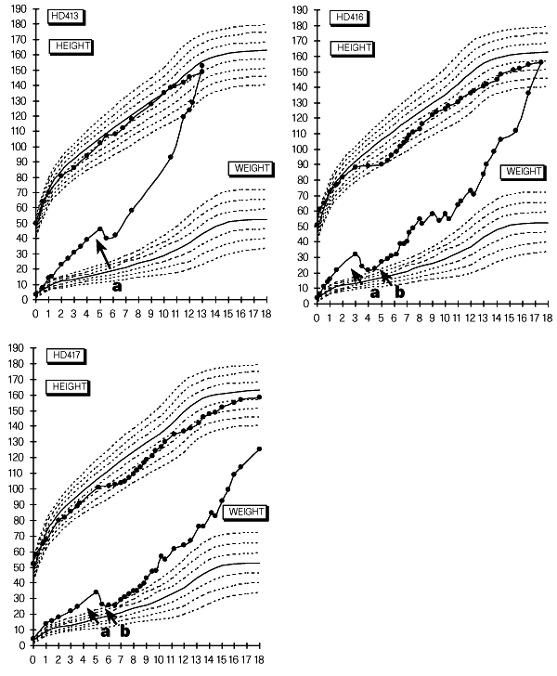
Family with
genetic
deficiency
of leptin
receptor

Slide 30
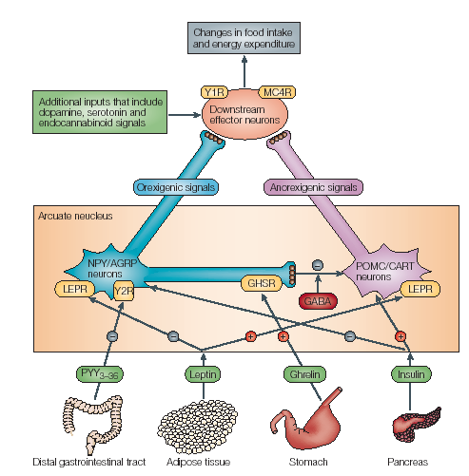
The leptin-
-melanocortin
“adipostat”
regulates
body fat levels
Bell, Nature Reviews, 2005

Slide 31
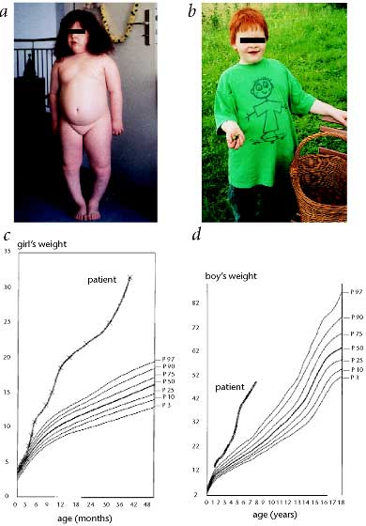
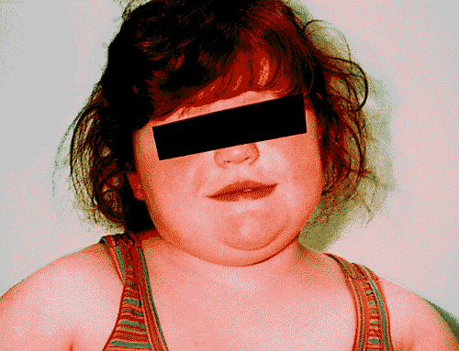
Hunger
Obesity
Red hair
Low adrenal activity
Pro-opiomelanocortin gene

Slide 32
Other genes in the same pathway also cause single-gene obesity………..
PC1 – recessive obesity
MC4R – most common single-gene form of obesity (2-6%)
ALL AFFECT APPETITE REGULATION

Slide 33
Monogenic Forms of Obesity
Environment
Genes
Single gene
(recessive)
LEP
LEPR
POMC
PC-1
Single gene
(dominant)
MC4-R
(up to 6%)
Common obesity

Slide 34
Common obesity
Obesity in the general population

Slide 35
Genome-Wide Association
Hypothesis-free
“Common disease, common variant”
Up to 1M SNPs typed in one experiment
At least 6 GWA studies carried out

Slide 36
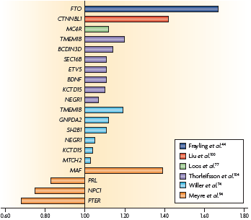

Slide 37
Searching throughout the genome
Looked at single nucleotide polymorphisms throughout the genome (comparing obese vs non-obese people)
GWAS-identified SNPs explain only a small proportion of common obesity risk
32 confirmed BMI loci account for just 1.5% of inter-individual variation
It is estimated that even meta-analysis involving 0.5M subjects will only explain 3% of variation in BMI

Slide 38
Problems with GWAS
GWAS so far has identified associations that are statistically strong and reproducible
However, their contribution to the genetic component of BMI is estimated to be low (<5%)
More work is needed

Slide 39
Common variants of subtle effect not PREDICTIVE OF severe forms of obesity

Slide 40
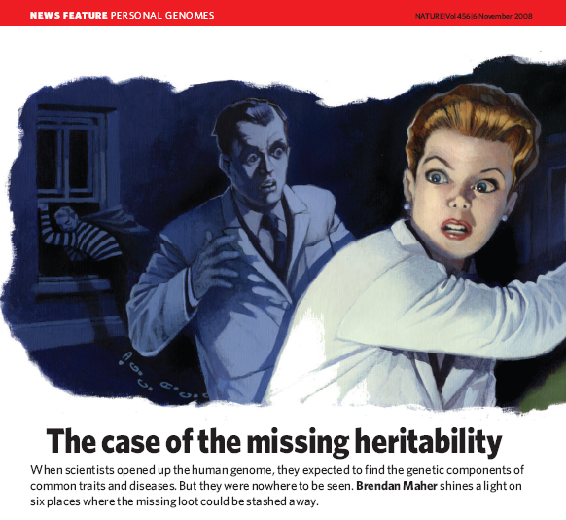
Missing heritability of complex diseases.......
Rare variants?
Epigenetics?
Genomic structural
variation?
Notes:
Concentrate on rare variants and GSVs!

Slide 41
Ongoing research......Copy number variants
Patients with syndromic forms of obesity have more GSVs
Threefold more deletions >500kb than control populations
Bochukova et al., Nature 2010, 463:666-70
Use large GSVs found in patients with “obesity-plus” phenotypes to identify new obesity loci
Investigate these loci in the general population to find rare variants

Slide 42
Genomic structural variants (including CNVs)
Missing pieces of the genome (deletions)
Extra copies of certain regions (duplications or amplifications)
Parts of the genome switched around (inversions or translocations)
We all have many GSVs – some have no known effect, but others are associated with ill effects

Slide 43
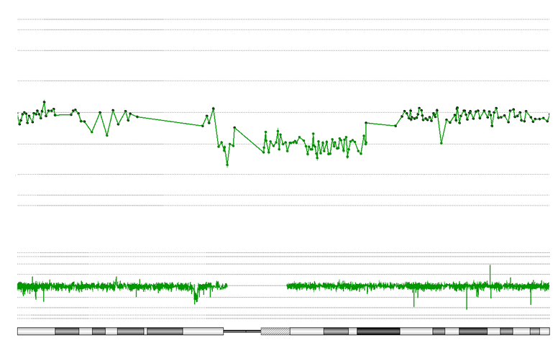
One example: Chromosome 16p11.2 deletion
Chromosome 16
+ 4
+ 2
+ 1
Log₂ ratio
0
- 1
- 2
- 4
28.8 Mb
29.1 Mb
29.4 Mb
29.8 Mb
30.1 Mb
30.4 Mb
p13.2
p13.12
p12.3
p12.1
p11.2
q12.2
q21
q22.2
q23.1
q23.3
q24.2
Notes:
Large deletion of up to 68 probes identified. Size = 500 to 700kb

Slide 44
deletion at 16p11.2 in a patient with ‘obesity plus’
Phenotype:
BMI = 29.2 kg.m⁻² at age 7½ (>97th centile)
Moderately-severe mental retardation and poor speech
Congenital nystagmus, squint, hypertelorism, downslanting palpebral fissures, large protruding ears and bilateral 2+3 toe syndactyly
Coarse hair with a double crown on his scalp

Slide 45
16p11.2 deletions already observed in patients with neurocognitive problems
Multiple reports of 16p11.2 deletions and duplications in patients with neurocognitive phenotypes: autism, developmental delay, schizophrenia, bipolar disorder
eg. Deletion seen in autism spectrum disorder
13/2252 (0.58%) of subjects
Weiss et al. (2009)

Slide 46
16p11.2 deletion in obesity and population cohorts
Cohort | Obese | Lean/ Normal Weight
French child obesity case:control | 4/643 | 0/530
British extreme early-onset obesity (SCOOP) | 3/931 | -
French adult obesity case:control | 4/705 | 0/669
French bariatric surgery patients | 2/141 | -
Swedish discordant siblings | 2/159 | 0/140
Population cohorts (NFBC1966, CoLaus, EGPUT) | 3/1592 | 1/6235
Obesity: P = 5.8x10⁻⁷ OR = 29.8 [3.9–225]
Morbid obesity: P = 6.4x10⁻⁸ OR = 43.0 [5.6–329]

Slide 47
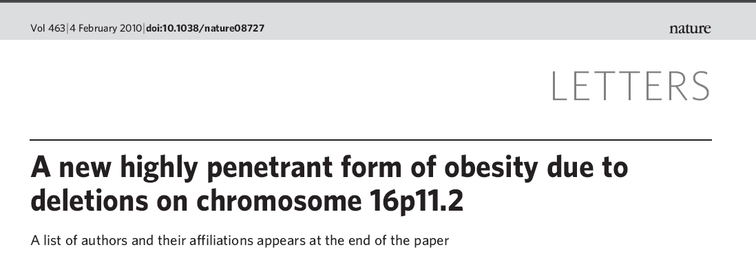
16p11.2 deletion is the first CNV directly associated with obesity…
This deletion was found in about 1% of morbidly obese adults in the general population cohorts
Notes:
Highly penetrant as if you have deletion you will get fat.....so going back to what i said about media, people with this deletion, body weight purely due to genetic defect

Slide 48
Reciprocal phenotype in 16p11.2 duplications
Duplications reported to be associated with schizophrenia, bipolar disease and microcephaly
Investigated BMI of 105 duplication carriers:
BMI was shifted towards underweight (p=0.04), especially among adult females (p=0.003) (but not many adult males found)
Failure to thrive as children

Slide 49
Another 16p11.2 deletion nearby also causes childhood obesity
Convincing obesity association for deletions of the ~700kb 16p11 ‘autism’ locus
onset of obesity at 8-10 years of age
explains ~1% of adult morbid obesity in the general population
duplication carriers are more likely to be underweight
Strong association with child obesity of nearby 220kb deletion encompassing SH2B1
explains >0.5% of child morbid obesity cases
impact on adult obesity is less clear
Investigation of GSVs in cohorts with “obesity-plus” is a
promising route to the identification of novel obesity loci

Slide 50
Personalised medicine in obesity
Around 1:20 morbidly obese patients has a highly-penetrant Mendelian form of obesity
Obese patients are rarely offered screening or genetic counselling (eg. for obesity or autism risk)
Immediate implications for personalised medicine:
Choice of medications that might cause weight gain (especially where there is neurocognitive dysfunction)
New drug development (MC4R)
Potential for intensive lifelong preventative intervention
Choice of obesity surgery type
Notes:
It was initially thought that common diseases where caused by effects of common variants, but GWAS has not been able to account for much of the heritability of complex diseases
Firstly, rare variants……Paradigm shift from CDCV to CDRV!

Slide 51
Obesity is a topical example
This lecture could have been based on any of a number of diseases
Key points
Common diseases may have a range of causes, some very strongly genetic
Progress in genetics is very fast
Genetic cause does not imply that there’s nothing that can be done
Do not suspend evidence-based medicine because of stigmatisation of particular patients

Slide 52
Further reading
wonderful online lecture on genetics of obesity (Prof Steve O’Rahilly – starts half way in – his is a must-see talk):
http://www.imperial.ac.uk/college.asp?P=7812
(you may need to download RealPlayer or similar to see this)
Short review of genetics of diabetes, including implications for treatment:
http://tinyurl.com/diabetes-review-amelie
Interplay between genetics of autism, bipolar disease and schizophrenia:
http://www.ncbi.nlm.nih.gov/pmc/articles/PMC2784305/?tool=pubmed
short

