Slide 1
Blood and blood cells
Dr Mike Emerson
Course code (MBBS) : Cells 3
Course code (BMS) : BCT-L3

Slide 2
Main functions of blood
Connective tissue
Transport (connects every part of body)
Heat distribution
Immunity
Haemostasis
Support (e.g. external genitalia - VIAGRA)
MAINTAIN HOMEOSTASIS (constant internal environment)
Blood volume (5l male; 3.5l female)

Slide 3
How blood serves cells
Products of digestion e.g. fatty acids, amino acids, glucose
Metabolic waste e.g. lactic acid and urea
CO₂
Hormones
Heat
Vitamins
H₂0
O₂

Slide 4
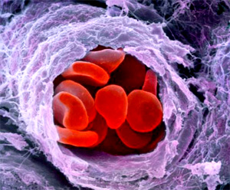
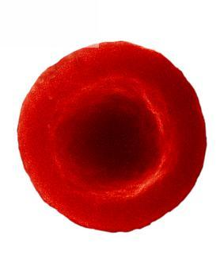
Blood Cells: Erythrocytes
Red cells
Respiratory transport O₂ (haemoglobin) and CO₂ (carbonic anhydrase)
Biconcave disc (maximizes surface area/ diffusion, flexible so squeeze through capillaries)
No nuclei or organelles
Molecules on surface confer blood group
oxyhaemoglobin
bicarbonate
7.5μm

Slide 5
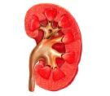
Regulation of Erythrocyte Production
Negative feedback
Low O₂
(altitude, lung/ heart disease)
Blood O₂
Blood Hb
Erythropoiesis
Bone marrow
stem cells
Erythrocytes
Erythropoietin (hormone)
Testosterone

Slide 6
Erythrocyte Life Cycle
Produced in bone marrow from precursors which produce haemoglobin then lose organelles
Immature erythrocytes contain ribosomes: reticulocytes.
High circulating reticulocytes diagnostic (e.g. anaemia, chemotherapy)
Removed through reticulo-endothelial system (phagocytic macrophages in spleen)
Lifespan = 120 days (short, no nuclei; 1% or 250 billion cells per day)
Dependent on dietary iron (meat, egg yolk, nuts), iron deficiency causes anaemia

Slide 7
Haemoglobin
4 subunits: each a polypeptide with a haem group
Haem contains Ferrous iron (Fe²⁺)
Each Fe²⁺ binds one O₂ molecule
Oxidized form (methaemoglobin – Fe³⁺) cannot carry O₂
Different form in foetus with higher O₂ affinity
100ml blood: 15.8g (male)
13.7g (female)
Major breakdown product = bilirubin (yellow), returned to plasma

Slide 8
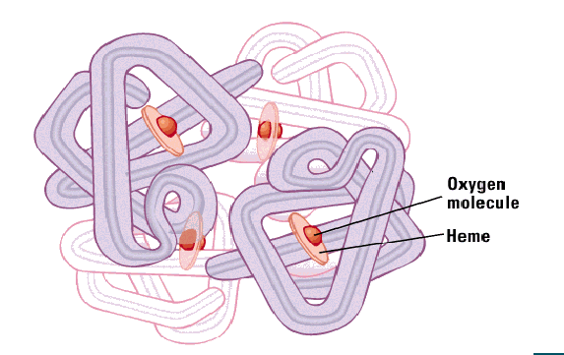
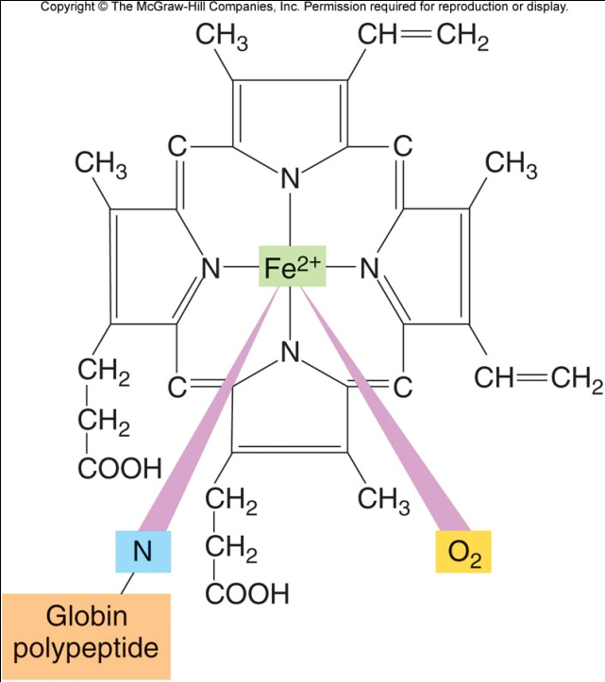
Haemoglobin
Haem
Haemoglobin binding:
CO binds haem 200x greater affinity
than O₂ and reduces O₂ binding
O₂ + Hb
HbO₂
CO + Hb
COHb
Hb = deoxyhaemoglobin
HbO₂ = oxyhaemoglobin
COHb = carboxyhaemoglobin

Slide 9
Haemoglobin: Oxygen binding
Haemoglobin low affinity for oxygen due to conformational shape of globin molecules
Oxygen binding beaks conformation and opens up structure
Second oxygen molecule binds more easily and so on
This is cooperative binding
Allows more oxygen to be carried

Slide 10
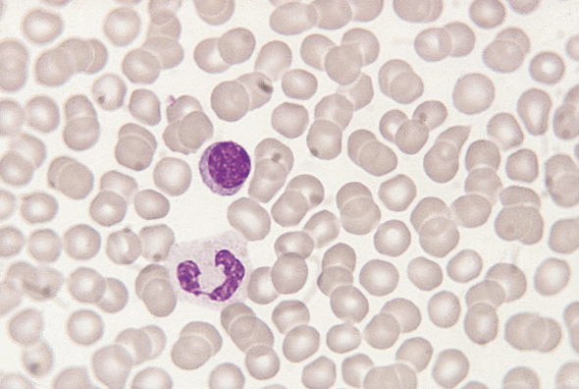
Normal blood film

Slide 11
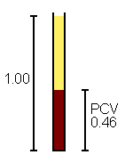
Key red cell parameters
Conc^{n} haemoglobin (135-165♂; 115-145 ♀ g/l)
Red cell count (5.4 x 10¹²/l (♂) and 4.8 x 10¹²/l (♀)
Haematocrit (packed cell volume): 0.40-0.54 (♂)
0.35-0.47 (♀)
Derived indices Normal
MCV mean cell volume 82-99fl
(MCH mean cell haemoglobin 27-33pg)
(MCHC mean cell haemoglobin concentration 320-340g/l)

Slide 12
Anaemia
“Low blood haemoglobin concentration”
Microcytic (small MCV): Failure of haemoglobin synthesis
Fe deficiency: menstruation (daily loss 1mg M; 2mg F)
GIT lesions or cancers
parasitic infection
Normocytic (normal MCV)
Acute blood loss
Macrocytic (large MCV)
DNA synthesis and cell division fail and reduced division of progenitor cells so fewer but larger erythrocytes.
Folic acid (required for thymine synthesis) deficiency : pregnancy
Vit B12 (needed for folic acids actions) deficiency: autoimmune disease, destroys B12 uptake in gut: pernicious anaemia; vegetarians, vegans

Slide 13
Sickle Cell Anaemia
Haemoglobin mutation
Distorted erythrocytes – destroyed – anaemia
Homozygous = disease manifests
Heterozygous = sickle cell trait
= malaria resistant
Polycythemia
Excess erythrocytes, high haematocrit
High altitude
Increased viscosity leads to heart problems

Slide 14
Leukocytes
White blood cells
Use circulation for transport
Travel near capillary wall and invade tissue space to fight infection
Classified by structure and dye binding

Slide 15
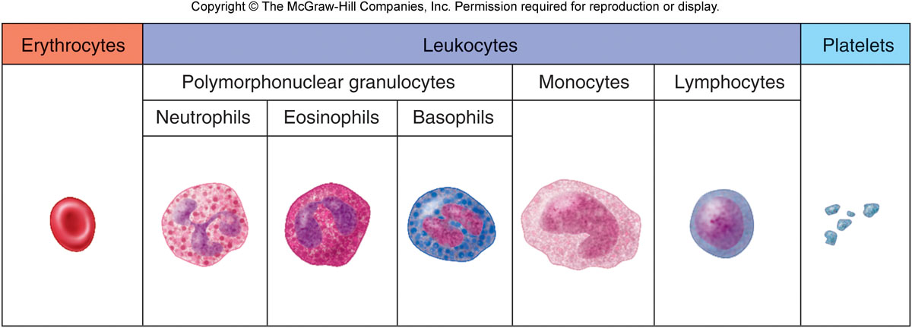
Leukocyte Types
Polymorphonuclear granulocytes:
Multilobed nuclei, many granules neutrophils (phagocytic, abundant)
eosinophils (allergy)
basophils (produce histamine)
Lymphocytes (antibody producing)
Monocytes (phagocytic)

Slide 16
Polymorphonuclear granulocytes
Segmented nucleus
Full of cytoplasmic granules
First on scene
Adhere to blood vessels in infected area and migrate to tissue
Engulf, kill and digest microorganisms
Release inflammatory mediators: toxic oxygen products, digestive enzymes, vasodilators, chemotaxins

Slide 17
B-lymphocytes (B cells)
Mature in bone marrow
Humoral (antibody-mediated) immunity
Foreign antigen → immunoglobulin (antibody) production
Immunoglobulins: IgM; IgG; IgA; IgD; IgE
Antibody-antigen reactions: assist phagocytosis by precipitation; agglutination (clumping) or coating in antibody (opsonisation) or prevent attachment of mico-organism to tissues (neutralisation)
Primary immune response: first exposure, antibodies appear after latent period, peak then fall
Secondary response: greater, quicker, longer response due to memory cells (long lived B-lymphocytes)
Passive immunity: inject immunoglobulins (vaccine) or cross placenta (colostrum in some species)

Slide 18
T-lymphocytes (T cells)
Thymus dependent (derived in bone marrow, migrate to thymus, acquire surface antigenic molecules and become immunologically competent)
Cellular immunity (i.e. not antibodies)
Circulate → foreign antigen → blast transformation → progeny with receptors for antigen
Activated T-lymphocytes → chemotaxins (attract macrophages); lymphotoxin (kills cells); interferon (kills viruses)
Subgroups:
Cytotoxic T cells (CD8+, “attack cells”)
Helper T cells (CD4+, secrete cytokines to help B and T cells, essential, HIV infects)
Supressor cells (modify lymphocytes responses)

Slide 19
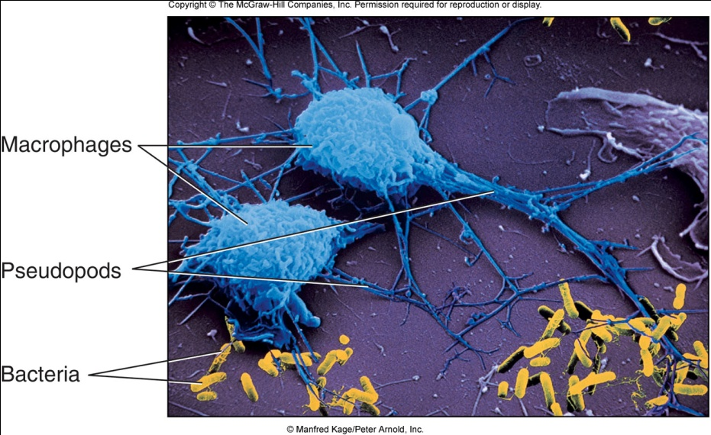
Monocytes
Large, single horse-shoe nucleus
Appear after granulocytes
In tissue become macrophages (“big eaters”)
Engulf micro-organisms, tissue debris and dead polymorphs
Secrete inflammatory mediators and stimulate angiogenesis (vessel growth = repair)
Ingest and store antigens, present modified antigen to lymphocytes

Slide 20
Normal leukocyte count
Total 3.5 - 10.0 x 10⁹/L
Neutrophils | 2.5 - 7.5 (40 - 75%)
Eosinophils | 0.04 - 0.4 (1 - 6%)
Basophils | 0.01 - 0.1 (<1%)
Monocytes | 0.2 - 0.8 (2 - 10%)
Lymphocytes | 1.5 - 4.0 (20 - 45%)
Leukocytosis = raised e.g. infection, cancer
Leukopenia – low e.g. chemotherapy, HIV

Slide 21
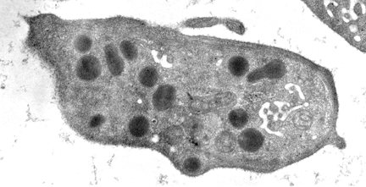
Platelets
Derive from megakaryocytes
2 - 3 µm diameter (small)
Normal platelet count 25 x 10⁴/μl
Life span 8 - 10 days
Granules
Many organelles, no nucleus

Slide 22
Platelets and Haemostasis
Express surface receptors for platelet activators (e.g. collagen in vessels or thrombin from coagulation cascade)
Adhesion to exposed collagen in wound or atherosclerosis
Release of granules promotes platelet aggregation
Platelets produce thromboxane A₂ from cycloxygenase enzyme
Aspirin inhibits cycloxygenase and is anti-platelet
Involved in clot or thrombus formation
The vascular endothelium produces e.g. prostacyclin and nitric oxide which inhibit platelet activation

Slide 23
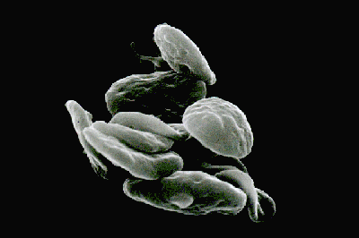
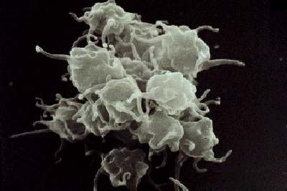
Platelet Activation
Filopodia
Unactivated
Activated

Slide 24
Plasma
Fluid component of blood
Carrier
“Organic and inorganic substances dissolved in water”
Plasma proteins
Exert osmotic pressure to maintain blood volume
Albumins
Globulins
Fibrinogen – clotting, platelet aggregation
Carrier molecules e.g. hormones, bile salts, water insoluble drugs
Serum: plasma with proteins removed due to clotting

