Slide 1
Carcinogenesis and Neoplasia
Dr Rathi Ramakrishnan
Cellular Pathology
“it begins to appear that everything one does to gain a livelihood or for pleasure is fattening, immoral, illegal, or, even worse, oncogenic”

Slide 2
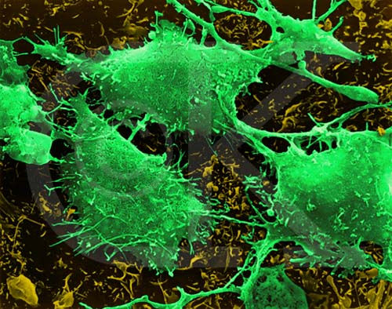
Definition
What is cancer?
Socio-economic problem
Morbidity/mortality
Cancer prevention programs

Slide 3
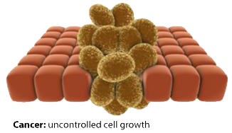
Definition- cont’d
Neoplasm- new growth “abnormal mass of tissue, the growth of which is virtually autonomous and exceeds that of normal tissues. The growth is uncoordinated and persists after the cessation of the stimuli that initiated the change” – Willis 1952

Slide 4
Nomenclature
Basic components
Parenchyma- transformed parenchymal cells
Stroma
Without ‘stroma’ blood vessels, tumour cannot grow !!

Slide 5
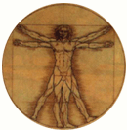
Names of tumours
Benign tumours- suffix ‘oma’
Malignant tumours- ‘carcinoma’ for parenchyma tumours &
‘sarcoma’ for stromal tumours

Slide 6
Nomenclature
From glandular tissues:
Adenoma
Cystadenoma
Papilloma
Polyp
From stromal tissues:
Fibroma
Lipoma
Angioma
Leiomyoma
Osteoma/chondroma

Slide 7

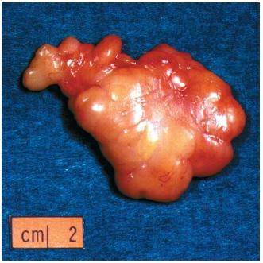
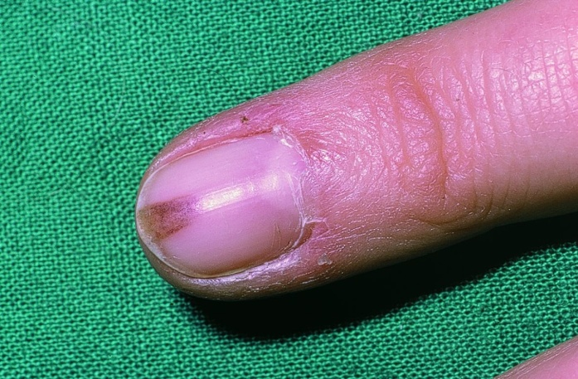
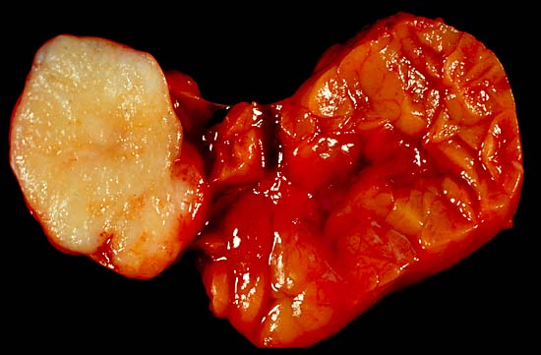
Benign tumours

Slide 8
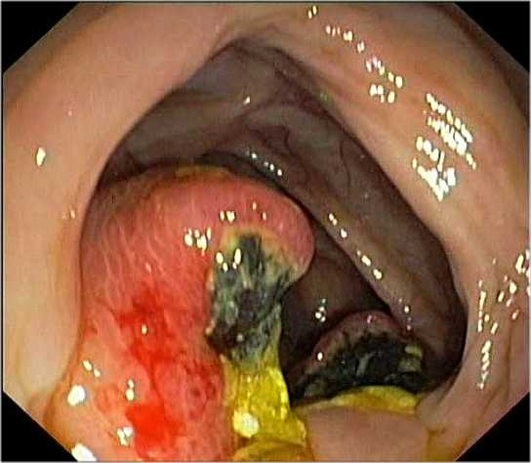
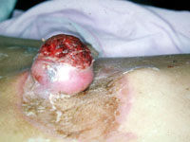
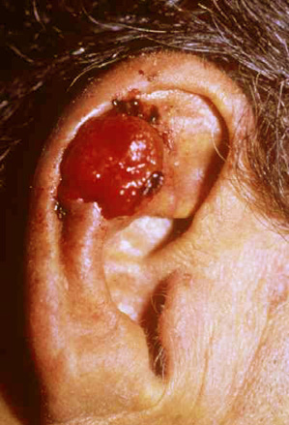
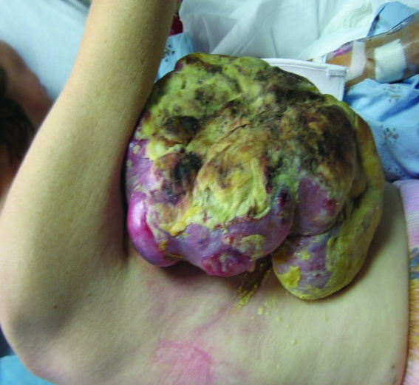
Malignant tumours

Slide 9
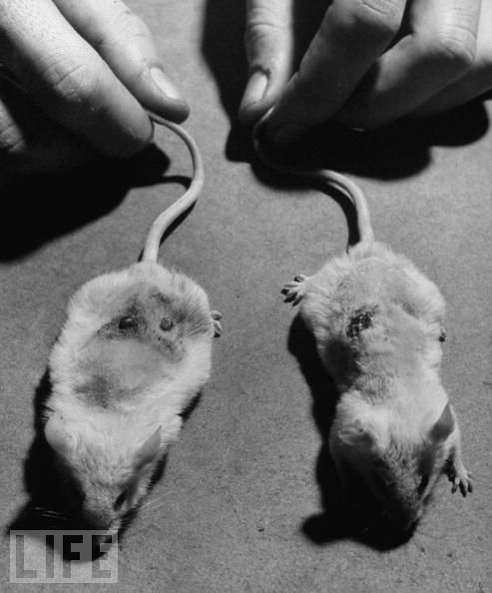
Benign Vs Malignant
A. Differentiation and anaplasia
B. Rate of growth
C. Local invasion
D. Metastasis

Slide 10
Benign Vs Malignant
Anaplasia- complete lack of differentiation
Rapid turnover- ‘chemo targets’
‘Infiltrative’ margins
Metastasize (except 2 tumours!!)
‘Well’ differentiated
Usually slow growing
Rarely invade locally-cohesive, expansile, encapsulated mass
Seldom metastasize

Slide 11
Mechanisms of invasion/metastasis
Lymphatic
Hematogenous
Body cavities
Contiguous

Slide 12
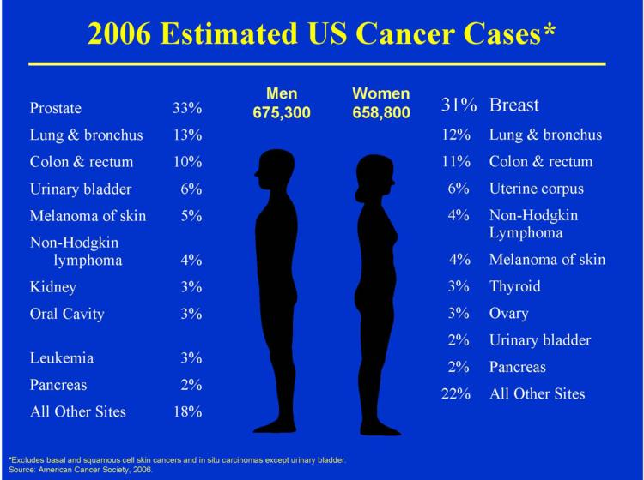
Epidemiology
Age
Geography
Environmental
Genetics

Slide 13
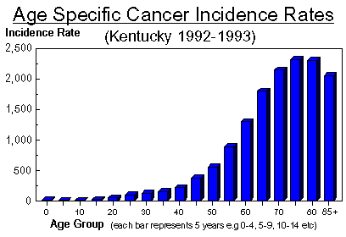
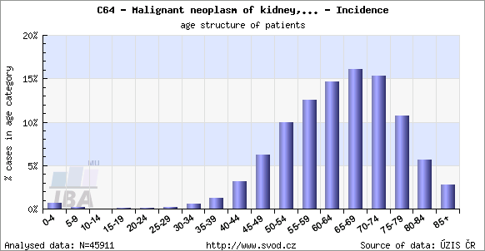
Age
Incidence of cancer increasing overall as the world’s population lives longer.
In general, higher incidence > 55 years
Certain cancers specifically affect the young e.g leukaemias, neuroblastoma, Wilm’s tumour, retinoblastoma, primary bone sarcomas

Slide 14
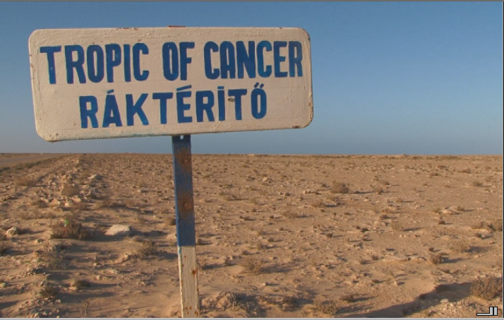
Geography
Stomach cancer higher (approx 7 times) in Japan compared with USA. Colon cancer much less in Japan
Melanoma much higher in NZ and Australia compared with scandinavia.
HCC more common in Uganda- aflatoxin
High incidence of oesophageal cancer in China and Iran- nitrates in soil, abrasives in diet

Slide 15
Environmental
UV light
Occupational agents like asbestos, naphthyl amine and vinyl chloride, diet and weight, alcohol (liver cancers), smoking (lung, bladder cancer) and
Infections notably viruses (HPV, HBV, EBV etc)
Percival Pott made the observation in 1777 about scrotal skin cancer being related to a particular occupation (chimney sweeps/soot). It was not until 150 years later that the specific carcinogen was identified !!!

Slide 16
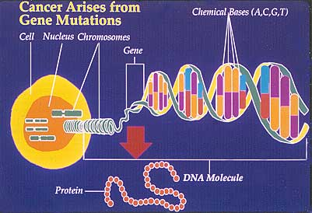
Genetics- heredity (3-fold)
Inherited cancer syndromes- single mutant gene responsible eg. retinoblastoma, FAP
Defective DNA repair mechanisms
Familial cancer syndromes

Slide 17
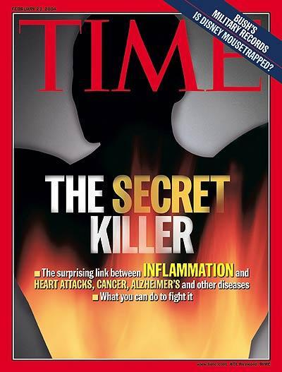
Non-heredity
Increased risk i.e liver cirrhosis & HCC, UC and colon cancer
Inflammation & cytokines with growth of transformed cells, promoting genetic instability, carcinogenesis’

Slide 18
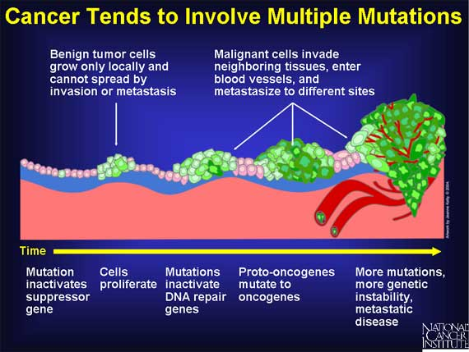
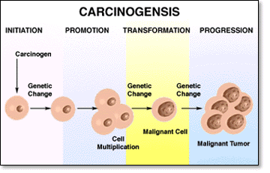
Carcinogenesis
Multistep process
Malignancy acquired in a step wise fashion- ‘tumour progression’
Accumulation of successive mutations

Slide 19
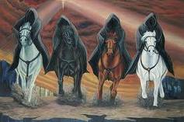
Oncogenes
Common targets of genetic
4 classes of regulatory genes:
1. Growth promoting genes - Oncogenes
2. Growth inhibiting (tumour suppressor) - Anti-oncogenes
3. Genes regulating programmed cell death - Apoptosis
4. DNA repair genes

Slide 20
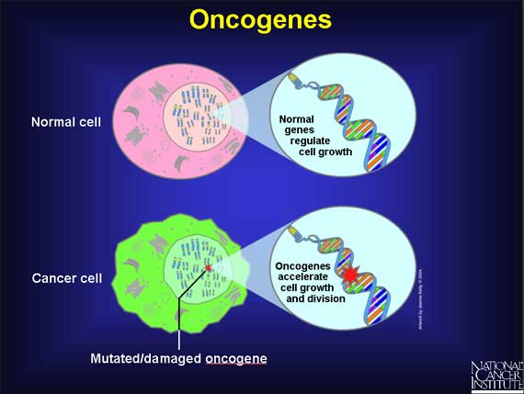
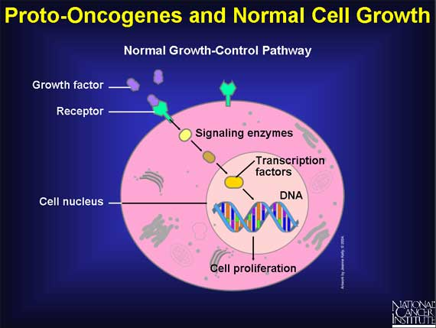
Oncogenes-cont’d
Oncogenes: derived from
genes regulating normal cellular growth
Examples of oncogenes associated with tumours
Burkitt lymphoma - Myc
Neuroblastoma - N-myc
Mantle cell lymphoma - CyclinD1

Slide 21
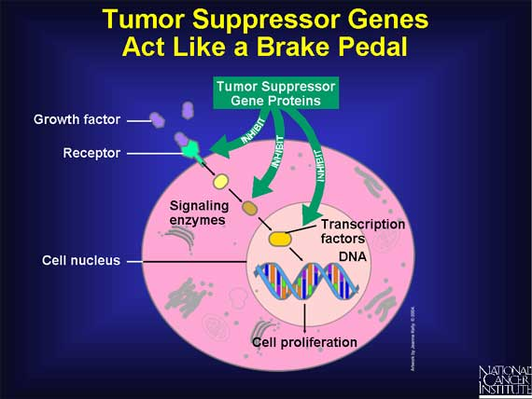
Tumour suppressor genes
Usually regulate normal cell growth
Classic example is Rb gene (13q)in genetically inherited retinoblastoma (40%)
P53 (17) house-keeper of genome) ,
BRCA-1 & BRCA-2 breast cancers are familial and one of these mutations present in 80% of breast cancers

Slide 22
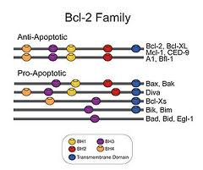
Anti-apoptosis genes
Genetic defects accumulate causing pro-apoptotic genes (Bax family) cause programmed cell death
Anti-apoptotic (bcl2) genes prevent this causing unregulated proliferation
Bcl2 upregulated in lymphomas and other somatic malignancies

Slide 23
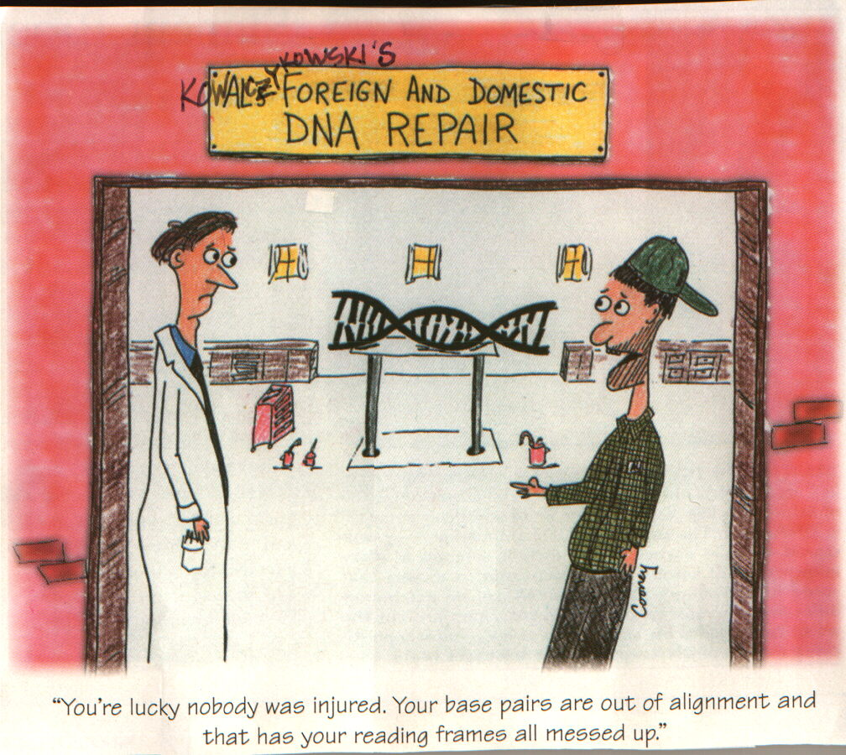
DNA repair genes
DNA repair genes
Genomic instability syndromes - inherited mutations of DNA repair proteins
Not directly oncogenic, act by permitting mutations to occur during normal cell cycles (mismatch repair, nucleotide excision repair and recombination repair)

Slide 24
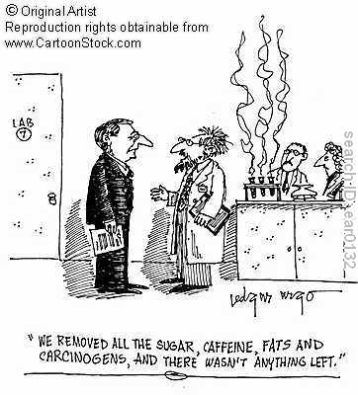
Carcinogens- classes
Chemicals
Viruses
Ionising/non-ionising radiation
Hormones
Bacteria, fungi,parasites
Miscellaneous

Slide 25
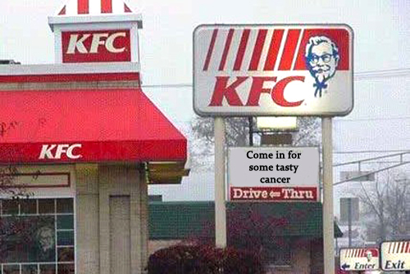
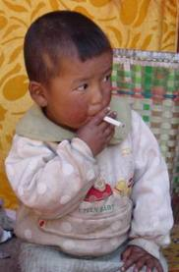
Chemical carcinogens
No common structural features
Need metabolic conversion (procarcinogen) to active peptide (ultimate carcinogen)
Major classes- hydrocarbons, amines, nitrosamines, azo dyes, alkylating agents

Slide 26
Chemical carcinogens-cont’d
Some act directly without conversion
If enzyme present within tissues, tumour occurs at the site- I.e skin and lung cancers with aromatic HC
Others may require metabolic conversion in the liver eg aromatic amines causing UB cancer
Alkylating agents - cyclophos and busulphan
Polycyclic aromatic hydrocarbons - cigarette smoking in lung cancers
Aromatic amines and azo dyes - b-naphthalene dyes in bladder cancers
Naturally occurring carcinogens - aspergillus flavus in liver cancers
Nitrosamines and amides - gastric cancer
Miscellaneous agents – asbestos, vinyl chloride and metals like nickel, estrogens in breast/endometrial cancer

Slide 27

Oncogenic viruses
Fowl sarcomas and rabbit skin tumours-Rous (1991); injectible ‘cancer’
Generally in young
Immunosupression
EBV (BL) and HPV (CC), HBV & HCV hepatic cancers

Slide 28
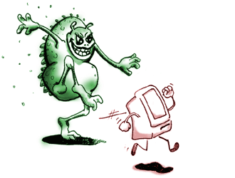
Oncogenic virus-mechanism
Oncogenic viral DNA genome directly incorporated into host cell DNA
Oncogenic RNA viral genome transcribed into DNA by enzymes prior to incorporation

Slide 29
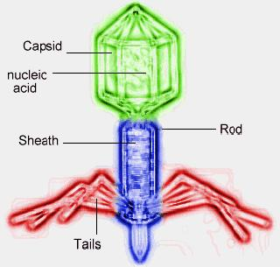
Viruses-cont’d
DNA oncogenic viruses HPV, EBV, HBV and HHV8
RNA viruses HTLV-1
Bacterial carcinogens; Helicobacter Pylori

Slide 30
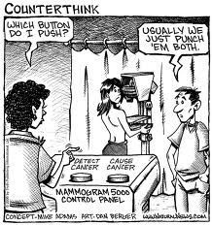
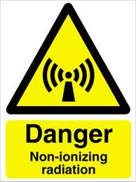
Radiations
Ultraviolet (SCC, BCC, MM)
Ionising electromagnetic i.e. X-rays
Cause an increase in leukaemia and solid tumours

Slide 31
Clinical effects of tumour
Both benign and malignant tumours affect the host
Anxiety (breast lumps)
Related to location i.e pressure, ulceration, infection, bleeding (hormonal effects)
Metabolic cancer cachexia (increased BMR, reduced fat and muscle bulk) TNF alpha
Paraneoplastic syndromes- endocrinopathies, hypercalcemia, thrombotic diathesis, acanthosis nigricans

Slide 32
Cancer diagnosis
Laboratory methods
Cytology FNA (freehand or USS guided)
Histology (core biopsy, incisional or excisional biopsy)
Other methods
Tumour typing
Immunocyto/histochemistry
Flow cytometry
Molecular methods (PCR, FISH, DNA microarrays, spectral karyotyping)
Tumour markers- CEA AFP Ca125 etc

Slide 33
Grading & staging of cancer
Histological – low and high grade (Less useful than staging); based on the degree of differentiation
Staging –SINGLE most important parameter
Combination of clinical, radiological and pathological
Main staging system- TNM (WHO), based on
  Size of the primary lesion (T1-T4)
  Spread to regional lymph nodes (N0, N1-3)
  Presence of metastases (M0,M1-2)
Others include DUKE’s for colorectal, FIGO for ovarian cancer and Ann Arbor for lymphoma

Slide 34
Prevention and screening
Detect cancer either at preinvasive stage/early (stage 1)
For successful screening programs,
a) Reliable prediction of tumour behaviour
b) Treatment available
c) Target population has enough people at risk to justify expense
d) Cost-effective and reliable screening tool
In UK, cervical cancer and breast cancer screening with piloting for colorectal cancer
Vaccinations- Human Papilloma virus, Hepatitis B virus to protect against cervical/liver cancers

